Slide 1
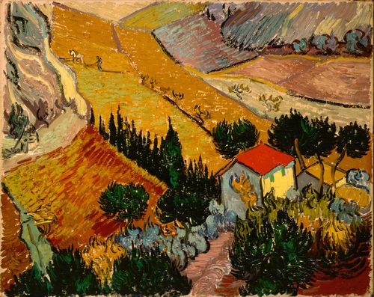
Strategies for Proofs
01/24/13
Landscape with House
and Ploughman
Van Gogh
Discrete Structures (CS 173)
Madhusudan Parthasarathy, University of Illinois

Slide 2
Goals of this lecture
Practice with proofs
Become familiar with various strategies for proofs

Slide 3
Review: proving universal statements
Claim: For any integer $a$, if $a$ is odd, then $a^{2}$ is also odd.
Definition: integer $a$ is odd iff $a=2m+1$ for some integer $m$

Slide 4
Proving existential statements
Claim: There exists a real number x, such that $\left|x^{3}\right|<x^{2}$
overhead

Slide 5
Disproving existential statements
Claim to disprove: There exists a real $x$,$x^{2}−2x+1<0$
In general,$┐\left(∃x, P\left(x\right)\right)≡∀x,$ $┐P\left(x\right)$
overhead

Slide 6
Disproving universal statements
Claim to disprove: For all real $x$, ${\left(x+1\right)}^{2}>0$
In general, $┐\left(∀x,P\left(x\right)\right)≡∃x,┐P(x)$
overhead

Slide 7
Proof by cases
Claim: For every real x, if $\left|x+7\right|>8$, then $\left|x\right|>1$

Slide 8
Proof by cases
Claim: For every real x, if $\left|x+7\right|>8$, then $\left|x\right|>1$

Slide 9
Rephrasing claims
Claim: There is no integer $k$, such that $k$ is odd and $k^{2}$ is even.

Slide 10
Proof by contrapositive
Claim: For all integers $a$ and $b$, $(a+b≥15)→(a≥8∨b≥8)$

Slide 11
Proof strategies
Does this proof require showing that the claim holds for all cases or just an example?
Show all cases: prove universal, disprove existential
Example: disprove universal, prove existential
Can you figure a straightforward solution?
If so, sketch it and then write it out clearly, and you’re done
If not, try to find an equivalent form that is easier
Divide into subcases that combine to account for all cases
OR in hypothesis is a hint that this may be a good idea
Try the contrapositive
OR in conclusion is a hint that this may be a good idea
More generally rephrase the claim: convert to propositional logic and manipulate into something easier to solve

Slide 12
More proof examples
Claim: For integers $j$ and $k$, if $j$ is even or $k$ is even, then $jk$ is even.
Definition: integer $a$ is even iff $a=2m$ for some integer $m$

Slide 13
More proof examples
Claim: For all integers $k$, if $3k+5$ is even, then $k$ is odd.

Slide 14
Another proof
Claim: For any real $k$, if $k$ is rational, then $k^{2}$ is rational.
Definition: real $k$ is rational iff $k=\frac{m}{n}$for some integers $m$ and $n$, with $n≠0$.
overhead

Slide 15
More proof examples
Claim: For all integers $x$, if $x$ is odd, then $x=4k+1$ or $x=4k−1$ for some integer $k$.
(Note, this requires knowing a little about modular arithmetic.)

