Slide 1
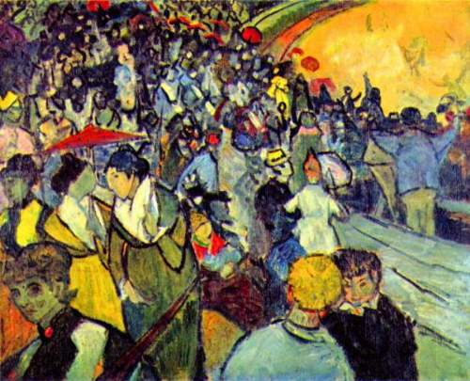
More Logic
The arenas of Arles
Van Gogh
Discrete Structures (CS 173)
Madhusudan Parthasarathy

Slide 2
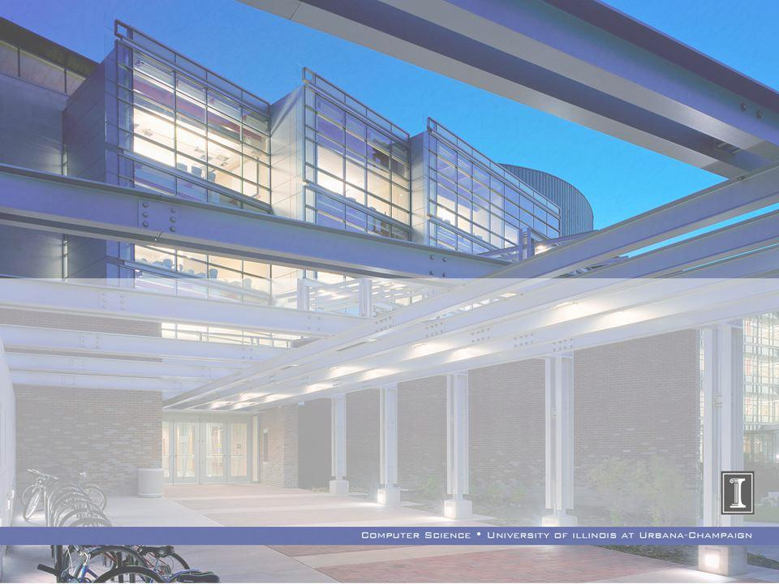
Promoting Undergraduate Research in Engineering (P.U.R.E.)
Promoting Undergraduate Research in Engineering (P.U.R.E.)
Fall 2013 Information Session
Wednesday, September 4th from 7pm to 8pm at 1404 Siebel Center
Food will be provided!
https://wiki.engr.illinois.edu/display/PURE/Home)
The PURE Research Program is an interdisciplinary program in the College of Engineering pairing freshman and sophomore undergraduates with research mentors(graduate students). The general goal of the program is to encourage underclassmen to explore research at an early stage in their academic career.
Spring 2010 Information Session
Undergraduate Advising Office
Program Director
Slides are borrowed and adapted from fall 2008
(PURE Committee
HKN, Alpha Chapter
University of Illinois at Urbana-Champaign
August 30, 2008)
Visit http://pure.engr.illinois.edu

Slide 3
Brief Review
Propositional logic
AND, OR, T/F, implies, etc.
Equivalence and truth tables
Manipulating propositions

Slide 4
The satisfiability problem (SAT)
Recall:
f is a tautology if f evaluates to true in all models
f is satisfiable if there is some model M under which f evaluates to true
E.g., $p \bigvee{q }$
Non example: $p ∧ ¬p$
In fact, for any formula f, $f$ is satisfiable iff $¬f$is not a tautology!
Important problem in theoretical CS… NP-complete
The classical hard problem that no one knows how to solve in polynomial time (P=?NP question)

Slide 5
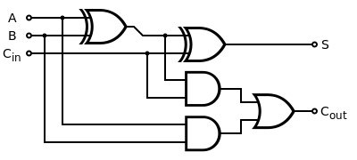
Applications of SAT solvers: model checking
Recent advent of extremely fast SAT solvers
(despite theoretical hardness of problem) See Z3 online: http://rise4fun.com/z3
Circuits/hardware checking
Pentium division error - half a billion dollars to Intel
Can we check whether a circuit is correct?
Idea: model circuit as a Boolean formula
Each wire can be carrying hi/lo voltage – 1/0
Each gate is a propositional operator (or, xor, and, not..)
So equivalence of circuits is a satisfiability problem!
$¬$ (<<c>> ⬄ <<d>>)

Slide 6
Predicate logic
All men are mortal
Socrates is a man
Inference: Socrates is mortal.
$$∀x. p\left(x\right)⇒q\left(x\right)$$
$$p\left(h\right)$$
Inference: q(h)
Can’t say this is propositional logic.
We need variables (like x) …

Slide 7
Predicate logic (first-order logic)
Example: Consider the universe of integers, with constants 0, 1, 2, …, functions +, -, *, … and relations <, =, ≤, etc.
Every number n added to 0 gives n
$∀n. \left(n+0=n\right)$
There is some number which when multiplied by itself is 0:
$x. \left(x ∗x=0\right)$
There are two numbers whose sum is 1.
$x ∃y. \left(x+y=1\right)$

Slide 9
Quantifiers
For some $x$ or there exists some x: $∃x$
Some creatures are greyhounds that run fast.
$∃x, x^{2}=0$
$∃x, x^{2}>0$
For all $x$: $∀x$
For all creatures, if it is fat, then it does not run well.
$∀x, x^{2}≥0$
For exactly one $x$: $∃!x$
There is exactly one fat creature than runs well.
$∃!x, x^{2}=0$

Slide 10
Binding and scope
binding
$$∀x, p\left(x\right)→q\left(x\right)$$
$$∃x, x^{2}=0$$
scope
Similar to local variables in programs:
int f(x) {
int y;
y := x+2;
}

Slide 11
Manipulating quantifiers
Negation
$$┐\left(∀x, p\left(x\right)\right)≡∃x,┐p\left(x\right)$$
$$┐\left(∃x, p\left(x\right)\right)≡∀x,┐p(x)$$
“Not all dogs are fat” is equivalent to “At least one dog is not fat.”
“There does not exist one fat dog” is equivalent to “All dogs are not fat.”
Contrapositive
$$∀x, p\left(x\right)→q\left(x\right)≡∀x,┐q\left(x\right)→┐p(x)$$

Slide 12
Manipulating quantifiers
Negation
$$┐\left(∀x, p\left(x\right)\right)≡∃x,┐p\left(x\right)$$
$$┐\left(∃x, p\left(x\right)\right)≡∀x,┐p(x)$$
“Not every number is even” is equivalent to “There is some number that is not even”
“There is some number that is prime” is equivalent to “All numbers are not composite.”
Contrapositive
$$∀x, p\left(x\right)→q\left(x\right)≡∀x,┐q\left(x\right)→┐p(x)$$
Every number that is a square is a composite number.
Every number that is a prime number is not a square.

Slide 13
Quantifiers with two variables
For all integers $a$ and $b$, $a+b≥a$ (false)
$∀a∈Z,∀b∈Z,$ $a+b≥a$ or $∀a,b∈Z,a+b≥a$
There are two integers whose sum is 12 (true)
$∃a ∈Z,∃b∈Z. (a$+b = 12)
For every real $a$, there exists an integer $b$, such that $a+b≥a$ (true)
$∀a∈R,∃b∈Z,a+b≥a$

Slide 14
Proving universal statements
Claim: For any integers $a$ and $b$, if $a$ and $b$ are odd, then $ab$ is also odd.
Definition: integer $a$ is odd iff $a=2m+1$ for some integer $m$

Slide 15
Approach to proving universal statements
State the supposition (hypothesis) and define any variables
Expand definitions such as “odd” or “rational” into their technical meaning (if necessary)
For clarity, state the definition being used
Manipulate expression until claim is verified by a simple statement
E.g., ${\left(x+1\right)}^{2}≥0$ because any squared value is non-negative.
End with “This is what was to be shown.” or “QED” to make it obvious that the proof is finished
Tip: work out the proof on scratch paper first, then rewrite it in a clear, logical order with justification for each step.

Slide 16
Proving universal statements
Claim: For any real $k$, if $k$ is rational, then $k^{2}$ is rational.
Definition: real $k$ is rational iff $k=\frac{m}{n}$for some integers $m$ and $n$, with $n≠0$.

Slide 17
Proving universal statements
Claim: For all integers n, 4(n² + n + 1) − 3n² is a perfect square.
Definition: $k$ is a perfect square iff $k=m^{2}$ for some integer $m$

Slide 18
Proving universal statements
Claim: The product of any two rational numbers is a rational number.
Definition: real $k$ is rational iff $k=\frac{m}{n}$for some integers $m$ and $n$, with $n≠0$.

Slide 19
Applications of first-order logic
Programming models:
Imperative programming (C, …)
Functional programming (Haskell, Ocaml, …)
Object-oriented programming (Java, C++, ...)
Logic programming (Prolog, Datalog, …)
Declaratively state what you want in logic;
program will compute it.
Prolog: Rules of the form p(X, Y) if q(X) and r(Y), etc.
Question: p(Obama, president)?

Slide 20
Take home messages
Propositions with “for all” and “there exists” can be encoded with quantifiers
Remember rules for negation and equivalence of quantifiers
Universal proofs are solved by
Stating supposition
Expanding definitions
Manipulating expressions to reach claim
Stating that the claim has been shown

Slide 21
To do
Mini-HW 1 due tomorrow, Wed, at 11:45pm on Moodle
Reading quiz due tomorrow night at 1:00am
Next class:
Strategies for proving and disproving different types of claims

