Slide 1
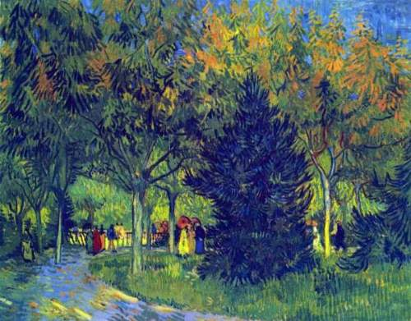
Introduction to Discrete Structures
Fall 2013
Allee in the Park
Van Gogh
Discrete Structures (CS 173)
Madhusudan Parthasarathy University of Illinois

Slide 2
Today’s class
A little about me
Introduction to discrete structures
Course logistics

Slide 3
About me
India → Germany → Philadelphia → Urbana

Slide 4
My research
Building safe and secure software
Examples:
- How do we build a secure voting machine?
- Safe Mars rover?
- Safe operating system?
- Secure Android platform?
- Secure cloud computing system?
Not just “reasonably correct” but “provably correct”!
Idea: View the system being secure as a theorem in mathematics. Prove the theorem!

Slide 5
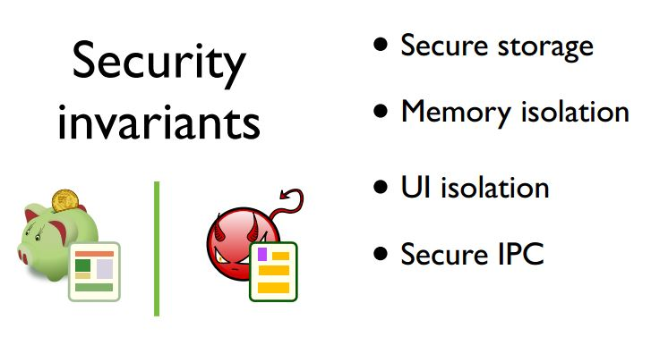
My research
Recent work: Secure Android platform(~10KLOC)
Combination of logic, theorem proving, algorithms and software engineering

Slide 6
Discrete mathematics
Really, you should have done this course in school!
Reasons you didn’t:
- Science has hijacked math courses to teach what’s useful for science … calculus
- Very little discrete math in current student curricula

Slide 7
Discrete Structures
We want to solve problems computationally
This requires
modeling the world
devising an algorithm
determining the efficiency and correctness of that algorithm
Discrete structures: how to model the world and think computationally and rigorously

Slide 8
Fastest path from Chicago to Bloomington?

Slide 9
Fastest path from Chicago to Bloomington?

Slide 10
Fastest path from Chicago to Bloomington?
start
2
1
3
end
4

Slide 11
Fastest path from Chicago to Bloomington?
start
C
2
1
20
30
4
15
1
2
120
35
3
110
4
60
90
end
B
3

Slide 12
Modeling using graphs
MAP
src,dest
Directed weighted
graph
Shortest path
In graphs algm

Slide 13
Fastest path from Chicago to Bloomington?
Problem: find shortest path from C to B
Many solutions: try random paths, enumerate all paths, depth first search
C
20
30
15
1
2
120
35
3
110
4
60
90
B

Slide 14
Fastest path from Chicago to Bloomington?
Problem: find shortest path from C to B
Many solutions: try random paths, enumerate all paths, depth first search
Dijkstra’s algorithm
Explore neighboring nodes and keep track of shortest path to each
C
20
30
20
15
30
1
2
120
35
3
110
4
140
65
60
90
B
140

Slide 15
Fastest path from Chicago to Bloomington?
Problem: find shortest path from C to B
Many solutions: try random paths, enumerate all paths, depth first search
Dijkstra’s algorithm
Explore neighboring nodes and keep track of shortest path to each
How good is this algorithm?
Does it find the best solution?
How long does it take to compute?
C
20
30
20
15
30
1
2
120
35
3
110
4
140
65
60
90
B
140

Slide 16
Fastest path from Chicago to Bloomington?
Problem: find shortest path from C to B
Many solutions: try random paths, enumerate all paths, depth first search
Dijkstra’s algorithm
Explore neighboring nodes and keep track of shortest path to each
How good is this algorithm?
Does it find the best solution?
How long does it take to compute?
How does the computation grow as the number of vertices or edges increases?
C
20
30
20
15
30
1
2
120
35
3
110
4
140
65
60
90
B
140

Slide 17
Modeling using graphs
MAP….
src,dest
Directed weighted
graph
DIJSKTRA’s Shortest path
In graphs algm
Self-bal bin tree
Priority queue

Slide 18
Modeling using graphs
MAP….
src,dest
Asymotitic
Worst-case analysis
Modeling using Discrete Structures
Directed weighted
graph
DIJSKTRA’s Shortest path
In graphs algm
DS using discrete structures
Self-bal bin tree
Priority queue

Slide 19
Another example: recommender systems
Shopper buys a “badonkadonk tank”
What will she buy next?

Slide 20
Another example: recommender systems
Shopper buys a “badonkadonk tank”
What will she buy next?
Solutions
Frequent itemset mining: find sets of items that are often purchased or viewed within the same browser episode
Associative graph: learn probability of transition between product pages and compute overall strength of connection

Slide 21
From my work: Memory Isolation in Android OS
…
PID: 12
PID: 30
PID: 19
…
Verify invariants in ExpressOS [@UIUC, ASPLOS’13]
“Every two assigned memory chunks are disjoint“
“The start addresses are sorted along the doubly-linked list”
“The memory allocator modifies only this doubly-linked list”
Key Idea:
Model the security properties of ds using logic
Prove the program correct using logical reasoning!
Start Addr
Start Addr
Start Addr
End Addr
End Addr
End Addr
Prev
Next
Prev
Next
Prev
Next
…
…
Structure, Data, and Separation are mixed

Slide 22
A puzzle
Can you draw this on paper, without retracing any line/curve and without removing your pencil from the paper?

Slide 23
Proofs
How do you convince a fellow human being
(or your roommate) that something is really really true?
Eg. How do you show him/her that drawing
this is impossible?

Slide 24
What you’ll learn in this course
How to model the world (and problems)
Logic, sets, trees, graphs, functions, etc.
Techniques to prove and disprove statements
Direct, existential, contradiction, contrapositive, induction, combinatorics, etc.
How to model the computational behavior of algorithms (time complexity)
A foundation for computational thinking that will serve you all your life…

Slide 25
Course logistics
Course website:
http://courses.engr.illinois.edu/cs173/
Lecture B:
http://courses.engr.illinois.edu/cs173/B-lecture/

Slide 26
Course Logistics: Weekly Schedule
Time | Monday | Tuesday | Wednesday | Thursday | Friday
Class |  | Lecture 11am-12:15pm |  | Lecture 11am-12:15pm
Office Hours
Discussion Sections |  |  |  |  | Discussion Sections 11am; 12pm; 1pm; 2pm; 3pm; 4pm
Homework | Reading Quiz due 1:00am (before lecture) |  | Mini-HW and Long-form HW due 11:45pm Reading Quiz due 1:00am (before lecture
TBD
Mon night: finish reading exercise for Tue class
Tue: come to lecture
Wed: submit HW (start working previous week!)
Wed night: finish reading exercise for Thu class
Thu: come to lecture; start working on new problem set
Fri: attend one discussion section
Weekend: complete as much of HW as possible
Throughout week: attend office hours, as needed

Slide 27
Course Logistics: Grading
Homework/quizzes (32%)
Reading quiz: 8% (lowest 3 grades dropped)
Auto-graded: can see score, fix, and resubmit
Mini-HW: 8% (lowest dropped)
Auto-graded for fast feedback
Long-form HW: 16% (lowest dropped)
Exams (68%)
Midterm 1: 18%
Midterm 2: 20%
Midterm 3: 22%
Final Exam: 8%
Late policy
Simple: late assignments will not be accepted
See website for details on extenuating circumstances
Cheating policy
See course website

Slide 28
Course Logistics: Grading
Thresholds for guaranteed grades
A 94%
A- 90%
B- 80%
C- 70%
D- 60%
We reserve right to curve up
In previous terms, this course has given about 20% A's, 30% B's, 30% C's, 15% D's, and 5% F's

Slide 29
Reading and Textbook
Margaret Fleck’s Building Blocks for Theoretical Computer Science http://www.cs.uiuc.edu/~mfleck/building-blocks/
simple condensed text
Optional book: Rosen “Discrete Mathematics and its Applications”, 5th to 7th edition
More detail, practice problems; heavy!

Slide 30
Getting help
Discussion sections and office hours
- None this week; starts next week!
Newsgroup: piazza.com
Password: baggins
Major problems
See “When disaster strikes” on the course page.

Slide 31
RESOURCES
Discussion problems:
Need to buy from bookstore! (~$5)
Textbook:
Fleck (avlbl online)
Alt Textbook:
Rosen
Moodle
Piazza
pwd: baggins
sign up for right section
use any email addr
ONLINE
ROUTINE WORK
Reading assignments/ quiz
(online: Moodle)
Mini-HW
(online, auto-graded, any num of attempts:
Moodle)
Long-form HW
(hardcopy; but you can prepare it using LaTex/Word)
Midterms
3 of them
Final
(very short)

Slide 32
Tips
This class is very difficult for most students
New ways of thinking require lots of practice; math is hard
But if you grasp things early, you will sail smoothly.
Basic approach to taking this class
Come to lectures, take notes
If you have trouble following lecture, read the relevant sections of the book first
Try doing the homework
Read the online textbook
Complete the homework (use TAs, Piazza, Rosen book, online resources as needed)
Preparing for exams
Find extra problems from past homeworks and exams (see past courses linked via website)
Do a few extra problems every week in a topic that is difficult for you
2 weeks before exam, start doing extra problems every day until all the past homework and exam problems are easy

Slide 33
Prerequisites, proficiency, honors
Prerequisites
Calculus I (Math 220 or 221 or 234) and CS 125 or ECE 190 or CS 101 or a high grade in INFO 103
If you aren't sure whether you have the right background, speak to me (or Margaret Fleck)
Proficiency exam
See course website
Wed this week, 7pm-10pm (sign up by 9am); conflict on Saturday.
Write to us immediately
Honors addon
See main webpage

Slide 34
To do now
Read syllabus and course information online
Navigate and look at all parts of the course website
Enroll in Piazza to get announcements
Access code: baggins
Make sure you can access Moodle
First “reading quiz” due Wed night!
If you’re not yet registered, come up front after lecture and put your name on a list
Note: no discussion section this week!

Slide 35
Thank you
Next class: Logic!

