Slide 1
Classifiers

Slide 2
Classifying?
Identify the cat pictures?

Slide 3

Probability
$$P\left(E\right)= \frac{\left|E\right|}{\left|S\right|}$$
Find the probability by counting the number of events in the set of all equally likely events.

Slide 4
Use Statistics and Probability
Assume sample is representative and count the number in each class
  3 cats
  2 dogs
  1 tank
Generate probabilities from the stats
  P(cat) = 3/6
  P(dog) = 2/6
  P(tank) = 1/6
Predict based on the probability
  All pictures must be cats!
We must do better

Slide 5

Conditional Probability
$$P\left(A | B\right)=\frac{P(A∩B)}{P(B)}$$
The chance of $A$ given $B$ can be used to predict $A$ if we have events $B$ that we can identify.

Slide 6
Features?
Cat pictures to hard
Numbers in black in white with only one number at a time?
  Images the same size
  Pixels are either foreground or background
  Use pixels

Slide 7

Bayes' Theorem
$$P\left(A | B\right)= \frac{P\left(B | A\right)P(A)}{P(B)}$$

Slide 8
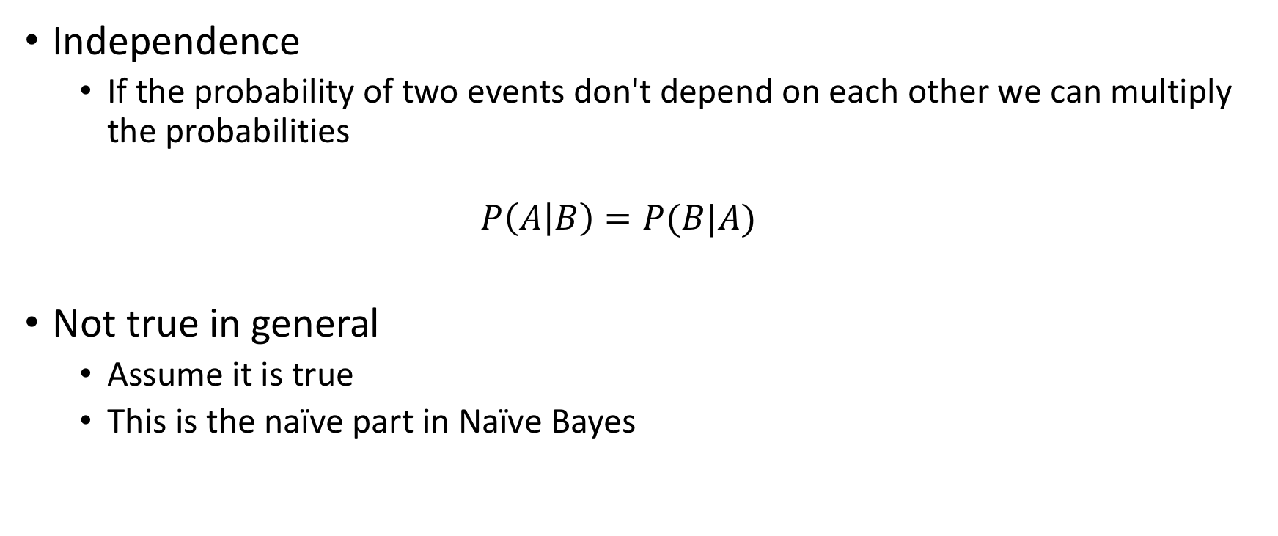
Combining Probabilities - Independent
Independence
  If the probability of two events don't depend on each other we can multiply the probabilities
  $$P\left(A | B\right)=P(B|A)$$
Not true in general
  Assume it is true
  This is the naïve part in Naïve Bayes

Slide 9
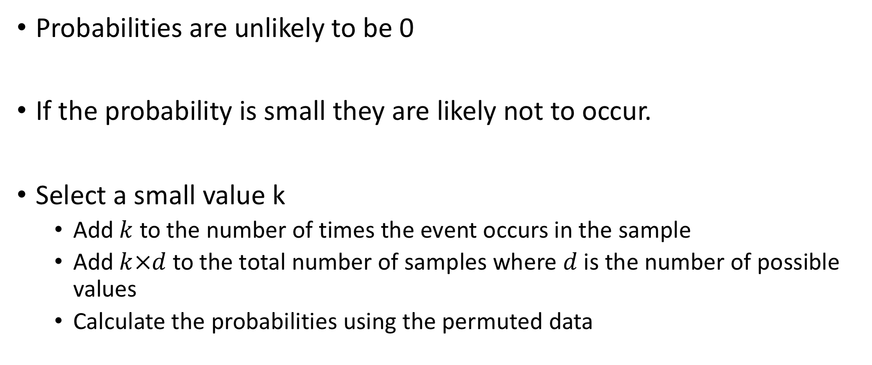
Laplace Smoothing
Probabilities are unlikely to be 0
If the probability is small they are likely not to occur.
Select a small value k
  Add $k$ to the number of times the event occurs in the sample
  Add $k×d$to the total number of samples where $d$ is the number of possible values
  Calculate the probabilities using the permuted data

Slide 10
Classify an image - Informal
Find all the features in the image
  pixel is either foreground or background
For each class computer the probability that the image is in the class
  Compute for each feature from gathered data
  Combine using Bayes' Theorem
Select the most probable class based on the computed values

Slide 11
Naive Bayes Assignment

