Slide 1
Get To Know Your Compiler
Inspired by Matt Godbolt

Slide 2
Compilation Stages
Preprocessor
  Run preprocessor directives –E for clang
Compiler
  Compile the preprocessed source code
    -S Generate Assembly
    -c Generate Object Code
Linker
  Generate executable from object files

Slide 3
Does it matter?

Slide 4
X86 Assembly Registers
rax, rbx, rcx, rdx, rsp, rbp, rsi, rdi, r8-r15
xmm0-xmm15
rdi, rsi, rdx … arguments
rax is the return value

Slide 5
Register Details

Slide 6
Instructions
op is call, ret, add, sub, cmp…
dest, src is register or memory reference
  [base + reg1 + reg2 (1, 2, 4, or 8) ]

Slide 7
Instruction Examples

Slide 8
Summary
Register: rax, rbx, rcx …
Size: rax, eax, ax ..
Params: rdi, rsi, rdx, rcx …
Result: rax
Format: op dest, src
dest and src are registers or memory

Slide 9
So Does it matter?

Slide 10
Compiler Explorer
Godbolt.org

Slide 11
What is going on?

Slide 14
Multiplication

Slide 15
Fancy Multiplication

Slide 16
Division

Slide 17
Summation
int sumTo(int x) {
int sum = 0;
for( int i = 0; i <= x; ++i ) {
sum += i;
}
return sum;
}
What is the runtime?
A) O(1) B) O(x) C) O(x^2) D) What on earth is big O?

Slide 18
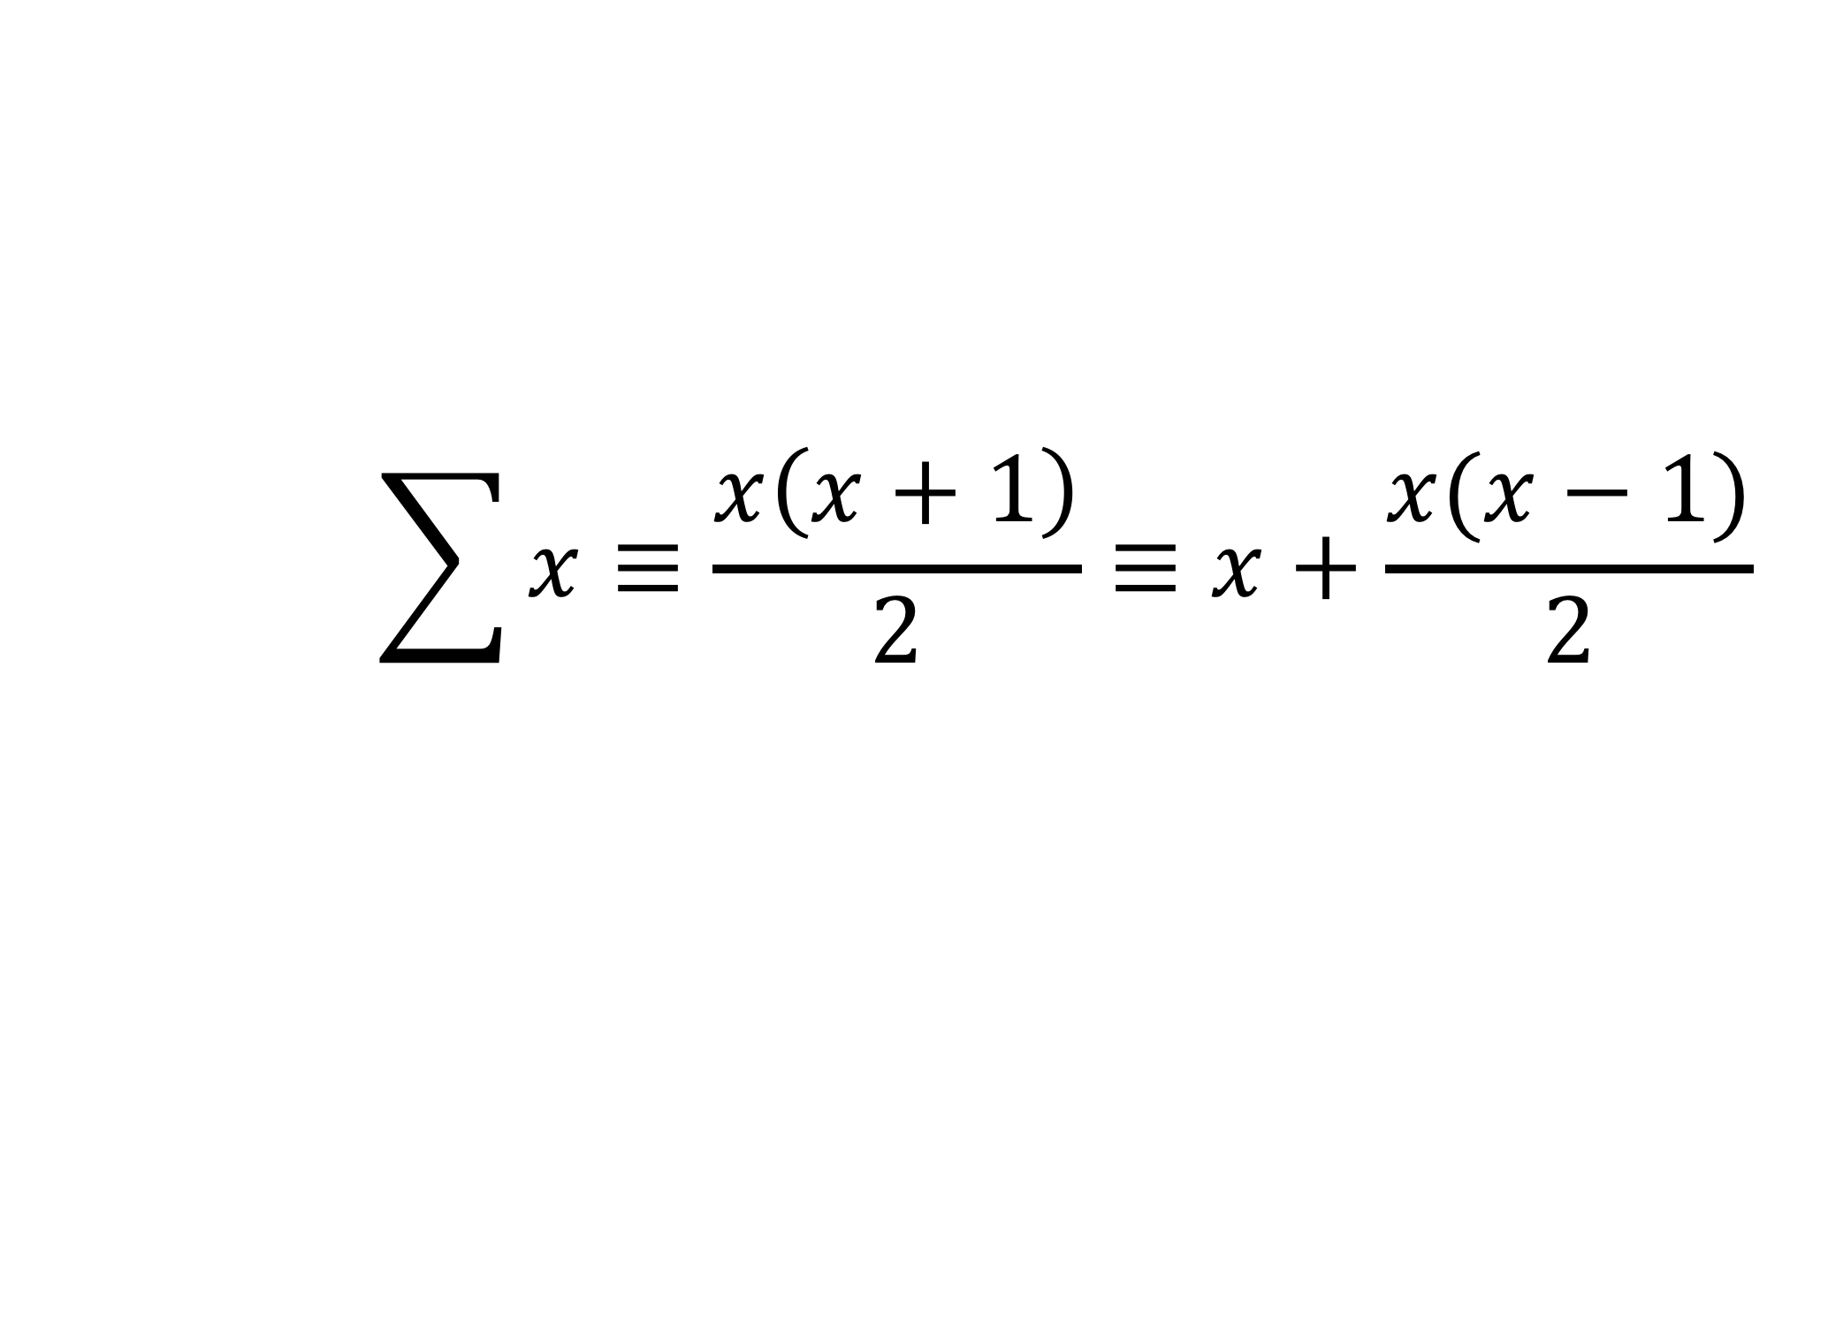
Sum(X) from CS 173
$$\sum{x≡\frac{x\left(x+1\right)}{2}≡x+\frac{x(x−1)}{2}}$$

Slide 19
The compiler is your friend

