Slide 1
Code Layout
The goal of code layout/formatting is to show logical structure
Good layout is shows intention, is consistent, improves readability, and withstands modification.

Slide 2
Which is best?
A) for(int i=0;i<str.length();i++){
B) for (int i=0; i<str.length(); i++) {
C) for (int i = 0; i < str.length(); i++) {
D) for (int i = 0 ; i < str.length() ; i ++) {
E) for( int i = 0 ; i < str.length() ; i ++ ){

Slide 3
Which is better?
A) for (int i = 0; i < args.length; i++)
B) for (int i = 0;
i < args.length;
i++)
C) Both are fine
D) Both are lacking

Slide 4
Which is better?
A) char [][] game = new char[3][3];
B) char [][] game = new char[ 3 ][ 3 ];
C) Both are fine
D) Both are lacking

Slide 5
Hmmm…
I like spacing operands like the following:
int x = a + b + c + d + 17;
But in the below, I personally prefer the second option:
data[i][i] = data[i - 1][i - 1];
data[i][i] = data[i-1][i-1];

Slide 6
Are you familiar with the ternary operator?
if (a) {
x = b;
} else {
x = c;
}

Slide 7
What is wrong with this?
int foo = a + b == 10 ? c : d + e;

Slide 8
Which is better?
A) int parenthesis;
parenthesis = 0;
B) int parenthesis = 0;
C) Both are fine
D) Both are lacking

Slide 9
Which is better?
A) int paren = 0, eqnLength = eqn.legnth();
B) int paren = 0;
int eqnLength = eqn.legnth();
C) Both are fine
D) Both are lacking

Slide 10
Finish the sentence
Initialize each variable ...
A) as early as possible.
B) as it is declared.
C) if necessary.
D) before every use.

Slide 11
How much time did TV Time assignment take?
0 – 3 hours
4 – 6 hours
7 – 9 hours
10– 12 hours
More than 12 hours

Slide 12
How much difficult was the TV Time assignment?
Trivial
Easy
Reasonable
Difficult
Excessive

Slide 13
Academic Integrity
http://studentcode.illinois.edu/article1/part4/1-402/
https://provost.illinois.edu/policies/policies/academic-integrity/students-quick-reference-guide-to-academic-integrity/#sthash.nNysTBA7.dpbs

Slide 14
Amnesty for TV Time Issues
Due to the significant number of issues with the TV Time assignment we will have a partial amnesty for academic integrity issues. To receive this you have to do the following.
Email: cs126sp19@gmail.com
Email must say that you want to take a zero on the assignment and must be received by the end of the day Friday.
If you do this you will not have any academic integrity issues pursued for this assignment. We will still have the record and can and will use it if someone who did not apply for the amnesty program used it. We will also have it to help us find a pattern in the future though this assignment will not be used directly in any FAIR case we pursue in the future.

Slide 15
Making HTTP requests, Exceptions
Slides adapted from Craig Zilles

Slide 16
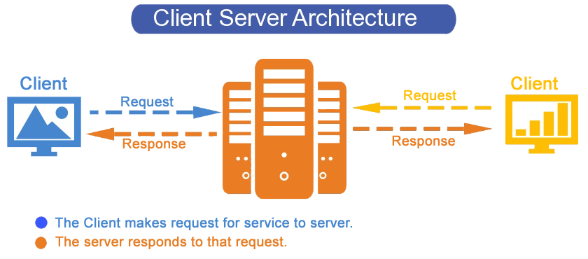
Client / Server Architecture
Server maintains durable state
Clients connect to server to access/modify state
Server supports multiple clients simultaneously

Slide 17
Server state typically kept as “tables”
Managed by databases
E.g., Movies table at themoviedb.org
We won’t do server-side stuff in CS 126.
id | title | original_title | original_language | popularity | vote_count | vote_average

Slide 18
Application Programming Interfaces (API)
APIs are the interface between the client and server
Like everything, there are good & bad APIs
Some best practices to be aware of

Slide 19
RESTful APIs
REST = Representational State Transfer
Stateless, client-server, cacheable communications protocol
Generally built on HTTP/HTTPS
Supports Creating, Reading, Updating & Deleting (CRUD)
Language/Platform independent
REST operations should be self-contained
Nice overview:
https://twincl.com/programming/*6af/rest-api-design

Slide 20
REST Concepts: Verbs
Standard Verbs:
GET: Read an existing resource (IDEMPOTENT, SAFE)
POST: Create a new resource ()
PUT: Update an existing resource (IDEMPOTENT)
DELETE: Delete an existing resource (IDEMPOTENT)
Other Standard Verbs:
OPTIONS: Get list of what verbs are allowed(IDEM, SAFE)
HEAD: Get headers (e.g., metadata) of GET (IDEM, SAFE)
PATCH: Update part of existing resource ()
You can create your own, but some discourage it

Slide 21
REST Concepts: Nouns (a.k.a. resources)
Mostly Describe Resources
/movies, /movies/17, /movies/17/reviews
Prefer plurals, use numbers to index into collection
Narrow selection through use of query string
/movies?genre=13&year=2015
Can also specify utility APIs
/search?q=keyword&order=alphabetical
Note: query parameters: key=value pairs
separated from resource by a ?
separated from each other by &

Slide 22
Interacting with a REST API
Hyper Text Transport Protocol (HTTP)
Client makes requests, server responds
Uniform Resource Locators (URL) to specify server/resource
http://host.name.here:port/path/to/resource (or https)
Port defaults to 80
Requests:
A verb (e.g., GET), a URL, and an HTTP version
Request headers and optional message body
Responses:
Status code: 200 (OK), 401 (Unauthorized), 404 (Not Found)
Response headers and optional message body

Slide 23
In Java
Easy with the power of libraries
java.net.URL*
URL url = new URL(“http://google.com”); // throws MalformedURLException
InputStream inStream = url.openStream();
InputStreamReader inStreamReader =
new InputStreamReader(inStream, Charset.forName("UTF-8"));
*https://docs.oracle.com/javase/7/docs/api/java/net/URL.html

Slide 24
Even easier with better libraries
http://unirest.io/java.html
HttpResponse<String> response = Unirest.get(url) .header("user-key", Zomato.API_KEY) .asString(); if (response.getStatus() == 200) { String json = response.getBody();
...
}

Slide 25
What (all) is wrong with this code?
public class Variables { private static String invalid = "INVALID"; private static String [] args; public static String handleIt(String argString) { args = argString.split(" "); return handleArgs(); } public static String handleArgs() { int strLength; for (int i = 0; i < args.length; i++) { strLength = args[i].length(); if (strLength > 5) { return args[i] + ": " + strLength; } } return invalid; } }

Slide 26
Are the following two things the same?
if (func1(arg1, arg2) ||
func2(arg1, arg2)) {
return true;
}
bool isGood = func1(arg1, arg2);
bool isOkay = func2(arg1, arg2);
if (isGood || isOkay) {
return true;
}
A) Same B) Different C) I don’t know

Slide 27
Short-circuit evaluation
Java stops evaluating conditionals as soon as knows the outcome:
if ((0 == 1) && willNeverBeCalled()) { …
if ((1 == 1) || willNeverBeCalled()) { …
In the above, the function will never be called.
Short-circuiting can be useful
if ((pointer != null) && (pointer->field == VAL)) {
Be judicious on when you rely on short circuiting

Slide 28
switch (type) {
// checks if the type is an open parenthesis
case "(" :
// comment relating to the condition
if (someCondition) {
// comment explaining why this return value
return false;
}
if (anotherCondition) {
// another explanatory comment
return aFunctionCall(arg1, arg2, arg3);
}
// comment relating to final return value possibility
else return (anotherFunctionCall(anotherArg1));
// if type is a closing parenthesis
case ")":
// comment relating to this different condition
if (aDifferentCondition) {
// explanation of this return value
return true;
}
if (anotherConditionToConsider) {
// comment relating to this return value
return aDifferentFunctionCall(arg1, arg2, arg3);
}
// checks if the next value in the input is an operator and returns accordingly
else return aValue;

Slide 29
switch (type) {
// checks if the type is an open parenthesis
case "(" :
// comment relating to the condition
if (someCondition) {
// comment explaining why this return value
return false;
}
if (anotherCondition) {
// another explanatory comment
return aFunctionCall(arg1, arg2, arg3);
}
// comment relating to final return value possibility
else return (anotherFunctionCall(anotherArg1));
// if type is a closing parenthesis
case ")”:
// comment relating to this different condition
if (aDifferentCondition) {
// explanation of this return value
return true;
}
if (anotherConditionToConsider) {
// comment relating to this return value
return aDifferentFunctionCall(arg1, arg2, arg3);
}
// checks if the next value in the input is an operator and returns accordingly
else return aValue;
8-16% blank lines is “optimal”

