Slide 1
Parsing JSON, Using Libraries, Java Collections, Generics

Slide 2
JSON (www.json.org)
JavaScript Object Notation
A lightweight data-interchange format
Very commonly used by APIs
It is easy for humans to read and write.
It is easy for machines to parse and generate.

Slide 3
Example JSON object
{
name_of_a_string: “a string”,
name_of_a_number: 2080.8827,
objects_can_be_values: { here_is: “another object” },
an_array: [ 27, “word”, { objects_can: “be in arrays” } ]
}

Slide 4
Using APIs (e.g., https://newsapi.org)
API = Application Programming Interface
Get an API key
Grab some JSON:
https://newsapi.org/v1/articles?source=associated-press&sortBy=top&apiKey=YOUR_API_KEY_HERE
JSON formatter/pretty printer
https://jsonformatter.curiousconcept.com
There are a bunch of these, use your favorite

Slide 5
How much time did TicTacToe assignment take?
0 – 3 hours
4 – 6 hours
7 – 9 hours
10– 12 hours
More than 12 hours

Slide 6
How much difficult was the TicTacToe assignment?
Trivial
Easy
Reasonable
Difficult
Excessive

Slide 7
Parsing JSON in Java
Use the GSON library from Google
https://github.com/google/gson/blob/master/UserGuide.md
Use Maven to add the library to your project
Build classes with fields for the desired elements of the JSON
Use the same names and get the types right
Instantiate a Gson object
Gson gson = new Gson();
Use the fromJSON method to parse the JSON
Thing newThing = gson.fromJson(jsonString, Thing.class);
Thing [] thingArray = gson.fromJson(jsonString, Thing[].class);
Extended example using NewsAPI

Slide 8
Java Collections
collection: an object that stores data; a.k.a. "data structure"
the objects stored are called elements
some collections maintain an ordering; some allow duplicates
typical operations: add, remove, clear, contains (search), size
examples found in the Java class libraries:
ArrayList, HashMap, TreeSet
all collections are in the java.util package
import java.util.*;

Slide 9
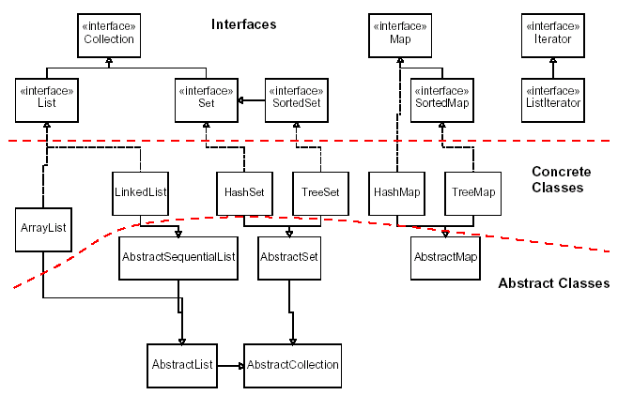
Java Collection Framework

Slide 10
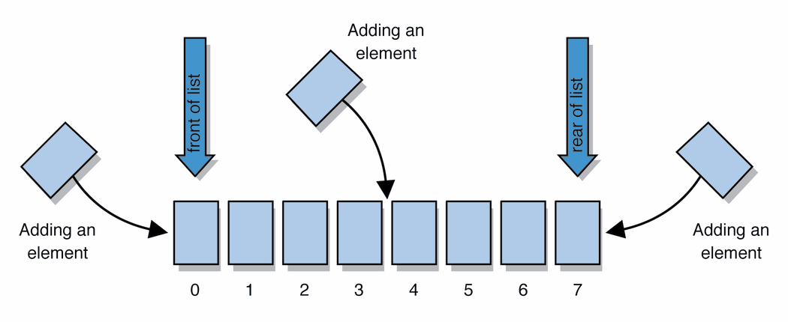
Lists
list: a collection storing an ordered sequence of elements
each element is accessible by a 0-based index
a list has a size (number of elements that have been added)
elements can be added to the front, back, or elsewhere
in Java, a list can be represented as an ArrayList object

Slide 11
ArrayList Methods (partial list)
add(value) | appends value at end of list
add(index, value) | inserts given value just before the given index, shifting subsequent values to the right
clear() | removes all elements of the list
indexOf(value) | returns first index where given value is found in list (-1 if not found)
get(index) | returns the value at given index
remove(index) | removes/returns value at given index, shifting subsequent values to the left
set(index, value) | replaces value at given index with given value
size() | returns the number of elements in list
toString() | returns a string representation of the list such as "[3, 42, -7, 15]"

Slide 12
Map
Allows lookups from one kind of object to find another object
Map<KeyType, ValueType> myMap =
HashMap<KeyType, ValueType>();
KeyType key = …;
ValueType value = …;
myMap.put(key, value);
ValueType lookup = myMap.get(key);
assert lookup == value;

Slide 13
Map Interface
put(k,v) Associate v with k
get(k) The value associated with k
size() The number of pairs
isEmpty() Whether it is empty
remove(k) Remove the mapping for k
clear() Remove all mappings
containsKey(k) Whether contains a mapping for k
containsValue(v) Whether contains a mapping to v

Slide 14
Generics
ArrayList<Type> name = new ArrayList<Type>();
When constructing an ArrayList, you must specify the type of elements it will contain between < and >.
This is called a type parameter or a generic class.
Allows the same ArrayList class to store lists of different types.
Must be objects (vs. primitive types)

Slide 15
Boxed Primitive Types
Can’t do ArrayList<int>
Java provides “boxed primitives”: E.g., Integer
Sub-class of object
Can do:
ArrayList<Integer> lengths = new ArrayList<Integer>
lengths.add(7); // automatically promoted to boxed type
Primitive Type | Wrapper Type
int | Integer
double | Double
char | Character
boolean | Boolean

