Slide 1
CS 126: Software Design Studio
Prof. G Carl Evans

Slide 2
What is this class about?
My goals for this class:
Improve your programming productivity by >= 3x
Build your self-sufficiency as a programmer
Introduce you to modern computing environments
Provide skills for getting internships / doing hack-a-thons
Have you build a large project relating to your interests

Slide 3
What is this class NOT about?
This is NOT a ‘Computer Science’ class
This is a programming class
(i.e., don’t hate CS even if you hate this class)
But, this class will help you in your ‘Computer Science’ classes
Alleviate the low-level programming struggles
You can focus your attention on the big ideas!

Slide 4
What is Programming? (two views)
“The programmer, like the poet, works only slightly removed from pure thought-stuff. He builds his castles in the air, from air, creating by exertion of the imagination. Few media of creation are so flexible, so easy to polish and rework, so readily capable of realizing grand conceptual structures....
Yet the program construct, unlike the poet's words, is real in the sense that it moves and works, producing visible outputs separate from the construct itself. […] The magic of myth and legend has come true in our time. One types the correct incantation on a keyboard, and a display screen comes to life, showing things that never were nor could be.” — Fred Brooks
Pragmatically, programming is the tool that computer scientists use to collect, analyze, and visualize data, automate tasks, make products, mechanically prove theorems, and build tools. As lawyers write prose and architects build models, programming is the underlying tool of the computer scientist.

Slide 5
Programming is unique
“The gap between the best software engineering practice and the average practice is very wide—perhaps wider than in any other engineering discipline” — Fred Brooks
“The original study that found huge variations in individual programming productivity … studied professional programmers with an average of 7 years' experience and found that the ratio of initial coding time between the best and worst programmers was about 20 to 1; the ratio of debugging times over 25 to 1; of program size 5 to 1; and of program execution speed about 10 to 1.” — Steve McConnell

Slide 6
How much programming experience do you have?
A. Six months or less
B. Six to 12 months
C. One to two years
D. Two to six years
E. More than six years

Slide 7
How do you get better at something?
1. Get lessons from experts
2. Practice
3. Get feedback
4. Metacognition

Slide 8
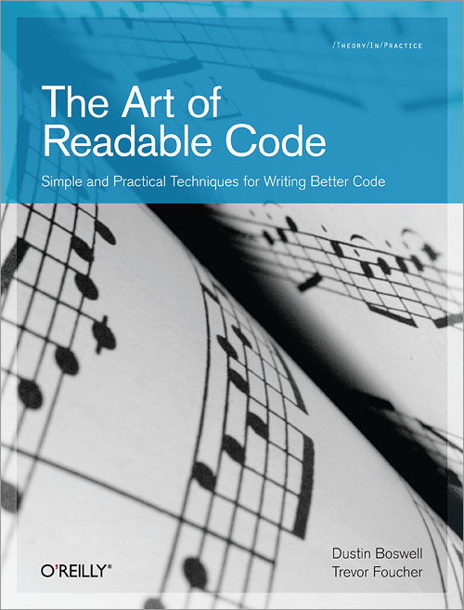
Course Textbook (part 1)
A solid, concise book on software construction.
Less than $30 on Amazon prime (or $16 for a Kindle version).
Check out reviews on Amazon about how good this book is.

Slide 9
Code Reviews
Groups of <=6 students + 1 moderator
Meets 2 hours/week (arranged time)
Present code that you’ve written in the past week
Get feedback on your style & design
See other possible designs (pick up ideas)
Practice presentation & verbal communication skills

Slide 10
Meta-cognition (or Metacognitive Regulation)
“Regulation of cognition" contains three essential skills:
Planning: appropriate selection of strategies and the correct allocation of resources that affect task performance.
Monitoring: refers to one's awareness of comprehension and task performance
Evaluating: refers to appraising the final product of a task and the efficiency at which the task was performed. This can include re-evaluating strategies that were used.

Slide 11
Learning to help yourself
Very few programs are written completely from scratch.
Most rely heavily on libraries, APIs, and frameworks
Existing code is person-made and arbitrary
No one inherently knows how to interface to it
Need to be able to read documentation
Google and StackOverflow are your friend
In this class, we’ll encourage you to help yourself
Teach a person to fish, and you feed them for a lifetime.

Slide 12
What are we going to do this semester?
style, refactoring, code reviews
layout, commenting, variable usage and naming, control structures
test-driven development, testing frameworks, coverage
defensive programming, assertions, exception handling
design, design of routines, object-oriented frameworks
design patterns, event-driven programming, MVC
tools: IDEs, source control, debugging, logging, Unix
user interface design, prototyping, user testing

Slide 13
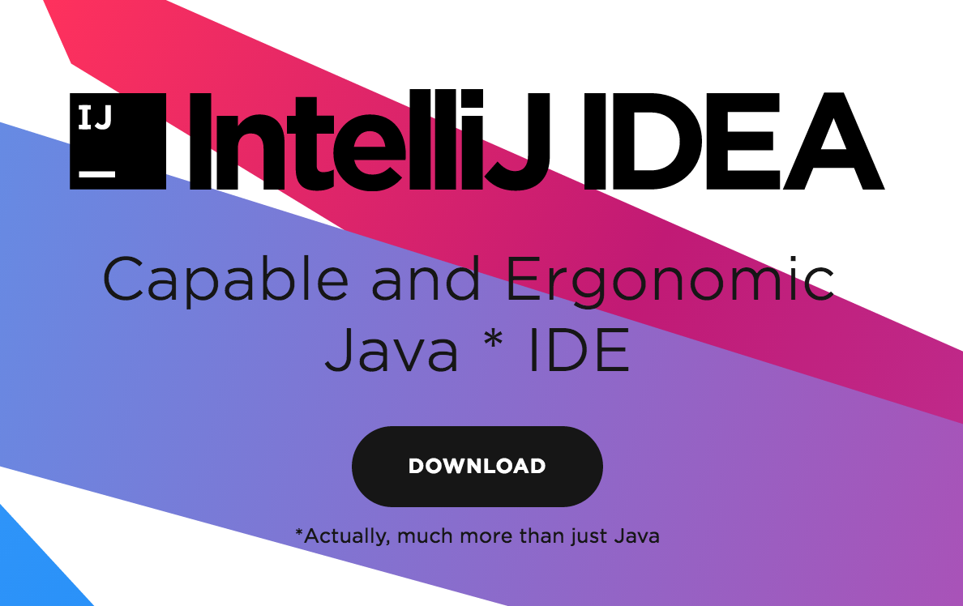
Course Infrastructure (1)
Java is a relatively verbose language
Having a good tool accelerates routine drudgery.
IntelliJ IDEA is a really good tool (basis for Android Studio)

Slide 14
Course Infrastructure (2)
Version control systems (VCS):
A practice that tracks and provides control over changes to a collection of documents/files.
Allows access to any prior version.
Facilitates collaboration between multiple developers.
Git: an industry-standard distributed VCS
You’ll use this for developing/submitting your code.
Very sophisticated tool; we’ll use a subset of features

Slide 15
VCS concepts
Repository: A collection of files under version control, along with all of their previous (committed) versions.
Checkout (verb): To make a working copy on your local machine for editing/testing.
Commit (verb): To take a set of file modifications and add them to the repository, usually with a descriptive message.
Commit (noun): The set of changes (a “diff”) along with its descriptive message resulting from a commit (verb).

Slide 16
Git concepts
Local repository vs. remote repository:
Git lets you have as multiple related repositories on different machines.
Clone:
Make a local repository from a remote repository.
Staged:
Files whose changes are to be committed.
Push:
Copying local commit to remote repository.
Pull:
Bringing changes from remote to local repository. Implemented by a “fetch” then a “merge”.

Slide 17
Version Control, why do we care?
Single Developer:
Most things worth doing are too big to do all at once.
Break large projects into small steps:
Design, implement, test, debug, commit each step.
Have access to every working version through VCS
If things stop working:
Can inspect the differences between current and last working versions.
Can always revert back to last working version (e.g., throw away changes)
Multiple developers:
Coordinate edits to a shared set of files

Slide 18
Things to have been doing
Join UIUC CS 126 on Piazza
Get an iClicker registered
Get a GitHub account
Install IntelliJ on your laptop (students can get the Ultimate version for free)
Review course Policies:
https://courses.engr.illinois.edu/cs126
Code Review Survey
https://doodle.com/poll/bm9q2c5ip88qicaq
7 times as the poll instructions say
Please use your netid not your name for the poll

Slide 20
Your friend offers to send you the code for the MP so you can hang out.
Good Idea
Bad Idea

Slide 21
Your friend is having difficulties starting the assignment, so you give them a general overview of what you did.
Good Idea
Bad Idea

Slide 22
Your friend is having difficulties starting the assignment, so you show them the first few methods you wrote.
Good Idea
Bad Idea

Slide 23
Your friend is having difficulties with the assignment, so you help them debug their code.
Good Idea
Bad Idea

Slide 24
Your friend just does NOT have time this week for CS 126 and they ask you to give them your code. Don't worry they'll change it up a little.
Good Idea
Bad Idea

Slide 25
You get stuck on how to do something on an MP, so you google it and copy ~30 lines from the very helpful first StackOverflow post.
Good Idea
Bad Idea

Slide 26
You get stuck on how to do something on an MP, so you google it and add a comment citing the code you took from StackOverflow. You can explain what the code does in code review.
Good Idea
Bad Idea

Slide 27
You get stuck on how to do something on an MP, so you google it and use code from an past student's incredibly handy GitHub repository! That student's intro programming assignment surely looks impressive to recruiters!
Good Idea
Bad Idea

Slide 28
You think you're smarter than course staff, so you "borrow" your friend's code and attempt to modify it enough so that you don't get caught.
Good Idea
Bad Idea

