Slide 1
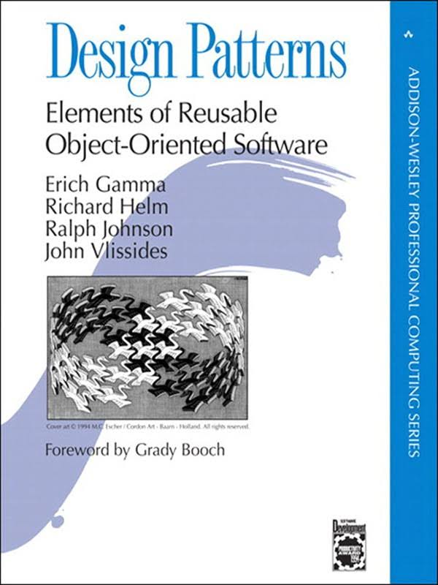
Introduction to
Design Patterns
Slides adapted from Craig Zilles

Slide 2
Design Pattern
“Each pattern describes a problem which occurs over and over again in our environment, and then describes the core of the solution to that problem, in such a way that you can use this solution a million times over, without ever doing it the same way twice.” -- Christopher Alexander
Each pattern has 4 essential elements:
  A name
  The problem it solves
  The solution
  The consequences

Slide 3
Let’s start with some “Micro-Patterns” (1)
Name: Most-wanted holder
Problem: Want to find the “most wanted” element of a collection.
Solution: Initialize most-wanted holder to first element. Compare every other element to value in most-wanted holder, replace if the new value is better.
Thing mostWanted = things[0];
for (int i = 1 ; i < things.length ; i ++) {
if (thing[i].isBetterThan(mostWanted)) {
mostWanted = thing[i];
}
}

Slide 4
Let’s start with some “Micro-Patterns” (2)
Name: One-way flag
Problem: Want to know if a property is true/false for every element of a collection.
Solution: Initialize a boolean to one value. Traverse the whole collection, setting the boolean to the other value if an element violates the property.
boolean allValid = true;
for (Thing thing : things) {
if (!thing.isValid()) {
allValid = false;
break;
}
}

Slide 5
Let’s start with some “Micro-Patterns” (3)
Name: Follower
Problem: Want to compare adjacent elements of collection.
Solution: As you iterate through a collection, set the value of the follower variable to the current element as the last step.
boolean collectionInOrder = true;
Thing follower = null;
for (Thing thing : things) {
if (follower != null &&
thing.isBiggerThan(follower)) {
collectionInOrder = false;
}
follower = thing;
}

Slide 6
Other ”Micro-Patterns”

Slide 7
“Design Patterns” focus on object-level
Relate to relationships between classes & objects
  IsA (inheritance) and HasA (containment) relationships
Many of these seem obvious (in hind sight)
  The power is giving these names, codifying a best practice solution, and understanding their strengths/limitations.

Slide 8
UML Class Diagrams
Unified Modeling Language (UML)
  A standard for diagrammatic representations in software engineering.
The Class Diagram is the main building block for object-oriented modeling; it shows:
  the system's classes
  their attributes and operations (or methods), and
  the relationships among objects

Slide 9
Class/Object Notation
Class definitions
Abstract in italics
Methods have parentheses
Variables do not
Types are optional;
included when useful

Slide 10
Class/Object Notation (cont.)
Class relationships
Diamond = Has A collection of
Solid dot = multiple
Triangle = Inheritance (Is A)
Dashed line = creates
Solid line = Has A (containment)

Slide 11
Class/Object Notation (cont.)
Object instances
Objects have rounded corners

Slide 12
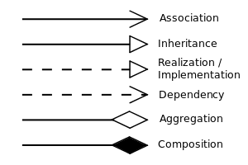
Relationships

Slide 13
Strategy
Intent: define a family of algorithms, encapsulate each one, and make them interchangable. Strategy lets the algorithm vary independently from clients that use it.
Use the strategy pattern when:
  Many related classes differ only in their behavior.
  You need different variants of an algorithm (e.g., trade-offs)
  An algorithm uses data that clients shouldn’t know about
    E.g., encapsulate the algorithm data from client
  A class defines multiple behaviors and these are implemented using conditionals.

Slide 14
Strategy Pattern
Solution
  Strategy abstract base class exposes algorithm interface.
  Context object HasA Concrete Strategy object.
  Context object invokes algorithm interface from strategy.

Slide 15
Problem: Social media updates
You have your InstaTwitInYouFaceTrest app open and a friend makes a post / updates their status. How do you get the info before the next time you (manually) refresh your app?

Slide 16
The Observer Pattern (a.k.a. Publish/Subscribe)
Problem: Keep a group of objects “in sync” in the presence of asynchronous updates, while minimizing the amount of coupling.
Intent: Define a one-to-many dependency between objects so that when one object changes state, all its dependents are notified and updated automatically.
Use the Observer pattern when:
  When changes to one object requires changes to other and you don’t know which and/or how many.
  When an object should be able to notify other objects without making assumptions about who these other objects are (i.e., you don’t want these objects tightly coupled).

Slide 17
Observer Pattern
A) Classes
B) Objects

Slide 18
Observer Pattern
A) HasA (containment)
B) IsA (inheritance)

Slide 19
Observer Pattern
Solution:
  Observers can “attach” to a Subject.
  When Subject is updated, it calls Update() on all Observers
  Observers can query Subject for updated state.

Slide 20
Class/Object Notation (cont.)
Interaction Diagram
Solid vertical line = existed before/after interaction
Dashed vertical line = didn’t exist
Time
passing
Dashed horizontal
line = creation
Box = period active during interaction
Solid horizontal
line = invocation

Slide 21
Observer Pattern Interaction Example
aConcreteObserver modifies a ConcreteSubject

Slide 22
Adapter Pattern
Intent: Convert the interface of a class into another interface that a client expects. Adapter lets classes work together that couldn’t otherwise because of incompatible interfaces.
Use the Adapter pattern when:
  You want to use an existing class and interface doesn’t match the one that you need
  You want to create a reusable class that cooperates with unrelated and unforeseen classes (non-compatible interfaces)
  You need to use several existing subclasses, but it’s impractical to adapt their interface by subclassing every one.

Slide 23
Adapter Pattern
Solution:
  Adapter class IsA derived class of Target type
  Adapter class HasA Adaptee class
  Adapter class delegates requests to Adaptee class

Slide 25

Scrabble

Slide 26
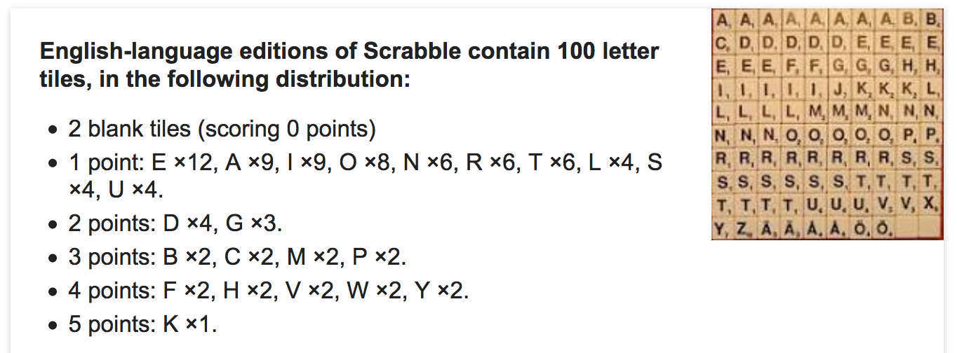
Scrabble word score
Sum of the letter values

Slide 27
Scrabble word score, continued
public static int wordScore(String word) {
int score = 0;
for (int i = 0 ; i < word.length() ; i++) {
char letter = word.charAt(i);
score += letterScore(letter);
}
return score;
}

Slide 28
Control-flow based
public static int letterScore(char c) {
char upperC = Character.toUpperCase(c);
switch (upperC) {
case 'A':
case 'E':
case 'I':
case 'L':
case 'N':
case 'O':
case 'R':
case 'S':
case 'T':
case 'U':
return 1;
case 'D':
case 'G':
return 2;
case 'B':
case 'C':
case 'M':
case 'P':
return 3;
case 'F':
case 'H':
case 'V':
case 'W':
case 'Y':
return 4;
case 'K':
return 5;
case 'J':
case 'X':
return 8;
case 'Q':
case 'Z':
return 10;
default:
// handle error
}
// should never reach here
return 0;
}

Slide 29
Table-based Solution
private static final int [] scoresByChar =
{/* A */ 1, /* B */ 3, /* C */ 3, /* D */ 2, /* E */ 1,
/* F */ 4, /* G */ 2, /* H */ 4, /* I */ 1, /* J */ 8,
/* K */ 5, /* L */ 1, /* M */ 3, /* N */ 1, /* O */ 1,
/* P */ 3, /* Q */ 10, /* R */ 1, /* S */ 1, /* T */ 1,
/* U */ 1, /* V */ 4, /* W */ 4, /* X */ 8, /* Y */ 4,
/* Z */ 10};
public static int letterScore2(char c) {
char cAsUppercase = Character.toUpperCase(c);
int index = cAsUppercase - 'A';
if (index < 0 || index >= 26) {
// handle error
}
return scoresByChar[index];
}

