Slide 1
Model – View – Controller
Debugging
Slides adapted from Craig Zilles

Slide 2
Model – View – Controller (MVC)
A Software Architectural Pattern
  Much like a design pattern
  It uses design patterns
Provides low coupling in User Interface systems.

Slide 3
MVC Key Idea
Break application into 3 logical components
Model:
  Holds the state of the application and logic/rules of how state can be updated.
View:
  Output representation of information
Controller:
  Accepts user input and translates it into commands for the model or a view
  Decouple interface from application state

Slide 4
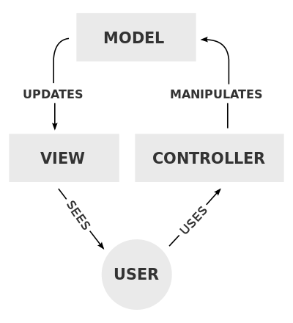

Slide 5
Low Coupling from Views/Controllers to Model
Model code is independent from interface
Can support many different views
  Simultaneously or one-at-a-time (e.g., summary vs. detail)
  Use Observer pattern to attach Views to Model
Can support many different controllers

Slide 6
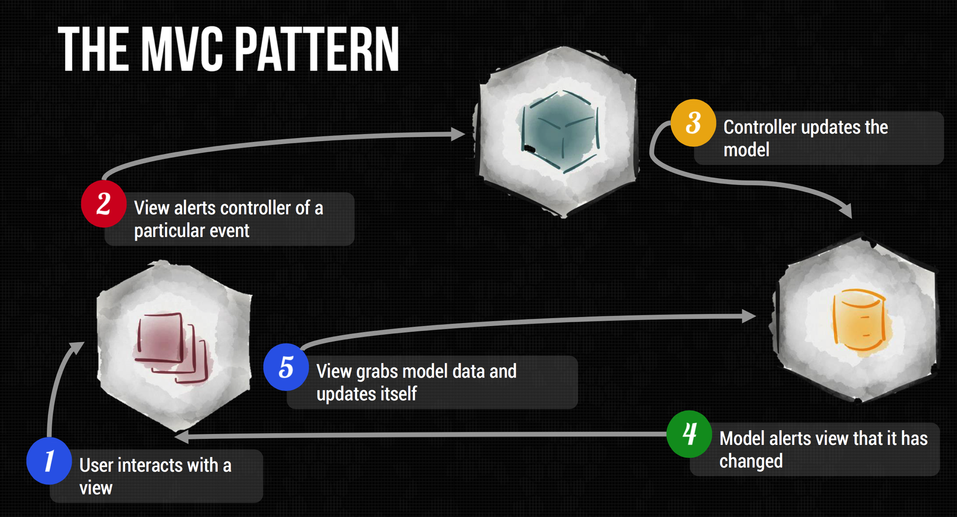

Slide 7
How hard was CS 126 Linked List?
Easy
Moderate
Challenging
Unreasonable

Slide 8
How long did it take to complete CS 126 Linked List?
Less than 3 hours
3 to 6 hours
6 to 9 hours
9 to 12 hours
More than 12 hours

Slide 9
Final Project
Application using openFrameworks
Use a window
Use a significant library not presented in class

Slide 10
We will cover
GUI and UI Design
openFramework gui
smart pointers
Unix tools

Slide 11
What to Cover?
Native GUI
3d Graphics
Networking
Sound
Database Stuff

Slide 12
What are these?
char *str[10];
int (*q)(int);

Slide 13
More Examples (Arrays and Pointers)
    int *x[];
    int (*y)[];

Slide 14
More Examples (Const and Pointers)
const char *chptr;
char * const chptr;

Slide 15
More Examples (Functions and Pointers)
int *z(int);
int (*q)(int);

Slide 16
What does the pointer point to?
    int (*foo)[];
    A pointer to an array of integers
    An array of pointers to integers
    A pointer to a function that takes no arguments and returns an integer
    A function that takes no arguments and returns a pointer to an integer
    None of the above

Slide 17
Stack Heap and Memory
Clone this repo:
git clone https://github.com/gcevans/smart

Slide 18
More Pointers
T*
  This is a raw pointer and has no required ownership
unique_ptr<T>
  This is a pointer that owns an object
shared_ptr<T>
  This is a pointer that allows shared ownership of an object
weak_ptr<T>
  This is a pointer has no ownership of an object

