Slide 1
Get To Know Your Compiler
Inspired by Matt Godbolt

Slide 2
Did you get the openFrameworks Example Working?
Yes
No
What???

Slide 3
Compilation Stages
Preprocessor
  Run preprocessor directives –E for clang
Compiler
  Compile the preprocessed source code
    -S Generate Assembly
    -c Generate Object Code
Linker
  Generate executable from object files

Slide 4
Does it matter?

Slide 5
X86 Assembly Registers
rax, rbx, rcx, rdx, rsp, rbp, rsi, rdi, r8-r15
xmm0-xmm15
rdi, rsi, rdx … arguments
rax is the return value

Slide 6
Register Details

Slide 7
Instructions
op is call, ret, add, sub, cmp…
dest, src is register or memory reference
  [base + reg1 + reg2 (1, 2, 4, or 8) ]

Slide 8
Instruction Examples

Slide 9
Summary
Register: rax, rbx, rcx …
Size: rax, eax, ax ..
Params: rdi, rsi, rdx, rcx …
Result: rax
Format: op dest, src
dest and src are registers or memory

Slide 10
So Does it matter?

Slide 11
Compiler Explorer
Godbolt.org

Slide 12
What is going on?

Slide 15
Multiplication

Slide 16
Fancy Multiplication

Slide 17
Division

Slide 18
Summation
int sumTo(int x) {
int sum = 0;
for( int i = 0; i <= x; ++i ) {
sum += i;
}
return sum;
}
What is the runtime?
A) O(1) B) O(x) C) O(x^2) D) What on earth is big O?

Slide 19
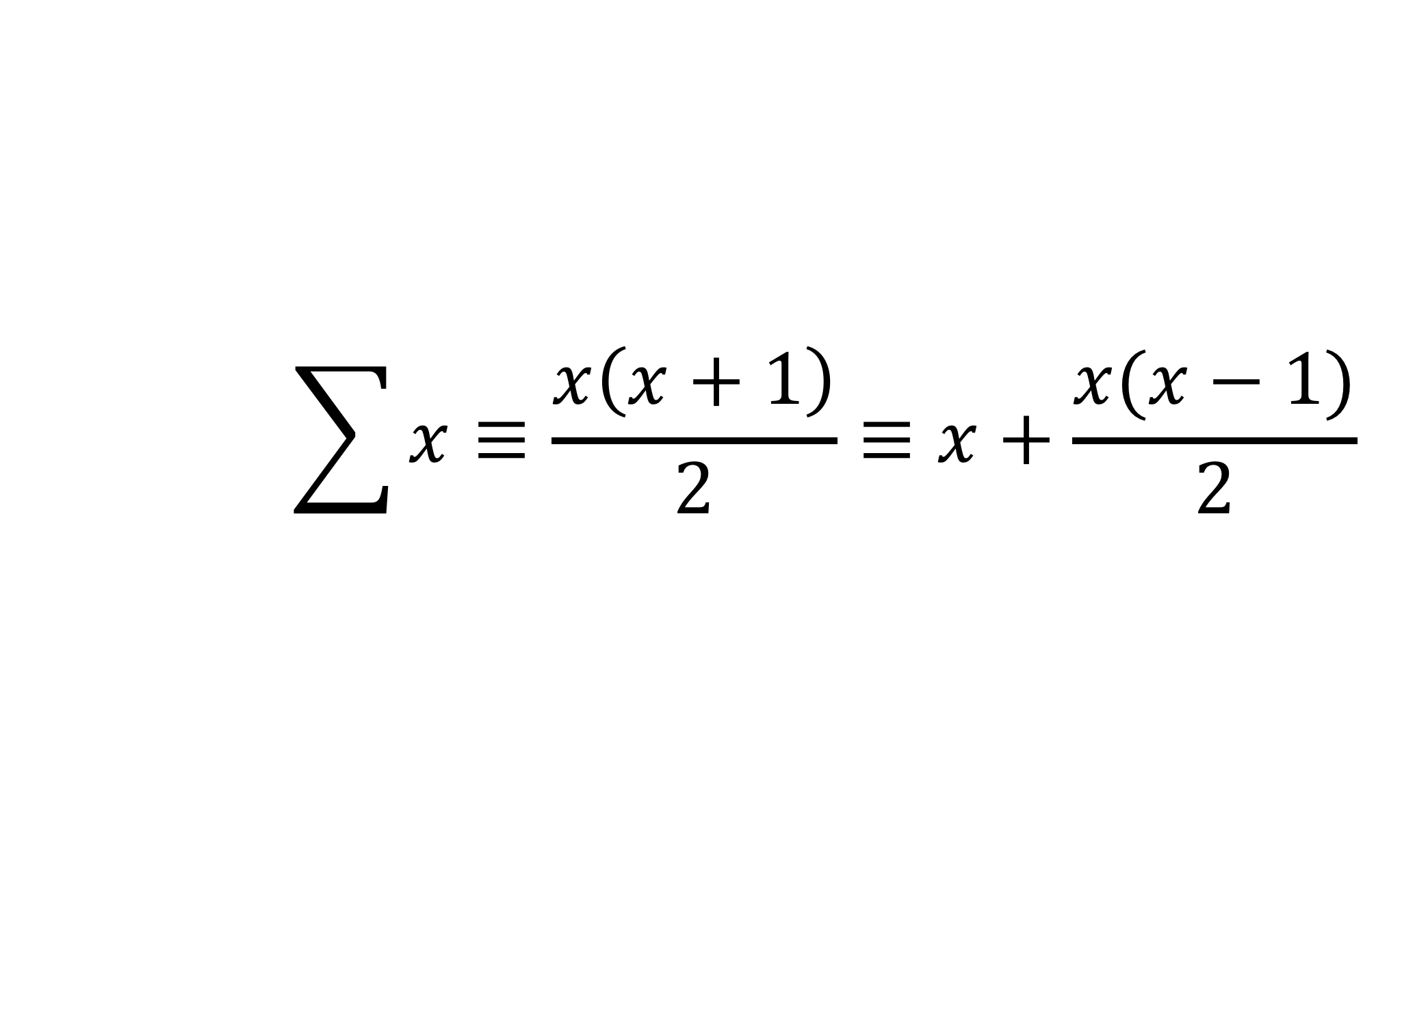
Sum(X) from CS 173
$$\sum{x≡\frac{x\left(x+1\right)}{2}≡x+\frac{x(x−1)}{2}}$$

Slide 20
The compiler is your friend

