Slide 1
Human Factors / User Interface Design Guidelines
Slides adapted from Craig Zilles

Slide 2
How hard was week 10 Naïve Bayes code review assignment?
Easy
Moderate
Challenging
Unreasonable

Slide 3
How long did week 10 Naïve Bayes assignment take?
Less than 3 hours
3 to 6 hours
6 to 9 hours
9 to 12 hours
More than 12 hours

Slide 5

How would you interact with this?
Notes:
Here's another bizarre interface, taken from a program that launches housekeeping tasks at scheduled intervals.
The date and time look like editable fields (affordance), but you can't edit them with the keyboard. Instead, if you want to change the time, you have to click on the Set Time button to bring up a dialog box.
This dialog box displays time differently, using 12-hour time (7:17 pm) where the original dialog used 24-hour time (consistency). Just to increase the confusion, it also adds a third representation, an analog clock face.
So how is the time actually changed? By clicking mouse buttons: clicking the left mouse button increases the minute by 1 (wrapping around from 59 to 0), and clicking the right mouse button increases the hour. Sound familiar? This designer has managed to turn a sophisticated graphical user interface, full of windows, buttons, and widgets, and controlled by a hundred-key keyboard and two-button mouse, into a clock radio!
Perhaps the worst part of this example is that it's not a result of laziness. Somebody went to a lot of effort to draw that clock face with hands. If only they'd spent some of that time thinking about usability instead.

Slide 6
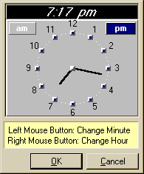
How about this?

Slide 7
Design Terminology: Affordances
An affordance is a relation between an object/environment and an organism that affords the opportunity for that organism to perform an action.
For example, a knob affords twisting, and perhaps pushing, while a cord affords pulling.
An affordance enables the possibility of some action.

Slide 8
Design Terminology: Signifiers
A "signifier" is some sort of indicator, some signal in the physical or social world that can be interpreted meaningfully

Slide 9
User Experience design in a nutshell
1. Provide the affordances desired by users
2. Organize those affordances appropriately
  “Information Architecture”
3. Make your affordances obvious through correct use of signifiers
Sounds pretty easy…

Slide 10
User Experience Design is Hard
Most users are not like you
Users can’t always tell you what they want
But, they can sure tell you what is wrong.
  Consistent problems are the system’s fault

Slide 11
You won’t get it right the first time:
UX Design is an Iterative Process
Design
Implement
Evaluate
Iteration can be costly
  Might have to re-write a lot of your code

Slide 12
Spiral Model of Design
Use throwaway prototypes and cheap evaluation early in the cycle.
Design
Evaluate
Implement

Slide 13
Usability
How well users can use the system.
Dimensions of Usability:
  Learnability: Easy to learn?
  Visibility: Is the state of the system clear?
  Efficiency: Once learned, is it fast to use?
  Errors: are errors few and recoverable?
  Satisfaction: is it enjoyable to use?
Design Principles guide building usable systems
  Guided by findings in Ergonomics / Human Factors

Slide 14
Ergonomics / Human Factors
the scientific discipline concerned with the understanding of interactions among humans and other elements of a system
applies theory, principles, data and methods to design in order to optimize human well-being and overall system performance
Characterizes the capabilities and limitations of humans

Slide 15
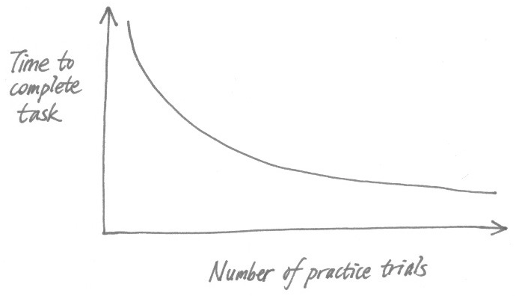
Human Factors: Power Law of Practice
The log time to complete a task decreases linearly with of # practice trials.

Slide 16
Usability
How well users can use the system.
Dimensions of Usability:
  Learnability: Easy to learn?
  Visibility: Is the state of the system clear?
  Efficiency: Once learned, is it fast to use?
  Errors: are errors few and recoverable?
  Satisfaction: is it enjoyable to use?
Design Principles guide building usable systems
  Guided by findings in Ergonomics / Human Factors

Slide 17
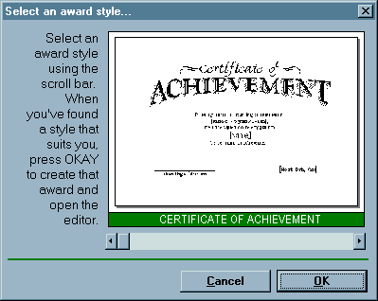
What is wrong with this?
Notes:
What is wrong with this?
http://web.mit.edu/6.813/www/sp16/classes/01-usability/

Slide 18
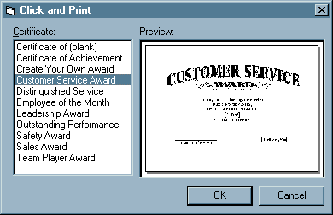
Alternative Design
Notes:
Scrollbar not continuous
Discoverability

Slide 19
Design Principles for Learnability
Consistency (in design and metaphors)
  Similar looking things act similarly
  Different looking things act differently
  In wording, location, color, ordering
Use common words not jargon
Recognition, not recall
  Labeled buttons rather than command languages
2 kinds of users: Beginners & Experts

Slide 20
Visibility
Avoid affordances w/o signifiers
  E.g., pop-up menus by clicking on open space
Avoid hidden modes
Perceptual Fusion:
  Stimuli <100ms apart seems fused to humans
  10 frames/second appears as moving picture

Slide 21
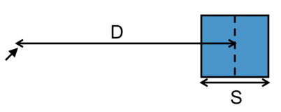
Efficiency: Hand motion tasks
Moving mouse on screen
Finger on keyboard/touchscreen
Hand from keyboard to mouse
Fitts’s Law
  Time = a + b*log(D/S)
  log(D/S) = index of difficulty
Bigger, closer = easier
For mousing, S is infinite on edge of screen (good!)

Slide 22
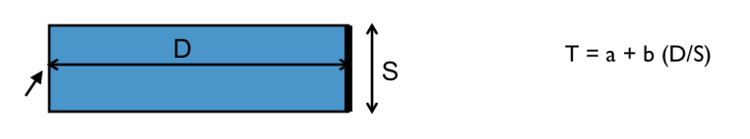
Efficiency: Path Steering Tasks
Fitts’s law only for unconstrained movements
Task much harder if constrained to tunnel

Slide 23
Design for Efficiency
Fitt’s Law & Steering Law
  Important targets: big, nearby, or at screen edges
  Avoid steering tasks
Provide shortcuts
  Keyboard accelerators (for expert users)
  Bookmarks
  History

Slide 24
Reminder: Using the internet/citing sources
It must be publicly available
It must be a minority (<25%) of the code that you submit
You must understand what the code does.
Cite any distinctive or substantial code snippets (e.g., more than 2-3 lines) immediately preceding the code
// code below derived from:
// https://stackoverflow.com/questions/21626439/how-to-implement-the-java-comparable-interface
public int compareTo(LineItem other) {
return Integer.compare(this.position, other.position);
}

Slide 25
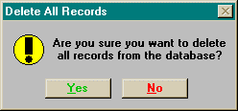

Slide 26
Errors
Principle: Protect User’s Work
Prevent Errors as much as possible:
  Selection rather than typing (within reason)
  Constrain user input
  Separate risky commands from common ones
Undo (design pattern)
Confirmation Dialogs (when appropriate)
Understandable error messages

Slide 27
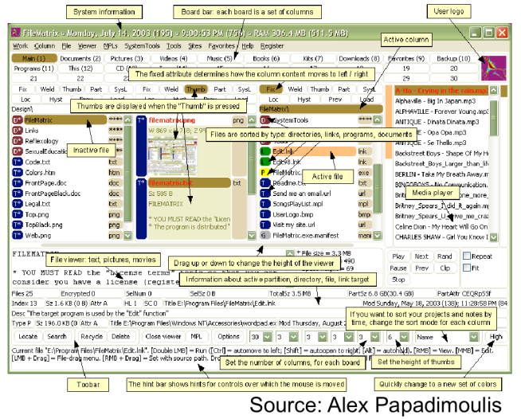

Slide 28
Simplicity
Less is More
  Omit extraneous information, graphics, features
Hick's Law:
  time to make a decision is proportional to log(# choices)

Slide 29
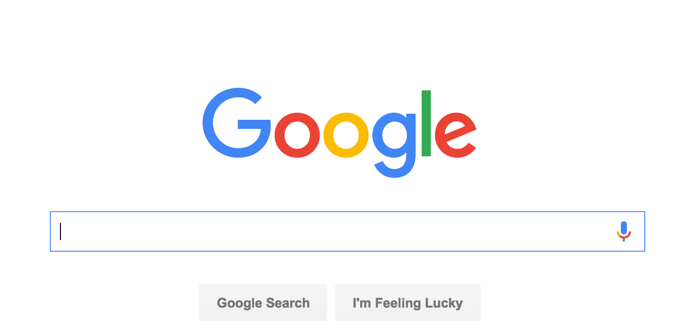

Slide 30
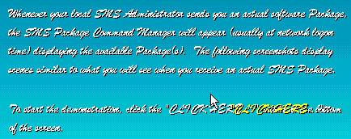

Slide 31
Simplicity, cont.
Good graphic design
  Few, well-chose colors and fonts
  Group with whitespace
Use concise language
  Choose labels carefully

Slide 32
How not to design
https://www.uxpin.com/studio/blog/10-worst-design-failures-of-all-times/

Slide 33
How do users hold phones
http://www.uxmatters.com/mt/archives/2013/02/how-do-users-really-hold-mobile-devices.php
http://scotthurff.com/posts/how-to-design-for-thumbs-in-the-era-of-huge-screens

