Slide 1
Templates and Iterators

Slide 2
Linked List Data Structures
struct ListNode {
Data data_;
ListNode *next_;
ListNode(Data d) : data_(d), next_(nullptr) {};
}
class LinkedList {
ListNode *head_;
…
public:
…

Slide 3
What about a Linked List of something else?
struct ListNode {
int data_;
ListNode *next_;
ListNode(int d) : data_(d), next_(nullptr) {};
}
class LinkedList {
ListNode *head_;
…
public:
…

Slide 4
Better Choice Templates
We have used templates such as in std::vector
Templates allow for generic code that is parameterized by types.
Think of them as recipes to generate code
With templates all code must be included as headers are included.
  We use the following at the end of the header example for template version ll.h
  // needed for template instantiation
  #include "ll.cpp"
  } // namespace snakelinkedlist
  #endif //LL_H

Slide 5
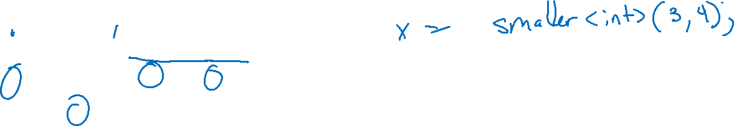
Simple Template Function Example
template<typename T>
T smaller(T a, T b) {
T smaller_value;
smaller_value = ( a < b ) ? a : b;
return smaller value;
}

Slide 6
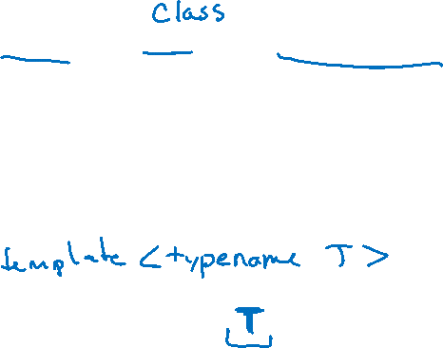
Now List
template<typename ElementType>
struct ListNode {
ElementType data_;
ListNode *next_;
ListNode(ElementType d) : data_(d), next_(nullptr) {};
}
class LinkedList {
ListNode<???> *head_;
…
public:
…

Slide 7

Better Plan
template<typename ElementType>
class LinkedList {
struct ListNode {
ElementType data_;
ListNode *next_;
ListNode(ElementType d) : data_(d), next_(nullptr) {};
}
ListNode<ElementType> *head_;
…
public:
…

Slide 8

Template Insert at start from included .cpp
template<typename ElementType>
void LinkedList::InsertHead(ElementType new_data) {
ListNode *new_node = new ListNode(new_data);
new_node->next_ = head_;
head_ = new_node;
}

Slide 9
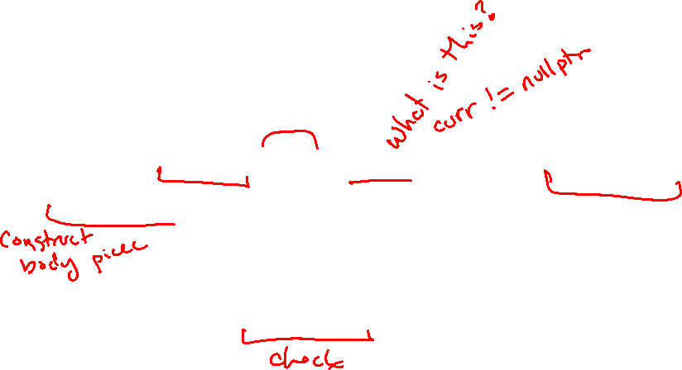
How to access the linked list?
…
for(SnakeBody* curr = head_->next; curr; curr = curr->next) {
ofRectangle body_rect(curr->position.x,
curr->position.y,
body_size_.x, body_size_.y);
if (head_rect.intersects(body_rect)) {
return true;
}
}

Slide 10
STL style interface using range for?
…
for(auto snake_segment : snake_list_ )
ofRectangle body_rect(snake_segment.position.x,
snake_segment.position.y,
body_size_.x, body_size_.y);
if (head_rect.intersects(body_rect)) {
return true;
}
}

Slide 11
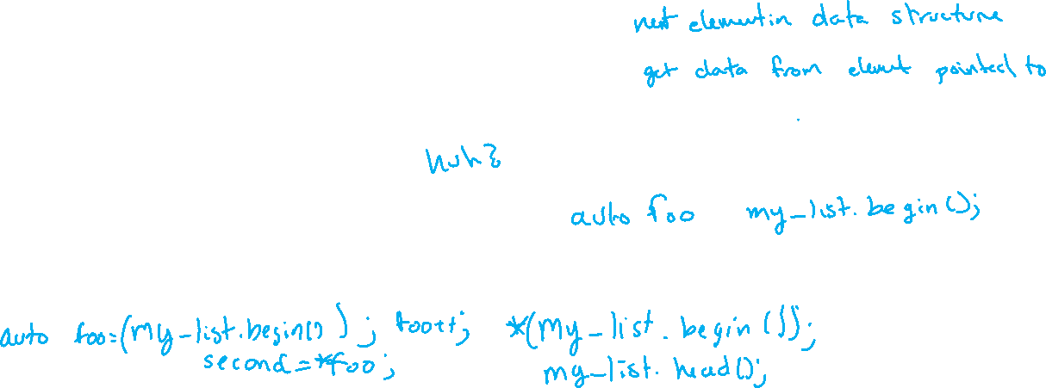
Iterators – Simple Forward Iterator Interface
Required Functions of iterator
Iterator() – default constructor
Iterator & operator++() – post increment as next element
ElementType &operator*() – dereference operator as to access
bool operator!=(const Iterator &rhs) – not equal to detect end.
Required Functions of Linked List class
Iterator begin() – return an iterator to the start of the list
Iterator end() – return an iterator to past the end of the list

Slide 12
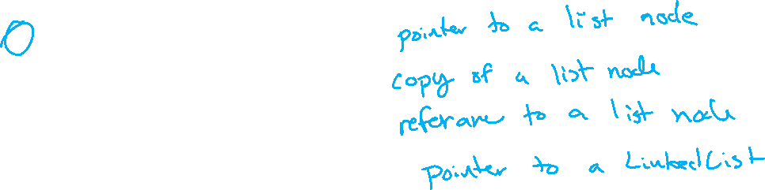
What to store in our iterator to access the list?
ListNode *current_;
ListNode current_;
ListNode &current_;
LinkedList *current_;

Slide 13
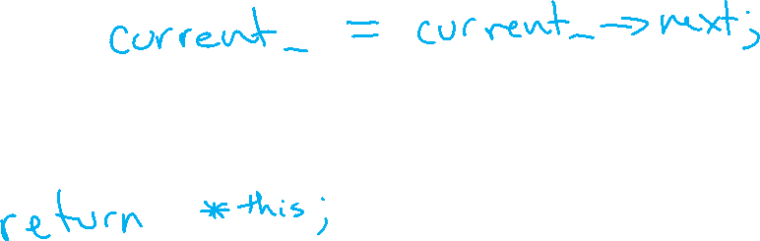
Iterator & operator++()
Iterator & operator++() {
}

Slide 14
ElementType &operator*()
ElementType &operator*() {
}

Slide 15
bool operator!=(const Iterator &rhs)
bool operator!=(const Iterator &rhs) {
}

Slide 16
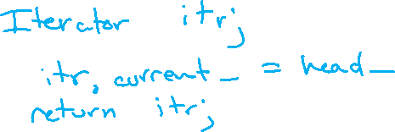
Iterator begin()
Iterator begin() {
}

Slide 17
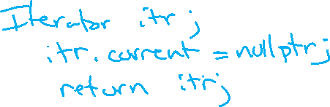
Iterator end()
Iterator end() {
}

