Slide 1
The Big 5 and Lists

Slide 2

Classes – No Internal "new"
Member variables
Methods
Constructor
Rule of Zero

Slide 3
How hard was week 9 Sudoku code review assignment?
Easy
Moderate
Challenging
Unreasonable

Slide 4
How long did week 9 Sudoku assignment take?
Less than 3 hours
3 to 6 hours
6 to 9 hours
9 to 12 hours
More than 12 hours

Slide 5
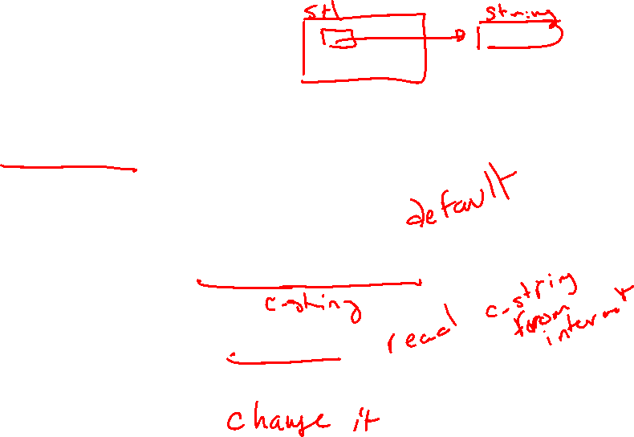
Case Study: StringHolder
class StringHolder {
std::string *string_;
public:
StringHolder() : string_(nullptr) {};
StringHolder(const char *initial_string);
const char* c_str() const noexcept;
void ChangeString(const char *input_string);
};

Slide 6

Classes – Containers Use "new"
Rule of Zero won't work
Deep vs Shallow Copy

Slide 7
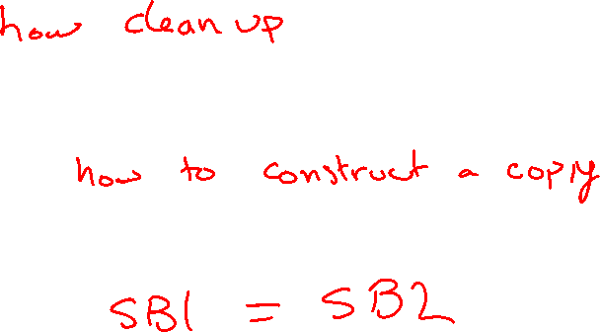
Rule of Three
Destructor
Copy Constructor
Copy Assignment Operator

Slide 8
Rule of Three - Destructor
~StringHolder()

Slide 9

Rule of Three - Destructor
~StringHolder(){
delete string_;
}

Slide 10
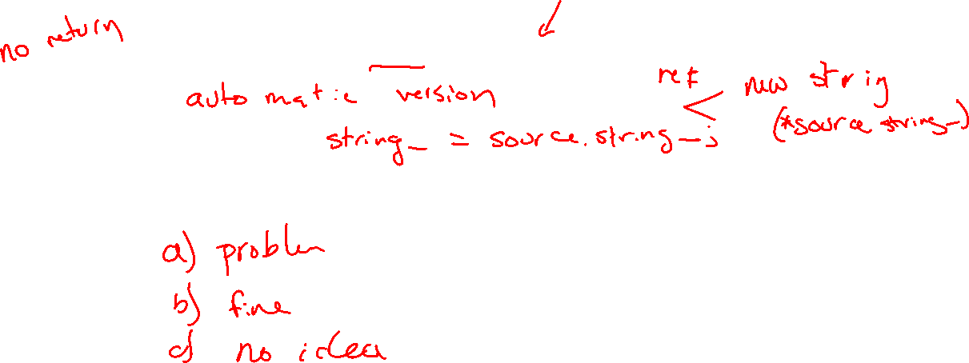
Rule of Three - Copy Constructor
StringHolder(const StringHolder &source)

Slide 11
Rule of Three - Copy Constructor
StringHolder(const StringHolder &source) {
if(source.string_) {
string_ = new std::string(*source.string_);
} else {
string_ = nullptr;
}
}

Slide 12

Rule of Three – Copy Assignment Operator
StringHolder& operator=(const StringHolder &source)

Slide 13
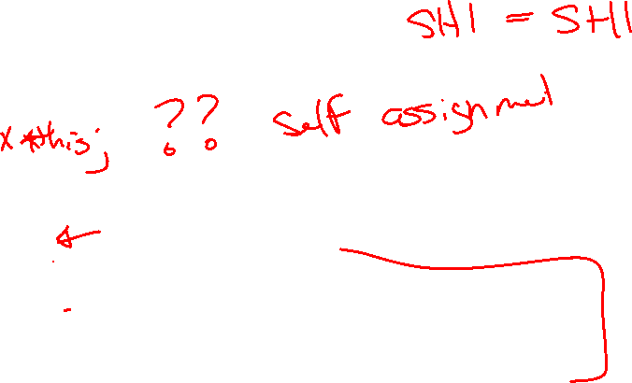
Rule of Three – Copy Assignment Operator
StringHolder& operator=(const StringHolder &source){
if(this == &source) {
return;
}
delete string_;
string_ = nullptr;
if(source.string_) {
string_ = new std::string(*source.string_);
}
return *this;
}

Slide 14
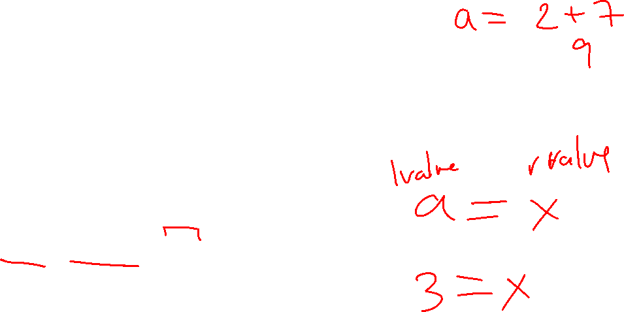
Rule of Three vs Rule of Five
Rule of five (move semantics new with C++11)
Move Constructor
Move Assignment Operator
rvalue reference &&
Can bind to a temporary (rvalue)

Slide 15
Rule of Five - Move Constructor
StringHolder(StringHolder&& source)

Slide 16
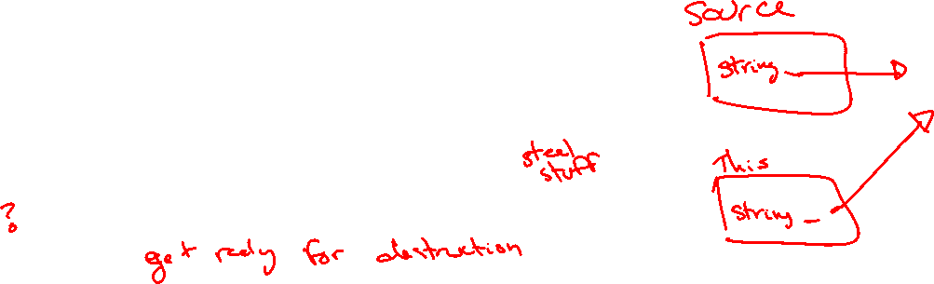
Rule of Five - Move Constructor
StringHolder(StringHolder&& source) {
string_ = source.string_;
source.string_ = nullptr;
}

Slide 17
Rule of Five – Move Assignment Operator
StringHolder& operator=(StringHolder&& source)

Slide 18

Rule of Five – Move Assignment Operator
StringHolder& operator=(StringHolder&& source) {
if(this == &source) {
return;
}
delete string_;
string_ = source.string_;
source.string_ = nullptr;
return *this;
}

Slide 19
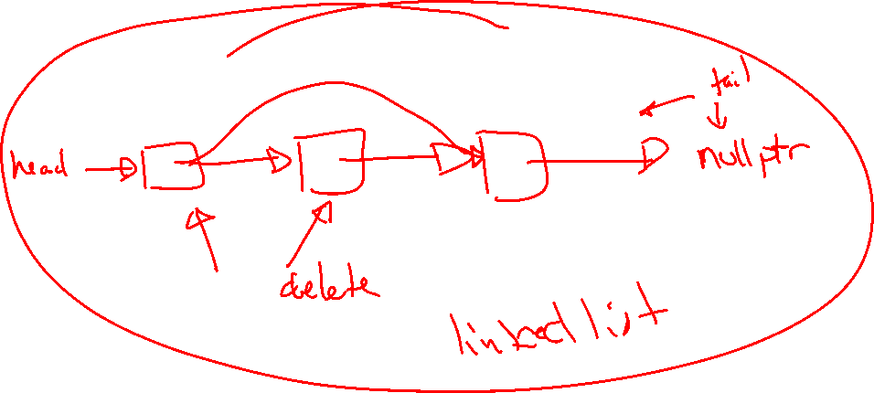
Linked Lists

Slide 20
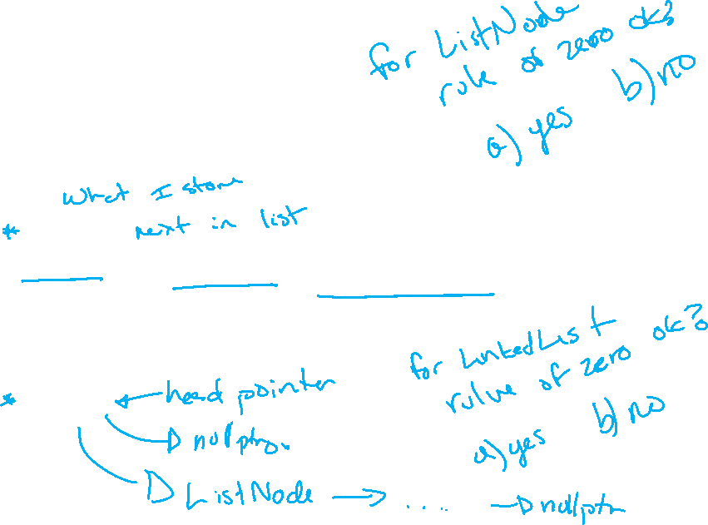
Linked List Data Structures
struct ListNode {
Data data_;
ListNode next_;
ListNode(Data d) : data_(d), next_(nullptr) {};
}
class LinkedList {
ListNode head_;
…
public:
…

Slide 21
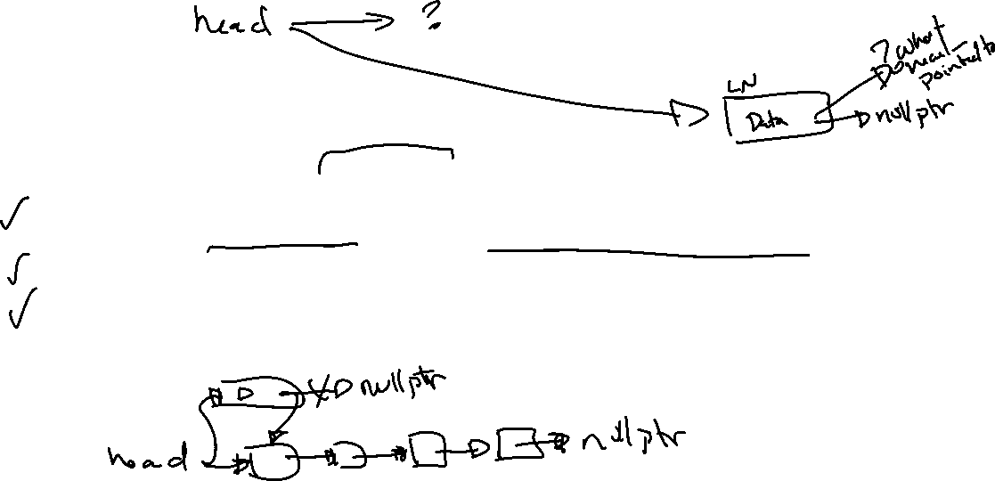
Insert at start
void InsertHead(Data new_data) {
ListNode *new_node = new ListNode(new_data);
new_node->next_ = head_;
head_ = new_node;
}

Slide 22
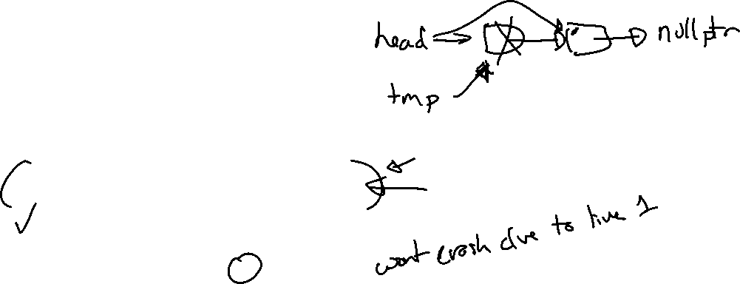
Remove Head
void RemoveHead() {
if(!head_) { return; }
ListNode *tmp = head_;
head_ = head_->next_;
delete tmp;
}

Slide 23
Remove Tail
void RemoveTail() {
if(!head_) { return; }
if(head_->next_ == nullptr)
{ delete head_; head_ = nullptr; return;}
ListNode *remove_next = head_;
while(remove_next->next_ && remove_next->next_->next_) {
remove_next = remove_next->next_;
}
delete remove_next->next_;
remove_next = nullptr;
}

Slide 24
VisuAlgo
https://visualgo.net/en/list

