Slide 1
Lecture 8

Slide 2
What will I learn in this lecture?
What is a program?
What is a “Window Manager” ?
What is a “GUI” ?
How do you navigate the Unix directory tree?
What is a wildcard?
Readings: See CCSO’s Unix pages and

Slide 3
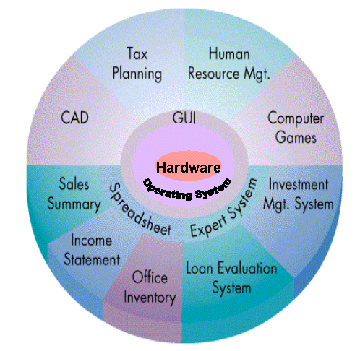
Hardware and Software
Applications
Unix
Engineering
Workstations
UNIX- operating system / C- programming language / Matlab
Facilitate machine independent program development

Slide 4
Software
Computer program(software): a sequence of instructions that tells the computer what to do. A program takes raw data as input and produces information as output.
System Software:
• Operating Systems
Unix,Windows,MacOS,VM/CMS,...
• Editor Programs
gedit, pico, vi
Applications Software:
• Translators and Interpreters
gcc--gnu c compiler
matlab – interpreter
• User created Programs!!!

Slide 5
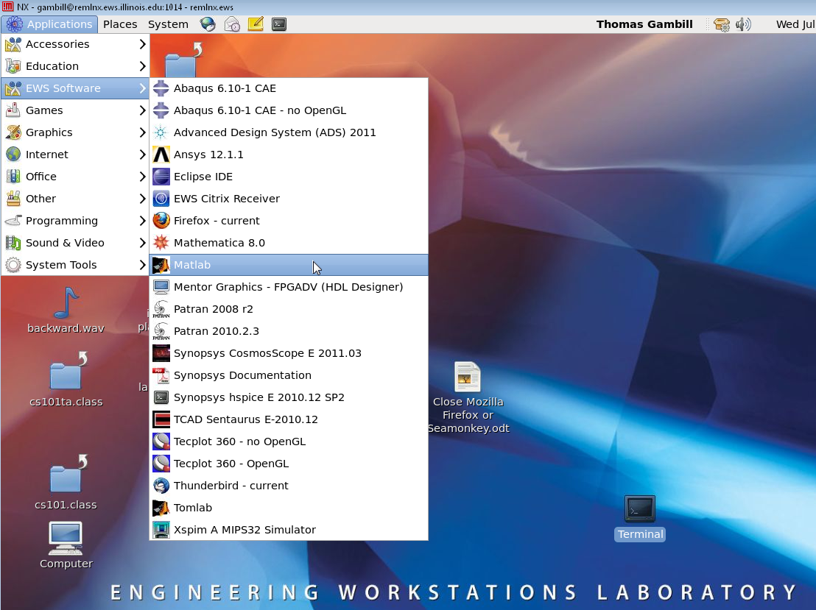
X-Windows / Unix - GUI
X-windows-a Window Manager and GUI(Graphical User Interface)
Click Applications and follow the menus or click on an icon to run a program.

Slide 6
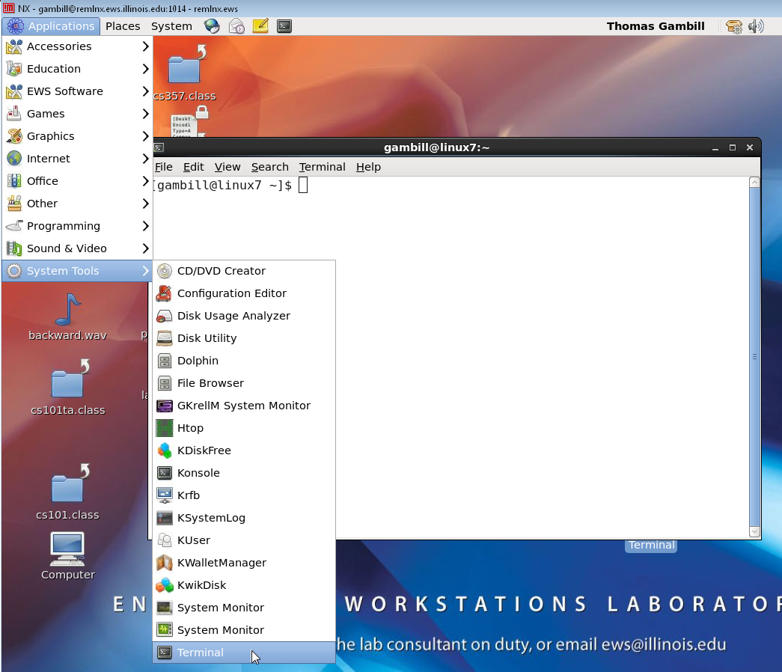
Unix - Command line interface
Click Terminal to produce a command line interface.
When the following slides refer to Unix commands it is assumed that these are entered on the command line that begins with the symbol “>” (prompt symbol).

Slide 7
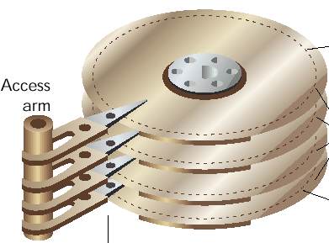
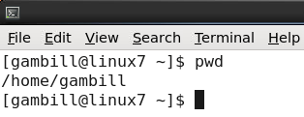
Unix file system - the directory tree
Data, information, computer instructions, etc. are saved in secondary storage (auxiliary storage) in files. Files are collected or organized in directories. Each user on a multi-user system has his/her own home directory. In Unix users and system administrators organize files and directories in a hierarchical tree.
secondary storage
Home Directory
When a user first logs in on a computer, the user will be “in” the users home directory. To find the name of the directory type
> pwd (this is an acronym for
print working directory)
So the user is in the directory “gambill”

Slide 8
Unix file system - the directory tree
The string “/home/gambill” is called a path.
The path defines the location of a file or directory in the tree known by the Unix system. For this example we know that the directory tree contains the following:
The directory “ / ” is called the root directory.
/
home
gambill

Slide 9
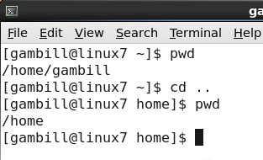
Unix directories - Navigation
We can navigate through the directories using the “cd” command. For example, typing in cd .. gives

Slide 10
Unix directories - Navigation
Absolute and Relative Paths
We are now in the home directory. To go back to the gambill directory :
> cd ~ (tilde)
or
> cd
or
> cd gambill (relative path)
or
> cd /home/gambill (absolute path)
To go to a particular directory we can always list a path starting with the root “ / ” and going down directory by directory using the
“ / ” as in the last example. This is an example of an absolute path.
However since “gambill” is the name of a subdirectory of “home” we can use a relative path “gambill” . Here, the symbol “ / ” does not appear before gambill.

Slide 11
Unix directories - viewing the contents
Use the “ls” (list) command to view the contents of a directory. Note that the contents of a directory are files and subdirectories, however using “ls” alone does not distinguish between the two.

Slide 12
Unix directories - ls command general format
ls options arguments
where options are any combinations of
-a List all entries, including dot entries
-c List by time of last file change
-l List in long format, giving links, owner, size in bytes,
and time of the last file change.
-F Marks directories with a /
-R Also lists each subdirectory found
and arguments is a list of directories and / or filenames separated by blanks.

Slide 13
Unix directories - ls command option -la
> ls -la produces the output

Slide 14
Unix directories - ls command option -la
The last two lines of output from the ls -la command are described below. Note: to set permissions use the chmod command.

Slide 15
Unix directories - ls command option -la
Permissions
r - read
w - write
x - execute
Permissions are assigned to the user, a group and
other users.

Slide 16
ls command with paths
jsmith
pwd
mp1
Given the above directory tree. Assume that your pwd is named jsmith. Use the ls command to list the contents of the mp1 directory.
> ls mp1

Slide 17
ls command with paths
jsmith
pwd
mp1
{FILES: main.m , final_graphs.m, test.fig, input.mat}
Given the files listed in the mp1 directory. Use the ls command to list just the files with the .m suffix.
> ls mp1/*.m

Slide 18
ls command with paths
jsmith
{FILES: data.mat, a.out, }
mp1
pwd
Given the files listed in the jsmith directory. Use the ls command to list just the files with the .mat suffix. Assume that mp1 is the pwd
> ls ../*.mat

Slide 19
ls command with paths
cs101
jsmith
data
mp1
pwd
{FILES: mp1_data.m, mp1.m }
List all the files in the cs101/data directory.
> ls ~cs101/data/*
The tilde (~) character is shorthand for the absolute path to any home directory.

Slide 20
chmod command
From slide 14, if we want others to be able to read or run files in the ‘tom’ directory we would type:
> chmod o+rx tom
To change back to the original status, restricting permissions to just the user we would type:
> chmod o-rx tom
r - read
w - write
x - execute
Permissions are assigned to the
u user,
g group and
o other users.

Slide 21
Unix directories - ls command wildcards
In matlab function files will have names like f.m or test.m and workspace variables and data are stored in files like my.mat . C files will have names like f.c or test.c . If you forget the exact name of a file use
> ls *.m
The “ * “ is a wildcard character meaning, match zero or more characters. Another wildcard is “ ? “ which means match exactly one character.

Slide 22
Unix directories - "more" command
To see the contents of a file (without using the editor program gedit) on the terminal use the more command.
> more time_to_impact.m

Slide 23
What have I learned in this lecture?
A program is a sequence of instructions that tells the computer what to do.
X-Windows is an example of a “Window Manager”.
“GUI” means graphical user interface.
You navigate the Unix directory tree by using the cd command.
A wildcard is a character such as “ * ” or “ ? ” (in UNIX) that are used to match filenames or directory names.

