Slide 1
Lecture 4 of 4
(13:1)
Physics 524
Survey of Instrumentation & Laboratory Techniques:
Unit 5: Cooling & Thermal management

Slide 2
(5.7) Examples from cooling silicon tracking detectors in particle physics (ATLAS, CMS, LHCb)
We’ve seen some examples from the present running of ATLAS:
Saturated Fluorocarbons of the form C_{n}F_{(2n+2)}
  like C₆F₁₄ (current use as liquid coolant in parts of the CMS Silicon tracker)
  and C₃F₈ (current use in most of the ATLAS Silicon tracker)
which have respective GWP₂₀ of around 6640 & 5890 x CO₂.
New upgraded trackers are however being built
for the High Luminosity phase of LHC to run from 2029-2041
A core aim in these detectors is to use low Global Warming Potential coolants
Any coolant must be non-flammable, non-toxic, non-oxone depleting,
(electrically) non-conductive, radiation resistant and have low or zero GWP
CO₂ cooling is being pushed hard at CERN but has problems of high operating pressure
and a limiting evaporating temperature of -56 °C (triple point temperature where
3 phases of CO₂ co-exist (liquid, vapor, solid CO₂ ‘snow’)

Slide 3
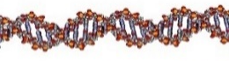
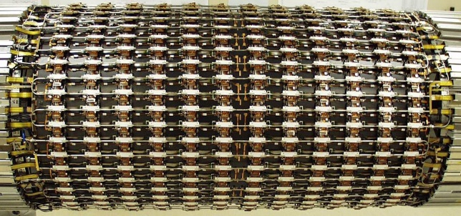
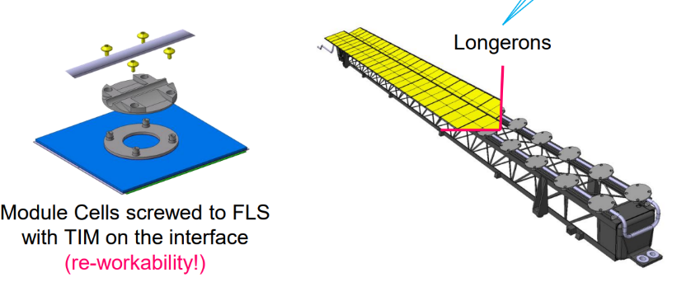
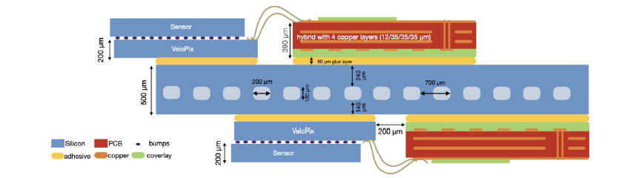
(5.7) Examples from cooling particle physics Si trackers (ATLAS, CMS, LHCb)
Two distinct types of detector cooling geometry:
Tube and block ‘DNA’
ATLAS barrel SCT (present) ATLAS ITK Barrel longerons and Si module
block attachment (future HL-LHC)
Disadvantages: longer heat conduction path (more interfaces) Si➔ (colder) coolant
(2) Micro-channel cooling
LHCb VELO upgrade
Advantages: shortest heat conduction path to coolant: coolant can be warmer:
Disadvantages: fraglity issues: channels etched in silicon and cover plate attached

Slide 4
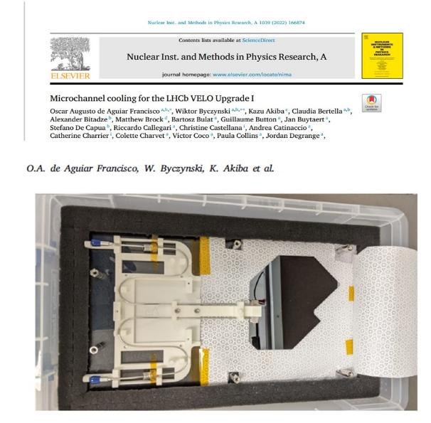
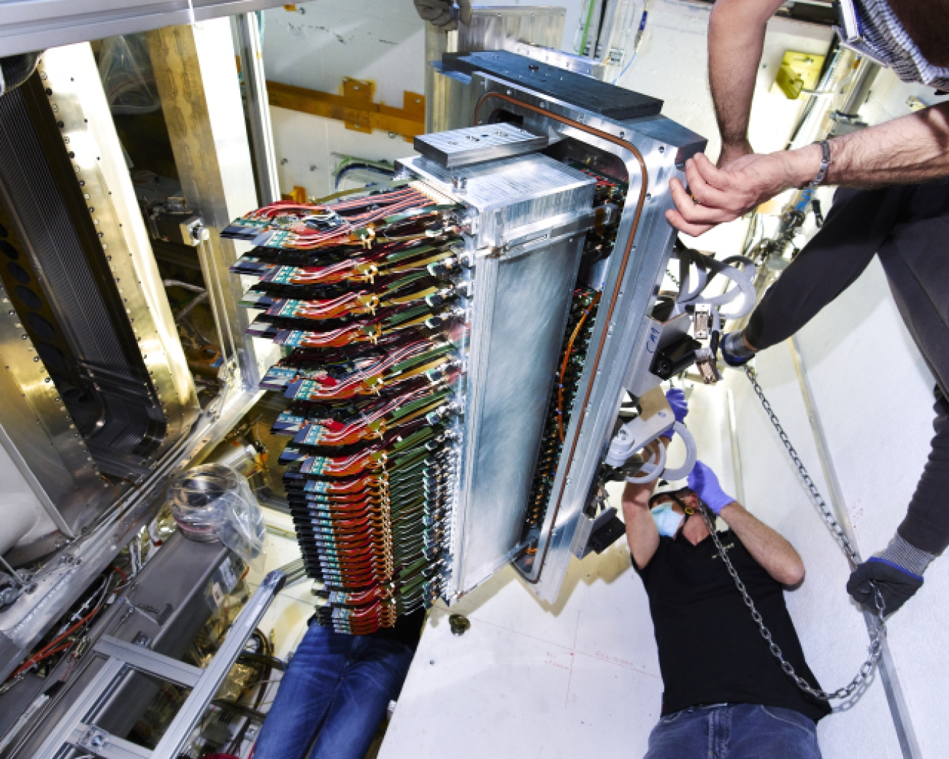

(5.7) Examples from cooling particle physics Si trackers (ATLAS, CMS, LHCb)
Micro-channel cooling: more on the LHCb VELO upgrade
https://www.youtube.com/watch?v=RmlQwLdfFZg

Slide 5
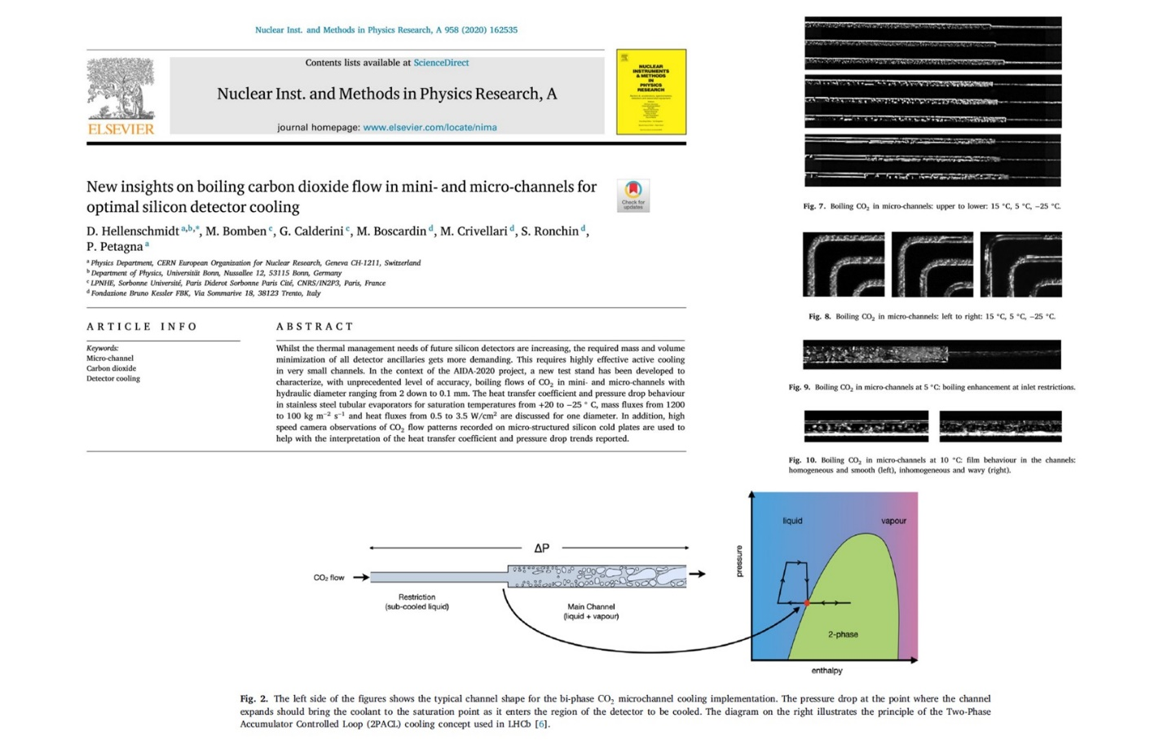
https://www.youtube.com/watch?v=hsLXi9QTxUo
(5.7) Examples from cooling particle physics Si trackers (ATLAS, CMS, LHCb)
Micro-channel cooling: more on the LHCb VELO upgrade
Recent mastery of evaporative CO₂ cooling in microchannels
High CO₂ evaporation pressure
(~70 bar at room temp.)
A film narrated by LHCb physicist Paula Collins

Slide 6
(5.7) Examples from cooling particle physics Si trackers (ATLAS, CMS, LHCb)
Despite these evident successes, the coolant is not directly passing through the detector chips,
just through a heat collector plates onto which they are bonded which contain 200 x 120 micron
etched microchannels .
So the silicon pixel detectors and their readout electronics are almost directly cooled by fluid
evaporating in microchannels.
We can therefore ask:
will processor chips ever have microchannels etched into them for direct coolant flow?
will this coolant be liquid, or evaporative for reduced mass flow?
how would the cooling pipes be connected?
what would the (necessarily electrically non-conductive) fluid be: a fluorocarbon,
CO₂ or a new low GWP fluid, for example from the 3M “NOVEC” range?

Slide 7
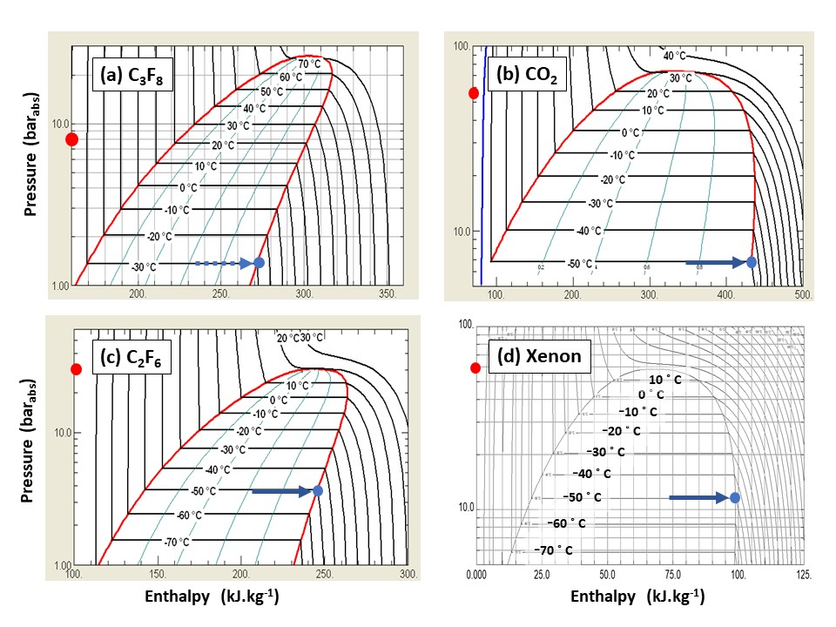

(5.7) Examples from cooling particle physics Si trackers (ATLAS, CMS, LHCb)
The CO₂ problems:
High evaporation pressure at room temperature (60-70 bar)
the detector has to ‘surf ‘ down the saturated vapor line to the operating evaporation temperature of -30 ➔ -40 °C (pressure around 12 - 18 bars):
fatigue cycling an issue in microchannels..?
(2) The high triple point temperature of -56 °C
limits the lowest temperature attainable in the tubes of a tube & block cooling system: may not be cold enough for operation of Si detectors after years of irradiation in the LHC High Luminosity program (2019-41)

Slide 8
(5.7) Examples from cooling particle physics Si trackers (ATLAS, CMS, LHCb)
Low GWP Alternatives to CO₂:
Noble gases like Xenon and Krypton
Very expensive and in very short supply, particularly since the war in Ukraine.
Complex transcritical circulation for Krypton (outside the scope of this unit);
Xenon probably just squeaks in (~50 bar @ 15 C) but still has relatively high pressure evaporation at room temp, but no triple point problem (-112 ˚C)
(2) Fluoroketone (C_{n}F_{2n}O) replacements for saturated fluorocarbons (C_{n}F_{(2n+2)})
The substitution of two fluorine atoms with an oxygen atom can reduce the GWP to zero: if the oxygen atom is on the end or on a side-arm of the molecule (see next slide);
Ultraviolet scission of the molecules in the upper atmosphere des not created long-lived debris
molecules (references given in unit support notes);
(C_{n}F_{2n}O) molecules with the same number of carbons as their (C_{n}F_{(2n+2)}) partners will hve similar thermodynamics (molecular weight difference = 22 units);
3M NOVEC 649 (C₆F₁₂O) authorised for use as a C₆F₁₄ replacement at CERN (liquid cooling)

Slide 9
(5.7) Examples from cooling particle physics Si trackers (ATLAS, CMS, LHCb)
A Fluoroketone (C_{n}F_{2n}O) replacement for a saturated flurorcarbon (C_{n}F_{(2n+2)})
Thermophysical Properties of NOVEC 649 (C₆F₁₂O) & C₆F₁₄
(at 25ºC except where noted: after [7.15])
Fluid thermophysical property | NOVEC 649: C₂F₅C(O)CF(CF₃)₂ Perfluoro-2-methyl-3-pentanone (C₆F₁₂O fluoro-ketone) | C₆F₁₄ (Perfluorohexane, Saturated fluorocarbon)
Boiling temp @ 1 atm (˚C) | 49 | 56
Critical Temp (˚C) | 169 | 178
Critical Pressure (MPa) | 1.87 | 1.89
Freezing temperatre (˚C) | < -100 | < -100
Specific heat (J.kg⁻¹K⁻¹) | 1103 | 1050
Density (kg.m⁻³) | 1610 | 1680
Kinematic viscosity (cSt) | 0.42 | 0.4
Latent Heat (J.kg⁻¹) | 88 | 88
Vapour Pressure @ 25 ˚C (kPa) | 40.4 | 30.9
Vapour Pressure @ 100 ˚C (kPa) | 441 | 350
Water solubility (ppm_{w}) | 21 | 10

Slide 10
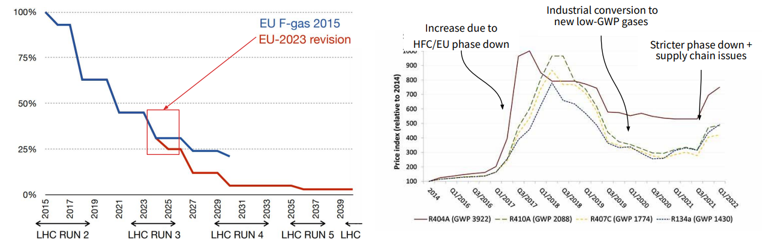
On the turning away…
Example: The uncertain ECHA (European Chemicals Agency) route to fluorocarbon (PFC, PFAS…) prohibition
(A path paved with impracticalities..?)
Au revoir 3M… need to clarify manufacturers’ attitudes (Dehon Co. (Fr), Synquest (USA), F2 (UK), various companies in China)…
on future lin-fluoroketone (C_{n}F_{2n}O) production
Electronics industry is the driver: physics just rides the coat-tails!
[51] ECHA/NR/23/04;
https://echa.europa.eu/-/echa-publishes-pfas-restriction-proposal]
[52] ECHA Candidate List of substances of very high concern for Authorisation;
https://echa.europa.eu/candidate-list-table
[53] Annex to the Annex XV restriction report proposal for restriction: Per- & polyfluoroalkyl substances (PFASs); ECHA; 22/03/2023
https://echa.europa.eu/documents/10162/d2f7fce1-b089-c4fd-1101-2601f53a07d1
[54] Per- and polyfluoroalkyl substances (PFAS); ECHA
https://echa.europa.eu/hot-topics/perfluoroalkyl-chemicals-pfas
[references from https://link.springer.com/article/10.1140/epjp/s13360-023-04703-w
: see back –up material
Dynamic Pricing to regulate demand
Physics 524: Survey of Instrumentation & Laboratory Techniques:
Unit 5: Cooling & Thermal management © G. Hallewell (2024)

Slide 11
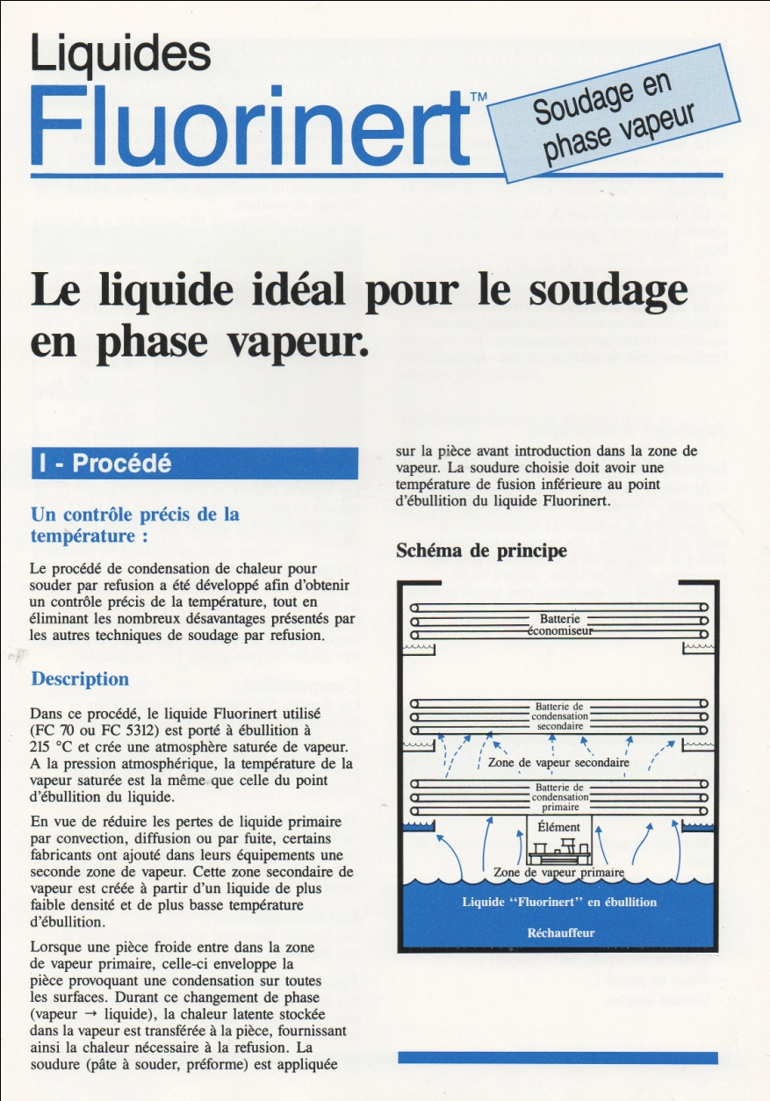
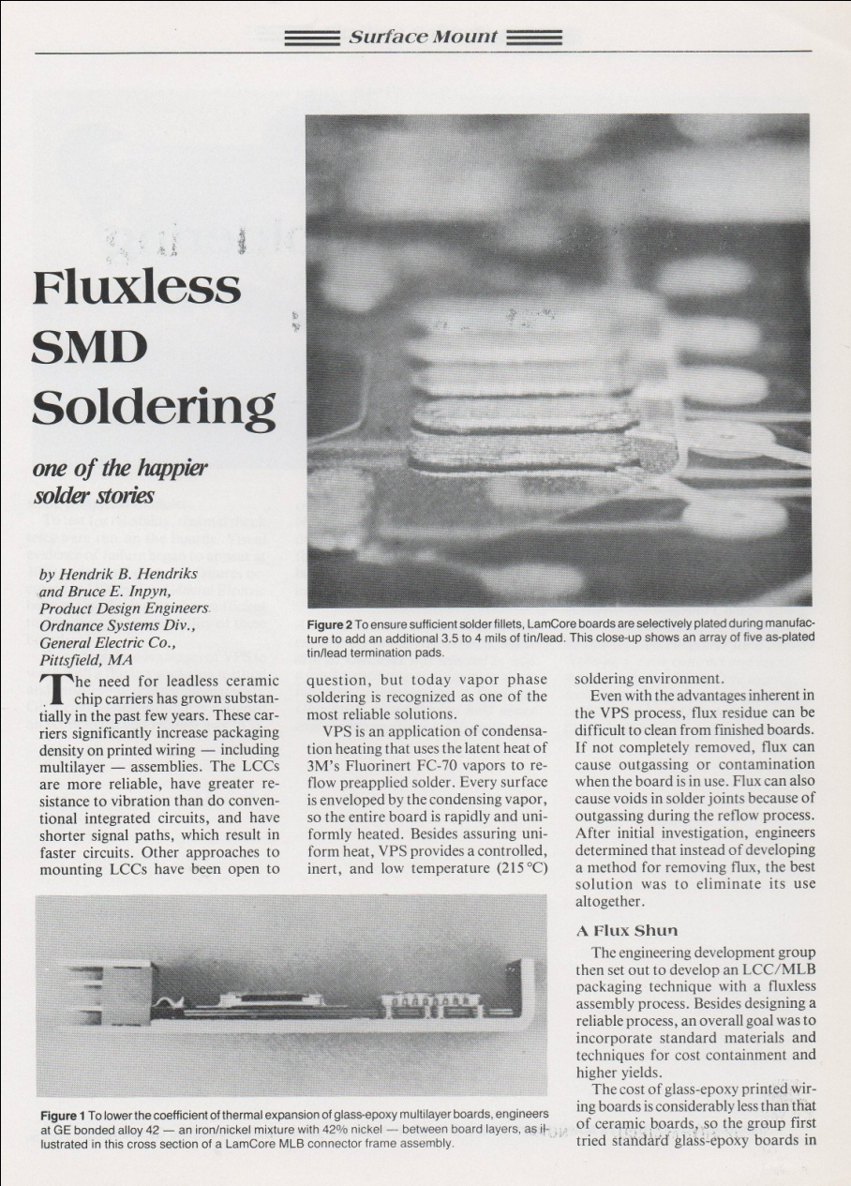
Massive use of fluorocarbons in electronics industry for semiconductor manufacture and soldering complex computer mother boards with SMD components
Vapour phase (non-contact) soldering of components on PCBs
(particularly surface mount) in high T fluorocarbon atmosphere !!!
The demand for vapour phase soldering is hardly going to “evaporate”.
New, lower GWP, transfer vapours will be needed (e.g. fluoroketones)
Physics 524: Survey of Instrumentation & Laboratory Techniques:
Unit 5: Cooling & Thermal management © G. Hallewell (2024)
11

Slide 12
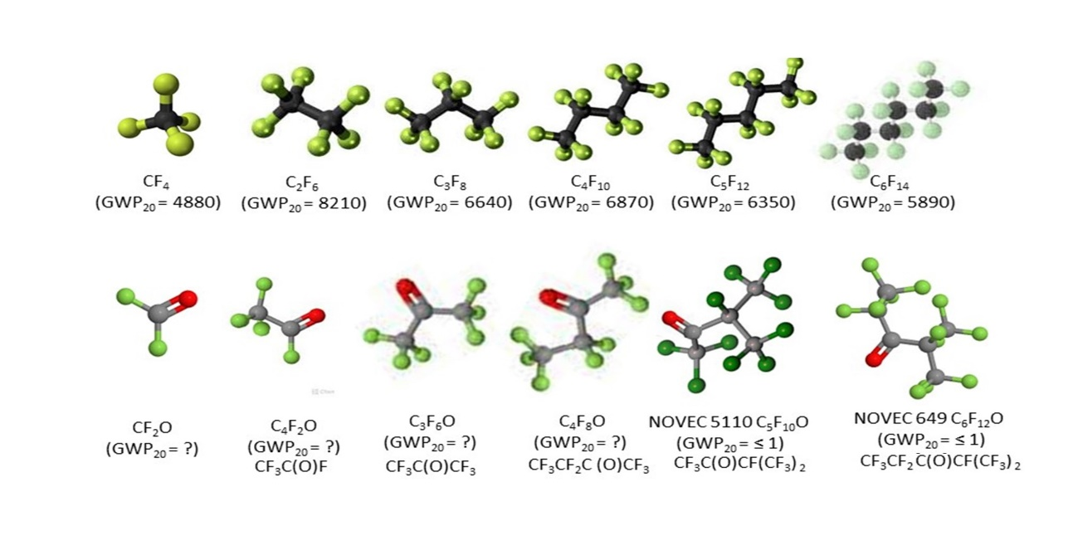
(5.7) Examples from cooling particle physics Si trackers (ATLAS, CMS, LHCb)
https://link.springer.com/article/10.1140/epjp/s13360-023-04703-w
Saturated fluorocarbons (C_{n}F_{(2n+2)}) and their Spurred fluoroketone (C_{n}F_{2n}O) analogs
(with 20 year Global Warming Potentials, where measured)
Si COOLING (Evap.)
COOLING (Liq.)
Ih.T. H335
Ih.T. H335
Ih.T. H335
Ih.T. H335
Ih.T. H335
Ih.T. H335
Ih.T H330, reactive
Ih.T H331,
reactive
Ih.T H331,
reactive
Ih.T. H335
Ih.T. H335
COOLING (Liq.)
Ih.T. H335

Slide 13
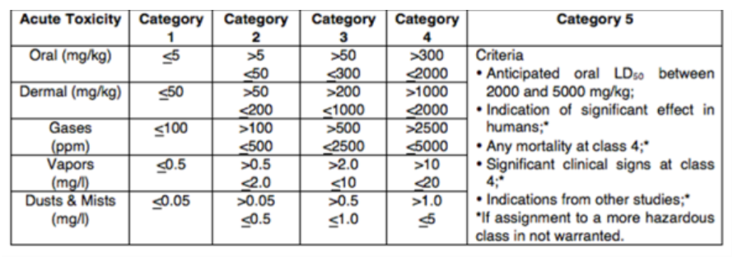
GHS Classification Criteria for Inhalation Toxicity
H330 | Fatal if inhaled
H331 | Toxic if inhaled
H332 | Harmful if inhaled
H333 | May be harmful if inhaled
H334 | May cause allergy or asthma symptoms or breathing difficulties if inhaled
H335 | May cause respiratory irritation
H336 | May cause drowsiness or dizziness
H310 | Fatal in contact with skin
H311 | Toxic in contact with skin
H312 | Harmful in contact with skin
H313 | May be harmful in contact with skin
H314 | Causes severe skin burns and eye damage
H315 | Causes skin irritation

Slide 14
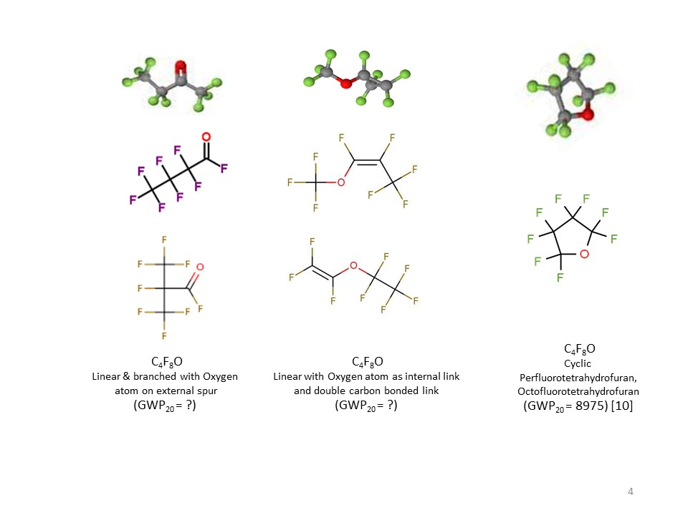
Molecular shapes is important for GWP and toxicity
☺
CAS: 67641-44-5
H332, H335, H336
CAS: 337-20-2
H335
Ih.T. H335
CAS 335-42-2
H331, H335
GWP ?
GWP ?
CAS 773-14-8
Unlisted
GWP ?
CAS:10493-43-3
H332, H335, H336
High GWP!!
CAS: 677-84-9
H335
Cyclic, non-cyclic & non-cyclic double carbon-bonded C₄F₈O isomers: refs at end.
Placement of oxygen atom can also determine chemi-potential, flammability & toxicity­
Physics 524: Survey of Instrumentation & Laboratory Techniques:
Unit 5: Cooling & Thermal management © G. Hallewell (2024)

Slide 15
Massive use of fluorocarbons in electronics industry for semiconductor manufacture and soldering complex computer mother boards with SMD components
Vapour phase (non-contact) soldering of components on PCBs
(particularly surface mount) in high T fluorocarbon atmosphere !!!
The demand for vapour phase soldering is hardly going to “evaporate”.
New, lower GWP, transfer vapours will be needed (e.g. NOVEC)
15
G. Hallewell: Seminaire CPPM: 16 sep 2024

Slide 16
(5.7) Examples from cooling particle physics Si trackers (ATLAS, CMS, LHCb)
Some Thermodynamic comparisons two convenient SFCs, CO₂, Xe
(F-K thermodynamics should be similar to same carbon order SFCs)

Slide 17
(5.7) SWOT analysis of cooling fluids HL-LHC
Strengths CO₂ Non-flammable, non-toxic, electrical insulator, non-ozone-depleting, radiation resistant, GWP=1 | Weaknesses CO₂ High pressure circulation (60 bar) at ambient temp before cooldown to operating temp High triple point ( -56°C)
Threats CO₂ High triple point may make Si tracker operation problematic: less thermal ‘headroom’ after heavy irradiaton (‘thermal runaway’ phenomenton) | Opportunities CO₂ Extensive R&D program at CERN Evaporative coolant of choice for ATLAS, CMS for start of HL-LHC program
Strengths C₂F₆ Non-flammable, non-toxic, electrical insulator, non-ozone-depleting, radiation resistant | Weaknesses C₂F₆ Very high GWP (around 6000 x CO)
Threats C₂F₆ Production will be phased out unless a strong motivation from semiconductor manufacture industry | Opportunities C₂F₆ Proved to decrease the operating temp of an ATLAS SCT thermal model in blend with 75% C₃F₈
Strengths xenon Non-flammable, non-toxic, electrical insulator, non-ozone-depleting, radiation resistant, GWP=0 | Weaknesses xenon High pressure circulation (50 bar) at ambient temp before cooldown to operating temp (amost transcritical) Extremely expensive
Threats xenon Very difficult future procurement (war in Ukraine) (10⁻⁸ atmospheric content.) | Opportunities xenon Could find expertise In particle physics community for fabrication of circulators: already used in dark matter experiments
Strengths C_{n}F_{2n}O Non-flammable, non-toxic, electrical insulator, non-ozone-depleting, radiation resistant, GWP=0 | Weaknesses C_{n}F_{2n}O
Threats C_{n}F_{2n}O Large scale industrial production may depend on the phasing-out of SFCs, needs of semiconductor manufacture industry: Toxicity, material compatibility need further study. | Opportunities C_{n}F_{2n}O Expertise in particle physics community for 3M NOVEC 649 (C₆F₁₂O)

Slide 18
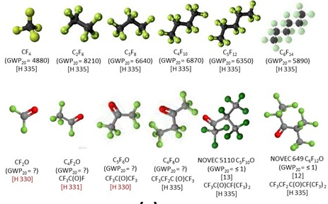
Last problem (6): See separate sheet – really one for the sleuth:
while a new C₃F₆O isomer might have similar thermodynamics to C₃F₈, at low to zero GWP, (C₃F₈ & C₃F₆O differ in mol. wt. by 22 units) it is not perfect for cooling a processor chip at room temperature. An evaporation pressure nearer 1 bar_{abs} would be better). What fluid (or even blend of fluids) in the C_{n}F_{2n}O spectrum might be better, and why?
Hint: the figures below may help in this.

Slide 19
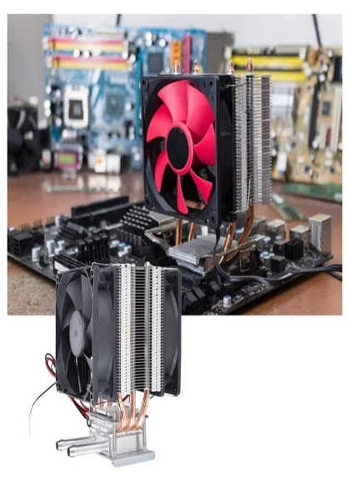
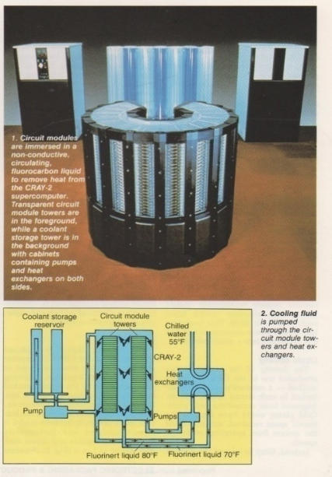
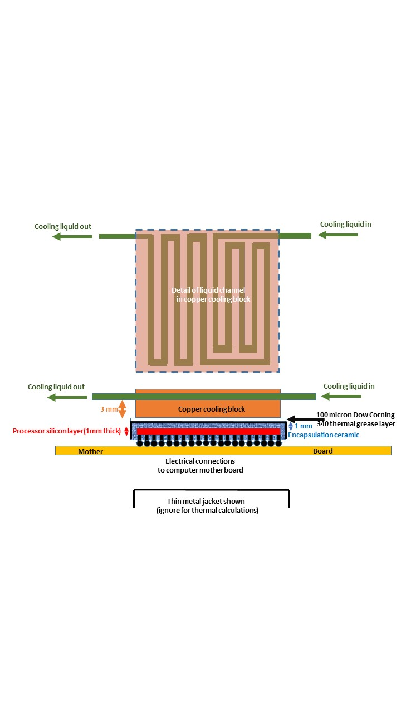
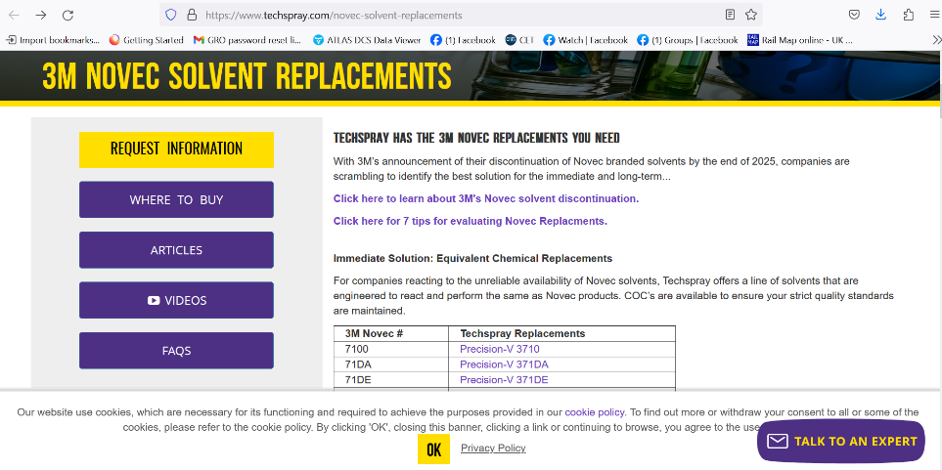
So where does this leave the option of immersion cooling of processors,
or the direct liquid cooling of processor ships themselves thru microchannels?
Will processor chips ever look like this?
Can semiconductor lithography, implantation, microchannel
etch & sealing be achievable in one final device?
3M seem to have lost enthusiasm to produce any more fluorinated fluids after 2025, but companies like
F2 Chemicals (Preston, UK), Astor (Ru), Synquest (FL), Techspray (GA) continue (probably many others: e.g.China)
Some 3M NOVEC fluids are HFCs with GWPs
in the ranges of hundreds:
Better to concentrate on C_{n}F_{2n}O molecules
over the full carbon spectrum with GWP = 0.
But the needs of the semiconductor &
electronics industries will be determinant…

