Slide 1
Lecture 3 of 4 (10:3)
Physics 524 Survey of Instrumentation & Laboratory Techniques:
Unit 5: Cooling & Thermal management

Slide 2
5.5 Heat pipes & Peltier devices (1)
Heat pipes: (typical ref.[3.4])
Hollow tubes (usually Cu) containing:
A micro-climate with a volatile fluid evaporates at the “hot” end & flows as vapour to
the cold end, condensing & giving up heat acquired in evaporation;
tube with grooved wall or sintered metal “wick” for condensed fluid to return to
hot end by capillarity
These are phase-change cooling devices with an evaporation-condensation cycle.
The thermal conductivity of a heat pipe may far exceed (1500 - 50000 W.m⁻¹.K⁻¹)
a copper (400 W.m⁻¹.K⁻¹) rod of the same external diameter.
now ubiquitous in cooling computer cores, desktops & laptops, GPUs etc.

Slide 3
5.5 Heat pipes & Peltier devices (2)
De-min H₂O typically used for normal room temperature operation:
extremely high enthalpy, of evaporation (~2.5 MJ.kg⁻¹) very low pressure (few mbar):
fraction of a gramme of water injected into a typical computer application heat pipe:
requires long-term hermeticity against air ingress;
ammonia, acetone, methanol for lower temperature applications.
Left: low profile installation (laptop or server) channelling heat to radiator & ventilator fan:
Right: installation for a desktop, (less stringent space constraints)
“hot” ends often clamped in contact with the processor chip;
may be flattened to increase contact area (over their entire length - low profile geometries;
Several heat pipes in parallel gives redundancy;
Cold ends usually enter finned radiator for large contact area with fan-driven air flow ;
(Heat pipes can, of course, also be used to conduct heat to liquid-cooled heat exchangers)

Slide 4
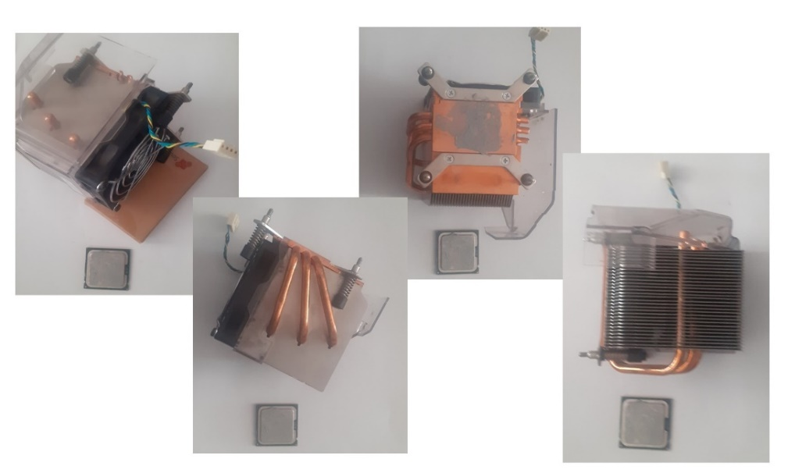
Problem 4: see also separate sheet:
A processor chip dissipating 75W must be cooled by conducting heat away to a finned heat exchanger (the heat sink).
The cooling block in contact with the chip through a thin thermal grease joint has grooves for three 6 mm diameter heat conduits,
as shown in the photo montage below.
The total cooling path from the center of the cooling block to the center of the
finned radiator is 15 cm.
The fan is powerful enough (and has enough range of driving voltage) to keep the heat sink at 40˚ C under all circumstances.
(This temperature is maintained by feedback from a temperature sensor mounted near the fan itself (note the 4-wire connector
in the photo montage).
The computer user notices that, after turn-on the processor chip (monitored by its own internal temperature sensor) rapidly increases
to over 12 ˚C higher than its normal operating temperature before the system annoyingly takes remedial action by decreasing the processor
clock frequency etc.
Doing some research the user finds that this cooling configuration uses three low-pressure water-filled copper heat pipes with 1mm
wall thickness and a nominal thermal conductivity 2000 W.m⁻¹.K⁻¹ and surmises that one might have failed
(leaked up to atmospheric pressure).
Q1: Would the user be correct in this assumption?
Q2: Why, or why not? Show your reasoning with a calculation.
Hint: a failed heat pipe would revert to the thermal conductivity of a copper tube of 6mm outer diameter and 1mm wall thickness.

Slide 5
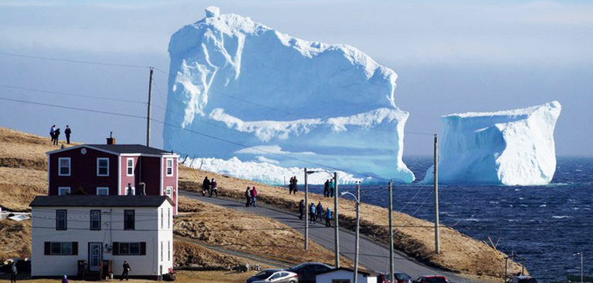
Problem 5: an ecological problem: see also separate sheet.
This could easily sink the Titanic, but is as a minnow to a whale in terms of the Global ice loss problem
Part of the Larsen-C ice shelf broke off from Antarctica in July 2017 and drifted North as iceberg A-68 before melting away.
A-68 was 170 km long, 50 km wide with an average thickness of 200m.
(a) Using the Latent heat of fusion L of water (333 kJ.kg⁻¹) estimate the combined energy absorbed from the sea and atmosphere
to melt A-68. (Let’s assume that the energy comes from global warming).
It is estimated (with big uncertainties, as inspections are less frequent than they used to be) that the World’s stockpile of nuclear
weapons contains around 10 000 megatonnes of TNT equivalent. The explosion of 1 MT_TNT releases around 4.2.10¹⁵ Joules.
What percentage of the World’s 10000 Mt stockpile of nuclear weapons would need to be exploded to melt iceberg A-68?
(Assume all the energy goes into melting ice). How many gigajoules is that?
Now let’s pretend that A-68 never existed (i.e. that there is no ice to buffer atmospheric heating), and that the global
warming energy calculated from (a) above went instead into heating the Earth’s atmosphere. Taking the Earth’s radius as 6370 km
and assuming the effective atmospheric depth to be 16 km (this height contains more than 90% of the atmospheric mass), how much
would the atmospheric mass be raised in temperature?
Should we be worried? Why, or why not?
Hints on next slide…

Slide 6
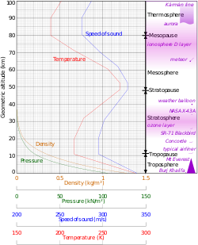
Problem 5 (cont): an ecological problem: see also separate sheet.
Hints
use “average values” of the Cp (1.0036 kJ.kg⁻¹.K⁻¹) and density
of air (0.45 kg.m⁻³) [3.1] at the temperature of – 43˚C and pressure
(0.3 bar_{abs}) [3.5] , corresponding to an altitude of 8 km:
half the 90% mass height of 16 km;
The average sea depth is 3688 metres and sea covers 71% of the
Earth’s surface. Oceans hold 96.5% of the Earth’s water
According to the U.S. Geological Survey, there are over
1,386,000,000 cubic kilometers of water on the planet.
Of this vast volume NOAA's National Geophysical Data Center
estimates that 1,335,000,000 cubic kilometers is in the oceans.
Ocean water mass = 1.335. 10¹⁸ tonnes.

Slide 7
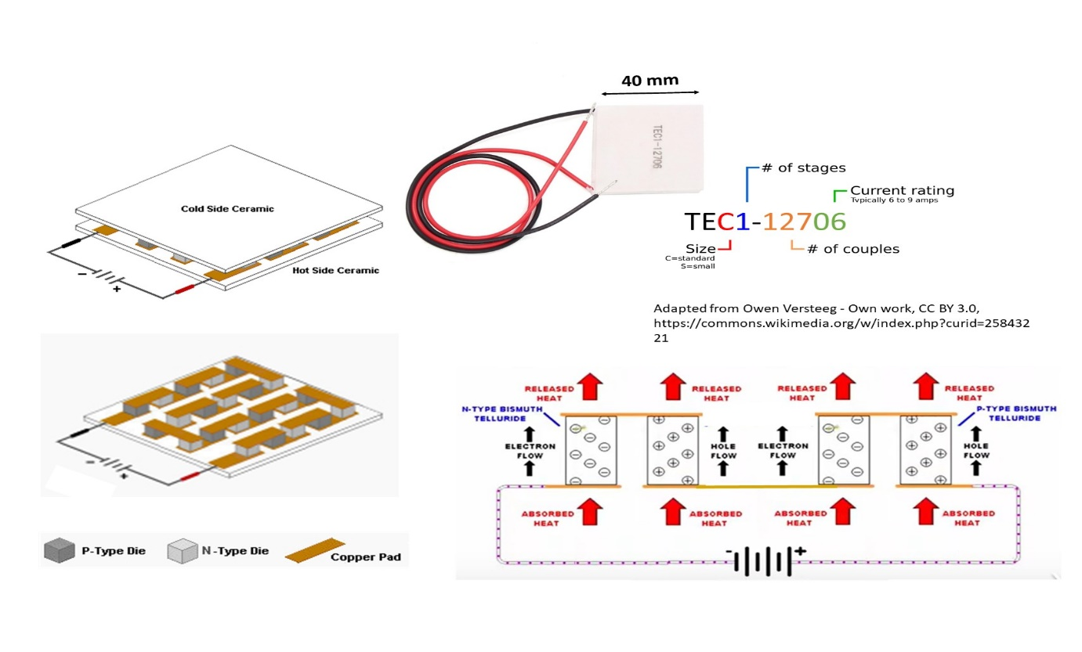
Peltier Cooling Devices (1)
Peltier devices exploit the Seebeck thermoelectric effect of dissimilar metals or semiconductors.
Just as the temperature change of a junction of two dissimilar metals generates a measureable
voltage, passing electric current through a bi-metallic junction can generate a temperature gradient.
A Typical Peltier thermoelectric cooling (TEC) device
The descriptor on the cooled “heat absorbing” side indicates the number of stages
(the number of “heat parallel, electric series” semiconductor “couples”) & the current rating in amperes.
The inexpensive (40 x 40 mm) TEC1-12706 (depth of 3 – 4 mm) can transport ~60 W of heat
for a typical DC voltage of around 12 V and current of 6 A (resistance 2 Ω).

Slide 8
Peltier Cooling Devices (2)
(b)
(b)
(b)
(b)
(b)
(b)
(a)
Two alumina ceramic substrates “sandwich” many pairs, or "couples", of (e.g.) Bismuth Telluride (Bi₂Te₃) semiconductor
dies connected through copper pads in series in an alternating n-doped (e⁻ rich) & p-doped (e⁻ deficient) sequence.
Couples are mechanically constrained to be thermally in parallel, forming heat-conducting “columns” between
(electrically-insulating) ceramic plates, with heat transferred through the columns by the majority charge carriers
(electrons in n-type Bi₂Te_{3,} holes in p-type) with no moving parts.
The current flowing through the series die circuit naturally configures for all couples:
(a) the more +ve voltage contact onto p-type (& the more -ve contacts onto n-type) material: heat absorbing junctions;
(b) the more -ve voltage contacts onto p-type (& the more +ve contacts onto n-type) material: heat emitting junctions
from which heat must be extracted by a cooled thermal drain.
Since junctions of type (a) are all at the same temperature (as are those of type (b), in contact with the other plate)
side (a) of a thermally-isolated TEC will cool from the contributions of all the couples, while side (b) will heat up.

Slide 9
Peltier Cooling Devices (2)
TECs are reversible and typical offsets of 60 ˚C are possible in 12 Volt, 6A devices.
The power in Watts, Q, that can be moved by a TEC device is proportional to the current,
I, and the temperature-dependent Peltier coefficient of the material, P, expressed in volts:
Q = P.I
P depends on temperature & TEC material choice. Bi₂Te₃ the most economical material for ambient temp. applications. Below -110 ˚C its semiconducting properties diminish.
Peltier coefficients of 10 W.A⁻¹ are common, but are offset by two phenomena:
(1) parasitic heat Q_{P} (Watts) due to resistive self-heating:
Q_{P} = I².r
where r is the resistance of the series couples circuit;
(2) the heat flux from the hot (emitting) side to the cool (absorbing) side by reverse
thermal conduction through the columnar structure of the couples themselves.
(This heat is in the opposite direction to the extraction direction of the TEC itself, and subtracts more from its efficiency as the temperature difference grows.
A single-stage thermoelectric cooler can typically produce a maximum temperature difference of 70 °C between its hot and cold sides.

Slide 10
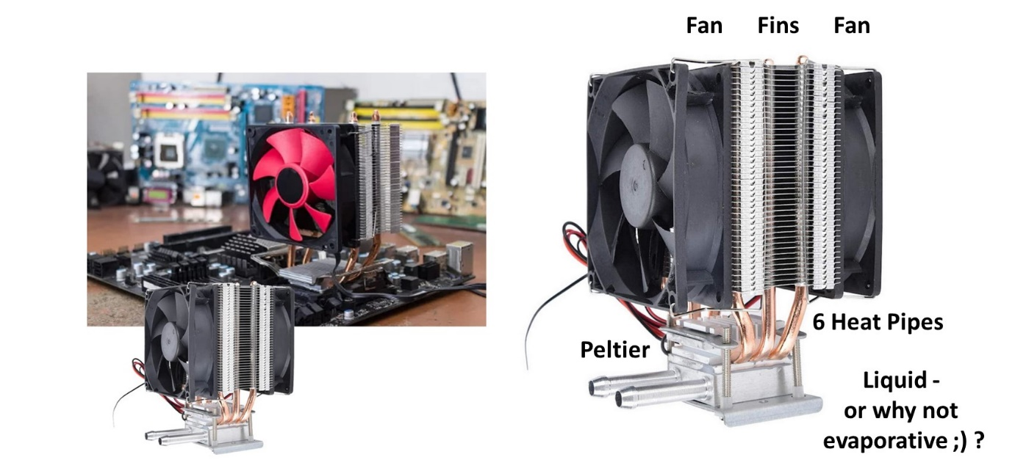
Peltier Cooling Devices (3)
In refrigeration applications TEC devices have an efficiency of 10-15%,
compared with 40–60% in phase change systems.
As a result, TE cooling is normally used in environments where the compact,
solid-state nature (low maintenance through no moving parts) and
insensitivity to orientation outweigh efficiency considerations.
In a typical processor cooling configuration the "hot" (emissive) side of the TEC is attached
to a heat sink, which may be water-cooled or finned and fan-cooled, while the “cold”
(absorbing) side is attached to the processor core through a thermally-conducting paste.
The (almost) ultimate ($60 on Amazon) do-it-yourself processor chip cooling kit:
liquid? Peltier? heat pipes? fins? fans? Mix ‘n match?

Slide 11
Vortex tube: an extreme example of Joule-Thompson Cooling
Deceptively simple - also known as a Ranque-Hilsch tube
Very high flow (usually filtered dry compressed air) injected tangentially into a tube
creating extremely fast vortex (up to 10⁶ rotations per minute);
Gas spirals along the tube, is slowed down and compressed by a conical valve,
exiting from one end of the device as hot gas;
By contrast the heat exchange with the wave produced in return cools the gas reflected by
the cone, which exits as cold gas from the opposite end.
Adjusting the cone opening aperture varies the cold gas output
flow: the greater the outlet flow, the lower the temperature.
Devices typically 10 - 40 cm long, 1 to 5 cm diameter:
can create a temp. difference of 70°C between inlet gas
& cold exhaust.
Very high gas consumption (& noise) levels
(for example a device with a power of 85 (3000)W can have a
gas consumption of 113 (4000!!) l.min⁻¹
Much less efficient in terms of energy (PV consumption)
than conventional refrigerating units,
but their low cost and simple installation
make them attractive for electronic rack cooling.
Ranque-Hilsch tube: operating principle, typical dimensions,
electronics cabinet cooling installation .

