Slide 1
Physics 524 Survey of Instrumentation & Laboratory Techniques: Unit 5: Cooling & Thermal management Lecture 1 of 4 (26:4)

Slide 2
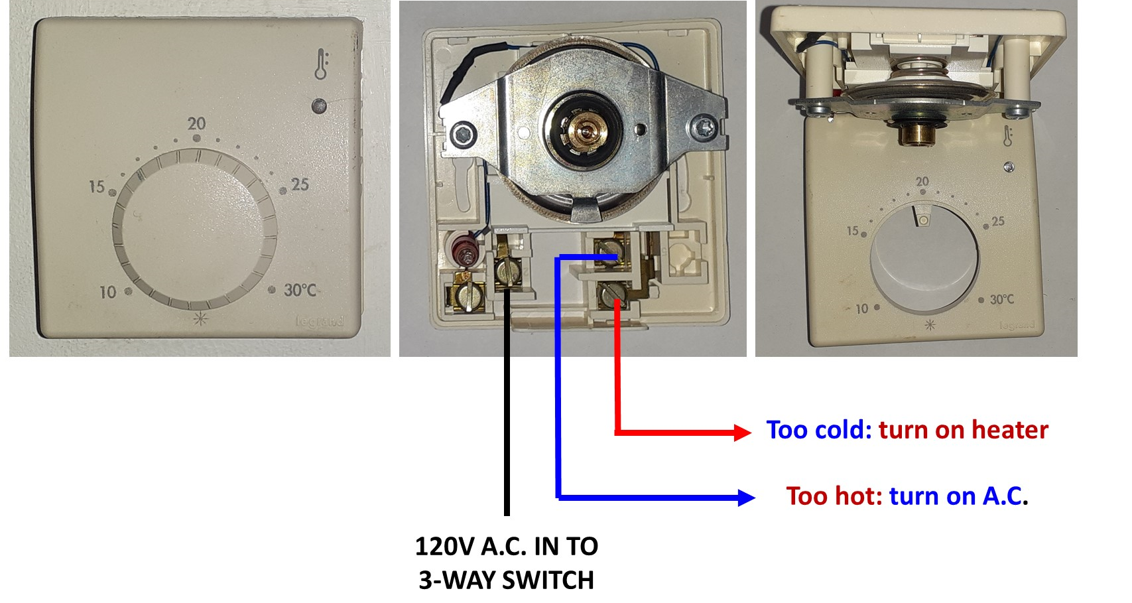
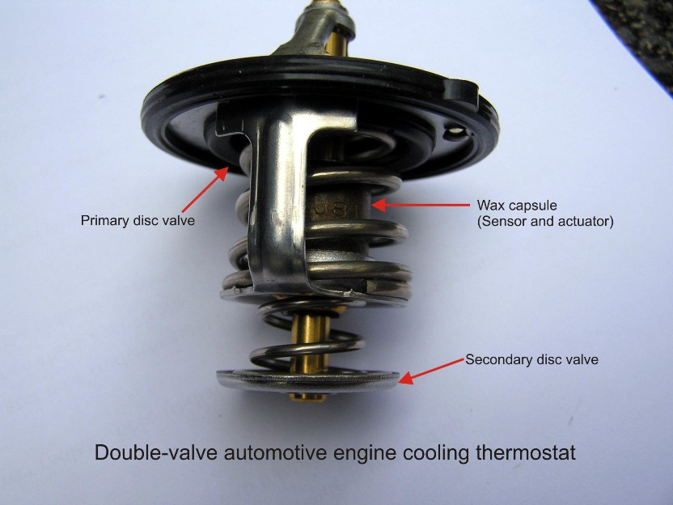
5.1 Some thermal regulation devices (1)
The humble room thermostat:
Bi-metallic strip electric with actuator
Feedback:
slow, thru room air convection
The almost-as humble automobile radiator thermostat
Feedback:
Fast, immersed, expanding wax plug capsule counteracts
closure spring to increase coolant flow as engine warms up

Slide 3
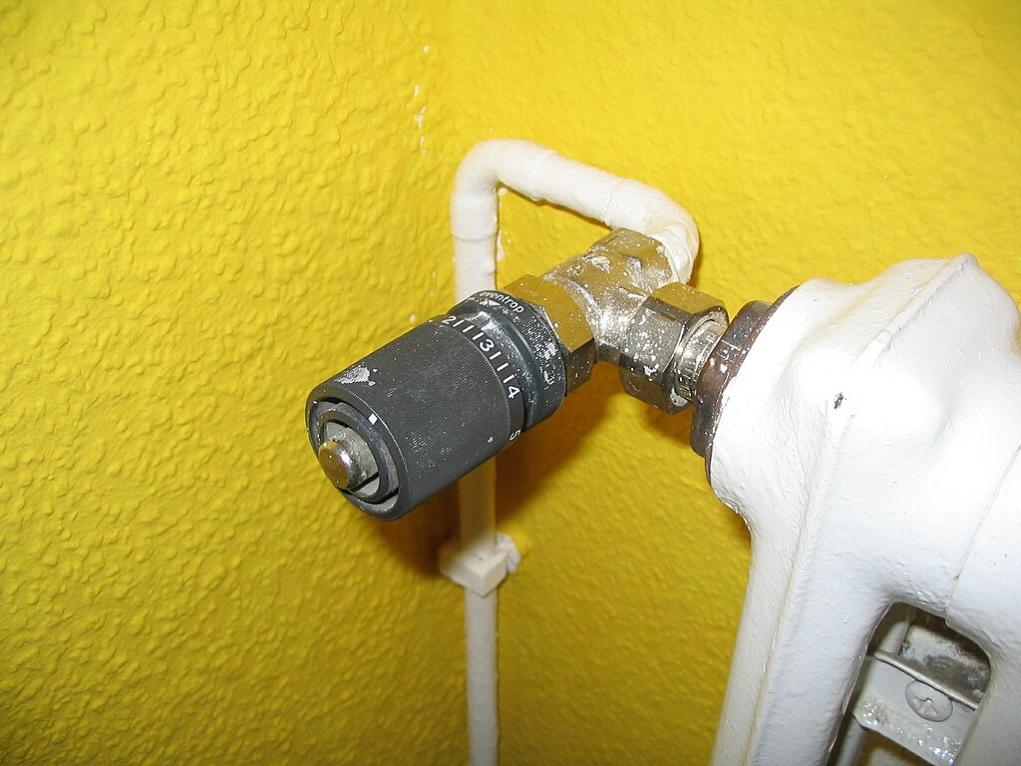
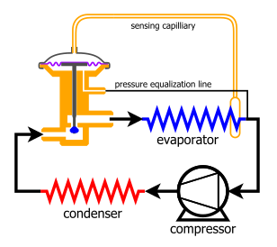
5.1 Some thermal regulation devices (2)
The water heating radiator thermostatic valve:
Feedback
Fast, immersed, expanding wax plug capsule closes valve orifice as set temperature is approached.
Vapor bulb-driven thermo-regulation valve:
Feedback:
Very Fast, Bulb usually clamped to a metal tube in a cooling circuit:
When sensed tube temp too high vapour expands (or evaporates), pushing on diaphragm, opening valve stem to let more coolant into the circuit.

Slide 4
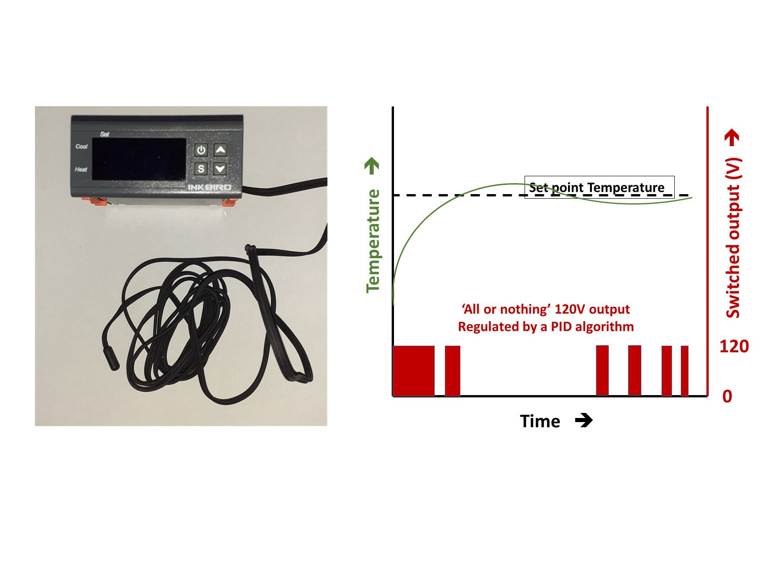
5.1 Some thermal regulation techniques (1)
Inexpensive digital controller with NTC thermistor
& Pulse Width Modulated (“All or Nothing”) relay output
driven by a PID (Proportional, Integral and Derivative algorithm)

Slide 5
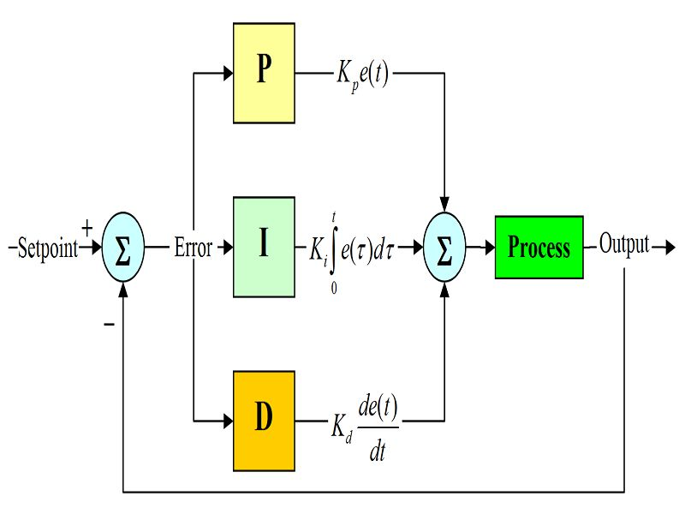
5.1 Proportional, Integral &Derivative Control (1)
Three correctional terms K_{p}, K_{I} and K_{D} : proportional, integral and differential gain:
form the collective (time dependent) response u_{(t)} of the control algorithm to differences
e_{(t)} between measured value of a Process Variable & Set Point to be maintained or reached;
K_{p}, K_{I} & K_{D} are “tunable” parameters
t is the current time (or timestamp) of the
measured PV at which e_{(τ)} is calculated.
The variable t is the internal integration time
which can take on values from a start time t
of the most recent timestamp t.
A modern PID controller will contain a “learn mode”
algorithm that will vary K_{p}, K_{I} & K_{D} to find the
optimum combination. In doing so it will find the
feedback characteristic (or “transfer function”) of the system.
One such autotune is the Zeigler-Nicholls approach

Slide 6
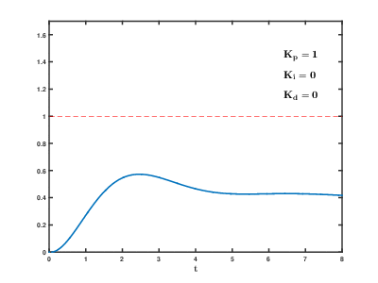
5.1 Proportional, Integral &Derivative Control (2)
PV/SP ➔
Time➔
Time➔
Time➔
Screenshots (from https://en.wikipedia.org/wiki/File:PID_Compensation_Animated.gif)
the time-dependent response of the measured value
(blue curve) of a process variable (PV) following a step
change in setpoint (SP) when regulated by an automatic
learning-mode PID algorithm.
x-axis: time (arbitrary units):
y axis: measured value of the process value relative
to the new set point (taken to be 1).
PV/SP ➔
Time➔

Slide 7
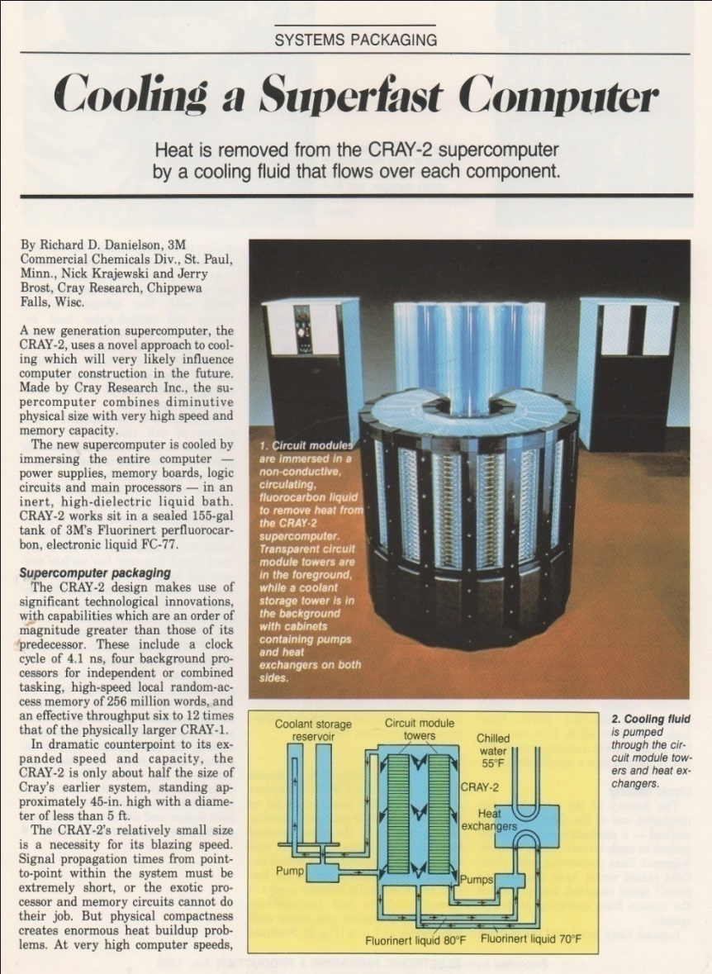
5.2 Monophase liquid cooling (1)
A cold blast from the past:
Cray II supercomputer completely immersed in (electrically non-conductive) liquid coolant here 3M FC-77® fluorocarbon* (weighs ~1.8 x H₂O)
(See liquid pumps and fluorocarbon / water heat exchanger).
*Such fluorocarbon fluids have very high Global Warming Potential (GWP_{20y}: 5000-10000* CO₂) and are being progressively replaced with new compounds.
The military remain big users (e.g. radar systems)

Slide 8
5.2 Monophase liquid cooling (2)
Heat capacity, temperature rise vs. power & liquid flow rate
A fluid will rise in temperature according to its mass, m (kg), the heat energy Q, (Joules) absorbed, and its own heat capacity, C, expressed in units of J.kg⁻¹.K⁻¹;
C relates the energy needed to raise 1kg of the fluid by 1 ˚C or 1 Kelvin (K);
Let’s consider a practical situation:
We have a source of heat, P, (Watts or J.s⁻¹) which we wish to evacuate
using a cooling fluid, but what mass flow ṁ (kg.s⁻¹) do we need, and by
how much can we allow the temperature in the fluid itself to rise (DT, ˚C)?
Liquid temperature rise is related to the absorbed power & liquid heat capacity via
DT = $\frac{P}{C∗ ṁ}$

Slide 9
5.2 Monophase liquid cooling (3)
Approximate heat capacity of some cooling fluids
[references refer to unit support notes]
Fluid (Gas) | C: J/(kg.°C) | Fluid (Liquid) | C: J/(kg.°C)
Air (20 ˚C, 1 bar) | 1006 [2.1] | Mercury | 126
Helium (20 ˚C, 1 bar) | 5192 [2.1] | 3M NOVEC® 649 (liq.) (20 ˚C) | 1103 [2.2]
Hydrogen (20 ˚C, 1 bar) | 14288 [2.1] | 3M FC-72® (liq.) (25 ˚C) | 1100 [2.3]
 |  | Water (liq.) | 4187 [2.1]

Slide 10
5.2 Monophase liquid cooling
Problem (1) – see also separate sheet:
A core processor chip in a PC dissipates 100W of heat. The user has attached a liquid-channel
cooling block directly to it, through which coolant liquid can flow.
The user has a choice between water or a non-conductive modern liquid coolant with GWP=0
(3M NOVEC® 649 [2.2]). What is the mass flow ṁ of (1) water and (2) 3M NOVEC® 649
needed to ensure that the coolant liquid temperature rise DT is limited to 10 ˚C?

Slide 11
5.2 Monophase liquid cooling (4)
In practice of course, heat must be channelled into a cooling fluid through adhesive
or thermal grease and through the wall of the cooling block into the fluid.
All these materials have thermal resistances which stack up, resulting in a significant
temperature offset between the dissipating structure and cooling fluid evacuating the heat.

Slide 12
5.2 Thermal Conductivity, thermal resistance – getting heat into a coolant
Thermal conductivity & resistance can be considered similarly to
electrical conductivity & resistance, with expressions similar those derived from Ohm’s law.
The temperature difference, δT (K) across a thermal interface (a good thermal conductor
like a metal or a poor conductor like a foam insulator) of thickness l (m)
when a power density of q (W.m⁻²) is applied to one side is given by:
δT = $\frac{q.l}{k}$
where k is the thermal conductivity of the interface expressed in SI units of W.m⁻¹.K⁻¹
Alternatively the above equation can be expressed in terms of the thermal resistance, R
(expressed in SI units of m.K.W⁻¹) of the interface as follows:
δT = q. R. l
This equation has a similar form to that of the expression linking the voltage drop,
δV, along a wire of cross sectional area, a, and length, l, with its resistivity, r, in Ohm-metres:
δV = $\frac{I.r.l}{a}$
where (I/a) is the current flux, in A.m⁻², in direct analogy to q in W.m⁻²

Slide 13
Approximate thermal conductivity of some common materials
Material | Thermal Conductivity W.m⁻¹.K⁻¹ | Application
Air (20 ˚C, 1 bar) | 0.026??? [2.1] | Insulator
Aluminium | 236 | Good elec & heat conductor
Asbestos (200 ˚C) | 0.21 | Historic insulator (hazardous)
Beryllia (ceramic) | 285 (room temp) | Heat spreader (hazardous)
Brass | 109−160 | Good elec & heat conductor
Copper | 400 | Very good elec & heat conductor, cooling systems
Cork | 0.043 | Insulator
Diamond (CVD wafer) | 2300 | Heat spreader
Dow Corning 340 heat conducting paste | 0.67 | Demountable thermal connection heat source ➔ heat sink
3M FC-72® (liq.) (25 ˚C) | 0.06 [2.3] | Cooling liquid
Glass | 0.935
Glass Fiber (20 ˚C) | 0.042 | Insulator
Gold | 312 | Electrical connections
­Graphite | 151 | Heat spreader
Lead | 35 | Electrical connections
Mica (50 ˚C) | 0.43 | Heat resistant Electrical Insulator
3M NOVEC® 649 (liq.) (25 ˚C) | 0.06 [2.2] | Cooling liquid
Rockwool (20 ˚C) | 0.034 | Insulator
Silver | 425 | Very Good elec & heat conductor
Silicon | 148-150 | Active semiconductor
304, 316 Stainless Steel | 14-18 (room temp) | Poor heat conductor (for a metal), cooling systems
STYCAST® 2850 (Emeron & Cuming) | 1.02-1.68 [2.4] | Thermally conductive epoxy: permanent connection heat source ➔ heat sink
Urethane Foam (Rigid) (20 ˚C) | 0.026 | Insulator
Water (20˚ C) | 0.613 | Cooling liquid

Slide 14
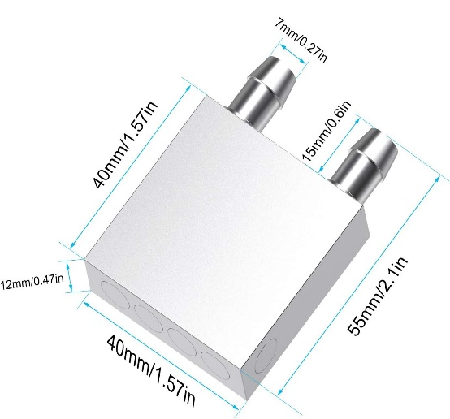
Example from a common application: cooling a processor core with a liquid-channel block (plan and elevation views)
5.2 Monophase cooling
and conducting heat into a coolant (1)

Slide 15
Problem (2) – see also separate sheet:
A core processor chip in a PC dissipates 100W of heat. The chip has a (3 cm x 3cm) square profile. The user has attached a (3 cm x 3cm) square channelled copper block on top of it, through which coolant liquid can flow to cool the processor. The cooling block makes contact with a thin metal jacket on top of the chip through a 100 micron layer of Dow Corning 340 thermally-conducting grease.
The processor chip package itself is 3 mm thick in total (as illustrated in the figure), made from a 1 mm-thick active silicon layer that is centrally-sandwiched with 1 mm of ceramic encapsulant above and below it. The ceramic fill has a thermal conductivity of 200 Wm⁻¹.K⁻¹.
Note: the heat is dissipated in the doped semiconductor implanted into the surface of the active silicon layer facing down towards the connector to the mother board, and must pass through 1 mm of silicon substrate in the opposite (up) direction on its way to the cooling block. Any heat loss by conduction through the connector pins to the mother board can be ignored. The very small thermal resistance of the thin topside metal jacket can also be neglected in the calculation; you can pretend that it isn’t there.
5.2 Monophase cooling
and conducting heat into a coolant
Problem (2) – see also separate sheet:
A core processor chip in a PC dissipates 100W of heat and has a 4 x 4cm square profile.
The user has attached a 4 x 4cm channelled copper block on top, through which liquid
flows to cool the processor. The cooling block makes contact with a thin metal jacket
on top of the chip through a 100 micron layer of Dow Corning 340 thermal-conductive grease.
The processor chip package itself is 3 mm thick in total (as illustrated), made from a
1 mm-thick active silicon layer centrally-sandwiched with 1 mm of ceramic encapsulant
above & below it. The ceramic fill has a thermal conductivity of 200 Wm⁻¹.K⁻¹. 4

Slide 16
Problem (2) – see also separate sheet:
A core processor chip in a PC dissipates 100W of heat. The chip has a (3 cm x 3cm) square profile. The user has attached a (3 cm x 3cm) square channelled copper block on top of it, through which coolant liquid can flow to cool the processor. The cooling block makes contact with a thin metal jacket on top of the chip through a 100 micron layer of Dow Corning 340 thermally-conducting grease.
The processor chip package itself is 3 mm thick in total (as illustrated in the figure), made from a 1 mm-thick active silicon layer that is centrally-sandwiched with 1 mm of ceramic encapsulant above and below it. The ceramic fill has a thermal conductivity of 200 Wm⁻¹.K⁻¹.
Note: the heat is dissipated in the doped semiconductor implanted into the surface of the active silicon layer facing down towards the connector to the mother board, and must pass through 1 mm of silicon substrate in the opposite (up) direction on its way to the cooling block. Any heat loss by conduction through the connector pins to the mother board can be ignored. The very small thermal resistance of the thin topside metal jacket can also be neglected in the calculation; you can pretend that it isn’t there.
5.2 Monophase cooling
and conducting heat into a coolant
Problem (2: cont) – see also separate sheet
Note: the heat is dissipated in the doped semiconductor implanted into the surface of the
active silicon layer facing down towards the connector to the mother board, and must first
pass through 1 mm of silicon substrate in the opposite (up) direction on its way to the
cooling block. Any heat loss by conduction through the connector pins to the mother
board can be ignored. The very small thermal resistance of the thin topside metal jacket
can also be neglected in the calculation; you can pretend that it isn’t there.
The heat from the chip can be thought of as passing through 1 mm of silicon and a further
1mm of ceramic before passing through a 100 micron (0.1 mm) thick layer of Dow Corning
340 thermal paste, and finally through the copper cooling block with an effective thickness
of 3 mm before reaching the cooling liquid channel, as shown in the figure.

Slide 17
5.2 Monophase cooling
and conducting heat into a coolant
Problem (2: cont) – see also separate sheet
For the first 4 questions you can consider that the coolant to enters the block 20 ˚C and leaves at 30 ˚C. The average temperature of the liquid in the cooling channel can thus be taken to be 25 ˚C.
What are the (progressively-increasing) temperatures on the following surfaces;
Q1: The surface of the copper block in contact with the top face of the Dow Corning 340 thermal grease film (A)?
(This is 3mm from the plane of the coolant channel)
Q2: The surface of the ceramic in contact with the bottom face of the 100 micron Dow Corning 340
thermal grease film (B)?
Q3: The hot (downfacing) side of the1 mm thick processor chip itself (C)?
Note: you have to consider the thermal resistance of two materials in series to get to this figure.
Q4: Which material contributes the biggest temperature difference (temperature difference across itself)?
Q5: What method would you use to reduce the contribution of this layer (mechanical solutions acceptable)?
Building on knowledge
Q6: The user has a choice between water or a non-conductive modern liquid coolant with GWP = 0 (3M NOVEC® 649 [2.2]), but the pump available can only circulate a maximum of 3 grams per second (a mass flow of 0.03 kg.s⁻¹) of any liquid. What is the input temperature of NOVEC 649 to the copper cooling block to maintain an average temperature in the block cooling channel of 25 ˚C? (Hint: this calculation uses the concept of coolant heat capacity and mass flow from the previous problem.

Slide 18
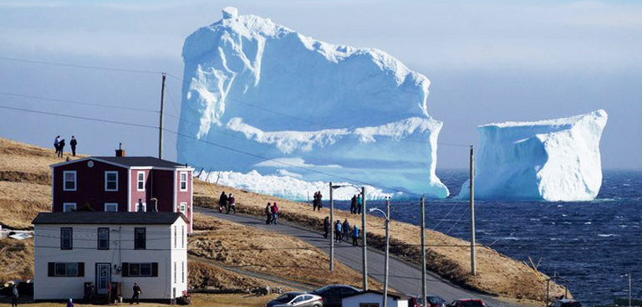
Heat exchangers (1)
Example of a “perfect” (full contact, not full jacket) heat exchanger
in which all 3 phases of matter interact (no intermediate surfaces):
solid fresh water ➔ sea water (water with around 35 kg/tonne of salt,
which acts as a freezing point depressant);
solid fresh water ➔ air;
peripheral fresh meltwater ➔ sea water and air ;
(Picture credit: TheRiderPost.com:
https://www.theriderpost.com/lifestyle/environnement/iceberg-titanic-sechoue-cote-canada/ )
Beautiful but something perhaps you would rather wish you were not witnessing
on a Sunday afternoon bike ride along the coast.

Slide 19
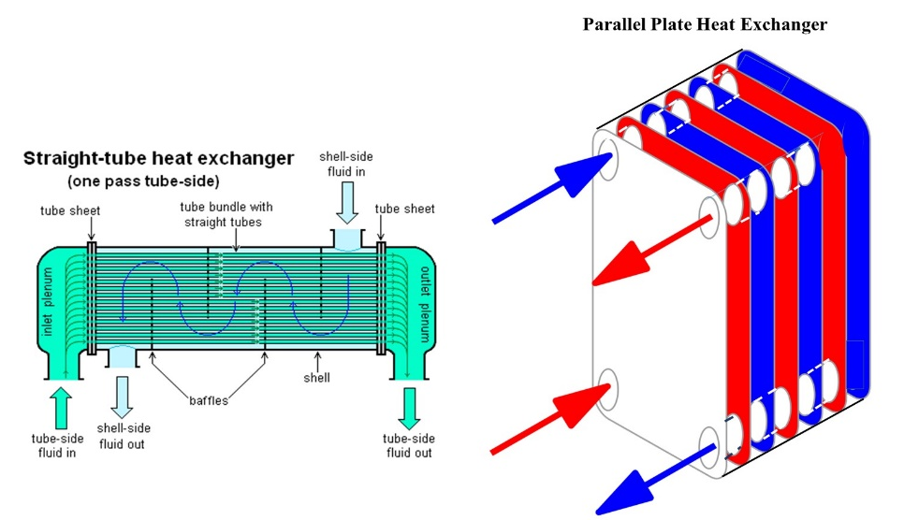
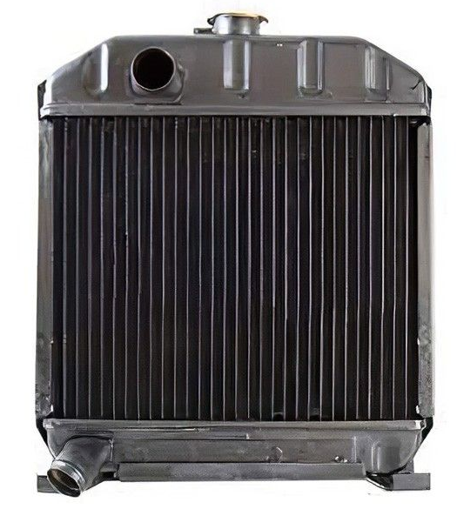
Heat exchangers (2)
Hot liquid➔ cold liquid
(can also be used in
evaporators and condensers)
Hot liquid➔ Cold gas (air)
the humble automobile radiator

Slide 20
Heat exchangers (3): and in your refrigerator…
Gas (air in closed
volume to be cooled)
to
(liquid ➔ vapor)
(refrigerator
evaporator)
Gas (room air
to be cooled)
to
(liquid ➔ vapor)
(A/C
evaporator)
Hot (Vapor➔ liquid)
to
cooler gas
(room air)
(refrigerator
condenser)
Hot (Vapor ➔ liquid)
to
cooler gas
(outside air)
(A/C
condenser)

Slide 21
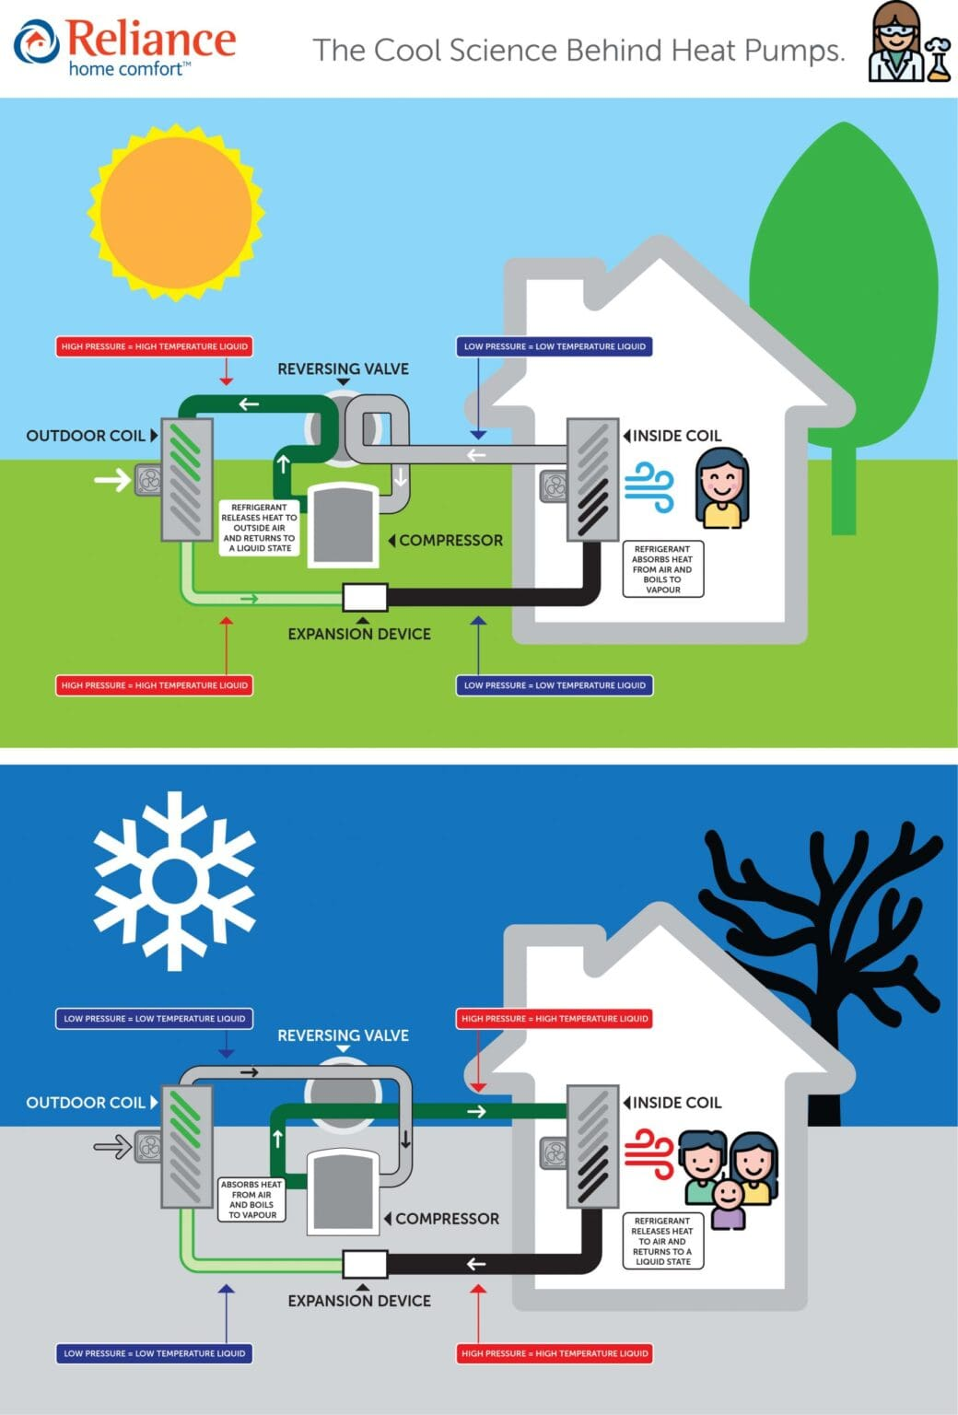
https://reliancehomecomfort.com/learning-centre/cool-science-behind-heat-pumps/
Credit: reliance home comfort Inc.

Slide 22
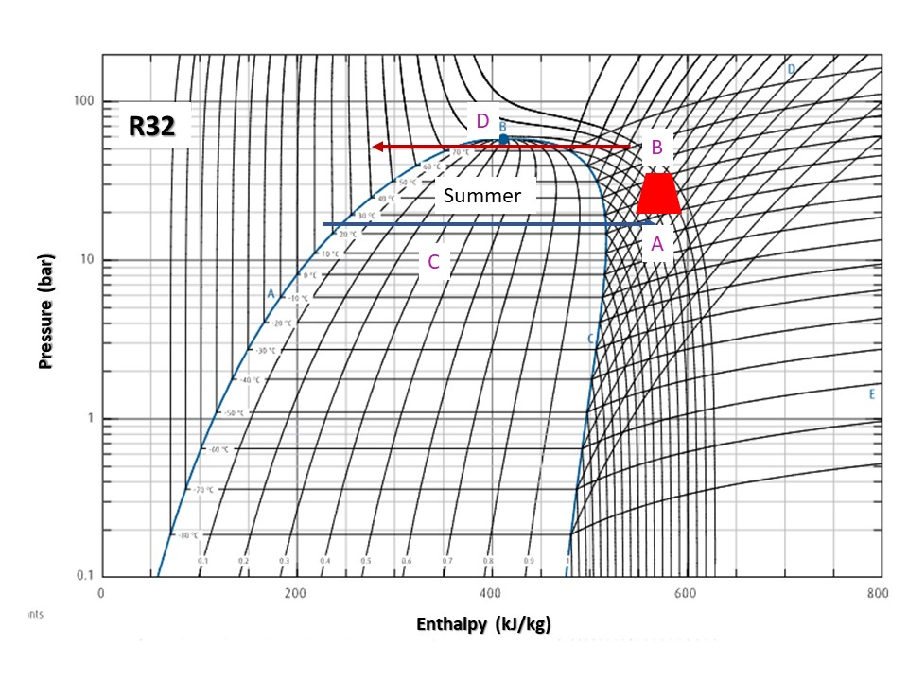
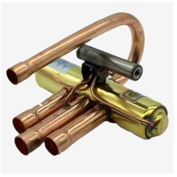
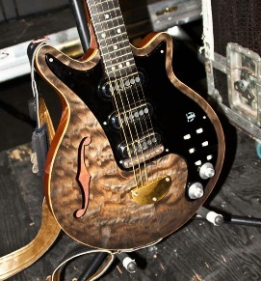
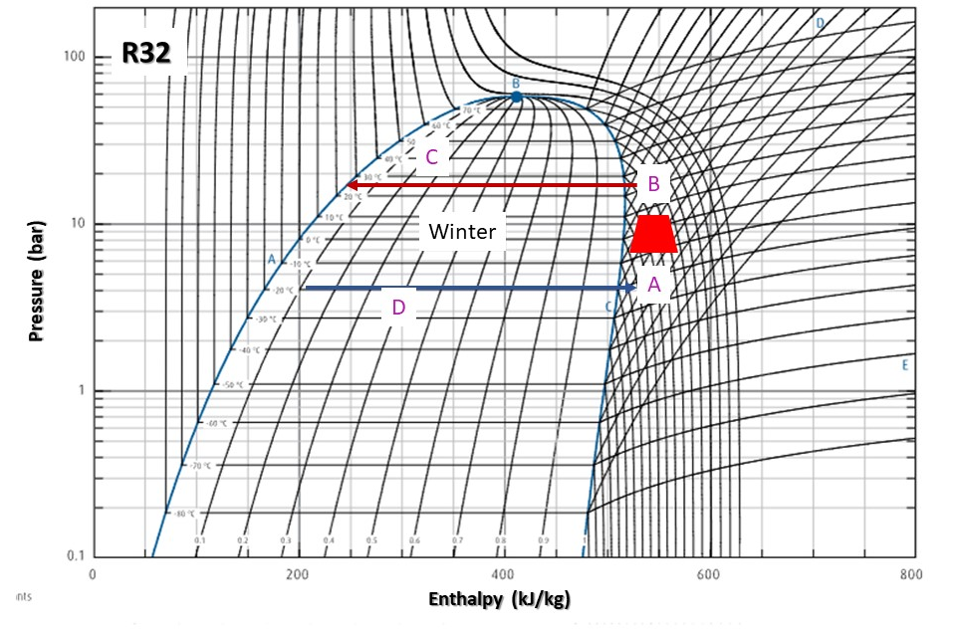
The special component: a (usually
electric – driven) fluid “4-way switch”
C
C
B
(Evaporator)
B
COMP
E.D.
D
A
A
D
(Condenser)
Electrical analogs
C
B
D
A
B
C
(Condenser)
COMP
E.D.
A
D
(Evaporator)

Slide 23
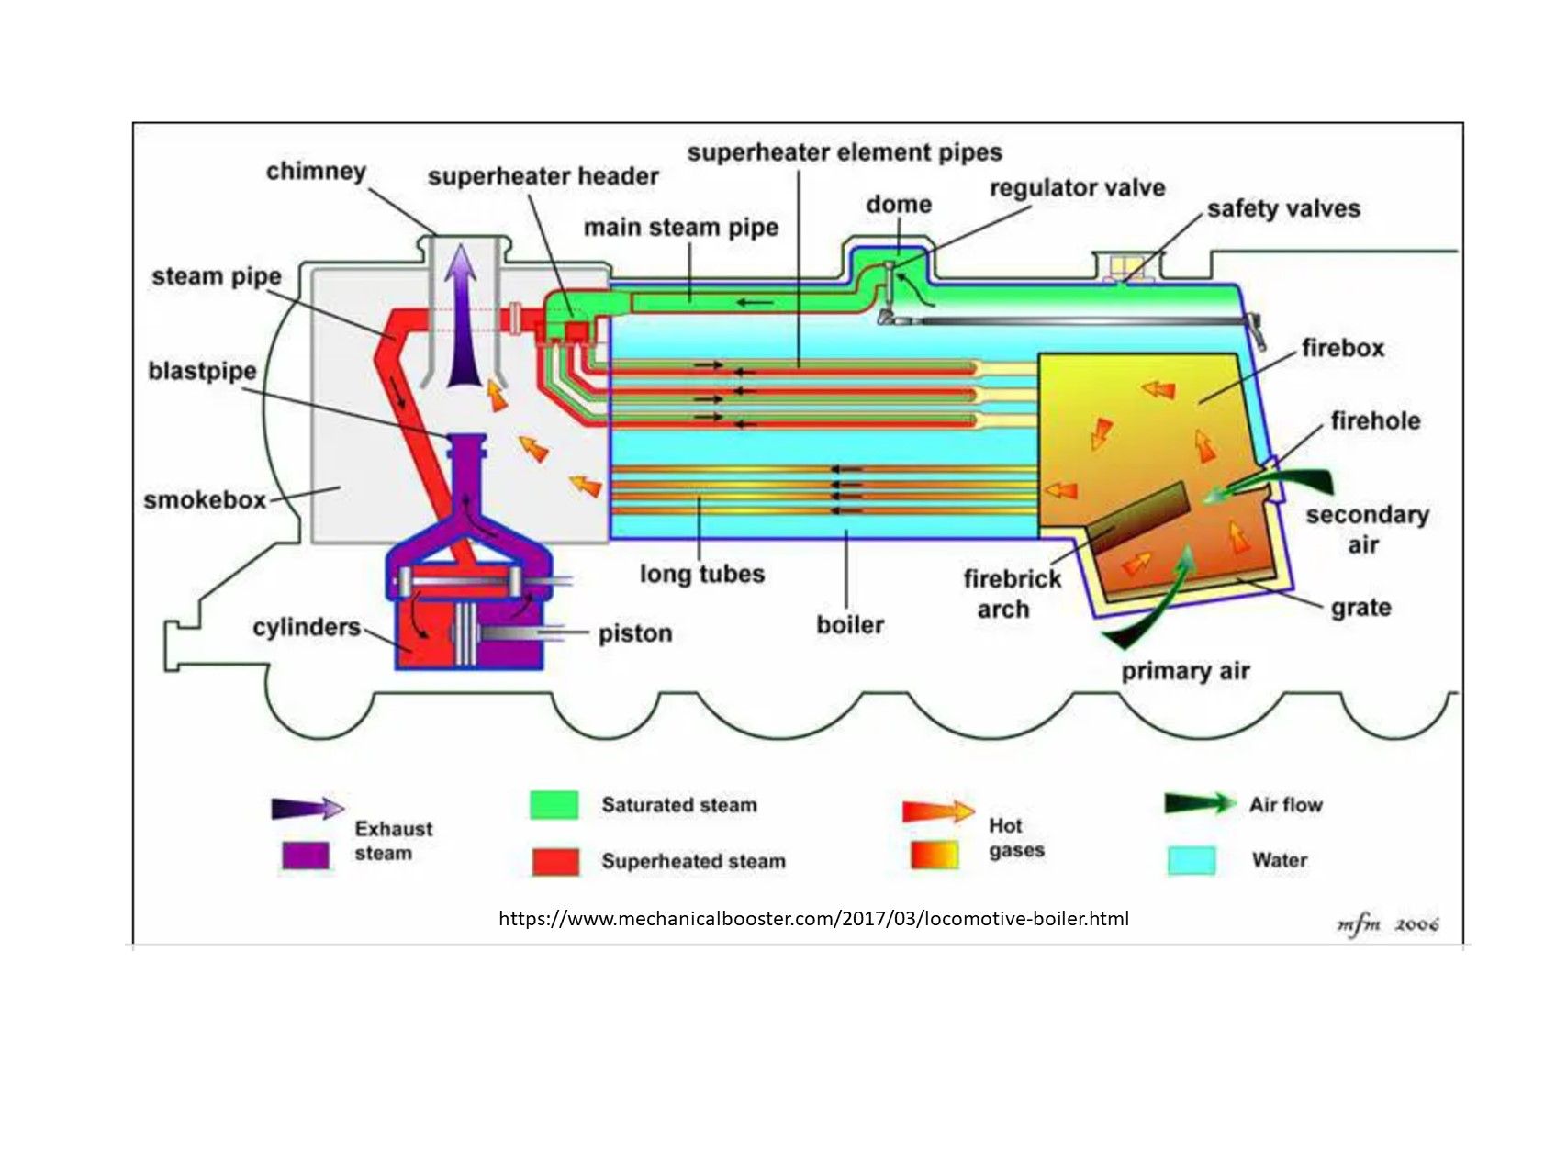
Heat exchangers (4): …
Another form of evaporative heat exchanger: the steam locomotive:
Boils water, then adds another thermodynamic step: superheating steam to reduce its saturation content and lessen the risk of compressive condensation in the cylinders

Slide 24
Heat exchangers (5): can be huge - like this condenser…
Hot (Steam➔ liquid)
to
cooler liquid (sea water)
(Oil-fired boilers➔
steam turbines ➔
condensers
(closed feedwater circuit))
Seawater coolant enters
& leaves condensers
through openings in hull.
RMS Queen Mary (Long Beach, CA)
Ship completed 1936, John Brown shipyard, Clydebank, Glasgow, Scotland
Displacement: 77,400 long tons (78,642 metric tons)
Length: 1,019.4 ft (310.7 m): Beam: 118 ft (36.0 m), Height: 181 ft (55.2 m)
Draught: 38 ft 9 in (11.8 m), Decks: 12
Installed power: 24 × Yarrow boilers Propulsion: 4 × Parsons geared steam turbines,
4 shafts, 200,000 shp (150,000 kW) Speed: 28.5 kts (52.8 km/h; 32.8 mph)

Slide 25
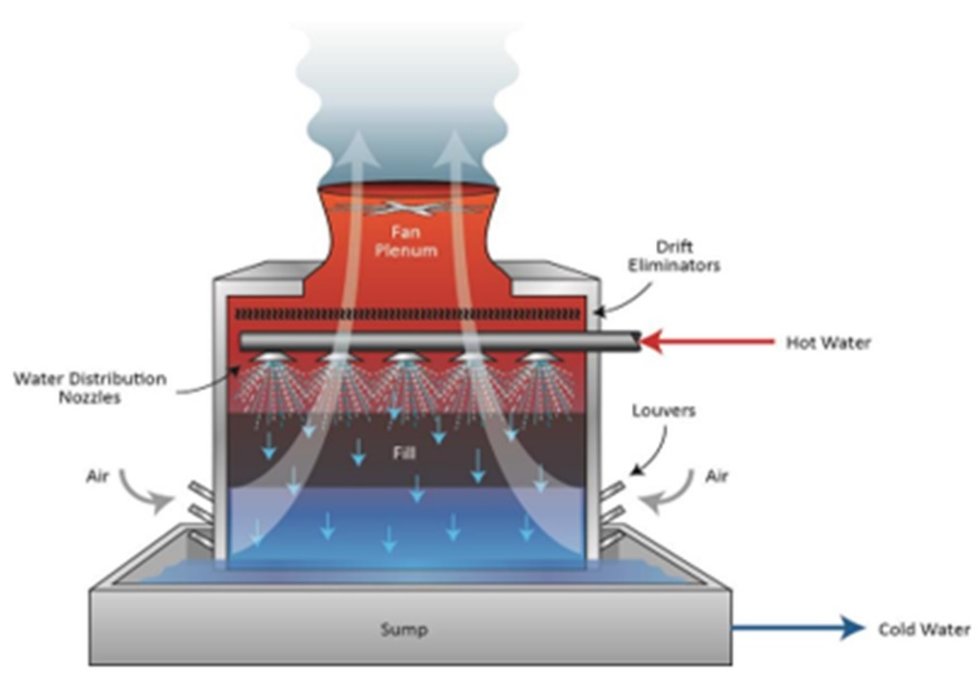
Heat exchangers (6): can be huge - like this cooling tower…
Water cooling tower, typically used at power stations
and big industrial plants & data centers.
Secondary hot water from a heat exchanger cooling
an industrial process is pumped to the top of the
tower and sprayed into a counter flow of air.
Water is thus cooled and collected in the bottom
pond. The circuit is open, some water escapes as
vapour and must be replenished,
while that collected in the bottom pond must be
filtered on its way back to the heat exchanger
Hot liquid to cooler gas (air):

Slide 26
Heat exchangers (7): and small too (100 Wattish) – like this overclocking (?) installation…

