Slide 1
Lecture 4 of 4 (13:1)

Slide 2
(5.7) Examples from cooling silicon tracking detectors in particle physics (ATLAS, CMS, LHCb)
We’ve seen some examples from the present running of ATLAS:
Saturated Fluorocarbons of the form C_{n}F_{(2n+2)}
like C₃F₈ (current use in most of the ATLAS Silicon tracker)
and C₆F₁₄ (current use as liquid coolant in parts of the CMS Silicon tracker)
which have respective GWP₂₀ of around 5890 & 6640 x CO₂.
New upgraded trackers are however being built
for the High Luminosity phase of LHC to run from 2029-2041
A core aim in these detectors is to use low Global Warming Potential coolants
Any coolant must be non-flammable, non-toxic, non-oxone depleting,
(electrically) non-conductive, radiation resistant and have low or zero GWP
CO₂ cooling is being pushed hard at CERN but has problems of high operating pressure
and a limiting evaporating temperature of -56 °C (triple point temperature where
3 phases of CO₂ co-exist (liquid, vapor, solid CO₂ ‘snow’)

Slide 3
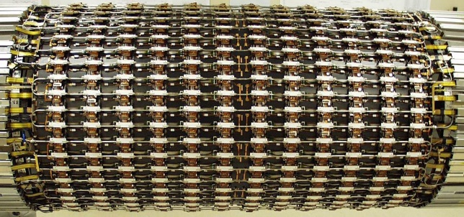
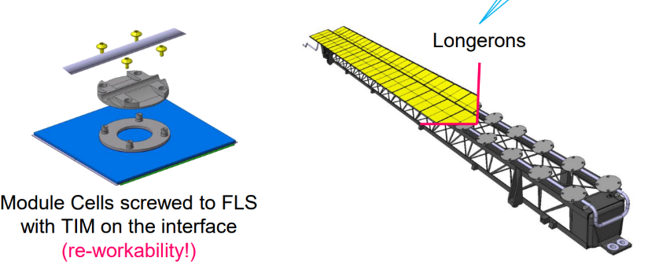
(5.7) Examples from cooling particle physics Si trackers (ATLAS, CMS, LHCb)
Two distinct types of detector cooling geometry at HL-LHC:
Tube and block ‘DNA’
ATLAS barrel SCT (present) ATLAS ITK Barrel longerons and Si module
block attachment (future HL-LHC)
Disadvantages: long(er) heat conduction path (more interfaces) Si➔ cold(er) coolant
(2) Micro-channel cooling
LHCb VELO upgrade
Advantages: shortest heat conduction path to coolant: coolant can be warmer:
Disadvantages: fraglity issues: channels etched in silicon and cover plate attached

Slide 4
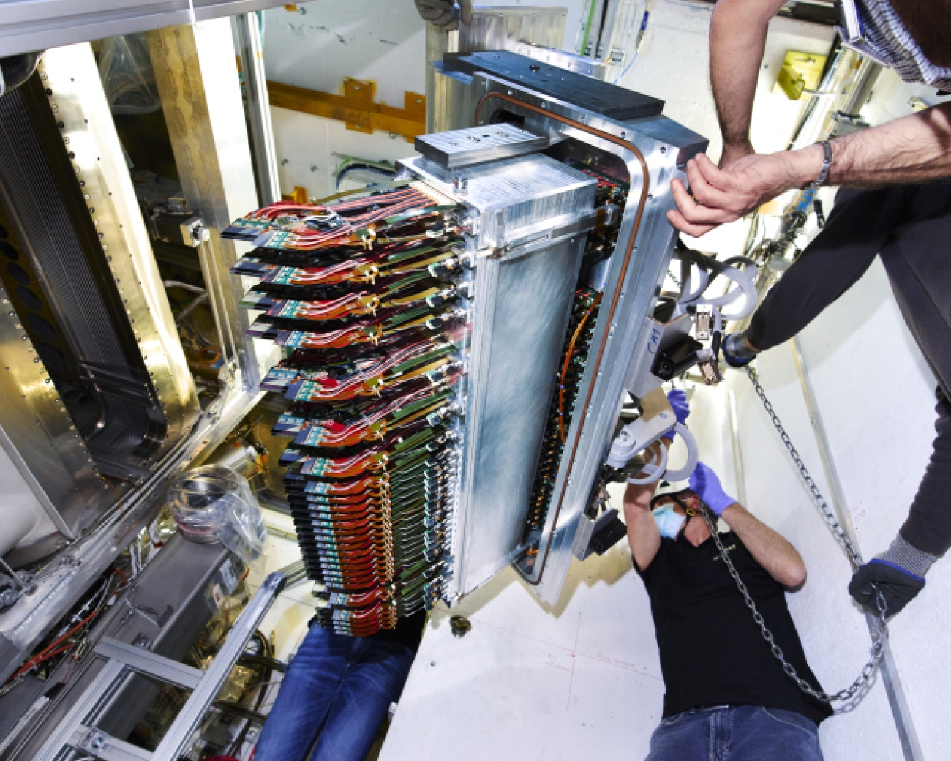
(5.7) Examples from cooling particle physics Si trackers (ATLAS, CMS, LHCb)
Micro-channel cooling: more on the LHCb VELO upgrade
https://www.youtube.com/watch?v=RmlQwLdfFZg

Slide 5
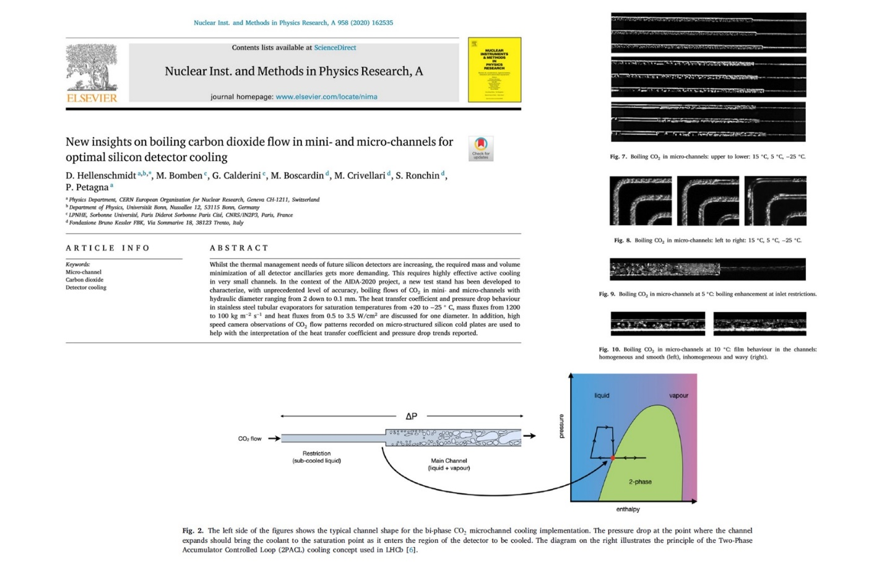
https://www.youtube.com/watch?v=hsLXi9QTxUo
(5.7) Examples from cooling particle physics Si trackers (ATLAS, CMS, LHCb)
Micro-channel cooling: more on the LHCb VELO upgrade
Recent mastery of evaporative CO₂ cooling in microchannels
High CO₂ evaporation pressure
(~70 bar at room temp.)
A film narrated by LHCb physicist Paula Collins

Slide 6
(5.7) Examples from cooling particle physics Si trackers (ATLAS, CMS, LHCb)
Despite these evident successes, the coolant is not directly passing through the detector chips,
just through a heat collector plates onto which they are bonded which contain 200 x 120 micron
etched microchannels .
So the silicon pixel detectors and their readout electronics are almost directly cooled by fluid
evaporating in microchannels.
We can therefore ask:
will processor chips ever have microchannels etched into them for direct coolant flow?
will this coolant be liquid, or evaporative for reduced mass flow?
how would the cooling pipes be connected?
what would the (necessarily electrically non-conductive) fluid be: a fluorocarbon,
CO₂ or a new low GWP fluid, for example from the 3M “NOVEC” range?

Slide 7
(5.7) Examples from cooling particle physics Si trackers (ATLAS, CMS, LHCb)
The CO₂ problems:
High evaporation pressure at room temperature (60-70 bar)
the detector has to ‘surf ‘ down the saturated liquid line to the operating evaporation temperature of -30 ➔ -40 °C (pressure around 12 - 18 bars):
fatigue cycling an issue in microchannels..?
(2) The high triple point temperature of -56 °C
limits the lowest temperature attainable in the tubes of a tube & block cooling system: may not be cold enough for operation of Si detectors after years of irradiation in the LHC High Luminosity program (2029-41)

Slide 8
(5.7) Examples from cooling particle physics Si trackers (ATLAS, CMS, LHCb)
Low GWP Alternatives to CO₂:
Noble gases like Xenon and Krypton
Very expensive and in very short supply, particularly since the war in Ukraine.
Complex transcritical circulation for Krypton (outside the scope of this unit);
Xenon probably just squeaks in (~50 bar @ 15 C) but still has relatively high pressure evaporation at room temp, but no triple point problem (-112 ˚C)
(2) Fluoroketone (C_{n}F_{2n}O) replacements for saturated fluorocarbons (C_{n}F_{(2n+2)})
The substitution of two fluorine atoms with an oxygen atom can reduce the GWP to zero: if the oxygen atom is on the end or on a side-arm of the molecule (see next slides);
Ultraviolet scission of the fluoroketone molecules in the upper atmosphere does not create long-lived debris molecules (references given in unit support notes);
(C_{n}F_{2n}O) molecules with the same number of carbons as their (C_{n}F_{(2n+2)}) partners will have similar thermodynamics (molecular weight difference = 22 units);
3M NOVEC 649 (C₆F₁₂O) authorised for use as a C₆F₁₄ replacement at CERN (liquid cooling)

Slide 9
(5.7) Examples from cooling particle physics Si trackers (ATLAS, CMS, LHCb)
A Fluoroketone (C_{n}F_{2n}O) replacement for a saturated flurorcarbon (C_{n}F_{(2n+2)})
Thermophysical Properties of NOVEC 649 (C₆F₁₂O) & C₆F₁₄
(at 25°C except where noted: after [7.15])
Fluid thermophysical property | NOVEC 649: C₂F₅C(O)CF(CF₃)₂ Perfluoro-2-methyl-3-pentanone (C₆F₁₂O fluoro-ketone) | C₆F₁₄ (Perfluorohexane, Saturated fluorocarbon)
Boiling temp @ 1 atm (˚C) | 49 | 56
Critical Temp (˚C) | 169 | 178
Critical Pressure (MPa) | 1.87 | 1.89
Freezing temperatre (˚C) | < -100 | < -100
Specific heat (J.kg⁻¹K⁻¹) | 1103 | 1050
Density (kg.m⁻³) | 1610 | 1680
Kinematic viscosity (cSt) | 0.42 | 0.4
Latent Heat (J.kg⁻¹) | 88 | 88
Vapour Pressure @ 25 ˚C (kPa) | 40.4 | 30.9
Vapour Pressure @ 100 ˚C (kPa) | 441 | 350
Water solubility (ppm_{w}) | 21 | 10

Slide 10
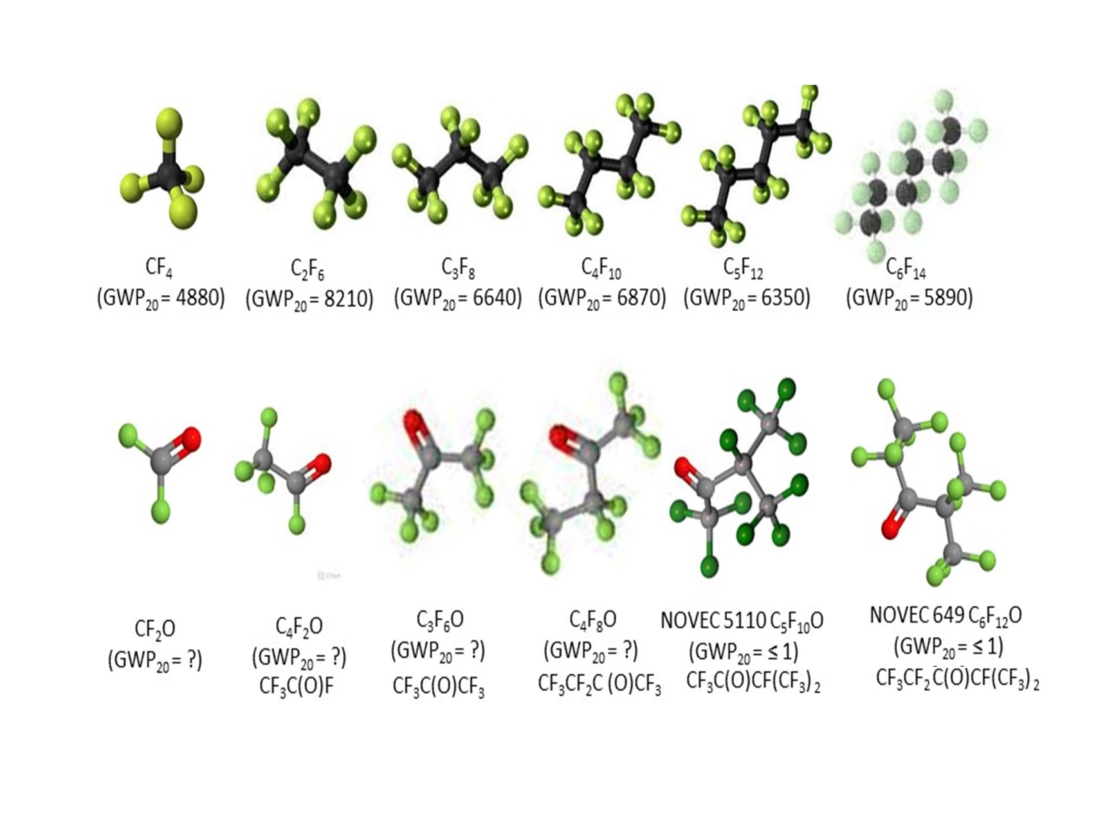
(5.7) Examples from cooling particle physics Si trackers (ATLAS, CMS, LHCb)
Saturated fluorocarbons (C_{n}F_{(2n+2)}) and their Spurred fluoroketone (C_{n}F_{2n}O) analogs
(with 20 year Global Warming Potentials, where measured)
C₂F₄O

Slide 11
(5.7) Examples from cooling particle physics Si trackers (ATLAS, CMS, LHCb)
Some Thermodynamic comparisons two convenient SFCs, CO₂, Xe
(F-K thermodynamics should be similar to same carbon order SFCs)
C₃F₈ probably
won’t go cold
enough for
HL-LHC operation

Slide 12
(5.7) SWOT analysis of cooling fluids HL-LHC
Strengths CO₂ Non-flammable, non-toxic, electrical insulator, non-ozone-depleting, radiation resistant, GWP=1 | Weaknesses CO₂ High pressure circulation (60 bar) at ambient temp before cooldown to operating temp High triple point ( -56°C)
Threats CO₂ High triple point may make Si tracker operation problematic: less thermal ‘headroom’ after heavy irradiaton (‘thermal runaway’ phenomenon) | Opportunities CO₂ Extensive R&D program at CERN Evaporative coolant of choice for ATLAS, CMS for start of HL-LHC program
Strengths C₂F₆ Non-flammable, non-toxic, electrical insulator, non-ozone-depleting, radiation resistant | Weaknesses C₂F₆ Very high GWP (around 6000 x CO₂)
Threats C₂F₆ Production will be phased out unless a strong motivation from semiconductor manufacture industry | Opportunities C₂F₆ Proved to decrease the operating temp of an ATLAS SCT thermal model in blend with 75% C₃F₈
Strengths xenon Non-flammable, non-toxic, electrical insulator, non-ozone-depleting, radiation resistant, GWP=0 | Weaknesses xenon High pressure circulation (50 bar) at ambient temp before cooldown to operating temp (amost transcritical) Extremely expensive
Threats xenon Very difficult future procurement (war in Ukraine) (10⁻⁸ atmospheric content.) | Opportunities xenon Could find expertise In particle physics community for fabrication of circulators: already used in dark matter experiments
Strengths C_{n}F_{2n}O Non-flammable, non-toxic, electrical insulator, non-ozone-depleting, radiation resistant, GWP=0 | Weaknesses C_{n}F_{2n}O
Threats C_{n}F_{2n}O Large scale industrial production may depend on the phasing-out of SFCs, needs of semiconductor manufacture industry: Material compatibility needs further study. | Opportunities C_{n}F_{2n}O Expertise in particle physics community for 3M NOVEC 649 (C₆F₁₂O)

Slide 13
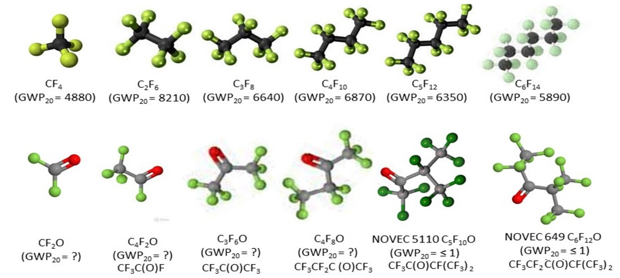
Last problem (6): See separate sheet – one for the sleuth:
while a new fluid C₃F₆O would have all the advantages of C₃F₈, but with zero GWP, the thermodynamics of C₃F₈ and presumably of C₃F₆O (which differs in molecular weight by 22 units) is not perfect for cooling a processor chip at room temperature. What fluid in the C_{n}F_{2n}O spectrum might be better, and why?
Hint: the figures below may help in this.
C₂F₄O

Slide 14
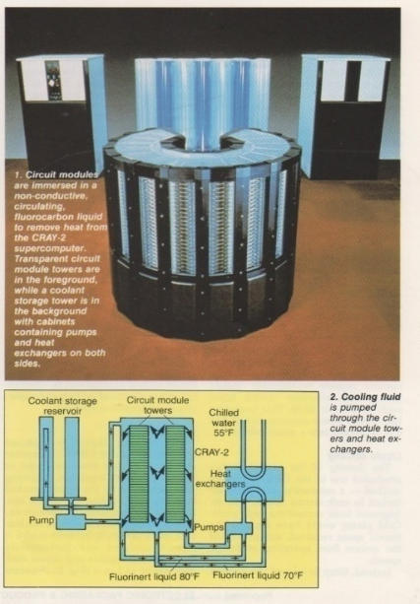
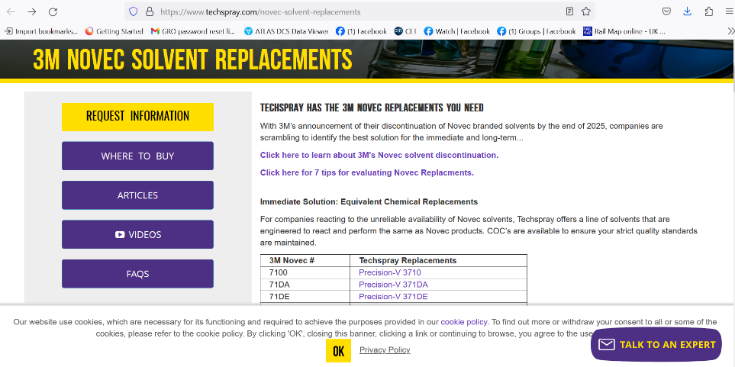
So where does this leave the option of immersion cooling of processors,
or the cooling of processor chips themselves thru microchannels?
Will processor chips ever look like this?
Can semiconductor lithography, implantation, microchannel
etch, sealing and connectivity be achievable in one final device?
3M seem to have lost enthusiasm to produce any more fluorinated fluids after 2025, but companies like
F2 Chemicals (Preston, UK), Astor (Ru), Synquest (FL), Techspray (GA) continue (probably many others: e.g.China)
Note *Some 3M `NOVEC’ fluids are HFCs
with GWPs in the ranges of hundreds:
**Better to concentrate on C_{n}F_{2n}O molecules
over the full carbon spectrum with GWP = 0.
But the needs of the semiconductor &
electronics industries will be determinant…

