Slide 1
Lecture 2 of 4 (27:1)

Slide 2
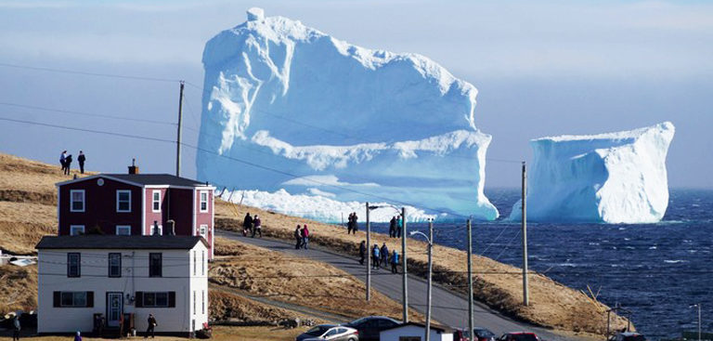
Heat exchangers (1)
Example of a “perfect” (full contact, not full jacket) heat exchanger
in which all 3 phases of matter interact (no intermediate surfaces):
solid fresh water ➔ sea water (water with around 35 kg/tonne of salt,
which acts as a freezing point depressant);
solid fresh water ➔ air;
peripheral fresh meltwater ➔ sea water and air ;
(Picture credit: TheRiderPost.com:
https://www.theriderpost.com/lifestyle/environnement/iceberg-titanic-sechoue-cote-canada/ )
Beautiful but something perhaps you would rather wish you were not witnessing
on a Sunday afternoon bike ride along the coast.

Slide 3
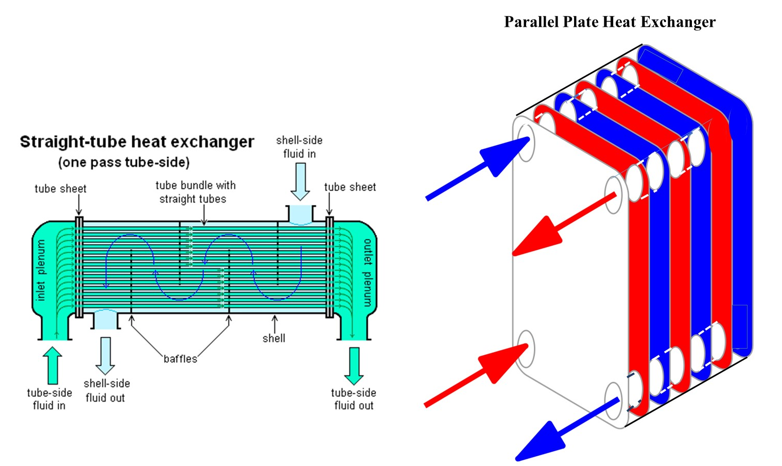
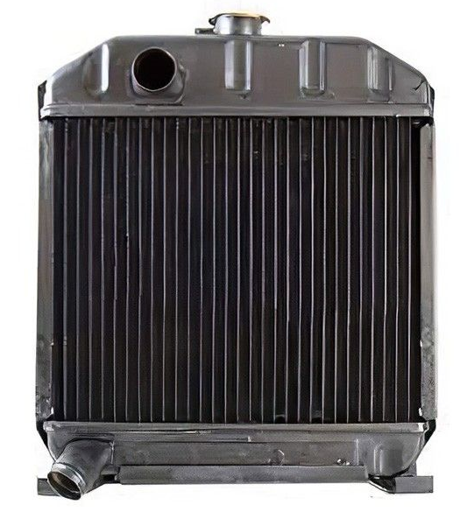
Heat exchangers (2)
Hot liquid➔ cold liquid
(can also be used in
evaporators and condensers)
Hot liquid➔ Cold gas (air)
the humble automobile radiator

Slide 4
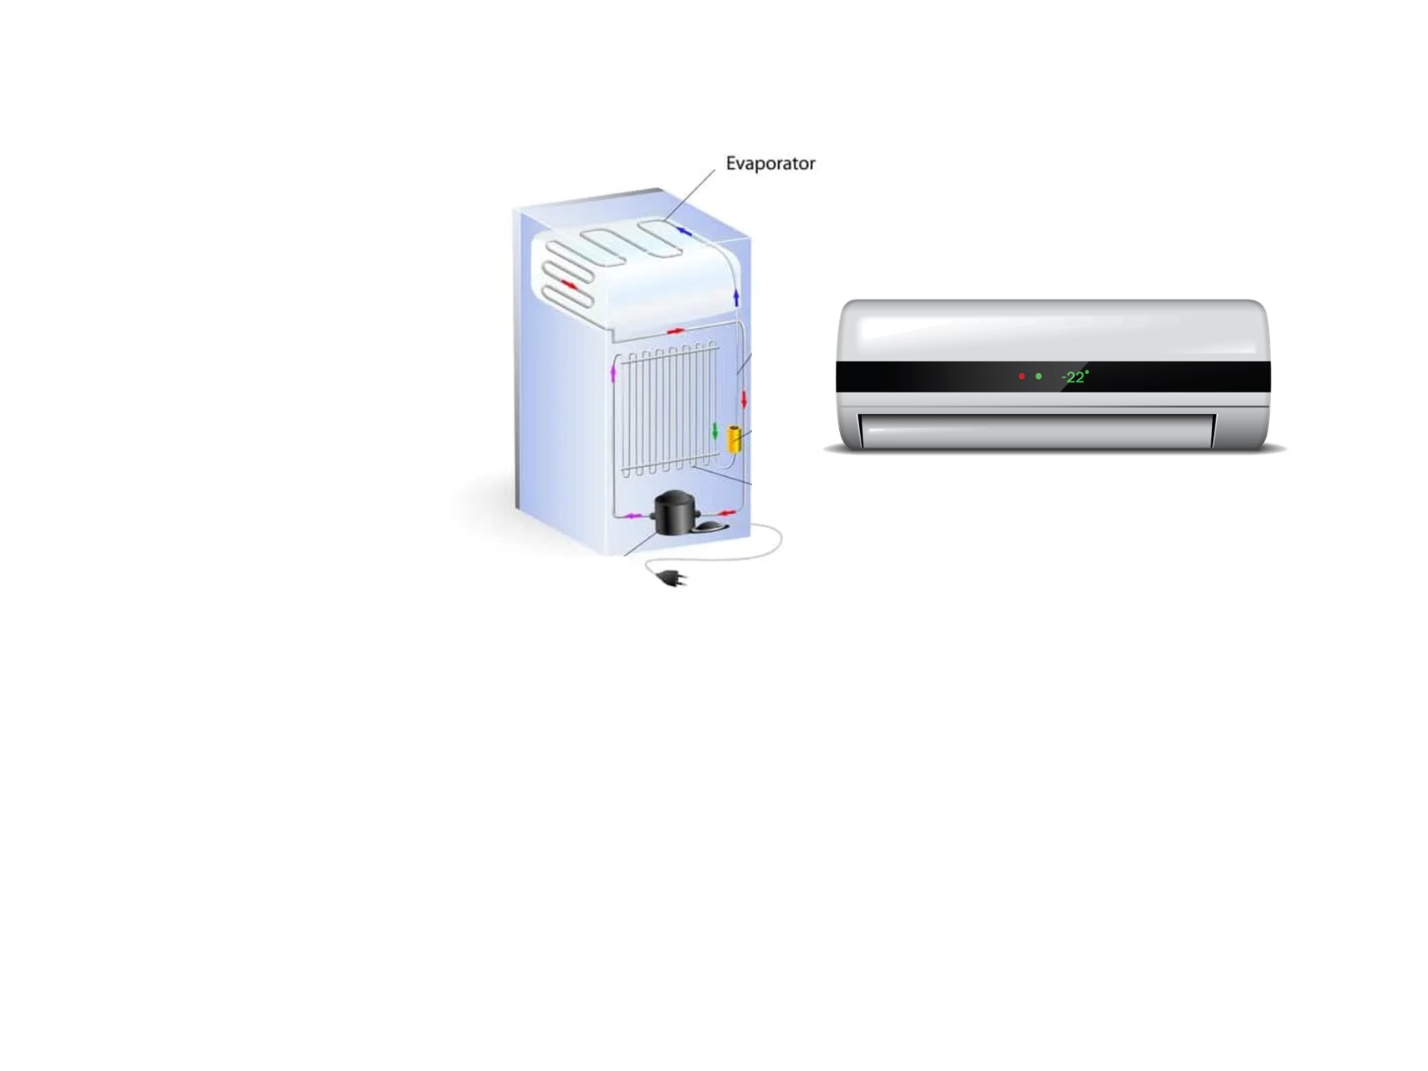
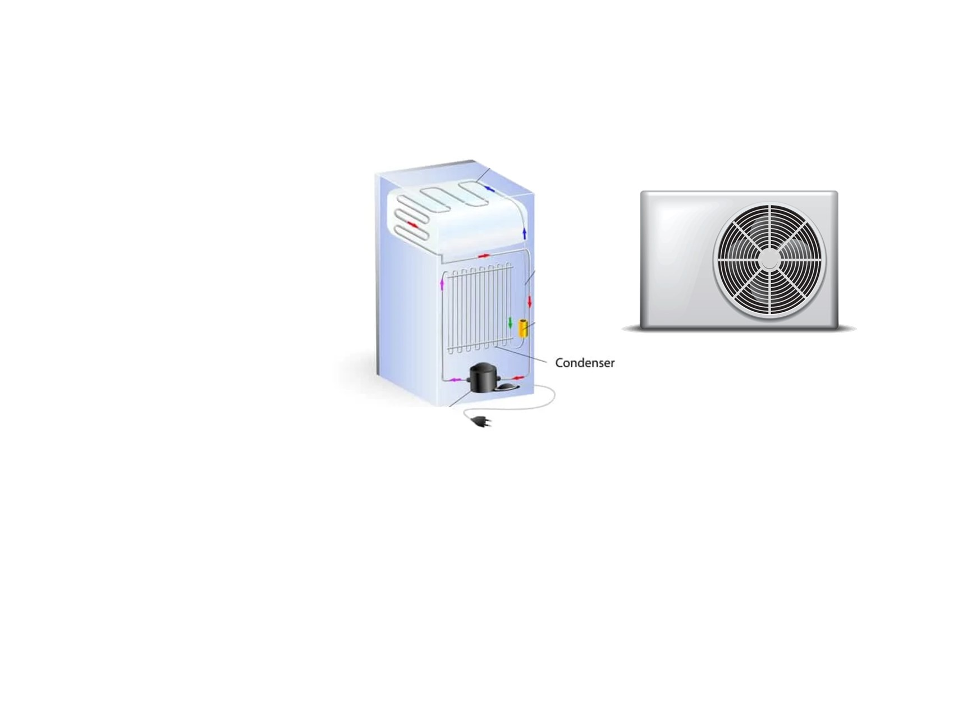
Heat exchangers (3): and in your refrigerator…
Gas (air in closed
volume to be cooled)
to
(liquid ➔ vapor)
(refrigerator
evaporator)
Gas (room air
to be cooled)
to
(liquid ➔ vapor)
(A/C
evaporator)
Hot (Vapor➔ liquid)
to
cooler gas
(room air)
(refrigerator
condenser)
Hot (Vapor ➔ liquid)
to
cooler gas
(outside air)
(A/C
condenser)

Slide 5
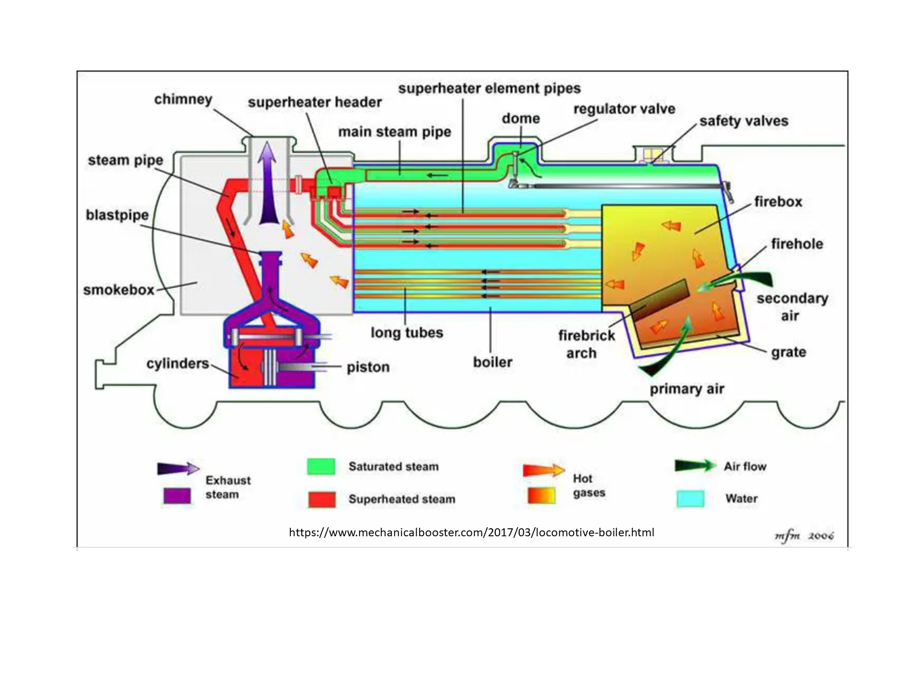
Heat exchangers (4): …
Another form of evaporative heat exchanger: the steam locomotive:
Boils water, then adds another thermodynamic step: superheating steam to reduce its saturation content and lessen the risk of compressive condensation in the cylinders

Slide 6
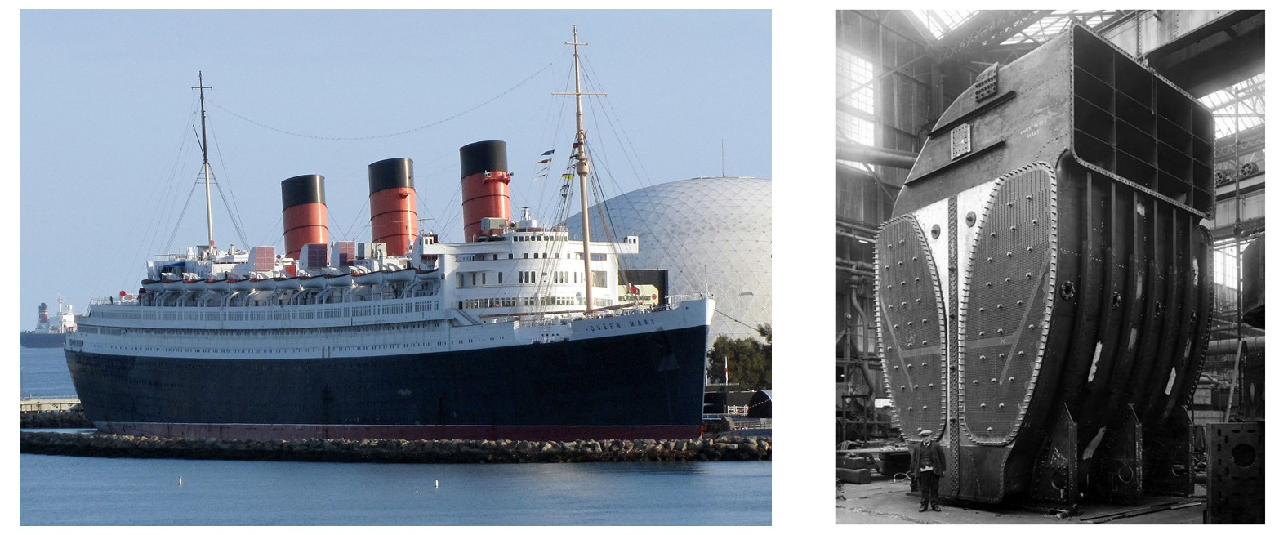
Heat exchangers (5): can be huge - like this condenser…
Hot (Steam➔ liquid)
to
cooler liquid (sea water)
(Oil-fired boilers➔
steam turbines ➔
condensers
(closed feedwater circuit))
Seawater coolant enters
& leaves condensers
through openings in hull.
RMS Queen Mary (Long Beach, CA)
Ship completed 1936, John Brown shipyard, Clydebank, Glasgow, Scotland
Displacement: 77,400 long tons (78,642 metric tons)
Length: 1,019.4 ft (310.7 m): Beam: 118 ft (36.0 m), Height: 181 ft (55.2 m)
Draught: 38 ft 9 in (11.8 m), Decks: 12
Installed power: 24 × Yarrow boilers Propulsion: 4 × Parsons geared steam turbines,
4 shafts, 200,000 shp (150,000 kW) Speed: 28.5 kts (52.8 km/h; 32.8 mph)

Slide 7
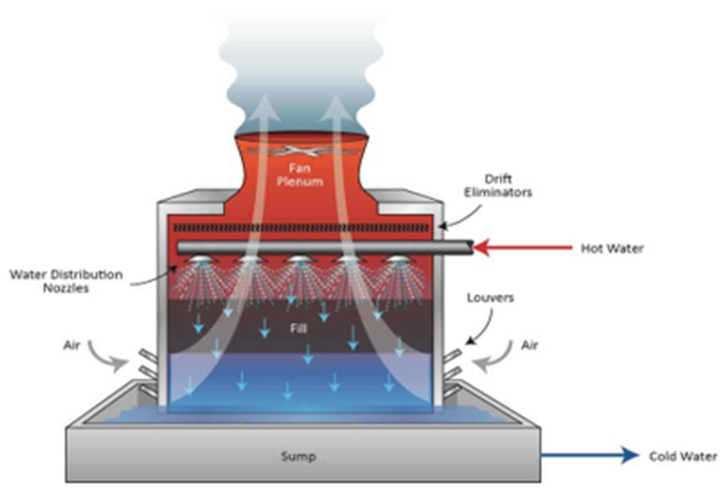
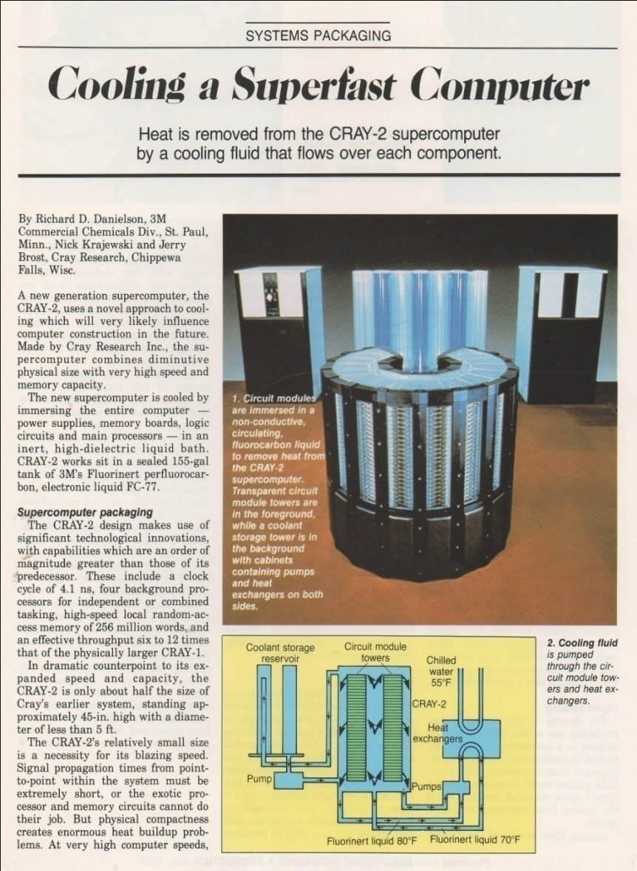

Heat exchangers (6): can be huge - like this cooling tower…
Water cooling tower, typically used at power stations
and big industrial plants & data centers.
Secondary hot water from a heat exchanger cooling
an industrial process is pumped to the top of the
tower and sprayed into a counter flow of air.
Water is thus cooled and collected in the bottom
pond. The circuit is open, some water escapes as
vapour and must be replenished,
while that collected in the bottom pond must be
filtered on its way back to the heat exchanger
Hot liquid to cooler gas (air):

Slide 8
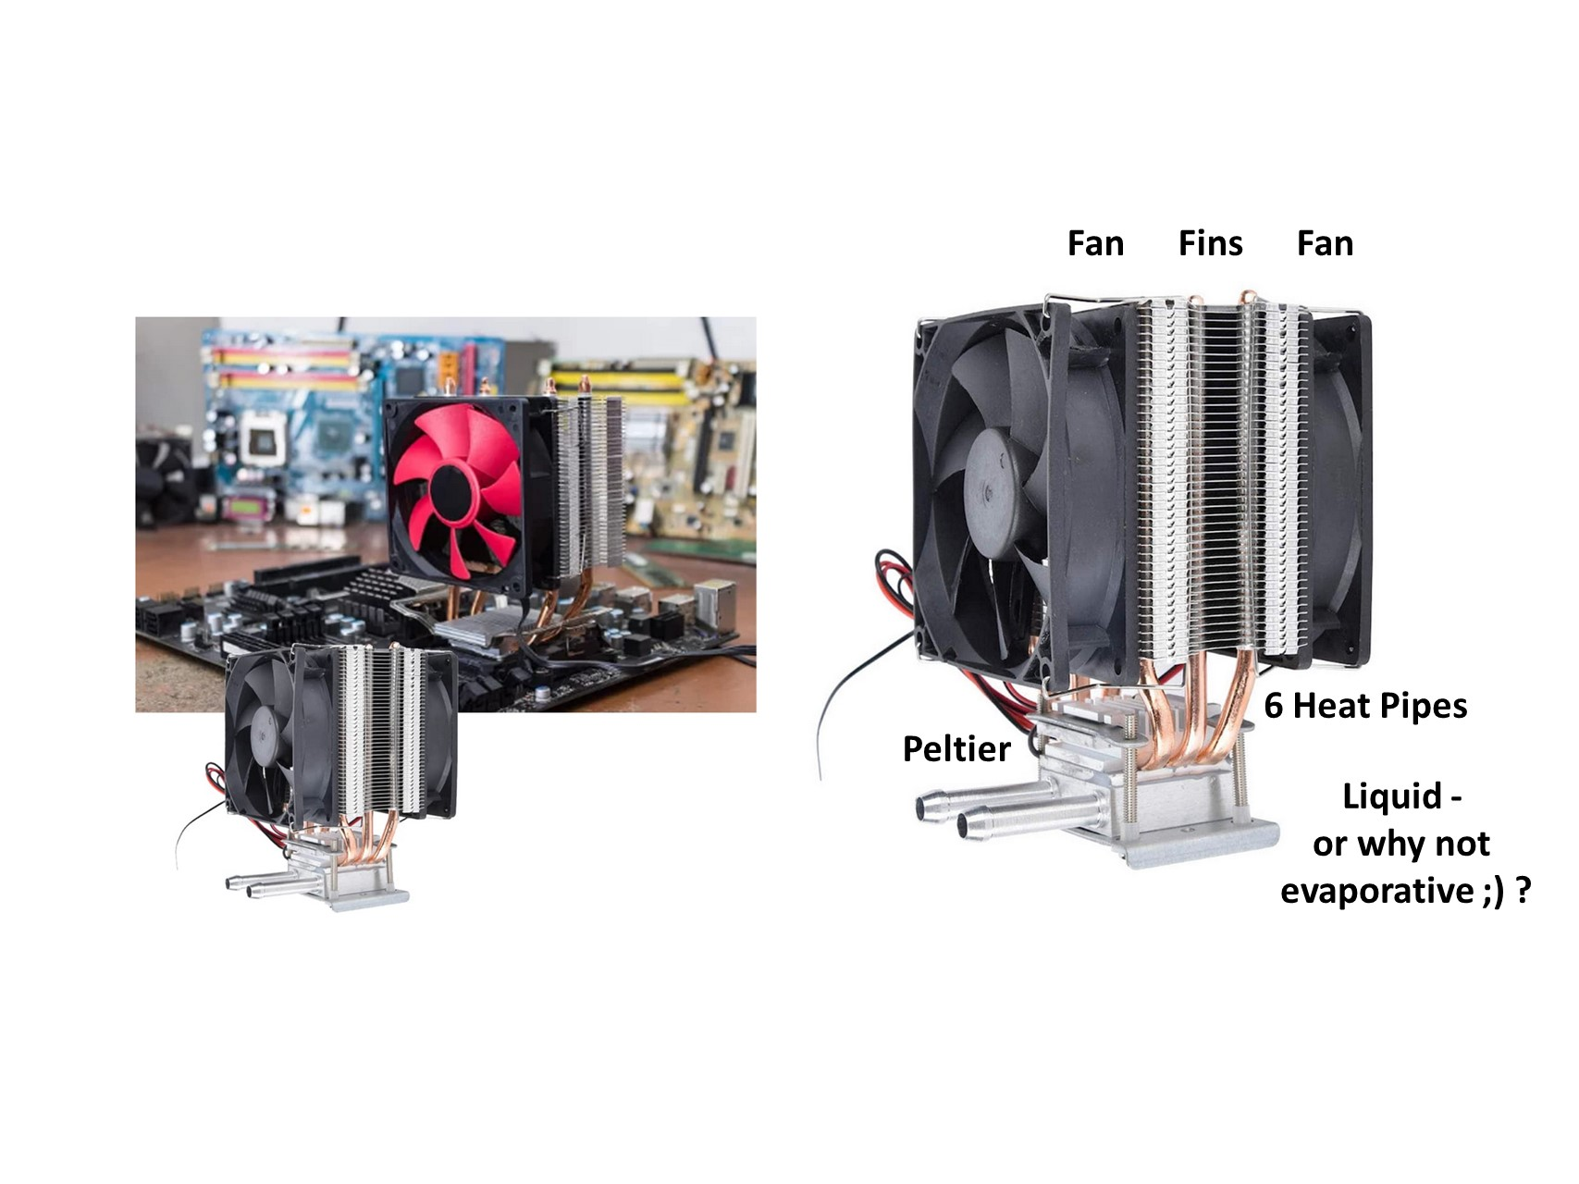
Heat exchangers (7): and small too (100 Wattish) – like this overclocking (?) installation…

Slide 9
5.3 Phase Change Cooling
We saw in the examples of some of the heat exchangers that a
phase change can occur in one of the fluids.
Changing the phase of a fluid requires the right combination of
temperature & pressure, and requires a lot of energy transfer
to achieve.
Indeed: phase change is a very good way to achieve cooling
with a much smaller flow of coolant than in a monophase system.
We will now go on to explore the energy uptake capabilities
of phase change cooling.

Slide 10
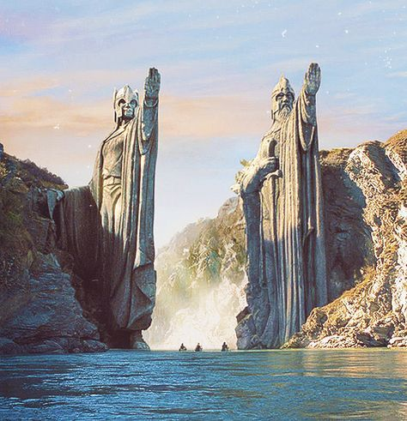
Attention: ye approach Isenthalp

Slide 11
5.3 Phase Change Cooling (2)
A kitchen crisis…
Materials can contain a huge amount of energy, and we are not talking about E = mc² (we wont).
Your kitchen kettle holds 1 litre of water and has a power rating of 2000 Watts.
(You can ignore the loss of heat through the kettle wall to the kitchen for now).
You fill it and turn it on noticing that the kitchen temperature is 20 ˚C.
In just under 3 minutes on the kitchen clock (167 seconds later) the water is boiling and bubbling nicely: 1 kg of water has been raised 80 ˚C for a total delivered electrical energy of 334.7 kilojoules
(It already sounds like a lot: did you need all this energy just to boil water for one cup of mint tea?).
The bell rings: somebody’s at the front door and you forget to switch off the kettle, which doesn’t have an automatic cut out at 100 ˚C. Some time later you smell a nasty smell coming from the kitchen, which is full of steam. The kettle is empty and finally its thermal interlock trips. You look at the kitchen clock and see that almost 19 more minutes have passed!
Q: How much extra energy was wasted boiling that water into steam at 100 ˚C while you were outside?
A: around 2.25 Mega Joules*! (or about 0.1% of the output of a typical 2GW electrical power station for 1 second). This is around eight times more than you used to raise the liter of water to its boiling temperature for that cup of tea.
*The amount is calculated from the 2250 kJ.kg⁻¹ latent heat (or “enthalpy”) of evaporation, of water
at atmospheric pressure (1 bar) where the evaporation temperature is 100 ˚C.

Slide 12
5.3 Phase Change Cooling (3)
So what is enthalpy: - in thermodynamic terms?
Well, the key here is in the “dynamics” of the word “thermodynamics”.
Thermodynamics is the study of changes in key parameters of material systems:
pressure, temperature and energy being carried, in response to perturbations applied to
the system caused by the delivery of external heat energy, the extraction of energy from
the system and by the application of mechanical work to the system, or indeed making
the system perform mechanical work.
Enthalpy (H) is usually expressed in terms of the internal energy (E) of a system and its
temperature T, volume V, and pressure P. for example:
H = E + P.V
The internal energy of a system is hard to measure directly. The energy carrying capability
of fluids depends on factors including their chemical composition. Surprisingly, water
(mol. wt. 18) has a much higher heat capacity (4181 J.kg⁻¹.K⁻¹ @25˚C ) than cooling fluids
with higher molecular weights. Its enthalpy of evaporation is also much higher.
The absolute enthalpy, H, of a system can perhaps be thought of as containing a baseline
energy on top of which energetic changes (thermodynamic changes) of interest occur.
In terms of a particular material it can be expressed in kJ.kg⁻¹.

Slide 13
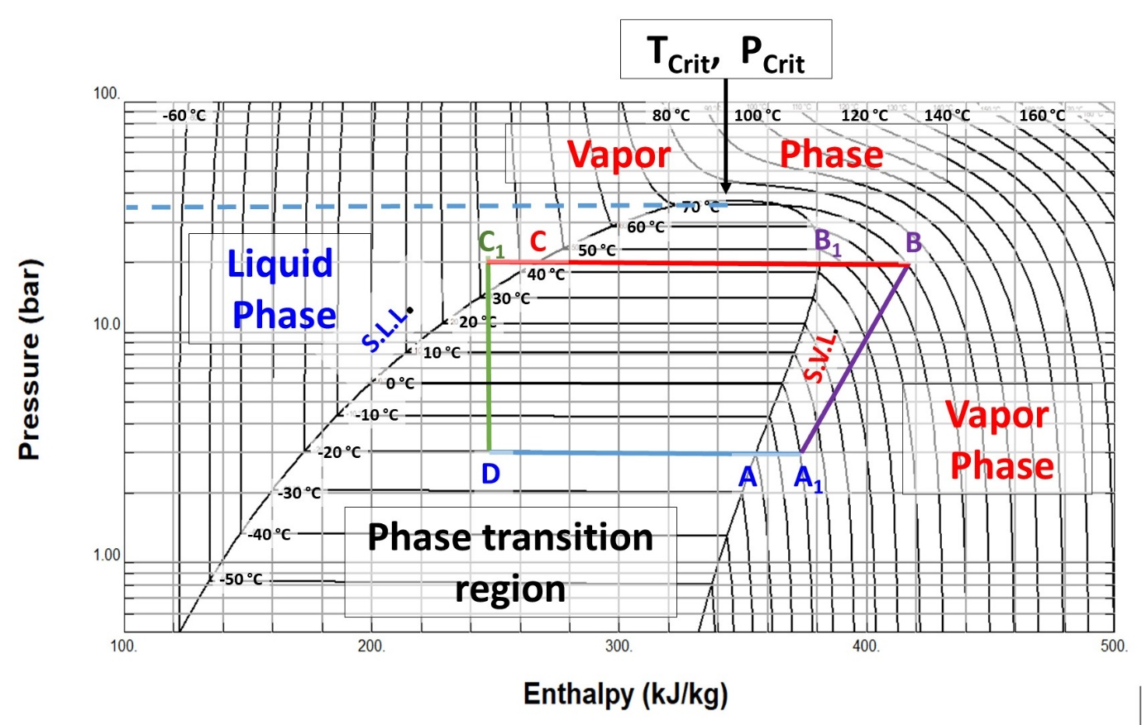
5.3 Phase Change Cooling (4)
Isenthalp
R404A
Pressure-enthalpy diagram: example: for a domestic refrigerator closed-loop cycle (R404A):
(D➔A): heat extraction (enthalpy increase) - evaporation at -20 ˚C;
(A₁➔B) vapour compression (temperature & pressure increase through mechanical work)),
(B➔C) condensation (enthalpy decrease) at 43 ˚C (hot condenser radiator of refrigerator);
(C₁➔D) liquid “detent” (Joule-Thompson cooling through forced pressure drop at constant
enthalpy) through a throttling element like an orifice, valve or thin tube (capillary).
P-h diagram calculated with REFPROP Standard reference database 23, version 9.0 (2010):
E. Lemmon, M. Huber, & M. McLinden U.S. National Institute of Standards & Technology

Slide 14

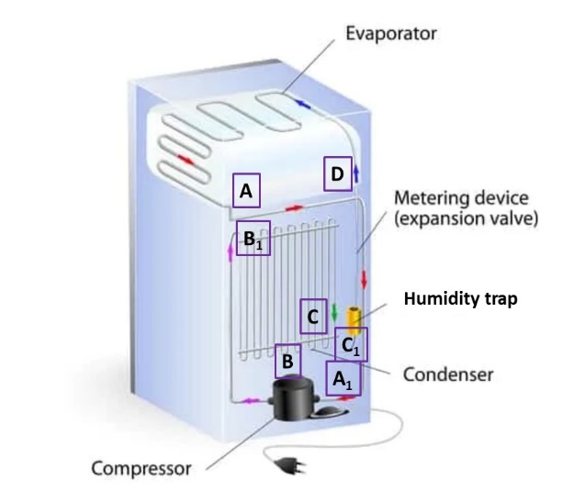
5.3 Phase Change Cooling (5)
R404A
Path (D➔A): shows the that difference in enthalpy necessary to evaporate 1 kg of R404A
between points D (245 kJ.kg⁻¹) & A (360 kJ.kg⁻¹) is 115 kJ.kg⁻¹ on the enthalpy axis.
This enthalpy difference of tells us the refrigerative (here evaporative) power ERP_{P,T} (W)
that a mass flow of 1 kg.s⁻¹ of this fluid can remove at these conditions of
(constant) temperature and pressure, as follows:
ERP = δH_{P,T *} ṁ
where ṁ is the mass flow in kg.s⁻¹
.The mass flow ṁ of refrigerant necessary for required refrigerative power ERP is thus:
ṁ = ERP/δH_{P,T}
For example, a small domestic refrigerator must evaporate 2.6 grams per second of R404A
for a refrigerative power of 300 Watts in the conditions of transition D➔A above.

Slide 15

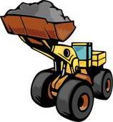




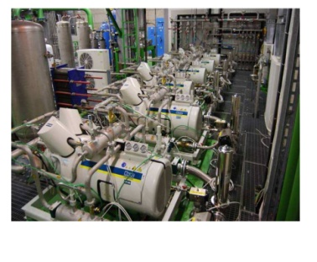
5.3 Phase Change Cooling (6): LHC ATLAS detector with C₃F₈ coolant
Another way of looking at energy exchange: Digger = fluid; heat in vapour form = sand...
C₃F₈
Condensation at 17 bar
Liquid supply & detent
Vapour compression
On-detector
evaporation
Compression

Slide 16
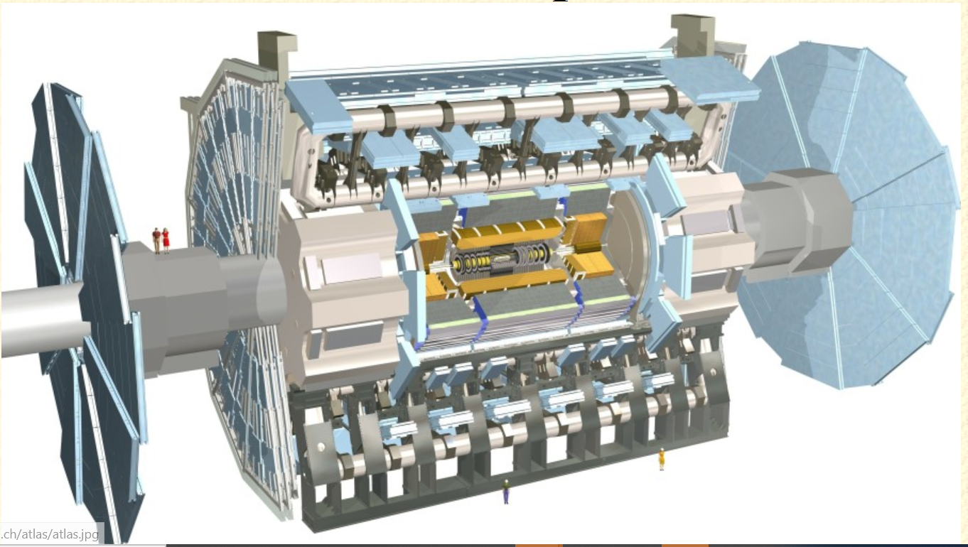
Let’s digress! Here is ATLAS at LHC

Slide 17
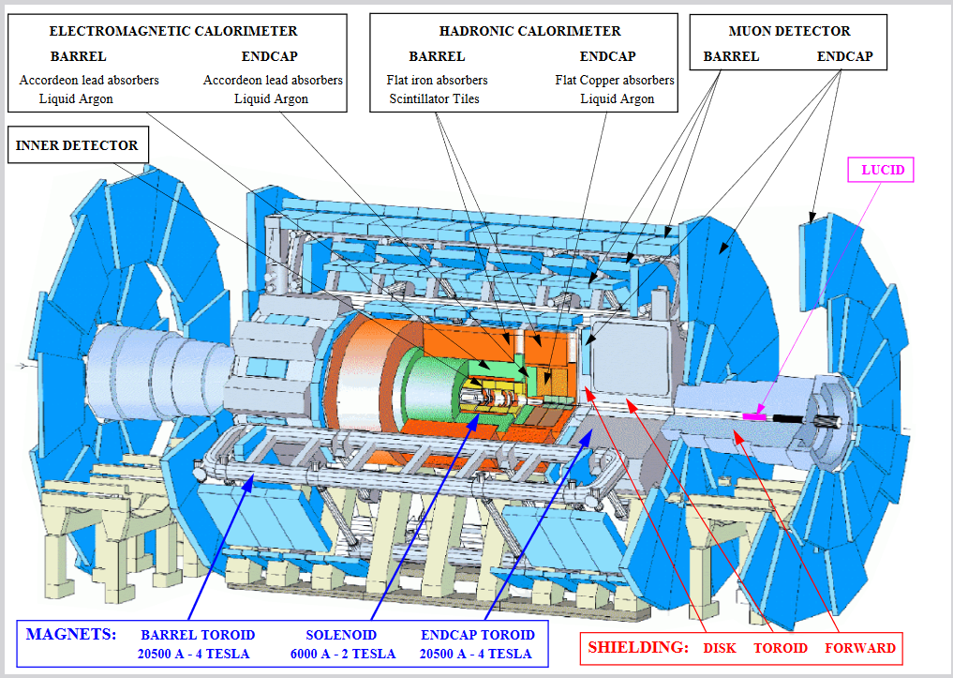
Unpeeling the ATLAS Onion

Slide 18
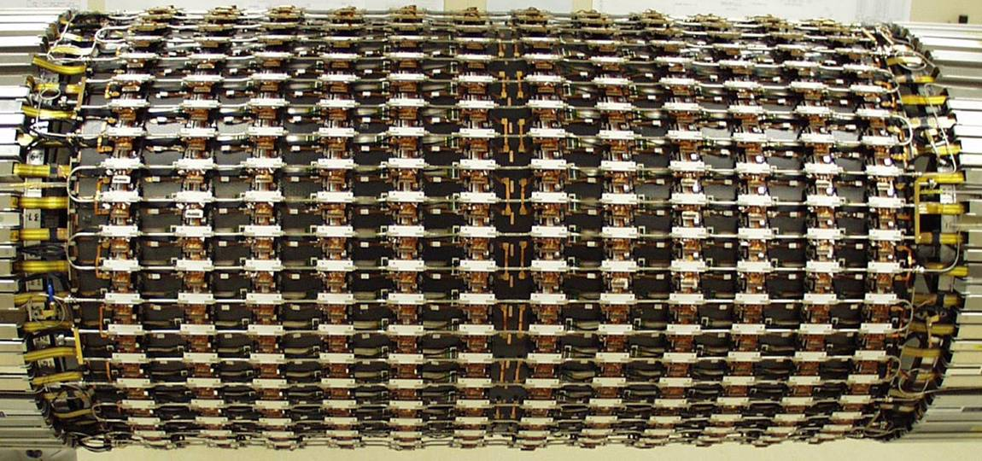
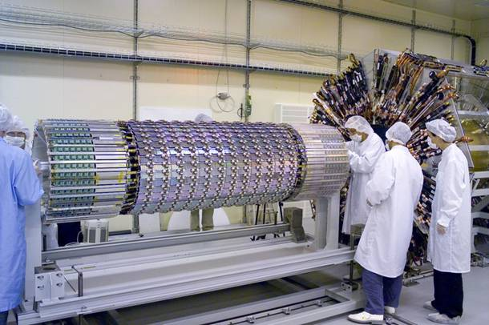
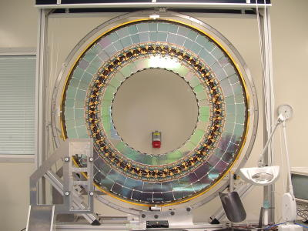
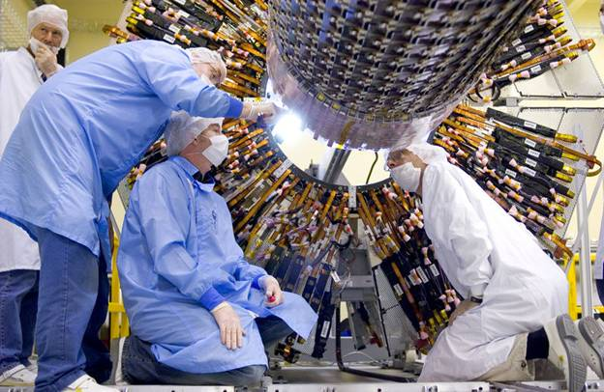
Unpeeling the ATLAS Onion: the evaporators ‘Semi-Conductor Tracker’ (SCT) silicon microstrip tracker surrounding pixel detector
SCT + pixels: 204 C₃F₈ evaporative cooling circuits
60kW total power to evacuate (1.2 kgs⁻¹ C₃F₈)

Slide 19
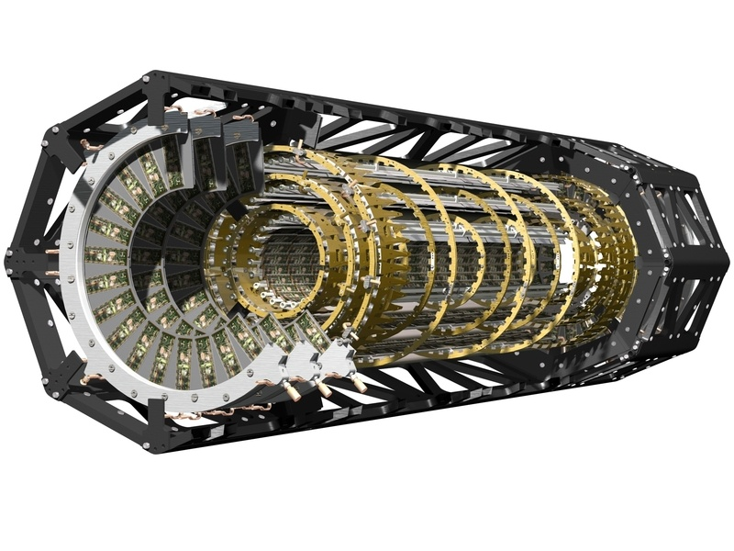
Unpeeling the ATLAS Onion: the evaporators ATLAS – Silicon Pixel Detector Structure
~50 Horizontal stave cooling channels (l ~ 1,60m)
18 “radial” channels: disk sectors

Slide 20
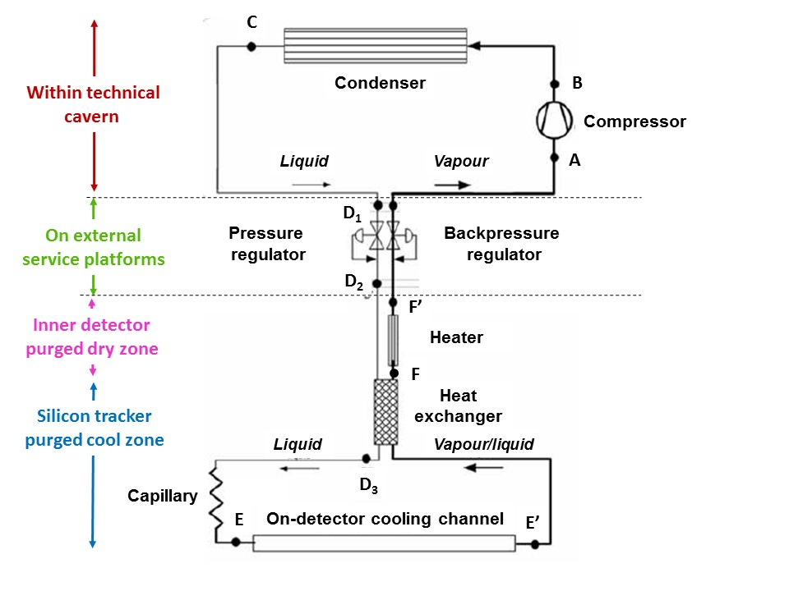
5.3 Phase Change Cooling (7): LHC ATLAS Pixel & SCT detector cooling
with evaporating C₃F₈ : you’ve just seen the evaporators;
now the other parts of the system (including the problematic compressors)
Compression

Slide 21


5.3 Phase Change Cooling (8):
Let’s get rid of the compresssors and do it in reverse with no moving parts!
Animation: Digger = fluid; heat in vapour form = sand...
On –detector Evaporation @-25ºC
Condensation @-60ºC

Slide 22
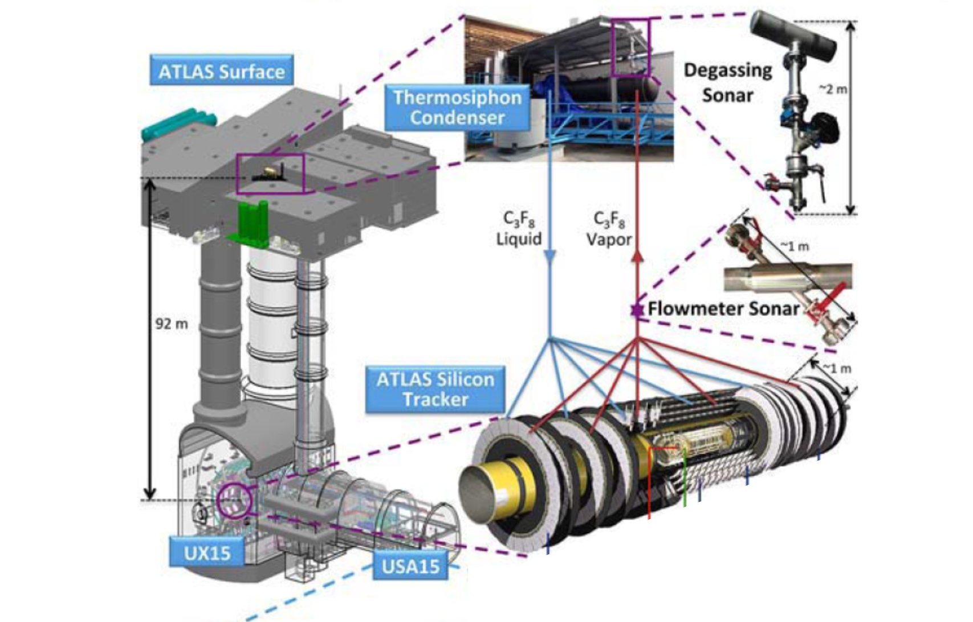
5.3 Phase Change Cooling (9):
The ATLAS Si tracker C₃F₈ 92 m (300’) thermosiphon cooling system: no moving parts (except valves) in C₃F₈ circuit.

Slide 23
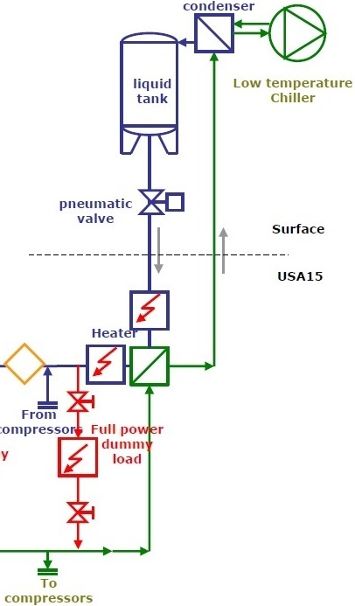
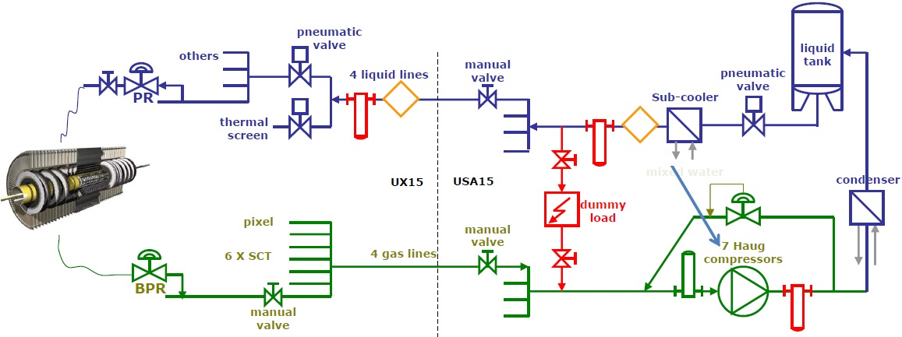
92m pit depth at ATLAS ➔ > 13 bar (ρgh) hydrostatic pressure liquid C₃F₈ or C₃F₈/C₂F₆
Gravity-driven thermosiphon evaporative cooling system
Compressors kept as backup solution
INTERNAL PART
EXTERNAL PART
ρgh from 92m of C₃F₈ vapour is only ~70mbar …
not difficult to return vapour to a cold condenser on the surface, but condenser must be highest geographic - but lowest temperature & pressure - component

Slide 24
Thermosiphon: Reversal on Pressure-Enthaply Diagram
Gravity thermosiphon driven
Compressor driven

Slide 25
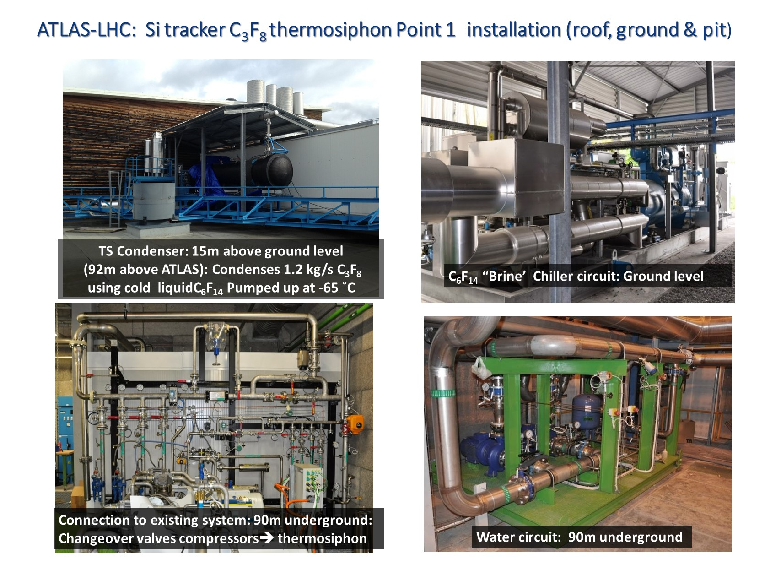
5.3 Phase Change Cooling (10):

Slide 26
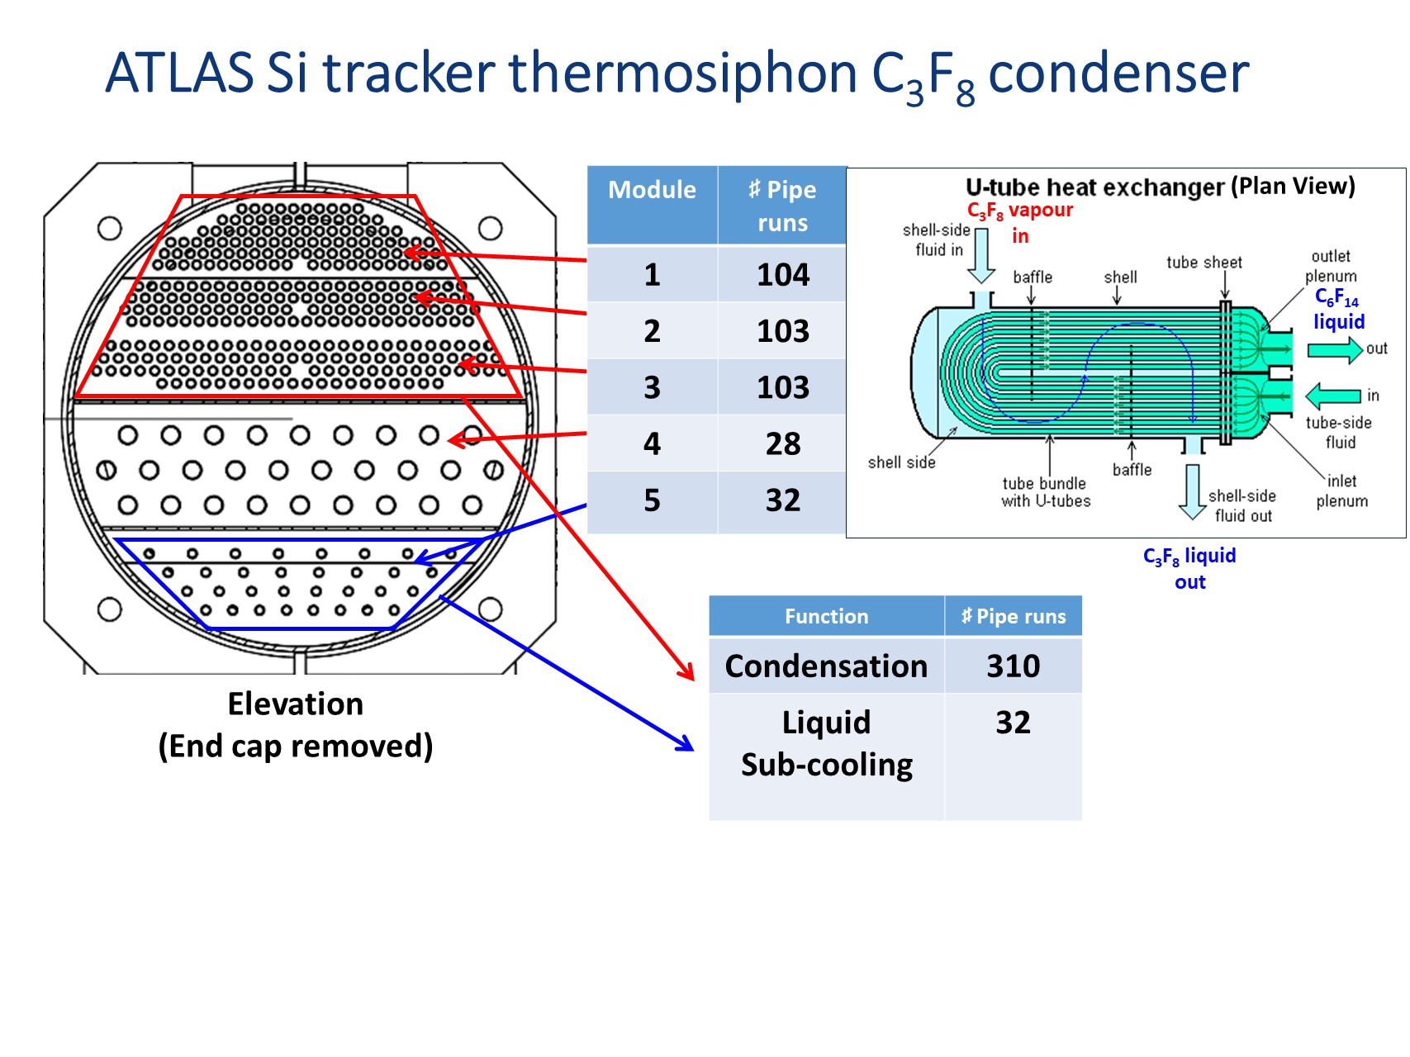
5.3 Phase Change Cooling (11):
* Liquid C₆F₁₄ is used to condense C₃F₈ vapor at around -60 °C

Slide 27
5.3 Phase Change Cooling:
Problem (3) on the ATLAS thermosiphon see also separate sheet:
From the previous slide it is clear that a large number of tubes are needed to condense
Approximately 1.2 kgs⁻¹ of C₃F₈ to cool the ATLAS silicon tracker. This implies that a
high mass flow of C₆F₁₄ liquid is needed, but what this mass flow (kg.s⁻¹)?
Hints to solve this problem:
Looking at figure 3.10 we see that considerable thermal energy has to be extracted from
the C₃F₈ vapor to reduce its temperature from around 20 ˚C (the temperature acquired
in traveling through more than 92 meters of pipes to the condenser) to -60 ˚C,
where phase change can occur under the “dome”;
Some of this heat is extracted from the vapour at a C₃F₈ pressure of 320 mbar within
the condenser itself (using a counter-flow of cold C₆F₁₄), cooling the vapor from -25 ˚C
(point C) to -60 ˚C before the vapour begins to condense at the saturated vapour
boundary of the dome.
Moving left from the saturated vapour boundary of the dome all energy goes into
condensing the C₃F₈. You should therefore use the entire CD enthalpy difference in your
calculation, and only this;
The specific heat capacity of C₆F₁₄ in the range -60 ➔ -65 ˚C is around 925 J.kg⁻¹.
C₆F₁₄ remains a liquid and does not change phase during this process, but heats up by 5 ˚C.

Slide 28
5.3 Phase Change Cooling (12.2):
Problem on the ATLAS thermosiphon see also separate sheet
(Diggers removed to make the cycle on the C₃F₈ ph diagram easier to read)
C₃F₈
On –detector Evaporation @-25ºC
Condensation @-60ºC

Slide 29
