Slide 1

Your comments
Exam Info:
Units 1-6
Date: June 30th
Conflict Date: June 29th
More details to come from CBTF
Many different formulas for finding first maxima of interference. How do you choose? The problem setup can help you
At this point I really don't even know what I don't know and I'm worried about the first exam, could you explain what exactly we need to know for this exam and the best way to study for it? It’s Units 1-6. Homework, discussions 1-4, worked problems, lectures, prelectures, example exam.
My understanding of these concepts is in a state of superposition. Exactly!

Slide 2
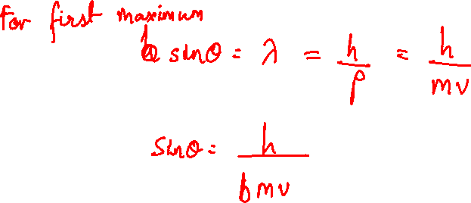
Momentum and wavelength
An electron with velocity $v$ is incident on a 2-slit experiment. What equation will give the angle of the first maximum in terms of the distance between the two slits $b$?
$\sin{θ=\frac{h}{bmv}}$
$\sin{θ=\frac{bm}{hv}}$
$\sin{θ=\frac{hv}{bm}}$

Slide 3
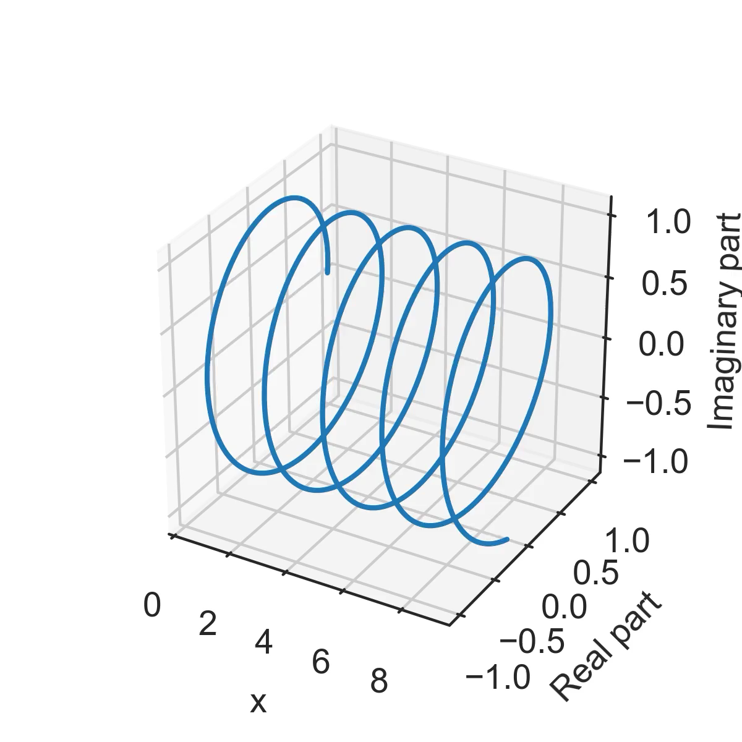
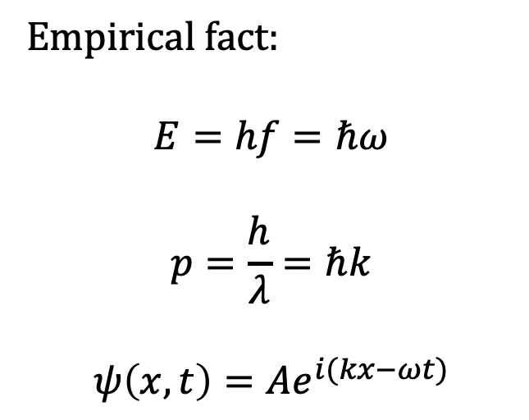
Wave function of a particle with momentum p
Empirical fact:
$$E=hf=ℏω$$
$$p=\frac{h}{λ}=ℏk$$
$$ψ\left(x,t\right)=Ae^{i(kx−ωt)}$$

Slide 4
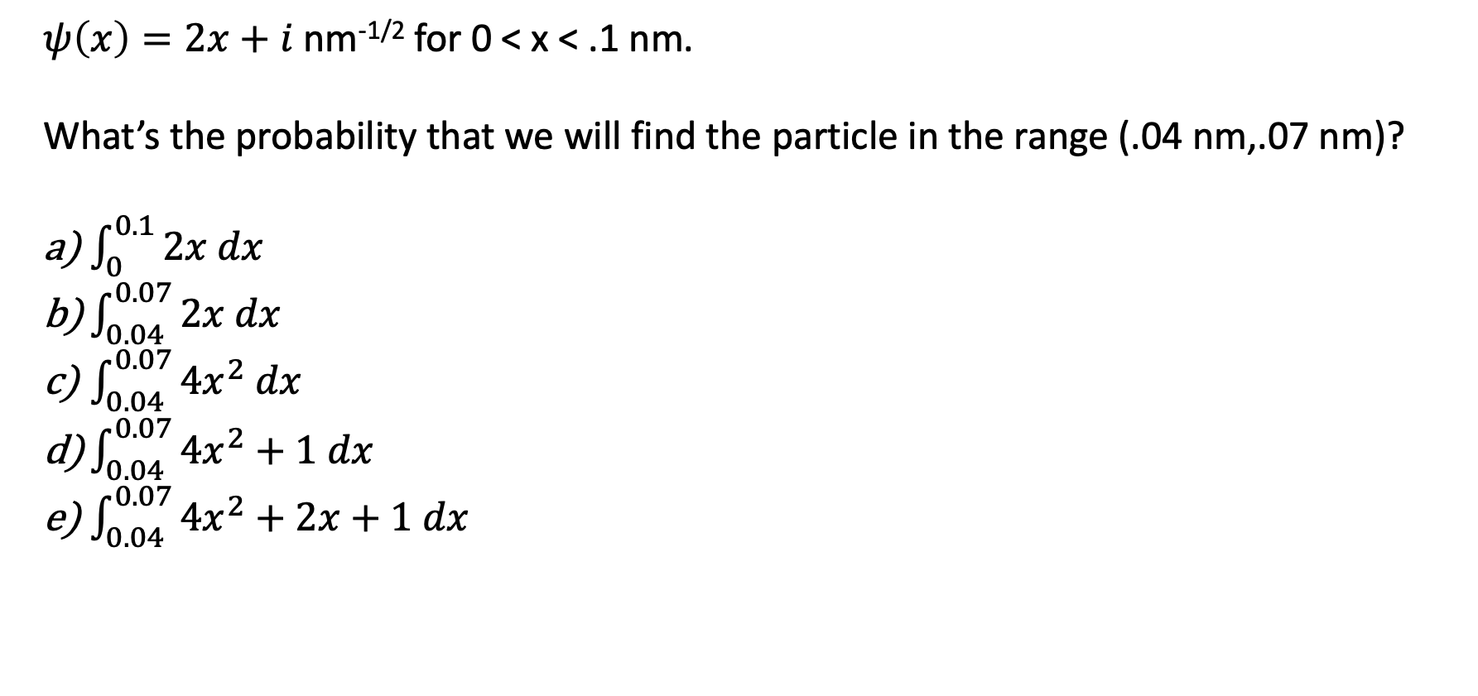
Probability density
$ψ\left(x\right)=2x+i$ nm^{-1/2} for 0 < x < .1 nm.
What’s the probability that we will find the particle in the range (.04 nm,.07 nm)?
$\int_{0}^{0.1}{2x dx}$
$\int_{0.04}^{0.07}{2x dx}$
$\int_{0.04}^{0.07}{4x^{2} dx}$
$\int_{0.04}^{0.07}{4x^{2}+1 dx}$
$\int_{0.04}^{0.07}{4x^{2}+2x+1 dx}$

Slide 5
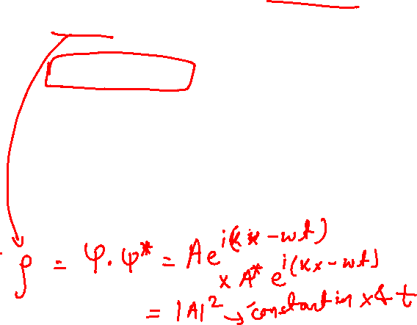
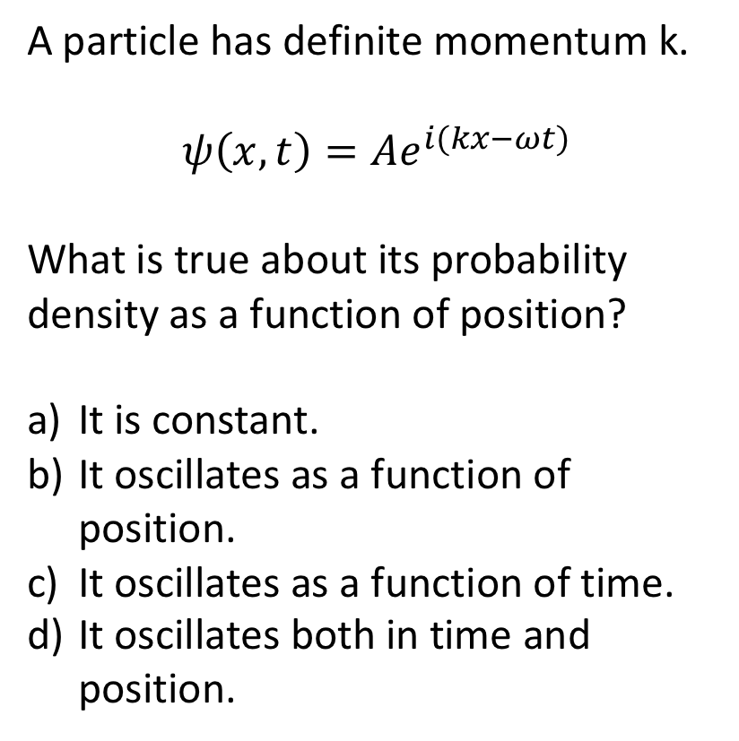
Position probability density
A particle has definite momentum k.
$$ψ\left(x,t\right)=Ae^{i(kx−ωt)}$$
What is true about its probability density as a function of position?
It is constant.
It oscillates as a function of position.
It oscillates as a function of time.
It oscillates both in time and position.

Slide 6

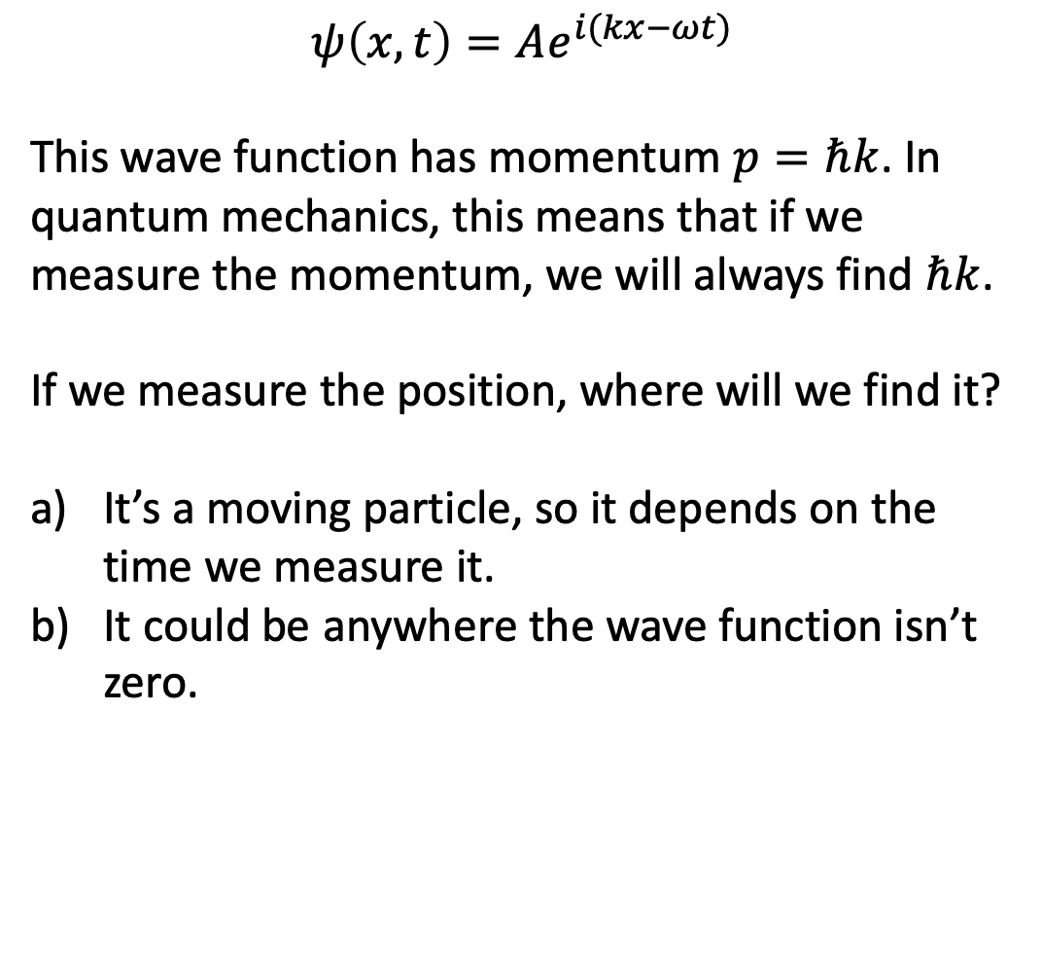
Wave function of an electron with momentum p
$$ψ\left(x,t\right)=Ae^{i(kx−ωt)}$$
This wave function has momentum $p=ℏk$. In quantum mechanics, this means that if we measure the momentum, we will always find $ℏk$.
If we measure the position, where will we find it?
It’s a moving particle, so it depends on the time we measure it.
It could be anywhere the wave function isn’t zero.

Slide 7
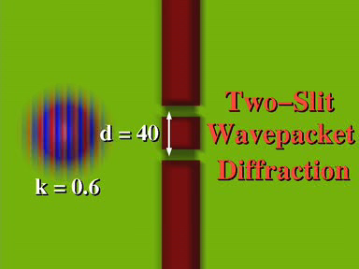
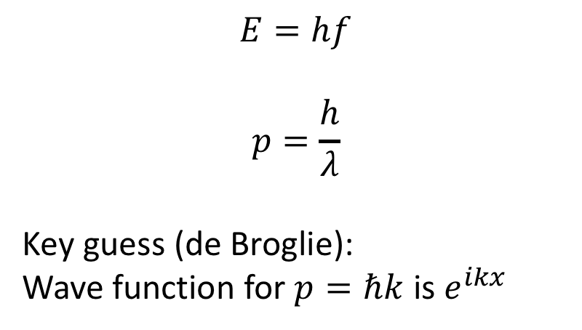
Lecture 7: Momentum and Position
$$E=hf$$
$$p=\frac{h}{λ}$$
Key guess (de Broglie):
Wave function for $p=ℏk$ is $e^{ikx}$

Slide 8
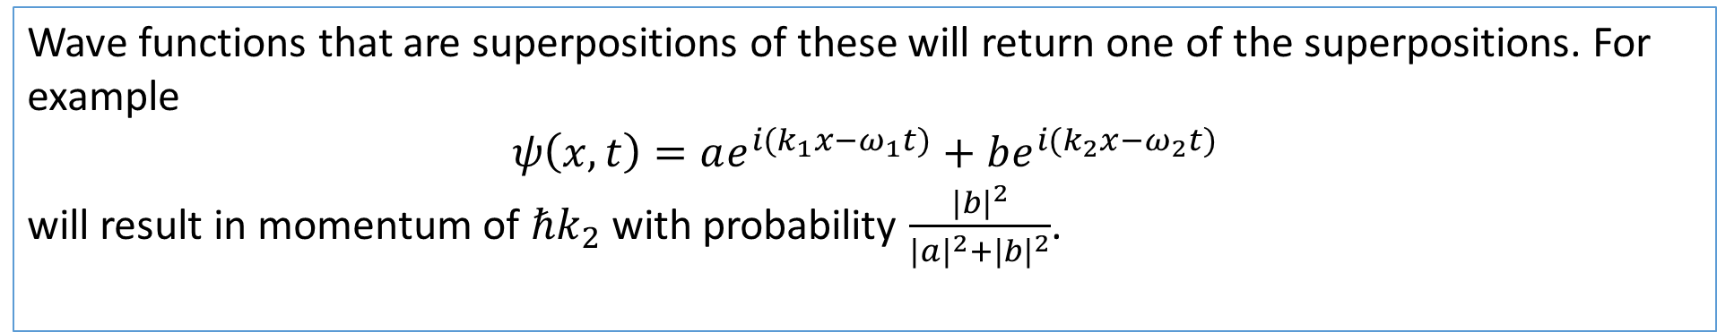

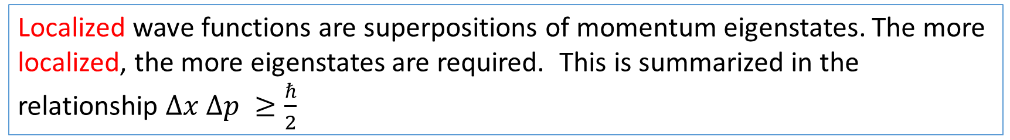
What we will learn today
Particles with momentum $p=ℏk$are also described by a wave function.
$$ψ\left(x,t\right)=Ae^{i(kx−ωt)}$$
If we measure the momentum, we will always find $ℏk$.
Wave functions that are superpositions of these will return one of the superpositions. For example
$$ψ\left(x,t\right)=ae^{i(k_{1}x−ω_{1}t)}+be^{i(k_{2}x−ω_{2}t)}$$
will result in momentum of $ℏk_{2}$ with probability $\frac{|{b|}^{2}}{{|a|}^{2}+{|b|}^{2}}$.
Localized wave functions are superpositions of momentum eigenstates. The more localized, the more eigenstates are required. This is summarized in the relationship $Δx Δp ≥\frac{ℏ}{2}$

Slide 9
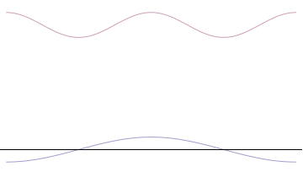
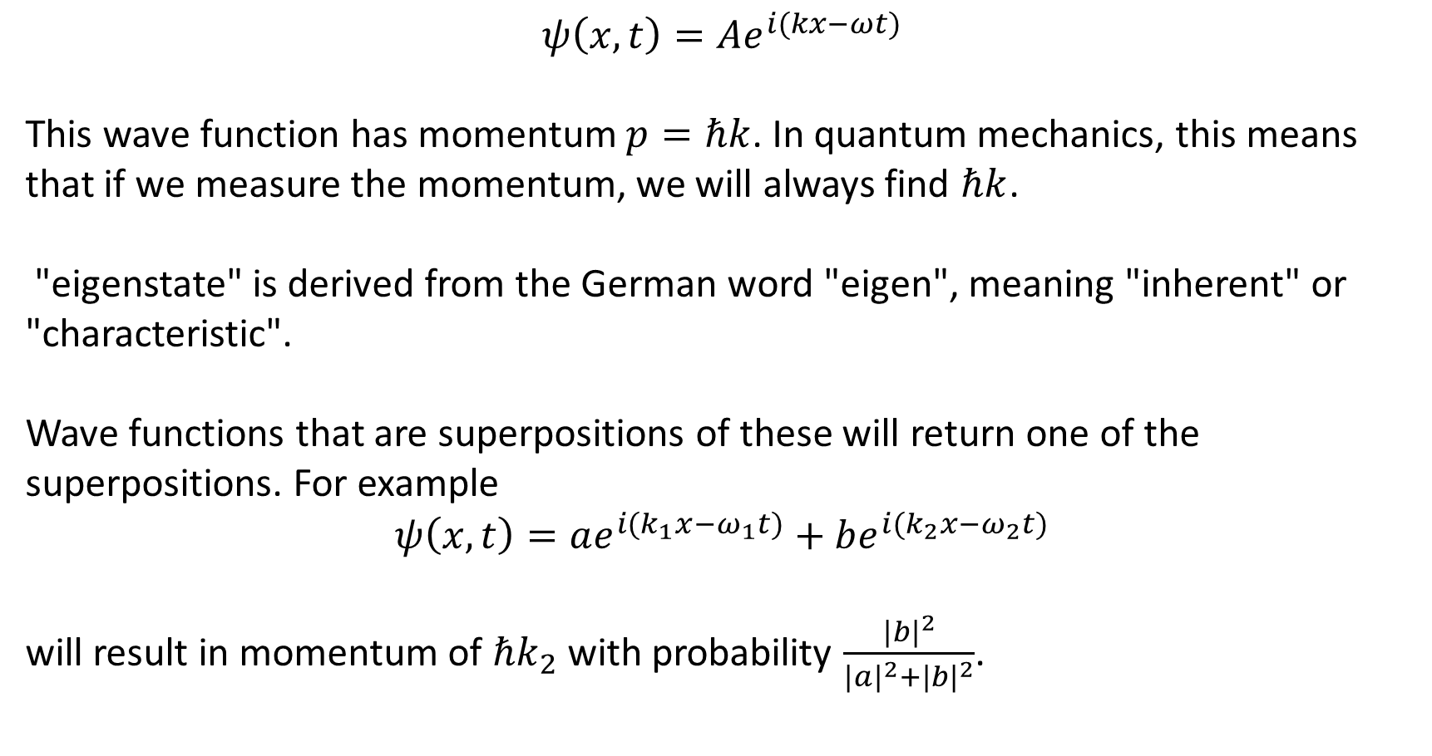
Eigenstates of momentum
$$ψ\left(x,t\right)=Ae^{i(kx−ωt)}$$
This wave function has momentum $p=ℏk$. In quantum mechanics, this means that if we measure the momentum, we will always find $ℏk$.
"eigenstate" is derived from the German word "eigen", meaning "inherent" or "characteristic".
Wave functions that are superpositions of these will return one of the superpositions. For example
$$ψ\left(x,t\right)=ae^{i(k_{1}x−ω_{1}t)}+be^{i(k_{2}x−ω_{2}t)}$$
will result in momentum of $ℏk_{2}$ with probability $\frac{{|b|}^{2}}{{|a|}^{2}+|{b|}^{2}}$.

Slide 10
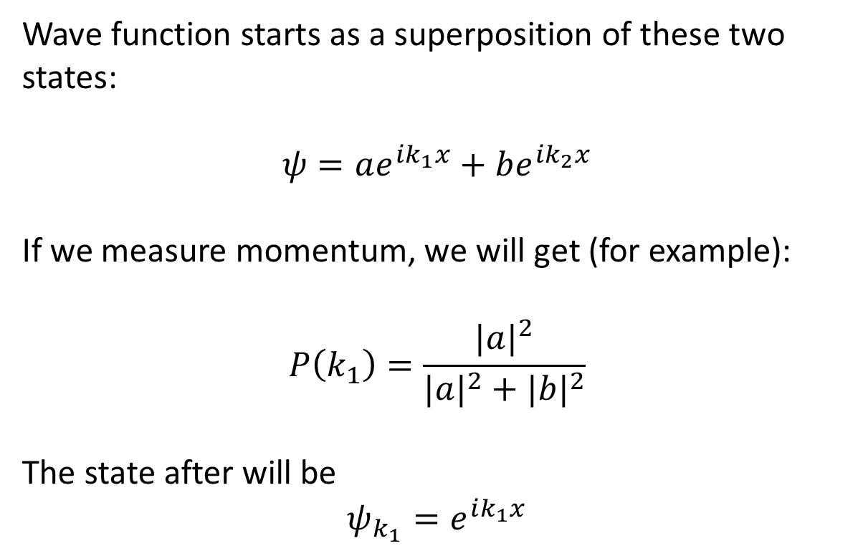
Measurement rule
Wave function starts as a superposition of these two states:
$$ψ=ae^{ik_{1}x}+be^{ik_{2}x}$$
If we measure momentum, we will get (for example):
$$P\left(k_{1}\right)=\frac{{|a|}^{2}}{{|a|}^{2}+{|b|}^{2}}$$
The state after will be
$$ψ_{k_{1}}=e^{ik_{1}x}$$

Slide 11
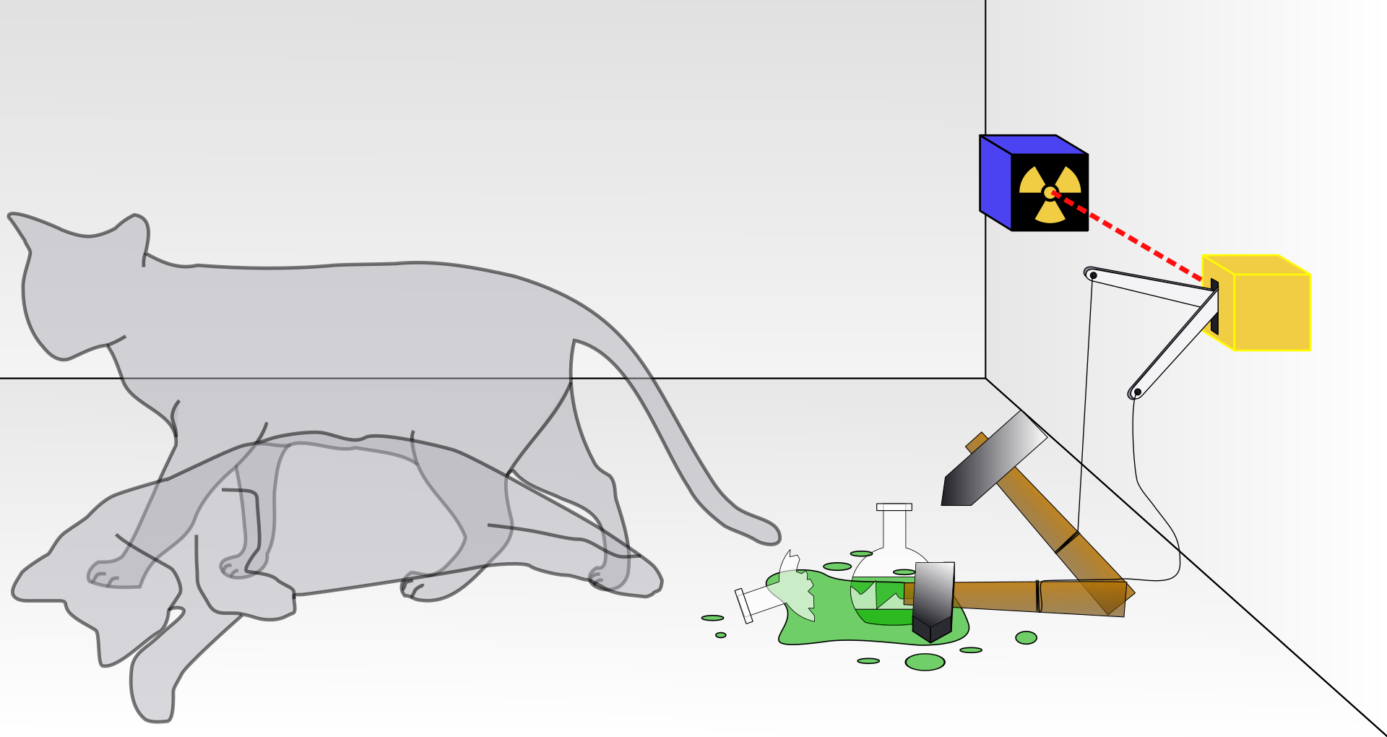
Schrodinger’s Cat
Wave function starts as a superposition of these two states:
$$ψ=ae^{ik_{1}x}+be^{ik_{2}x}$$
If we measure momentum, we will get (for example):
$$P\left(k_{1}\right)=\frac{{|a|}^{2}}{{|a|}^{2}+{|b|}^{2}}$$
The state after will be
$$ψ_{k_{1}}=e^{ik_{1}x}$$

Slide 12
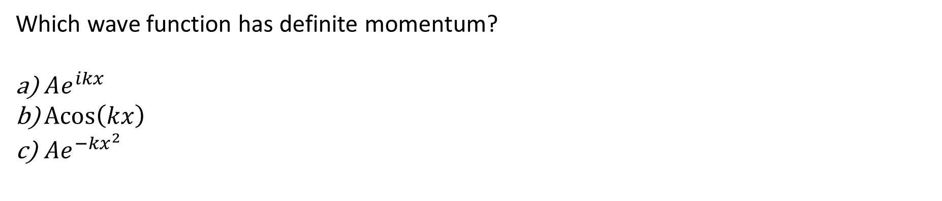

Eigenstates
Which wave function has definite momentum?
$Ae^{ikx}$
$\operatorname{Acos}\left(kx\right)$
${Ae}^{−kx^{2}}$

Slide 13
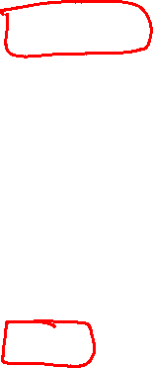
Eigenstates
Which wave function has definite momentum?
$Ae^{ikx}$
$\operatorname{Acos}\left(kx\right)$
${Ae}^{−kx^{2}}$
What is the value of the momentum?
$k$
$hk$
$ℏk$

Slide 14
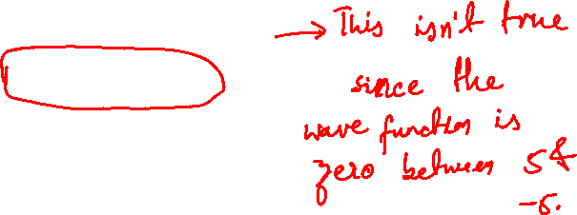
Superposition
A particle has a wave function as depicted. Assume that the spikes are infinitely narrow.
If we measure its position, what will we observe?
5
-5
Between 5 and -5
Either 5 or -5

Slide 15
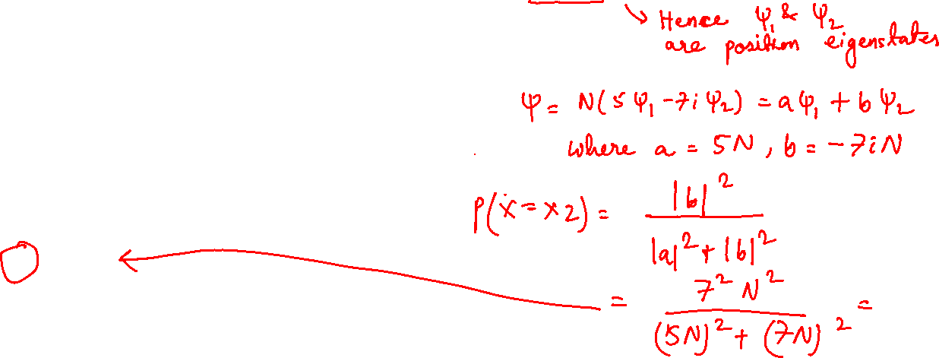
Superposition of eigenstates
Suppose that $ψ_{1}$ has definite position $x_{1}$ and $ψ_{2}$ has definite position $x_{2}$. Both are normalized.
If the wave function is $N\left(5ψ_{1}−7iψ_{2}\right)$, then what is the right probability of measuring $x_{2}$?
1/2
$7^{2}$
$−7^{2}$
$\frac{7^{2}}{5^{2}+7^{2}}$
$\frac{{−7}^{2}}{5^{2}+7^{2}}$

Slide 16
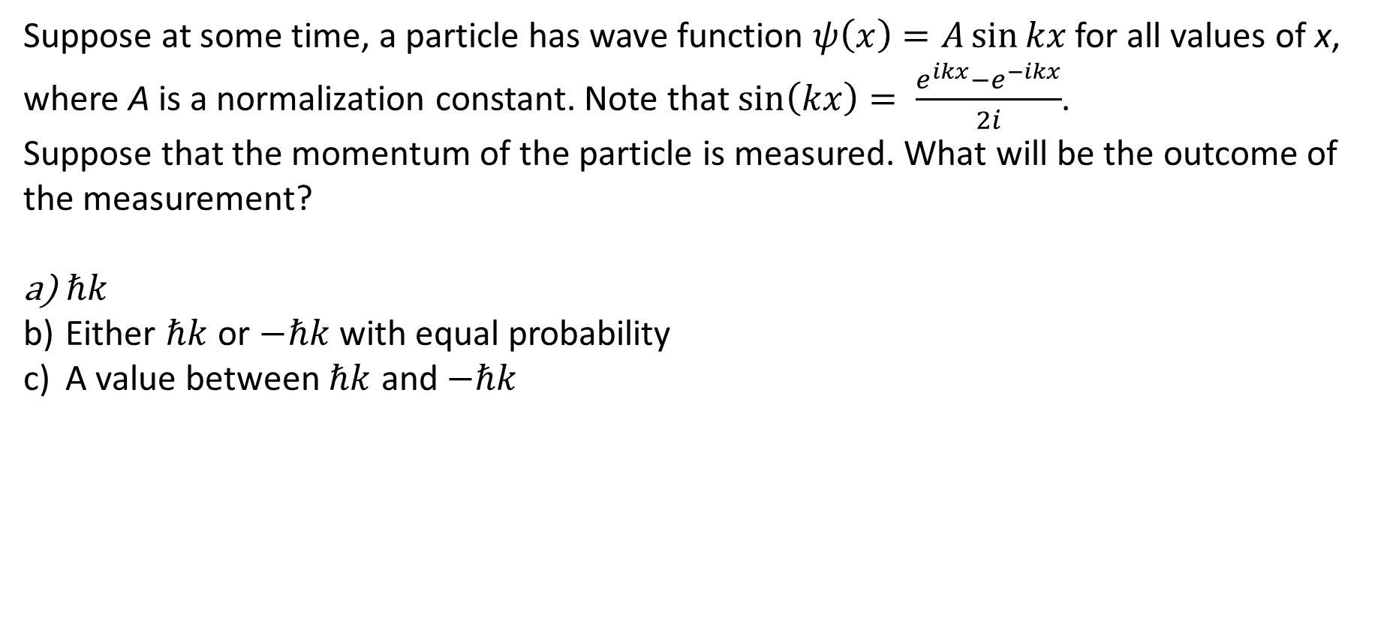
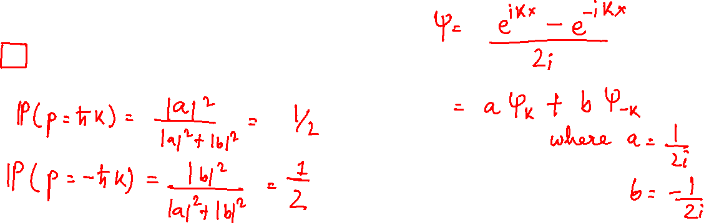
Superposition
Suppose at some time, a particle has wave function $ψ\left(x\right)=A\sin{kx}$for all values of x, where A is a normalization constant. Note that $\sin\left(kx\right)= \frac{e^{ikx}−e^{−ikx}}{2i}$.
Suppose that the momentum of the particle is measured. What will be the outcome of the measurement?
$ℏk$
Either $ℏk$ or $−ℏk$ with equal probability
A value between $ℏk$ and $−ℏk$

Slide 17
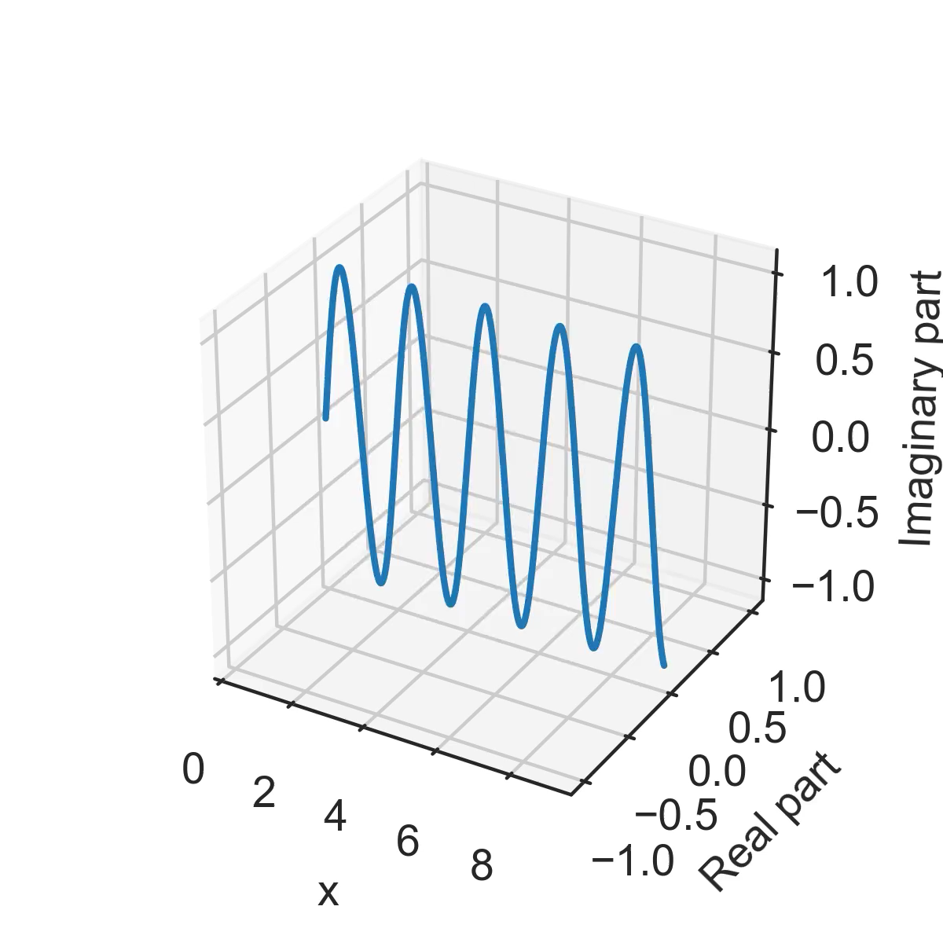
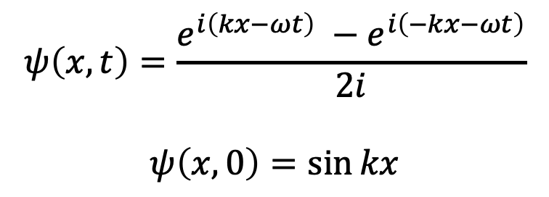
Why?
$$ψ\left(x,t\right)=\frac{e^{i\left(kx−ωt\right)} −e^{i\left(−kx−ωt\right)}}{2i}$$
$$ψ\left(x,0\right)=\sin{kx}$$

Slide 18
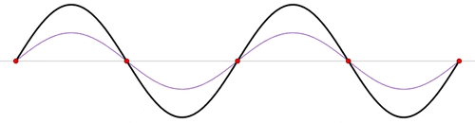
Why?
$$ψ\left(x,t\right)=\frac{e^{i\left(kx−ωt\right)} −e^{i\left(−kx−ωt\right)}}{2i}$$
$$ψ\left(x,0\right)=\sin{kx}$$

Slide 19
Some interesting comments and responses
Momentum will oscillate as the wave function is sinusoidal.
Because the the wave is being normalized, it will appear to be some value between hk and –hk
Due to heisenberg uncertainty principle, since we know the position of the particle, we cannot be completely sure the exact momentum of it, we only know it can be between hk and its opposite.
There is no oscillation (in this wave function); at any time it’s the same superposition. You can only get a value of k that’s in the superposition
It’s not the value of the wave function, it’s what momentum eigenstates make up the superposition.
The position is quite indeterminant for this wave function! The wave function is nonzero for many values of x.

Slide 20
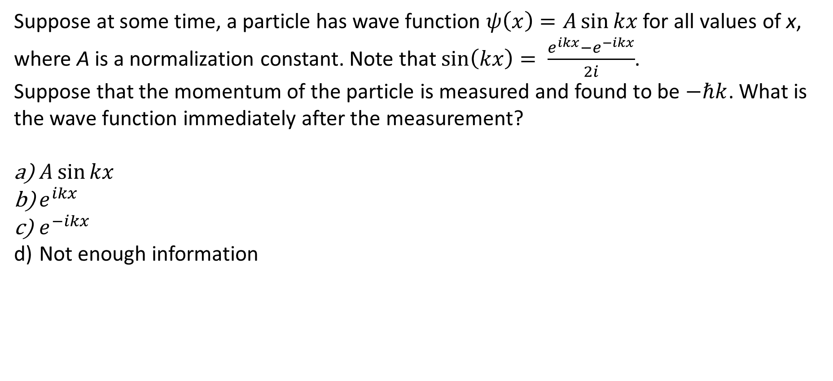

Measurement
Suppose at some time, a particle has wave function $ψ\left(x\right)=A\sin{kx}$for all values of x, where A is a normalization constant. Note that $\sin\left(kx\right)= \frac{e^{ikx}−e^{−ikx}}{2i}$.
Suppose that the momentum of the particle is measured and found to be $−ℏk$. What is the wave function immediately after the measurement?
$A\sin{kx}$
$e^{ikx}$
$e^{−ikx}$
Not enough information

Slide 21

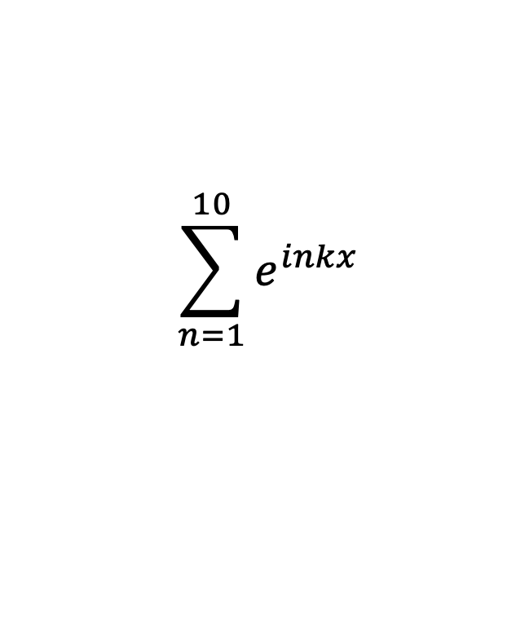
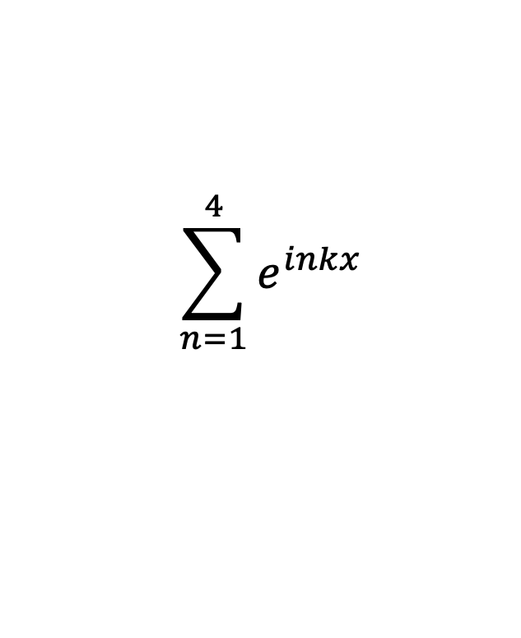
Making localized wave functions
$$e^{ikx}$$
$$\sum_{n=1}^{4}{e^{inkx}}$$
$$\sum_{n=1}^{10}{e^{inkx}}$$

Slide 22
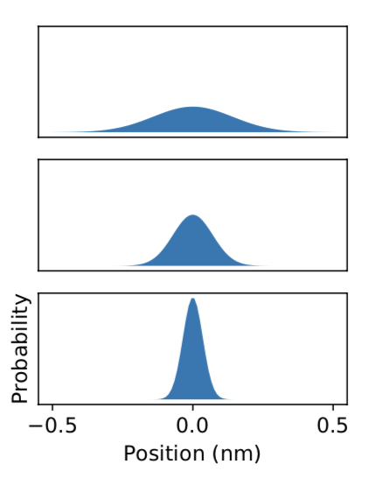
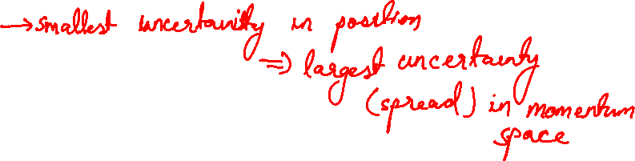
Heisenberg uncertainty
A
Probability densities on the left.
Suppose we measure momentum of this particle. Which will have the largest spread of possible momentum values?
B
C

Slide 23

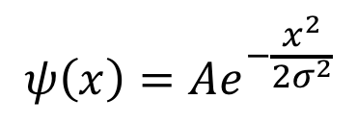
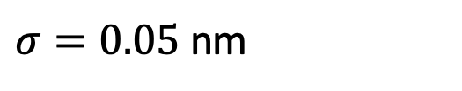
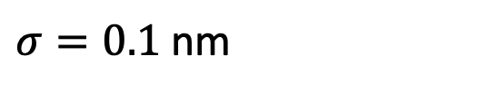
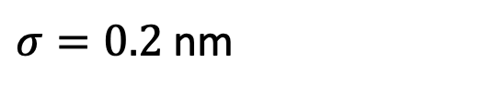
Which wave function has the most momentum uncertainty (or indeterminateness)?
$$ψ\left(x\right)={Ae}^{−\frac{x^{2}}{2σ^{2}}}$$
A
$σ=0.2$ nm
B
$σ=0.1$ nm
C
$σ=0.05$ nm

Slide 24
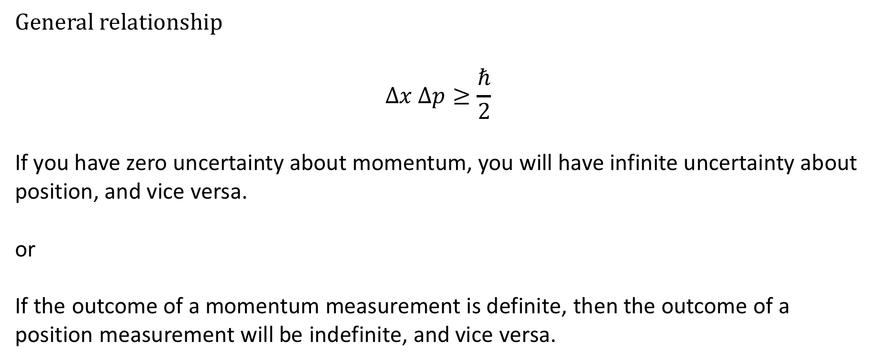
Heisenberg uncertainty relation
General relationship
$$Δx Δp≥\frac{ℏ}{2}$$
If you have zero uncertainty about momentum, you will have infinite uncertainty about position, and vice versa.
or
If the outcome of a momentum measurement is definite, then the outcome of a position measurement will be indefinite, and vice versa.

