Slide 1
Your thoughts/comments/hopes/wishes
Three physicists held a beach party and hade so much fun they made it annual. Its now known as a popular wave function among the department.
Can we go over some worked examples of applying wave equations like in the checkpoint? I feel like im getting my math wrong
Yep, we’ll go over it. It’s not too bad once you get used to it. Like weather in Illinois.
I tried to think of a quantum mechanics joke, but the thing about them is that they can be incredibly funny and incredibly unfunny at the same time. ☺

Slide 2
Lecture 6: The Wave Function

Slide 3
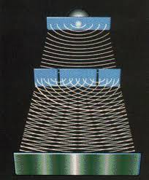
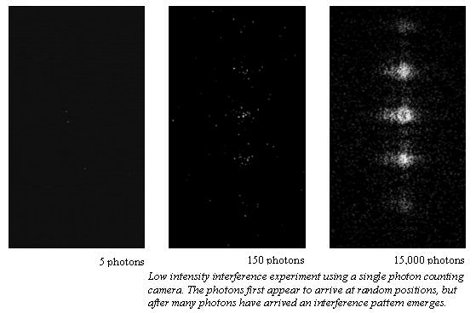
Last time: Interference of individual photons

Slide 4
Double slit experiment for electrons
Suppose that, instead of photons, we electrons one at a time through a pair of slits. We place an electron detector on a distant screen. Do we expect to see interference?
a) No, interference is due to electrons interfering with one another.
b) No, interference is a wave property while electrons are particles.
c) Yes, the electron’s wave function will have interference.

Slide 5
Wave function summary
$ψ\left(x,t\right)$ is a complex number.
The probability density is given by
$$ρ\left(x,t\right)={\left|ψ\left(x,t\right)\right|}^{2}=ψ\left(x,t\right)ψ^{∗}(x,t)$$
The probability to find the particle between $a$ and $b$ at time $t$ is
$$P\left(a<x<b, t\right)= \int_{a}^{b}{ρ\left(x,t\right) dx}$$

Slide 6
Checkpoint
An electron has the wave function $\frac{1}{\sqrt{2}}\left(ψ_{1}+ψ_{2}\right)$, where
$ψ_{1}=\frac{1}{√2}+\frac{i}{√2}$ for $−2<x≤−1$ ,
$ψ_{2}=1$for $1<x≤2$,
And zero elsewhere. If we measure the position of the electron, what is the probability we find it with $x≤0$?
0
¼
½
¾
1

Slide 7
Normalization
Suppose that $ψ\left(x\right)=\operatorname{Asin}{\frac{2πx}{L}}$ for 0 < x < L, and 0 otherwise. What equation must A satisfy?
$A\int_{−∞}^{∞}{\sin{\frac{2πx}{L}}}dx=1$
$A\int_{0}^{L}{\sin{\frac{2πx}{L}}}dx=1$
${\left|A\right|}^{2}\int_{−∞}^{∞}{|}\sin{\frac{2πx}{L}{\left.​\right|}^{2}}dx=1$
${\left|A\right|}^{2}\int_{0}^{L}{|}\sin{\frac{2πx}{L}{\left.​\right|}^{2}}dx=1$
${\left|A\right|}^{2}=1$

Slide 8
What is the wave function of a particle with wavelength $λ$?
What we know:
Must interfere like classical light with wavelength $λ$.
Probability must be proportional to the intensity computed classically.
A guess:
$$Ψ\left(x,t\right)∝e^{i\left(kx−ωt\right)}$$

Slide 9
What if particles were like photons
Particle with momentum $p=\frac{h}{λ}=ℏk$: $ψ\left(x,t\right)= {Ae}^{i(kx−ωt)}$.
Superposition of paths:
$$ψ(y,t)=A(e^{ikr_{1}}+e^{ikr_{2}})e^{iωt}$$
$$ρ\left(y,t\right)={\left|A\right|}^{2}{\left|e^{ikr_{1}}+e^{ikr_{2}}\right|}^{2}$$
deBroglie hypothesis!
If this is true, then passing particles through slits would result in interference fringes in the probability that they arrive at a screen.

Slide 10
Wave function of a particle with momentum p
Empirical fact:
$$E=hf=ℏω$$
$$p=\frac{h}{λ}=ℏk$$
$$ψ\left(x,t\right)=Ae^{i(kx−ωt)}$$

Slide 11
The quantum description of the two-slit experiment
Particle with wavelength $λ=\frac{2π}{k}$
$$ψ\left(x,t\right)= {Ae}^{i(kx−ωt)}$$
Superposition of paths:
$$ψ(y,t)=A(e^{ikr_{1}}+e^{ikr_{2}})e^{iωt}$$
Notes:
Find peak difference from

Slide 12
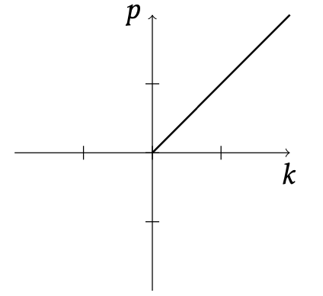
$$p=ℏk$$
Relationship between momentum and wave number is empirical! (based on experiment)
But it is the same relationship for electrons and for photons.

Slide 13
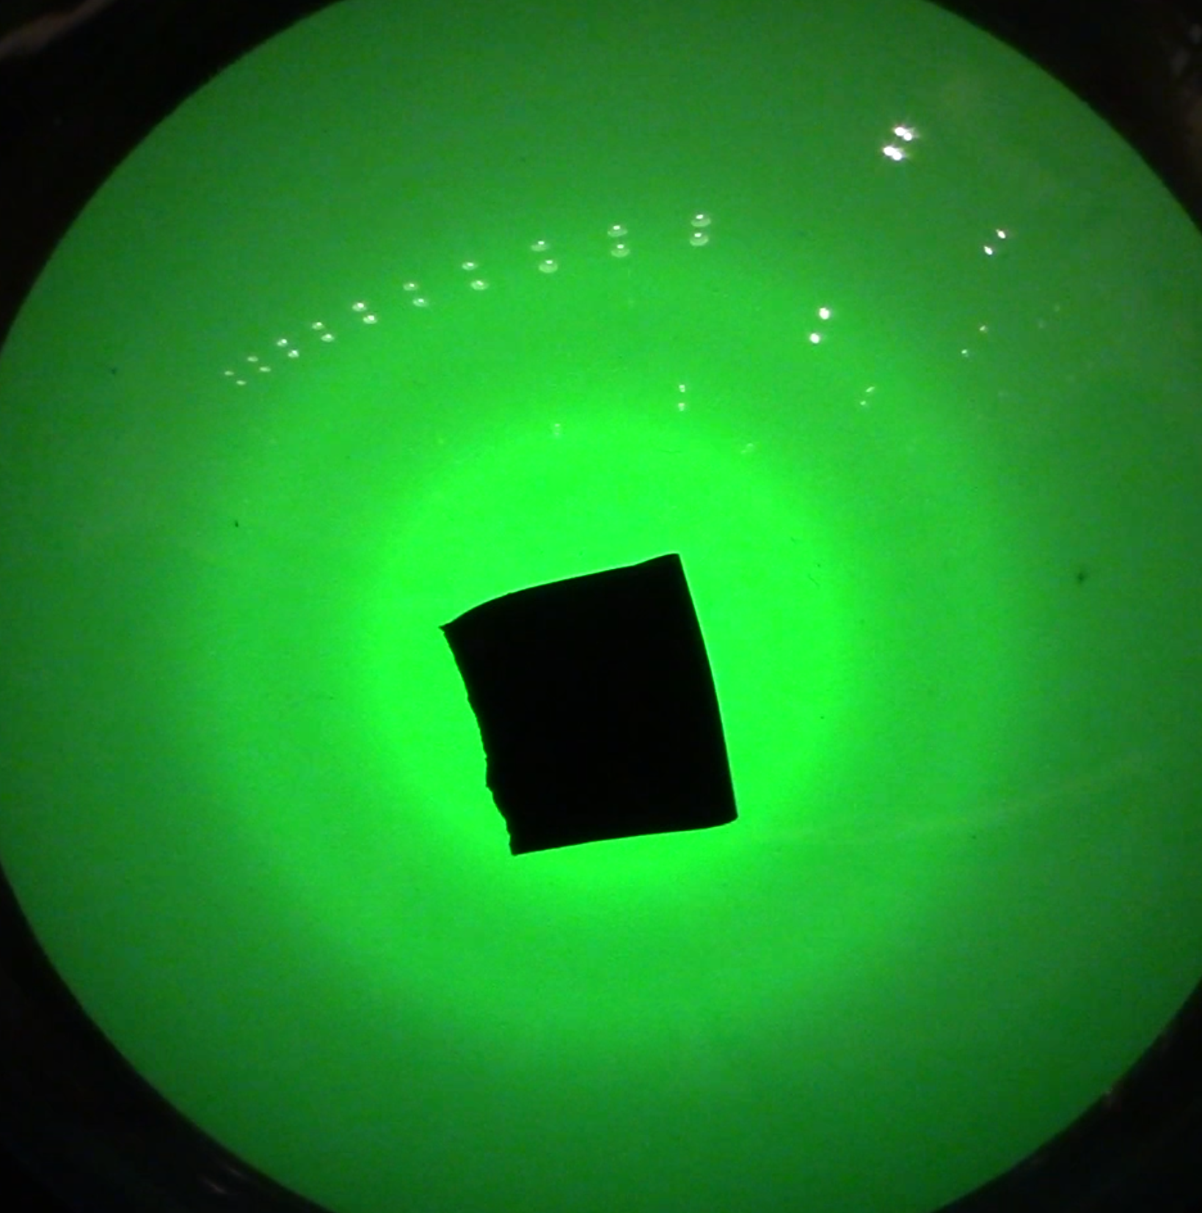
Measuring momentum
Suppose that electrons with momentum $p$ are described by a wave function $e^{ikx}$, with $p=ℏk$.
If we decrease the velocity of the electrons, what will happen to the spacing between fringes?
Decrease.
Stay the same.
Increase.

Slide 14
Final summary
$ψ\left(x,t\right)$ is a complex number.
The probability density is given by
$$ρ\left(x,t\right)={\left|ψ\left(x,t\right)\right|}^{2}$$
The probability to find the particle between $a$ and $b$ at time $t$ is
$$P\left(a<x<b, t\right)= \int_{a}^{b}{ρ\left(x,t\right) dx}$$
Superposition: Add wave functions, then square to get probabilities (like waves)

Slide 15
Review
Light comes in packets called photons with energy $hf$ and momentum $h/λ$.
We describe quantum objects using a wave function $ψ(x,t)$. The probability density that the object is observed at $x,t$ is $ψ\left(x,t\right)ψ^{∗}(x,t)\text{.}$
Quantum objects like electrons also have a wavelength given by $λ=h/mv$

Slide 16
Wave functions and probabilities
Suppose that we are told that the wave function for an electron is given by
$$ψ\left(x\right)= \frac{1}{\sqrt{2}}\left(1+i\right)$$
nm^{-1/2} between x=2 nm and x=2.5 nm, where there is a sensor that will register a 'click' if an electron is detected.
What is the probability that the sensor will click?
0
¼
½
¾
1
2nm
2.5nm

Slide 17
Adding waves of unequal amplitude
Suppose that the total wave function of an electron at a given spot on the screen (within a small region) x is given by $ψ\left(x\right)=2e^{ikr_{1}}+3e^{ikr_{2}}$ m^{-1/2}.
What is the maximum probability density that the electron will be observed at that spot?
0.5 m⁻¹
1 m⁻¹
5 m⁻¹
25 m⁻¹
What’s the minimum probability density that the electron will be observed at that spot?
0.5 m⁻¹
1 m⁻¹
5 m⁻¹
25 m⁻¹

