Slide 1
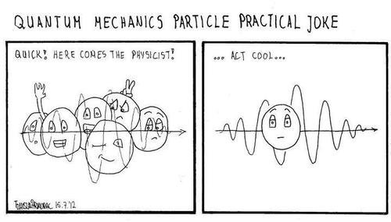
Your comments/notes/etc
if a probability function is given, do we assume that the function is normalized?
Not necessarily. You may need to normalize it.
Its about time I get to learn why i is useful
You don’t have to remember trig identities!
I had a really small problem with my car so I took it to a quantum mechanic
Why do we need probability density? Is it something like intensity that could describe the brightness? Yep! It determines the average number of photons we see -> intensity.
I know we did not just learn complex numbers in one unit...
We are not using *all* of complex numbers, mainly just i*i=-1 and $e^{iθ}=\cos{θ+i\sin{θ}}$

Slide 2
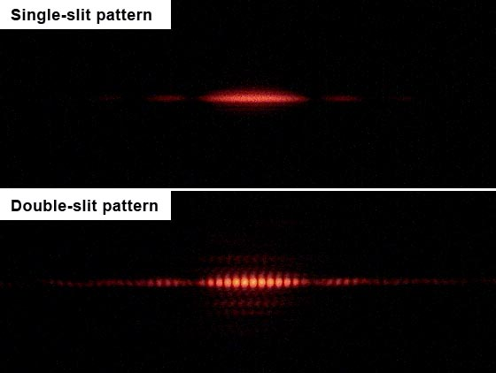
Lecture 5: Probability and Complex Numbers

Slide 3

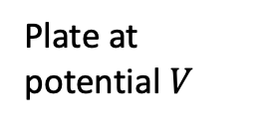
Last lecture: Photons
Light comes in quantized bits we call photons.
Energy can only be added and removed from the electromagnetic field amounts of $hf$.
Light
Metal
Plate at potential $V$
Electrons
$$E=hf$$
$$p=\frac{h}{λ}$$
$$KE=hf−Φ$$
e⁻

Slide 4
Are photons billiard balls?
Let’s turn down the lights.
We send one photon at a time through a two-slit apparatus. Will we still observe interference fringes?
a) No, the fringes are due to photons interfering with one another.
b) No, interference is a wave property while photons are particles.
c) No, probability is positive, so it doesn’t interfere.
d) Yes, the photon is still an electromagnetic wave.
e) Yes, the photon’s probability of being observed will have interference.

Slide 5
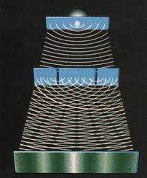
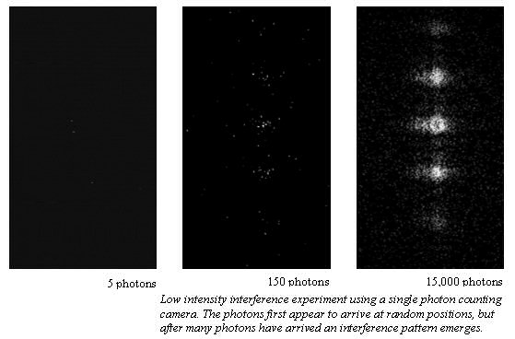
Are photons billiard balls?

Slide 6
We need to combine probability and interference
Probability and intensity
Power on a detector:
(absorbed number of photons/sec)*hf
Absorbed number of photons/sec:
probability*(number emitted/sec)
Detectors
1) Each time we detect a photon, we remove hf from the EM field.
2) The events come at random, even when the intensity is constant.
3) Even for a single photon, we see interference.

Slide 7
We need to combine probability and interference
Probability and intensity
Power on a detector:
(absorbed number of photons/sec)*hf
Absorbed number of photons/sec:
probability*(number emitted/sec)
hf
Detectors
1) Each time we detect a photon, we remove hf from the EM field.
2) The events come at random, even when the intensity is constant.
3) Even for a single photon, we see interference.

Slide 8
We need to combine probability and interference
Probability and intensity
Power on a detector:
(absorbed number of photons/sec)*hf
Absorbed number of photons/sec:
probability*(number emitted/sec)
hf
Detectors
1) Each time we detect a photon, we remove hf from the EM field.
2) The events come at random, even when the intensity is constant.
3) Even for a single photon, we see interference.

Slide 9
We need to combine probability and interference
Probability and intensity
Power on a detector:
(absorbed number of photons/sec)*hf
Absorbed number of photons/sec:
probability*(number emitted/sec)
hf
Detectors
1) Each time we detect a photon, we remove hf from the EM field.
2) The events come at random, even when the intensity is constant.
3) Even for a single photon, we see interference.

Slide 10
What we are learning today
Classical mechanics :
Position as a function of time $x(t)$
Electricity and magnetism:
vector fields $E\left(x,t\right), B(x,t)$
Quantum mechanics:
Complex probability amplitude $ψ\left(x,t\right)$
This applies to matter as well as light!
$Today:Review of probability and comp$lex numbers

Slide 11
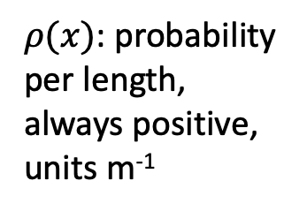
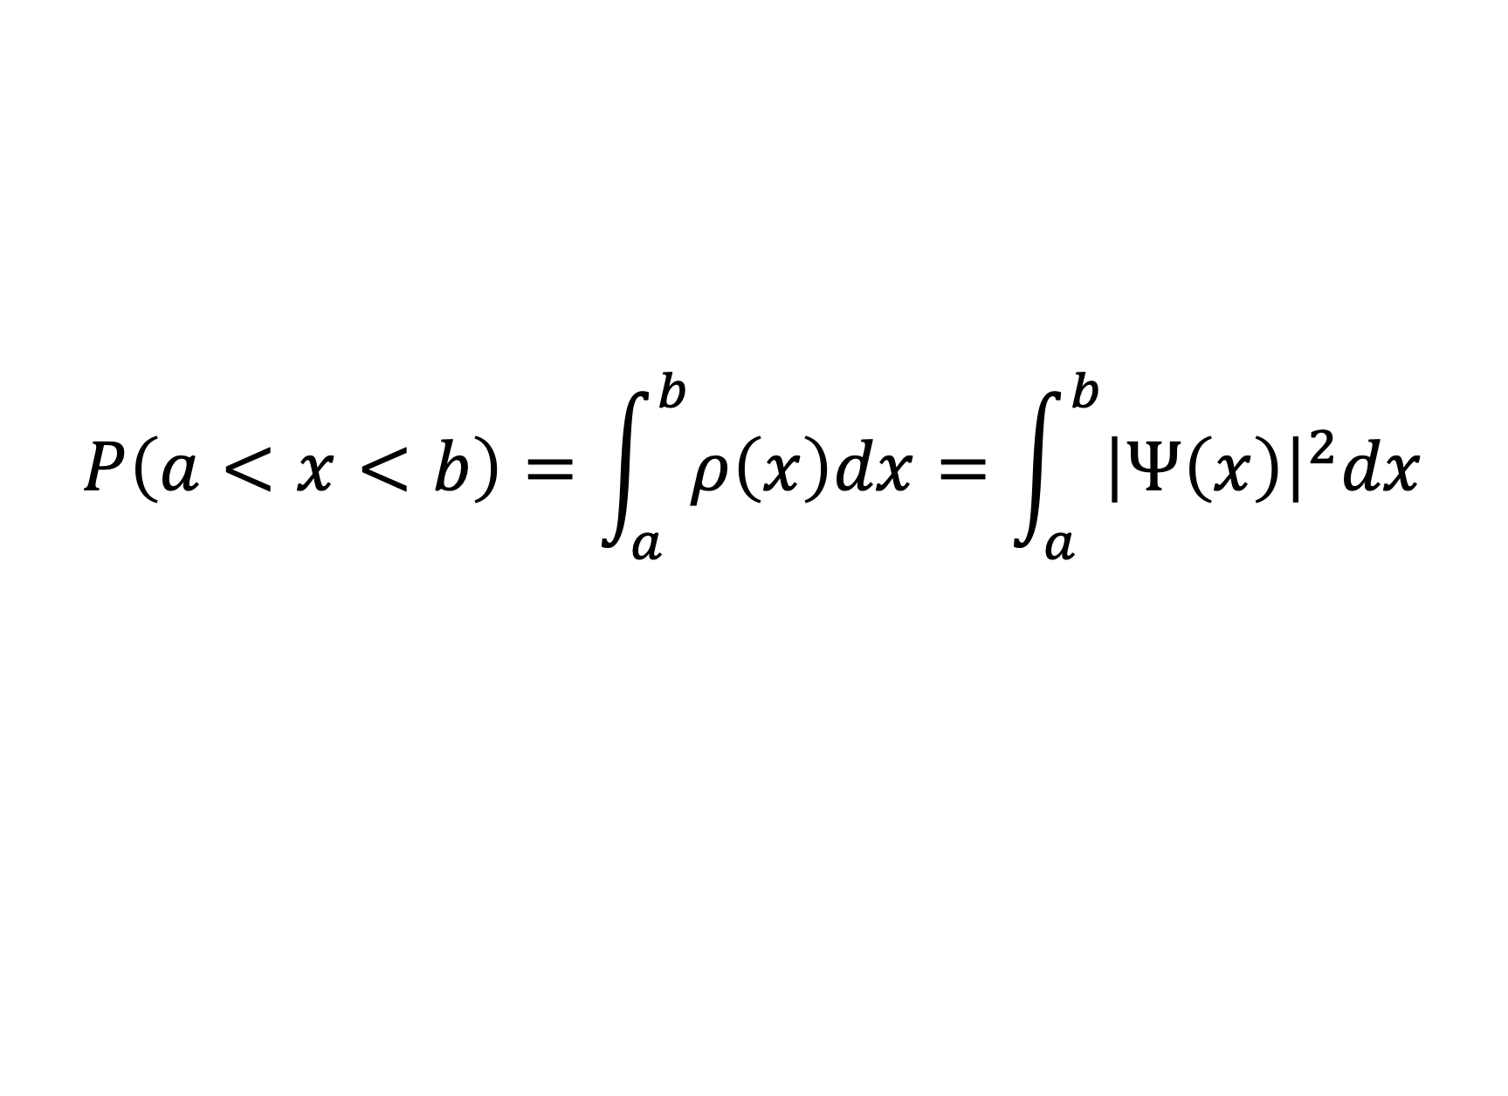
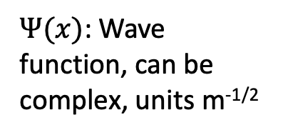
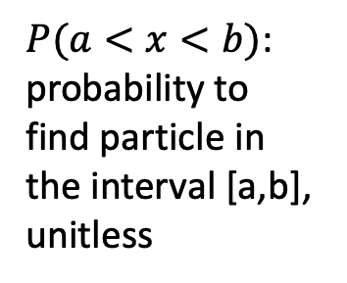
Probability, probability density
$$P\left(a<x<b\right)=\int_{a}^{b}{ρ\left(x\right)dx}=\int_{a}^{b}{{\left|Ψ\left(x\right)\right|}^{2}dx}$$
$P(a<x<b)$: probability to find particle in the interval [a,b], unitless
$ρ(x)$: probability per length, always positive, units m⁻¹
$Ψ(x)$: Wave function, can be complex, units m^{-1/2}

Slide 12
Probability density practice
1/2
1/4
x
-3
-1
0
1
2
Compare $P\left(x>0\right)$ and $P(x<0)$.
$P\left(x>0\right)>P(x<0)$
$P\left(x>0\right)=P(x<0)$
$P\left(x>0\right)<P(x<0)$

Slide 13
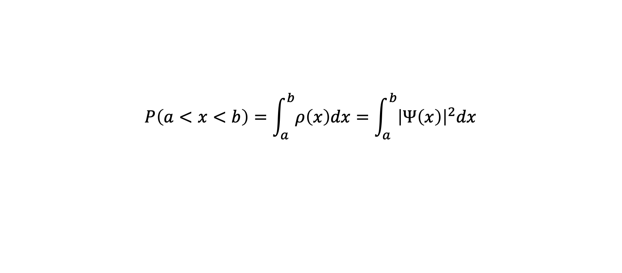
Checkpoint
Suppose that we are told that the probability density for a photon is given by
ρ$\left(x\right)=1$ nm⁻¹
between x=2 nm and x=2.5 nm, where there is a sensor that will register a 'click' if a photon is detected.
What is the probability that the sensor will click?
0
¼
½
¾
1
2nm
2.5nm
$$P\left(a<x<b\right)=\int_{a}^{b}{ρ\left(x\right)dx}=\int_{a}^{b}{{\left|Ψ\left(x\right)\right|}^{2}dx}$$

Slide 14
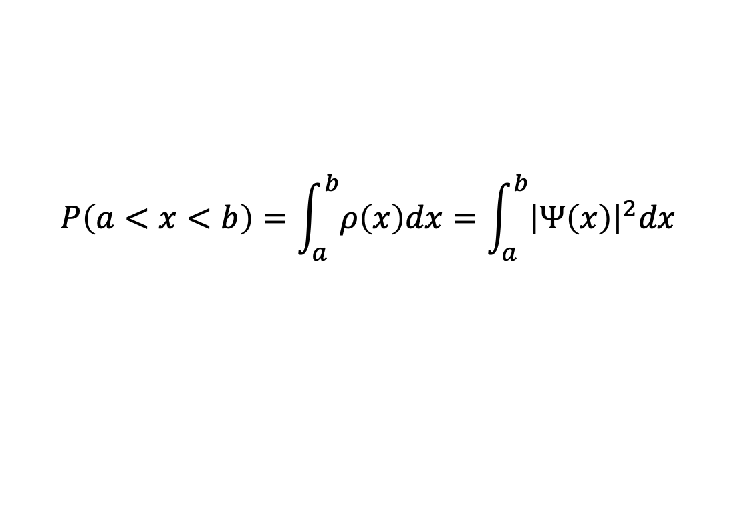
Probability and intensity
Let’s suppose that N particles per second with kinetic energy E are impacting a screen with average (over time) probability density $ρ(x)$. What is the power per meter that impacts the screen?
$ρ(x)$
$Nρ(x)/E$
$Nρ\left(x\right)E$
$NE$
$$P\left(a<x<b\right)=\int_{a}^{b}{ρ\left(x\right)dx}=\int_{a}^{b}{{\left|Ψ\left(x\right)\right|}^{2}dx}$$

Slide 15
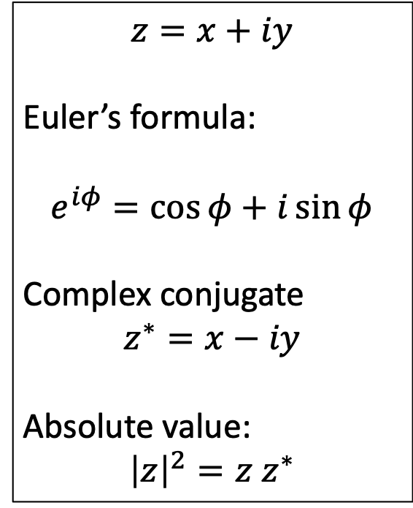
Complex numbers: $Ψ$ can be complex
$$z=x+iy$$
Euler’s formula:
$$e^{iφ}=\cos{φ}+i\sin{φ}$$
Complex conjugate
$$z^{∗}=x−iy$$
Absolute value:
$${\left|z\right|}^{2}=z z^{∗}$$
Imaginary part (y)
Real part (x)
Real part (x)
Complex numbers add just like phasors! The math is the same.

Slide 16
Complex number practice
Suppose that $z=3+4i$. What is ${\left|z\right|}^{2}$?
7
-1
25
5

Slide 17
Complex number practice
Suppose that $z=3+4i$. What is ${\left|z\right|}^{2}$?
7
-1
25
5
Now let’s try to write $z=Aeiθ$. How do we find θ?
$\tan\left(θ\right)=4/3$
$\tan\left(θ\right)=3/4$
$θ=0$
$θ=π$

Slide 18
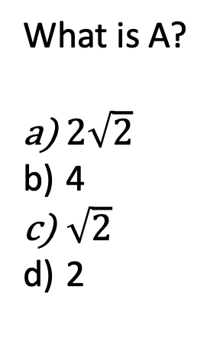
Complex angle
Suppose that $Ae^{iθ}=2+2i$.
What is $θ$?
$π$
$\frac{π}{2}$
$\frac{π}{4}$
What is A?
$2\sqrt{2}$
4
$\sqrt{2}$
2

Slide 19
Summary
Photons are NOT billiard balls
The probability to find the particle between $a$ and $b$ at time $t$ is
$$P\left(a<x<b, t\right)= \int_{a}^{b}{ρ\left(x,t\right) dx}$$
Intensity is given by (probability density)(energy)(number per second)
Next time: Complex numbers and Probability → Interference of Matter Waves

