Slide 1
Announcements
The first lab is tomorrow (Thursday)
  no more reminders like this!
First two homework assignments are due tomorrow (Thursday) at 8:00am
  see smartPhysics for late turn-in deadline
  no more reminders like this!
Please check that your iClicker is correctly registered in the gradebook

Slide 2
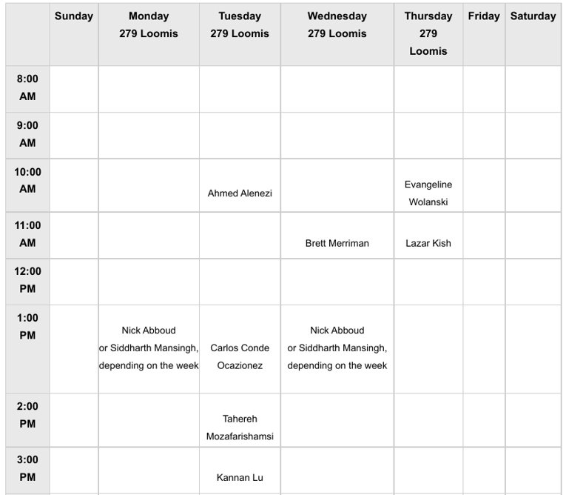
Are you able to access the office hour schedule?

Slide 3
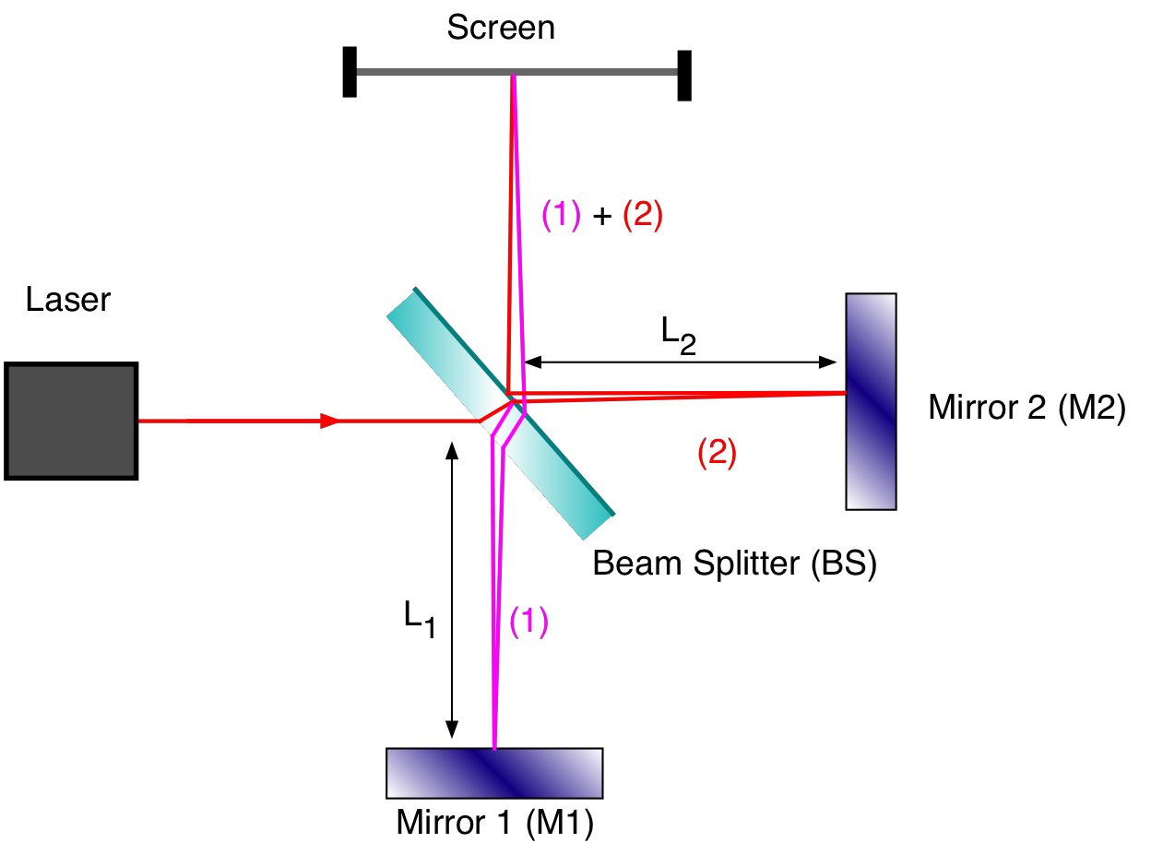
Practice with interference
Light source
Michaelson interferometer
Diffraction grating
Notes:
\

Slide 4


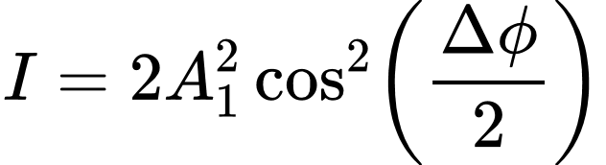




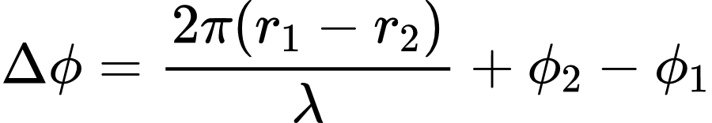
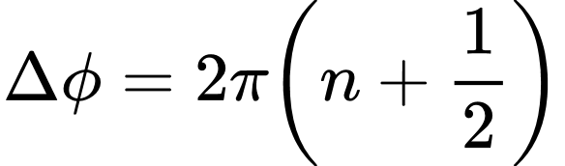


Phasors: here today, gone tomorrow
Interference between waves from two coherent monochromatic sources
If , then
Constructive interference occurs when
Destructive when
If , then the phasor diagram tells us how to compute the intensity.
Remember, phasors represent oscillating quantities.
length of phasor <--> amplitude
angle of phasor wrt horizontal <--> phase (a.k.a. argument)
(superposition principle)

Slide 5
Michaelson Interferometer
We know the lengths L₁ and L₂ of the arms.
What is r₂-r₁, the difference in path lengths?
A) L₂-L₁
B) (L₂-L₁)/2
C) 2(L₂-L₁)
D) not enough info to determine

Slide 6


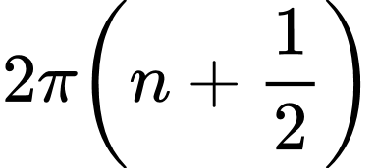

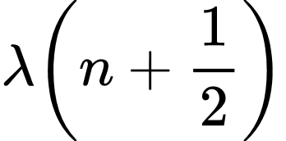
Michaelson Interferometer
Suppose the laser has wavelength .
We observe constructive interference at the screen (maximal intensity). What is the phase difference between the two paths?
A)
B)
C)
D)

Slide 7
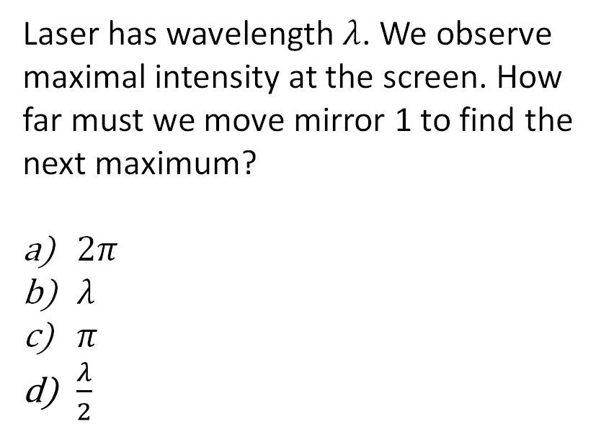
Michaelson Interferometer
Laser has wavelength $λ$. We observe maximal intensity at the screen. How far must we move mirror 1 to find the next maximum?
$2π$
$λ$
$π$
$\frac{λ}{2}$

Slide 8
Example usage: measuring index of refraction
When light passes through the gas, it slows down, so its wavelength decreases.
==> MORE wavelengths now fit into the container
==> the interference pattern shifts
==> by measuring the shift, we can infer index of refraction n
gas container
n = ?

Slide 9
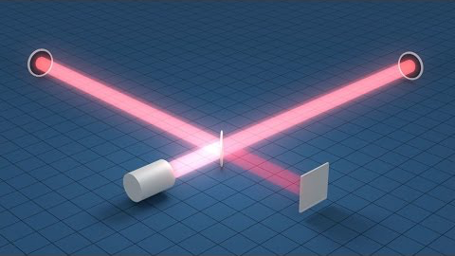
Application: LIGO
https://youtu.be/tQ_teIUb3tE

Slide 10
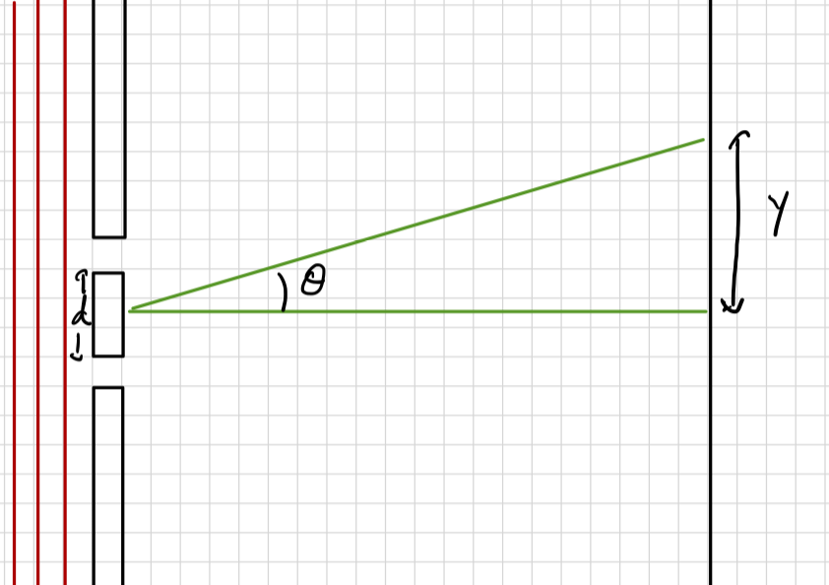


Young's double-slit experiment
Each slit acts as a source for coherent light of the same wavelength.
What do you expect to see for ?
coherent monochromatic light
a) Isolated peak
Newton vs. Huygens
(Corpuscles vs. Waves)
Who will emerge victorious??
(Huygens will. But also Newton, in a way...)
b) Repeating peaks
c) Two isolated peaks
Notes:
d: distance between the sources
theta: angle from the perpendicular
Make the approximately isosceles triangle
Compute $δ=d\sin{θ}$
So $φ=\frac{2πδ}{λ}=\frac{2πd\sin{θ}}{λ}$

Slide 11
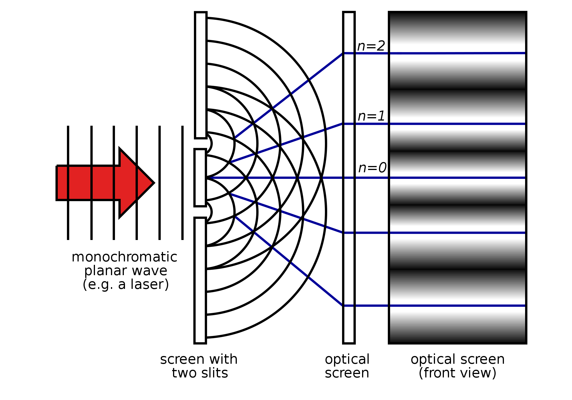
Young's double-slit experiment

Slide 12




Young's double-slit experiment: geometry
screen
Approximation: L is very big compared to d.
d
coherent monochromatic light
Notes:
d: distance between the sources
theta: angle from the perpendicular
Make the approximately isosceles triangle
Compute $δ=d\sin{θ}$
So $φ=\frac{2πδ}{λ}=\frac{2πd\sin{θ}}{λ}$

Slide 13
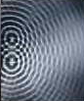




Condition for constructive interference
m=2
For what values of
does constructive interference occur?
A)
B)
C)
D)
m=1
m=0
m=-1
m=-2

Slide 14





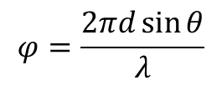
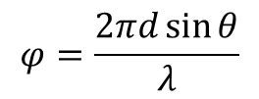
Multiple equally spaced slits/sources
phasor
diagram?
2
$$φ=\frac{2πd\sin{θ}}{λ}$$
a.
2
d
$$θ$$
$$φ=d\sin{θ}$$
coherent monochromatic light
d
b.
$$φ=\frac{2πd\sin{θ}}{λ}$$
c.
a.k.a "diffraction grating"
$$φ=d\sin{θ}$$
d.

Slide 15
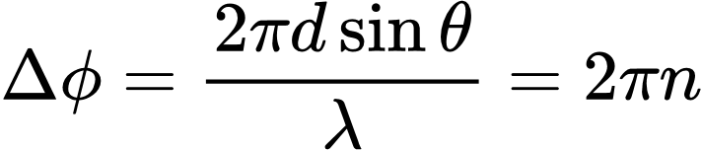




Condition for constructive interference with multiple slits
d
$$θ$$
d
When there are two slits, the first intensity maximum is observed at
A) less than
B) at
C) greater than
d
$$θ$$
When there are three slits (same d, same ), where will we find the first intensity maximum?
d
$$θ$$
d

Slide 16
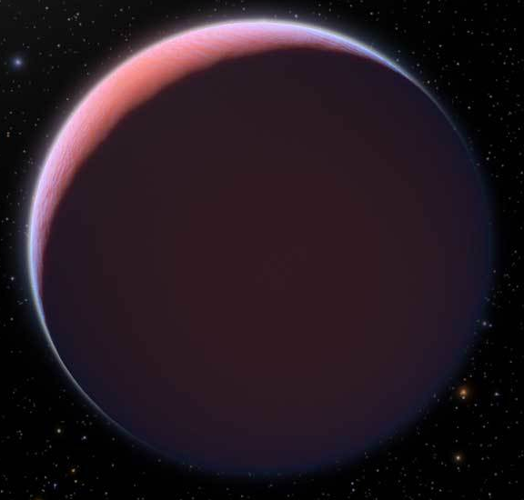
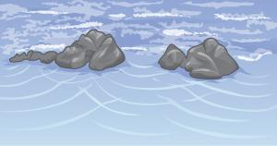
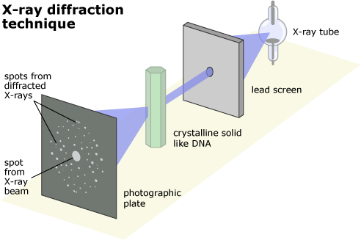
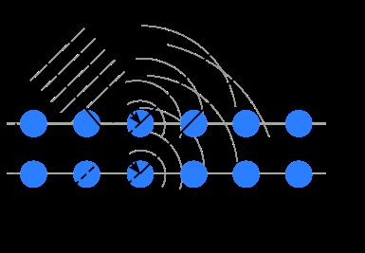
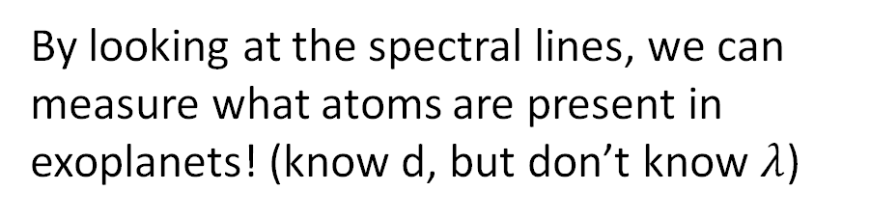
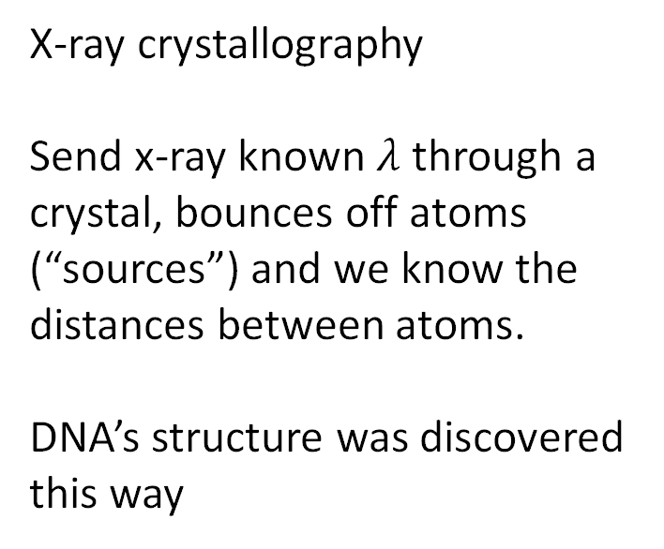
Application of diffraction gratings: spectroscopy
By looking at the spectral lines, we can measure what atoms are present in exoplanets! (know d, but don’t know $λ$)
X-ray crystallography
Send x-ray known $λ$ through a crystal, bounces off atoms (“sources”) and we know the distances between atoms.
DNA’s structure was discovered this way

Slide 17
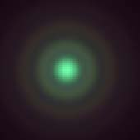
Diffraction from a single aperture
Diffraction: the spreading of waves around obstacles or upon passing through an aperture
Diffraction: interference between multiple sources
"that's the same thing" - Huygens

Slide 18

Summary
coherent monochromatic light
$$θ$$
a or D
L
We'll use "a" for non-thin slit apertures, and "D" for circular apertures

Slide 19
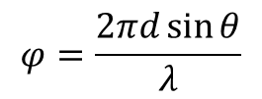
Multiple equally spaced slits --> aperture
d=a/3
d
2
a
$$θ$$
$$φ=\frac{2πd\sin{θ}}{λ}$$
coherent monochromatic light
d
d
aperture ≈ 3 slits
$$θ$$
same a
$$θ$$
same a
aperture ≈ 4 slits
aperture ≈ 5 slits
aperture = ∞ slits

Slide 20

6 slits: when do we get zero intensity?
= phase diff between waves arriving from adjacent slits
What is the smallest value of which makes the phasors sum to zero?
A) 2π
B) π
C) π/3

Slide 21
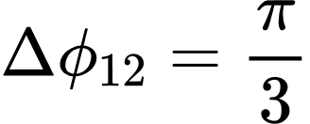




6 slits: when do we get zero intensity?
Which is the correct condition for the angle of the first diffraction minimum ?
A)
B)
C)

Slide 22
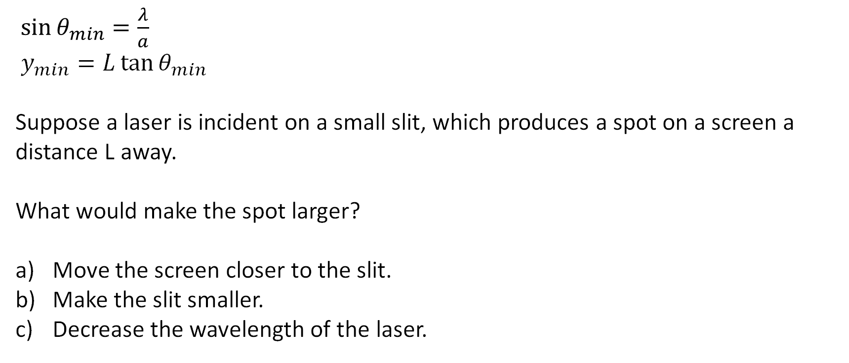
Checkpoint question: spot size
$$θ$$
L
$\sin{θ_{min}=\frac{λ}{a}}$
$y_{min}=L\tan{θ_{min}}$
Suppose a laser is incident on a small slit, which produces a spot on a screen a distance L away.
What would make the spot larger?
Move the screen closer to the slit.
Make the slit smaller.
Decrease the wavelength of the laser.

Slide 23
Spots from circular apertures

Slide 24
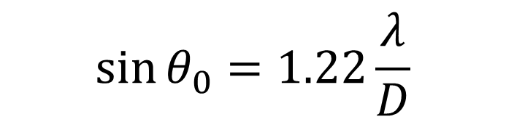


Circular apertures: Airy disk
$${\sin{θ}}_{0}=1.22\frac{λ}{D}$$
$$θ_{0}$$
$$D$$

Slide 25
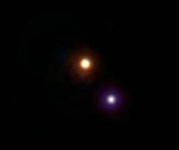
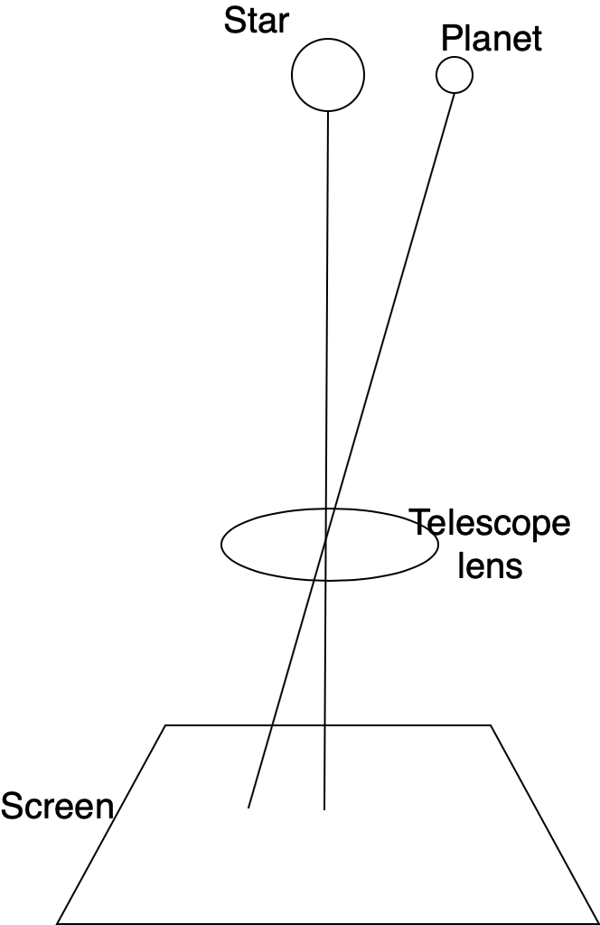




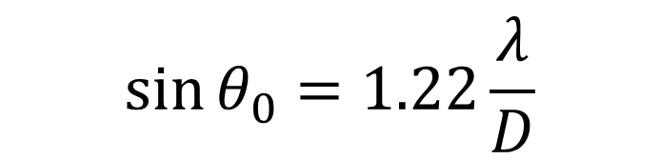
Seeing stars: Beta Cygni (Albireo)
Star 1
Star 2
$${\sin{θ}}_{0}=1.22\frac{λ}{D}$$
Visible light
This photo shows the beautiful double star, Albireo, in Cygnus the Swan. Equipment used: Celestron C9.25 telescope and Casio QV8000SX digital camera
George Lilley
==> need at the bare minimum (Rayleigh criterion)
Angular separation
= 35.3’’ = 0.00017 radians

Slide 26
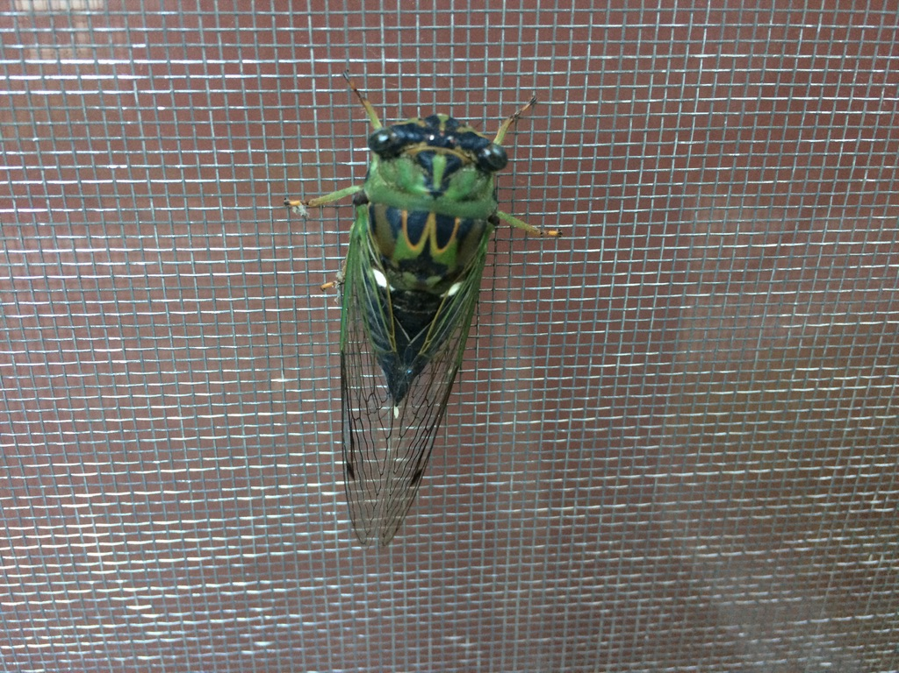
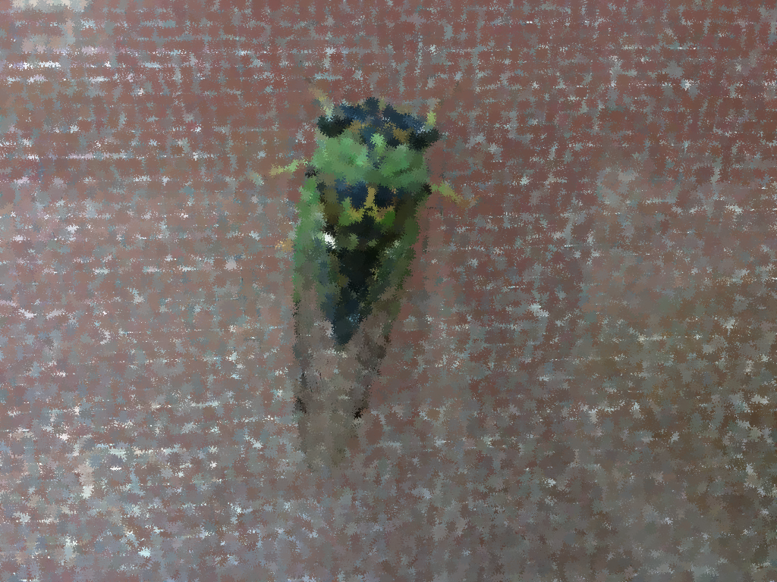
Big camera/small camera
If diffraction spots are too large, then features will bleed into each other and crisp images can’t be resolved (like the screen here). What should you do to your camera aperture to avoid this effect?
Increase the aperture size
Decrease the aperture size
Doesn’t matter

Slide 27
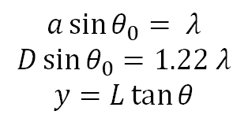
Summary
Screen
a or D
$$θ$$
L
$$a\sin{θ_{0}}= λ$$
$$D\sin{θ_{0}}=1.22 λ$$
$$y=L\tan{θ}$$

