Slide 1
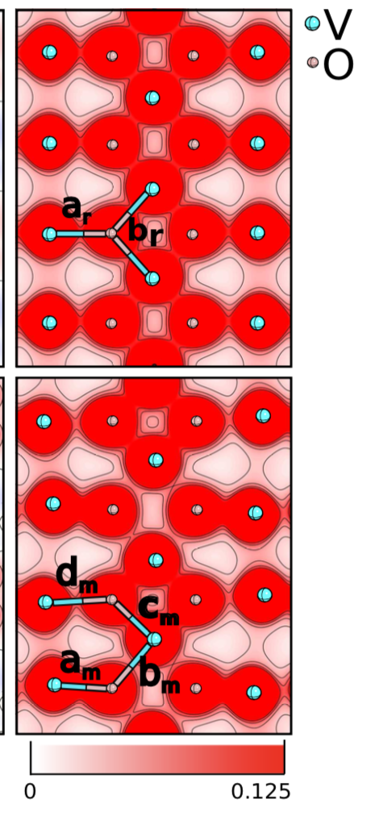
Quantum physics
D. Eigler, IBM Research Center, Almaden, CA
Welcome to PHYS 214!
Phys. Rev. Lett. 105 106601 (2010). Courtesy of H. Kulik

Slide 2

Your comments/questions/jokes
"I'm excited to learn this semester!"
"what did the cell phone send to the cell tower... nothing, it just waved"
"so phil, is it?"
Some (all?) of you are having trouble accessing secured course material
  Should be fixed soon; we will "unsecure" most material in the meantime. You can click the links as usual.
How will the course be graded?
  Checkpoints, lecture attendance, homework, labs, discussions, exams. Refer to course website.

Slide 3



Course directors and contact info
Course director
Prof. Naomi Makins
(makins@illinois.edu)
(217) 721-3793
prefer text over email!
Lecturer
Siddharth Mansingh
(sm38@illinois.edu)
Lecturer
Nick Abboud
(nka2@illinois.edu)
Undergrad office (registration, etc): undergrad@physics.illinois.edu
Only email us from your @illinois.edu account.
Please use CampusWire for most questions/requests. That way they get routed to the right person.

Slide 4
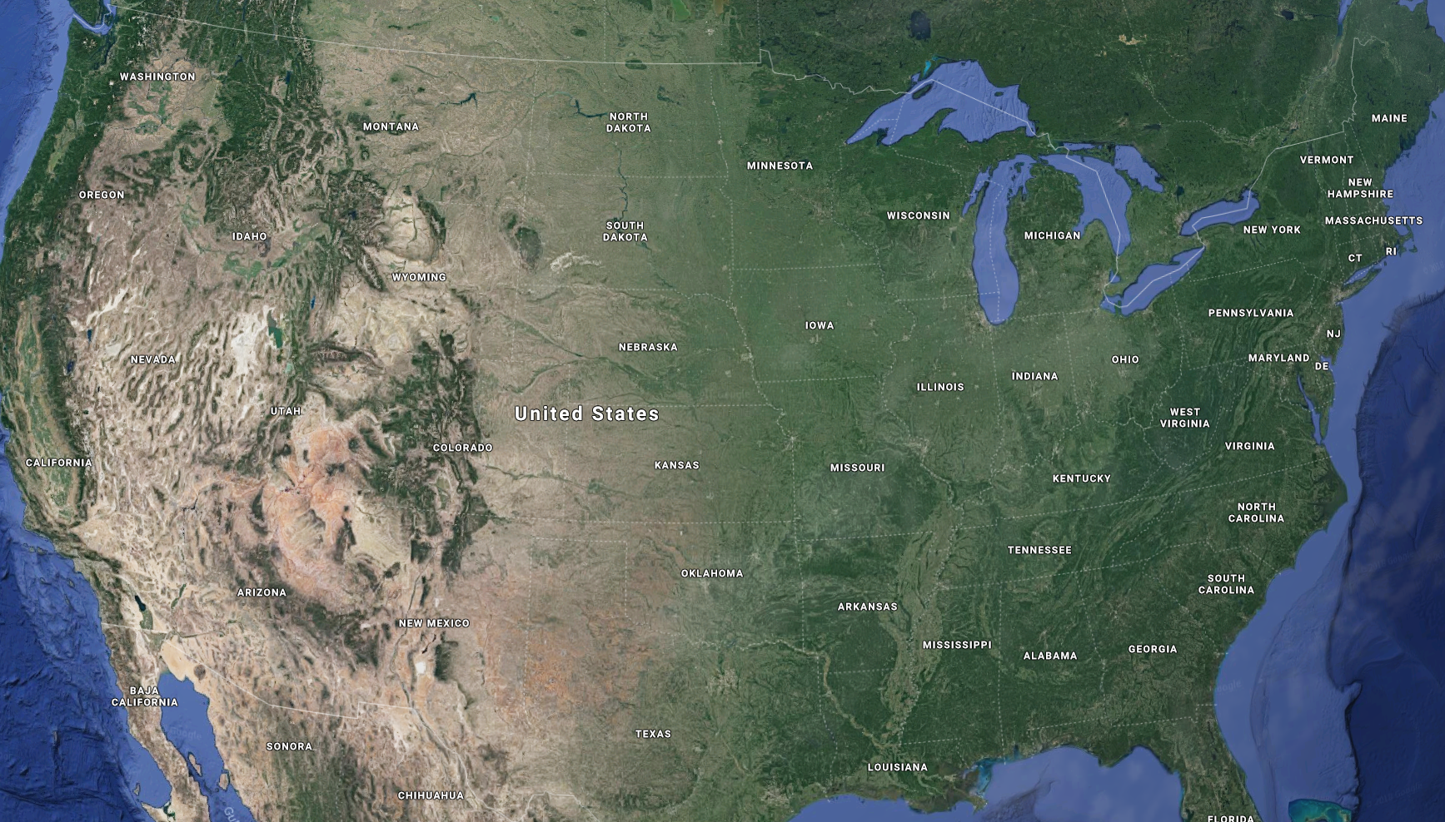
About me (Nick)
PhD student

Slide 5



About me (Nick)
My roommates
Landau
PhD student
Lifshitz

Slide 6
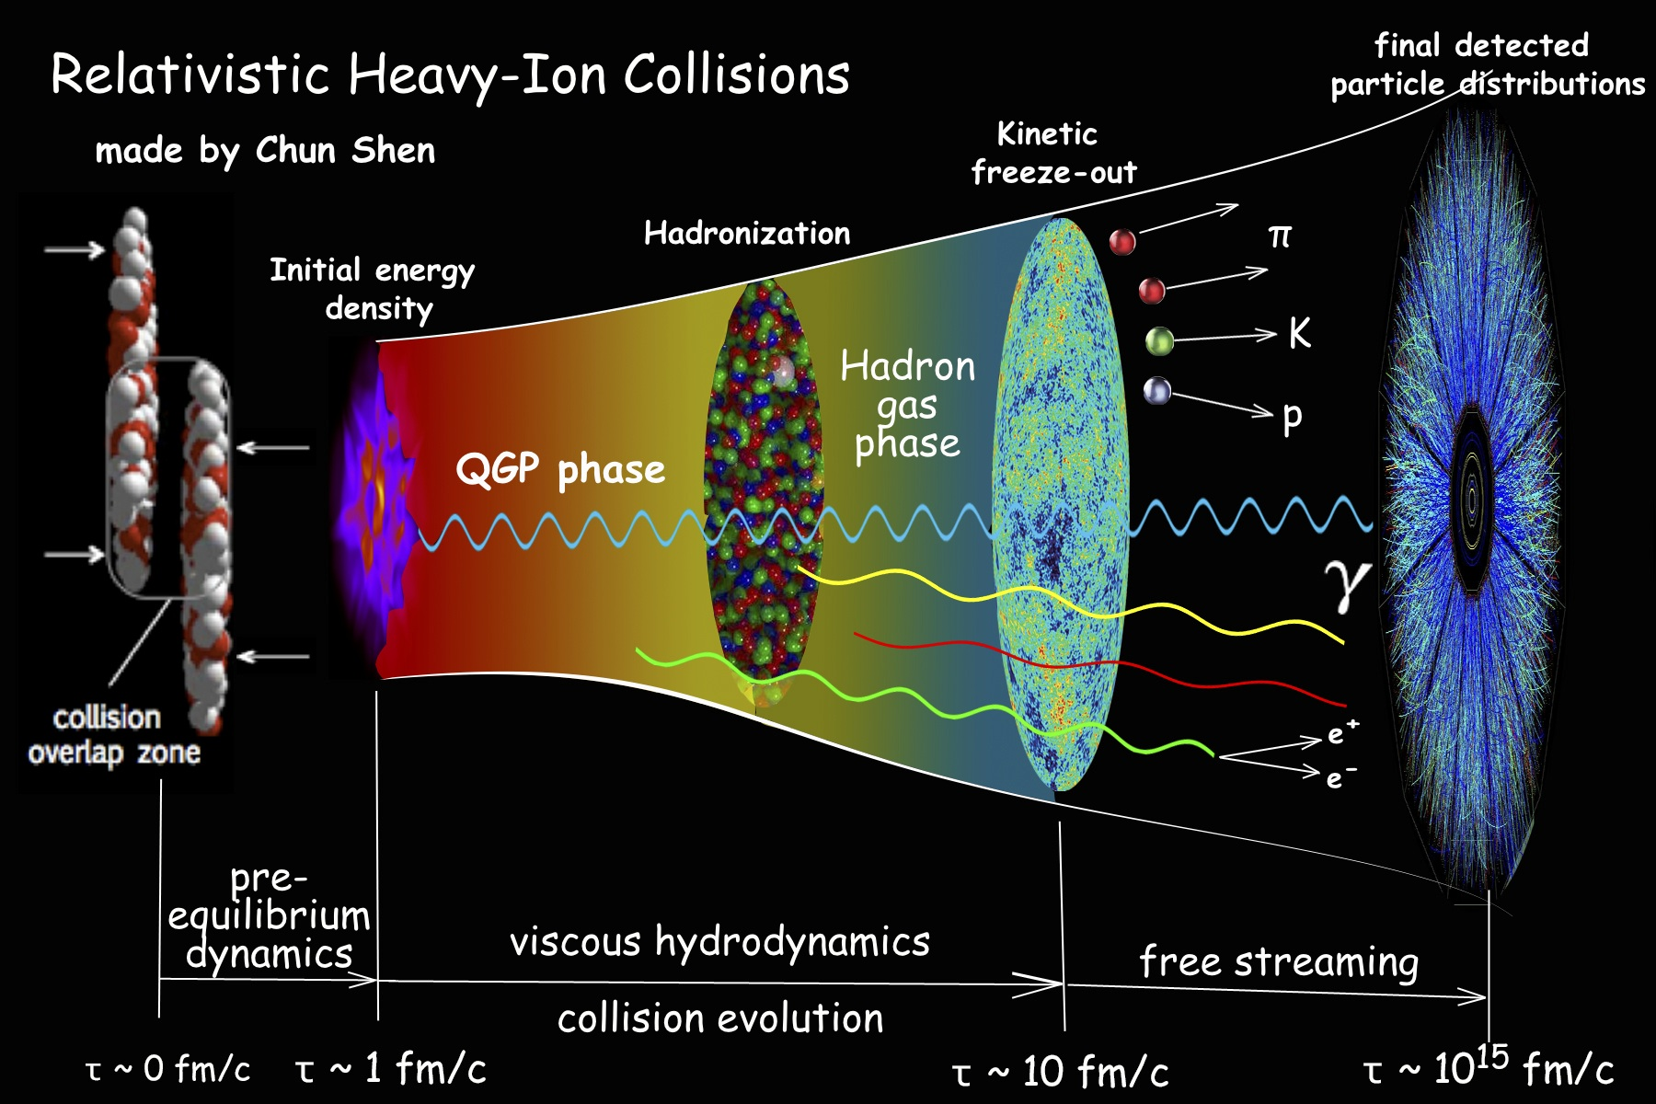
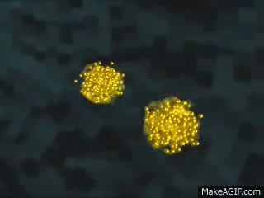
About me (Nick) - research - nuclear theory
A heavy-ion collision (e.g. Gold Nucleus + Gold Nucleus)
Some questions
What phases of matter does the strong nuclear force give rise to?
How to formulate and extend relativistic hydrodynamics?
How to simulate neutron star mergers -> gravitational waves?

Slide 7
About you
1. What’s your major?
MatSE
Physics
ECE or CS
Chemistry or Chem. Eng.
Other

Slide 8
About you
2. Cats or dogs?
Cats
Dogs
Don’t like pets
Both!
Other

Slide 9
Class rules
Put cell phones away
Close laptops (tablets OK for notetaking)
Save conversation for Q&A portions of lecture
If you’re sick, stay home and get better!
  Excused absence request form

Slide 10
Class structure
Refer to course schedule page for all due dates and links.
Prelecture: read notes before each lecture (course schedule)
Checkpoint: short, due 8:00am before each lecture (smartPhysics)
Lecture: take notes, discuss clicker questions in small groups (here)
Homework: work in study groups, use Campuswire, attend office hours (smartPhysics)
Discussion: work on problems in small groups (1047 Sidney Lu Mech. Eng. Bldg.)
Lab: experience the physics, complete lab worksheets (64 Loomis)
Exams: 2 midterms and 1 final (CBTF; see course schedule; use the online scheduler in advance!)

Slide 11
Read the course website
http://courses.physics.illinois.edu/phys214
If you have a question, check the website!
Excused absences, grading, schedule, etc..

Slide 12
Getting help
Homework and physics questions: Office hours and Campuswire
(Please don’t post solutions!)
Excuses/absences: Check the webpage. Most things are explained there.
Logistical/policy questions: Course website, then Campuswire
DRES exam accommodations: CBTF, see "exam info" page on course website
Recommended textbook: University Physics with Modern Physics by Young & Freedman (12th Edition, 2008)

Slide 13
Campuswire
Post any questions you have there; we will help as soon as we can!
Please do not:
Ask or share direct solutions
Be unconstructive
Please do:
Help your fellow students (crafting an explanation is great practice!)
Read answers to other people’s questions (maybe they’ll help you!)
Let us know if something is wrong

Slide 14
Emergency response
Notes:
Emergencies can happen anywhere and at any time, so it’s important that we take a minute to prepare for a situation in which our safety could depend on our ability to react quickly. Take a moment to learn the different ways to leave this building. If there’s ever a fire alarm or something like that, you’ll know how to get out and you’ll be able to help others get out. Next, figure out the best place to go in case of severe weather – we’ll need to go to a low-level in the middle of the building, away from windows. And finally, if there’s ever someone trying to hurt us, our best option is to run out of the building. If we cannot do that safely, we’ll want to hide somewhere we can’t be seen, and we’ll have to lock or barricade the door if possible and be as quiet as we can. We will not leave that safe area until we get an Illini-Alert confirming that it’s safe to do so. If we can’t run or hide, we’ll fight back with whatever we can get our hands on. If you want to better prepare yourself for any of these situations, visit police.illinois.edu/safe. Remember you can sign up for emergency text messages at emergency.illinois.edu.

Slide 15


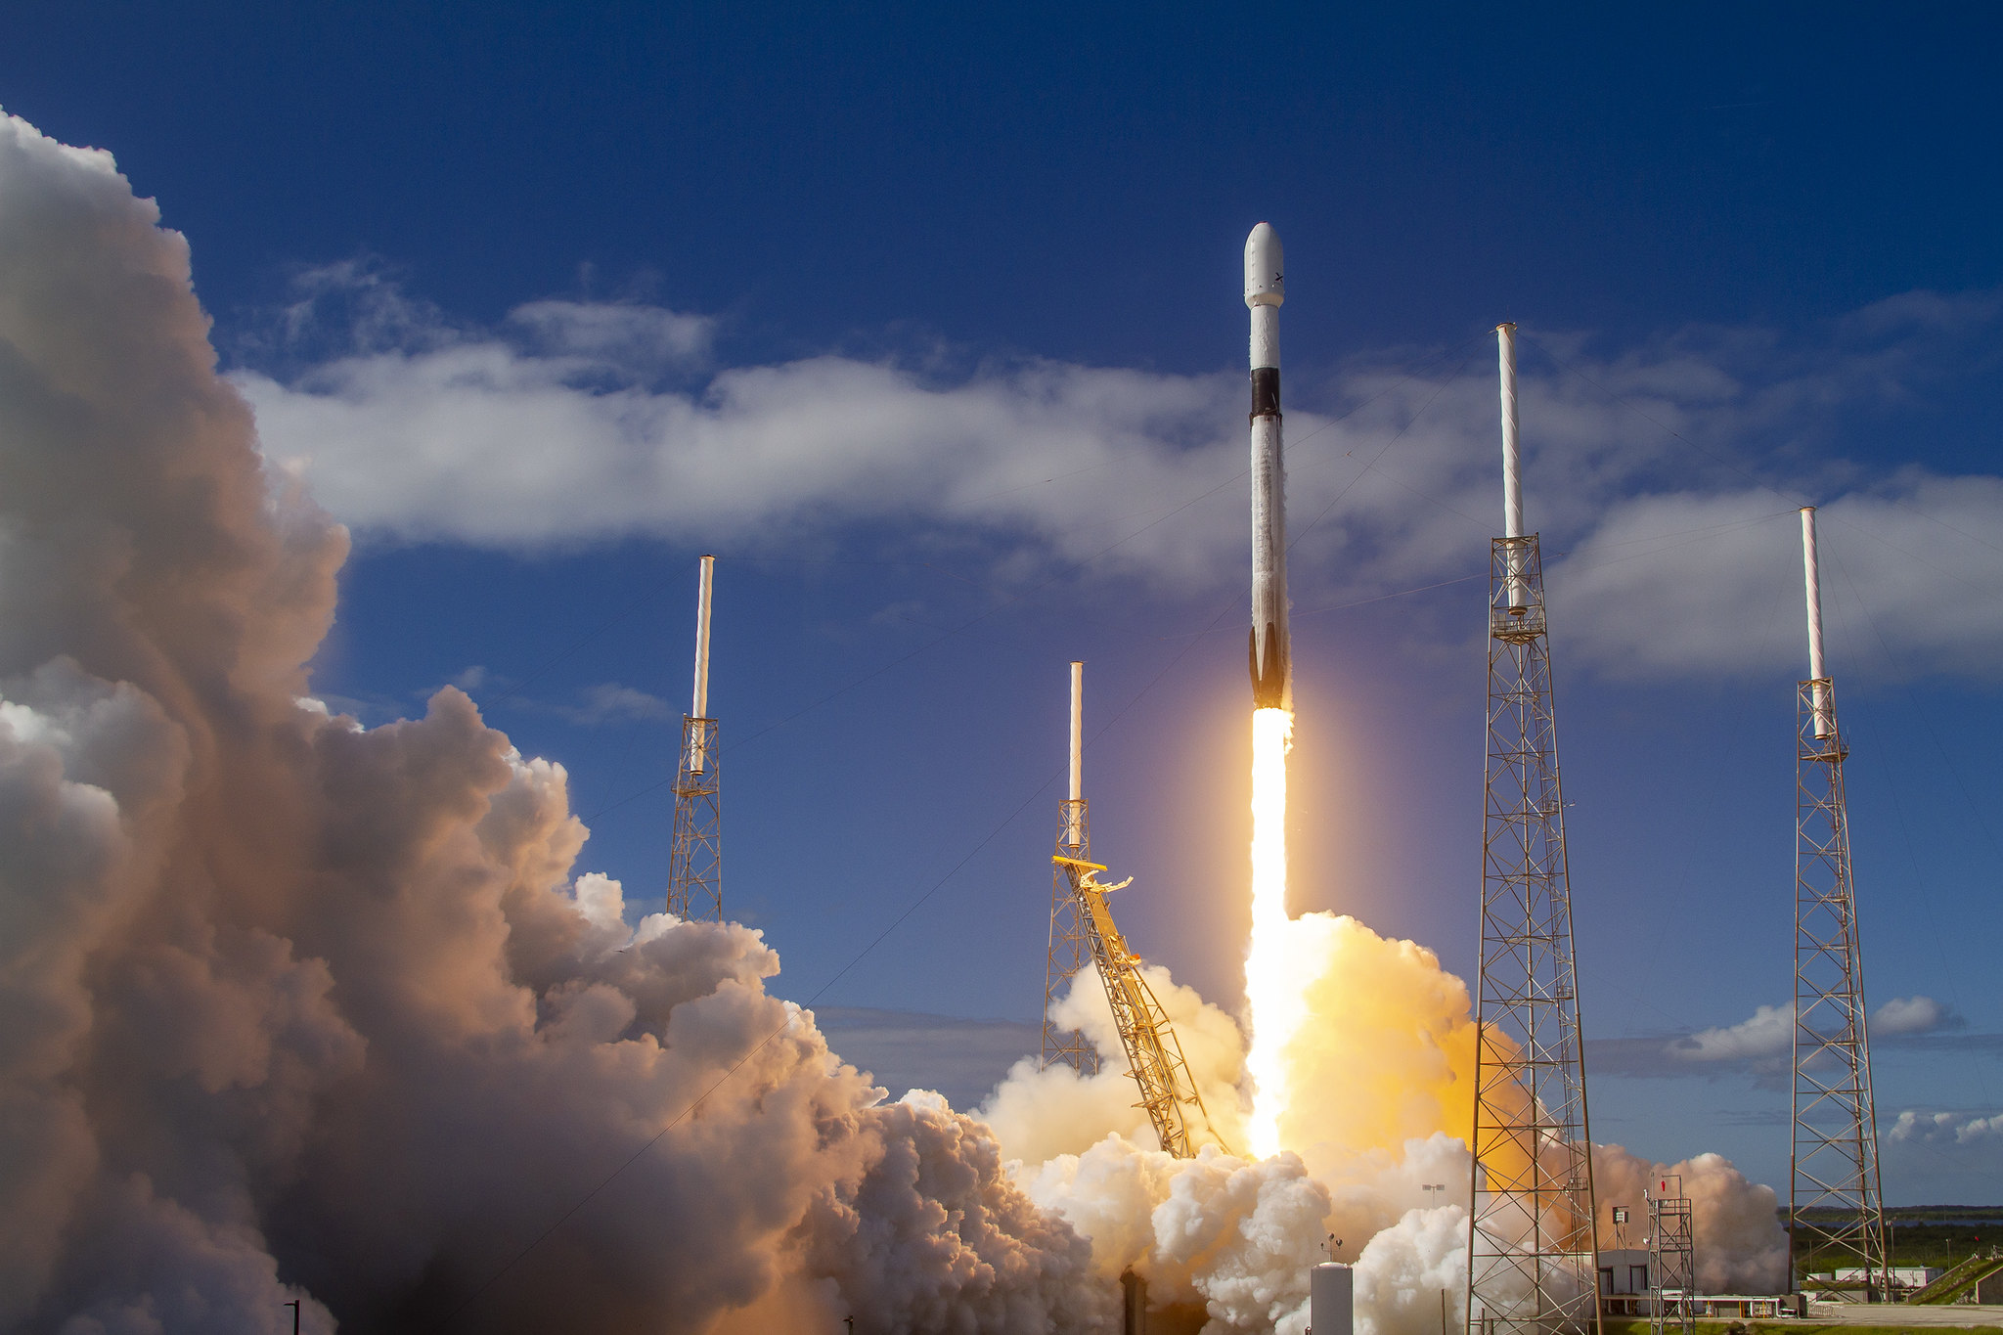


Quantum mechanics
Quantum mechanics is the toolset used to describe many things.
Chemistry
New ways of computing
and transmitting information
Electronics

Slide 16
Course plan
Classical waves
  Interference and diffraction
  Applications: interferometers, spectroscopy, diffraction-limited optics
Wave-particle duality
  Light waves arrive in lumps (photons), and lumps of matter (electrons, protons, etc.) have wave-like properties
  Complex numbers, wavefunction, position/momentum measurement, double-slit experiment, photoelectric effect
Quantum states
  States with definite properties and time-dependent states
  Schrödinger equation
  Particle in a box, quantum harmonic oscillator, energy levels, transitions
Atoms, molecules and solids
  The hydrogen atom, building the periodic table from quantum mechanics
  Electrons in solids: band structure
  Two-state systems: light polarization, quantum mechanical spin
Applications

Slide 17
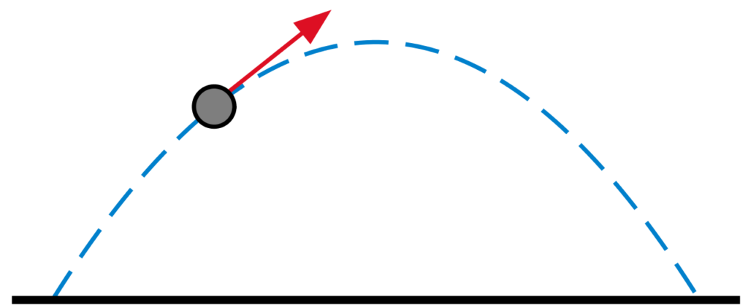
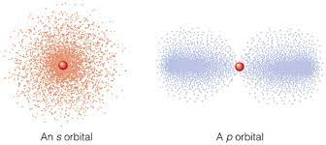
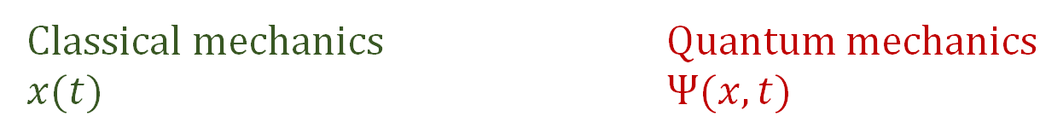
Classical vs quantum
Classical mechanics Quantum mechanics
$x(t)$ $Ψ(x,t)$
Objects have definite position as a function of time
At a given time, we can only describe the probability of observing a particle at a certain position

Slide 18

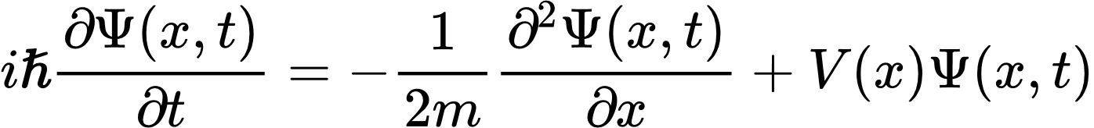
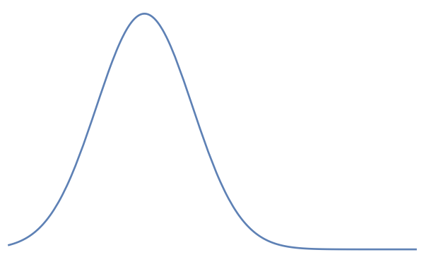
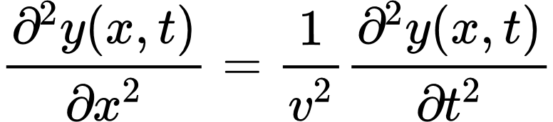


The wavefunction obeys an equation called the Schrödinger equation
is called the particle's wavefunction
describes the position of the particle probabilistically
It obeys the Schrödinger equation
(don't need to understand this yet!)
2
which looks kind of like the wave equation describing waves on a string
so we need to understand these "classical waves" first

Slide 19

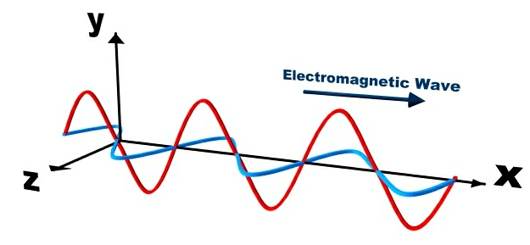



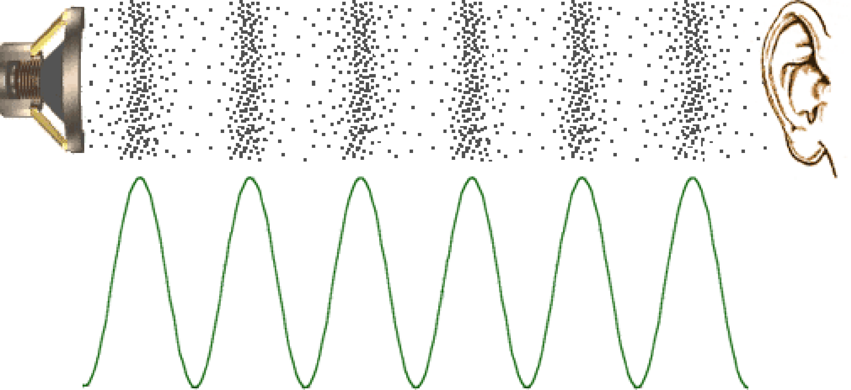
There are many examples of classical waves
a component of electric or magnetic field in a radio wave
height of a water wave
pressure in a sound wave
All satisfy the wave equation (at least approximately)

Slide 20




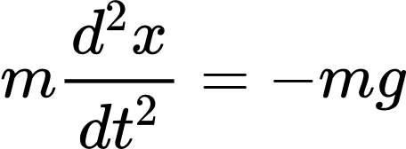
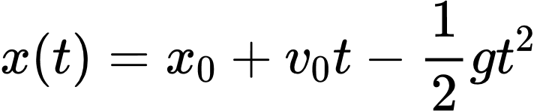

The equations of motion tell us what happens
wave on a string
initial position and velocity
ball
= height of ball above ground
Equation of motion:
Equation of motion:
Guess solution:
Guess a solution:
Check if equation of motion is satisfied
Check if equation of motion is satisfied
Check if initial conditions are satisfied
If so, x(t) describes what the ball actually does!
If so, y(x, t) describes a possible motion of the string!
We are avoiding getting into the details of initial conditions for a string...

Slide 21


We have discovered travelling wave solutions
Note:
can be any shape
We haven't talked about the ends of the string...
The wave speed is a property of the string (depends on tension, mass density) and is same for all waves

Slide 22
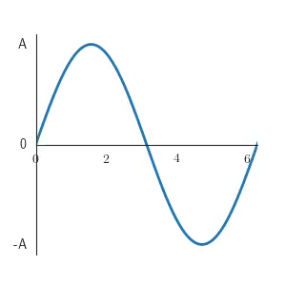





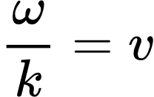
Harmonic travelling waves are travelling waves with a sinusoidal shape
Here is a harmonic travelling wave:
This wave is moving...
A) rightward
B) leftward
C) squidward
and must be related to the wave speed for this to be a true solution. How are they related?
A)
B)
C)

Slide 23
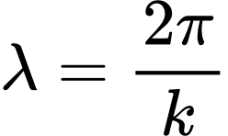
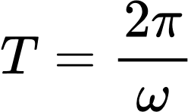


The anatomy of a harmonic travelling wave
amplitude
angular frequency
wavenumber
phase offset
wave speed
period
wavelength
To understand and talk about harmonic waves, it is important to know what these quantities mean and why they are related in these ways
frequency
Notes:
How quickly does the peak move?
When t is 1/f, it completes one cycle, because we just added 2pi to the argument.
In one cycle, the peak moves by $λ$.
So the velocity is delta x/ delta t = $λf$

Slide 24
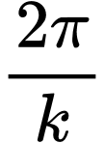

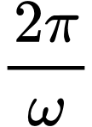


The anatomy of a harmonic travelling wave
amplitude
angular frequency
wavenumber
phase offset
Why is equal to the wavelength ?
Why is equal to the period ?
Why ?
What does the phase offset signify?
To understand and talk about harmonic waves, it is important to know what these quantities mean and why they are related in these ways
Notes:
How quickly does the peak move?
When t is 1/f, it completes one cycle, because we just added 2pi to the argument.
In one cycle, the peak moves by $λ$.
So the velocity is delta x/ delta t = $λf$

Slide 25

Waves transport energy
Sunlight intensity is about 1000 W/m² at Earth's surface. What is the approximate energy absorbed by a perfect 30 cm x 30 cm solar panel during a 10 second interval?
A) 10 J
B) 100 J
C) 1,000 J
D) 10,000 J

Slide 26



Wave amplitude
The amplitude of a wave is the largest (peak) value of the displacement.
height of water in a water wave
component of E-field in a light wave
pressure in a pressure wave
generally called the displacement at x and t

Slide 27
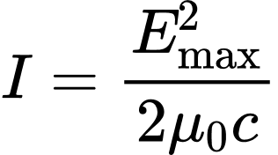




Intensity is proportional to the square of the amplitude
approximately
exactly
For many types of waves, the intensity is (at least approximately) proportional to the amplitude
approximately

Slide 28
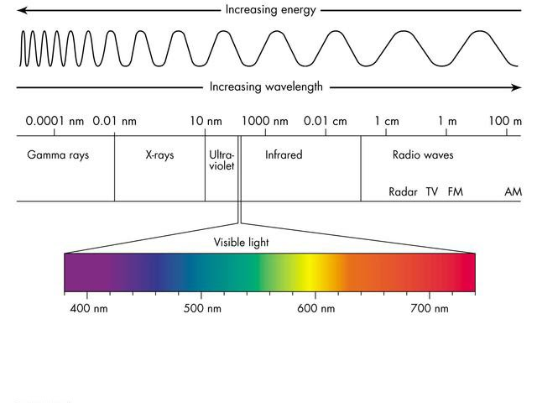
Spectrum of electromagnetic radiation

Slide 29

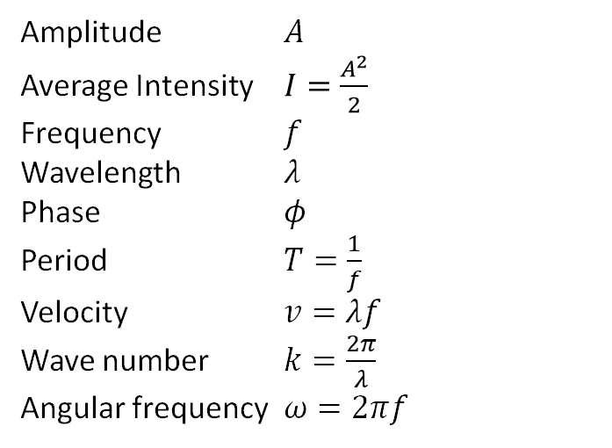
Summary: harmonic waves
Amplitude $A$
Average Intensity $I=\frac{A^{2}}{2}$
Frequency $f$
Wavelength $λ$
Phase $φ$
Period $T=\frac{1}{f}$
Velocity $v=λf$
Wave number $k=\frac{2π}{λ}$
Angular frequency $ω=2πf$
Which quantity most closely corresponds to how loud a sound is?
A) Amplitude
B) Intensity
C) Frequency
D) Wavelength
E) Wave speed
offset

Slide 30
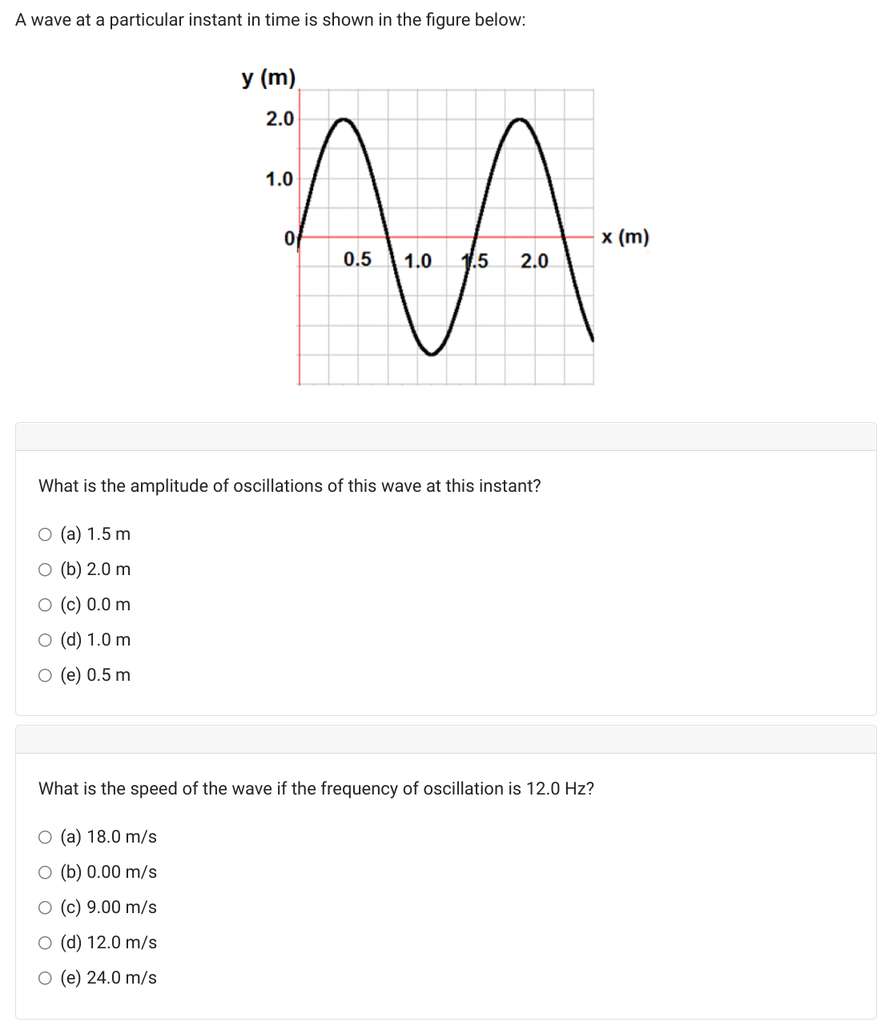
Sample problem

Slide 31

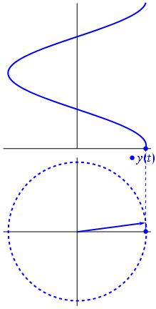


Phasors are a graphical tool for representing and adding harmonically oscillating quantities

Slide 32
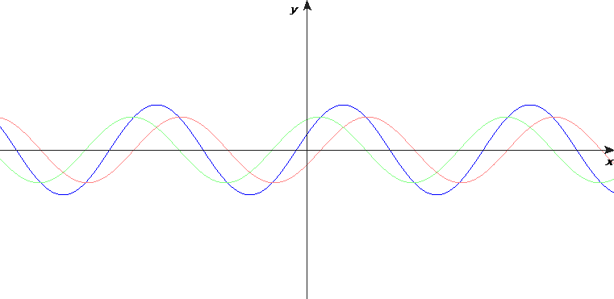







Adding harmonic waves is easier with phasors
What is the intensity experienced by the observer?
Draw and label the phasor diagram
Add the phasors like vectors
Find the length of the resultant
Take the square:
"superposition principle"
If , what is the intensity A² at a point where and
A) A² = 0 B) A² = 4 (A₁)² C) A² = 2 (A₁)²

