Slide 1
Lecture 20: Final review

Slide 2
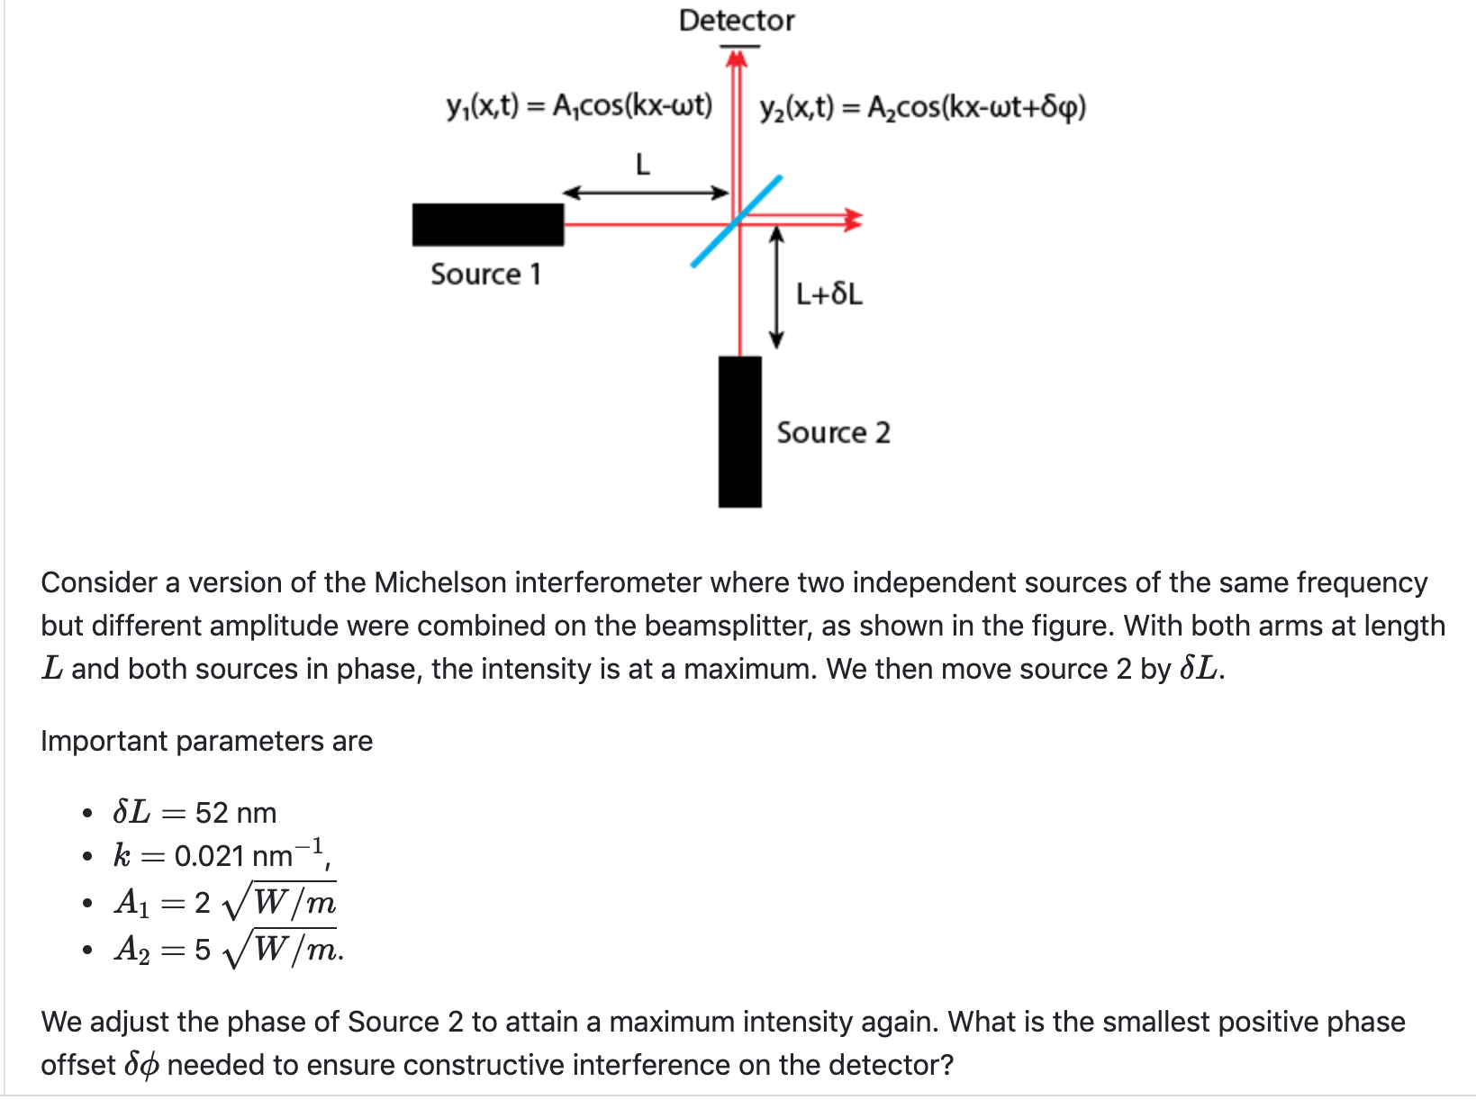

Slide 3
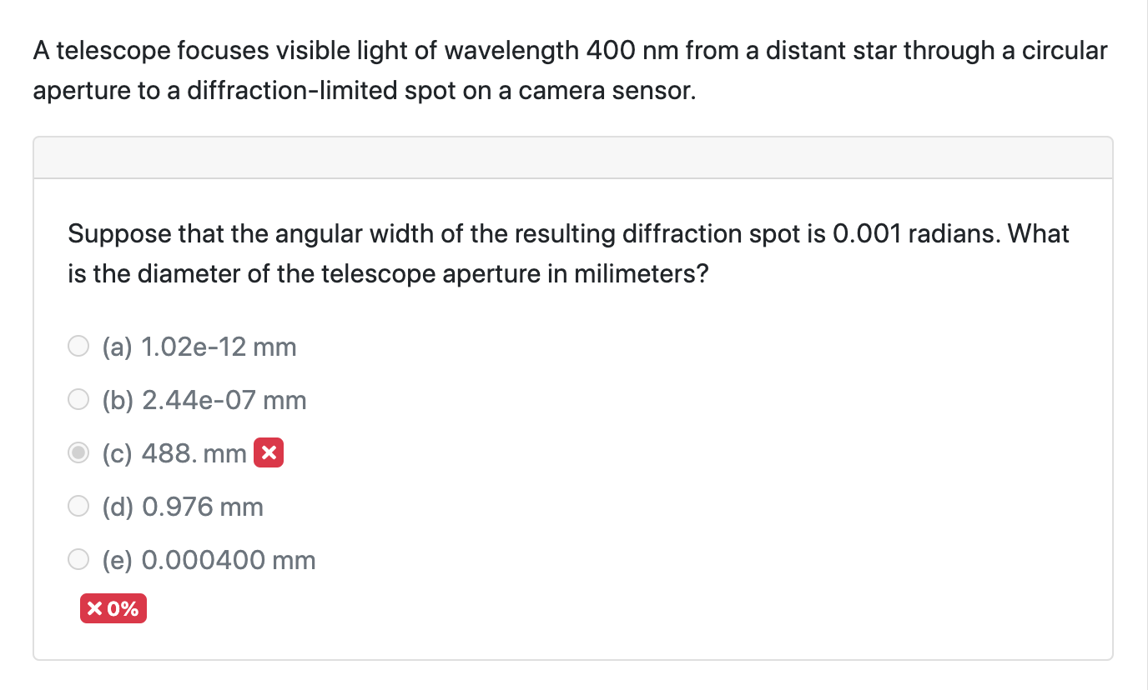

Slide 4
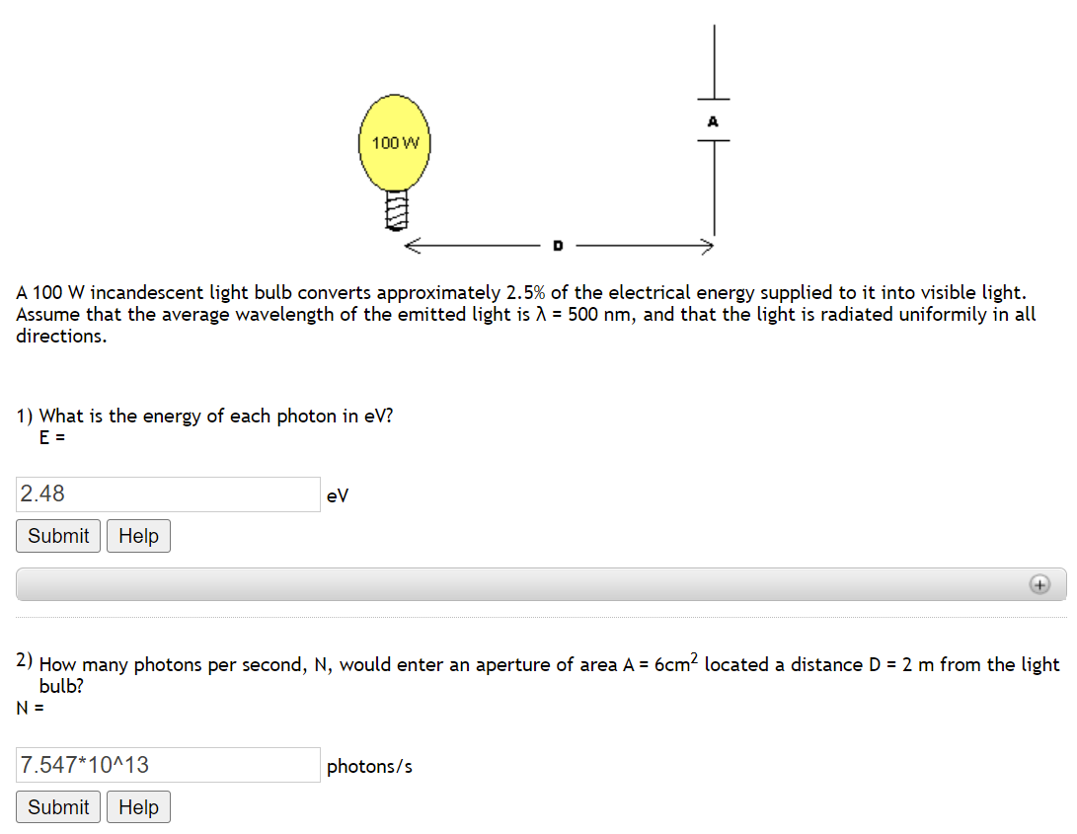

Slide 5
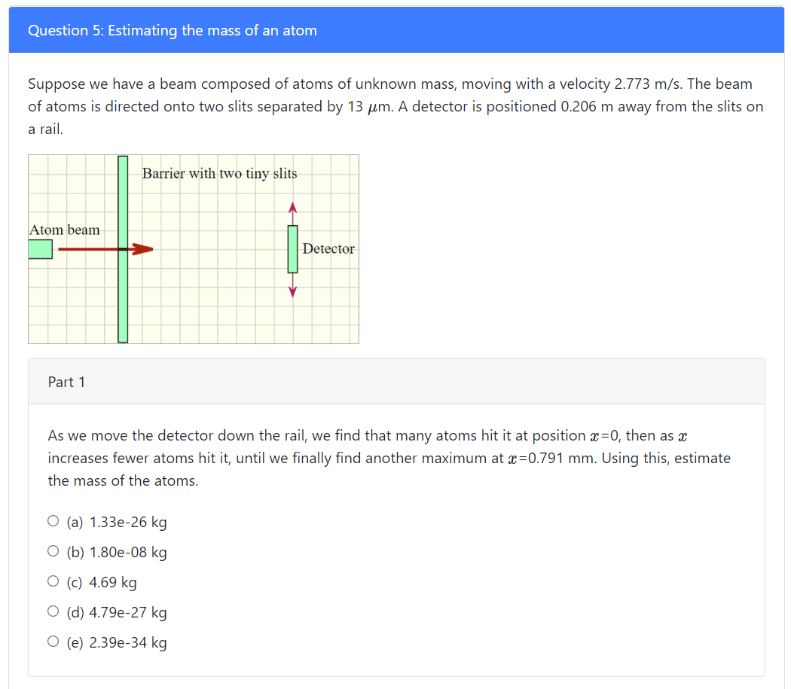

Slide 7
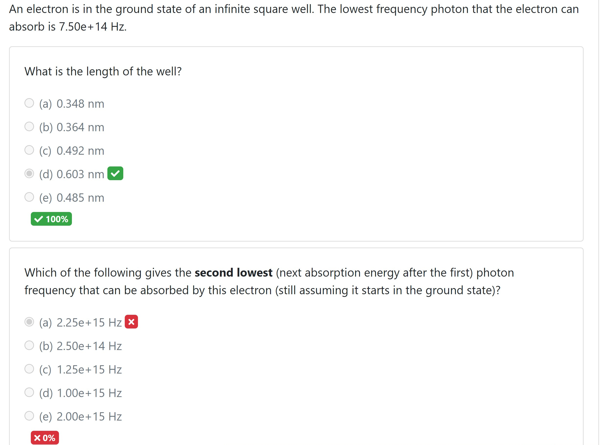

Slide 8
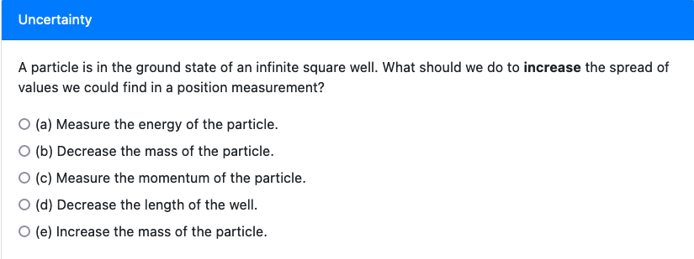
Since p also equals m * v, why does decreasing mass not produce the same effect?

Slide 9
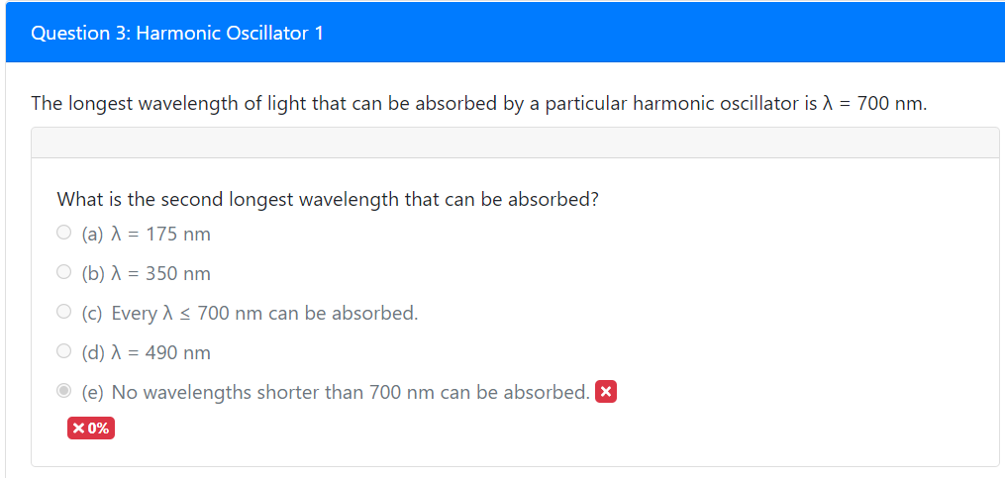

Slide 10
Unit 5-8: quantum description of matter
Use the relationship of a particle’s momentum and wavelength to compute the outcome of interference experiments.
Explain whether a wave function has definite momentum.
From a superposition of eigenstates, determine the probability of a measurement.
Apply the Heisenberg Uncertainty principle to determine the limits of what can be predicted about measurement outcomes.

Slide 11
Eigenstates
Which wave function has definite momentum?
$Ae^{ikx}$
$\operatorname{Acos}\left(kx\right)$
${Ae}^{−kx^{2}}$
What is the value of the momentum?
$k$
$hk$
$ℏk$

Slide 12
Momentum and wavelength
An electron with velocity $v$ is incident on a 2-slit experiment. What equation will give the angle of the first maximum in terms of the distance between the two slits $b$?
$\sin{θ=\frac{h}{bmv}}$
$\sin{θ=\frac{bm}{hv}}$
$\sin{θ=\frac{hv}{bm}}$

Slide 13
Superposition of eigenstates
Suppose that $ψ_{1}$ has definite position $x_{1}$ and $ψ_{2}$ has definite position $x_{2}$. Both are normalized.
If the wave function is $N\left(5ψ_{1}−7iψ_{2}\right)$, then what is the right probability of measuring $x_{2}$?
1/2
$7^{2}$
$−7^{2}$
$\frac{7^{2}}{5^{2}+7^{2}}$
$\frac{{−7}^{2}}{5^{2}+7^{2}}$

Slide 14
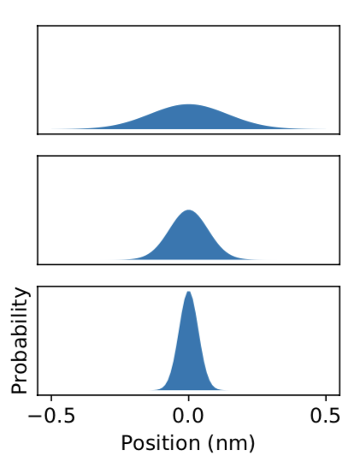
Heisenberg uncertainty
A
Probability densities on the left.
Suppose we measure momentum of this particle. Which will have the largest spread of possible momentum values?
B
C

Slide 15
Unit 8: time independent Schrödinger eqn
Check whether wave functions satisfy the time-independent S.E.
Relationship between wavelength, momentum, and energy for a free particle.
Compute energies for the infinite square well, and what photon energies can be absorbed/emitted.

Slide 16
Satisfying the time independent Schroedinger equation (twofer)
For a free particle, how can we satisfy the time independent S.E.?
a) $\sin{\frac{2πx}{L}}$ for $0<x<L$, 0 otherwise
b) $Ae^{−kx}$
c) $Ae^{ikx}$
$$\frac{−ℏ^{2}}{2m}\frac{∂^{2}Ψ(x)}{∂x^{2}}+U\left(x\right)Ψ\left(x\right)=EΨ(x)$$

Slide 17
Energies of the infinite square well
An electron is in an infinite square well. Starting in the ground state, the longest wavelength that it can absorb is $λ$. What is the length of the well $L$?
$\frac{hc}{λ}=\frac{{4ℏ}^{2}π^{2}}{{2mL}^{2}}$
b) $\frac{hc}{λ}=\frac{h^{2}}{{8mL}^{2}}(3^{2}−1^{2})$
c) $\frac{hc}{λ}=\frac{ℏ^{2}π^{2}}{{2mL}^{2}}(2^{2}−1^{2})$

Slide 18
Unit 9: Energy levels and harmonic oscillator
Use the allowed energies for a system to explain whether it is more likely that the system is described by a harmonic oscillator or infinite square well potential.
The levels of a harmonic oscillator are given by $\left(n+\frac{1}{2}\right)ℏω$, with $ω=\sqrt{\frac{k}{m}}$

Slide 19
Chemical bonds
Chemical bonds are well-described by harmonic oscillators. What is true about the photons that can be absorbed by a vibration in a material, assuming it starts in its ground state?
It can only absorb one frequency of light.
It can absorb frequencies of light that are $nC$, with $C$ a constant.
It can absorb frequencies of light that are $n^{2}C$, with $C$ a constant.

Slide 20
Unit 10: Many electrons
Determine the ground state of a system of non-interacting electrons using energy level diagrams
Be able to determine whether a material is transparent from the energy levels and filling.
Be able to determine whether a material is metallic from the energy levels and filling.

Slide 21
Filling energy levels
1 million eV
There are 3 electrons in this material. What is the lowest energy photon that it could absorb?
1 eV
2 eV
3 eV
4 eV
5 eV
Nothing in between!
5 eV
4 eV
1 eV
What is the energy of the second excited state?
4 eV
5 eV
9 eV
10 eV
14 eV

Slide 22
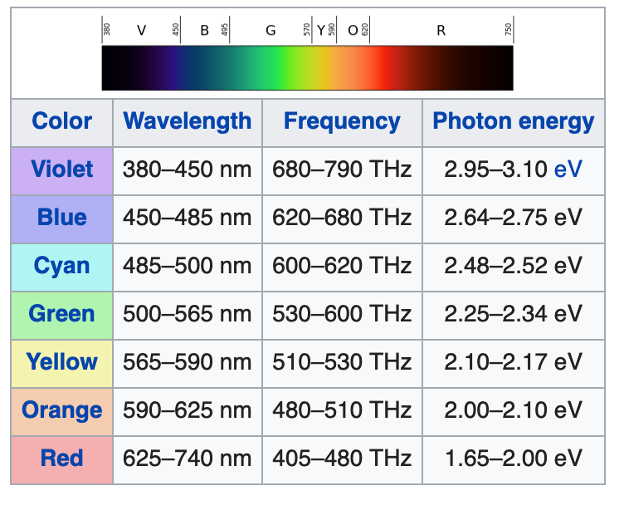
Unit 11: Energy levels
Empty levels
A material has energy levels as diagrammed.
What is true about the material?
It will conduct electricity very well.
Red light will pass through it.
Blue light will pass through it.
2.5 eV gap
Filled levels

