Slide 1
Acoustic Word Embeddings

Slide 2
Acoustic Word Embeddings (AWE)
Textual word embeddings map words to meaning and are thus based on semantics. Different words can map to a similar location in the features space even though the letters composing the word are not the same.
Acoustic word embeddings map varying acoustic patterns to the same token (word) in the feature space.

Slide 3
Acoustic Word Embeddings (AWE)
Goal is to create fixed-length representations of varying-length utterances such that utterances of the same word are close together in the feature space. Fixed-length representations allow similarity to be computed using some distance metric.

Slide 4
Different approaches to train AWEs
Downsampling / dimensionality reduction
Bottleneck Autoencoder-based reconstruction
Multimodal AWEs
Word Embeddings
Character embeddings
Image embeddings
Siamese / triplet training
Phonetic information
Linguistic information

Slide 5
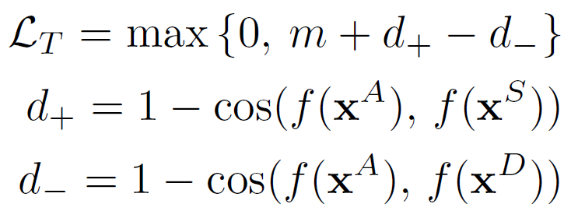
Learning Acoustic Word Embeddings With Phonetically Associated Triplet Network¹
Goal: Include phonetic information in the creation of acoustic word embeddings
Triplet Loss: encourage anchor and same sample to be close and anchor and different sample to be far apart

Slide 6
Loss Function
Triplet loss is at the utterance level but phonetic state loss is at the frame level
Monophone and tied-triphone states are from Kaldi forced alignment

Slide 7
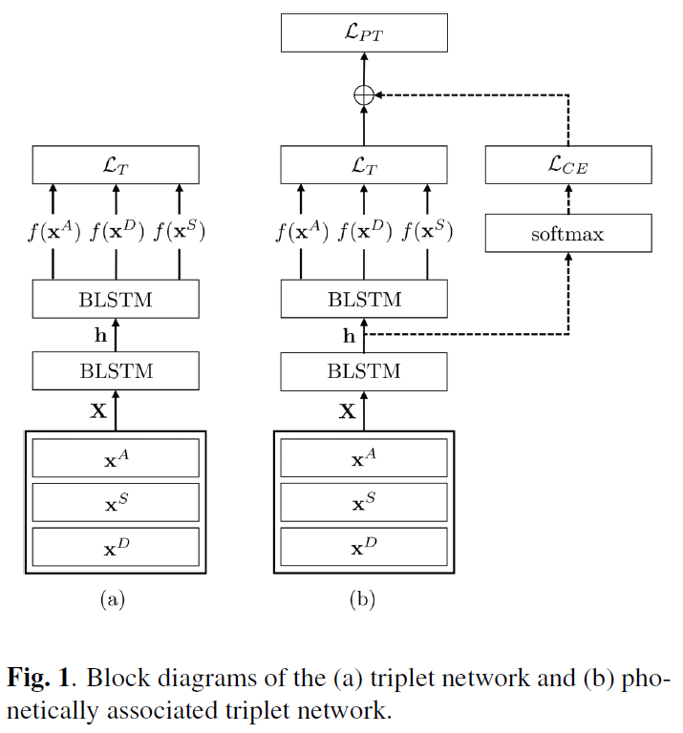
System Diagram

Slide 8
Experiments
Word discrimination: (1) Enrollment – pass 5 reference utterances through trained network and take mean of embeddings (2) Verification – pass test utterances through network and take cosine distance with respect to enrollment embedding
By adjusting distance threshold, a false alarm rate (1FA/hour) can be set. Recall is calculated with this threshold.

Slide 9
Data
100k triplets are generated from the WSJ SI-284 training set for training the model
WSJ eval92 and eval93 are used as in-domain test data
Training data from the RM database are used as out-of-domain data
Audio represented as 40-dimensional Mel filterbank log energy

Slide 10
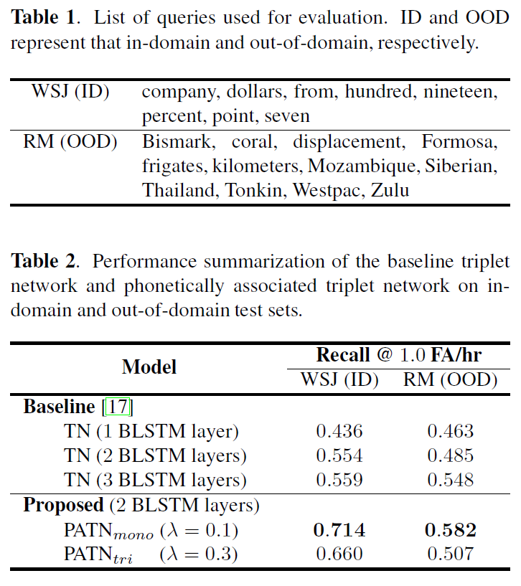
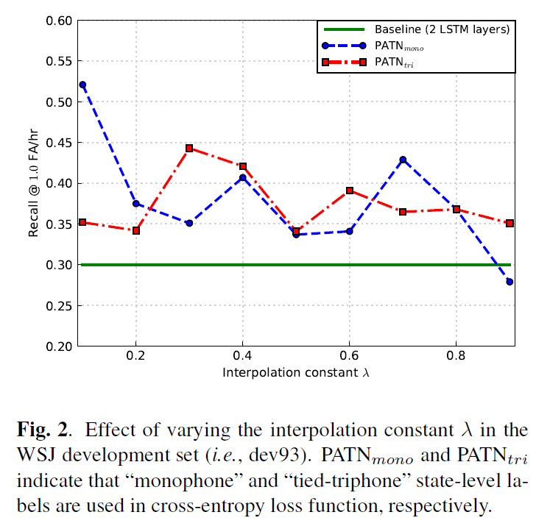
Numerical Results

Slide 11
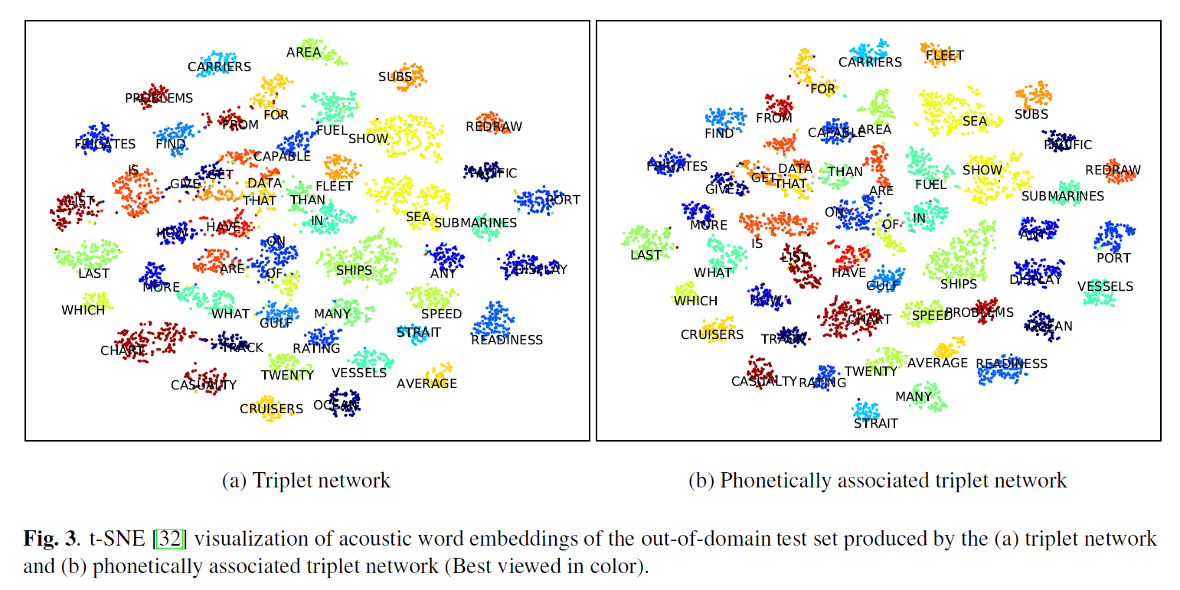
Qualitative Results

Slide 12
Query-by-Example Speech Search Using Recurrent Neural Acoustic Word Embeddings With Temporal Context²
Query-by-example (QbE): search for query in collection of audio
DTW has been used for this task but is computationally expensive
Applicable in low-resource scenario: only need labeled word pairs for target language. No need for pronunciation lexicon or phoneme definitions.

Slide 13
Method
Learn AWEs suitable for QbE search: Traditional AWEs are trained with isolated speech segments; QbE involves searching through continuous speech
Solution: provide context during training for AWEs

Slide 14
Bottleneck Features (BNF)
Audio is padded to a fixed length determined by longest isolated word in dataset
Feedforward network maps 39-dimension Fbank plus pitch features to tied triphone states. Hidden layer of dimension 40 used as frame-level BNF.

Slide 15
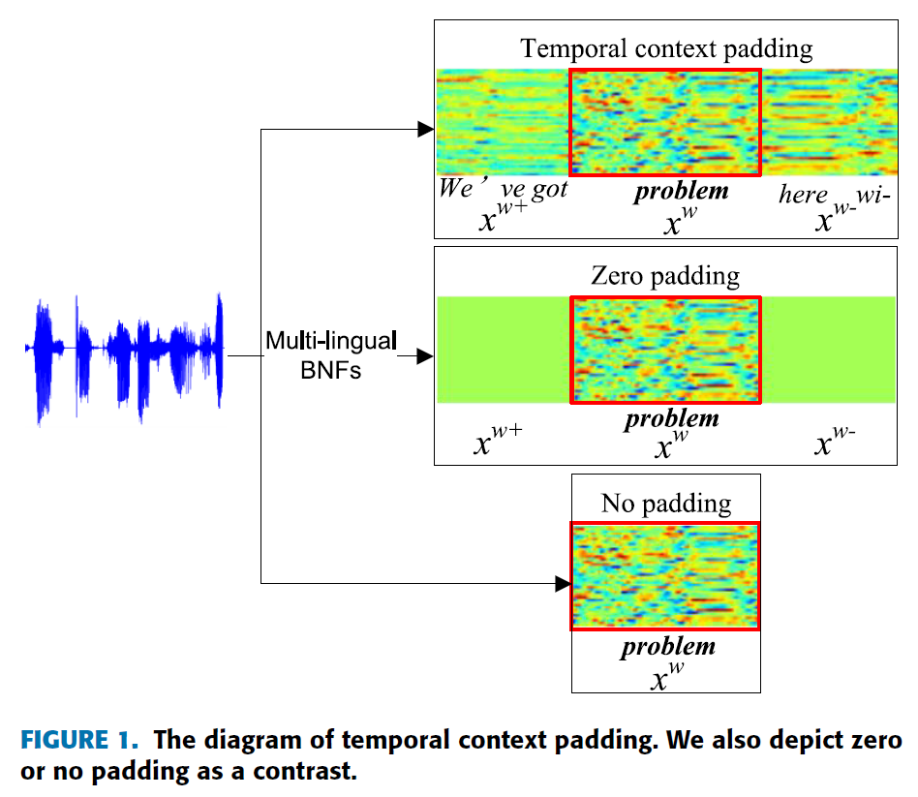
Context

Slide 16
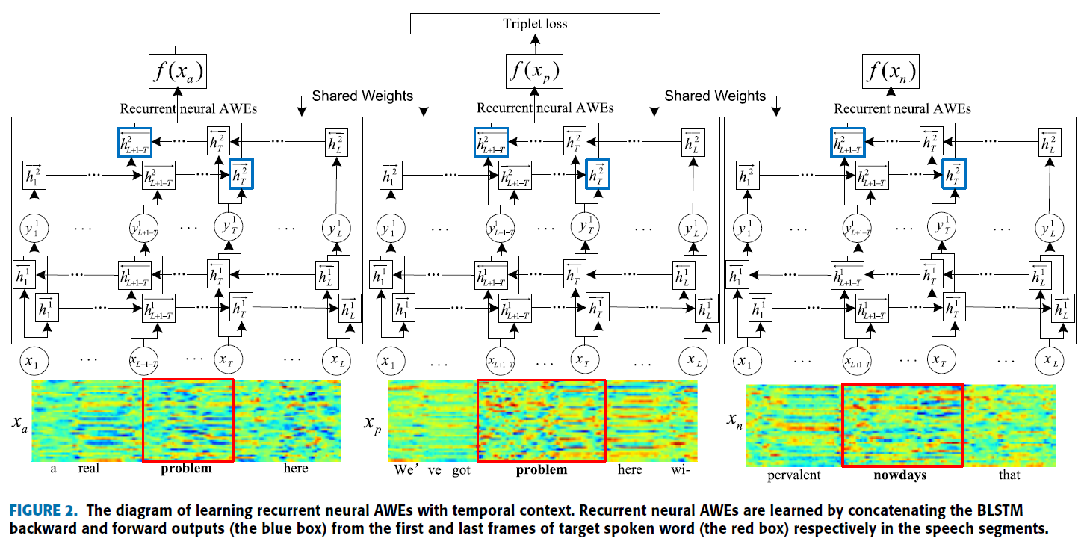
System Input and Triplet Loss

Slide 17
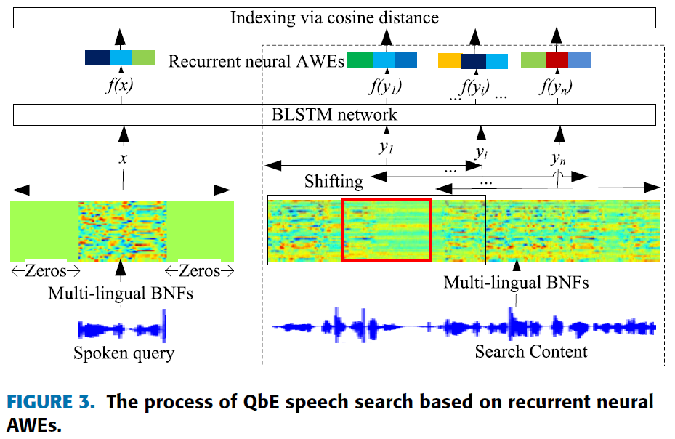
Search

Slide 18
Tradeoff
Context padding reduces performance on isolated words, but improves performance on continuous speech

Slide 19
Best Features
Multilingual BNFs are better input features than MFCCs. BNF representation was trained with tied triphone prediction task.

Slide 20
Linguistically-informed Training of Acoustic Word Embeddings for Low-resource Languages³
Motivation – Phonetic information should guide triplet generation
Two methods proposed
A triplet-based approach to group all utterances sharing same stem into the same class to generate anchor + positive pairs
MSE-based approach using phonetic edit distance between pairs of words as supervision for the distance of their trained acoustic embedding vectors

Slide 21
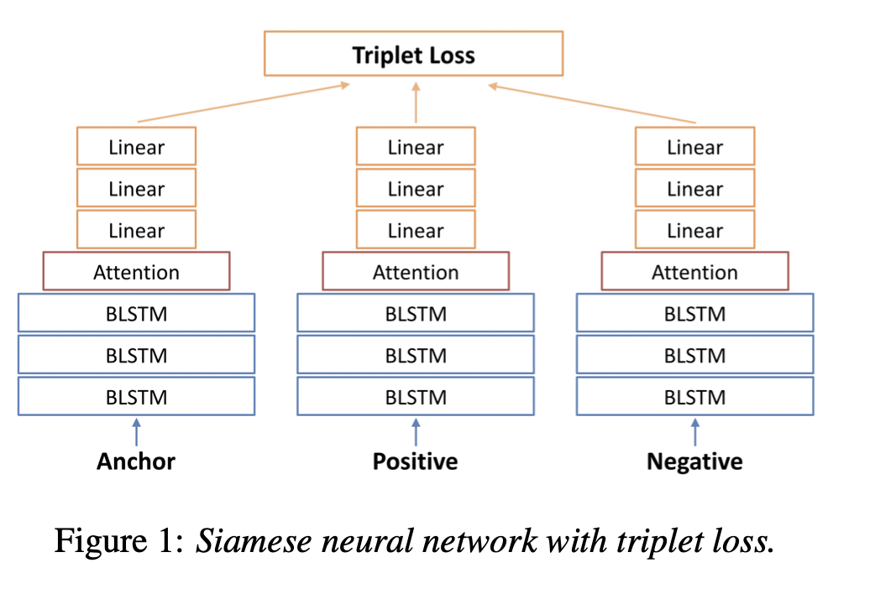
Architecture
First method
Second method
MFCC features for anchor / positive / negative inputs

Slide 22
Experiments – Switchboard query-by-example
‘Low resource’ setting – ~2 hours of training data
Words occurring at least twice are chosen in the train set
Duration between 0.5s to 2s
On the test set, task is further simplified
Instead of retrieving words using a query, test-set has word pairs. Using learnt representations for the words, word-pairs are classified as same or different based on a distance metric

Slide 23
Experiments – Zero Resource setting on Sinhala
Setting - Model only trained on English (full Switchboard corpus), directly applied to Sinhala
Hypothesis – AWEs learnt from one language, can be applied to embed the phonemes / orthography from another language
Motivation – Emergency responders not knowing a local language need to be able to extract relevant information
Dataset – Generated by native speakers uttering translations from ‘situation frames’ in the Switchboard corpus

Slide 24
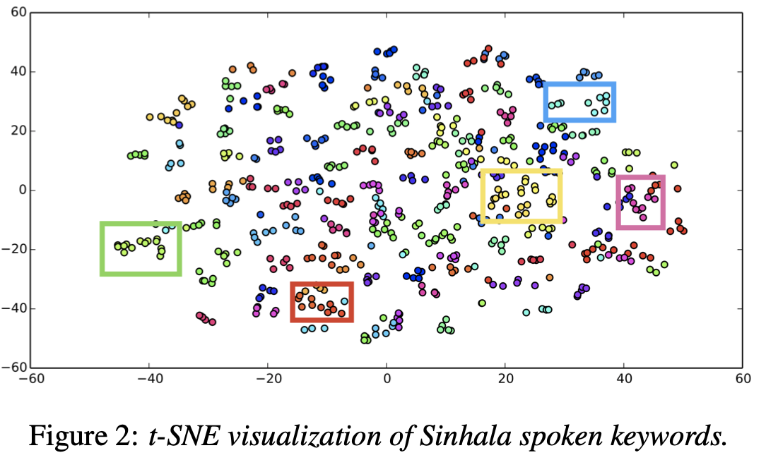
Experimental results
Phonetic Sim measures the Pearson correlation between
i. Average word embedding distance between each word in the test-set with every other word, AND
ii. Their phonetic edit distances
Boxes denote words with similar phonetic / semantic attributes

Slide 25
MULTI-VIEW RECURRENT NEURAL ACOUSTIC WORD EMBEDDINGS⁴
Jointly learning to embed acoustic sequences with orthographic (character) sequences for single words
Benefits of Multiview (joint) embedding approach
Acoustic and character embeddings correspond to each other, and can be used for different tasks
Allows for multiple formulations of triplet generation scheme

Slide 26
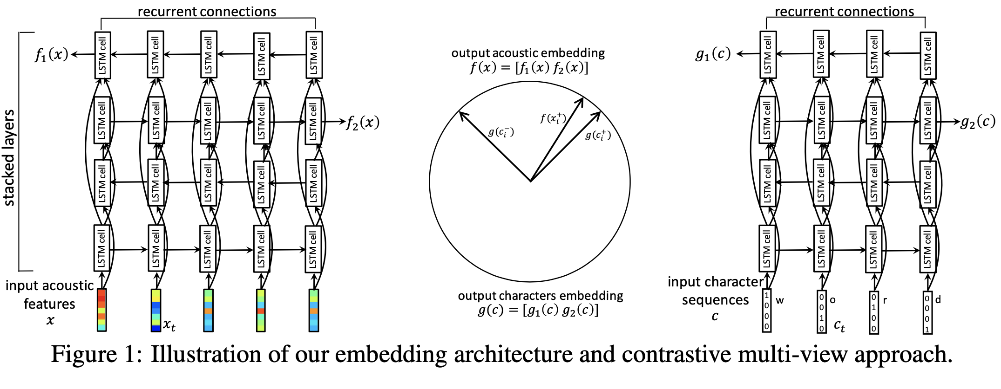
Architecture

Slide 27
Various versions of Multiview Contrastive Loss

Slide 28
Task and Dataset
Dataset – Full switchboard corpus, words between 0.5 – 2s long
Evaluated on word discrimination task, i.e. predicting whether two words in a pair are same or different based on cosine similarity
Acoustic discrimination – both words are acoustic sequences
Cross-view discrimination – word-pairs have one acoustic sequence and one as character sequence

Slide 29
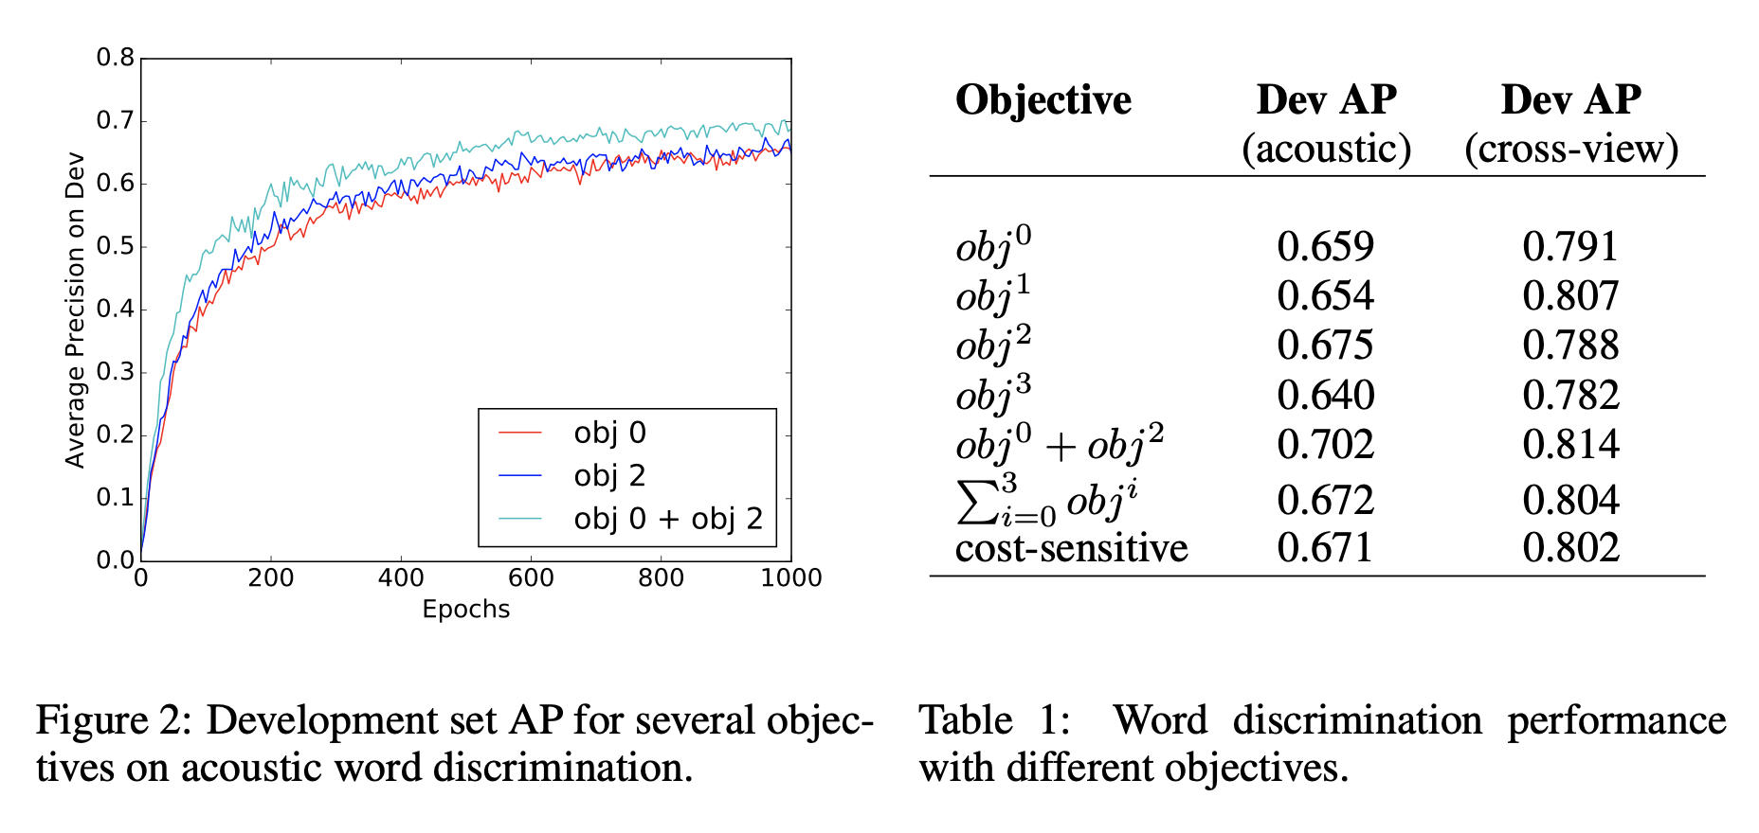
Experimental results

Slide 30
Discussion
Negative triplet sampling is uniformly done over character / acoustic examples
A symmetrized loss function (obj⁰ + obj²) works best
Analysis of correlation between learnt embedding with orthographic edit distances shows weak but consistent trend

Slide 31
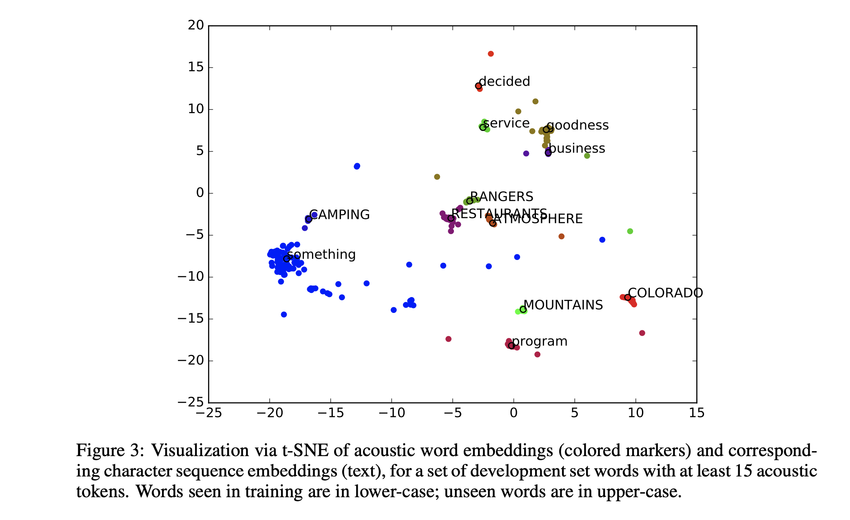
t-SNE plots - acoustic embeddings

Slide 32
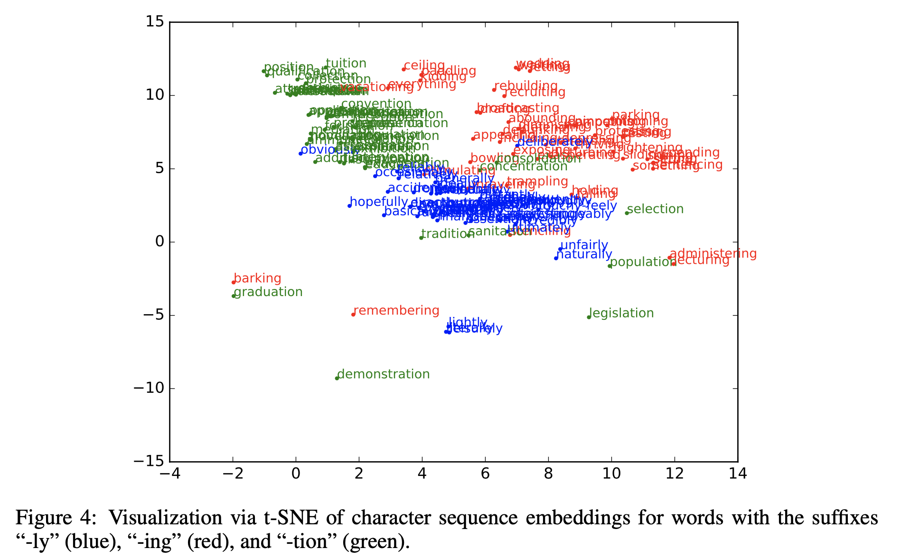
t-SNE plots - character embeddings

Slide 33
Future AWE Research
Instead of applying phonetic information at the frame level, apply it at the word level by sorting words based on articulatory feature distances. Train with smaller margin between different words that are more acoustically similar and larger margin for very dissimilar words.
Speech recognition using AWEs – some work exists by checking different segments (https://arxiv.org/abs/2007.00183), but we want to try using sliding window approach as input features for text or phone-based CTC recognition.

Slide 34
References
[1] - Hyungjun Lim, Younggwan Kim, Youngmoon Jung, Myunghun Jung, Hoirin Kim, “Learning acoustic word embeddings with phonetically associated triplet network”, ICASSP 2019
[2] - Y. Yuan, C. Leung, L. Xie, H. Chen and B. Ma, "Query-by-Example Speech Search Using Recurrent Neural Acoustic Word Embeddings With Temporal Context," in IEEE Access, vol. 7, pp. 67656-67665, 2019, doi: 10.1109/ACCESS.2019.2918638.
[3] - Z. Yang and J. Hirschberg, “Linguistically-informed training of acoustic word embeddings for low-resource languages,” Proc. Interspeech, 2019
[4] - Wanjia He, Weiran Wang, Karen Livescu, “Multi-view Recurrent Neural Acoustic Word Embeddings”, ICLR 2017

