Slide 1
Frame-Level Stutter Detection
John Harvill¹, Mark Hasegawa-Johnson¹, Changdong Yoo²
¹University of Illinois Urbana-Champaign
²Korea Advanced Institute of Science and Technology

Slide 2
Introduction
Stuttering:
Repetitions
Prolongations
Abrupt pauses
Interjections
Previous work:
Utterance-level stutter detection
This paper:
New task: Frame-level stutter detection
Evaluation: Stutter correction

Slide 3
Data
SEP-28k:
~28k 3-second chunks of speech (23 hours total)
FluencyBank:
Additional 3.5 hours of speech
Dysfluency types:
Prolongation
Sound Repetition
Word Repetition
LibriSpeech

Slide 4
Features
Resample audio to 16kHz
Extract F0:
Pitch (60-240Hz)
Pitch-delta
Voiced/unvoiced features
Log Mel Spectrogram:
Window size: 64ms
Hop length: 10ms
Mel frequency bins: 80
Limit dynamic range to 120dB

Slide 5
Artificial Stutter Pretraining
Problem: No ground truth frame-level alignments
Solution: Artificially introduce stuttering dysfluencies
Pretraining:
Advantage: Learn acoustic features from larger speech corpus (LibriSpeech)
Advantage: Train model with frame-level stuttering labels (artificial)
Artificial stutter types:
Sound Repetition (SoundRep)
Prolongation (Pro)
Word Repetition (WordRep)

Slide 6
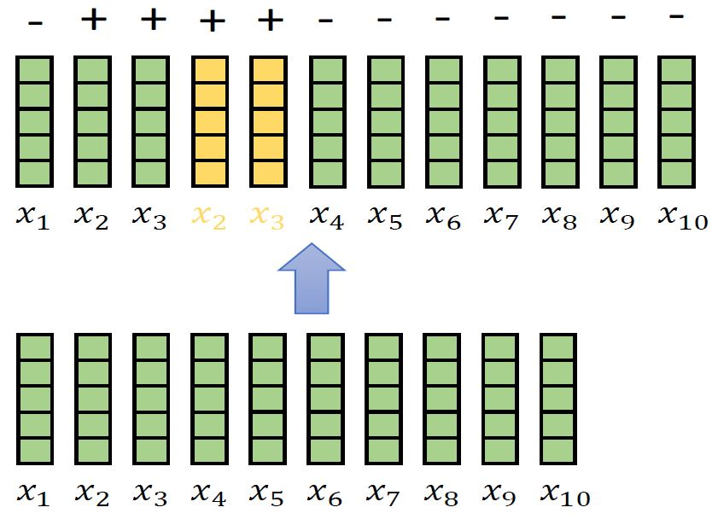
SoundRep
Phone-level alignment
Select phone to be repeated with probability 0.3
Repeat phone 2-5 times

Slide 7
WordRep
Word-level alignment
Select word to be repeated with probability 0.3
Repeat word 2-5 times

Slide 8
Prolongation (Pro)
Phone-level alignment
Select phone to be prolonged with probability 0.2
Stretch phone 2-4 times original length by interpolating spectrogram and pitch features

Slide 9
Frame-level Prediction Finetuning
Input: Sequence of acoustic feature frames: $x_{1},x_{2},…,x_{N}$
Output: Binary probability mass functions: $q_{1},q_{2},…,q_{N}$
Probability of no stuttering (negative label): $q_{n}^{−}$
Probability of stuttering (positive label): $q_{n}^{+}$
Frame with maximum positive class probability: $t_{max}=argmax_{n}q_{n}^{+}$
Crossentropy loss: $L=−p_{utt}^{−}\log\left(q_{t_{max}}^{−}\right)−p_{utt}^{+}log⁡(q_{t_{max}}^{+})$

Slide 10
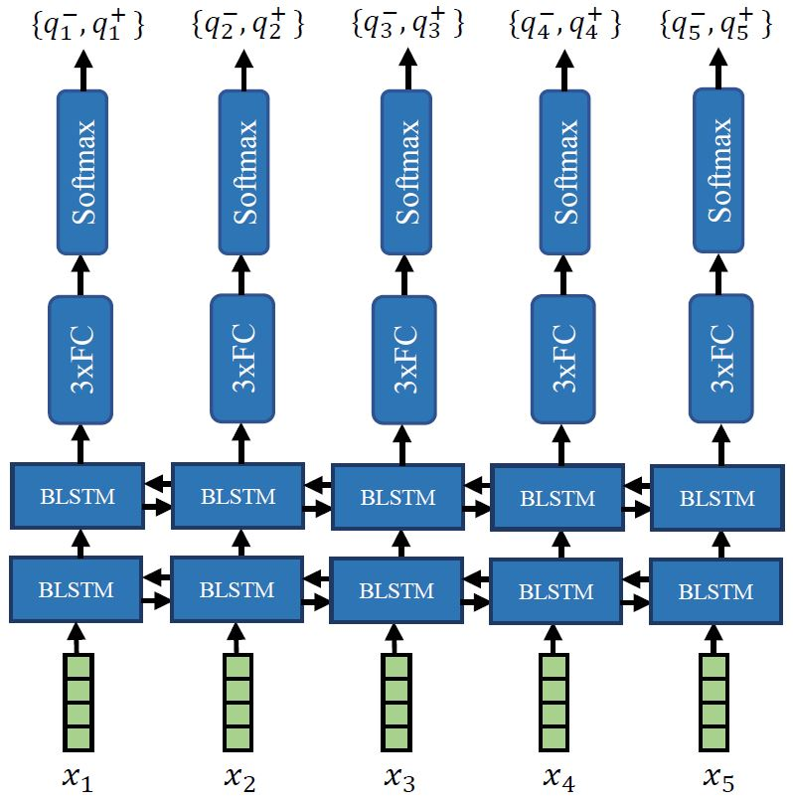
Model Architecture

Slide 11
Experiments
No pretraining (finetuning only)
Method-specific pretraining + finetuning
To recognize sound repetitions, pretrain with SoundRep
Combo pretraining + finetuning

Slide 12
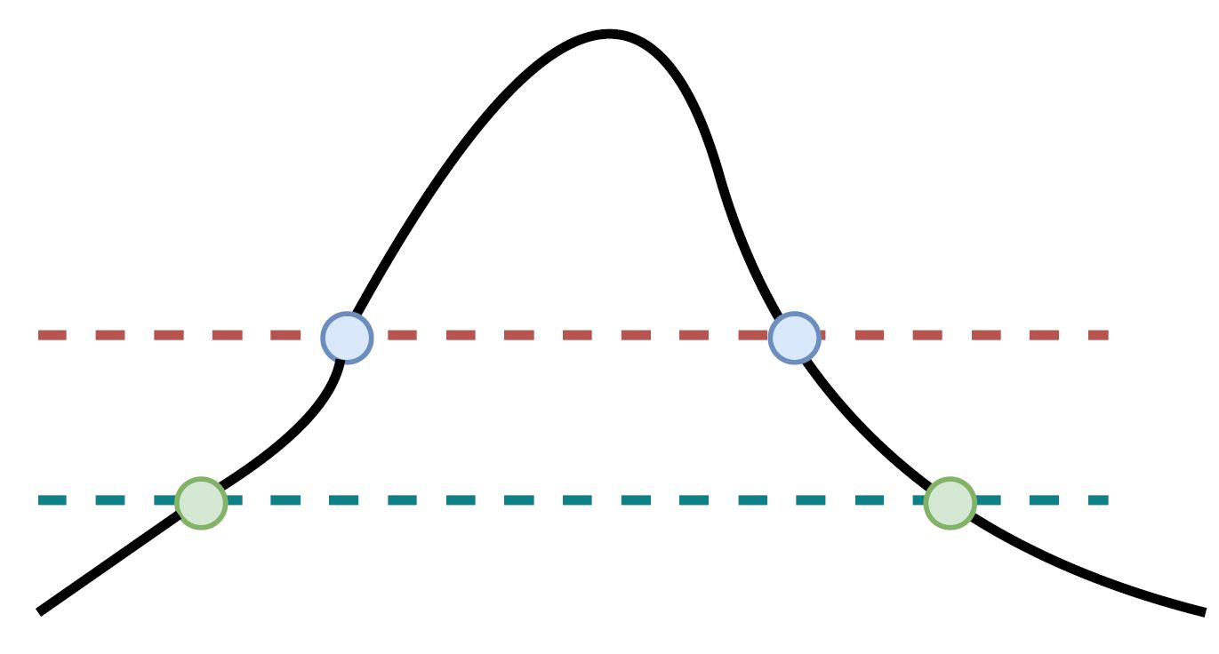
Stutter Correction
Thresholding approach on framewise positive class probability
$T_{up}$ triggers removal
Remove all speech between $T_{down}$
$$q^{+}$$
$$T_{up}$$
$$T_{down}$$

Slide 13
Evaluation
Human evaluations on Amazon Mechanical Turk (AMT)
How much stuttered speech removed? (proxy for recall)
Score 1-5:
1: no stuttering present
5: severe stuttering present
How much non-stuttered speech removed? (proxy for precision)
Score 1-5:
1: speech does not match transcript
5: speech exactly matches transcript

Slide 14
Evaluation
Choose 20 positive stuttered utterances each for Prolongation, Sound Repetition, Word Repetition
Process each sample with:
Different removal thresholds $T_{up}$
Pretraining scheme

Slide 15
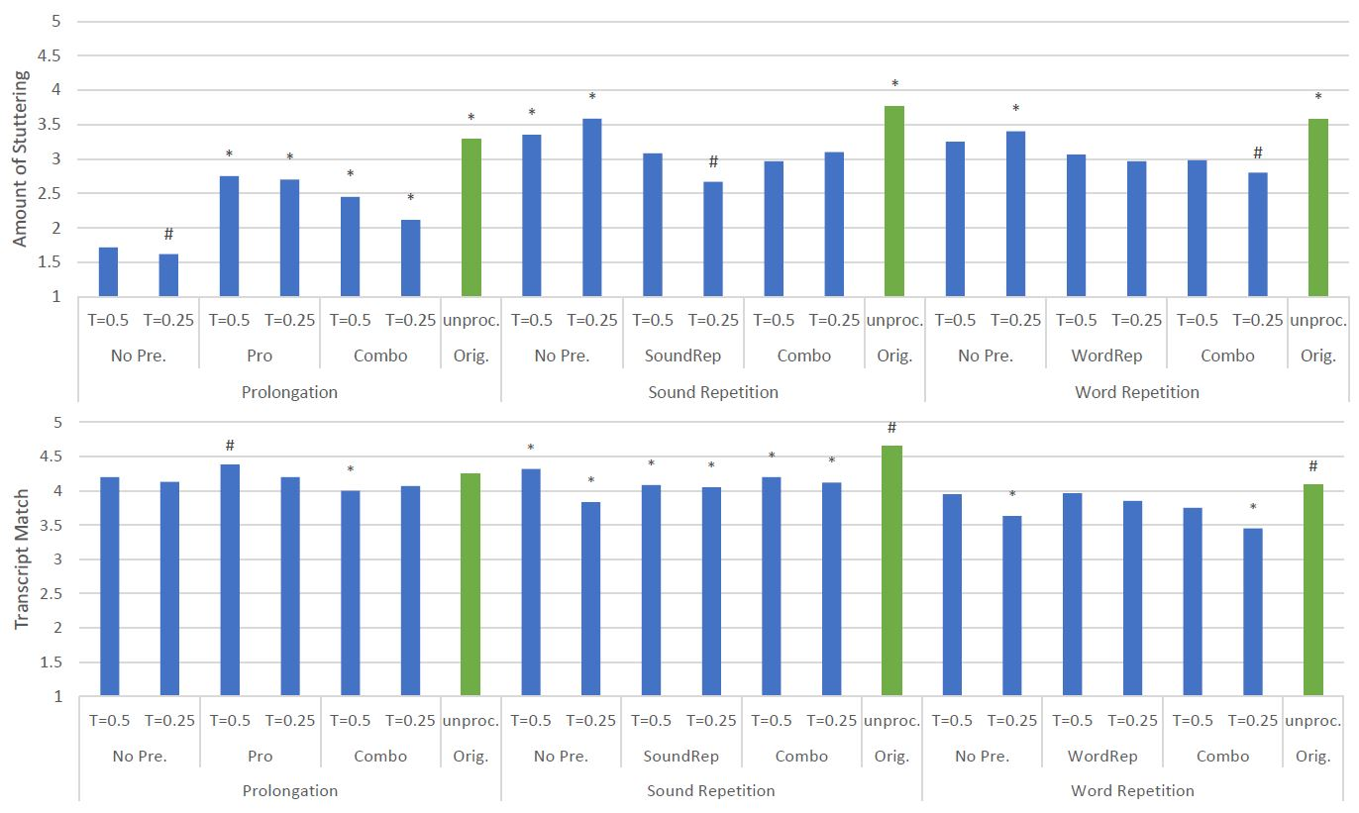

Slide 16
Results
Less stuttering in processed speech

Slide 18
Results
Less stuttering in processed speech
Small reduction in transcript match

Slide 20
Results
Less stuttering in processed speech
Small reduction in transcript match
Model pretraining helps for:
Sound repetition ✔️
Word repetition ✔️
Prolongation ❌

Slide 22
Results
Less stuttering in processed speech
Small reduction in transcript match
Model pretraining helps for:
Sound repetition ✔️
Word repetition ✔️
Prolongation ❌
$T_{up}$ does not affect performance

Slide 24
Conclusions
Proposed frame-level stutter detection approach
Artificial stutter pretraining
Multiple-instance learning via max-pooling
Future work:
Improve stuttered or dysarthric ASR via:
Preprocessing via stutter correction
Frame-level stutter probabilities as auxiliary feature

Slide 25
Thank you for listening
Contact email: harvill2@illinois.edu

