Slide 1
Generating Sense-specific Example Sentences with BART

Slide 2
Goal
Generate sentences using BART by encouraging the target word to appear in the sentence with the desired definition (sense).
Ex: cool (fashionable and attractive at the time; often skilled or socially adept) - “It's not cool to arrive at a party too early“
Ex: cool, chill, cool down (loose heat) - "The air cooled considerably after the thunderstorm"

Slide 3
Approach
Vanilla autoregressive generation models the probability of a sequence $Y$:
$$p\left(Y\right)=\prod_{t=0}^{N−1}{p_{θ}(y_{t}|y_{<t})}$$
In this work, we additionally condition on the target word $w$ and the contextual representation $c$ of that word from another sentence where it has the desired sense:
$$p\left(Y\right)=\prod_{t=0}^{N−1}{p_{θ}(y_{t}|y_{<t},w, c)}$$

Slide 4
Approach
Two components:
Contextual word encoder: Use pretrained Bi-Encoder Model (BEM) (https://aclanthology.org/2020.acl-main.95.pdf)
Conditional text generator: BART – given meaning representation $c$ from BEM and the target word $w$, generate a sentence with the target word having the desired sense.

Slide 5
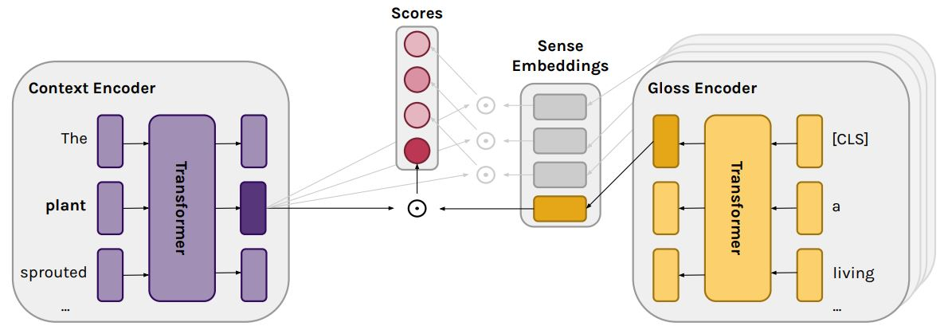
BEM

Slide 6
BEM
We condition on the output of the context encoder

Slide 7
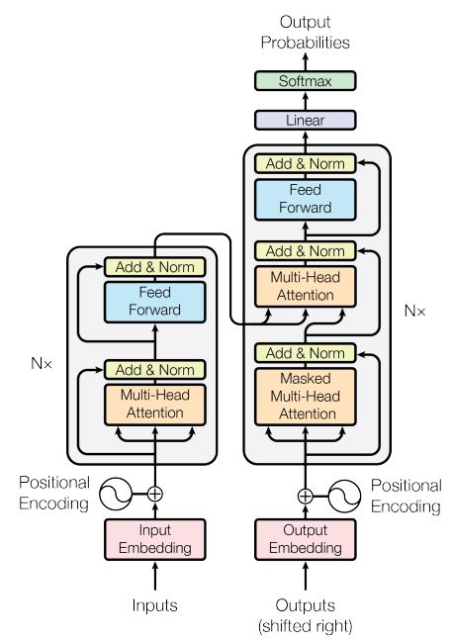
BART

Slide 8
BART
Encoder

Slide 9
BART
Decoder
Encoder

Slide 10
Self-supervised Decoder Training
Randomly choose polysemous target word from training sentence (from any text corpus). Pass sentence through BEM contextual word encoder and take the contextual embedding at the output for the target word.
Similarly, pass the target word through the BART encoder.
Concatenate the BEM contextual embedding to all timesteps of BART encoder output, then pass to BART decoder.
Encourage BART to reconstruct the training sentence via cross-entropy loss. Only update BART parameters (BEM is frozen).

Slide 11
Self-supervised Decoder Training
They might win the game. </s>
BART Decoder
BEM Encoder
BART Encoder
<s> They might win the game. </s>
They might win the game.
<s> might </s>

Slide 12
Self-supervised Decoder Training
Resolve meaning
Context invariant (doesn’t encode other words in sentence)
They might win the game. </s>
BART Decoder
BEM Encoder
BART Encoder
<s> They might win the game. </s>
They might win the game.
<s> might </s>

Slide 13
Self-supervised Decoder Training
Resolve meaning
Context invariant (doesn’t encode other words in sentence)
Indicate target word
Static word representation
They might win the game. </s>
BART Decoder
BEM Encoder
BART Encoder
<s> They might win the game. </s>
They might win the game.
<s> might </s>

Slide 14
Importance of BEM
BERT makes sentence reconstruction trivial
BERT encodes surrounding words
BEM creates context-invariant representation based on WSD objective → cross-entropy is only slightly lower than vanilla autoregressive model during training

Slide 15
Text Generation
Pass example sentence with same target sense through BEM encoder to get fixed-length embedding
Pass target word through BART encoder
Decode using BART: Generate text using top-k decoding. If target word already appears in generated sentence, set first token’s logit to $−∞$for remainder of decoding.

Slide 16
Examples
Input: “The two decided to get together tomorrow to discuss the terms of the contract.”
Output:
“and she wanted me to come with her and sign our contract.”
“so i am going to stay here until we finalize the contract, '' she explained.”
“he would not let them make any money until they had final negotiations of the contract.”

Slide 17
Examples
Input: "If he stayed here much longer, he thought he might contract a disease."
Output:
“he was in a coma, meaning he might contract an ulcer.”
“he wasn't sure he would contract an illness like that.”
“this means that his lungs wouldn't contract something called the bronchial disease.”

Slide 18
Evaluations
Word-in-Context
Word Sense Disambiguation
Human evaluations

Slide 19
Conclusions
Self-supervised approach for generating sentences with a target word sense
Future applications include data augmentation and construction of dictionaries for low-resourced languages

