Slide 1

Providing Speech Technology to Under-Resourced Communities
Mark Hasegawa-Johnson
June 16, 2021
Image: Gnu Free Documentation License. Brocken Inaglory, April 2005.

Slide 2
Providing Speech Technology to Under-Resourced Communities
Languages without speech technology
  Phones and phonemes
  Multilingual and cross-lingual end-to-end phone transcription
  Error patterns in cross-lingual phonetic transcription
Groups for whom speech recognition does not work well
  Fairness in automatic speech recognition
  Counterfactually fair automatic speech recognition

Slide 3
Phoneme = language-dependent and discrete
The phoneme is the smallest potential unit of difference between similar words recognizable as different to the native.
Given a correct native word, the replacement of one or more phonemes by other phonemes (capable of occurring in the same position) results in a native word other than that intended, or a native-like nonsense word.
- Morris Swadesh, “The Phonemic Principle,” 1934

Slide 4
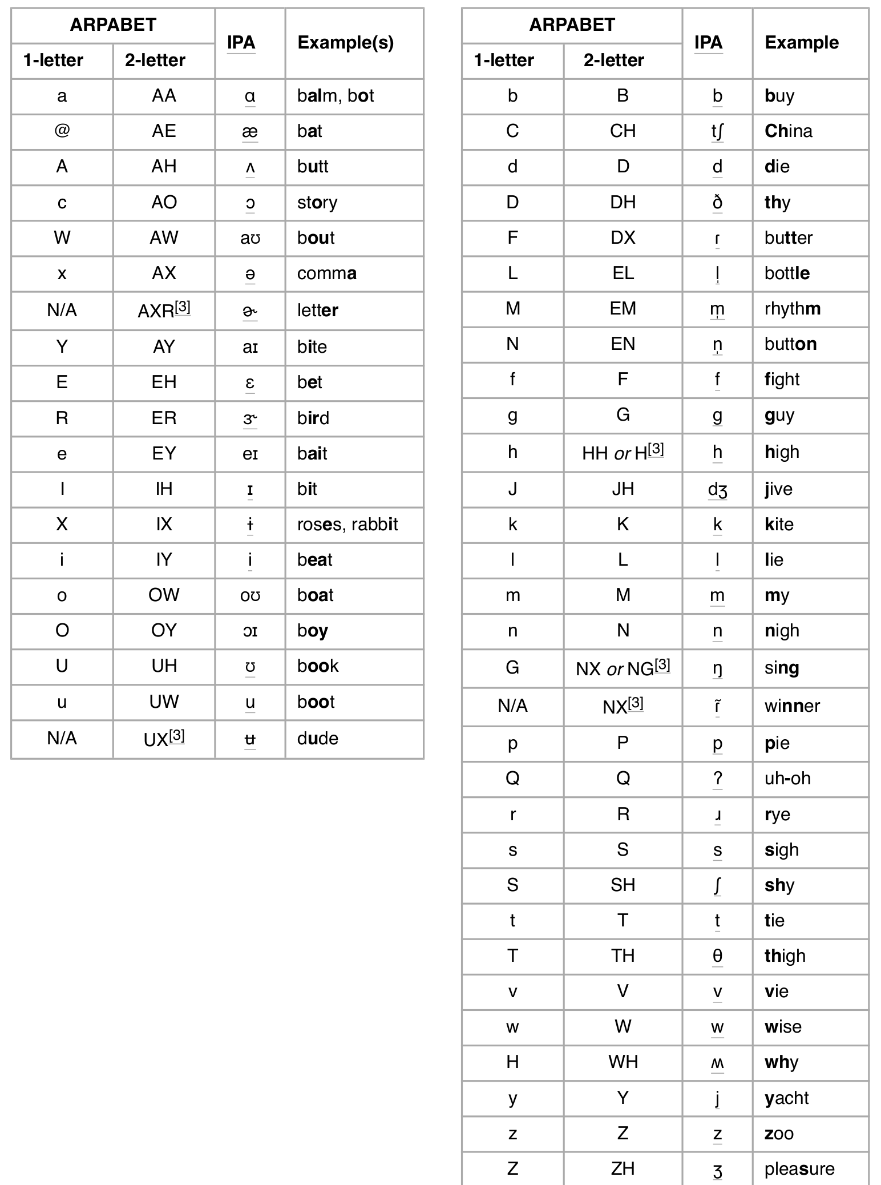
Language-dependent phones
ASR uses language-dependent phone sets
= phonemes plus a few extra symbols (flap, schwa, released vs. unreleased stops).
Example: Flap (/DX/, /ɾ/) is not a phoneme of English – replacing /d/ by /ɾ/ might make a word sound funny, but it wouldn’t change its meaning – but ASR works better if we have different models for /ɾ/ and /d/.

Slide 5
Language-independent phones: the International Phonetic Alphabet
Ladefoged, 1989: the IPA is organized around two principles.
Phonetic principle: “[p] is a shorthand way of designating the intersection of the categories voiceless, bilabial, and plosive; [m] is the intersection of the categories voiced, bilabial, and nasal; and so on.”
Linguistic principle: “the sounds that are represented are primarily those that distinguish one word from another” (in at least one language).
The phonetic principle means we can use IPA to train a phone model in one language that might be portable to another language. The linguistic principle protects us, somewhat, from trying to learn things that are irrelevant to the speech-to-text task in any language.

Slide 6

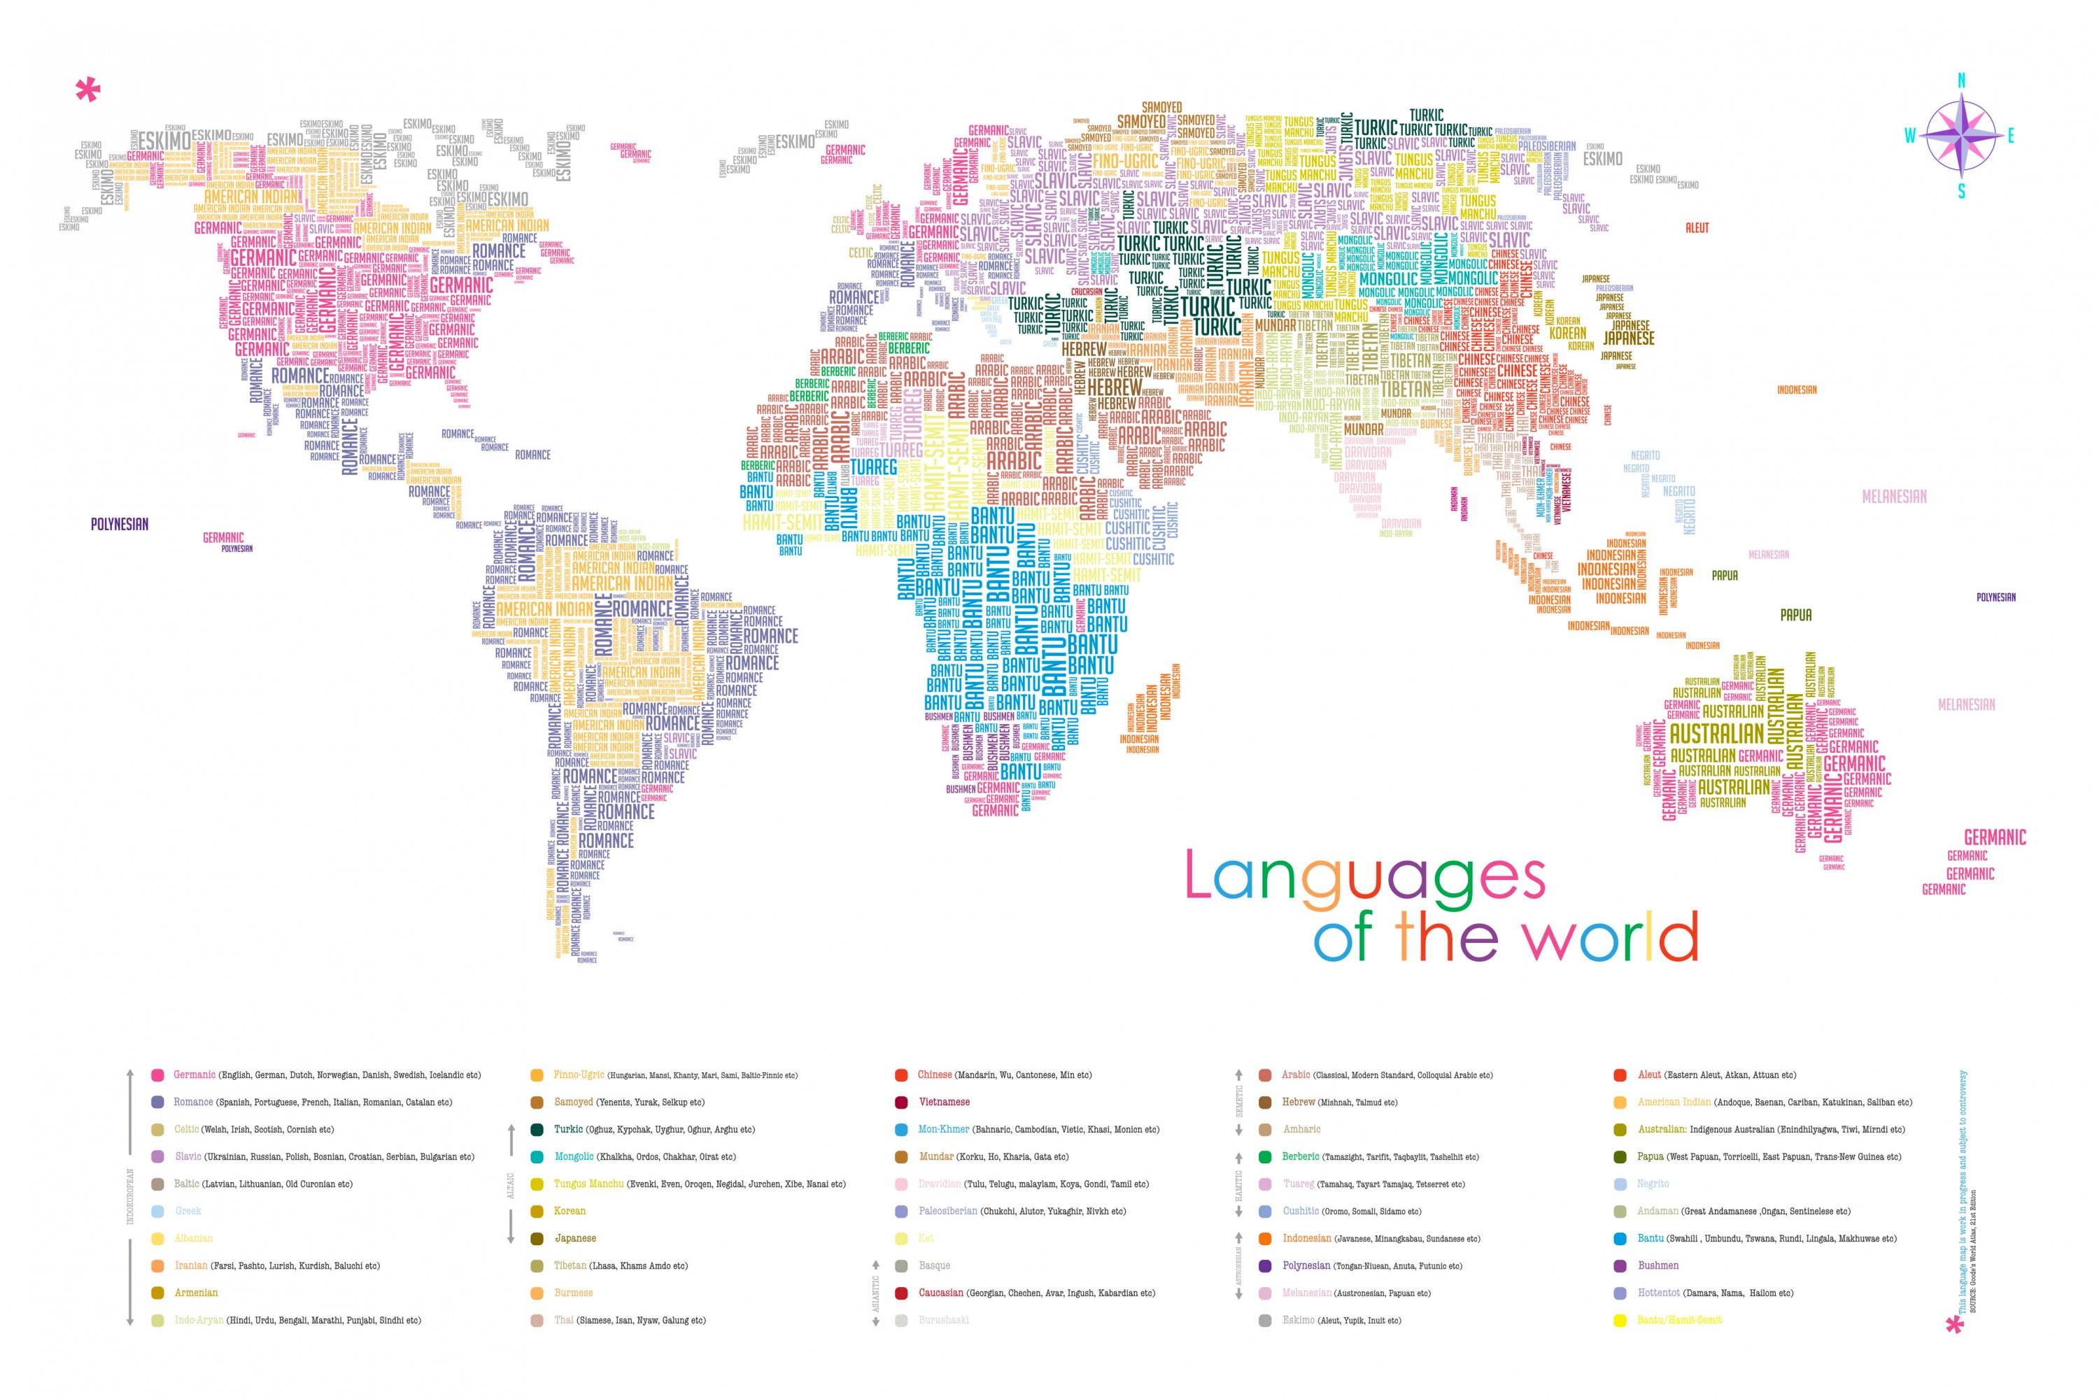
How many languages lack speech technology?
Ethnologue: there are 7000 languages in the world
Ethnologue: about 4000 of them have a writing system (2000 have published phone sets)
Wilderness corpus: transcribed speech (New Testament) exist for 700.
LREMap: Speech and/or NLP articles have been written about 97 languages (including classical and sign languages).
Globalphone: ASR with error rate < 50% exists for about 22.

Slide 7
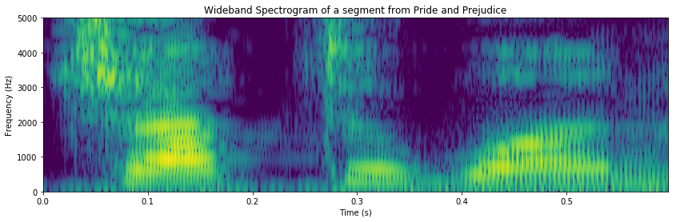
A paradigm for cross-language ASR
training languages
test language
Reference Text:
speech
口语
คำพูด
LanguageNet G2P
LanguageNet G2P
LanguageNet G2P
Reference Phones:
spitʃ
cross-entropy
kʰou˨˩˦y˨˩˦
kʰa˨˩mpʰuː˦d
cross-entropy
cross-entropy
Back-Prop
Hypothesis Phones:
s
p
t
k
ʰ
ʃ
ʰ
o
˩
p
u
˦
p
i
u
˩
˦
˦
k
˨
ɑ
ʁ
˨
a
m
ʰ
ː
o
˨
l
y
˩
trained parameters
Spectrograms:

Slide 8
How should we count the errors?
Phone Error Rate (PER) = standard metric
  Reference transcript of a Thai word (6 phones):
  kʰ a˨˩ m pʰ uː˦ d
  67% PER:
  k a m p u d
Phone Token Error Rate (PTER) = count the number of substitutions, insertions or deletions of IPA characters
  Reference transcript with 12 phone tokens:
  k ʰ a ˨ ˩ m p ʰ u ː ˦ d
  50% PTER:
  k a m p u d

Slide 9
Multilingual and Cross-lingual PER and PTER
Zelasko et al., in review
Multi-lingual (test language is part of the training set) is always better than cross-lingual
Multi: clean audio (GlobalPhone) better than noisy audio (Babel)
Cross: tone languages challenging even with clean audio

Slide 10
Phone/Phone Token inventory discovery
Zelasko et al., in review

Slide 11
Phone inventory discovery: it is difficult to discover the phones in a language with lexical tone

Slide 12
Phone token inventory discovery: 50-84% F1 score in all tested languages

Slide 13
Measuring the similarity of phone tokens based on the frequency of their confusions
Zelasko et al., in review

Slide 14
Measuring the similarity of phone tokens based on the frequency of their confusions

Slide 15
Providing Speech Technology to Under-Resourced Communities
Languages without speech technology
  Phones and phonemes
  Multilingual and cross-lingual end-to-end phone transcription
  Error patterns in cross-lingual phonetic transcription
Groups for whom speech recognition does not work well
  Fairness in automatic speech recognition
  Counterfactual fairness
  Matching the embeddings of factual and counterfactual speakers

Slide 16



Fairness, Accountability and Transparency (FAccT) in Human-Computer Interaction (HCI)
FAccT has received a lot of attention w.r.t. AI systems that make decisions, e.g., college admission, employment, parole
AI for HCI does not make decisions, it just helps people to accomplish things, therefore its fairness has received less scrutiny.
I need some information
Let me help you.
Success

Slide 17

I need some information
I need some information
Let me help you.
Let me help you.
An AI system works best when it’s seen lots of training examples
If it has seen fewer examples of successful outcomes for a particular gender, race, age, educational status, or type of disability, then it will be less effective in helping them.
The result: AI exacerbates inequality.
Success
Success
I don’t know what you are saying.
I need some information
Smaller
Success

Slide 18
Automatic Speech Recognition Word Error Rates (WER)
Gender:
  Women > Men (51% > 38%: Tatman, 2017, YouTube captioning)
  Women > Men (61% > 47%: Garnerin et al., 2019, European broadcast news)
  Black Men > Black Women (41% > 30%: Koenecke et al., 2020)
Dialect:
  Scottish > American (53% > 42%: Tatman, 2017)
Race:
  Black > White (35% > 19%: Koenecke: avg of Amazon, Apple, Google, IBM, Microsoft)
Disability:
  People w/Cerebral Palsy > People w/o (41% > 33%: Issa et al., in review)

Slide 19
Database Collection Efforts
UASpeech: dysarthria as a symptom of Cerebral Palsy (Kim et al., 2008)
  Perhaps 3.2 hours
CORAAL (Corpus of Regional African American Languages, Kendall et al., 2018)
  Perhaps 200 hours
  … but …
Librispeech: largest publicly available corpus of General American English speech:
  1000 hours
Librivox Complete (Baevski et al., 2020):
  10,000 hours

Slide 20



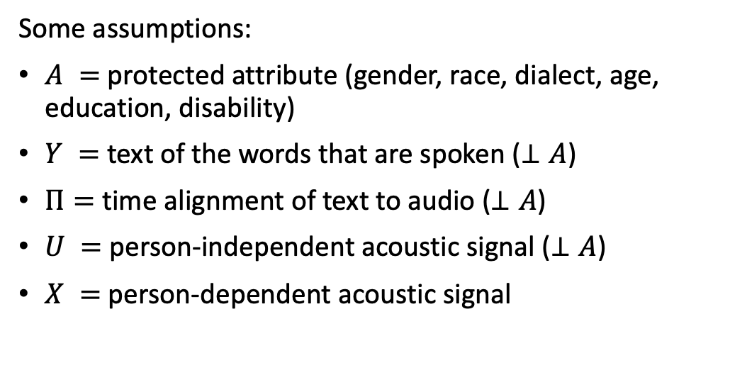


Counterfactually Fair Automatic Speech Recognition
Sarı, Hasegawa-Johnson & Yoo, in review
Some assumptions:
$A =$ protected attribute (gender, race, dialect, age, education, disability)
$Y =$ text of the words that are spoken ($⊥A$)
$Π=$ time alignment of text to audio ($⊥A$)
$U =$ person-independent acoustic signal ($⊥A$)
$X =$ person-dependent acoustic signal
$$A$$
$$X$$
$$Y$$
$$Π$$
$$U$$
Open circles denote unobserved variables
Filled circles denote variables that are observed during training

Slide 21


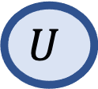
Counterfactually Fair Automatic Speech Recognition
Sarı, Hasegawa-Johnson & Yoo, in review
Abduction:
Infer $U$and $Π$ from $X$, $Y$ and $A$
$$A$$
$$X$$
$$Y$$
$$Π$$
$$U$$
Lightly-shaded circles denote variables whose values are inferred based on models of joint probability distribution

Slide 22
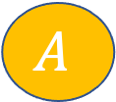


Counterfactually Fair Automatic Speech Recognition
Sarı, Hasegawa-Johnson & Yoo, in review
Action:
Change $A$ (e.g., male$→$female, old $→$young, etc.).
Change $X$, using the new value of $A$, and the previously inferred value of $U$.
$$A$$
$$X$$
$$Y$$
$$Π$$
$$U$$
Change in color denotes counterfactual action upon a variable

Slide 23
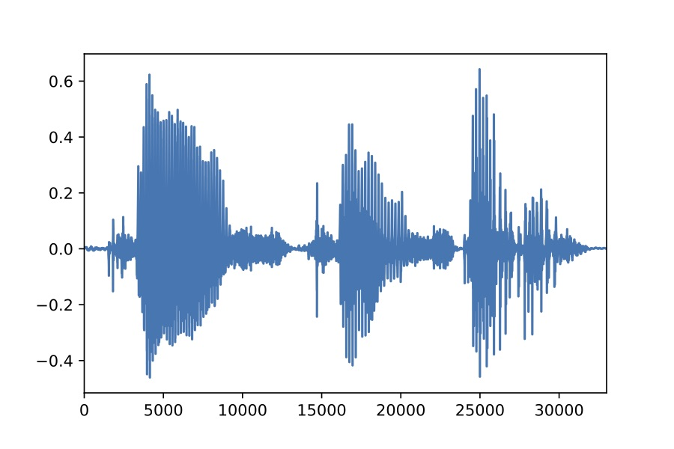
















AutoVC: Zero-shot voice style transfer with only autoencoder loss
Qian, Zhang, Chang, Yang, and Hasegawa-Johnson, 2019
Spectrogram Inverter
Content Encoder
Decoder
$$X_{1}$$
(a)
512 32$×$2 320 512 1024 80 512 80
$${\hat{X}}_{1→2}$$
(d)
Down1
$$C_{1→}$$
Up1
BLSTM $×2$
WaveNet
5$×$1 ConvNorm $×3$
1$×$1 Conv
Deconv $×4$
5$×$1 ConvNorm $×4$
LSTM $×3$
5$×$1 ConvNorm
5$×$1 ConvNorm $×3$
+
$$E_{s}\left(⋅\right)$$
Down2
$$C_{1←}$$
Up2
$$X_{2}$$
Concatenate
LSTM $×$2
Full Connect
Copy
Down1
Up1
Down2
Up2
Last Output
$$S_{2}$$
(b)
(c)
(e)
(f)
768 256 80
Speaker Encoder

Slide 24

AutoVC: Zero-shot voice style transfer with only autoencoder loss
Qian, Zhang, Chang, Yang, and Hasegawa-Johnson, 2019
To hear is to believe
Here are the reference speakers, in their own voices:
Adversarial game: Utterance will be “Please call Stella.” All three (T1, T2, and T3) are resynthesized from the content code of one (T1, T2, or T3). Which one?
Who is Sa? T1, T2 or T3?
Who is Sb? T1, T2 or T3?
 | T1 | T2 | T3
Sa
Sb

Slide 25



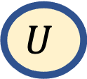
Counterfactually Fair Automatic Speech Recognition
Sarı, Hasegawa-Johnson & Yoo, in review
Prediction:
Re-compute the values of $U, Π$, and $Y$ from the modified versions of $X$ and $A$
$$A$$
$$X$$
$$Y$$
$$Π$$
$$U$$

Slide 26
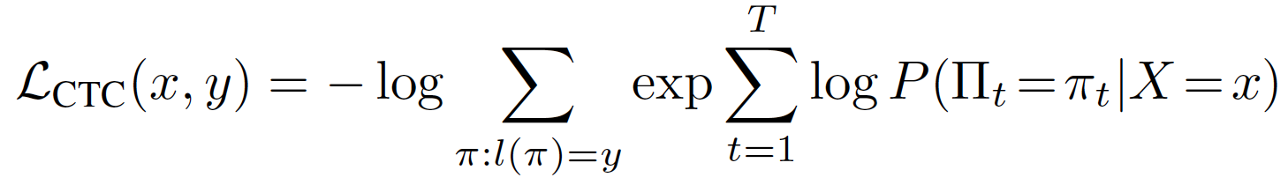

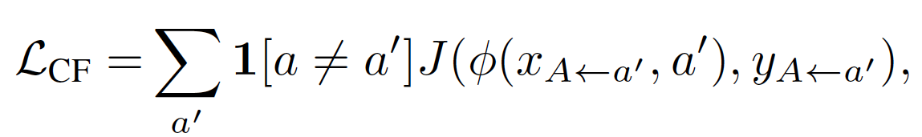
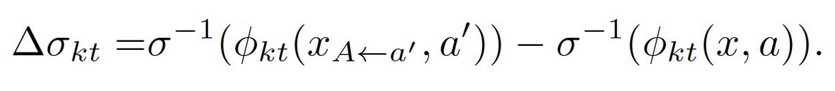
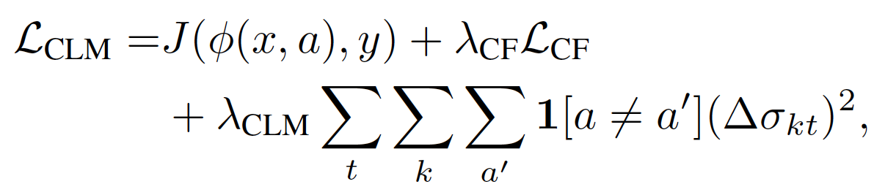




Counterfactually Fair Automatic Speech Recognition
Sarı, Hasegawa-Johnson & Yoo, in review
Counterfactual Speech Recognizer Training: Train the neural net so that the values of $U, Π$, and $Y$ do not change when you change the values of $X$ and $A$.
CTC loss estimates character error rate on real speech:
CF loss estimates error rate on counterfactual speech:
Counterfactual logit matching: how different are the system’s responses to factual vs. counterfactual speech?
$$A$$
$$X$$
$$Y$$
$$Π$$
$$U$$

Slide 27
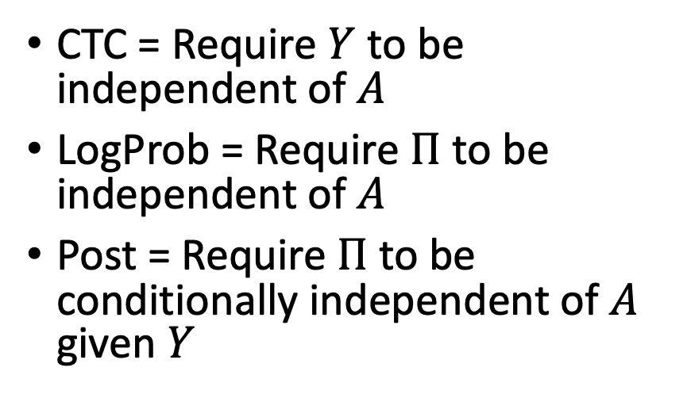
Average error rate, averaged across all speakers, as a function of counterfactual training weight
CTC = Require $Y$ to be independent of $A$
LogProb = Require $Π$ to be independent of $A$
Post = Require $Π$ to be conditionally independent of $A$ given $Y$
CER (character error rate) = a measure of average performance across all groups

Slide 28
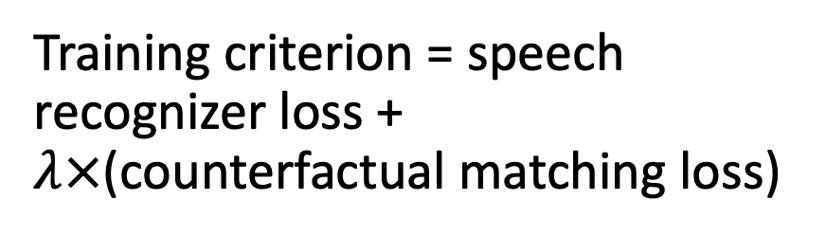
Standard deviation of error rate across speakers, as a function of counterfactual training weight
Training criterion = speech recognizer loss + $λ×$(counterfactual matching loss)
Stdev (of error rate, across speakers) = a measure of unfairness of the ASR

Slide 29
Counterfactual training w.r.t. different types of protected attributes
Model | CER – Avg | CER – Stdev | CER:M | CER:F | CER: M-F
Baseline – no adaptation | 38.0 | 8.3 | 44.0 | 32.6 | 11.4
w/Speaker adaptation | 31.8 | 10.1 | 39.2 | 24.8 | 14.4
Counterfactual for Gender | 37.1 | 7.9 | 42.4 | 32.5 | 9.9
Counterfactual for Age | 38.0 | 7.8 | 43.2 | 33.3 | 9.9
Counterfactual for Education | 37.5 | 7.6 | 42.4 | 33.3 | 9.1
Male:
Female:
Younger:
Older:
High
School:
College:

Slide 30
Observations
Speaker adaptation reduces average error rate, but increases unfairness (standard deviation among speakers, and M-F gap)
Counterfactual training:
  Achieves average error rate better than a speaker-independent system, but worse than a speaker-adaptive system
  Achieves fairness which is much better than either baseline
  By forcing the latent variables to be independent of gender/age/education, counterfactual training significantly improves performance of the high-error group, while leaving error rates for the low-error group unchanged or slightly worse.

Slide 31
General Observations
Current speech technology is useful for some people, not others.
Training acoustic models using the IPA gives us a way to port ASR across language boundaries.
  Error rates are high, but…
  the errors tend to replace each phone token with one that has similar manner or place of articulation.
Voice conversion gives us methods for generating synthetic training data for under-served populations.
  Counter-factual fairness: the outcome should be unchanged by counterfactual voice conversion.

