Slide 1
SpeechSplit 2: Unsupervised Speech Disentanglement Without Exhaustive Bottleneck Tuning
Chak Ho Chan, Kaizhi Qian, Yang Zhang, Mark Hasegawa-Johnson

Slide 2
Background
Speech contains very rich and complex information
Challenge: It is hard to modify a particular aspect of speech(duration, pitch, timbre, etc.) while keeping the others unchanged
Solution: Speech Disentanglement
VAE-based(Hsu et al., 2017)
GAN-based(Zhou et al., 2020)
Contrastive Learning(Ebbers et al., 2021)

Slide 3
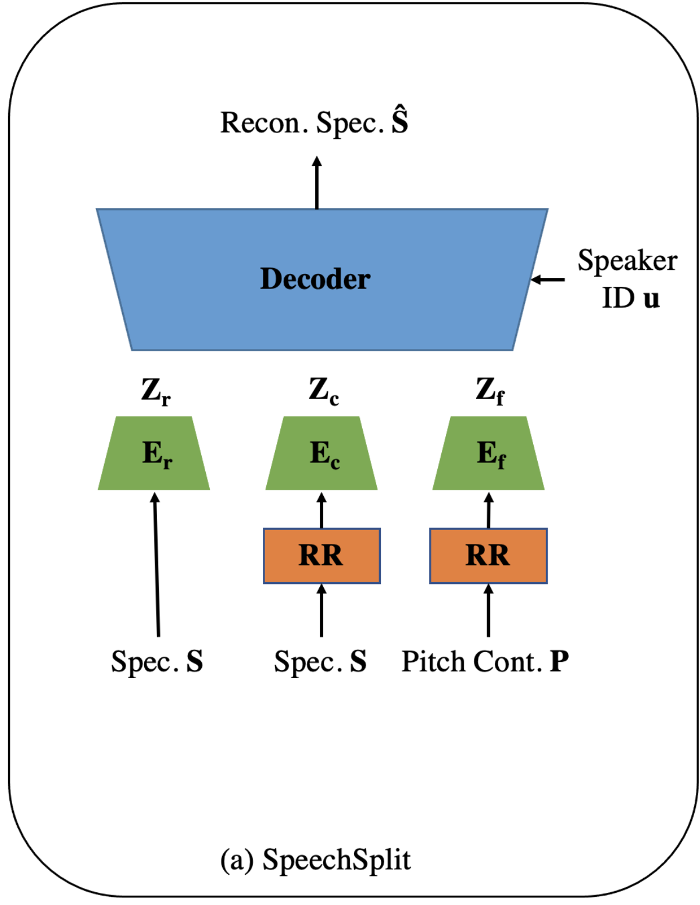
Background (Cont.)
So far, most approaches only focus on converting a single attribute(timbre)
SpeechSplit(Qian et al., 2020) disentangles speech into four components: rhythm, content, pitch, and timbre

Slide 4
Background (Cont.)
Why does it work?
Random resampling corrupts the rhythm information in the content and pitch encoder inputs
Carefully tune the rhythm encoder bottleneck so that it only encodes rhythm but not content/pitch/timbre
Carefully tune the content encoder bottleneck so that it only encodes content but not pitch/timbre
Carefully tune the pitch encoder bottleneck and normalize the pitch contour so that it only encodes pitch

Slide 5
Background (Cont.)
Why does it work?
Random resampling corrupts the rhythm information in the content and pitch encoder inputs
Carefully tune the rhythm encoder bottleneck so that it only encodes rhythm but not content/pitch/timbre
Carefully tune the content encoder bottleneck so that it only encodes content but not pitch/timbre
Carefully tune the pitch encoder bottleneck and normalize the pitch contour so that it only encodes pitch
Problem: Exhaustive bottleneck tuning

Slide 6
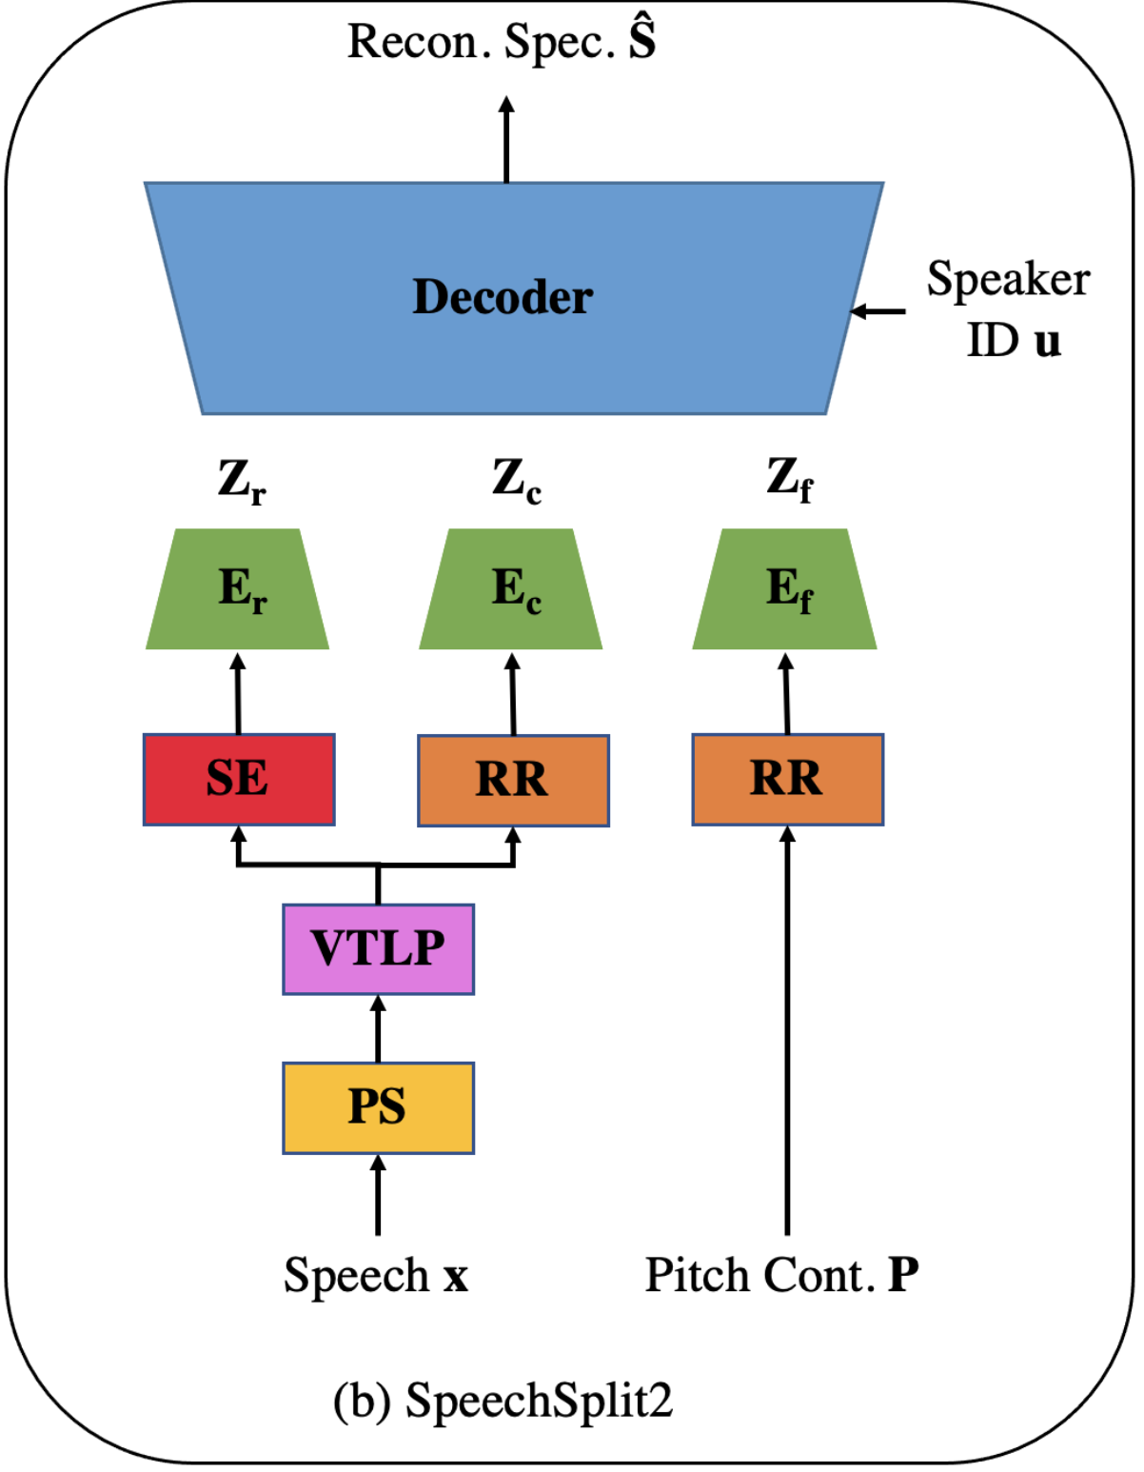
Proposed Method
SpeechSplit 2: Solve the bottleneck tuning issue in SpeechSplit using signal processing methods
Step 1: Remove the pitch dynamics along time in speech(“pitch smoother”)
Analyze the signal using WORLD analyzer, which extracts spectral envelope, F0 contour, and aperiodicity
For each utterance, replace the F0 contour with its mean value
Resynthesize the signal using WORLD synthesizer

Slide 7
Proposed Method (Cont.)
Step 2: Corrupt the timbre information using Vocal Tract Length Perturbation(Jaitly et al., 2013)
Step 3: With both pitch and timbre components removed, randomly resample the processed spectrogram and feed it into the content encoder
Step 4: Extract the corresponding spectral envelope and feed it into the rhythm encoder

Slide 8
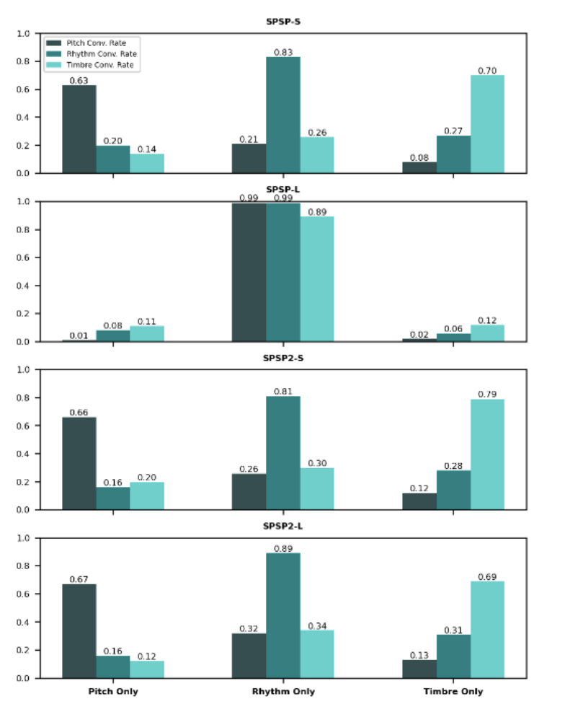
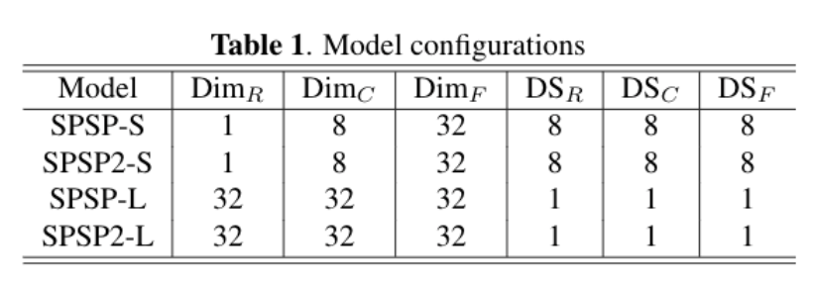
Experiments
Train both models using small and large bottleneck settings
Perform subjective evaluations on Amazon Mechanical Turk(MTurk)
For each model, apply rhythm-, pitch- and timbre-only conversions between utterance pairs that are conceptually distinct in these aspects
Each pair and the converted result are presented to 5 subjects on MTurk
The subjects are asked to select which reference is closer to the converted utterance in terms of all three aspects
Measure the conversion rate, defined as the percentage of subjects who select the target utterance

Slide 9
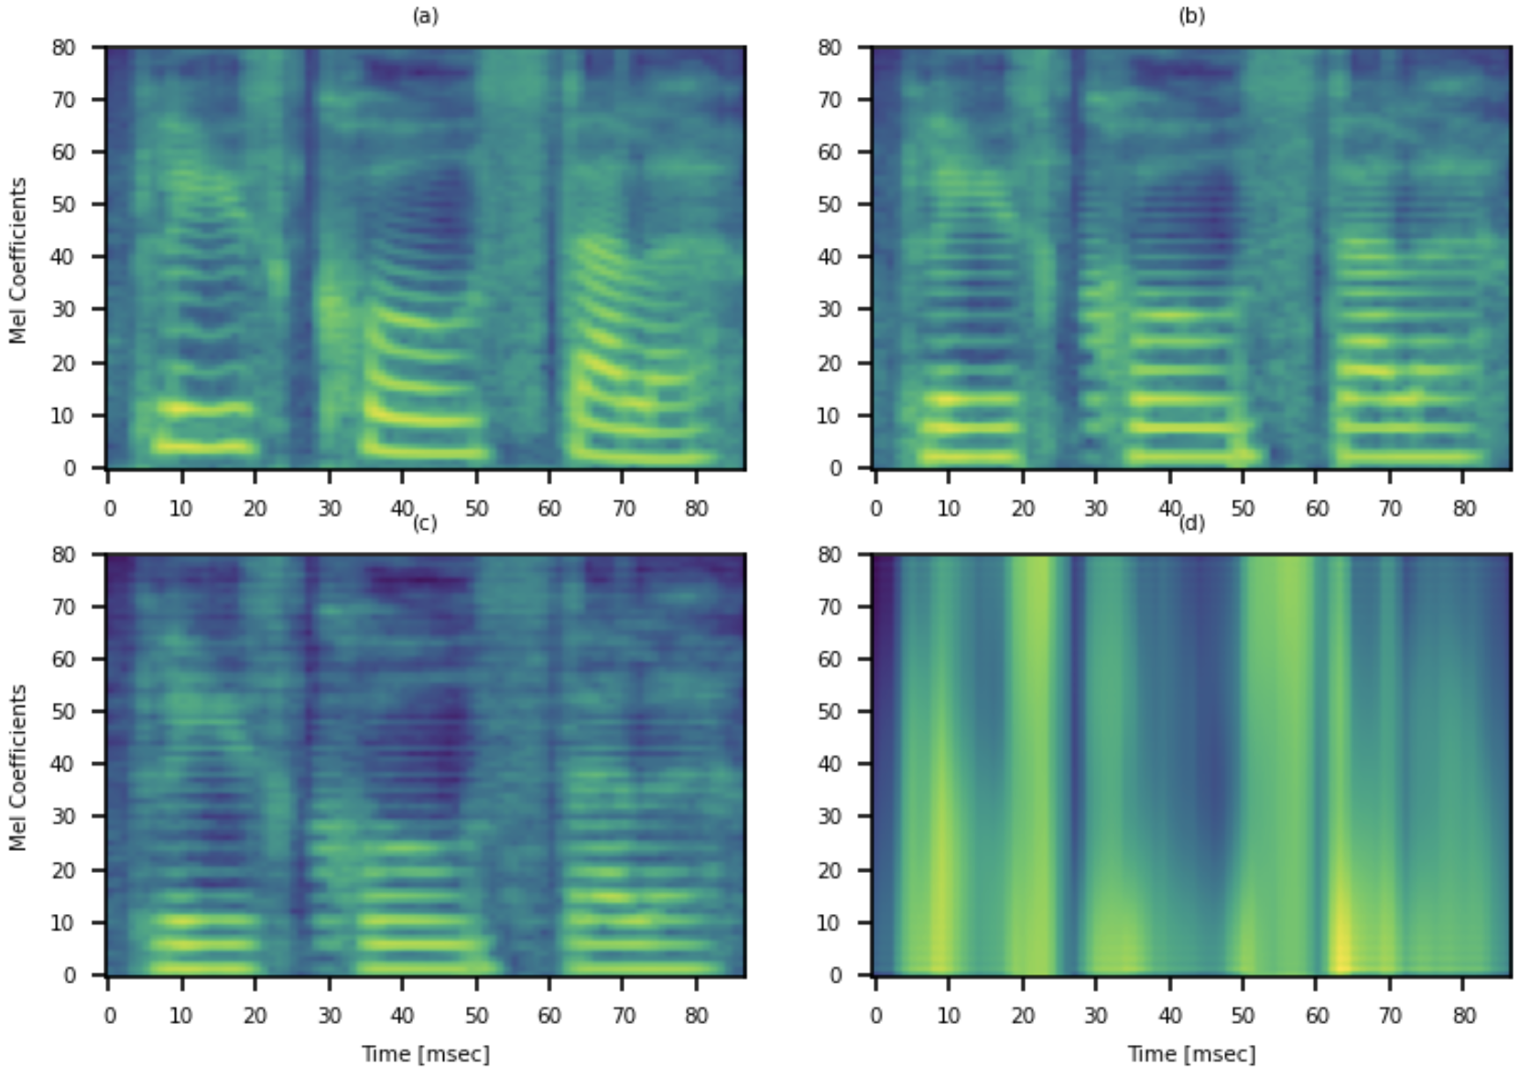
Demo
Original
PS
VTLP
PS+VTLP
https://biggytruck.github.io/

Slide 10
Conclusion
Leveraging signal processing methods, the proposed method achieves comparable performance in speech disentanglement without laborious bottleneck tuning
No need to fine-tune the bottleneck for different applications and corpus
Future work: apply the work to improving atypical speech recognition, e.g., dysarthric

Slide 11
References
K. Zhou, Berrak Sisman, and H. Li, “VAW-GAN for dis-entanglement and recomposition of emotional elementsin speech,”ArXiv, vol. abs/2011.02314, 2020.
K. Zhou, Berrak Sisman, and H. Li, “VAW-GAN for dis-entanglement and recomposition of emotional elementsin speech,”ArXiv, vol. abs/2011.02314, 2020.
Janek Ebbers, Michael Kuhlmann, Tobias Cord-Landwehr, and Reinhold Haeb-Umbach, “Contrastivepredictive coding supported factorized variational au-toencoder for unsupervised learning of disentangledspeech representations,” in IEEEInternational Conference on Acoustics, Speech and Sig-nal Processing (ICASSP), 2021, pp. 3860–3864.
Kaizhi Qian, Yang Zhang, Shiyu Chang, MarkHasegawa-Johnson, and David Cox,“Unsupervisedspeech decomposition via triple information bottle-neck,” inProceedings of the 37th International Con-ference on Machine Learning, 2020, pp. 7836–7846.

Slide 12
References
Navdeep Jaitly and Geoffrey E. Hinton, “Vocal TractLength Perturbation (VTLP) improves speech recogni-tion,” inIn International Conference on Machine Learn-ing (ICML), 2013.

