Slide 1
Back translation for semitic root extraction and entity transliteration
Solutions for text (And speech)
Notes:
So I originally wanted to survey the speech literature on clinical application which is my main focus research area, but I could barely find few works, so I decided to present some of my other side work this semester on another topic: multilingual text NLP specifically Semitic language hoping that through your suggestions, I might get some guidance on how my work can possibly help in speech research as well. More specifically, this work attempts to contribute to the root extraction problem for semitic languages.

Slide 2
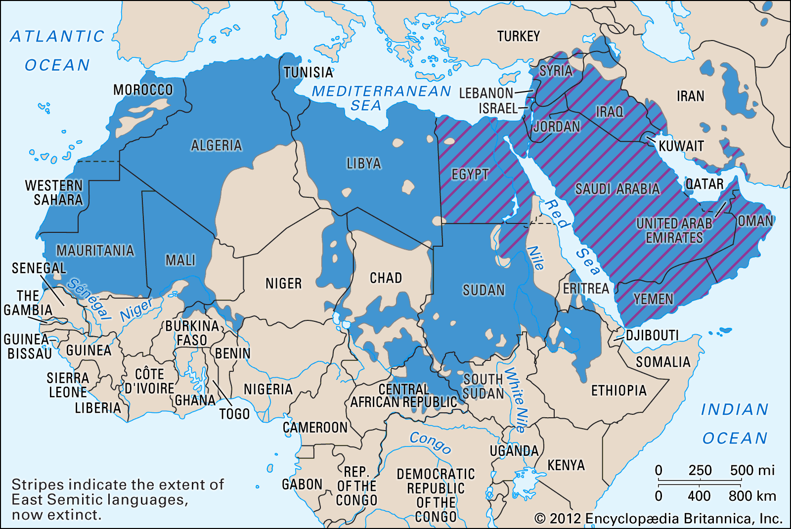
Semitic languages
Distribution
features: rich morphology
Root-and-pattern
Affixation and cliticization
Notes:
So as a start, The Semitic family of languages is spoken in the MENA region Middle East and North Africa, from Iraq reaching up to Morocco in the west, with over 300 million native speakers. The most widely spoken Semitic languages today are Arabic, Amharic, Tigrinya and Hebrew.
Most importantly to this research, semitic languages are known for the reliance on root-and-pattern paradigms for word formation. Word formation process requires a root (3-5 characters), and a pattern which is a combination of characters with ‘slots’ into which the root consonants can be inserted. Accordingly, words are created by interdigitating roots into patterns: the consonants of the root fill the slots of the pattern, usually in linear order.
Furthermore, other morphological processes in Semitic languages involve affixation and cliticization.(and thus the usual prefixes, suffixes, infixes and circumfixes)
The vast majority of the morphological processes known in other languages are concatenative. Therefore, existing computational solutions for other languages often fail with Semitic interdigitation with its distinctive Root-and-pattern morphology, which is a non-concatenative mechanism unique to Semitic languages.

Slide 3
arabic
Template morphology
Concatenative morphology
To write
Writer
Written
Library
The two libraries
They write
And they will write it (fem)
KTB
KATIB
MAKTOOB [maC1C2ooC3]
MAKTABA [maC1C2aC3a]
ALMAKTABATAN
YAKTOBOON
WASAYAKTOBOONAHU
ك ت ب
كاتب
مكتوب
مكتبة
المكتبتان
يكتبون
وسيكتبونها
it (fem)+ masculine plural + write + 3rd person will + and
Notes:
Here is the example of Arabic, which the most spoken Semitic language. So, Arabic uses both templatic and concatenative morphemes. Concatenative morphemes form words through sequential concatenation, whereas templatic morphemes are interdigitated (which are as we discussed a key property of semitic languages).
So for Templatic Morphology, For example, from the root katab “to write”, one can form using templatic morphology the words: kAtib writer/author/scribe”, maktuwb “written/letter”, maktab “office” and maktaba„ “library”. So these all share the root morpheme k.t.b “writing-related”. The template in this case is an abstract pattern in which roots are inserted. And it usually provides some meaning component. For example, the template maC1C2aC3, often indicating location, can be used to create to create the nouns maktab “office” and ma’mal “laboratory/factory” كتب “ writing - related ” عمل “ work - related ” respectively
The other type is Concatenative Morphology. So, The templatic morphemes form the stem onto which concatenative affixes (prefixes, suffixes and circumfixes) and clitics (proclitics and enclitics) attach. And, A word may include multiple affixes and clitics, e.g., the word wasayaktubuwnahu .. which is almost a sentence written in English.
And often times, the combination of both templatic and concatenative morphemes may involve a number of phonological and orthographic adjustments that modify the form of the created word beyond simple concatenation which adds to the complexity of root extraction.

Slide 4
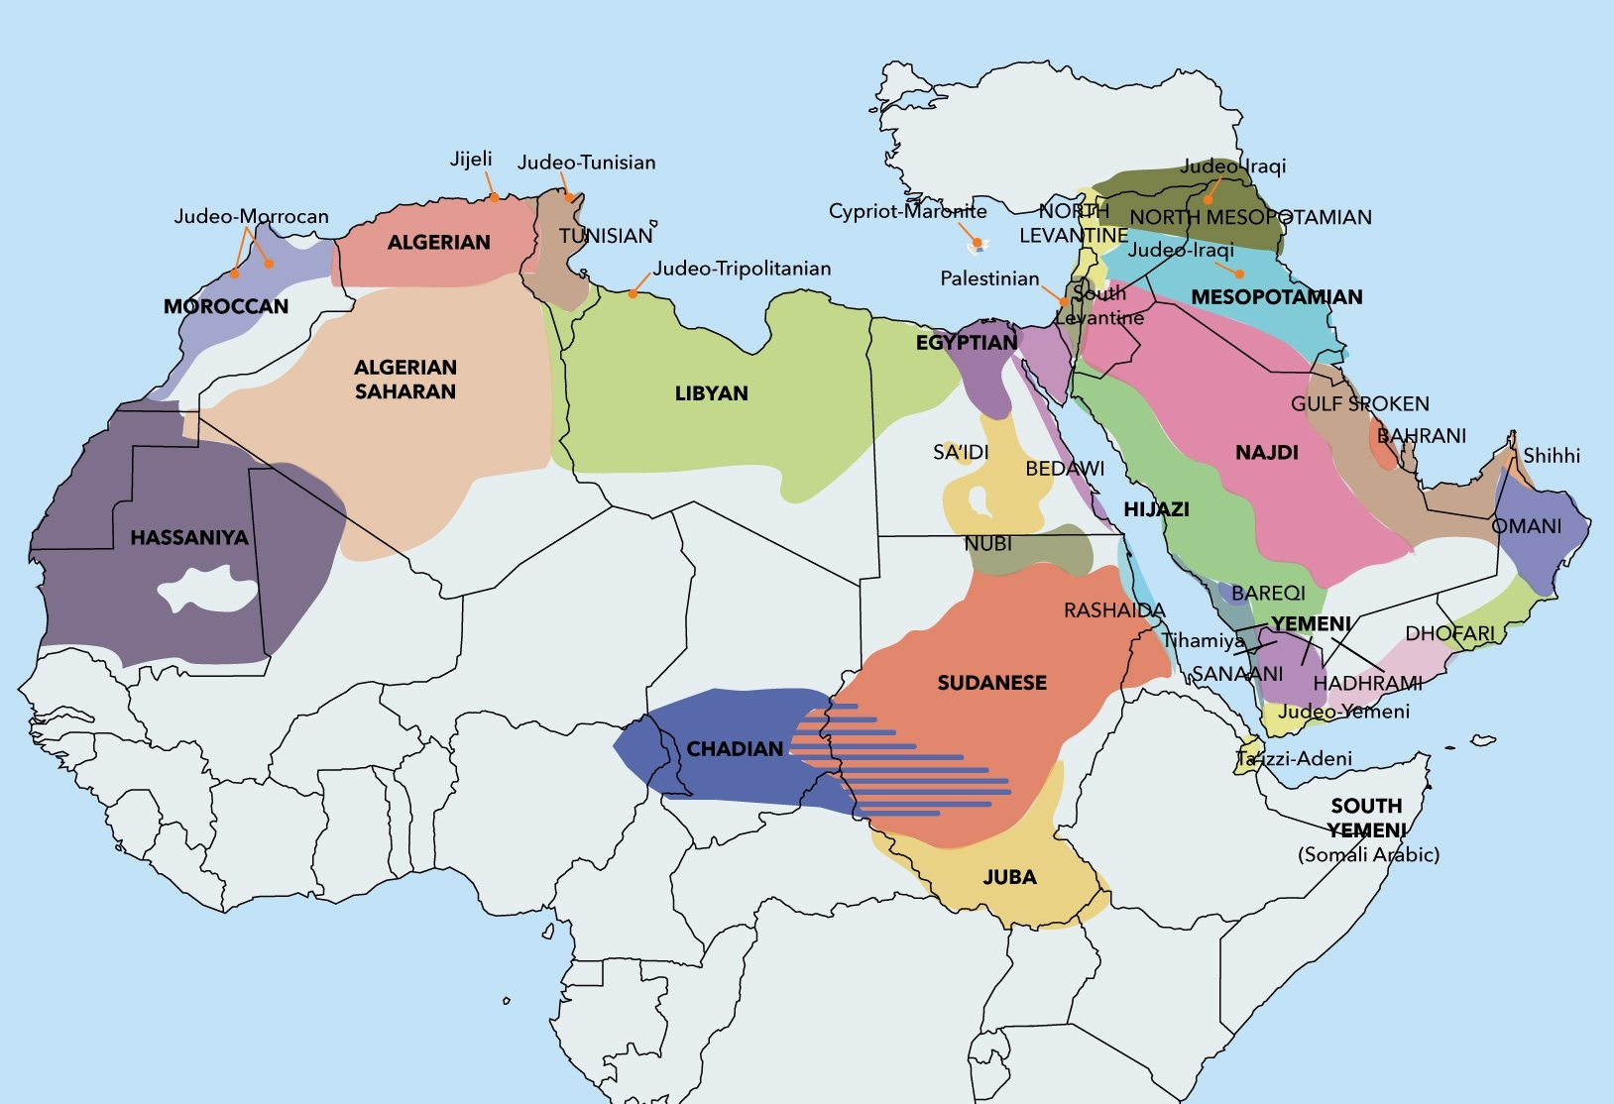
Dialects
Diglossia
Additional challenge for morphological analysis:
new functionality that does not exist in MSA
Different than in MSA (progressive verbs)
Different in different dialects (negation/question)
Notes:
Even more, added to the complexity of root extraction problem, is also the challenge posed by dialects. Why are dialects important in arabic (and also Syriac)?
It is because In fact arabic presents as extreme case of what is called diglossia which is the coexistence if two languages, the first being the Modern Standard Arabic (MSA) that is used in written texts and formal speech across the Arab world, and the other being dialectical Arabic that is essentially the native language that is used for everyday conversation, however, lack an agreed-upon script, syntax..
Dialects are even diverse: geolinguistically, the Arab World can be divided in many different ways, and on different levels (even up to the city scale at times). Main dialects are e.g.
• Egyptian Arabic, Levantine (LEV), Gulf Arabic (GLF), north African…
Although, dialectical arabic morphology is much simpler in some respects, it is more complex in others compared to MSA. For example, Arabic dialects introduce several additional clitics, some with new functionality that does not exist in MSA. And these are often even different between dialects.
Furthermore, as far as text is concerned, root extraction and morphological analysis is even future complicated by diacritics which are often assumed and not written explicitly by native speakers.

Slide 5
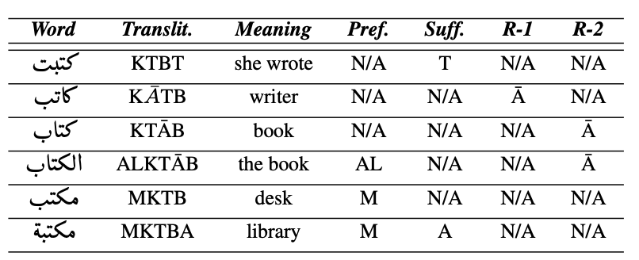
morphology
Morphological analysis is essential
Data sparsity
Long tail distribution
Notes:
[One of the main challenges for Arabic NLP is data sparsity due to morphological richness and the lack of orthography standards.]
But why are we so concerned about this property of basically complex morphology?
In fact, Morphological analysis is essential in working with Semitic languages as well as other highly- inflectional languages due to data sparsity problem ( which is both a challenge for text as well as speech). For instance, long-tail distributions in relation to word frequency is very common. Above is a plot for the Arabic wikipedia used in this work. And as you can see, around 60% of the words are mentioned <10 times in the whole wikipedia, 50% < 1. So for processing such long-tailed corpora, it is necessary to exploit finer-granularity, in specific it is important to exploit the highly-shared substructures between words that can be used to infer semantic meaning. That is if root extraction is possible, and thus as a result morphological analysis.. highly shared substructure that is encapsulated in namely the patterns can be further used and this can help in this extreme data sparsity problem.
So for example, this is again the selection of Arabic words sharing the common root – (transliteration K-T-B), which means to “write”. Despite the many surface words, the derivations share a semantic relationship based on the root, as well as with other concatenative and interdigitated templatic morphemes. (so each word with a certain pattern shares a semantic relationship with other words with the same pattern coming from different roots)
morphologically rich languages (MRLs):
These languages need very large lexicons, containing several hundred thousand words, to achieve
good lexical coverage. Since state-of-the-art automatic speech recognition (ASR) systems generally use fixed (also called closed) lexicons, only the words in the recognition lexicon can potentially be recognized. For MRLs, the rich morphology implies a high number of unknown or out-of-vocabulary (OOV) words, which typically produce 1.5 to 2 errors for each OOV word [1]. . This large lexical variety also poses a problem for language modeling, where it can be difficult to have reliable n-gram estimates for infrequent words.
(low resource): High OOV rates and poor language model estimation are problems that also arise when developing technologies for lessrepresented languages, for which little data are available in an
electronic form

Slide 6
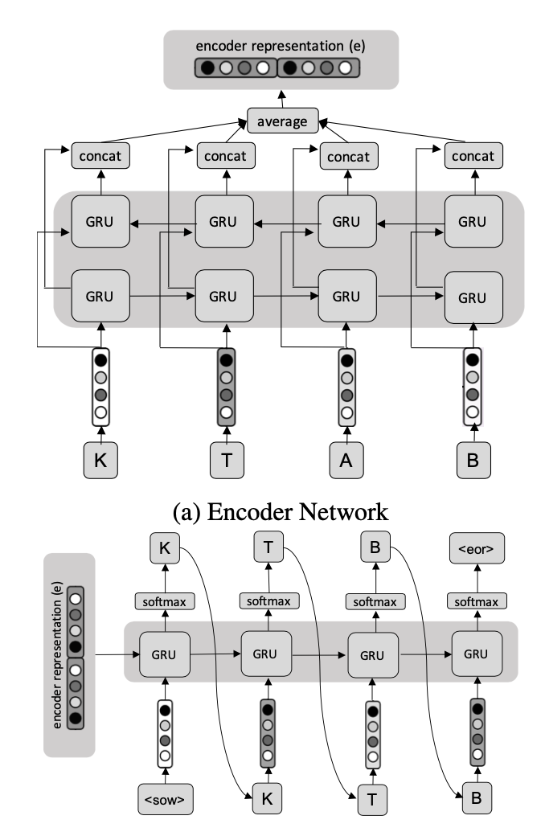
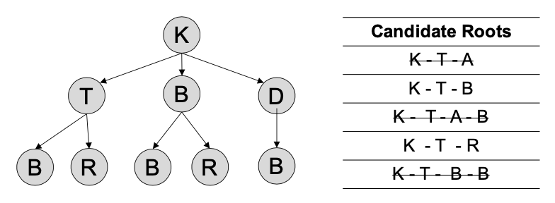
Semitic Root extraction
Early approaches
Supervised methods
Sequence-to-sequence models
Constrained seq2seq
Contribution
El-Kishky, Ahmed, et al. "Constrained Sequence-to-sequence Semitic Root Extraction for Enriching Word Embeddings." Proceedings of the Fourth Arabic Natural Language Processing Workshop. 2019.
Notes:
Early approaches to the problem of Arabic root extraction were predominantly unsupervised methods. A few of these methods relied on pattern matching and prefix/suffix pruning, or human-constructed rule-based constraints which obviously doesn’t often work well. Other models achieve high accuracy by incorporating sentence-level context (and thus cannot handle short sequences or single words). Later, Supervised methods have been developed for identifying Hebrew and arabic roots by combining various multiclass classification models. While the latter supervised methods effectively address the root-and-pattern (interdigitating) nature of Semitic roots, they fail to leverage the sequential structure of the roots space. (which is often preserved)
This work builds on this paper by Kishky whereby a “constrained” seq2seq model for multiclass classification is used. This model captures the sequential structure of the roots spaces while achieving high accuracy due to its constraining mechanism. Described in the following: Often times, a greedy approach is often used where the single best character output is selected and propagated to later time steps. However, this greedy approach may not only lead to suboptimal output sequences, but also result in invalid sequences. This can be met by using a beam search decoding scheme coupled with a constrain on the predicted root, and that is achieved by using a trie structure that holds all possible roots. Therefore, invalid roots can be pruned during the decoding process. And, accordingly this strictly improves overall extraction accuracy over traditional beam search/ greedy approaches.

Slide 7
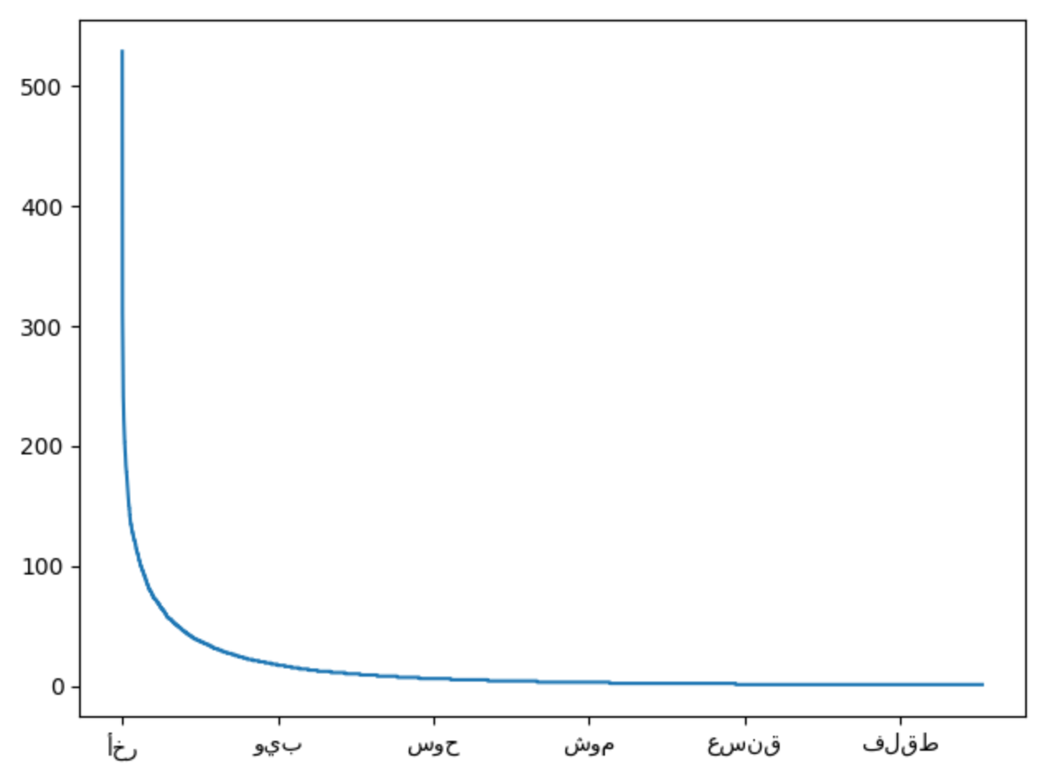
Rare roots
Poor performance
Underrepresentation
3173
Notes:
(Explain the rare roots problem, that it is a prevalent problem, so rich morphology +rare roots is a big issue.. the percentage )
However, this work’s shortcoming lies in its performance on rare roots. Above is a plot for the dataset used and you can see (I should have plotted in log space) that around 1/3 of the roots have one corresponding word that it is trained on. Even more challenging for rare roots is the zero-shot case, with only the seq2seq models handling unseen roots.
So, Performing poorly on rare roots (as listed above) means a degraded performance on 1/3 of the total roots. So, although the seq2seq methods greatly outperforms all multiclass methods, rare roots still deserve a separate treatment that aims to counteract the limitation of lacking enough data.
And for that, this work aims to generate augmented data for upsampling rare roots.

Slide 8
Model
ا ل م ك ت ب ت ا ن
ك ن ب
Seq2seq
Backtranslation (wikipedia)
Retraining root extraction model
كاتب، مكتوب، مكتبة، المكتبتان، يكتبون
ك ت ب
Method | Infreq. | Zero-Shot
CNN-Class | 0.48
GRU-Class | 0.56
BiGRU-Class | 0.57
GRU-S2S | 0.60 | 0.53
BiGRU-S2S | 0.62 | 0.55
Constrain-S2S | 0.69 | 0.62
BCT-Constrain-S2S | 0.80 | 0.77

Slide 9
Future WORK
Dialectical Arabic
Semitic Languages
Speech?

