Slide 1
In Class Problem Solving 1
CS/ECE 541

Slide 2
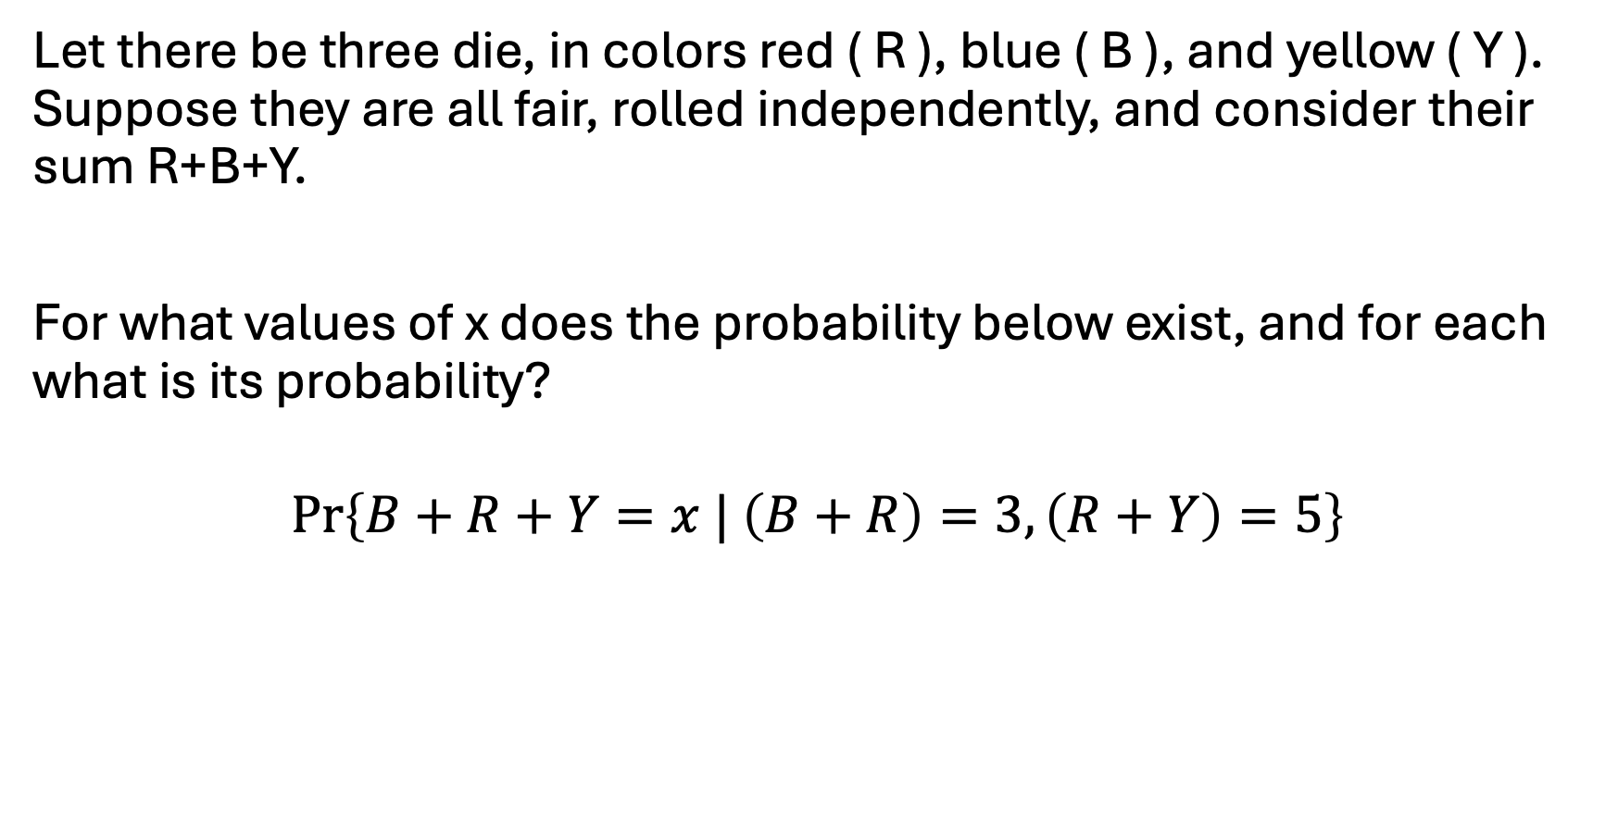
Problem #1
Let there be three die, in colors red ( R ), blue ( B ), and yellow ( Y ). Suppose they are all fair, rolled independently, and consider their sum R+B+Y.
For what values of x does the probability below exist, and for each what is its probability?
$$\operatorname{Pr}\left\{B+R+Y=x | \left(B+R\right)=3, \left(R+Y\right)=5\right\}$$

Slide 3
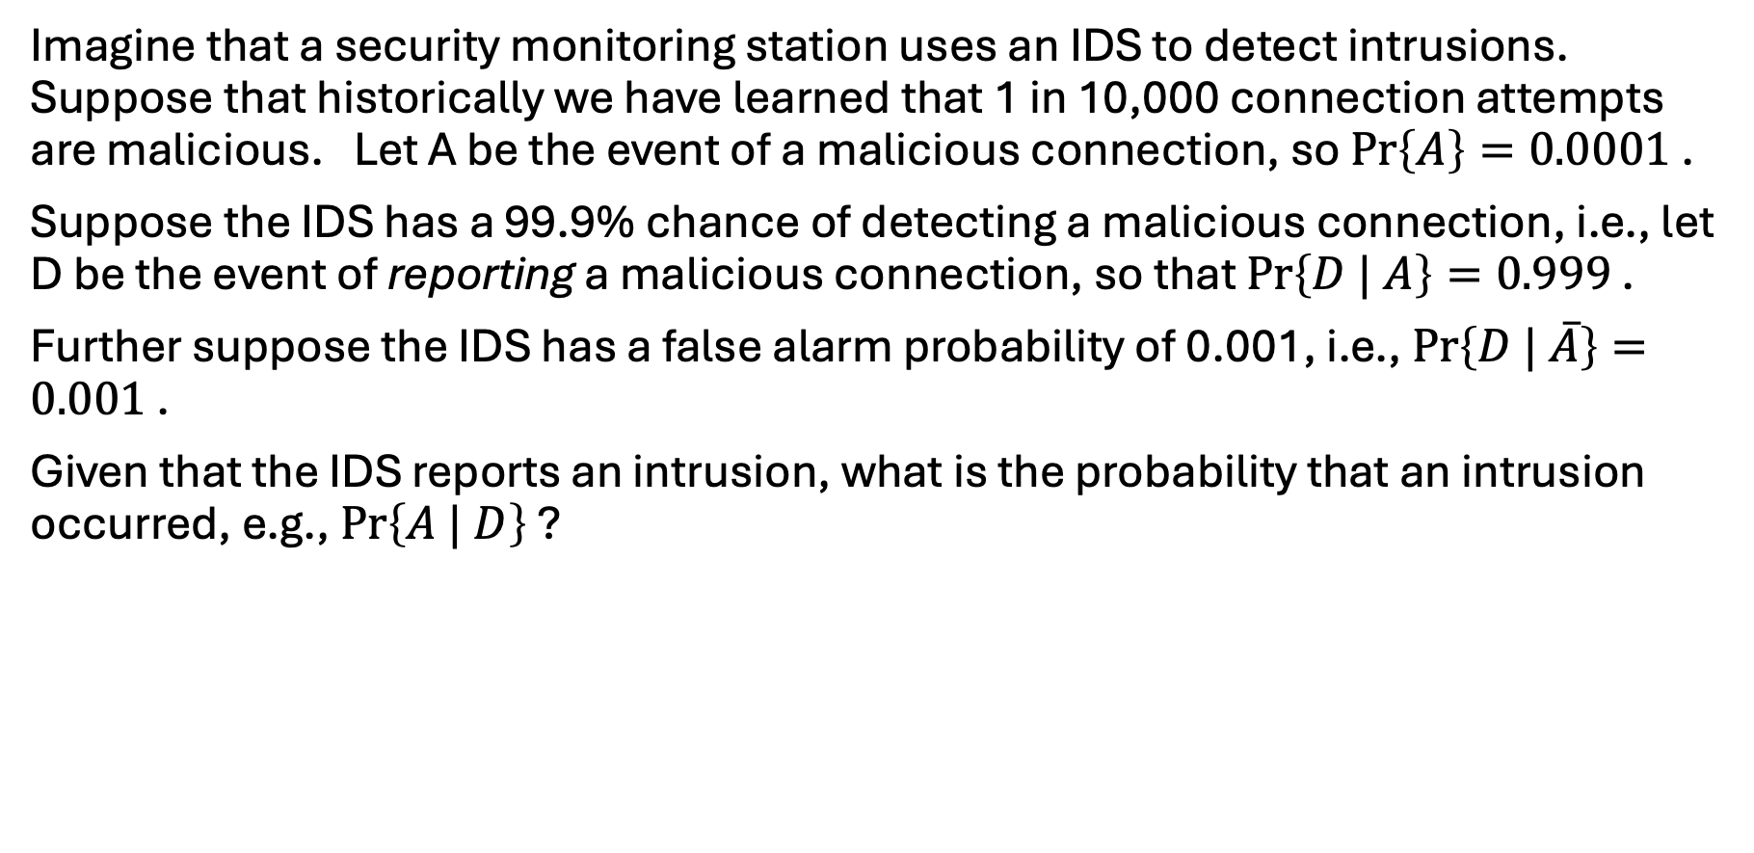
Problem #2
Imagine that a security monitoring station uses an IDS to detect intrusions. Suppose that historically we have learned that 1 in 10,000 connection attempts are malicious. Let A be the event of a malicious connection, so $\operatorname{Pr}\left\{A\right\}=0.0001$ .
Suppose the IDS has a 99.9% chance of detecting a malicious connection, i.e., let D be the event of reporting a malicious connection, so that $\operatorname{Pr}\left\{D | A\right\}=0.999$ .
Further suppose the IDS has a false alarm probability of 0.001, i.e., $\operatorname{Pr}\left\{D | \overline{A}\right\}=0.001$ .
Given that the IDS reports an intrusion, what is the probability that an intrusion occurred, e.g., $\operatorname{Pr}\left\{A | D\right\}$ ?

Slide 4
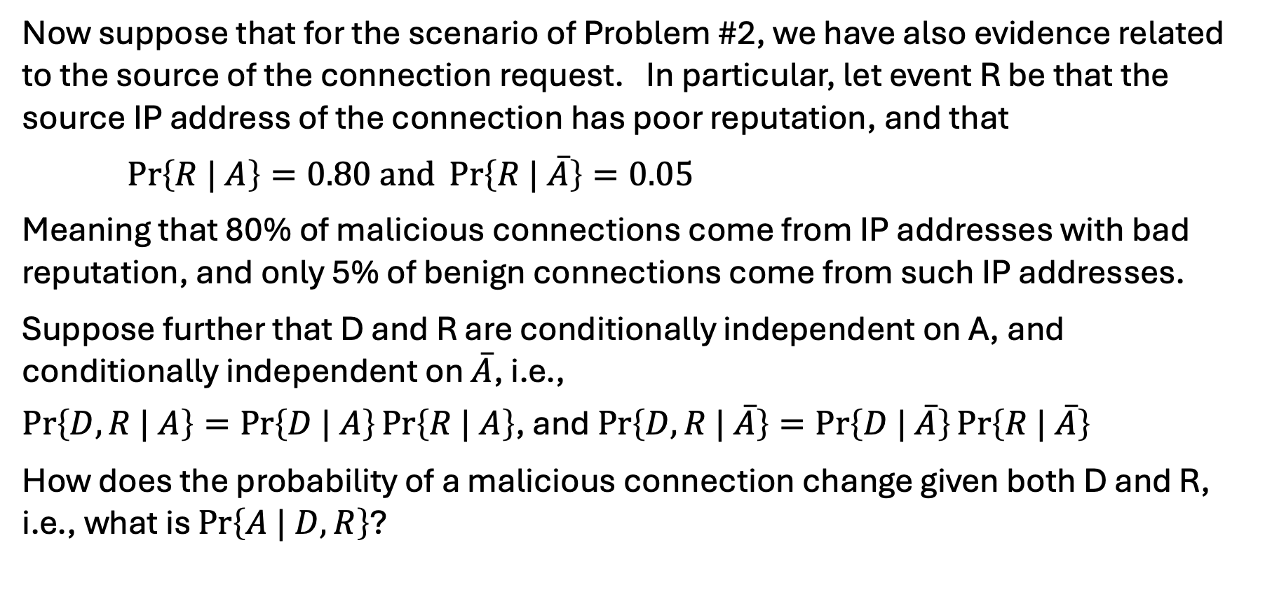
Problem #3
Now suppose that for the scenario of Problem #2, we have also evidence related to the source of the connection request. In particular, let event R be that the source IP address of the connection has poor reputation, and that
$\operatorname{Pr}\left\{R | A\right\}=0.80\text{ and }\operatorname{Pr}\left\{R | \overline{A}\right\}=0.05$
Meaning that 80% of malicious connections come from IP addresses with bad reputation, and only 5% of benign connections come from such IP addresses.
Suppose further that D and R are conditionally independent on A, and conditionally independent on $\overline{A}$, i.e.,
$\operatorname{Pr}\left\{D,R | A\right\}=\operatorname{Pr}\left\{D | A\right\}\operatorname{Pr}\left\{R | A\right\}$, and $\operatorname{Pr}\left\{D,R | \overline{A}\right\}=\operatorname{Pr}\left\{D | \overline{A}\right\}\operatorname{Pr}\left\{R | \overline{A}\right\}$
How does the probability of a malicious connection change given both D and R, i.e., what is $\operatorname{Pr}\left\{A | D,R\right\}$?

Slide 5
Problem #4
Imagine an intersection controlled by a traffic light. The East-West road is dominant and has green light cycles that are 4 minutes in length.
The North-South road has green light cycles that are 1 minute in length. We ignore yellow lights.
Model this system with a timed Petri net where the times associated with timed transitions is constant (and the transition is labeled by the duration) and which includes one place such that when non-empty causes green to be shown on East-West and red on North-South, and another place that when non-empty cause green to be shown on North-South and red on East-West.

Slide 6
Problem #5
Modify the Petri net of Problem #4 to include a sensor on the North-South road such that if a N-S vehicle stops at a red light in the 2nd or 3rd minute of the East-West green cycle, N-S is immediately given green for a minute, and then the East-West route restarts its 4-minute green cycle.

Slide 7
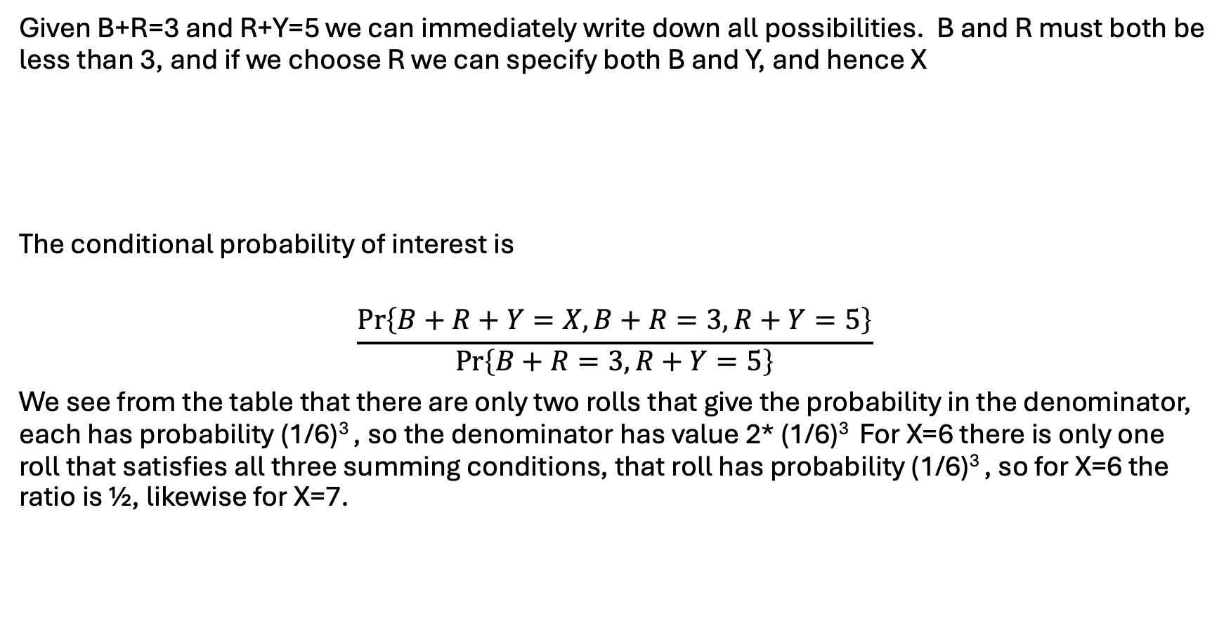
Problem #1 Solution
Given B+R=3 and R+Y=5 we can immediately write down all possibilities. B and R must both be less than 3, and if we choose R we can specify both B and Y, and hence X
The conditional probability of interest is
$$\frac{\operatorname{Pr}\left\{B+R+Y=X,B+R=3,R+Y=5\right\}}{\operatorname{Pr}\left\{B+R=3,R+Y=5\right\}}$$
We see from the table that there are only two rolls that give the probability in the denominator, each has probability (1/6)³ , so the denominator has value 2* (1/6)³ For X=6 there is only one roll that satisfies all three summing conditions, that roll has probability (1/6)³ , so for X=6 the ratio is ½, likewise for X=7.
B | R | Y | (B+R) | (R+Y) | X=B+R+Y
1 | 2 | 3 | 3 | 5 | 6
2 | 1 | 4 | 3 | 5 | 7

Slide 8
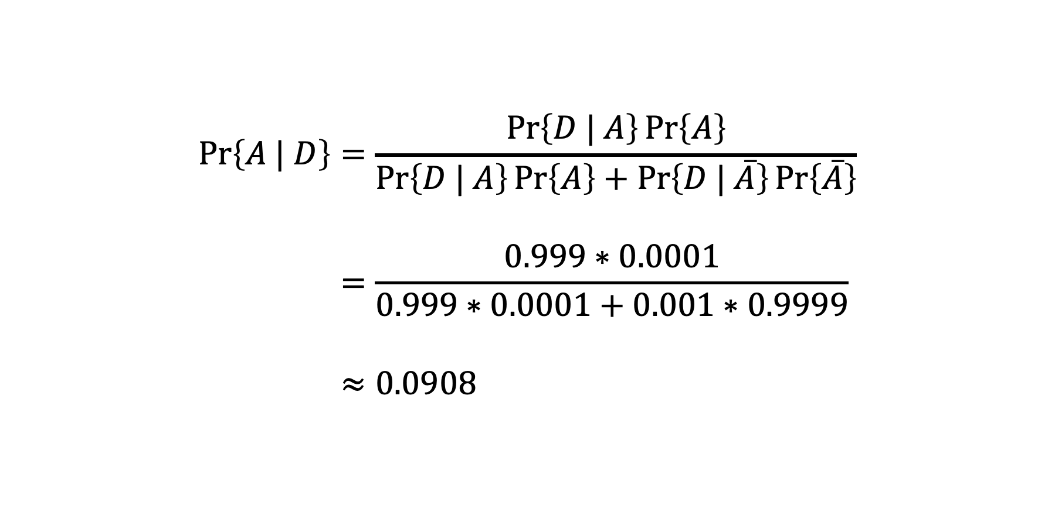
Problem #2 Solution
$$\begin{aligned}\operatorname{Pr}\left\{A | D\right\}&=\frac{\operatorname{Pr}\left\{D | A\right\}\operatorname{Pr}\left\{A\right\}}{\operatorname{Pr}\left\{D | A\right\}\operatorname{Pr}\left\{A\right\}+\operatorname{Pr}\left\{D | \overline{A}\right\}\operatorname{Pr}\left\{\overline{A}\right\}} \\ \\ &=\frac{0.999∗0.0001}{0.999∗0.0001+0.001∗0.9999} \\ \\ &≈0.0908\end{aligned}$$

Slide 9
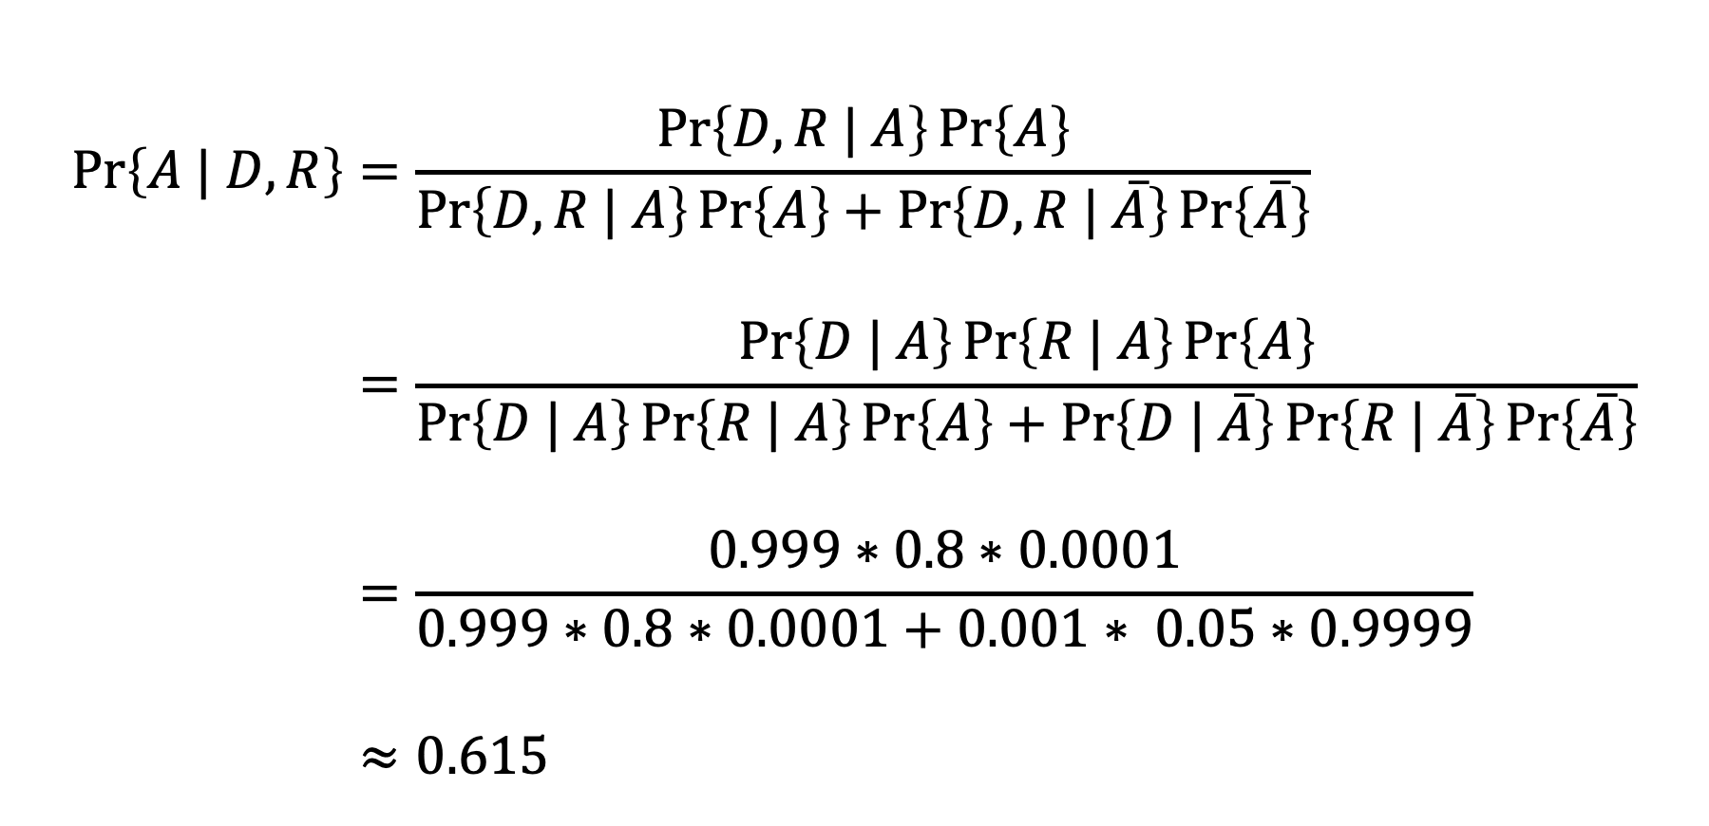
Problem #3 Solution
$$\begin{aligned}\operatorname{Pr}\left\{A | D,R\right\}&=\frac{\operatorname{Pr}\left\{D,R | A\right\}\operatorname{Pr}\left\{A\right\}}{\operatorname{Pr}\left\{D,R | A\right\}\operatorname{Pr}\left\{A\right\}+\operatorname{Pr}\left\{D,R | \overline{A}\right\}\operatorname{Pr}\left\{\overline{A}\right\}} \\ \\ &=\frac{\operatorname{Pr}\left\{D | A\right\}\operatorname{Pr}\left\{R | A\right\}\operatorname{Pr}\left\{A\right\}}{\operatorname{Pr}\left\{D | A\right\}\operatorname{Pr}\left\{R | A\right\}\operatorname{Pr}\left\{A\right\}+\operatorname{Pr}\left\{D | \overline{A}\right\}\operatorname{Pr}\left\{R | \overline{A}\right\}\operatorname{Pr}\left\{\overline{A}\right\}} \\ \\ &=\frac{0.999∗0.8∗0.0001}{0.999∗0.8∗0.0001+0.001∗ 0.05∗0.9999} \\ \\ &≈0.615\end{aligned}$$

Slide 10
Problem #4 Solution
N-S green,
E-W red
Time = 1
E-W green,
N-S red
Time = 4

Slide 11
Problem #5 Solution
sensor
N-S green,
E-W red
Time = 1
Time = 2
Time = 1
Time = 1
E-W green,
N-S red

