Slide 1
In Class Problem Solving
CS/ECE 541

Slide 2
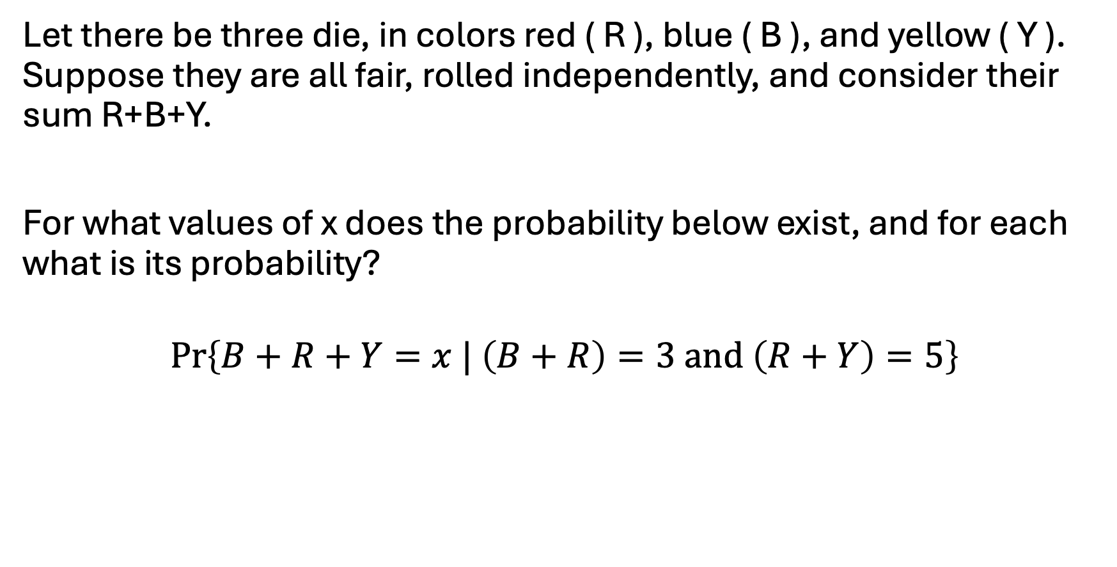
Problem #1

Slide 3
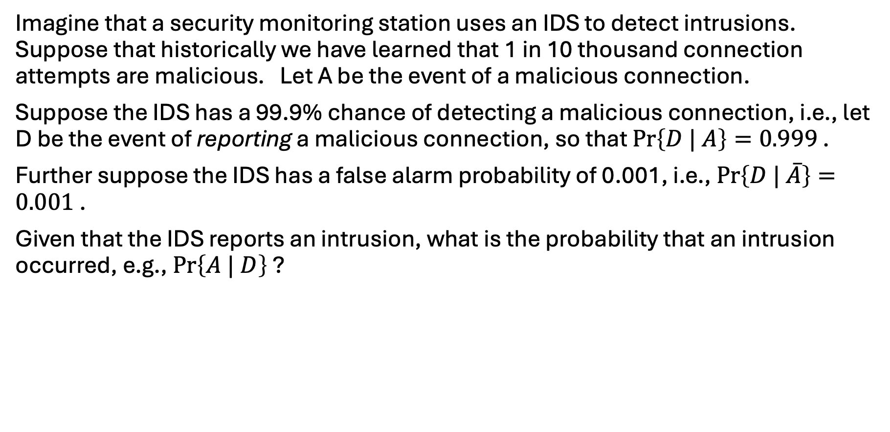
Problem #2

Slide 4
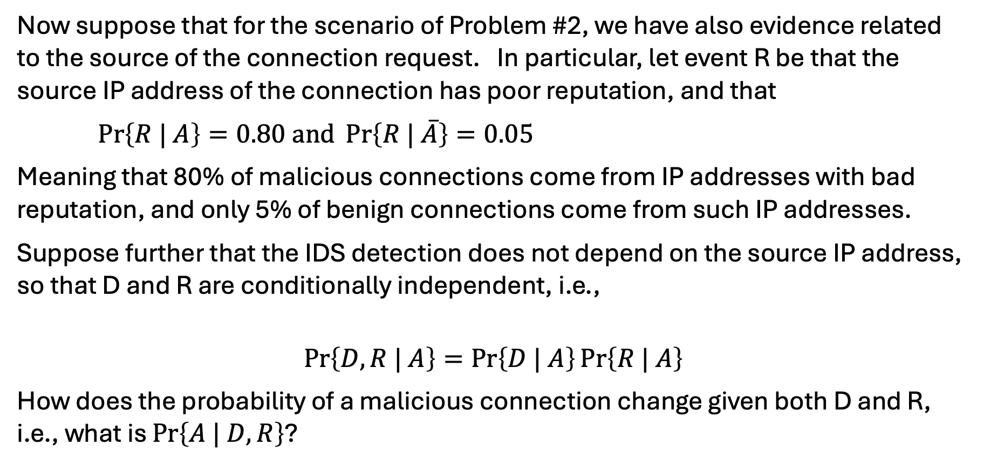
Problem #3

Slide 5
Problem #4
Imagine an intersection controlled by a traffic light. The East-West road is dominant and has green light cycles that are 4 minutes in length.
The North-South road has green light cycles that are 1 minute in length. We ignore yellow lights.
Model this system with a timed Petri net where the times associated with timed transitions is constant (and the transition is labeled by the duration) and which includes one place such that when non-empty causes green to be shown on East-West and red on North-South, and another place that when non-empty cause green to be shown on North-South and red on East-West.

Slide 6
Problem #5
Modify the Petri net of Problem #3 to include a sensor on the North-South road such that if a N-S vehicle stops at a red light in the 2nd or 3rd minute of the East-West green cycle, N-S is immediately given green for a minute, and then the East-West route restarts its 4-minute green cycle.

