Slide 1
Combinatorial Models

Slide 2
Introduction to Combinatorial Methods
Combinatorial validation methods are the simplest kind of analytical/numerical techniques and can be used for reliability and availability modeling under certain assumptions.
Assumptions are that component failures are independent, and for availability, repairs are independent.
When these assumptions hold, sometimes simple formulas for reliability and availability exist.

Slide 3
Reliability
One key to building highly available systems is the use of reliable components and systems.
Reliability: The reliability of a system at time t --- R(t) --- is the probability that the system operation is proper throughout the interval [0,t].
Probability theory and combinatorics can be directly applied to reliability models.
Let X be a random variable representing the time to failure of a component. The reliability of the component at time t is given by
R_{X}(t) = Pr[X > t] = 1 - Pr[X ≤ t] = 1 - F_{X}(t). Also called the survivor function
Similarly, we can define unreliability at time t by
U_{X}(t) = Pr[X ≤ t] = F_{X}(t).

Slide 4
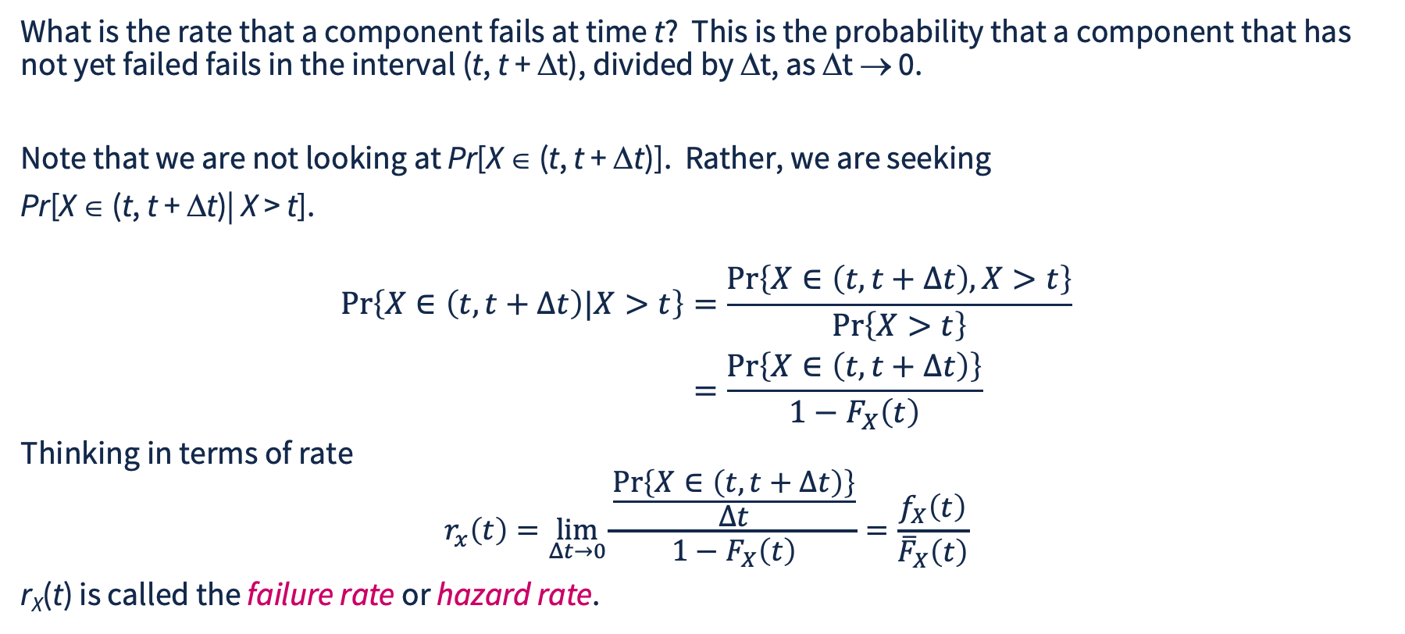
Failure Rate
What is the rate that a component fails at time t? This is the probability that a component that has not yet failed fails in the interval (t, t + Δt), divided by Δt, as Δt → 0.
Note that we are not looking at Pr[X ∈ (t, t + Δt)]. Rather, we are seeking
Pr[X ∈ (t, t + Δt)| X > t].
$$\begin{aligned}\operatorname{Pr}\left\{X∈\left(t,t+Δt\right)|X>t\right\}&=\frac{\operatorname{Pr}\left\{X∈\left(t,t+Δt\right),X>t\right\}}{\operatorname{Pr}\left\{X>t\right\}} \\ &=\frac{\operatorname{Pr}\left\{X∈\left(t,t+Δt\right)\right\}}{1−F_{X}\left(t\right)}\end{aligned}$$
Thinking in terms of rate
$$r_{x}\left(t\right)=\lim_{Δt→0}{\frac{\frac{\operatorname{Pr}\left\{X∈\left(t,t+Δt\right)\right\}}{Δt}}{1−F_{X}\left(t\right)}}=\frac{f_{X}\left(t\right)}{{\overline{F}}_{X}\left(t\right)}$$
r_{X}(t) is called the failure rate or hazard rate.

Slide 5
Typical Failure Rate
Break in Normal operation Wear out
r_{X}(t)
time t

Slide 6
System Reliability
While F_{X} can give the reliability of a component, how do you compute the reliability of a system?
System failure can occur when one, all, or some of the components fail. If one makes the independent failure assumption, for some systems failure can be computed quite simply. The independent failure assumption states that all component failures of a system are independent, i.e., the failure of one component does not cause another component to be more or less likely to fail.
Given this assumption, one can determine:
  1) Minimum failure time of a set of components
  2) Maximum failure time of a set of components
  3) Probability that k of N components have failed at a particular time t.

Slide 7
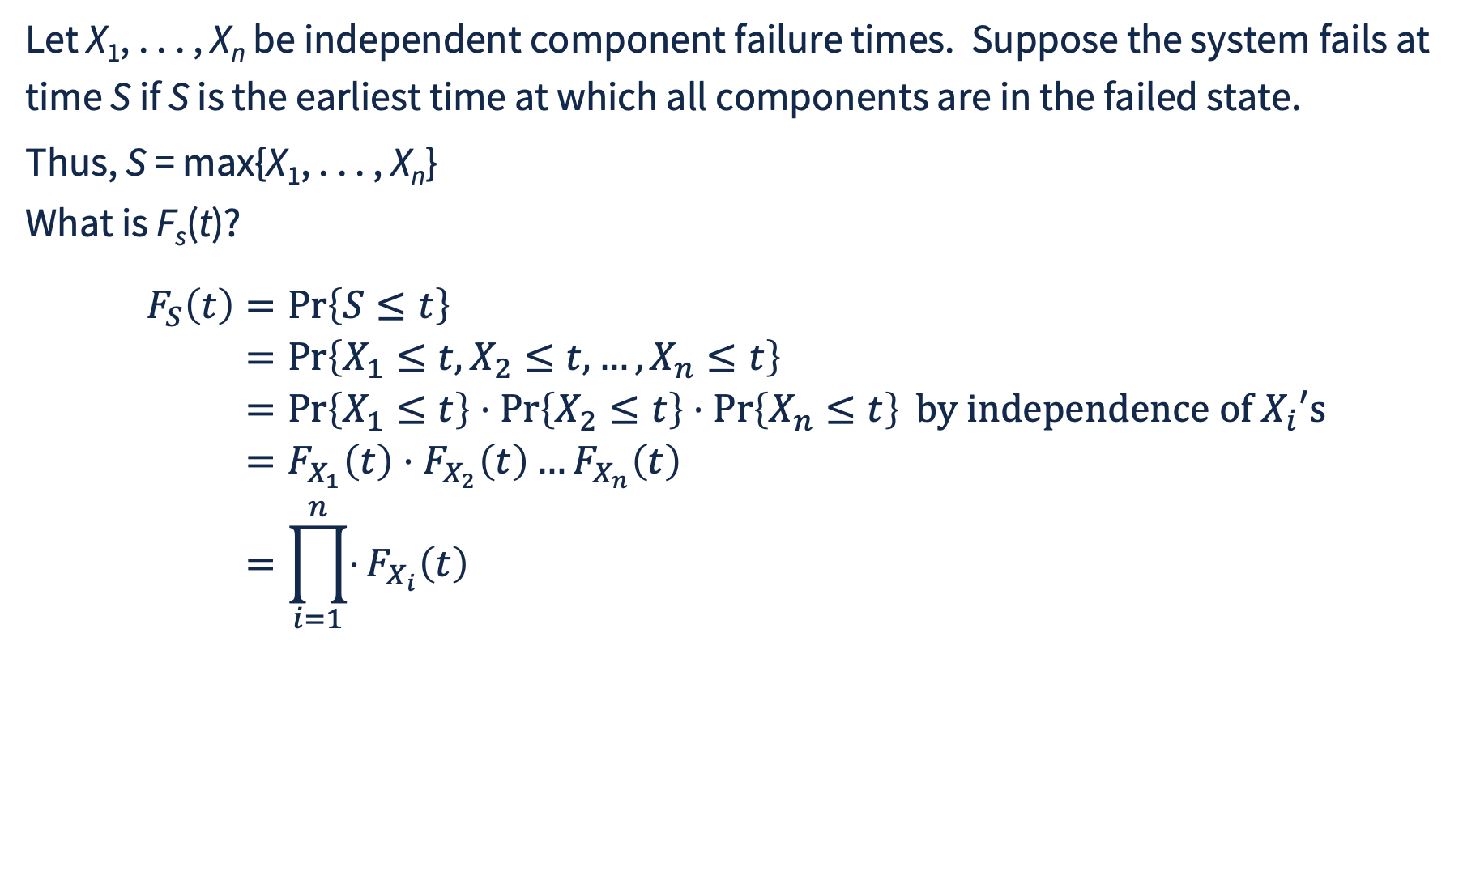
Maximum of n Independent Failure Times
Let X₁, . . . , X_{n} be independent component failure times. Suppose the system fails at time S if S is the earliest time at which all components are in the failed state.
Thus, S = max{X₁, . . . , X_{n}}
What is F_{s}(t)?
$$\begin{aligned}F_{S}\left(t\right)&=\operatorname{Pr}\left\{S≤t\right\} \\ &=\operatorname{Pr}\left\{X_{1}≤t,X_{2}≤t,…,X_{n}≤t\right\} \\ &=\operatorname{Pr}\left\{X_{1}≤t\right\}⋅\operatorname{Pr}\left\{X_{2}≤t\right\}⋅\operatorname{Pr}\left\{X_{n}≤t\right\} \text{by independence of }X_{i}\text{′s} \\ &=F_{X_{1}}\left(t\right)⋅F_{X_{2}}\left(t\right)…F_{X_{n}}\left(t\right) \\ &=\prod_{i=1}^{n}{⋅}F_{X_{i}}\left(t\right)\end{aligned}$$

Slide 8
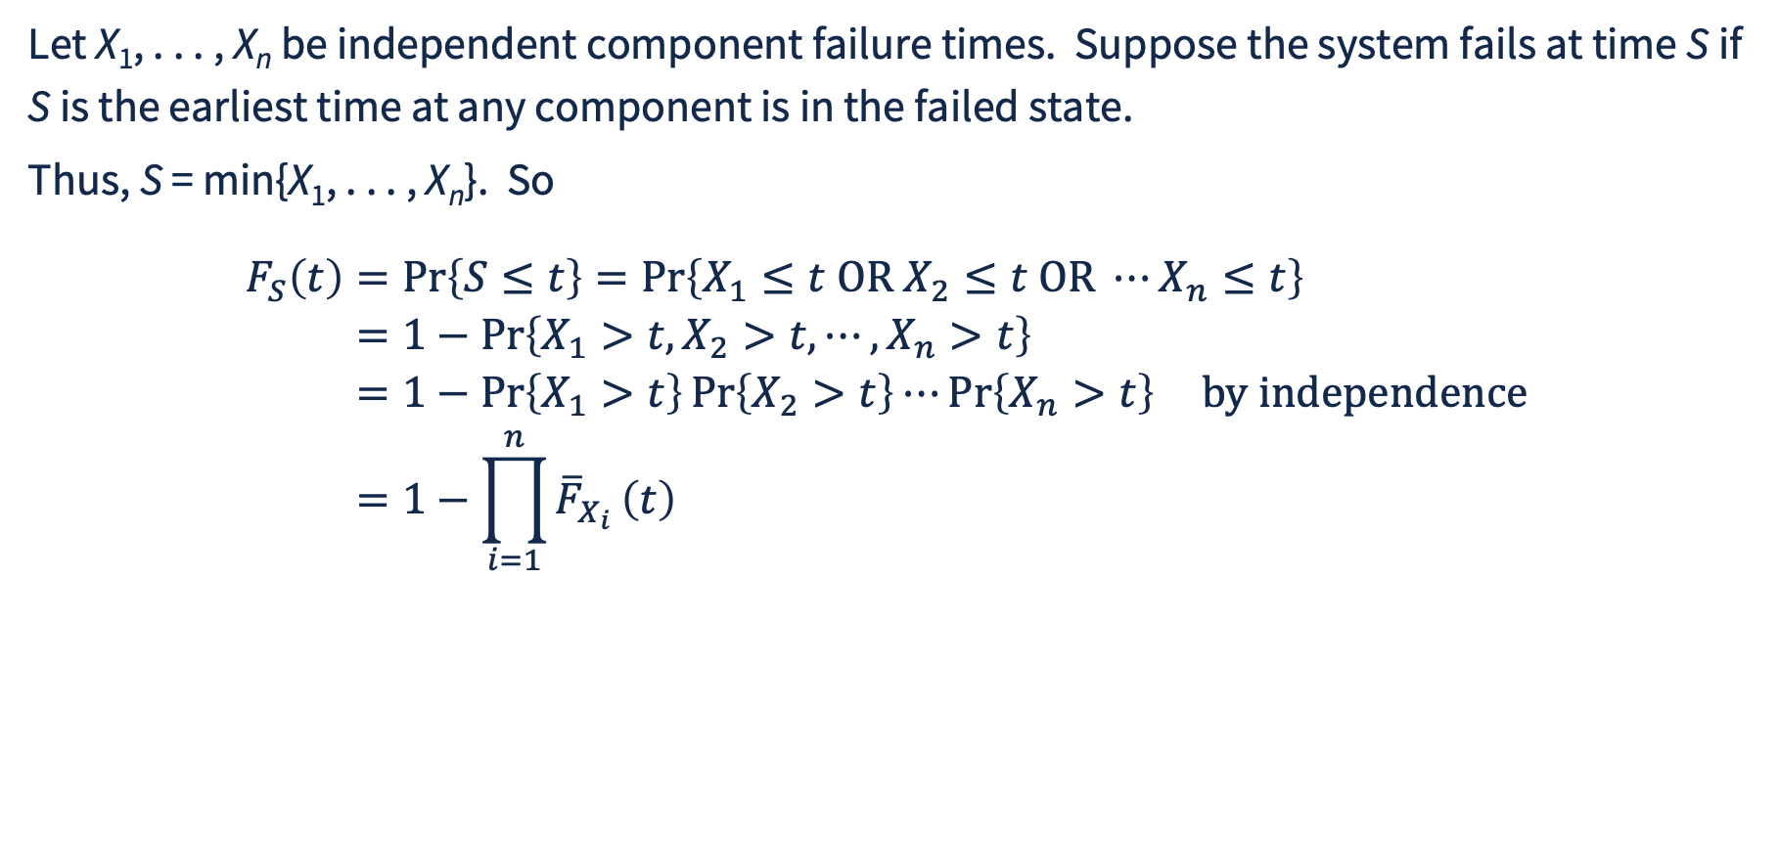
Minimum of n Independent Failure Times
Let X₁, . . . , X_{n} be independent component failure times. Suppose the system fails at time S if S is the earliest time at any component is in the failed state.
Thus, S = min{X₁, . . . , X_{n}}. So
$$\begin{aligned}F_{S}\left(t\right)&=\operatorname{Pr}\left\{S≤t\right\}=\operatorname{Pr}\left\{X_{1}≤t \text{OR} X_{2}≤t \text{OR} ⋯X_{n}≤t\right\} \\ &=1−\operatorname{Pr}\left\{X_{1}>t,X_{2}>t,⋯,X_{n}>t\right\} \\ &=1−\operatorname{Pr}\left\{X_{1}>t\right\}\operatorname{Pr}\left\{X_{2}>t\right\}⋯\operatorname{Pr}\left\{X_{n}>t\right\} \text{by} \text{independence} \\ &=1−\prod_{i=1}^{n}{{\overline{F}}_{X_{i}}}\left(t\right)\end{aligned}$$

Slide 9
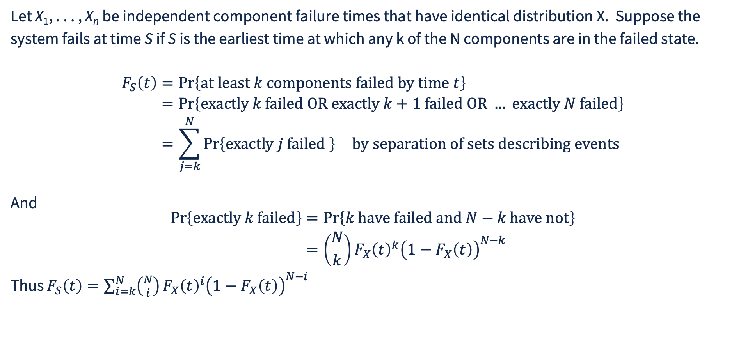
k of N
Let X₁, . . . , X_{n} be independent component failure times that have identical distribution X. Suppose the system fails at time S if S is the earliest time at which any k of the N components are in the failed state.
$$\begin{aligned}F_{S}\left(t\right)&=\operatorname{Pr}\left\{\text{at least }k\text{ components failed by time }t\right\} \\ &=\operatorname{Pr}\left\{\text{exactly }k\text{ failed OR exactly }k+1\text{ failed OR} …\text{ exactly }N\text{ failed}\right\} \\ &=\sum_{j=k}^{N}{\operatorname{Pr}\left\{\text{exactly }j\text{ failed }\right\}} \text{by separation of sets describing events} \\ \end{aligned}$$
And
$$\begin{aligned}\operatorname{Pr}\left\{\text{exactly }k\text{ failed}\right\}&=\operatorname{Pr}\left\{k\text{ have failed and }N−k\text{ have not}\right\} \\ &=\left({N \atop k}\right)F_{X}{\left(t\right)}^{k}{\left(1−F_{X}\left(t\right)\right)}^{N−k}\end{aligned}$$
Thus $F_{S}\left(t\right)=\sum_{i=k}^{N}{\left({N \atop i}\right)}F_{X}{\left(t\right)}^{i}{\left(1−F_{X}\left(t\right)\right)}^{N−i}$

Slide 10
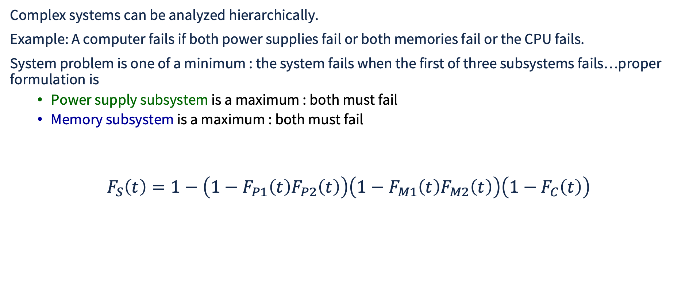
Component Building Blocks
Complex systems can be analyzed hierarchically.
Example: A computer fails if both power supplies fail or both memories fail or the CPU fails.
System problem is one of a minimum : the system fails when the first of three subsystems fails…proper formulation is
  Power supply subsystem is a maximum : both must fail
  Memory subsystem is a maximum : both must fail
$$F_{S}\left(t\right)=1−\left(1−F_{P1}\left(t\right)F_{P2}\left(t\right)\right)\left(1−F_{M1}\left(t\right)F_{M2}\left(t\right)\right)\left(1−F_{C}\left(t\right)\right)$$
P1 and P2 both fail by t
At least one of P1, P2 is up
at t
At least one of M1, M2 is up
at t
CPU is up at t
System is up, product of probabilities by independence

Slide 11
Reliability Block Diagram: Satellite Example
NASA satellite architecture designed for reliability
CPU
High speed network (data and transmission)
Low speed network (engineering and control)
Satellite fails if any of these systems fail.
3 CPUs, CPU system fails if 2 or more CPUs fail. Failure distribution is F_{C}
2 high-speed networks, high-speed network system is up if either is up, failure distribution is F_{H}
2 low-speed networks, low-speed network system is up if either is up. Failure distribution is F_{L}

Slide 12
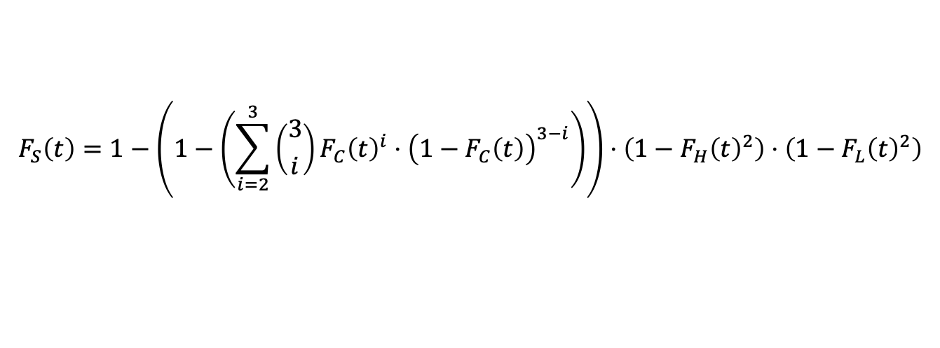
Reliability Block Diagram Example
computer
HSN
LSN
computer
source
sink
HSN
LSN
computer
2 of 3 to fail
CPU System fails
HS network
fails
LS network
fails
$$F_{S}\left(t\right)=1−\left(1−\left(\sum_{i=2}^{3}{\left({3 \atop i}\right)}F_{C}{\left(t\right)}^{i}⋅{\left(1−F_{C}\left(t\right)\right)}^{3−i}\right)\right)⋅\left(1−F_{H}{\left(t\right)}^{2}\right)⋅\left(1−F_{L}{\left(t\right)}^{2}\right)$$
HS network
survives
LS network
survives
CPU System survives

Slide 13
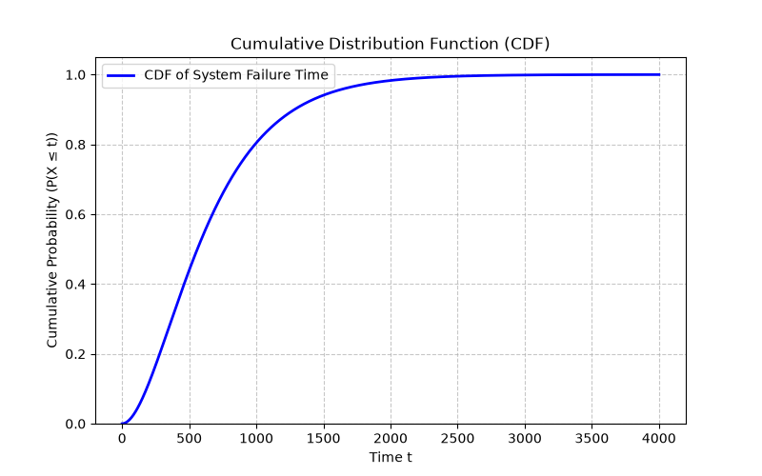
Reliability Block Diagram Computation
Python np and scipy modules extremely helpful
Code for computing min, max, and k-of-N distributions
NASA system example.

Slide 14



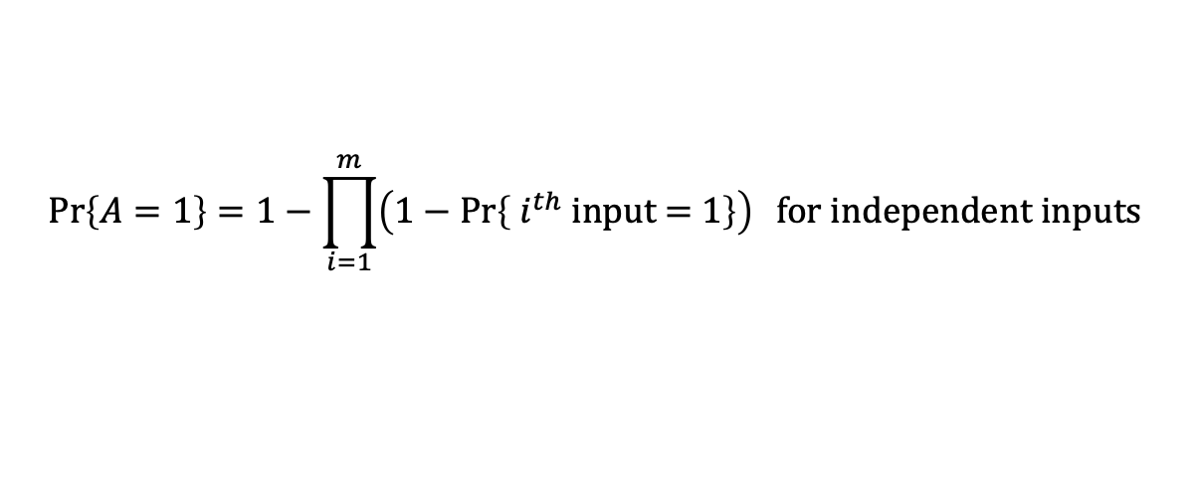
Fault Tree Computation, OR gate
Develop probability of failure at each gate output
Starting from the bottom, moving up the tree
$$\operatorname{Pr}\left\{A=1\right\}=1−\prod_{i=1}^{m}{\left(1−\operatorname{Pr}\left\{ i^{th}\text{ input = 1}\right\}\right)} \text{for independent inputs }$$
k of N
A
E₁
E₂
E₃
E₂
E₄
E₁
E₅
…
E₇
E₆
m inputs

Slide 15
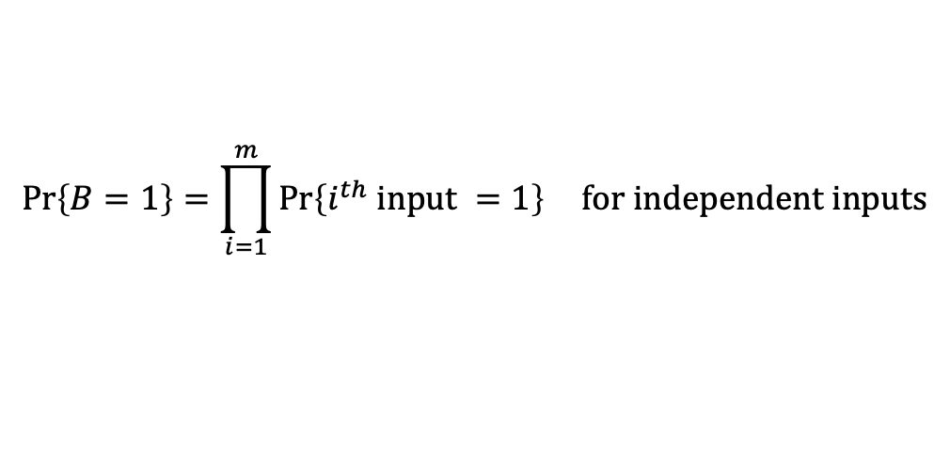
Fault Tree Computation, AND gate
Develop probability of failure at each gate output
Starting from the bottom, moving up the tree
$$\operatorname{Pr}\left\{B=1\right\}=\prod_{i=1}^{m}{\operatorname{Pr}\left\{i^{th} \text{input} =1\right\}} \text{for independent inputs}$$
k of N
B
E₁
E₂
E₃
E₂
E₄
E₁
E₅
…
E₇
E₆
m inputs

Slide 16
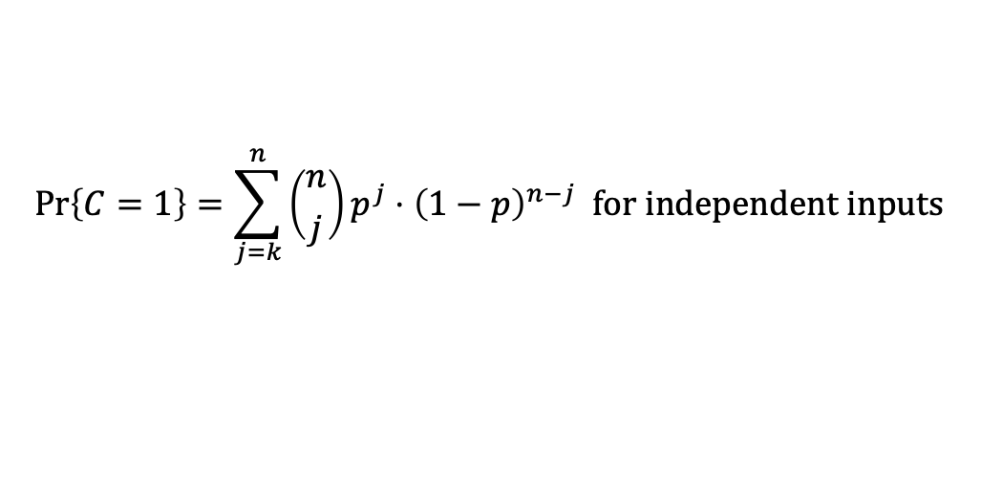
Fault Tree Computation, k of N gate
Develop probability of failure at each gate output
Starting from the bottom, moving up the tree
$$\operatorname{Pr}\left\{C=1\right\}=\sum_{j=k}^{n}{\left({n \atop j}\right)}p^{j}⋅{\left(1−p\right)}^{n−j} \text{for independent inputs}$$
k of N
C
k of N
E₂
…
E₁
E₂
E₃
E₄
E₁
E₅
E₇
E₆
n inputs, independent, for each probability p of failure (=1)

Slide 17
Fault Tree Example, Cyber Compromise of Critical Asset
Cyber adversary able to acquire critical asset if
Direct compromise of system
  requires initial access and exfiltration controls fail
Credentials are abused
  Requires that credential be stolen and access control accepts stolen credentials
Backup or copy is compromised
  Backup system breached and backup protection fails
G₁
G₂
G₃
G₄
E₁
E₂
E₃
E₄
E₅
E₆
E₁ : adversary gains access
E₂: exfiltration controls fail after after adv. access
E₃: adversary acquires credential
E₄: access control fails to detect credential is stolen
E₅: adversary breaches backup system
E₆: backup system exfiltration controls fail after adv. access

Slide 18
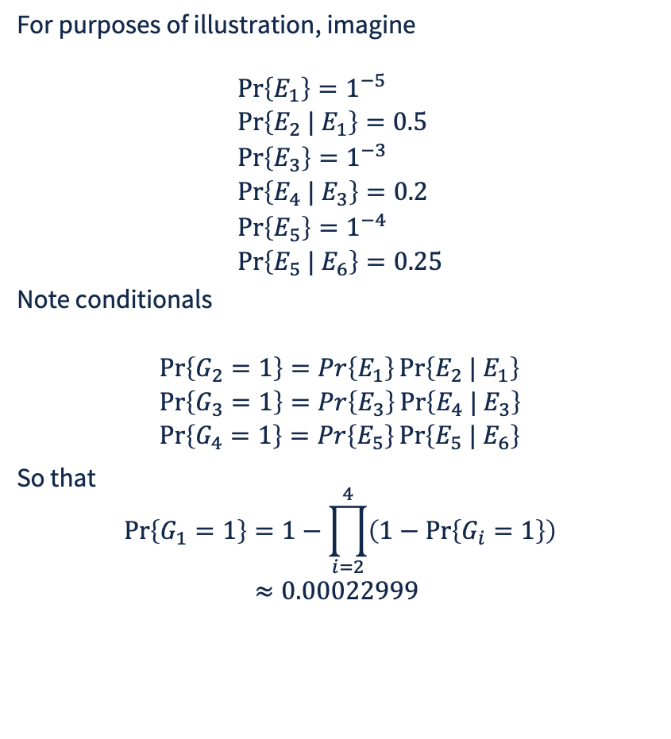
Fault Tree Example, Cyber Probabilities
For purposes of illustration, imagine
$$\begin{aligned} &\operatorname{Pr}\left\{E_{1}\right\}=1^{−5} \\ &\operatorname{Pr}\left\{E_{2} | E_{1}\right\}=0.5 \\ &\operatorname{Pr}\left\{E_{3}\right\}=1^{−3} \\ &\operatorname{Pr}\left\{E_{4} | E_{3}\right\}=0.2 \\ &\operatorname{Pr}\left\{E_{5}\right\}=1^{−4} \\ &\operatorname{Pr}\left\{E_{5} | E_{6}\right\}=0.25\end{aligned}$$
Note conditionals
$$\begin{aligned} &\operatorname{Pr}\left\{G_{2}=1\right\}=Pr\left\{E_{1}\right\}\operatorname{Pr}\left\{E_{2} | E_{1}\right\} \\ &\operatorname{Pr}\left\{G_{3}=1\right\}=Pr\left\{E_{3}\right\}\operatorname{Pr}\left\{E_{4} | E_{3}\right\} \\ &\operatorname{Pr}\left\{G_{4}=1\right\}=Pr\left\{E_{5}\right\}\operatorname{Pr}\left\{E_{5} | E_{6}\right\}\end{aligned}$$
So that
$$\begin{aligned} \operatorname{Pr}\left\{G_{1}=1\right\}&=1−\prod_{i=2}^{4}{\left(1−\operatorname{Pr}\left\{G_{i}=1\right\}\right)} \\ &≈0.00022999\end{aligned}$$
G₁
G₂
G₃
G₄
E₁
E₂
E₃
E₄
E₅
E₆
E₁ : adversary gains access
E₂: exfiltration controls fail after after adv. access
E₃: adversary acquires credential
E₄: access control fails to detect credential is stolen
E₅: adversary breaches backup system
E₆: backup system exfiltration controls fail after adv. access

Slide 19
Fault Tree Example, Sensitivity Analysis
Probabilities and security are not precise, but we can use model to assess sensitivity to changes
Clearly, for these range of values, hardening credentials has the greatest positive impact
G₁
G₂
G₃
G₄
Probability Change | Reduction in Pr{G₁=1}
E₁ from 1⁻⁵ to 1⁻⁶ | 2%
E₃ from 1⁻³ to 1⁻⁴ | 78%
E₄ from 1⁻⁴ to 1⁻⁵ | 10%
E₂ from 0.5 to 0.25 | 1%
E₄ from 0.2 to 0.1 | 43%
E₆ from 0.25 to 0.125 | 5%
E₁
E₂
E₃
E₄
E₅
E₆
E₁ : adversary gains access
E₂: exfiltration controls fail after after adv. access
E₃: adversary acquires credential
E₄: access control fails to detect credential is stolen
E₅: adversary breaches backup system
E₆: backup system exfiltration controls fail after adv. access

Slide 20
State-Space Methods

Slide 21
Availability: A Motivation for State-Based Methods
Availability quantifies alternation between proper and improper service
A(t) == 1 if service at time t is proper, 0 otherwise
E[A(t)] is probability that service is proper at time t
A(0,t) is fraction of time the system delivers proper service during [0,t)
Availability is a measure more focused on user than is reliability
Availability often more difficult to compute as it must account for repair, replacement, and recovery

Slide 22
Example of Availability
A $1000 radio transmitter has an expected time to failure of 500 days. Replacement takes an average of 48 hours.
A $200 transmitter has an expected time to failure of 150 days, but due to the cost, a replacement is readily available, and replacement can be done in 8 hours on average.
For t → ∞, A(t) = .996 for the more reliable transmitter, and A(t) = .998 for the less reliable transmitter.
Higher reliability does not necessarily mean higher availability!
For either choice, what is the cost we should budget for, including replacement?
How do we compute these numbers??

Slide 23
Example of Availability Computation
Transmitter operations nominally retains one spare
  Failed transmitter immediately replaced if spare is available
  Whenever the spare is placed into service, another spare ordered
  MTTF of transmitter is 150 days
  Mean time for delivery of spare is 15 days
  System non-operational if transmitter fails and no spare present,
    Order a second spare immediately
  What fraction of time is the transmitter operational?

Slide 24
Availability Modeling Using Combinatorial Methods
Availability modeling can be done with combinatorial methods, but only with the independent repair assumption, and most easily with exponential life-time distributions
This uses the theory of ON/OFF processes
on
off
“On” time distribution is reliability distribution, obtained using combinatorial methods, say mean value of an epoch in the On state, E[On]
“Off” distribution is repair time distribution, say mean of an epoch in the Off state is E[Off]
Availability is the fraction of time in the On state
Asymptotically, if instances of On periods are independent and identically distributed (i.i.d.) and instances of Off periods are i.i.d., then
  Availability = Pr{in On state} = E[On]/(E[On]+E[Off])

Slide 25
Other Combinatorial Models
Combinatorial validation methods are the simplest kind of analytical/numerical techniques and can be used for reliability and availability modeling under certain assumptions.
Assumptions are that component failures are independent, and for availability, repairs are independent.
When these assumptions hold, simple formulas for reliability and availability exist.

Slide 26
What is “State”? (Review)
Informally, what you need to remember in order to be able to checkpoint, go away, come back, and resume where you started.
Examples:
Game of chess : board position
    Football game
      Team that has possession of the ball
      Number of downs
      Position of the ball on the field
      First down line
    Grocery store
      For each line
        Remaining amount of time customer being served will still be present
        Number of customers in queue

Slide 27
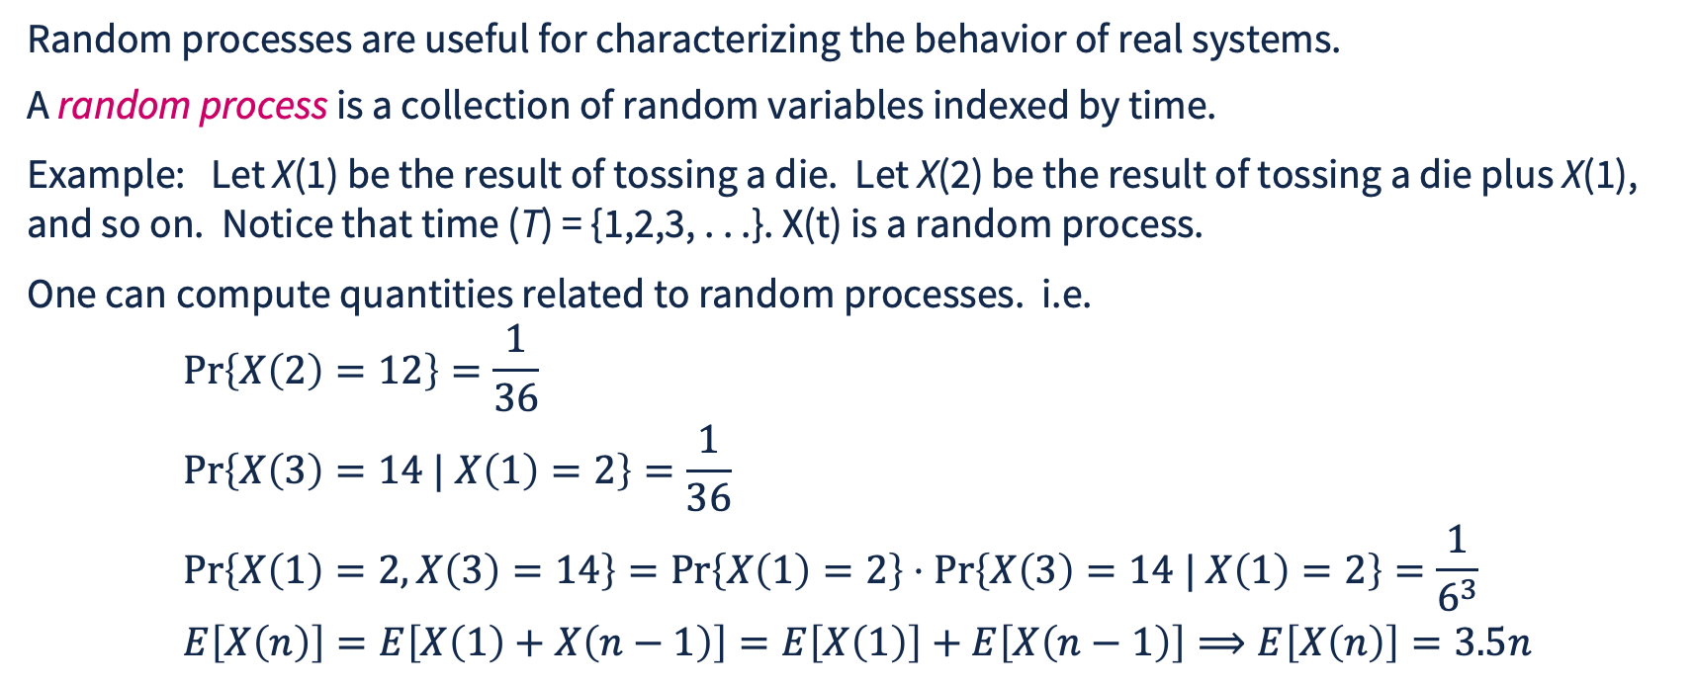
Random Processes
Random processes are useful for characterizing the behavior of real systems.
A random process is a collection of random variables indexed by time.
Example: Let X(1) be the result of tossing a die. Let X(2) be the result of tossing a die plus X(1), and so on. Notice that time (T) = {1,2,3, . . .}. X(t) is a random process.
One can compute quantities related to random processes. i.e.
$$\begin{aligned} &\operatorname{Pr}\left\{X\left(2\right)=12\right\}=\frac{1}{36} \\ &\operatorname{Pr}\left\{X\left(3\right)=14 | X\left(1\right)=2\right\}=\frac{1}{36} \\ &\operatorname{Pr}\left\{X\left(1\right)=2,X\left(3\right)=14\right\}=\operatorname{Pr}\left\{X\left(1\right)=2\right\}⋅\operatorname{Pr}\left\{X\left(3\right)=14 | X\left(1\right)=2\right\}=\frac{1}{6^{3}} \\ &E\left[X\left(n\right)\right]=E\left[X\left(1\right)+X\left(n−1\right)\right]=E\left[X\left(1\right)\right]+E\left[X\left(n−1\right)\right]⟹E\left[X\left(n\right)\right]=3.5n\end{aligned}$$

Slide 28
More on Random Processes
If X is a random process, X(t) is a random variable.
Remember that a random variable Y is a function that maps subsets of elements in set of basic outcomes Ω to numbers in ℜ.
Therefore, a random process X maps elements in the two-dimensional space 2^{Ω} × T to elements in ℜ.
A sample path of X is the history of sample space values X adopts as a function of time.

Slide 29
Examples of Random Processes
For a queue, Let X(t) be the number of jobs in the system at time t.
Fix n. Define random process X_{n}(t) = 1 if X(t) = n, else 0
  X₀(t) is particularly interesting
Let A(t) be the number of arrivals to the queue by time t
Let D(t) be the number of departures from the queue by time t
For a stochastic Petri net with place A and transition T,
let x_{A}(t) be the number of tokens in A at time t
Let f_{T}(t) be the number of times transition T has fired by time t
In all these cases there is a quantitative value and time involved

Slide 30
Description of a Random Process
Recall that for a random variable X, we can use the cumulative distribution F_{X} to describe the random variable.
In general, no such simple description exists for a random process.
However, a random process can often be described succinctly in different ways. For example, if Y is a random variable representing the roll of a die, and X(t) is the sum after t rolls, then we can describe X(t) by
X(t) = X(t - 1) + Y,
P[X(t) = i | X(t - 1) = j] = P[Y = i - j],
or X(t) = Y₁ + Y₂ + . . . + Y_{t}, where the Y_{i}’s are independent.

Slide 31
Classification by Time
If the number of time points defined for a random process, i.e., |T|, is finite or countable (e.g., integers), then the random process is said to be a discrete-time random process.
Example:
Let Z_{k}(n) be the number of times a thrown die turns up with face value k after n tosses
If |T| is uncountable (e.g., real numbers) then the random process is said to be a continuous-time random process.
Example: Let X(t) be the number of fault arrivals in a system up to time t. Since t ∈ T is a real number, X(t) is a continuous-time random process.

Slide 32
Random Process State Space Mapping to Integers
Let Φ be any set. We say that Φ is enumerable if Φ has a finite number of members, or the elements of Φ can be put in 1-to-1 correspondence with the positive integers Ν₊.
Formally, there exists a function Γ:Φ -> Ν₀ such that if α₁, α₂ are members of Φ with α₁ != α₂ then Γ(α₁) != Γ(α₂ ) .
Informally, you can “count” the members of Φ and represent each one with its index.

Slide 33
Examples Mapping State to Integers
Imagine in a simulation you want randomly sample ”the next” city to visit by a traveler, and from Chicago can choose from {Milwaukee, St. Paul, St. Louis, Indianapolis, Iowa City, Indianapolis}. Assign Milwaukee -> 1, St. Paul -> 2, Indianapolis ->3, Iowa City -> 4, Indianapolis -> 4.
  Randomly sampling 3 means choosing Indianapolis
Imagine a queuing network with 4 queues, exponential service times and Poisson external arrival processes ( implying state depends only on number of jobs in service @ each queue), maximum K jobs per queue
  Γ(n₁,n₂,n₃,n₄) = n₄+K*n₃+K²*n₂+K³*n₁ , but mapping is not unique
  Rather more challenging when queue sizes are unbounded

Slide 34
Random Process State Space
Let X be a random process. The state space of a random process is the set of all possible values that the process can take on, i.e.,
S = {y: X(t) = y, for some t ∈ T}.
If X is a random process that models a system, then the state space of X can represent the set of all possible configurations that the system could be in.
S may be discrete (e.g. queueing network), or continuous (voltage on power lines in representation of power grid).

Slide 35
Classification Matrix for Stochastic Processes
State \ Time | Continuous | Discrete
Continuous | Analog signal | A to D converter
Discrete | Computer availability model | Round-based network protocol model

