Slide 1
Model Formalisms

Slide 2



Modeling Formalisms
A well-defined modeling formalism enables us to develop simulators that work for large number of instances that can be described by that formalism
E.g., queueing network formalism extends to many instances
Manufacturing example leads to another
The need to wait until local conditions are satisfied before service applied is captured by Petri Nets

Slide 3
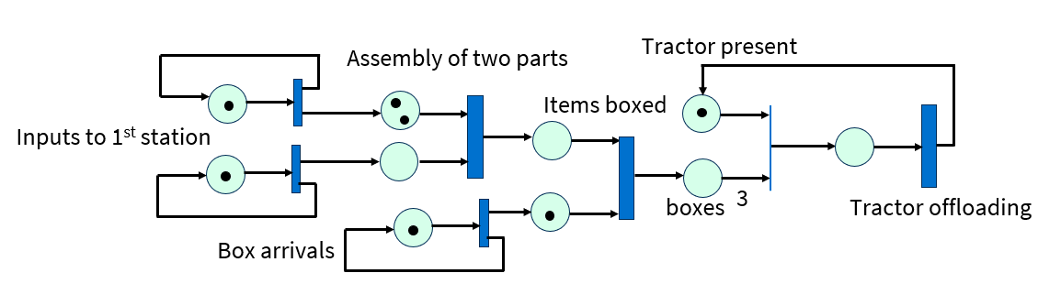
Manufacturing Example as Petri Net
A Petri net is comprised of “places”, “transitions”, and “arcs”. “Token” movement shaped by the topology
Consider manufacturing example
Tokens represent objects
Places represent buffers
Transitions represent synchronization dependencies
  Immediate transitions add no delay
  Timed transitions add random delay (typically exponentially distributed, more which more, anon)
1
1
1
1
1
1
1
1
1
1
1
1
1
1
1
1
1
1
1

Slide 4
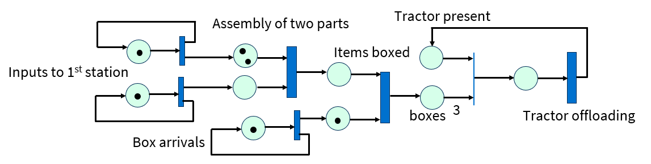
Petri Net
A place may hold multiple tokens
Transitions may be immediate (thin) or timed
A transition fires when each of its input places has a thresholded number of tokens
  Firing removes tokens from input places and deposits them in output places
State of a Petri net is a vector of its places’ markings (number of tokens)
  Stochastic Petri net associates firing delays with timed transitions
1
1
1
1
1
1
1
1
1
1
1
1
1
1
1
1
1
1

Slide 5
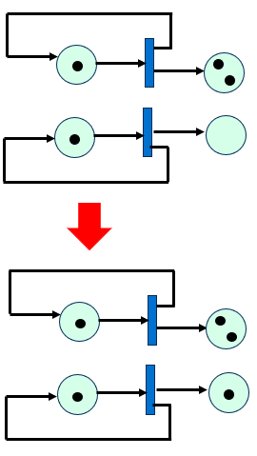
Petri Net Semantics Illustrated by Part Arrival
Consider generation of parts / boxes
Timed transitions take “inter object arrival time” to fire
On firing (lower transition fires earlier)
Input token is consumed
Tokens placed in output places
Effectively depositing a new object in the input buffer for the station, and starting the firing of the timed transition for the next arrival
Fires after 10 sec.
Fires after 2 sec.

Slide 6
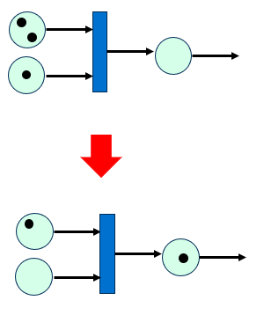
Petri Net Semantics Illustrated by Parts Assembly
Consider assembly of parts
Newly arrived part enables timed transition to begin its firing count-down, modeling the time to assemble two parts
On firing, tokens representing parts being assembled are consumed at input places, token representing assembled part placed in output place

Slide 7
Petri Net Semantics Illustrated by Tractor Movement
Tractor present
Consider tractor conveying product
Buffered assembled items are paired with boxes, timed transition models boxing time
Eventually 3 assembled boxes are represented
Immediate transition moves boxes to tractor, and removes tractor
Timed transition for tractor away time begins, eventually will fire and tractor token will again be present near boxes
Items
3
Tractor offloading
boxes
(multiple transitions)
Tractor present
Items
3
Tractor offloading
boxes
Tractor present
Items
3
Tractor offloading
boxes

Slide 8
Petri Net Analysis
Often the case where a description can be made of markings (assignments of tokens to places) that are of particular interest, e.g., represent system compromise or system failure
Question of whether a marking M can be achieved through transitions from an initial marking S is called the Reachability Problem
Reachability computations are typically combinatorially complex when the number of possible markings is combinatorially large
  Imagine a breadth-first expansion discovering reachable states
Same problem arises when trying to assign probabilities to markings (as we will!)

Slide 9
Continuous and Discrete Simulation

Slide 10
Continuous Simulation
Rules for modifying state in some simulations are
  Temporally local (only small time advance)
  Global (every state variable updated in every update cycle)
Models where state changes are described by differential equations are “Continuous” models
  Differential equation describes instantaneous change of state as a function of present state
  Continuous models extremely widespread (much of scientific computing)
  From the point of view of simulation time advance, we call them time-stepping models
    Key point is, global computation of new state at every point in model, every time-step
Δt
time

Slide 11
State Evolution in Discrete Models
Q₁
State = (a, n, r) where a is remaining time until next arrival, n is number of jobs in system, r is remaining service time
Observe how components of state vector evolve in time
Time | State | Observation
t | (10, 3, 4) | a = 10 and 4 for illustration
t + ε | (10 – ε, 3, 4 – ε) | After ε time both a and r decrease by ε
t+ (4 - ε) | (6 + ε, 3, ε) | After 4 - ε time both a and r decrease by 4 - ε
t + 4 | (6, 2, 14) | Job in service departs, next job in service requires 14 units
Could time-step, but most steps don’t involve anything interesting
t+ε
t+Νε
t + 4
time
(10 - ε, 3, 4 - ε)
(10 - Nε, 3, 4 - Nε)
(6, 2, 14)

Slide 12
Define Events
Q₁
State = (a, n, r) where a is remaining time until next arrival, n is number of jobs in system, r is remaining service time
Note that a and r decrease directly in time
n changes only when a goes to 0 or r goes to 0
Call these instances “events”
Maintain “event list” which efficiently yields event with least value of time
Event
Event
time
t+4
departure
Q₁
t+10
arrival
Q₁
type
location

Slide 13
Focus Computation on Event Times, Arrival to empty Q
Q₁
Q₁
Time
L
Time
L
t
t
arrival
Q₁
t
t+A
arrival
Q₁
t+S
departure
Q₁
Here assume inter-arrival time of A
Sample service time S, create departure event at time t+S
Sample inter-arrival time A, create arrival event at time t+A
Next event processed is arrival if A < S, is departure if S < A

Slide 14
Focus Computation on Event Times, Arrival to non-empty Q
Q₁
Q₁
Time
L
Time
L
t
t
arrival
Q₁
t+S
departure
Q₁
t
t+A
arrival
Q₁
t+S
departure
Q₁
Here assume inter-arrival time of A
Sample inter-arrival time A, create arrival event at time t+A

Slide 15
Focus Computation on Event Times, Departure, leaving empty Q
Q₁
Q₁
Time
L
Time
L
t
t
departure
Q₁
t+A
arrival
Q₁
t
t+A
arrival
Q₁
No processing other than removal of departure event from event list

Slide 16
Focus Computation on Event Times, Departure, leaving non-empty Q
Q₁
Q₁
Time
L
Time
L
t
t
departure
Q₁
t+A
arrival
Q₁
t
t+A
arrival
Q₁
t+S
departure
Q₁
Sample service time S, create departure event at time t+S

Slide 17
Events in Queueing Network Example
Q₁
Q₂
0.9
0.1
Q₃
0.2
Q₄
0.95
0.8
0.05
Similar to events in single queue system, with exception of departure event when branching involved
Includes random sampling of branch choice
May include creation of arrival event at another queue

Slide 18
Main Points to Observe
Particulars of event processing depends on
State of queue when the event is processed
Type of the event that is processed

Slide 19
Reliability Block Diagram
Blocks represent components, which may fail
A system failure : no path from source to sink through non-failed components
Series:
System fails if any component fails.
Parallel:
System fails if all components fail.
k of N:
System fails if k or more of N
components fail.
source
C1
C2
C3
sink
C1
source
C2
sink
C3
C1
source
C2
sink
C3
2 of 3

Slide 20
Reliability Block Diagram: Satellite Example
NASA satellite architecture designed for reliability
CPU
High speed network (data and transmission)
Low speed network (engineering and control)
Satellite fails if any of these systems fail.
3 CPUs, CPU system fails if 2 or more CPUs fail. Failure distribution is F_{C}
2 high-speed networks, high-speed network system is up if either is up, failure distribution is F_{H}
2 low-speed networks, low-speed network system is up if either is up. Failure distribution is F_{L}

Slide 21
Reliability Block Diagram Example
computer
HSN
LSN
computer
source
sink
HSN
LSN
computer
2 of 3

Slide 22



Fault Tree
Explicit representation of system decomposition and dependency of system operation on subsystems
Fault tree expresses logical conditions necessary for system failure
Logical conditions expressed using AND, OR, and k-of-N ‘gates’
  These map into Boolean functions
Tree graphically expressing aggregate Boolean equation
Note multiple appearances of same component
Complicates analysis
System is failed if logical output is True
k of N
S₁
S₂
S₃
S₂
S₄
S₁
S₅
S₇
S₆
S_{j} is True if component failed
k of N function is True if at least k input are True

Slide 23
Fault Tree Analysis
Allowing for common events (same event appearing in multiple places in a tree), computing the probability of system failure from probabilities of component failures is P-Hard
With common events you must condition on every combination, which grows as 2^{k} in k common conditions
Analysis can involve finding all minimum sets of component failures that cause system failure
Computational complexity NP-Hard
Number of cut sets grows exponentially
Conversion to other forms (like Binary Decision Tree) can cause exponential growth in state

Slide 24
Series-Parallel Graphs
Analysis of graph-based models is based notion of series-parallel graphs (SPG)
Recursive definition:
A single node with a source and a sink is a SPG
Two SPGs S₁ and S₂ where the sink of S₁ is connected to the source of S₂ is an SPG whose source is S₁’s source and whose sink is the sink of S₂
Two SPGs S₁ and S₂ whose source connects to the sources of both S₁ and S₂ , and the sinks of S₁ and S₂ join are joined
Every node has failure distribution, SPG fails if no path from source to sink only through non-failed nodes
Complex system decomposed into series-parallel components
source
sink
source
S₁
S₂
sink
S₁
source
sink
S₂

Slide 25
Series-Parallel: Multiple SGPs in Series
Observe that n>2 SPGs in series are an SPG
SPG by series definition
Given SPG
source
S₁
S₂
S₃
sink
source
S₁
S₂
sink
source
S₃
sink
SPG by series definition

Slide 26
Series-Parallel: Multiple Parallel SGPs
Observe that n>2 SPGs in parallel are an SPG
SPG by parallel definition
S₁
S₁
source
sink
source
S₂
sink
S₂
SPG by parallel definition
S₃
S₃
Given SPG

Slide 27
Series-Parallel: Decomposition
Computations of probability of failure depend on recognizing underlaying SPG structure
We’ll see how to compute probability that series fails and probability that parallel fails
Graph analysis decomposes network into representation of series and parallel components
Solve for each, build up solution
C₁
C₆
source
C₂
C₈
sink
C₇
C₃
C₄
C₅

Slide 28
Reliability Graphs
Graph structure, but arcs represent components, with failure distributions
Series-parallel decomposition not required
System failure if there is no path from source to sink
Can represent both series and parallel subsystems
Same solution techniques as with SPG to compute probability of no path from source to sink
C₁
C₁
C₂
source
sink
source
sink
C₃

Slide 29
Reliability Graph Example
C₁
2
C₄
Consider general network, where edges represent ability for nodes to communicate
  Not series-parallel
Solution technique is to condition on the state of selected edges and analyze graph under that condition
Condition on C₃ having failed
  Turns into series subsystem C₁ -> C₄ in parallel with series subsystem C₂ -> C₅ which we can solve
Condition on C₃ being operation
  Turns into a series where the system fails if either both C₁ and C₂ fail, or both C₁ and C₂ fail
1
C₃
4
C₂
C₅
3
C₁
2
C₄
1
4
C₂
C₅
3
C₁
C₄
1
2,3
4
C₂
C₅

Slide 30
Binary Decision Diagram
Formalism used to describe Boolean Functions
Supports queries on whether function can be True/False
Represent as a tree with variables as nodes
Various optimizations to reduce size of representation
x₁
x₁
x₁ = 0
x₁ = 1
x₂
x₂
x₂
x₂
share identical
subproblems
x₂ = 0
x₂ = 1
x₂ = 0
x₂ = 1
0
1
0
1
0
1
BDD: a directed acyclic graph
Decision tree: repeated subtrees

Slide 31
Reduced Ordered BDDs: Canonical form
ROBDDs impose structure so equality, simplification, and reuse become efficient
Fixed variable order
Reduction rules
For a given variable order, an ROBDD is canonical: identical functions have identical graphs.
x₁
x₁
x
A
x₂
x₂
x₂
A
A
Complemented-edge variants can reduce memory further by storing negations on edges.
Remove tests whose two edges go to the same child
x₃
x₃
x₃
The unique table enforces sharing; the computed table caches results of recursive operations.
x
x
x
T
0
1
B
C
B
C
The catch: graph size can change exponentially with a poor variable order.
Merge isomorphic nodes

Slide 32
Use of BDDs
Support symbolic analysis when graph size is not too large
Hardware / circuit
verification
Symbolic model
checking
Fault trees and
system reliability
BDD
engine
Network reachability
and policy analysis
Combinatorial search
and constraint solving
Probabilistic risk
assessment
Typical workflow: encode the Boolean structure → choose/order variables → reduce and cache → answer exact queries such as equivalence, reachability, counts, probabilities, and critical components.

Slide 33
Core Analysis
Most queries reduce to recursive graph operations, remembering past assignments
Build
Apply
Quantify
Count
Extract
from formula, circuit,
or state relation
Boolean ops:
AND, OR, XOR, NOT
∃ / ∀ over
variables
sat / model
count / probability
witnesses, cuts,
prime implicants
Recursive pattern
Satisfiability: nonzero terminal reachable from the root.
Reliability/probability: weighted model count with component failure probabilities.
op(f,g)
Equivalence: compare root pointers in a canonical ROBDD manager.
Sensitivity: repeat weighted counts after perturbing selected variables.
op(f₀,g₀)
op(f₁,g₁)
Model counting: dynamic program over the DAG, weighted by skipped variables.
split on top variable; cache each subproblem

