Slide 1
Probability

Slide 2
Origins of Probability Analysis
Italian Gerolamo Cardano (1526) The Book on Games of Chance
  Early thoughts on counting dice rolls (sum of three dice) and relative frequencies. Defined probability in terms of the ratio of favorable outcomes to total outcomes
Pascal and Femat correspondence in 1654 on fair splitting of stakes in a game if the game is interrupted
  Introduced notions of expected value, and ways to compute probabilities
Christiaan Huygens, textbook on probability (1656), examples include drawing balls from urns
Jacob Bernoulli: Proved the Law of Large Numbers, showing that averages of samples converge to underlaying mean
Pierr-Simon Laplace: Hypothesis testing

Slide 3
An Intuitive Understanding of Probability
Examples have shown models that “randomly choose
  Durations (e.g., between successive arrivals, time a job is given service)
  Selection of output arcs
An intuitive way to think about probability is in terms of “statistical frequency”
Imagine
  a container that is large enough to hold 1000 balls
  1000 balls, each labeled with a letter from {A,B,C,D,E,F,G,H}
    f_{A} is fraction of balls labeled A, f_{B} the fraction that are labeled B, and so on
    f_{A} + f_{B} + f_{C} + f_{D} + f_{E} + f_{F} + f_{G} + f_{H} = 1
  Repeat the process of (a) mixing balls thoroughly, (b) drawing out a ball, (c ) record its label, and (d) returning the ball, many times
  After many iterations you expect the fraction of balls drawn labeled as A to be ”close” to f_{A} , the fraction drawn labeled as B to be “close” to f_{B} , and so on.
We might say that “The probability of drawing a ball labeled A” on a single draw is p_{A} , meaning that if we did the experiment infinitely often, the fraction of times we’d draw A is p_{A} = f_{A .}

Slide 4
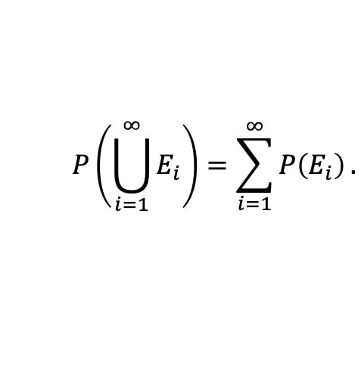
Kolmogorov’s Axiomatic Definition of Probability
Axiomatic treatment (1933) avoids resilience on interpretation of probability semantics (like frequency)
Ω
Define a sample space of elementary outcomes
An event is a subset of
Function P( E ) mapping events to [0,1]
P( E ) => 0 for all E in 2 (set of all subsets of )
P( ) = 1
For disjoint events E₁ , E₂ , …
Ω
Ω
Ω
Ω
$$P\left(\bigcup_{i=1}^{∞}{E_{i}}\right)=\sum_{i=1}^{∞}{P\left(E_{i}\right)}.$$
Notes:
\mbox{For every $E \in 2^{\Omega}$ there exists } \\
\mbox{ $\bar{E} \in 2^{\Omega}$ with $P(\bar{E}) = 1-P(E)$}

Slide 5
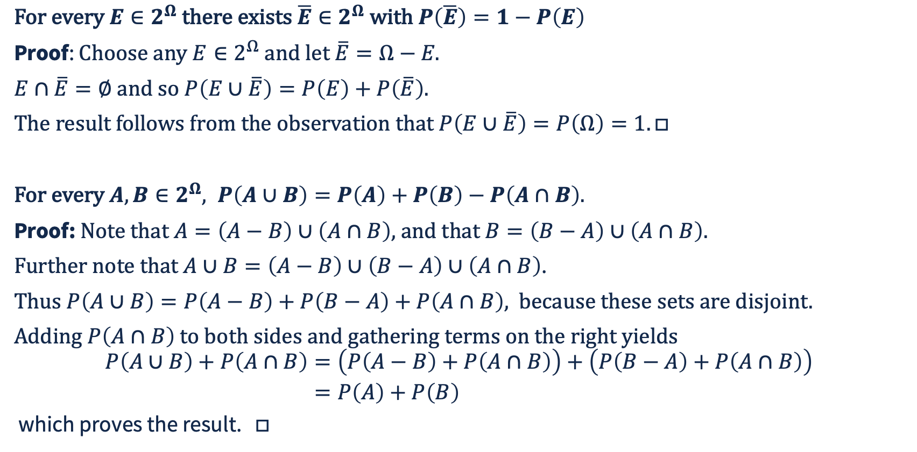
Theorems
$\text{For every }E∈2^{Ω}\text{ there exists }\overline{E}∈2^{Ω}\text{ with }P\left(\overline{E}\right)=1−P\left(E\right)$
Proof: $\text{Choose} \text{any} E∈2^{Ω} \text{and} \text{let} \overline{E}=Ω−E\text{.}$
$E∩\overline{E}=∅\text{ and so }P\left(E∪\overline{E}\right)=P\left(E\right)+P\left(\overline{E}\right).$
$\text{The} \text{result} \text{follows} \text{from} \text{the} \text{observation} \text{that} P\left(E∪\overline{E}\right)=P\left(Ω\right)=1.□$
$\text{For every }A,B∈2^{Ω}, P\left(A∪B\right)=P\left(A\right)+P\left(B\right)−P\left(A∩B\right).$
Proof: $\text{Note} \text{that} A=\left(A−B\right)∪\left(A∩B\right)\text{,} \text{and} \text{that} B=\left(B−A\right)∪\left(A∩B\right)\text{.}$
$\text{Further} \text{note} \text{that} A∪B=\left(A−B\right)∪\left(B−A\right)∪\left(A∩B\right)$.
$\text{Thus} P\left(A∪B\right)=P\left(A−B\right)+P\left(B−A\right)+P\left(A∩B\right)\text{, } \text{because these sets are disjoint.}$
$\text{Adding }P\left(A∩B\right)\text{ to both sides and gathering terms on the right yields}$
$$\begin{aligned}P\left(A∪B\right)+P\left(A∩B\right)&=\left(P\left(A−B\right)+P\left(A∩B\right)\right)+\left(P\left(B−A\right)+P\left(A∩B\right)\right) \\ &=P\left(A\right)+P\left(B\right)\end{aligned}$$
which proves the result. $□$
Notes:
\mbox{For every $E \in 2^{\Omega}$ there exists } \\
\mbox{ $\bar{E} \in 2^{\Omega}$ with $P(\bar{E}) = 1-P(E)$}

Slide 6
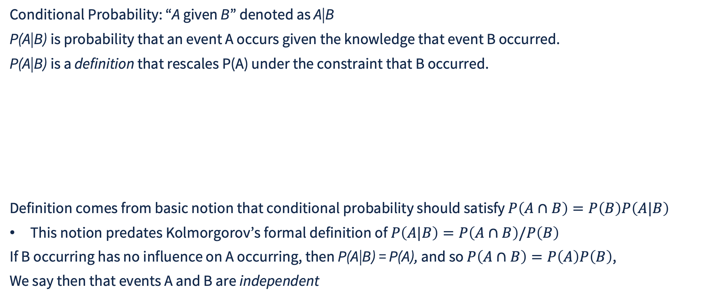

Conditional Probability
Conditional Probability: “A given B” denoted as A|B
P(A|B) is probability that an event A occurs given the knowledge that event B occurred.
P(A|B) is a definition that rescales P(A) under the constraint that B occurred.
Definition comes from basic notion that conditional probability should satisfy $P\left(A∩B\right)=P\left(B\right)P\left(A|B\right)$
This notion predates Kolmorgorov’s formal definition of $P\left(A|B\right)=P\left(A∩B\right)/P\left(B\right)$
If B occurring has no influence on A occurring, then P(A|B) = P(A), and so $P\left(A∩B\right)=P\left(A\right)P\left(B\right)$,
We say then that events A and B are independent
Sample space
B
$$A∩B$$
A
Notes:
\mbox{For every $E \in 2^{\Omega}$ there exists } \\
\mbox{ $\bar{E} \in 2^{\Omega}$ with $P(\bar{E}) = 1-P(E)$}

Slide 7
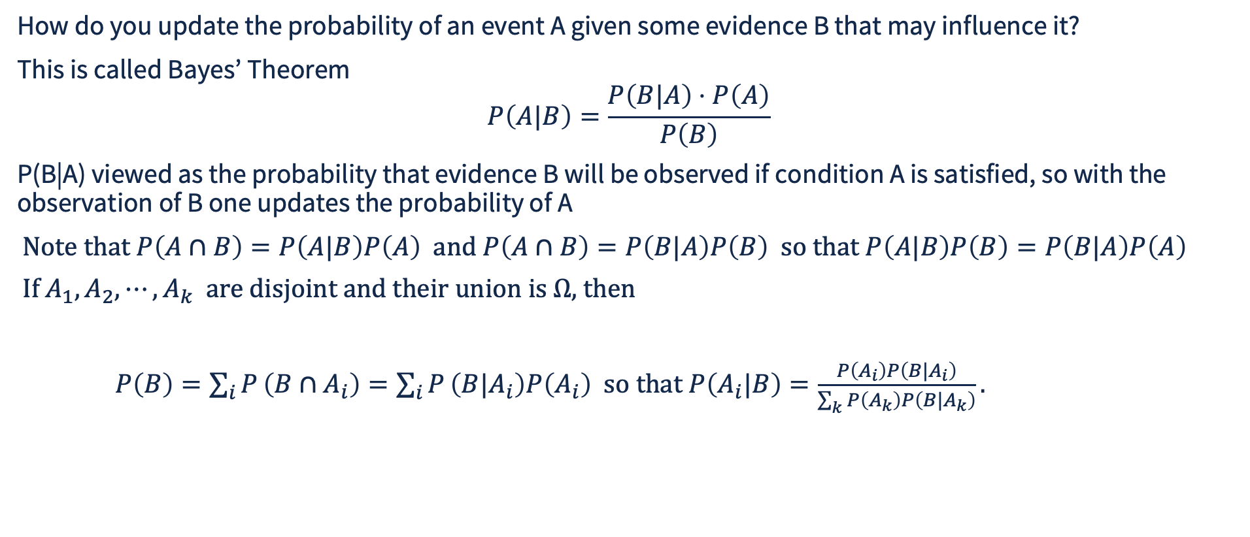
Bayes’ Theorem
How do you update the probability of an event A given some evidence B that may influence it?
This is called Bayes’ Theorem
$$P\left(A|B\right)=\frac{P\left(B|A\right)⋅P\left(A\right)}{P\left(B\right)}$$
P(B|A) viewed as the probability that evidence B will be observed if condition A is satisfied, so with the observation of B one updates the probability of A
$\text{Note that }P\left(A∩B\right)=P\left(A|B\right)P\left(A\right) \text{and }P\left(A∩B\right)=P\left(B|A\right)P\left(B\right) \text{so that }P\left(A|B\right)P\left(B\right)=P\left(B|A\right)P\left(A\right)$
$\text{If} A_{1},A_{2},⋯,A_{k} \text{are} \text{disjoint and their union is }Ω\text{, then}$
$P\left(B\right)=\sum_{i}{P}\left(B∩A_{i}\right)=\sum_{i}{P}\left(B|A_{i}\right)P\left(A_{i}\right) \text{so that }P\left(A_{i}|B\right)=\frac{P\left(A_{i}\right)P\left(B|A_{i}\right)}{\sum_{k}{P}\left(A_{k}\right)P\left(B|A_{k}\right)}.$
Notes:
\mbox{For every $E \in 2^{\Omega}$ there exists } \\
\mbox{ $\bar{E} \in 2^{\Omega}$ with $P(\bar{E}) = 1-P(E)$}

Slide 8
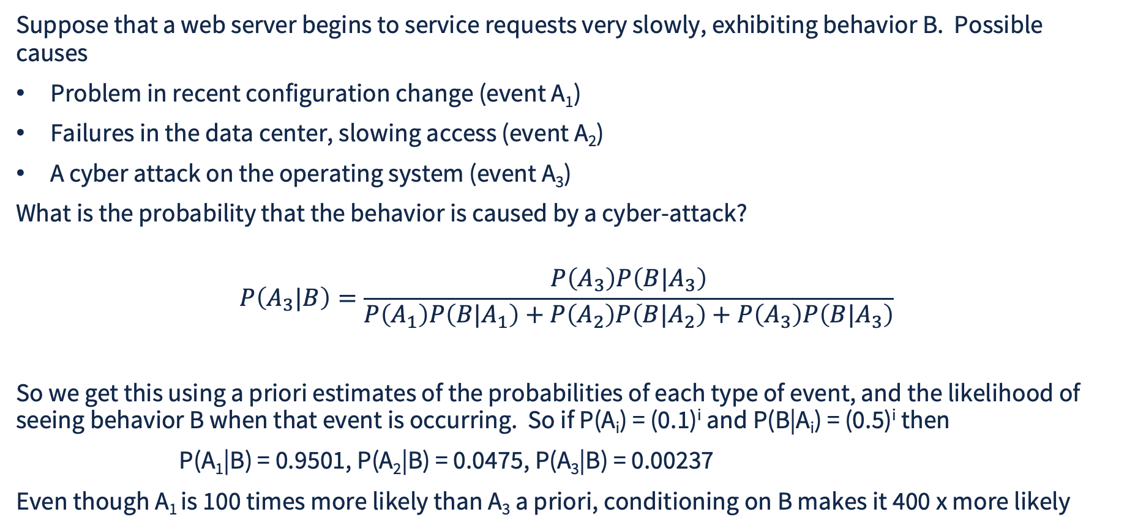
Application of Bayes’ Theorem in Computer Systems Modeling
Suppose that a web server begins to service requests very slowly, exhibiting behavior B. Possible causes
Problem in recent configuration change (event A₁)
Failures in the data center, slowing access (event A₂)
A cyber attack on the operating system (event A₃)
What is the probability that the behavior is caused by a cyber-attack?
$$P\left(A_{3}|B\right)=\frac{P\left(A_{3}\right)P\left(B|A_{3}\right)}{P\left(A_{1}\right)P\left(B|A_{1}\right)+P\left(A_{2}\right)P\left(B|A_{2}\right)+P\left(A_{3}\right)P\left(B|A_{3}\right)}$$
So we get this using a priori estimates of the probabilities of each type of event, and the likelihood of seeing behavior B when that event is occurring. So if P(A_{i}) = (0.1)^{i} and P(B|A_{i}) = (0.5)^{i} then
P(A₁|B) = 0.9501, P(A₂|B) = 0.0475, P(A₃|B) = 0.00237
Even though A₁ is 100 times more likely than A₃ a priori, conditioning on B makes it 400 x more likely
Notes:
\mbox{For every $E \in 2^{\Omega}$ there exists } \\
\mbox{ $\bar{E} \in 2^{\Omega}$ with $P(\bar{E}) = 1-P(E)$}

Slide 9
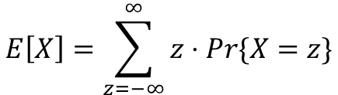

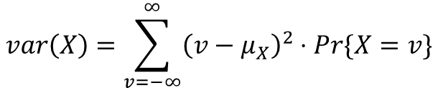

Mean and Variance
A discrete random variable X has measures that summarize its behavior (called moments)
Central tendency described by mean, or expected value
$$E\left[X\right]=\sum_{z=−∞}^{∞}{z}⋅Pr\{X=z\}$$
Frequently written as μ or μ_{X}
Dispersion is described by variance
$$σ^{2}$$
$$var\left(X\right)=\sum_{v=−∞}^{∞}{{\left(v−μ_{X}\right)}^{2}}⋅Pr\{X=v\}$$
Frequently written as known as the standard deviation
$$σ^{2}\text{ or }σ_{X}^{2},\text{ with }σ\text{ or }σ_{X}^{2}$$
N.B. It is possible for these measures to be infinite
Notes:
\sigma^2 \mbox{\ or \ } \sigma_X^2, \mbox{\ with\ }\sigma \mbox{\ or \ } \sigma_X^2

Slide 10
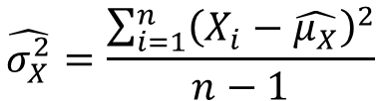

Sample Mean and Sample Variance
A discrete event simulation typically estimates mean and variance of X
  Distribution of X complicated, unknown
  Achieved taking many samples (observations) of X
    X₁ , X₂ , … , X_{n}
  Compute sample mean
  Compute sample variance
$$\hat{μ_{X}}=\frac{\sum_{i=1}^{n}{X_{i}}}{n}$$
$$\hat{σ_{X}^{2}}=\frac{\sum_{i=1}^{n}{{\left(X_{i}−\hat{μ_{X}}\right)}^{2}}}{n−1}$$
Notes:
\hat{\sigma}_X^2 = \frac{\sum_{i=1}^n (X_i - \hat{\mu}_X)^2}{n-1}

Slide 11
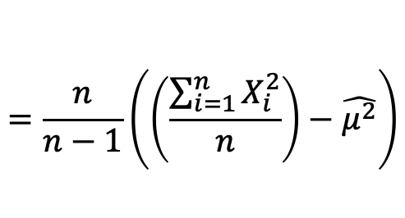
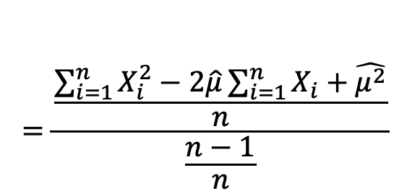
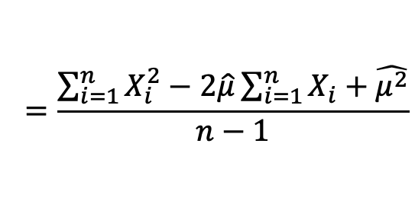
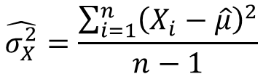

Clever Way to Compute Sample Variance
Maintain variables sum and sum2
Collecting X_{i} update
sum += X_{i}
sum2 += X_{i}²
Computing statistics
μ = sum/n
μ₂ = sum2/n
$$\hat{σ_{X}^{2}}=\frac{\sum_{i=1}^{n}{{\left(X_{i}−\hat{μ}\right)}^{2}}}{n−1}$$
$$=\frac{\sum_{i=1}^{n}{X_{i}^{2}}−2\hat{μ}\sum_{i=1}^{n}{X_{i}}+\hat{μ^{2}}}{n−1}$$
$$=\frac{\frac{\sum_{i=1}^{n}{X_{i}^{2}}−2\hat{μ}\sum_{i=1}^{n}{X_{i}}+\hat{μ^{2}}}{n}}{\frac{n−1}{n}}$$
$$=\frac{n}{n−1}\left(\left(\frac{\sum_{i=1}^{n}{X_{i}^{2}}}{n}\right)−\hat{μ^{2}}\right)$$
$$σ^{2}=\frac{n}{n−1}⋅\left(μ_{2}−μ^{2}\right)$$
Notes:
\begin{align*}
\hat{\sigma}_X^2 &= \frac{\sum_{i=1}^n (X_i - \hat{\mu})^2}{n-1} \\
&= \frac{ \sum_{i=1}^n X_i^2 - 2\hat{\mu} \sum_{i=1}^n X_i + \hat{\mu}^2}{n-1} \\
&= \frac{ \frac{ \sum_{i=1}^n X_i^2 - 2\hat{\mu} \sum_{i=1}^n X_i + \hat{\mu}^2}{n} }{ \frac{n-1}{n} } \\
&= \frac{n}{n-1} \bigg( \bigg( \frac{ \sum_{i=1}^n X_i^2 }{n} \bigg) - \hat{\mu}_X^2 \bigg)
\end{align*}

Slide 12
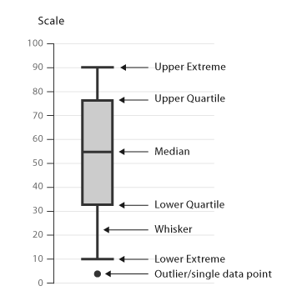
Percentiles
We often want to describe a position in the outcome space where we can say that a given fraction of all probability is less than that position
Called a “percentile”, such as 95th percentile, meaning 95% of probability
50th percentile commonly known as “median”
25th, 50th, and 75th percentiles known as “quartiles”
Often applied to data sets, not probabilities, with the percentile mean “fraction of data set with values below”
Illustrated with “boxplot” or “whispergraph”
Image courtesy of ttps://datavizcatalogue.com/methods/images/anatomy/box_plot.png
Notes:
\hat{\sigma}_X^2 = \frac{\sum_{i=1}^n (X_i - \hat{\mu}_X)^2}{n-1}

Slide 13
Random Variables
Probability usually discussed in terms of random variables
  A quantitative variable X whose possible values are outcomes of random phenomenon
We’ve seen already
  Random interval of time between successive arrivals on a given input port
  Random selection of output port when job completes service
  Random selection of label
Note that the outcomes of drawing a labeled balls are not obviously numeric, but could be recast through a mapping, e.g., A -> 2, B-> 3, C -> 5, D ->7, E -> 11, F -> 13, H -> 17
When the values are discrete (meaning the set of values can be placed in 1-to-1 correspondence with the integer) we define a probability mass function
Pr{X=z} = probability of observing z as the outcome of a random experiment

Slide 14
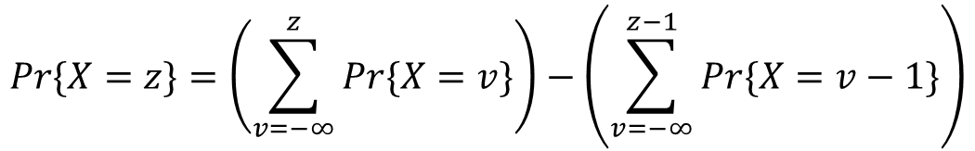
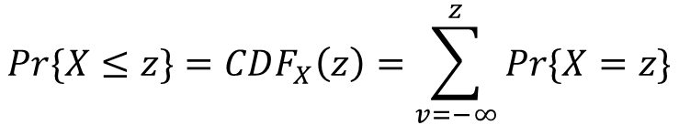

Cummulative Distribution Function
A random variable’s cumulative distribution function is given by
$$Pr\{X≤z\}=CDF_{X}\left(z\right)=\sum_{v=−∞}^{z}{Pr\{X}=z\}$$
Note that you can define CDF(z) given the probability mass function, and can derive the probability mass function from the CDF
$$Pr\{X=z\}=\left(\sum_{v=−∞}^{z}{Pr\{X}=v\}\right)−\left(\sum_{v=−∞}^{z−1}{Pr\{X}=v−1\}\right)$$
$$={\text{CDF}}_{X}\left(z\right)−{\text{CDF}}_{X}\left(z−1\right)$$

Slide 15
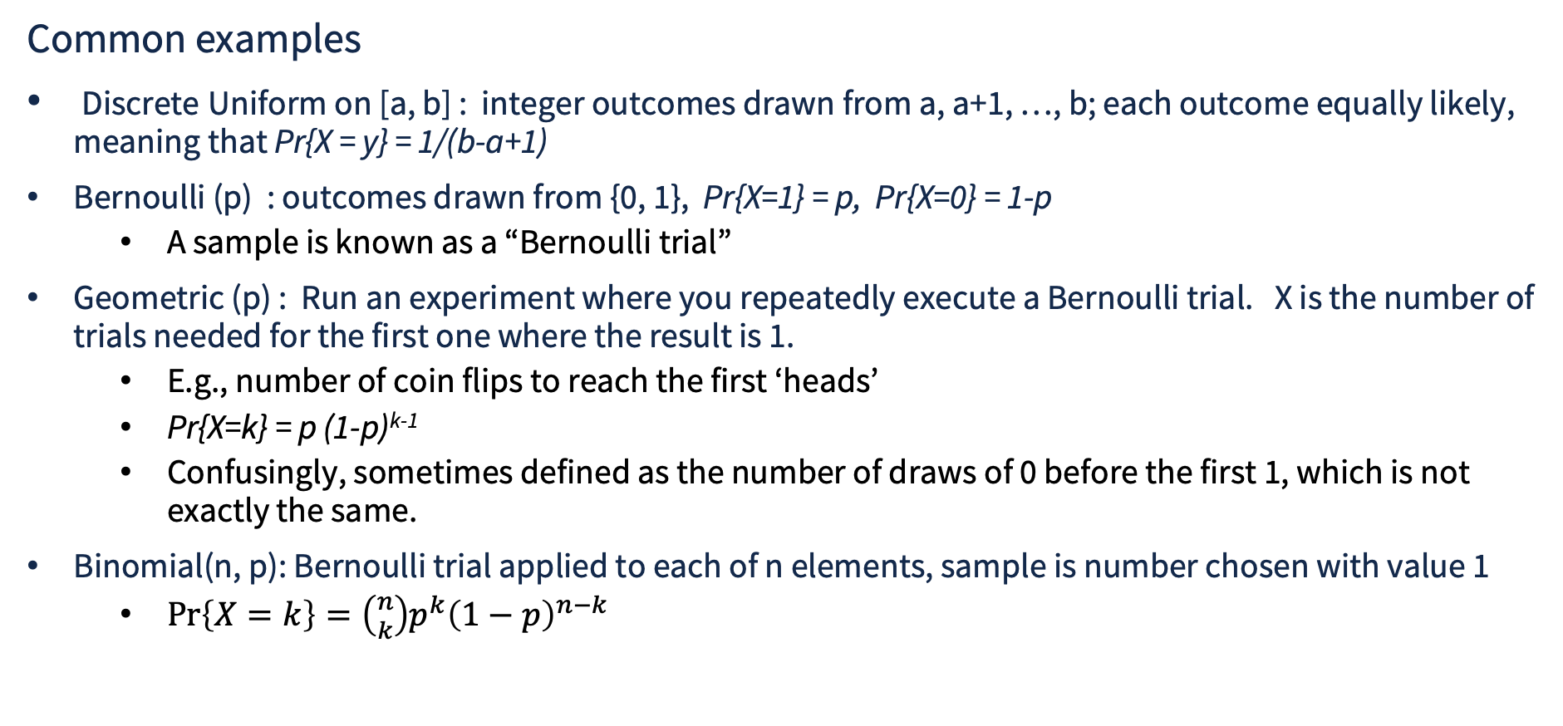
Examples of Discrete Random Variables
Common examples
Discrete Uniform on [a, b] : integer outcomes drawn from a, a+1, …, b; each outcome equally likely, meaning that Pr{X = y} = 1/(b-a+1)
Bernoulli (p) : outcomes drawn from {0, 1}, Pr{X=1} = p, Pr{X=0} = 1-p
  A sample is known as a “Bernoulli trial”
Geometric (p) : Run an experiment where you repeatedly execute a Bernoulli trial. X is the number of trials needed for the first one where the result is 1.
  E.g., number of coin flips to reach the first ‘heads’
  Pr{X=k} = p (1-p)^{k-1}
  Confusingly, sometimes defined as the number of draws of 0 before the first 1, which is not exactly the same.
Binomial(n, p): Bernoulli trial applied to each of n elements, sample is number chosen with value 1
  $\operatorname{Pr}\left\{X=k\right\}=\left({n \atop k}\right)p^{k}{\left(1−p\right)}^{n−k}$

Slide 16
The Most Basic Probability Distribution
The uniform 0-1 distribution is not discrete, but is fundamental
For any a, b in [0,1] with a<b, Pr{a <= X <= b} = (b-a)
  Note that all that is important here is b-a, not the values of a or b.
Random samples from uniform 0-1 can be transformed into samples from any other distribution
Theory of random number generation focuses on high quality samples from uniform 0-1

Slide 17
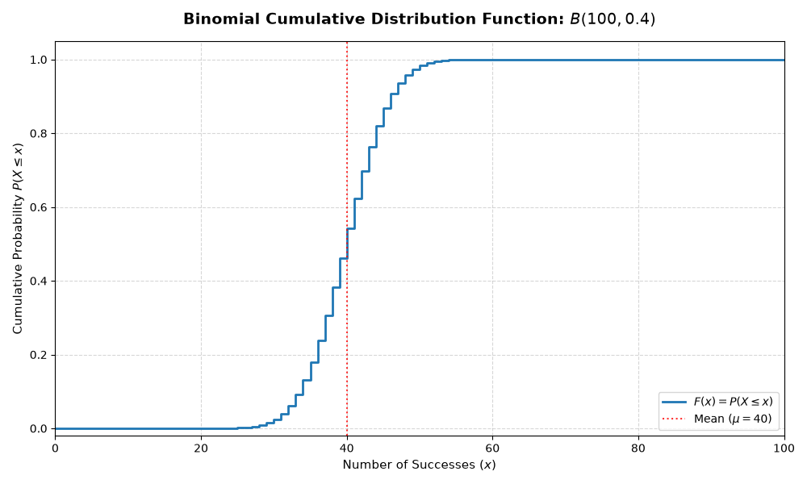
Graphical Depiction of CDF
Binomial B(100, 0.4) distribution
CDF grows monotonically, with step increases equal to probability mass function values
Recall that CDF(v) – CDF(v-1) = Pr{X=v}

Slide 18
Inverse Transform Sampling for Discrete Distributions
Technique works for any finite discrete distribution
Sample u from uniform 0-1
Find smallest v with u <= CDF(v)
v is sample
u
v

Slide 19
Python Code for Inverse Sampling
% python inv_sample.pysample 0, 41
sample 0, 39
sample 1, 48
sample 2, 42
sample 3, 42
sample 4, 38
sample 5, 43
sample 6, 41
sample 7, 40
sample 8, 38
sample 9, 31
%
import numpy as np
from scipy.stats import binom
import pdb
def sample_discrete_cdf(cdf):
u = np.random.rand() # sample uniform (0,1) random variable
value = np.searchsorted(cdf, u) # use np binary search
return value
# Generate all possible success values from 0 to 100
x = np.arange(0, 101)
# create binomial cdf
binom_cdf = binom.cdf(x, 100, 0.4)
# illustrate
for i in range(10):
print(f”sample {i}, {sample_discrete_cdf(binom_cdf)}”)

Slide 20

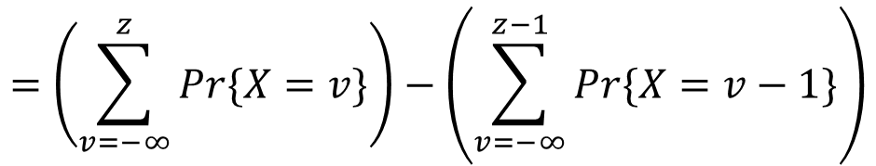
Inverse Transform Sampling Proof of Correctness, Discrete Distribution
$$\text{ Probability that z} \text{is the least index with }u≤CDF_{X}\left(z\right)\text{ is }$$
$$Pr\left\{CDF_{X}\left(z−1\right)≤u≤CDF_{X}\left(z\right)\right\}=CDF_{X}\left(z\right)−CDF_{X}\left(z−1\right)$$
$$=\left(\sum_{v=−∞}^{z}{Pr\{X}=v\}\right)−\left(\sum_{v=−∞}^{z−1}{Pr\{X}=v−1\}\right)$$
$$=Pr\{X=z\}$$

Slide 21
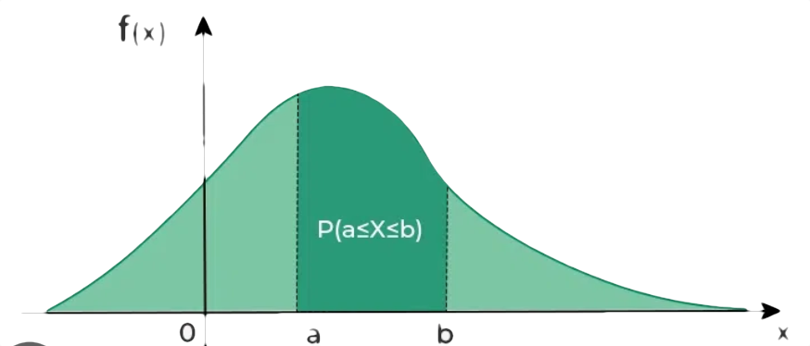
Continuous Random Variables
Many random variables are drawn from a continuum rather than a countable set
  uniform [0, 1] our first example
Their distributions are described by a probability density function f
Requirements
f(x) be nonnegative everywhere
Total area under f(x) curve sum to 1.0
For any a, b with a<b, Pr{a <= X <= b} is area under f(x) curve over [a,b]

Slide 22
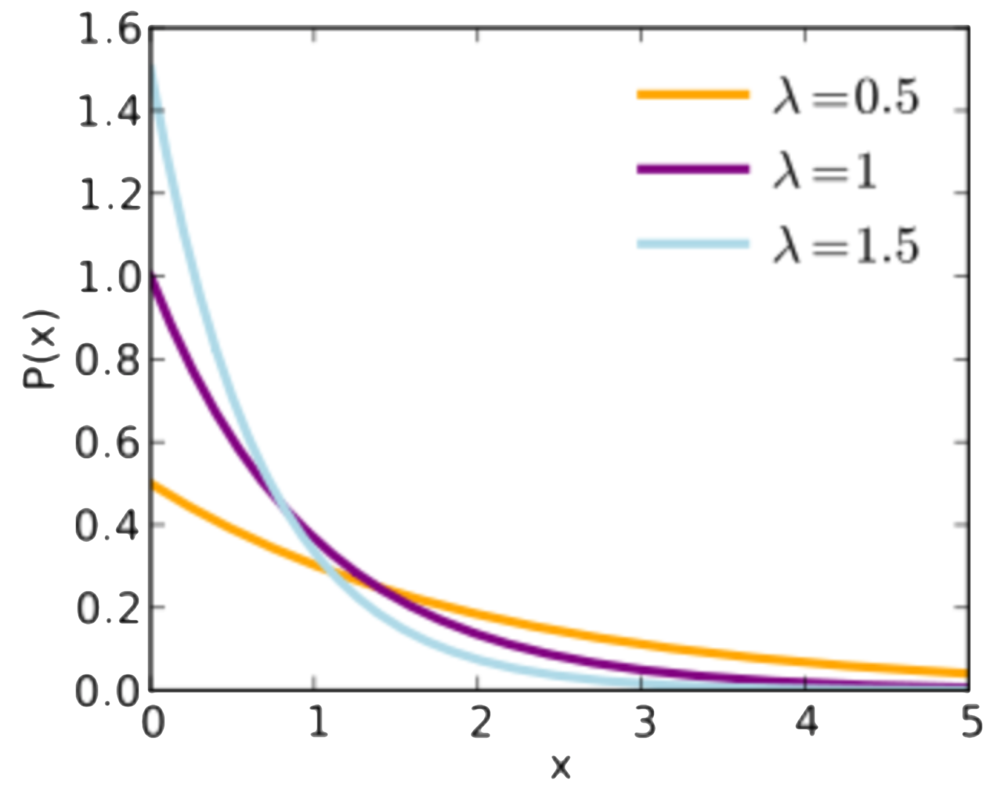
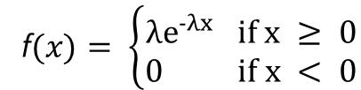

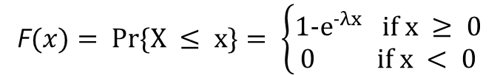
Examples of Continuous Random Variables : Exponential
Extremely common in reliability and performance modeling: exponential
known as the rate
Sole continuous distribution with the “memoryless” property, extremely useful in compressing model state
f$(x)= \left\{\begin{aligned}{λe}^{−λx} if x ≥ 0 \\ 0 if x < 0\end{aligned}\right.$
F$(x)= Pr\{X ≤ x\}= \left\{\begin{aligned}{1−e}^{−λx} if x ≥ 0 \\ 0 if x < 0\end{aligned}\right.$
$$μ_{X}=\frac{1}{λ},σ_{X}^{2}=\frac{1}{λ^{2}}$$
f(x)

Slide 23
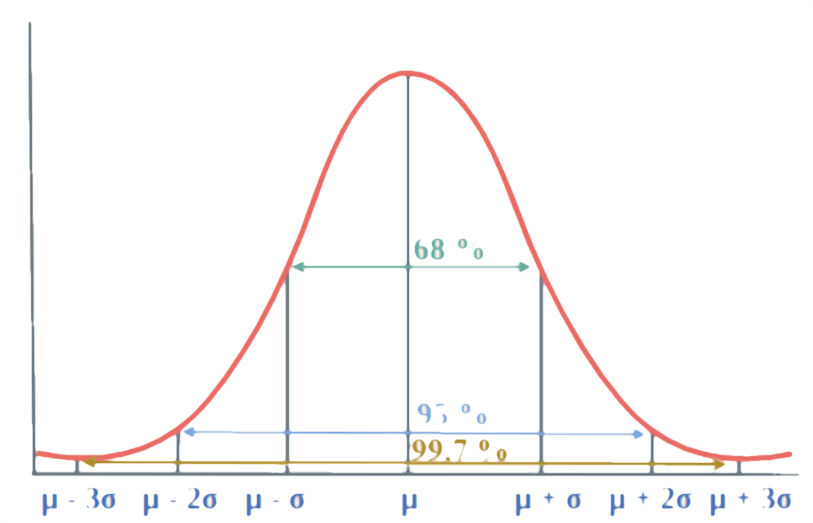
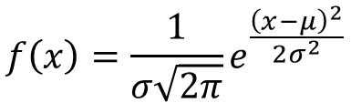

Examples of Continuous Random Variables : Gaussian
Commonly appears empirically in data
Note two parameters,
Frequently known as the “bell curve”
Arises naturally as result of “Central Limit Theorem”
For any distribution, the random variable constructed by taking the average of sufficiently many samples has a Gaussian distribution
$$f\left(x\right)=\frac{1}{σ\sqrt{2π}}e^{\frac{{\left(x−μ\right)}^{2}}{2σ^{2}}}$$
$$μ\text{ and }σ$$
*graphic courtesy of geekforgeek.org

Slide 24
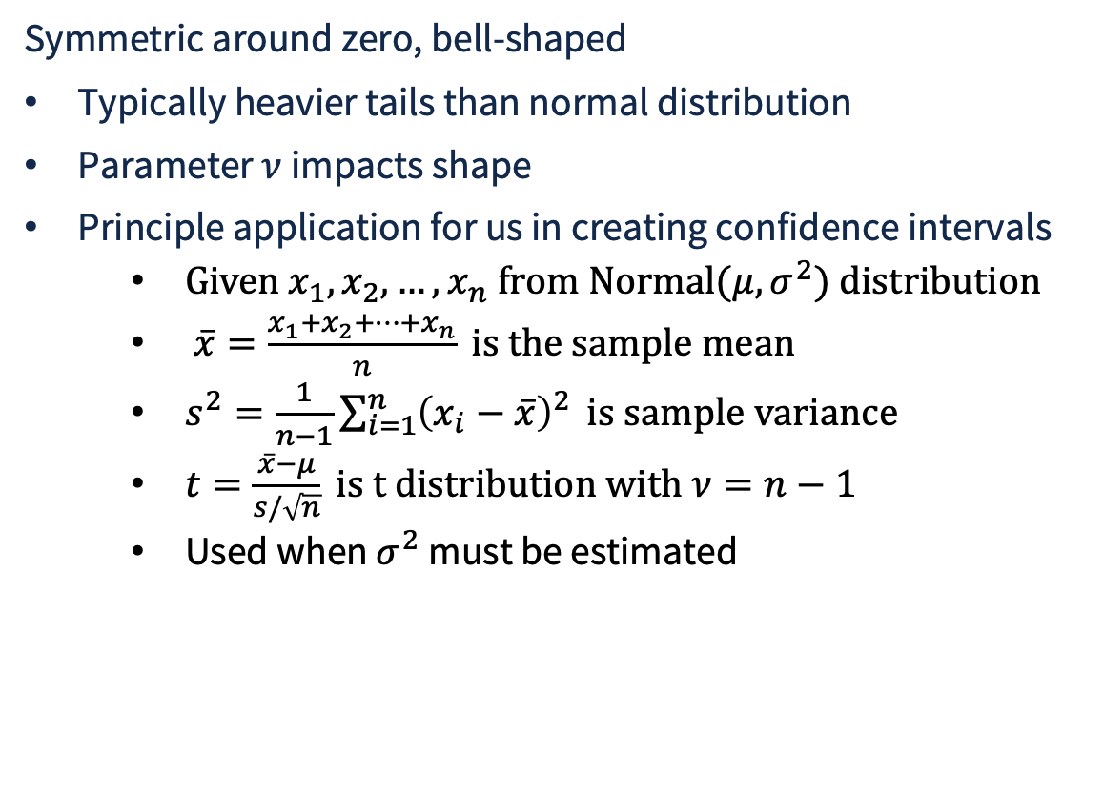


Examples of Continuous Random Variables : Student’s-t
Symmetric around zero, bell-shaped
Typically heavier tails than normal distribution
Parameter $ν$ impacts shape
Principle application for us in creating confidence intervals
  $\text{Given }x_{1},x_{2},…,x_{n}\text{ from Normal(}μ,σ^{2}\text{) distribution}$
  $\overline{x}=\frac{x_{1}+x_{2}+…+x_{n}}{n}\text{ is the sample mean}$
  $s^{2}=\frac{1}{n−1}\sum_{i=1}^{n}{{\left(x_{i}−\overline{x}\right)}^{2}}\text{ is sample variance}$
  $t=\frac{\overline{x}−μ}{s/\sqrt{n}}\text{ is t distribution with }ν=n−1$
  Used when $σ^{2}$ must be estimated
normal
$$ν=1$$
$$ν=2$$

Slide 25
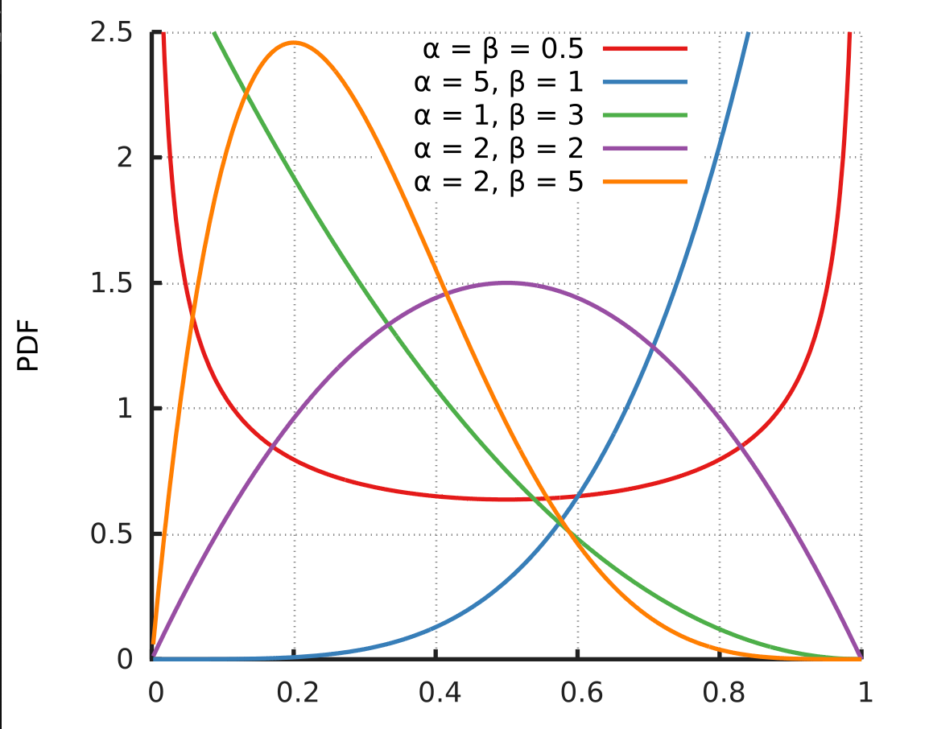
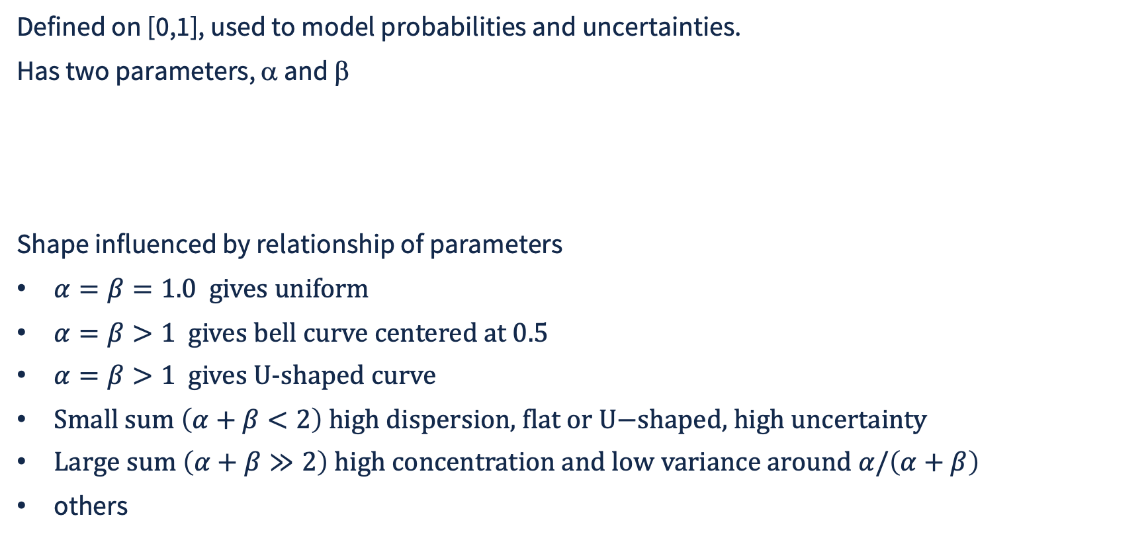
Examples of Continuous Random Variables : Beta
Defined on [0,1], used to model probabilities and uncertainties.
Has two parameters, α and β
Shape influenced by relationship of parameters
$α=β=1.0 \text{gives} \text{uniform}$
$α=β>1 \text{gives bell curve centered at 0.5}$
$α=β>1 \text{gives }\text{U−shaped curve}$
$\text{Small sum }\left(α+β<2\right)\text{ high dispersion, flat or U−shaped, high uncertainty}$
$\text{Large sum }\left(α+β≫2\right)\text{ high concentration and low variance around }α/\left(α+β\right)$
others

Slide 26
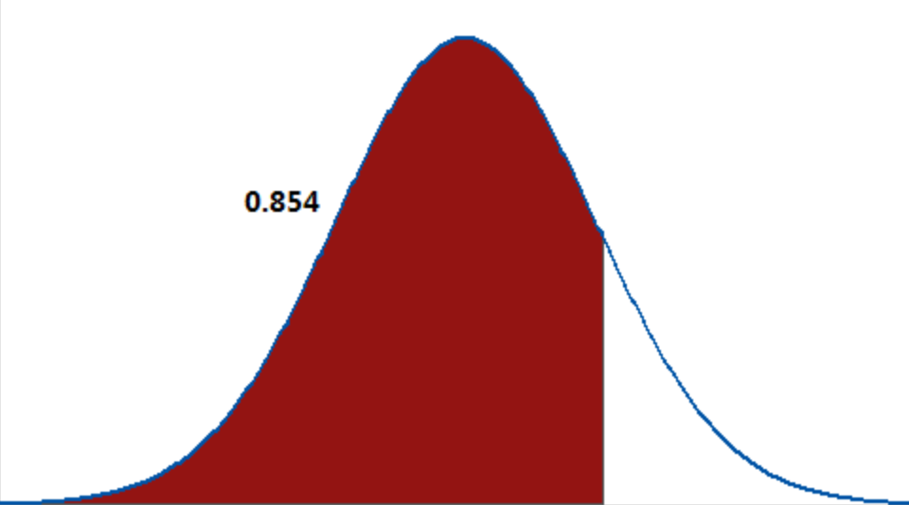
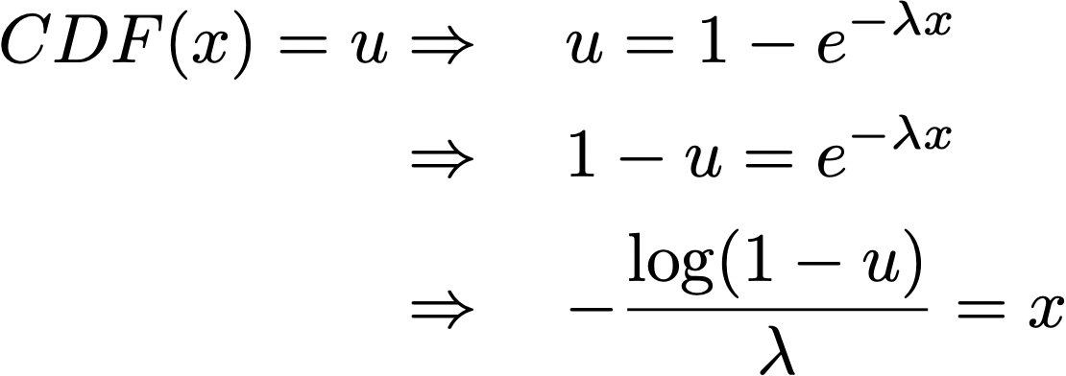
Inverse Transform Sampling Method for Continuous Distributions
Sample u from uniform 0-1 distribution
Compute X = F⁻¹(u) where F⁻¹ is the inverse of CDF F
  N.B., if CDF(v) = w, then CDF⁻¹(w) = v
  Requires that CDF be 1-to-1, which is not assured for discrete distributions, but is assured for continuous pdf
Example, exponential distribution
CDF is area under curve
u
pdf
v

Slide 27
Python Code Inverse Transform Sampling of Continuous Distributions
scipy package provides functionality based on this technique
(scipy.stats represents over 100 continuous distributions)
import numpy as np
from scipy import stats
beta_dist = stats.beta(a=2, b=5) # scipy rep. of beta distribution
for i in range(10):
u = np.random.rand()
v = beta_dist.ppf(u) # ppf function does the heavy lifting
print(f"sample {i}, {v}")
u

