Slide 1
Computer Systems Analysis
Fall 2026

Slide 2
Course Overview
Course objective is to equip students with knowledge of models, tools, and algorithms suitable for analysis of complex computer systems
Emphasis on experience engaging in developing and analyzing models
Typically, one class @ week where technical material is presented, one class @ week on in-class problem solving
  Instructor and teaching assistant on hand to aid and guide
Thanks to AI, evaluation done based on materials collected in class
Link to Canvas page on syllabus

Slide 3
Models

Slide 4
Models, State, and Parameters
Models are a collection of “variables” that describe the system at a particular instant in time.
  Variables may be quantitative, or more abstractly descriptive
In computer program, the collection of all variables and their values is an example of the implementation of “state”
  If you erased the program in a computer memory, and then restored them all, you could continue to run again
Model parameters are attributes that don’t typically change as the model state evolves but contribute to the evolution.
  Simulation studies typically vary model attributes to observe system response

Slide 5
Example: FCFS Queue
Q₁
“jobs” receive “service”, one at a time
  Intervals of time between successive arrivals (inter-arrival times)
  Job is queued on arrival if the server is busy
  Once a job starts to receive service, it is not interrupted
  If there is any job in queue when a previous job completes, the next job in queue enters service
State
  Number of jobs in system
  Remaining time until job in service completes
  Remaining time until next job arrives
Parameters
  Probability distribution of time between arrivals
  Probability distribution of time a job receives service

Slide 6
Example: Network of FCFS Queues
Q₁
Q₂
0.9
0.1
Q₃
0.2
Q₄
0.95
0.8
0.05
Output of a queue may be input to another queue, random selection of destination
State
  Times to next external arrivals
  Residual service times
  Numbers of jobs in each queue
Parameters
  For each external arrival, inter-arrival probability distribution
  For each server, routing probabilities, service time distribution

Slide 7



Example: Manufacturing Assembly
Similar to queuing network, but service at a station performed only when all materials needed for an assembly are present
State
  At each station
    Number of objects available at each input
  Time until next external arrival
Parameters
  For each external arrival, inter-arrival probability distribution
  For each station, service time distribution

Slide 8
Example: Projectile Trajectory
φ
First applications of computers for artillery tables
State of projectile: position, direction, velocity
Parameters
  Initial thrust
  Angle of cannon
  Wind direction and velocity

Slide 9
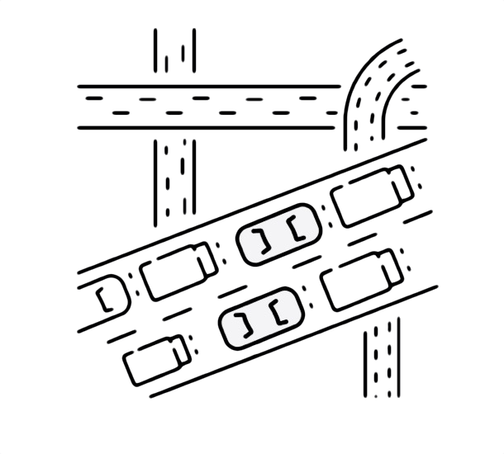
Example: Vehicle Traffic
Road traffic
State
  Individual vehicles, each with position, direction, velocity
Parameters
  Speed constraints, traffic laws, characterization of vehicle destination, description of vehicle sources

Slide 10

Example: Rocket Trajectory
More advanced than projectile because of active control and changes in mass
State of rocket: position, direction, velocity, thrust, mass, control surfaces
Parameters
  Control functions (thrust, direction)
  Initial mass

Slide 11
State Evolution: Projectile Trajectory
φ
State of projectile: position, direction, velocity
In one small Δt of time
  New position = old position + direction x velocity x Δt
  New direction = old direction + ((change due to gravity)+(change due to wind)) x Δt
  New velocity = old velocity - (changes due to wind resistance)

Slide 12
State Evolution: FCFS Queue
Q₁
State
  Number of jobs in system
  Remaining time until job in service completes
  Remaining time until next job arrives
Number of jobs in system remains constant until
min{ time of next arrival, completion of job in service }
Remaining times decrease in synchrony with clock

Slide 13
State Evolution: Network of FCFS Queues
Q₁
Q₂
0.9
0.1
Q₃
0.2
Q₄
0.95
0.8
0.05
State
  Times to next external arrivals
  Residual service times
  Numbers of jobs in each queue
Number of jobs in each queue remains constant until
min{ time of any next arrival, completion of any job in service }
Remaining times decrease in synchrony with clock

Slide 14
State Evolution: Manufacturing Assembly
State
  At each station
    Number of objects available at each input
  Time until next external arrival
Number of objects available changes when a new input arrives, or an item being assembled is completed

Slide 15
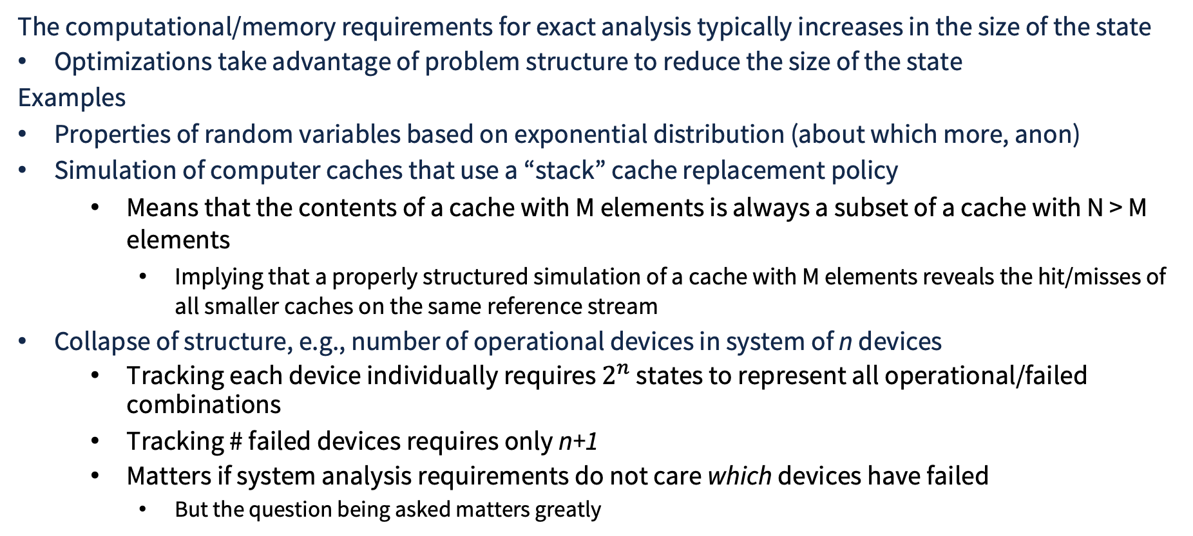
Criticality of State to Exact Analysis
The computational/memory requirements for exact analysis typically increases in the size of the state
Optimizations take advantage of problem structure to reduce the size of the state
Examples
Properties of random variables based on exponential distribution (about which more, anon)
Simulation of computer caches that use a “stack” cache replacement policy
  Means that the contents of a cache with M elements is always a subset of a cache with N > M elements
    Implying that a properly structured simulation of a cache with M elements reveals the hit/misses of all smaller caches on the same reference stream
Collapse of structure, e.g., number of operational devices in system of n devices
  Tracking each device individually requires $2^{n}$ states to represent all operational/failed combinations
  Tracking # failed devices requires only n+1
  Matters if system analysis requirements do not care which devices have failed
    But the question being asked matters greatly

Slide 16
Criticality of State to Exact Analysis Example
Suppose the question asks the number of devices in a network that are reachable from S
Network is common switch implies no distinction among devices---state can count number of operating devices
Mesh network yields different connectivity with same number of failures
S
S
S
4 reachable with 2 failures
4 reachable with 2 failures
0 reachable with 2 failures

Slide 17
State Reduction Techniques
Lumping states together, yielding approximations
Exact lumping, when aggregate transitions from any state in a block to any other block is identical for all states in the source block.
Truncation, removing parts of a large space that contribute little, and formally bound the impact the truncation has

