Slide 1
ECE 519
COPYRIGHT OF PROF. SHOBHA VASUDEVAN, ECE, UIUC.
PLEASE DO NOT DISTRIBUTE/REUSE ANY OF THESE SLIDES WITHOUT MY EXPLICIT PERMISSION.
Prof Shobha Vasudevan
Lecture 3

Slide 2

Equivalence checking using BDDs
Motivation: Combinational equivalence checking
Cannot simulate at gate level
Too slow
Formal techniques for checking combinational logic between flops

Slide 3
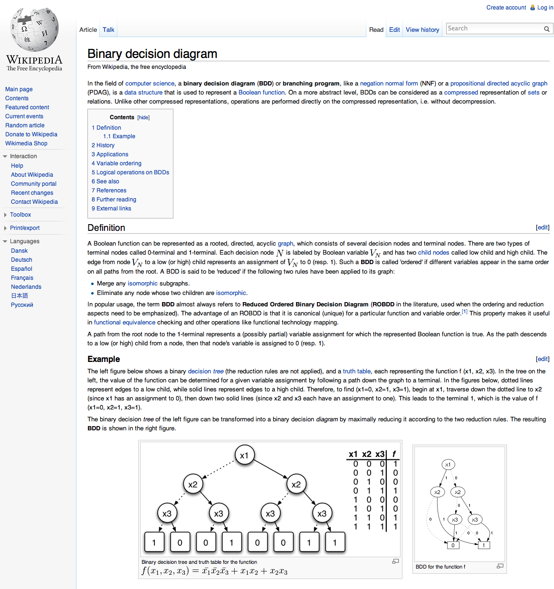
Background: BDDs
Originally studied by many
Lee first, then Boute and Akers
Got seriously useful in 1986
Randy Bryant of CMU made breakthrough of ROBDDs
Randy also provided many of the nice BDD pictures in this lecture –thanks!

Slide 4
BDDs: Motivation
Binary decision diagrams (BDDs) can represent an arbitrary Boolean function
BDDs are efficient
Easily represent large Boolean functions
Ideal for synthesis algorithms
Extremely useful for verification
Checking equivalence

Slide 5
Construction
Choose a variable ordering
Construct recursively using the Shannon Decomposition Theorem

Slide 6
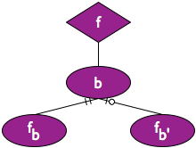


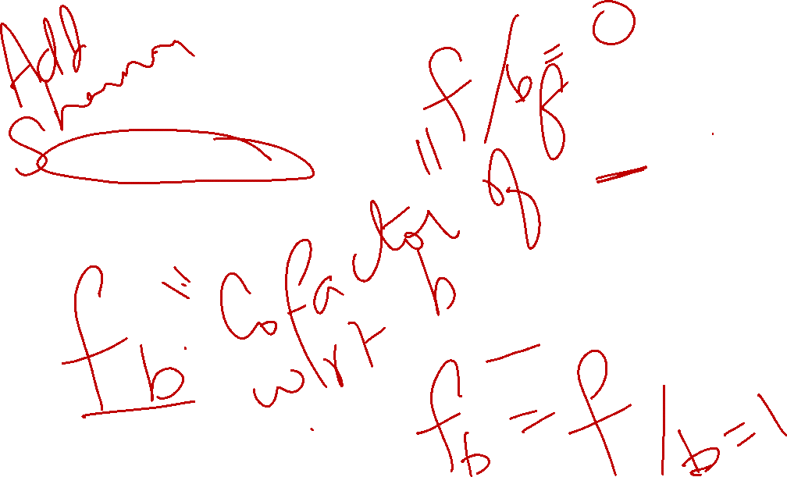
Construction: Example
f = abc + b’d + c’d
b < c < d < a
fb = ac + c’d
fb’ = d + c’d

Slide 7
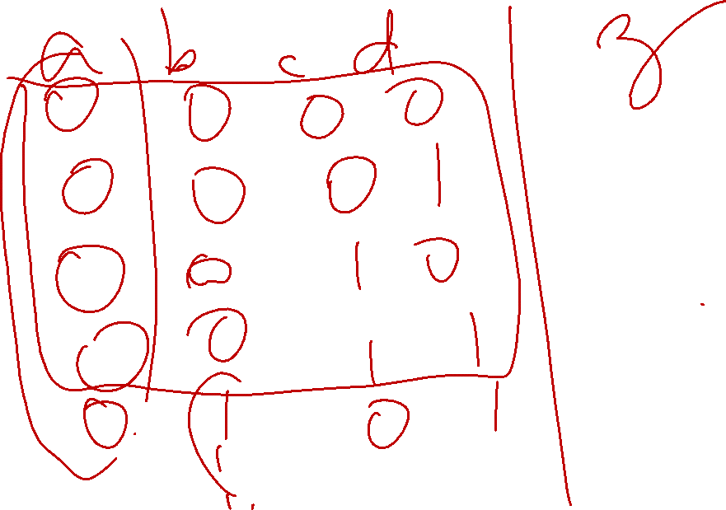

Slide 8
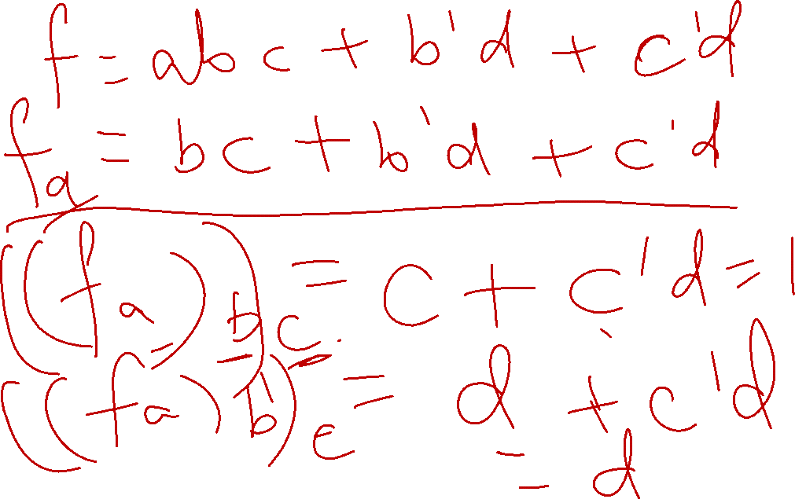

Slide 9

Construction: Example
Child nodes are cofactors of parent nodes with respect to variable ordering
(fb)c = fbc = a
fb’c = d
fbc’ = d
fb’c’ = d

Slide 10
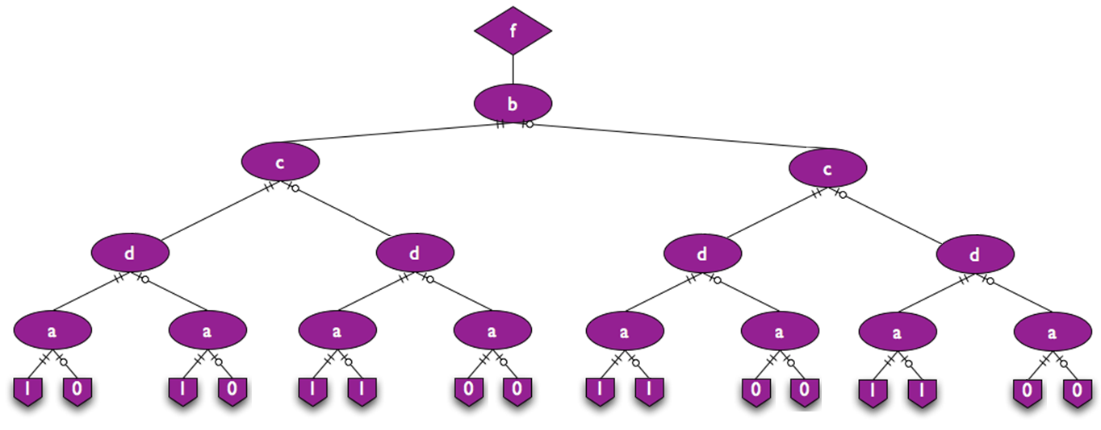
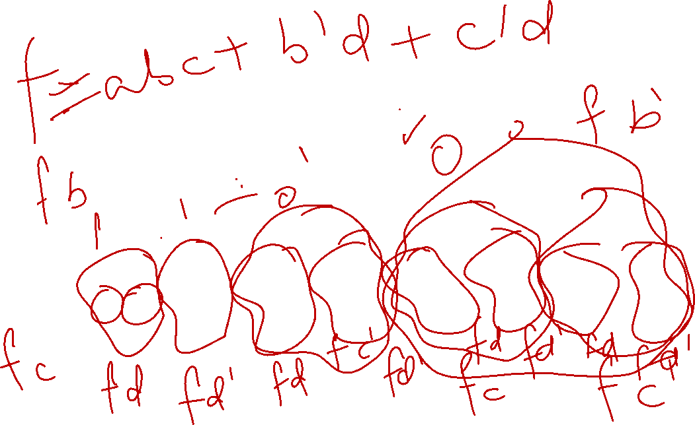

Slide 11
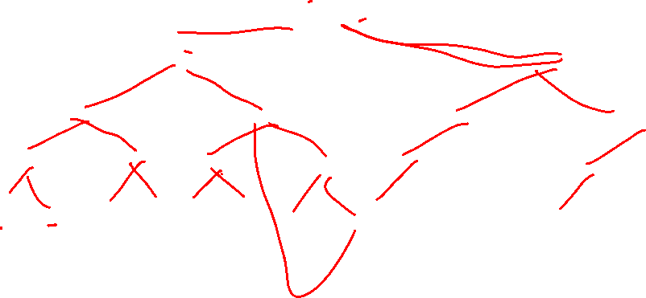

Slide 12

Reductions
Isomorphic subgraphs may be merged
Redundant nodes may be eliminated

Slide 14
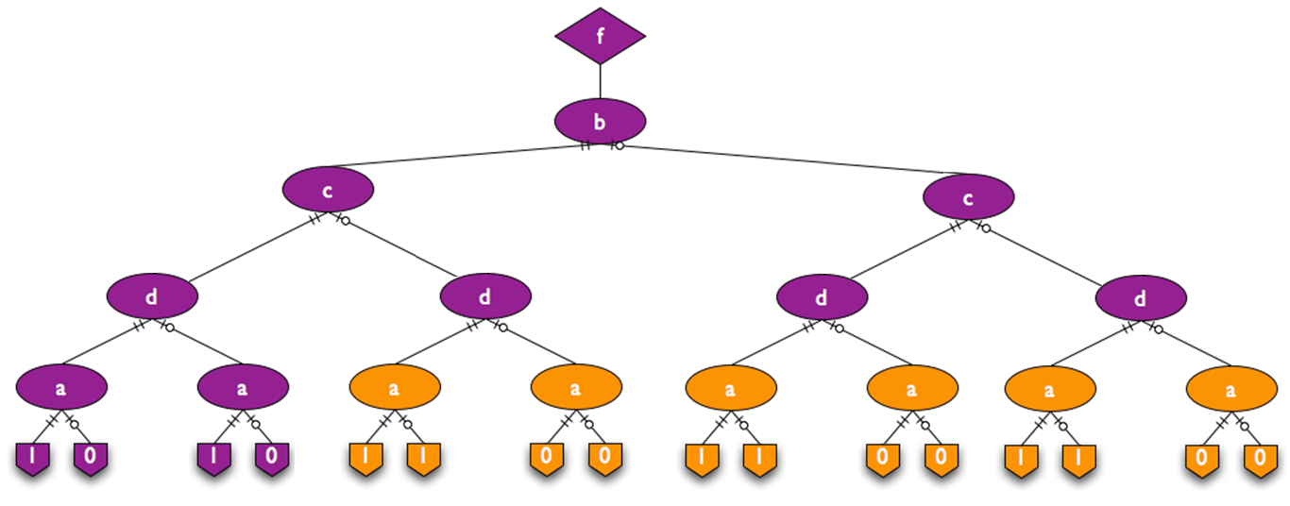


Slide 15
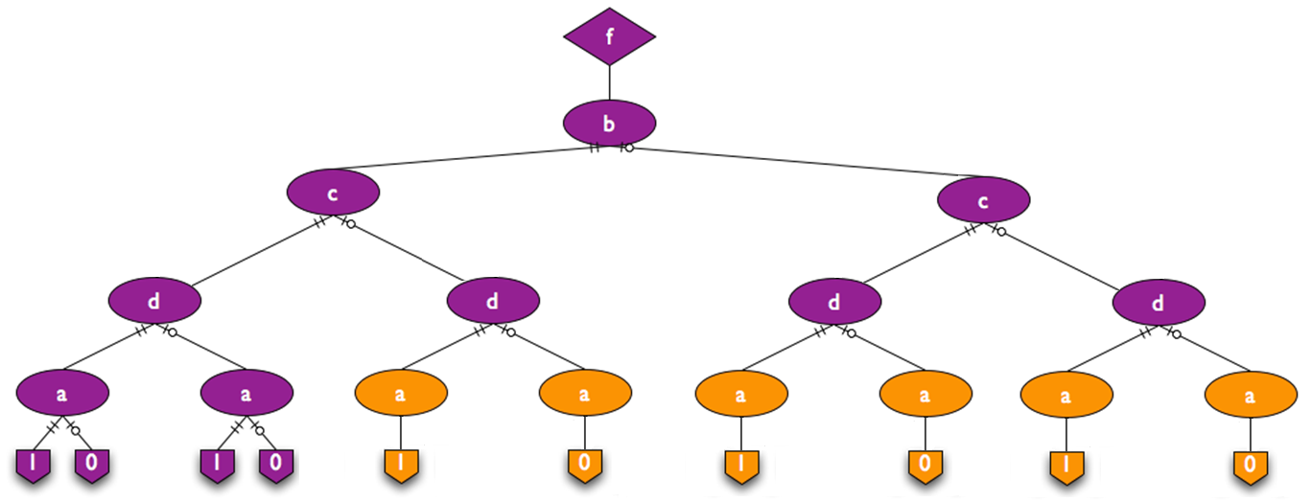


Slide 16
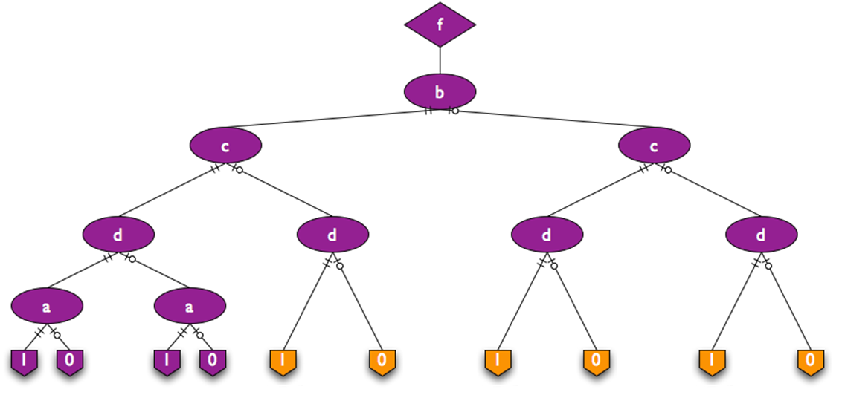


Slide 17
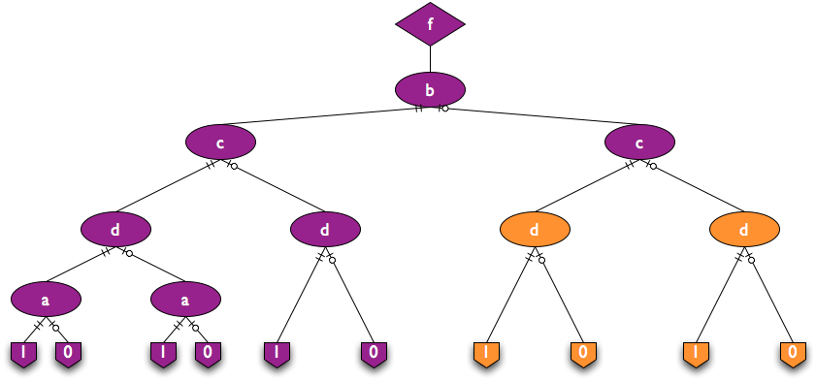

Slide 18
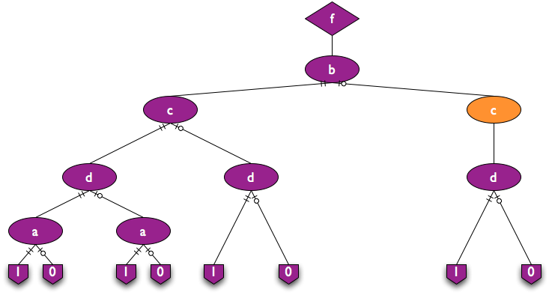

Slide 19
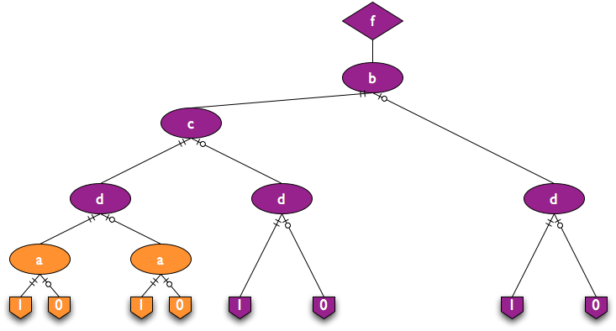


Slide 20
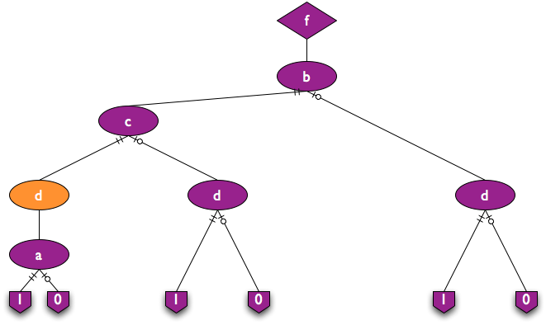


Slide 21
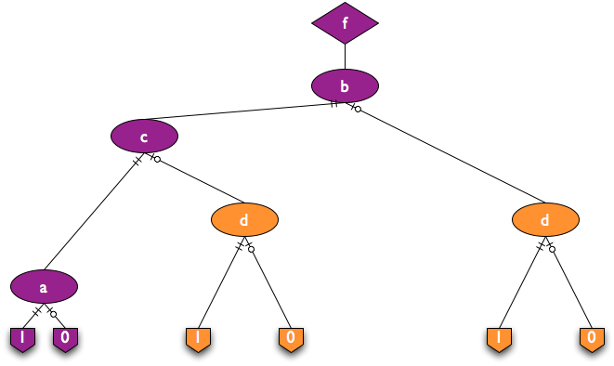
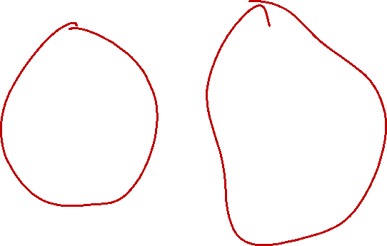

Slide 22
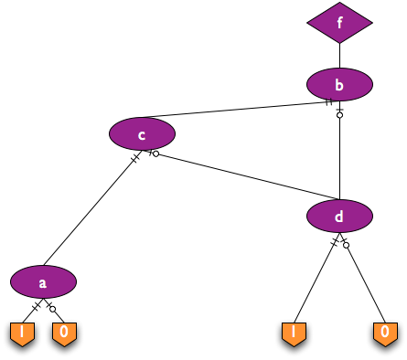

Slide 23
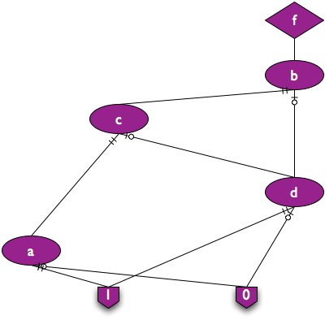


Slide 24
Reductions
After reductions, the new graph is called a reduced ordered binary decision diagram (ROBDD)
This is a canonical form, i.e. every Boolean function can be represented by exactly one reduced BDD, with respect to a given variable ordering.
Two functions are equivalent if they have the same reduced BDD with respect to the same variable ordering

Slide 25
Binary Decision Diagrams for Truth Tables
Truth Table
Big Idea #1: BDD
Turn a truth table for the Boolean function into a Decision Diagram
In simplest case, graph is just a tree
By convention – don’t draw arrows on the edges, we know where they go
Decision Tree
x
1
x
x
2
2
x
x
x
x
3
3
3
3
• Vertex represents a variable; edge out is a decision (0 or 1)
• Follow green (dashed) line for value 0
• Follow red (solid) line for value 1
• Function value determined by leaf value.

Slide 26
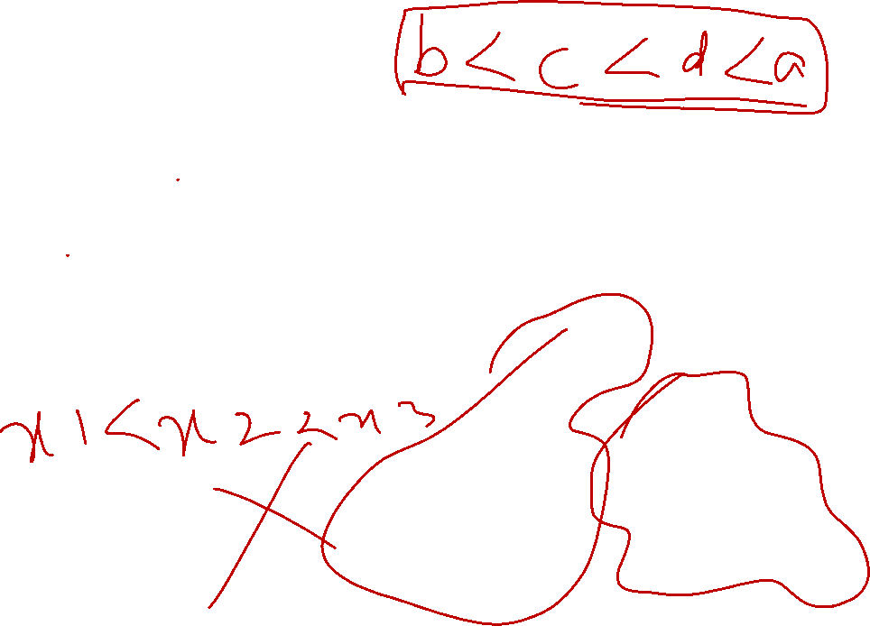

Ordering
Note: Different variable orders are possible
x
1
Order for this subtree is
X2 then X3
x
2
x
2
x
3
x
3
x
3
x
3
x
Here, it’s
X3 then X2
0
0
0
1
0
1
0
1
1
x
2
x
3
x
3
x
3
x
x
2
2
0
0
0
1

Slide 27

Binary Decision Diagrams
Observations
Each path from root to leaf traverses variables in a some order
Each such path constitutes a row of the truth table, ie, a decision about what output is when variables take particular values
But we have not yet specified anything about the order of decisions
This decision diagram is not unique for this function
Terminology: Canonical form
Representation that does not depend on gate implementation of a Boolean function
Same function of same variables always produces this exact same representation
Example: a truth table is canonical. We want a canonical form data structure.

Slide 28

Binary Decision Diagrams
What’s wrong with this diagram representation?
It’s not canonical, and it is way too big to be useful (it’s as big as truth table!)
Big idea #2: Ordering
Restrict global ordering of variables
Means:
Note
It’s OK to omit a variable if you don’t need to check it to decide which leaf node to reach for final value of function

Slide 29
Ordering BDD Variables
Assign arbitrary ordering to vars: x1 < x2 < x3
Variables must appear in this specific order along all paths; ok to skip vars
Properties
No conflicting assignments along path (see each var at most once on path).
OK
No!
x
1
x
1
x
3
x
1
x
2
x
2
x
3
x
3
x
1
x
1

Slide 30

Binary Decision Diagrams
OK, now what’s wrong with it?
Variable ordering simplifies things... But still too big, and not canonical
x
Original decision diagram
1
x
2
x
2
Equivalent, but
different diagram
x
3
x
3
x
3
x
3
x
1
0
0
0
1
0
1
0
1
x
x
2
3
x
3
x
3
0
1
0
0
0
1

Slide 31
Binary Decision Diagrams
Big Idea #3: Reduction
Identify redundancies in the graph that can remove unnecessary nodes and edges
Removal of X2 node and its children, replace with X3 node is an example of this
Why are we doing this?
GRAPH SIZE: Want result as small as possible
CANONICAL FORM: For same function, given same variable order, want there to be exactly one graph that represents this function

Slide 32
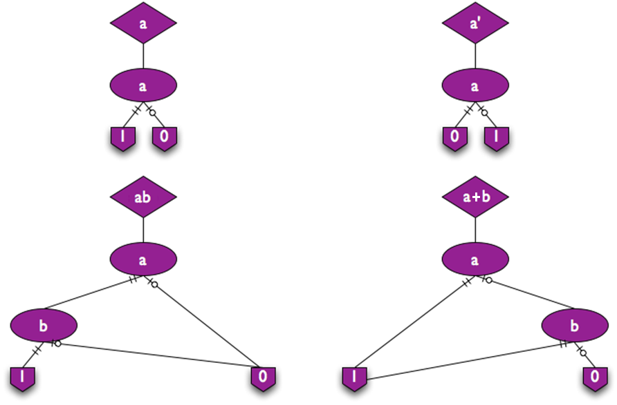
Common Functions

Slide 33
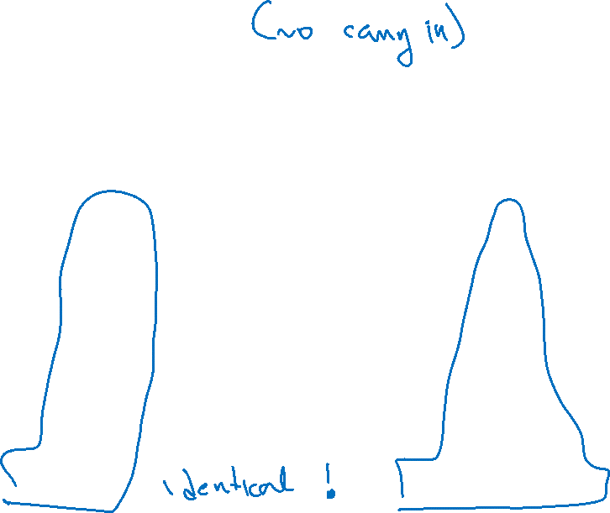
BDDs Sharing: Consider a 4bit Adder
Look at sum S3 msb & carry out Cout
a₃ b₃
a₂ b₂
a₁ b₁
a₀ b₀
Xor
4 bit binary adder
Cout
S₃
Positive
Logic
Carry
Chain
Negative
Logic
Carry
Chain
Basically same
shared
subfunction

Slide 34
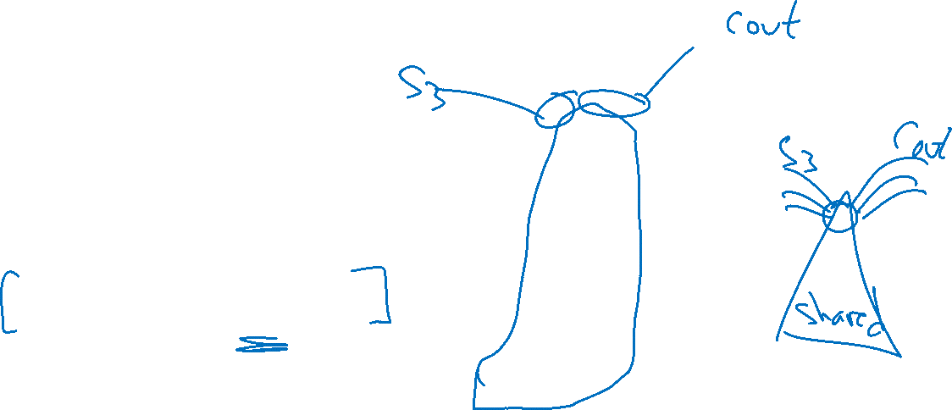
BDD Sharing: Multi-rooted Graph
Don’t represent it twice!
BDD can have multiple ‘entry points’, or roots
Called a multi-rooted BDD
Recall (again!)
Every node in a BDD represents some Boolean function
This multi-rooting idea just explicitly exploits this to better share stuff

Slide 35

Sharing: Multi-rooted BDD Graphs
Why stop at 2 roots?
Big savings for sets of functions
Minimize size over several separate BDDs by maximum sharing
Example: Adders
Separately
51 nodes for 4-bit adder
12,481 for 64-bit adder
Shared
31 nodes for 4-bit adder
571 nodes for 64-bit adder

Slide 36
BDDs: Seem Too Good To Be True?!
Problem : Variable ordering matters. Ex: a1•b1 + a2•b2 + a3•b3

Slide 37
Order Matters
For example…
f = ab + cd + ef
a < b < c < d < e < f
Product terms are eliminated one by one
If a product term is one, then the BDD is one
Otherwise the BDD only records a zero product term

Slide 38
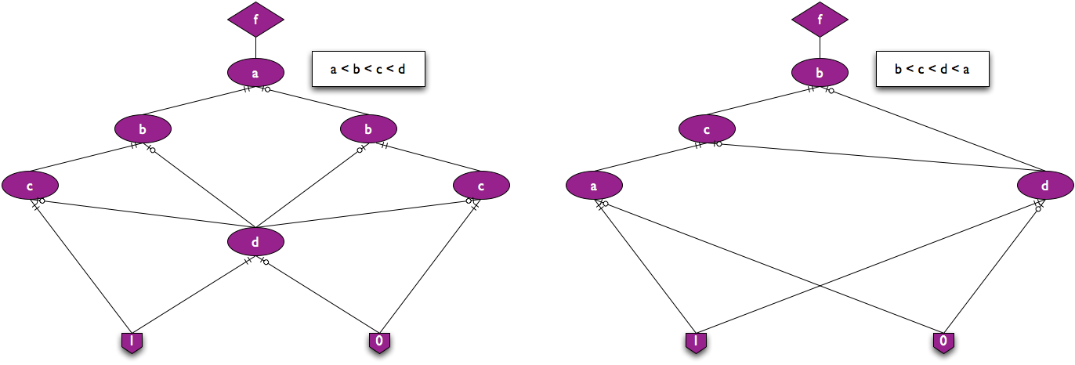
f = abc + b’d + c’d
Order Matters

Slide 39
Order Matters
Variable ordering significantly affects the size of the binary decision diagram
Optimal ordering is computationally hard to determine

Slide 40
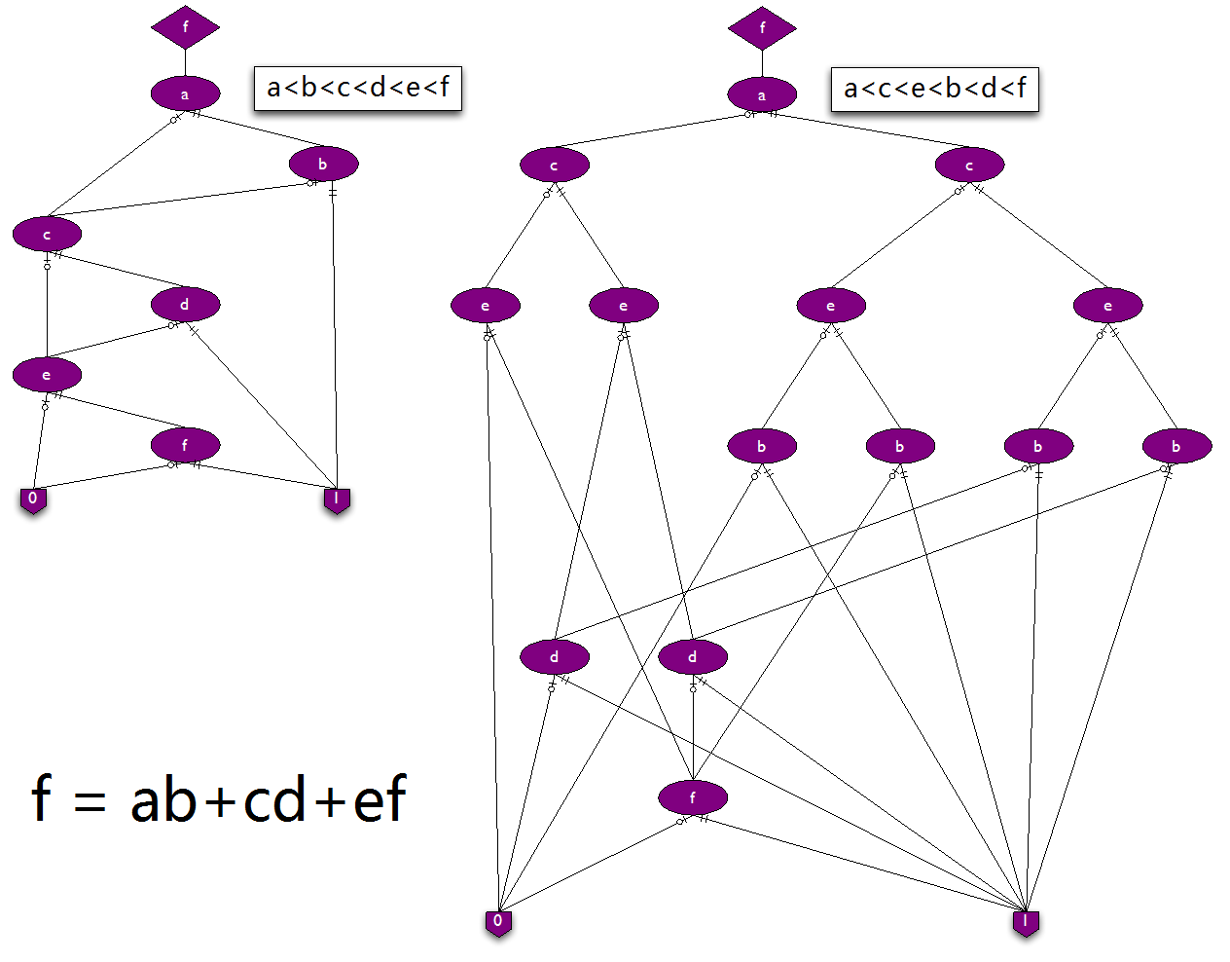
Order Matters

Slide 41
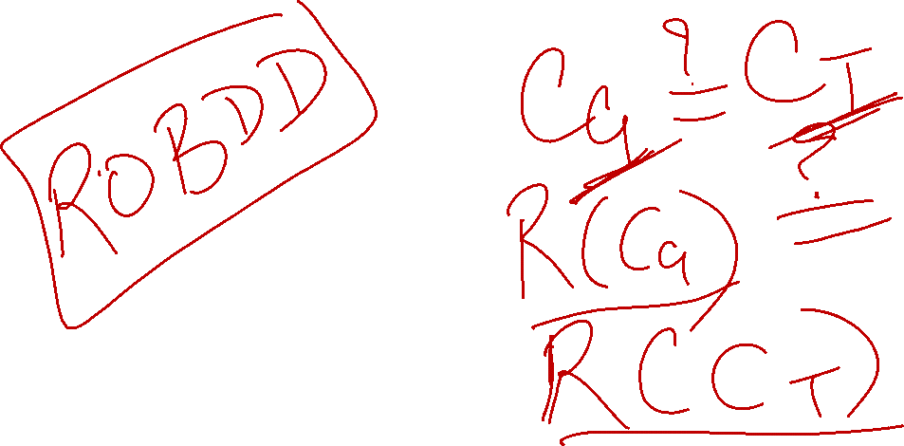
Combinational Equivalence Checking
If F and G are equivalent, then for the same ordering of variables their BDDs are isomorphic (identical)
F = a’bc + abc +ab’c
G = ac +bc

Slide 42
Boolean Satisfiability
SAT: Find an assignment to the variables such that the function’s output is 1
In BDD, find a path to terminal node 1 for a satisfying assignment
F = a’bc + abc +ab’c

Slide 43
Variable Ordering: Consequences
Interesting problem
Some problems known to be exponentially hard are very easy done with BDDs(!)
Trouble is, they are easy only if size of the BDD for the problem is “reasonable”
Some problems make nice (small) BDDs, others make pathological (large) BDDs
No universal solution (or could always to solve exponentially hard problems easily)
How to handle?
Variable ordering heuristics: make nice BDDs for reasonable probs
Characterization: know which problems never make nice BDDs (eg, multipliers)
Dynamic ordering: let the BDD software package pick the order… on the fly

Slide 44
Variable Ordering: Intuition
Rules of thumb for BDD ordering
Related inputs should be near each other in order; groups of inputs that can determine function by themselves should be (i) close together, and (ii) near top of BDD
Ex: (a1•b1 + a2•b2 + a3•b3)

Slide 45
Aside: Variable Ordering
Arithmetic circuits are important logic; how are their BDDs?
Many carry chain circuits have easy linear sized ROBDD orderings: Adders, Subtractors, Comparators, Priority encoders
Rule is alternate variables in the BDD order: a0 b0 a1 b1 a2 b2 … an bn
So – are all arithmetic circuits easy then? No, sorry
General experience with BDDs
Many tasks have reasonable OBDD sizes; algorithms practical to ~100M nodes
People spend a lot of effort to find orderings that work…
Function Class Best Order Worst Order
Addition linear exponential
Multiplication exponential exponential

Slide 46
BDD Summary
Reduced, Ordered, Binary Decision Diagrams, ROBDDs
Canonical form – a data structure – for Boolean functions
Two boolean functions the same if and only if they have identical BDD
A Boolean function is just a pointer to the root node of the BDD graph
Every node in a (shared) BDD represents some function
With shared BDD, test (F==G) → check pointers for equality, point to same root
Basis for much of today’s general manipulation or Boolean stuff
Problems
Variable ordering matters; sometimes BDD is just too big
Often, we just want to know SAT – don’t need to build the whole function

Slide 47
