Slide 1
Testbench architecture
Shobha Vasudevan ( Slides from lecture co-taught with Mentor Graphics)
PLEASE DO NT DISTRIBUTE WITHOUT PERMISSION

Slide 2
Agenda
Verification Planning
Testbench Architecture
Testbench Implementation
SystemVerilog Basics
OOP with SystemVerilog
OVM Introduction

Slide 3
Evolution of HVLs
Growing volume of Ecosystem products and services
OVM 1.0 released as open source
eRM
URM
AVM
OVM 1.1 update
OVM 2.0.1 update
2002
2005
Spring
2007
August
2007
Jan 9
May 7
Sept
2008
Oct
2008
Q1
2009
OVM 2.0
OVM Users guide
Unified sequences
TLM enhancements
Other capabilities
OVM announced: R&D teams demonstrate OVM will run on both Mentor and Cadence simulators
More capabilities to come!!
Notes:
3
This is the OVM collaboration roadmap. As we mentioned earlier, URM and AVM developed in parallel and customers recognized the similarities in the base classes. They asked us to bring AVM and URM together and we accomplished a proof of that concept by Aug 16, 2007. Since then, we launch OVM world with OVM 1.0 in January 2008 and we are now about to bring OVM 2.0 to the market.
The main benefits of OVM 2.0 are that we have unified the sequence methodology with Mentor and we are jointly delivering an OVM users guide. We will also enhance the reset methodology, Transaction Level Modeling (TLM), and configuration capabilities within the OVM.
Of course, OVM 2.0 will be available as open source on OVMworld just like OVM 1.0. And that’s not the end. We have collected many ideas from the OVM community and will provide more technology in the future with the same delivery mechanism.

Slide 4

What is OVM?
Open
Written in IEEE 1800 SystemVerilog
Runs on any simulator supporting the IEEE 1800 standard
Verified on Mentor Graphics’ Questa and Cadence’s Incisive Verification Platforms
True open-source license agreement (Apache 2.0)
Interoperable
Ensures VIP interoperability across ecosystem & simulators
Enables VIP ‘plug and play’ functionality for designers
Ensures interoperability with other high level languages
Proven
Based on Mentor’s Advanced Verification Methodology (AVM) and Cadence’s Incisive URM methodology
Incorporates best practices from >10 years of experience
Notes:
Read slide, highlight that OVM is LRM SystemVerilog, and if the customer are unable to run the examples on their simulator, it’s because the simulator don’t support SystemVerilog.
We then suggest that the customer are requesting the vendor to work with the OVM team to help them run OVM.
Notes:
OVM is available in open source form
Apache-2.0 license
http://opensource.org/licenses/apache2.0.php
Allows user to use, modify, and distribute code
Restrictions:
cannot modify any copyright or other ownership marks
cannot claim ownership
cannot redistribute under another license
Large customers choosing OVM
Project deployment
OVM infrastructure growing rapidly
Training
Consulting
IP

Slide 5
OVM = AVM + URM
OVM is a superset of both the AVM and URM
Cadence’s Incisive Plan-to-Closure (IPCM) URM and Mentor’s Advanced Verification Methodology (AVM)
OVM enables backward compatibility with AVM 3.0 & URM 6.2
Mentor & Cadence committed to collaborative development of OVM
OVM
Open, unified class library and methodology for interoperable VIP
Project-to-Project Reuse
Block-to-System Reuse
Coverage-Driven
Environment Configuration
Incremental Adoption
Multi-Layered Sequences
TLM Communication
Common Messaging

Slide 6
OVM = AVM + URM AVM forms the backbone of the OVM
OVM
TLM Communication
Constrained-Random & Sequential Stimulus
Functional Coverage
Greatest Flexibility for Modularity & Reuse
Environment Configuration
Incremental Adoption
AVM
TLM Communication
Constrained-Random Stimulus
Functional Coverage
Modularity & Reuse
Incremental Adoption
AVM
TLM Communication
Constrained-Random Stimulus
Functional Coverage
Modularity & Reuse
Incremental Adoption
URM
TLM Communication
Sequential Stimulus Specification
UVC Encapsulation Strategy
Environment Configuration
URM
TLM Communication
Sequential Stimulus Specification
UVC Encapsulation Strategy
Environment Configuration

Slide 7
What is the news?
The first truly open, interoperable, and proven verification methodology based on the SystemVerilog IEEE 1800 language
Jointly developed by Cadence and Mentor Graphics
Delivers simulator, VIP, and high level language interoperability across companies and ecosystem
Scalable to system level

Slide 8
OVM Benefits
Open
Written in IEEE 1800 SystemVerilog
Runs on any simulator supporting the IEEE 1800 standard
Verified on Cadence’s Incisive and Mentor Graphics’ Questa Verification Platform
True open-source license agreement (Apache 2.0)
Interoperable
Ensures VIP interoperability across ecosystem & simulators
Enables VIP ‘plug and play’ functionality for designers
Ensures interoperability with other high level languages
Proven
Based on Cadence’s Incisive Plan-to-Closure URM module and Mentor’s Advanced Verification Methodology (AVM)
Incorporates Best Practices from >10 years of experiences

Slide 9
OVM Description
OVM Class Library uses SystemVerilog language and runs on any compliant simulator
Provides building blocks (objects) for verification environment
Common set of low-level utilities
OVM Methodology
Framework to create VIP
Guidelines for how to use the class library
VIP and Verification
Environment
OVM Methodology
(documentation,
examples, code snippets)
OVM Class Library
SystemVerilog Language
IEEE 1800 Compliant
Simulator

Slide 10
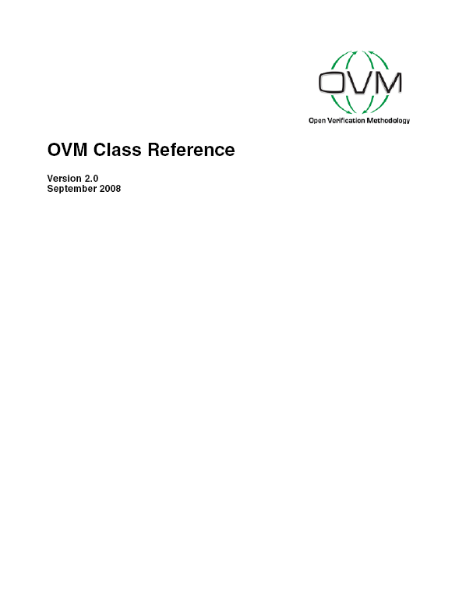
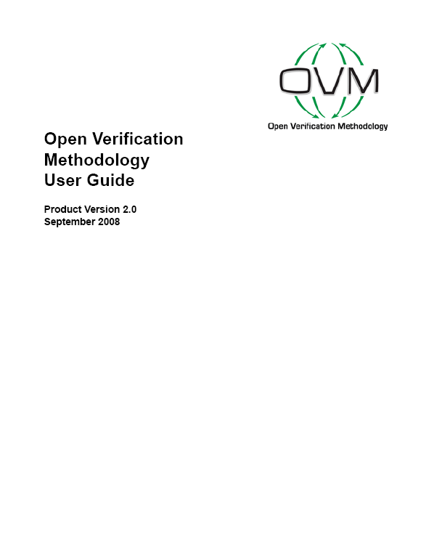
OVM Documentation
OVM Reference Guide
Documents all ovm classes, methods and macros in the OVM library
OVM User Guide
OVM Overview
Transaction Level Modeling
Developing Reusable Verification Components
Assembling Tests and Testbenches
Advanced Topics
Phasing
Factory & Overrides
Sequence Control & Protocol Layering
Detailed description of Xbus example
Notes:
Yes, we know the user guide is in the works, AVM books still valid, as OVM is just the natural evolution of AVM

Slide 11
OVM Concepts: Overview
Test/Testbench Separation
Improves reusability
Test customizes testbench
Flexible Component Instantiation
Test can override testbench
Configurability
Test controls
Structural, run-time parameters
Allows greater topological flexibility
Hierarchical Sequential Stimulus
Simplified Test Writer interface
Decouple stimulus from component hierarchy
TLM Communication
Improves component modularity
Enables plug-n-play reuse
Test
Env(Testbench)
Component2
Component
VC
VC
VC
VC

Slide 12
OVM: Combine SystemVerilog and TLM to build a true, reusable methodology
Vertical Reuse
From block to system in a single project
Horizontal Reuse
Reuse of modules, libraries across projects
Platform Reuse
Reuse of testbenches, assertions etc, across the tools
A
Testbench
A
B
B
Project A
A
B
Project B
Verification IP,
Methodology
A
B
Testbench
RTL Simulation TLM Modeling
Emulation
A
B
12

Slide 13
A Layered Approach to Verification
Analysis
Test (Config)
Testbench-Specific
Operational
Coverage
Coverage
Design-Specific
Transactors
Protocol-Specific
Stimulus/ Master
Slave
TLM DUT
Stimulus Generator
/ Master
Abstractor
Slave
Abstractor
Transaction-Level interfaces
Notes:
Modularity helps of connect and add stuff as needed.
Basic messages:
Transactors are protocol-specific and convert between pin-level communication to the dut and transaction-level communication to the environment.
Operational layer is transaction-level that describes the behavior of the world in which the dut operates and is design-specific.
We provide stimulus generator and other example components for you
Masters are bi-directional components that initiate transactions
Operational layer can be subdivided into “high-level” and “low-level” behaviors/transactions (think “frame” vs. “packet”)
Analysis layer is testbench-specific to extract information about what’s happening and whether it’s correct
Scoreboards compare, coverage collectors count
Information can be extracted from anywhere in the operational layer via analysis ports. Where you extract depends on what specific information you want.
Flexibility allows you to add additional analysis with minimal impact to existing environment, even late in the project
Test controller coordinates everything.
Starts/configures other components
Reacts to coverage or other information to adjust/stop behavior of components
This is the part that the “test writer” writes.
Practical tip: Picking coverage from driver etc. allows coverage development before monitor is complete. Other similar developmentat steps facilitated by TLM modularity of analysis_ports. Both coverage and scoreboards.

Slide 14
A Layered Approach to Verification
Analysis
Test (Config)
Testbench-Specific
Operational
Coverage
Scoreboard
Coverage
Design-Specific
Transactors
Protocol-Specific
Stimulus/ Master
Slave
Monitor
Monitor
Stimulus Generator
/ Master
Abstractor
Slave
Driver
DUT
Responder
Abstractor
Pin-Level interfaces
Assertions
Transaction-Level interfaces
Notes:
Modularity helps of connect and add stuff as needed.
Basic messages:
Transactors are protocol-specific and convert between pin-level communication to the dut and transaction-level communication to the environment.
Operational layer is transaction-level that describes the behavior of the world in which the dut operates and is design-specific.
We provide stimulus generator and other example components for you
Masters are bi-directional components that initiate transactions
Operational layer can be subdivided into “high-level” and “low-level” behaviors/transactions (think “frame” vs. “packet”)
Analysis layer is testbench-specific to extract information about what’s happening and whether it’s correct
Scoreboards compare, coverage collectors count
Information can be extracted from anywhere in the operational layer via analysis ports. Where you extract depends on what specific information you want.
Flexibility allows you to add additional analysis with minimal impact to existing environment, even late in the project
Test controller coordinates everything.
Starts/configures other components
Reacts to coverage or other information to adjust/stop behavior of components
This is the part that the “test writer” writes.
Practical tip: Picking coverage from driver etc. allows coverage development before monitor is complete. Other similar developmentat steps facilitated by TLM modularity of analysis_ports. Both coverage and scoreboards.

Slide 15
OVM Concepts: Separation
Separate architectural details from end-user
Testcase customizes testbench environment
Instantiate and configure the environment
Components within that env.
Tests are short, clear and descriptive
Easy to maintain
Changes are done in a central location
Test and environment can be derived
Build a base classes
Testcases
Derivatives change stimuli kinds, negative testing etc.
Environments
Topology for TLM, RTL connections etc.
Testcases…
Test
Env(Testbench)
Env1(Testbench)
Env2(Testbench)
Env3(Testbench)
Env4(Testbench)

Slide 16
OVM Concepts: Phasing
Built-in phases handle the basics
All phases run in-order
User can define additional phases
Can be inserted anywhere in the list
Automatically run in order
Instantiate top-level env
Construction
new
Build/config components
build
Define connections
Elaboration
connect
Resolve bindings
end_of_elaboration
Configure components
Simulation
start_of_simulation
Execute test (run task)
run
Gather information
Report
extract
check
Check results
report
Report results
Notes:
As we are working with dynamic types we need to start it all in a controlled way

Slide 17
Phased Build Process
class my_env extends ovm_env; A u1; B u2;
function new(string name, ovm_component parent); super.new(name, parent); endfunction
Don’t actually use “new”
Don’t actually use “new”
Don’t actually use “new” (discussed later)
function void build(); super.build();
u1 = new(“u1”,this);
u2 = new(“u2”,this);
u2.build();
endfunction
function void connect(); u1.p.connect(u2.e); endfunction
class A extends ovm_component;//u1 C u3, u4;
function void build(); super.build();
u3 = new(“u3”,this);
u4 = new(“u4”,this);
endfunction
class B extends ovm_component;//u2 D u5, u6;
function void build(); super.build();
u5 = new(“u5”,this);
u6 = new(“u6”,this); u6.build();
endfunction
function void connect(); ...
endfunction
function void connect(); ...
endfunction
u3
u4
u5
u6
Notes:
[tfitz] The change from 1.0.1 to 1.1 is that now build() is a proper phase. In 1.0x it was a method that got called from the post_new() phase. You still have the option of calling it explicitly if you want. You should also call super.build() as the first line of your build() method so we can automatically keep track of whether or not it was called manually or automatically.

Slide 18
Transaction-Level Modeling (TLM)
TLM is all about communication through interfaces
A TLM port specifies the “API” to be used
A TLM export supplies the implementation of the methods
Connections are between ports/exports, not components
Transactions are objects
Components with the same interfaces can be swapped transparently
No changes to parent connect()
Analysis ports/exports support 1:many write() calls
Write to scoreboard/collector
class my_trans extends ovm_transaction; … endclass
my_env
Coverage
Coverage
analysis_export
analysis_export
Target2
ovm_analysis_port
Initiator
Target1
ovm_put_port
Request
ovm_put_export
ovm_get_port
ovm_get_export
Response
function void connect(); i.p_port.connect(t.p_xport); i.g_port.connect(t.g_xport);
t.a_port.connect(c.analysis_export); t.a_port.connect(c2.analysis_export);
endfunction
Notes:
How are blocks that communicate transactions connected?
Done through Ports/Exports (Function calls)
Analogy: Two phones, only one has a phone number
Export has the phone number
Port receives the number during the connect phase

Slide 19
OVM Concepts: Configuration
class test;
...
set_config_int(“block”,“num_d”,2);
set_config_int(“*.d*”,“errinj”,1);
...
Configure anything
Modal configuration
Change modes of operation by changing values of variables
E.g. debug verbosity
Topological configuration
Changes variables to modify the topology
E.g. Verification environment
Manual configuration
Sets and gets the configuration manually
Automated configuration
Set the configuration manually
Gets the configuration via the build phases
class block_env; bit num_d = 1; driver d[0:num_d-1];
set_config_int(“d0”,“delay”,5);
get_config_int(“num_d”,num_d);
if(num_d == 2) set_config_int(“d1”,“active”,0);
class driver;
bit active = 1; bit delay = 2;
bit errinj = 0;
class driver;
bit active = 0; int delay = 2;
bit errinj = 0;
class driver;
bit active = 0; int delay = 2;
bit errinj = 1;
class driver; bit active = 1, errinj = 0; int delay = 2; function void build(); super.build();
get_config_int(“active”,active); get_config_int(“delay”,delay); get_config_int(“errinj”,errinj);
…
class driver; bit active = 1, errinj = 0; int delay = 2; function void build(); super.build();
get_config_int(“active”,active); get_config_int(“delay”,delay); get_config_int(“errinj”,errinj);
…
class driver;
bit active = 1; int delay = 2;
bit errinj = 0;
class driver;
bit active = 1; int delay = 5;
bit errinj = 0;
class driver;
bit active = 1; int delay = 5;
bit errinj = 1;

Slide 20
Running a Test
Built-in phased execution flow is launched by calling ovm_env::run_test(string test_name = “”)
Runs test specified by function argument if provided, unless overridden by command line plusarg +OVM_TESTNAME=
Elaboration, simulation and report (sub-)phases are executed in predefined order
Each phase invokes a function or task with the same name
run() is the only phase task
Each phase is executed for every component
Bottom-up or top-down
run() and pre_run() for threaded components only
Notes:
Controlling testcase selection
Structural testbench top level
run_test uses $plusargs to control factory
Allows execution of multiple tests without recompilation
vsim … +OVM_TESTNAME=fpu_test_add_sub
OVM testcases information stored in UCDB files

Slide 21
Managing Shutdown
Test
Static method global_stop_request()
Spawns stop() task in all “participating” components
Waits for all stop() tasks to complete
Components “register” for stop management
enable_stop_interrupt = 1;
override stop() task
Global stop timeout
Each component should have its own timeout as well
Global stop usually managed from base test
class my_env extends ovm_env; A u1;
B u2;
task run(); ...
global_stop_request();
// on to extract() phase
endtask
class my_env extends ovm_env; A u1;
B u2;
class A;
task run(); ...
ms = 1;
endtask
task stop(); wait(ms == 1); endtask
endclass
class B;
task run(); ...
-> st_ev;
endtask
task stop();
fork
begin @st_ev; wait(st==IDLE); end
# stop_time;
join_any disable fork;
endtask
endclass
Notes:
Test normally ends when ovm_env::run() ends

Slide 22
What are sequences?
What are sequences
Parallel tasks that arbitrate for access to a driver
Transaction-level
RTL-level
Sequence
Task()
Driver
Get(req);
Do_op
Put(rsp);
Sequence
Task()
Sequencer
arbitration
DUT
Sequence
Task()

Slide 23
Why Use Sequences?
Encapsulation and Modularity of Stimulus Generation
Separation of Structure from Behavior
Parallel Stimulus
Layering Protocols
packet -> cell, multi-word -> single-word, translations
Flexible Stimulus Control
injection of noise, gaps, errors
control ratios of stimulus types
Reuse of Stimulus
sequences for specific RTL blocks (i.e. configuration)
encapsulation of functions
ability to hand stimulus block to other project

Slide 24
Operations
Sequences
Create transactions (sequence_item)
Request access, send item to driver
Optionally get a response back
Sequencer – an arbitrating fifo
Queue requests from sequences
Wait for request from driver
Arbitrate and choose sequence, send item
Route response back to sequence
Driver
Get request, do operation, put response

Slide 25
Sequence Overview
A sequence requests for the driver
When granted, the sequence specifies the operation to do
The sequencer sends the operation from the sequence to the driver
The driver executes the operation
The driver optionally sends the response back to the sequence

Slide 26
Sequential Stimulus
OVM
A sequence has a method that generates a stream of transactions…
…or other sequences
Sequencer
Driver
DUT
trans
The sequencer provides transactions from the sequence to the driver
Notes:
In the AVM, the basic transaction generator is avm_random_stimulus, which randomizes individual transactions and usually puts them to a fifo, from which the driver gets them when the bus is ready. Because the stimulus generator pushes transactions, it will generate a new transaction as soon as there’s room in the fifo. Some time later, the driver will get this

Slide 27
Sequential Stimulus
OVM
The sequencer has a default sequence that it executes
A sequence can spawn another sequence
Sequencer
Sequencer
Each sequence attempts to execute an item in the sequence
arb
Driver
trans
The sequencer arbitrates between multiple sequences
Notes:
In the AVM, the basic transaction generator is avm_random_stimulus, which randomizes individual transactions and usually puts them to a fifo, from which the driver gets them when the bus is ready. Because the stimulus generator pushes transactions, it will generate a new transaction as soon as there’s room in the fifo. Some time later, the driver will get this

Slide 28
Sequential Stimulus
OVM
A lower-level sequence processes the pkt-level item into a set of cell items
Lower Sequencer
Upper Sequencer
A lower-level item may request a higher-level item
arb
Cell Driver
Pkt
cell
cell
Notes:
In the AVM, the basic transaction generator is avm_random_stimulus, which randomizes individual transactions and usually puts them to a fifo, from which the driver gets them when the bus is ready. Because the stimulus generator pushes transactions, it will generate a new transaction as soon as there’s room in the fifo. Some time later, the driver will get this

Slide 29
Sequences
Decouple stimulus specification from structural hierarchy
Add/remove/modify stimulus scenarios independent of testbench
Simplify test writer API
Sequences define transaction streams
s1.start(u1);
fork s2.start(u1); s3.start(u1); join
Sequences can call children
function void s5::body(); s1.start(u1,this);
fork s2.start(u1,this); s3.start(u1,this); join
s4.start(u1,this);
Built-in get_response() task
Sequences & transactions customizable via the factory
u1
u1
May start on any sequencer
u1
s1
s1
Optional parent sequence
s3
s5
s2
s4

Slide 30
Sequential Stimulus
Sequence/Sequencer
Driver
Sequence calls wait_for_grant()
Sequencer waits for get()
arbitrates and grants access
Transaction is randomized
Sequence calls send_request(req)
Sequence optionally calls get_response(rsp)
A sequence may request a transaction from another (higher-level) sequencer
u2 just sees a “driver”
Driver does get(req)
Performs bus cycle
Driver optionally does put(rsp)
rsp.set_id_info(req);
u1
s1
u2
s2
s3

Slide 31
Sequences
Sequences are objects
Sequences have a virtual method body() to specify the behavior
Executes items procedurally
Can contain other code
Can spawn other sequences
Can call other sequences
Can use all SV constructs
class my_seq extends ovm_sequence; ...
virtual task body();
logic [31:0] first_addr,next_addr;
read_count = 5;
for (int i=0; i<read_count; i++)
begin
`ovm_do_with(txn, {txn.trtype == WRITE32;})
first_addr = txn.addr;
`ovm_do_with(txn, {txn.addr == first_addr && txn.trtype == READ32;})
start(parallel_seq);
`ovm_do(sub_seq);
end
randsequence() ...
endtask
...
Notes:
In the AVM, the basic transaction generator is avm_random_stimulus, which randomizes individual transactions and usually puts them to a fifo, from which the driver gets them when the bus is ready. Because the stimulus generator pushes transactions, it will generate a new transaction as soon as there’s room in the fifo. Some time later, the driver will get this

Slide 32
Hierarchy and Elaboration
The OVM has structural base classes to aid hierarchy, elaboration and simulation
ovm_component
Base unit of structural hierarchy
Provides hierarchical naming
Provides access to the (TLM) connectivity infrastructure
connect() method
Provides a “run()” task
And associated kill(), suspend() and resume() methods
Provides reporting facilities
ovm_env
Derived from ovm_component to add sequence of pre-defined simulation phases
Including connect() and run() methods
Contains and manages all class based testbench components
Constructs, connects and configures the testbench
ovm_test
Also derived from ovm_component
Optional for encapsulating environment customizations
Notes:
Actually, as of OVM 2.0 I believe ovm_env is optional too, and the sequence of pre-defined simulation phases is not reliant on having an ovm_env top

Slide 33
OVM Component Hierarchy
ovm_test extends ovm_component;
// Customizes the environment
// Defines stop criteria
ovm_env extends ovm_component;
// Manages phasing // Encapsulates structural “testbench”
ovm_component;
// Basic unit of structural hierarchy

Slide 34
Integrated Reporting Infrastructure
Provides utilities for consistent report handling
Features:
Severities with one or more associated actions
Severities: message, warning, error, fatal
Actions: display, log, count, exit, no action, call hook
Filtering
By unique or common string ids
By numeric verbosity level
By component instance and hierarchy
Log files
Redirection to multiple output files

Slide 35
Modularity + Configurability
The Basics: driver, monitor, stimulus & analysis
Env defines topology & configures components
Number & type of components
Default stimulus sequence(s)
Encapsulate components for reuse
Packages
Reuse components in new env
Additional stimulus & analysis
Test customizes env
Choose env from library
Coordinate Stimulus
Additional tweaking
Test instantiated by top-level module
Test chosen from library
top
test
test
env
env

Slide 36
OVM Summary
True Multi-Vendor Support
Out-of-the-box, fully tested and supported
Architected for Reuse
Component/environment reuse
TLM-based components use standard interfaces
Test modifies testbench components and topology
Components control instantiation and configuration
Separate stimulus from testbench hierarchy
Simplified Test API
Sequential stimulus independent of testbench
Test defines
Component types and configuration settings
Stimulus to run on which components
Test writer does not need to know full OOP details of testbench
test
testbench
d
e

