Slide 1
Sequential Equivalence Checking
Prof. Shobha Vasudevan

Slide 2
Sequential circuits
What are sequential circuits?
How are they different from combinational circuits?
How do you describe/represent the functionality of sequential circuits?

Slide 3
FSM Verification: Reminders
What’s in an FSM?
States: unique bit pattern represents each state; FFs store state
External inputs: inputs from the outside world
Next state logic: from current state and external inputs, this makes the inputs to the FFs that determine the next state at the next clock tick
Output logic: from states (and maybe inputs) makes combinational FSM outputs
Clock: synchronizes everything; only states changes on clock tick
Next State
Logic
D Q
Output Logic

Slide 4
Definitions
In mathematical terms, a (completely specified, deterministic) Finite State Machine (FSM) of Mealy type is a 6-tuple
⟨I, S,𝛿,S₀,O,𝜆⟩
where:
I is the input alphabet i.e., a finite, non-empty set of input values;
S is the (finite, non-empty) set of states;
𝛿: 𝑆 × 𝐼 → 𝑆 is the next-state function;
𝑆⁰ ⊆ 𝑆 is the set of initial (reset) states;
O is the output alphabet;
𝜆 : 𝑆 × 𝐼 → 𝑂 is the output function;
How is this definition different for Moore machines?
Notes:
Answer: 𝜆 : 𝑆 -> 𝑂 is the output function;

Slide 5
Example state machine
0/0
D
0/0
B
0/0
1/1
1/0
1/0
A
F
1/1
1/1
0/0
1/0
E
C
0/0
0/0

Slide 6
Example
Give the tuple ⟨I, S,𝛿,S₀,O,𝜆⟩ and draw the state diagram for the following Flow Table:
Present State | Next State/Output
 | x = 0 | x = 1
A (Start) | E/0 | D/1
B | D/0 | F/0
C | E/0 | B/1
D | B/0 | F/0
E | C/0 | F/1
F | B/0 | C/0

Slide 7
Example
Answer:
I = {0,1};
S = {A,B,C,D,E,F};
O = {0,1}
𝛿(𝐴,0)=𝐸, 𝛿(𝐴,1)=𝐷, 𝛿(𝐵,0)=𝐷,
𝛿(𝐵,1)=𝐹, 𝛿(𝐶,0)=𝐸, 𝛿(𝐶,1)=𝐵,
𝛿(𝐷,0)=𝐵, 𝛿(𝐷,1)=𝐹, 𝛿(𝐸,0)=𝐶,
𝛿(𝐸,1)=𝐹, 𝛿(𝐹,0)=𝐵, 𝛿(𝐹,1)=𝐶;
S⁰ = {A}
𝜆(𝐴,0)=0, 𝜆(𝐴,1)=1, 𝜆(𝐵,0)=0,
𝜆(𝐵,1)=0, 𝜆(𝐶,0)=0, 𝜆(𝐶,1)=1,
𝜆(𝐷,0)=0, 𝜆(𝐷,1)=0, 𝜆(𝐸,0)=0,
𝜆(𝐸,1)=1, 𝜆(𝐹,0)=0, 𝜆(𝐹,1)=0;

Slide 8
Example
0/0
D
0/0
B
0/0
1/1
1/0
1/0
A
F
1/1
1/1
0/0
1/0
E
C
0/0
0/0

Slide 9
Incomplete Specification
An FSM is incompletely specified if the next-state function and/or the output functions are specified only for some combinations of inputs and present states.

Slide 10
Example
I | PS | NS | O
0 | s₁ | s₄ | 0
1 | s₁ | s₃ | 0
0 | s₂ | - | -
1 | s₂ | s₁ | -
0 | s₃ | s₁ | 1
1 | s₃ | - | 1
0 | s₄ | s₂ | 1
1 | s₄ | s₃ | 1
s₁
1/-
s₂
0/1
0/1
1/0
0/0
s₃
s₄
1/1
Is there any discrepancy between these representations?
Notes:
Answer: See next slide

Slide 11
FSM Verification: What’s the Problem?
Several scenarios
You have a “trusted” implementation of the machine that you know is correct (but maybe not optimal as hardware) and a “real” implementation as gates. Are they the same?
You have an “old” implementation in one technology, and a “new” implementation in another technology (eg, a different tech library). Is old == new?
Why is this hard?
Because of what “same” means here
Has to do with behavior over time -- this temporal dependence is new for us...
We need to be more precise

Slide 12

Equivalent FSMs
Means this:
Start them in some known “equivalent” states; clock starts running
For every possible combination of inputs over future clock ticks, two machines will have identical outputs
(Doesn’t say anything about logic delays or low level stuff like that; just think about ideal clock ticks here...)
FSM 1
FSM 2

Slide 13
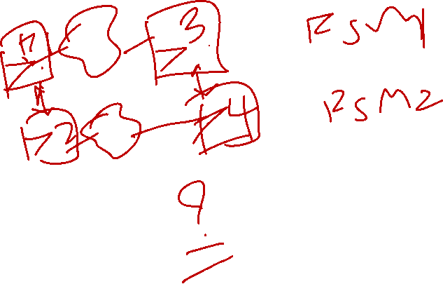
FSM Equivalence: Easy Case
Sometimes this isn’t too hard: special case
Suppose 2 FSMs have identical state encodings: same #bits, same unique bit pattern for each state, same kinds of FFs
Then this reduces to combinational equiv. checking
FSM 1
FSM 2

Slide 14

FSM Equivalence: Hard Case
FSMs not always so easy to check. More general case:
4 states. 2 state variables p,q. 1 input x. 1 output z. D FFs.
Input PS NS
x pq p+q+
0 0 0
0 1
1 0
1 1
1 0 0
0 1
1 0
1 1
State: pq=00
pq=01
A/0
x=0
B/0
x=0
x=1
x=0,1
x=1
x=0,1
C/0
D/1
pq=10
pq=11
pq
pq
p
x
00 01 11 10
x
00 01 11 10
q
0 1
0
1
0
1
0
1
z
p+ (= D input on p FF)
q+ (= D input on q FF)

Slide 15

FSM1 Implementation
It looks like this...
State
Logic
D Q
Next State Logic
D Q
Output Logic

Slide 16
FSM2: Same Behavior, Different Implementation
Let’s implement it as a 1-hot machine
Now, 4 state variables: abcd; again D FFs, but now 4 of them
State: abcd=1000
abcd=0100
Can just read off the NS logic
A/0
x=0
B/0
x=0
x=1
x=0,1
x=1
x=0,1
C/0
D/1
abcd = 0010
abcd=0001
1 hot example transition...

Slide 17

FSM 2 Implementation
It looks like this
State
Logic
D Q
Next State Logic
D Q
D Q
Output Logic
D Q

Slide 18
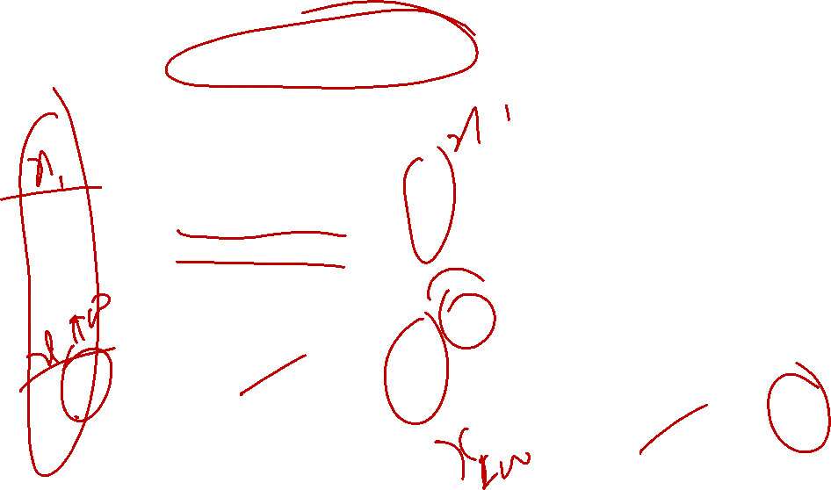
FSM Equivalance Checking
This is why it’s hard
Cannot just look at the logic now and state they are the same
Need a whole new, systematic method that deals with temporal aspect of things here, and the possible differences in encodings
FSM 1 Logic
FSM 2 Logic
p
q
Next State Logic
p+ = pq’ + p’x
q+ = p’q + p’x’
p+
q+
a
b
c
d
Next State Logic
a+ = d
b+ = ax’ + bx’
c+ = ax + c
d+ = bx
a+
b+
c+
d+
x
Output Logic
z = pq
z
x
Output Logic
z = d
z

Slide 19
FSM Formal Verification Strategy
4 Big Ideas
Sets as Boolean functions
Use BDDs to represent sets of things
Symbolic representation of FSMs
Represent them as sets of allowable transitions
Reachability analysis
Represents the sets of FSM states you can get to from the start state on 0 clock ticks, 1 clock tick, 2 ticks, etc.
Cross-product FSMs
Take 2 FSMs you want to compare for equivalence, and make 1 single new special machine, on which reachability analysis == verification

Slide 20
State Minimization Example

Slide 21
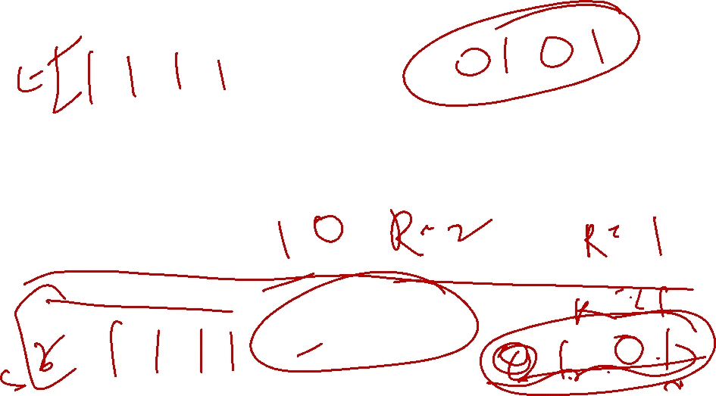
Distinguishing Sequences
Definition: Consider two states s and t of a given FSM, and a k-string (sequence of input symbols) x = (x₀,x₁,…,x_{k-1}). Suppose the string x produces one run Run_s = (s₀,s_{1,}…,s_{k-1}), when starting from s₀ (s=s₀) and another run Run_t = (t₀,t₁,…,t_{k-1}), when starting from t₀ (t=t₀). Further, let z^{s} = (z₀^{s},z₁^{s},…,z_{k-1}^{s}) and z^{t} = (z₀^{t},z₁^{t},…,z_{k-1}^{t}) be the corresponding output strings.
The string x is said to be a length-k distinguishing sequence for states s and t if and only if:
z_{k-1}^{s} ≠ z_{k-1}^{t}

Slide 22
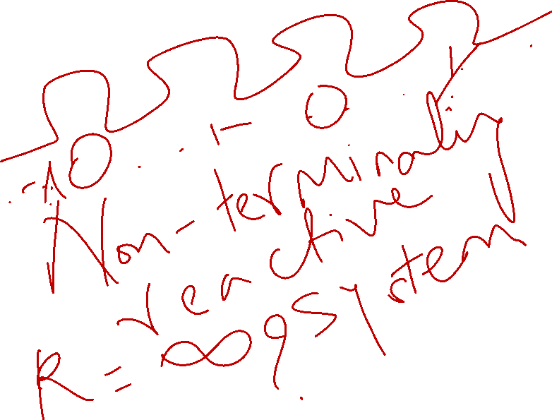

Slide 23

Equivalent States
Definition: Two states s and t are k-equivalent, written s ≡_{k} t, if and only if there does not exist a distinguishing sequence of length k or less for these states. Two states s and t are equivalent if and only if they are n-equivalent, where n = |S|.
|S| is the cardinality of S, i.e. total number of states in S.

Slide 24

Equivalent States
Theorem: s ≡_{k+1} t if and only if s ≡_{k} t and ∀𝑥∈𝑋, 𝑠_{𝑥} ≡_{𝑘} 𝑡_{𝑥} , where s_{x} and t_{x} are the x-successors of s and t.
For this particular case, x can be the immediate next state of s or t
Notes:
It is clearer when treating x as 1 more state after the k input string. The theorem itself is not well defined. Refer to text book p266.

Slide 26
Equivalence
Definition: We define the binary relation 𝜉^{𝑘}(𝑠,𝑡) ⊂ 𝑆 × 𝑆 as
𝜉^{𝑘}={(𝑠,𝑡) | 𝑠≡_{𝑘} 𝑡)}.
We also denote the 𝑚_{𝑘} equivalence classes of the relation 𝜉^{𝑘} by 𝐵_{𝑖}^{𝑘}, 𝑖=1,…,𝑚_{𝑘}

Slide 27
Equivalence
𝜉^{k} is an equivalence relation
Reflexive: A state is k-equivalent to itself
Symmetric: s ≡_{k} t ⇒ t ≡_{k} s
Transitive: s ≡_{k} t, t ≡_{k} u ⇒ s ≡_{k} u

Slide 28
Minimize this state machine
0/0
D
0/0
B
0/0
1/1
1/0
1/0
A
F
1/1
1/1
0/0
1/0
E
C
0/0
0/0

Slide 31
Equivalence
Present State | Next State/Output
 | x = 0 | x = 1
A (Start) | E/0 | D/1
B | D/0 | F/0
C | E/0 | B/1
D | B/0 | F/0
E | C/0 | F/1
F | B/0 | C/0
For Example:
States in B₁¹ = {A,C,E} are 1-equivalent
States in B₂¹ = {B,D,F} are also 1-equivalent
A and B are 1-distinguishable
A,C,E also 2-equivalent
Is one equivalent
Their successors under input 0 (E,E,C) are 1-equivalent
Their successors under input 1 (D,B,F) are also 1-equivalent
F not 2-equivalent to B
Input 1: F goes to C, B goes to D
C and D are not 1-equivalent
{A,C} and {B,D} are fully equivalent

Slide 32
Equivalence Checking

Slide 33

Partition-Refinement
Goal: Determine the set of all equivalent state pairs of a given FSM.
$P^{0}=\left\{B_{1}^{0}\right\};B_{1}^{0}=S;P^{1}=P^{0}$
$for\left(x∈X\right)\{$
$for\left(s_{j}∈S\right) o_{j}^{x}=λ(s_{j},x)$
$P_{x}^{1}=PARTITION\left(o^{x},s\right)$
$P^{1}=REFINE\left(P^{1},P_{x}^{1}\right)$
$\}$
Phase 1:
Initialize P⁰ and P¹ as partitions with one block containing all S states
Gather a vector o^{x} of the x outputs in each state s_{j}
Use o^{x} to partition the vector into blocks with the same output value, P_{x}¹
Refine P¹

Slide 34
Refinement
Definition: If Pª = {B_{i}ª}, and P^{b} = {B_{j}^{b}}, then Pª ⋅ P^{b}, called the meet, or intersection, of partitions Pª, and P^{b}, is given by:
Pª ⋅ P^{b} =∪_{ij}(B_{i}ª ∩ B_{j}^{b})
the meet P^{c} of two partitions Pª and P^{b} is a refinement of both Pª and P^{b}.
Notes:
Change a and b to subscript. Explain that it is value of x.

Slide 35

Partition-Refinement
Example (Phase 1):
Initial partition P¹ = P⁰ = {B¹}, where B1 = {A,B,C,D,E,F}.
First for loop:
x = 0: o⁰ = (0,0,0,0,0,0), s = (A,B,C,D,E,F), PARTITION returns P₀¹ = {S}, P¹ = P¹ ∩ P₀¹ = {S}
x = 1: o⁰ = (1,0,1,0,1,0), s = (A,B,C,D,E,F), PARTITION returns P₁¹ = {B₁^{x}, B₂^{x}}, where B₁^{x} = {A,C,E} and B₂^{x} = {B,D,F}. P¹ = P¹ ∩ P₁¹ = {{A,C,E},{B,D,F}}

Slide 36

Partition-Refinement
Phase 2:
On each pass through the loop over k, we initialize P^{k} to the empty partition.
Loop through the blocks B_{i} of P^{k-1} and compute P_{i}^{k} as a partition of B_{i}.
Gather a vector of the x-successors of the states in B_{i}.
Compute the corresponding vector of partition block indices (in partition P^{k-1}).
Partition B_{i} into blocks with like block indices
Refine the result with the current P^{ik}.
$for\left(k=2,…,\left|S\right|\right)\{$
$P^{k}=\{\}$
$for\left(B_{i}∈P^{k−1}\right)\{$
$P_{i}^{k}=\left\{B_{i}\right\}$
$for\left(x∈X\right)\{$
$for\left(s_{j}∈B_{i}\right) t_{j}^{x}=δ(s_{j},x)$
$b^{x}=BLOCK_INDEX\left(t^{x}, P^{k−1}\right)$
$Pb_{i}^{x}=PARTITION\left(b^{x},s\right)$
$P_{i}^{k}=REFINE\left(P_{i}^{k}, Pb_{i}^{x}\right)$
$\}$
$P^{k}=P^{k}∪P_{i}^{k}$
$\}$
$if \left(P^{k}=P^{k−1}\right) return \left(P^{k},k\right)$
$\}$

Slide 37
Partition-Refinement
Example (Phase 2):
First Pass (k = 2)
(block B,D,F)
x = 0: s = (B,D,F), t⁰ = (D,B,B), b⁰ = (1,1,1), Pb₁⁰ = {B_{i}} = {{B,D,F}}.
x = 1: s = (B,D,F), t₁ = (F,F,C), b₁ = (1,1,2), Pb₁¹ = {{B,D},{F}}.
Set union: P² = {{B,D},{F}}
(block A,C,E)
No refinement
P² = {{B,D},{F},{A,C,E}}
Notes:
Do k = 3… on board

Slide 38

Partition-Refinement Algorithm
$STATE_EQUIVALENCE\left(X,S,δ, λ\right)$:
$$/∗ Partition Refinement Algorithm for identifying state equivalence ∗/$$
$P^{0}=\left\{B_{1}^{0}\right\};B_{1}^{0}=S;P^{1}=P^{0}$
$for\left(s_{j}∈X\right)\{$
$for\left(s_{j}∈S\right) o_{j}^{x}=λ(s_{j},x)$
$P_{x}^{1}=PARTITION\left(o^{x},s\right)$
$P^{1}=REFINE\left(P^{1},P_{x}^{1}\right)$
$\}$
$if\left(P^{1}=P^{0}\right) return \left(P^{0},0\right)$
$for\left(k=2,…,\left|S\right|\right)\{$
$P^{k}=\{\}$
$for\left(B_{i}∈P^{k−1}\right)\{$
$P_{i}^{k}=\left\{B_{i}\right\}$
$for\left(x∈X\right)\{$
$for\left(s_{j}∈B_{i}\right) t_{j}^{x}=δ(s_{j},x)$
$b^{x}=BLOCK_INDEX\left(t^{x}, P^{k−1}\right)$
$Pb_{i}^{x}=PARTITION\left(b^{x},s\right)$
$P_{i}^{k}=REFINE\left(P_{i}^{k}, Pb_{i}^{x}\right)$
$\}$
$P^{k}=P^{k}∪P_{i}^{k}$
$\}$
$if \left(P^{k}=P^{k−1}\right) return \left(P^{k},k\right)$
$\}$
Phase 1
Sort and group by like outputs
Return: all states are 1-equivalent
Distinguishing path lengths
Initialize P^{k}
Initialize refined block partition
Phase 2
Sort and group by like block indices

Slide 39
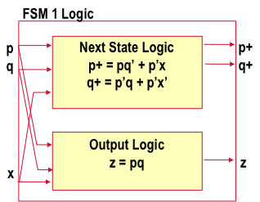
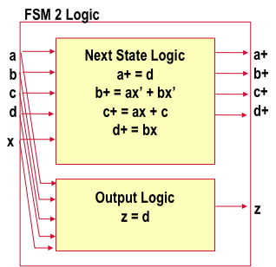
Cross Product Machine
Given 2 FSMs to check...
Just FSM1, FSM2, with FSM2’s states given new names (A → α, B→ β, etc)...
State: pq=00
pq=01
State: abcd=1000
abcd=0100
A/0
x=0
B/0
x=0
α/0
x=0
β/0
x=0
x=1
x=0,1
x=1
x=1
x=0,1
x=1
x=0,1
C/0
D/1
x=0,1
κ/0
Δ/1
pq=10
pq=11
abcd = 0010
abcd=0001

Slide 40
Cross Product Machine: FSM1 × FSM2
What are the states in FSM1 × FSM2? (× == “cross”)
All pairs of possible states (FSM1 state, FSM2 state)
State: pq=00
pq=01
State: abcd=1000
abcd=0100
A/0
x=0
B/0
x=0
α/0
x=0
β/0
x=0
x=1
x=0,1
x=1
x=1
x=0,1
x=1
x=0,1
C/0
D/1
x=0,1
κ/0
Δ/1
pq=10
pq=11
abcd = 0010
abcd=0001
FSM1 × FSM2 has 4*4=16 states

Slide 41
Cross Product Machine: FSM1 × FSM2
What are the state variables for FSM1 × FSM2
Easy, just “all” the state variables from FSM1 and from FSM2
State
Logic
D Q
p
q
a
b
c
d
Next State Logic
???
D Q
D Q
D Q
Output Logic
???
D Q
D Q

Slide 42
Cross Product Machine: FSM1 × FSM2
So, what then is the next-state logic for FSM1 × FSM2?
Easy again: just the 2 separate next-state blocks from FSM1, FSM2
State
Logic
Next State Logic
D Q
p
q
a
b
c
d
FSM1 Next State
Logic
D Q
FSM2 Next State
Logic
D Q
D Q
D Q
Output Logic
???
D Q

Slide 43
Cross Product Machine: FSM1 × FSM2
So, what is the output logic for FSM1 × FSM2
Now, it’s different.
The cross-product machine is really (up to now) just the 2 separate machines FSM1 and FSM2 running side-by-side
We want to know: if we start them both in the same “equivalent” state, will we ever reach a “combined” state (FSM1 state vars, FSM2 state vars) where the outputs of the 2 machines are different
FSM 1
FSM1 outputs
inputs
Should always
be == 1 if
FSM1 = FSM2
== ?
FSM 2
FSM2 outputs
clock

Slide 44
Cross Product Machine: FSM1 × FSM2
So, what is the output logic for FSM1 × FSM2?
State
Logic
Next State Logic
D Q
p
q
a
b
c
d
FSM1 Next State
Logic
D Q
FSM2 Next State
Logic
D Q
D Q
Output Logic
FSM1 Output Logic
D Q
=?
FSM2 Output Logic
D Q

Slide 45
Cross Product Machine Reachability Analysis
Where are we?
We can build, mechanically, the cross product machine
What good is this?
FSM1 and FSM2 are equivalent if, when started in the same initial “equivalent” states, it is never possible to reach a state where the output of the cross product machine == 0
Put another way: output of cross product machine should always be ==1, for any combined state (FSM1 state, FSM2 state) we can reach from (FSM1 start, FSM2 start)
How do we do this?
We already know how...

Slide 46
Cross Product Reachability Analysis
Build the cross product machine
Means build the next state logic, and the output logic for it
Do reachability analysis on [ FSM1 × FSM2 ]
In our little example, start with A=00, α = 1000 states: R₀(p+,q+,a+,b+,c+,d+) = (p+’ )(q+’)( a+)(b+’)(c+’){d+’)
Build R₁, R₂, ... R_{K} until it stops changing
Now, you know pairs of states it is possible to reach from (A, α) start state...

Slide 47
Cross Product Reachability Analysis
What does this tell you?
Pairs of states you can get to from (A, α)
Example
State: pq=00
pq=01
State: abcd=1000
abcd=0100
A/0
x=0
B/0
x=0
α/0
x=0
β/0
x=0
x=1
x=0,1
x=1
x=1
x=0,1
x=1
x=0,1
C/0
D/1
x=0,1
κ/0
Δ/1
pq=10
pq=11
abcd = 0010
abcd=0001
Example: 2 ticks, A→ B→ D
Example: 2 ticks, α → β→ β
So, in R₀ we have (A, α), and in R₂ we will have...

Slide 48
Verification via Reachability
OK, we can build R_{k} for this FSM1 × FSM2
Now what?
Want to know if we can reach a combined state where cross-product output ==0; consider this logic...
p+
q+
a+
b+
c+
d+
R_{k}
==1 if (p+ q+, a+ b+ c+ d+)
is a reachable pair
final
Output Logic
FSM1 Output Logic
=?
==1 if output from p+ q+
same as output from
a+ b+ c+ d+
FSM2 Output Logic

Slide 49
Verification via Reachability
Look what happens
Build a BDD for this ckt; it has 6 inputs p+ q+ a+ b+ c+ d+, has 1 output
If the 2 FSMs are equivalent, then this output == constant 0 BDD
If these 2 FSMs NOT equivalent, this is some BDD with a 1 node in it
All we have to do is see if this BDD != constant 0 BDD, and we are done!

Slide 50
Verification via Reachability
What did we do here?
We turned the complex temporal problem of verification of equivalence for all inputs over all subsequent clock ticks...
...into a series of BDD exercises, ending in a satisfiability check on a single (big, nasty) BDD; if any pattern of inputs makes this BDD ==1, then machines not equivalent
Amazingly useful result
Doable mechanically with a good BDD package
Definitely NOT something you want to try to do by hand.
On the HW, you get to do it for a similar pair of machines using the KBDD package to do the nasty Boolean manipulations

Slide 51
Simpler Example
FSM 1
FSM 2
x=0
x=0,1
x=0
x=0
A/0
x=1
B/1
C/0
x=1
D/1
State q=0
x=1
q=1
State p=0
p=1
Next state:
p+ = p+x
Output
z = p
Next state:
q+ = q  x
Output
z = q

Slide 52
Simple Example: Cross Product Reachability
FSM 1
FSM 2
x=0
x=0,1
x=0
x=0
A/0
x=1
B/1
C/0
x=1
D/1
x=1
What do we expect for reachability on FSM1 X FSM2?
R₀ = { (A,C) }
R₁ = reachable on 0 or 1 clock tick =
R₂ = reachable on 0, 1, 2 clock ticks =
R₃ = reachable on 0, 1, 2, 3 clock ticks =

Slide 53
Cross Product Reachability Analysis
So, we get R_{k} = { AC, BD, BC } ... what is Boolean func?
OK, let’s make the cross product satisfiability logic
R_{k}
==1 if (p+,q+) reachable
p+
q+
Output Logic
FSM1: z = p
=?
FSM2: z = q
==1 if output from p+
same as output from q+

Slide 54
Cross Product Reachability: Satisfiable?
==1 if (p+,q+)
reachable
p+
R
q+
k
Output Logic
FSM1: z = p
=?
==1 if output from p+
FSM2: z = q
same as output from q+
Well, can you get a 1 out of this...?

Slide 55
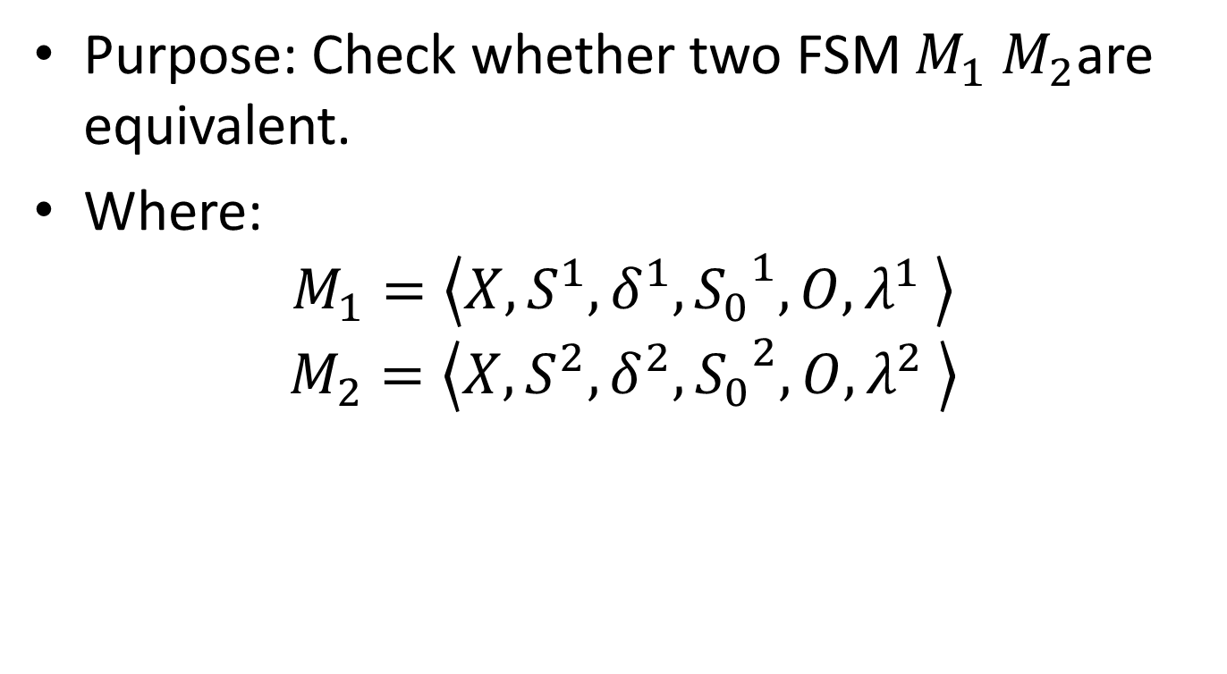
Product machine
Purpose: Check whether two FSM $M_{1} M_{2}$are equivalent.
Where:
$$M_{1}=\left\langle X,S^{1},δ^{1},{S_{0}}_{}^{1},O,λ^{1} \right\rangle$$
$$M_{2}=\left\langle X,S^{2},δ^{2},{S_{0}}_{}^{2},O,λ^{2} \right\rangle$$

Slide 56
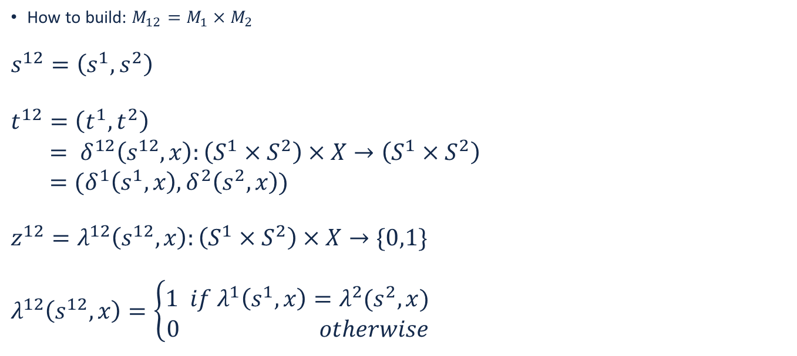
Product machine
How to build: $M_{12}=M_{1}{×M}_{2}$
$$s^{12}=\left(s^{1},s^{2}\right)$$
$$t^{12}=\left(t^{1},t^{2}\right)$$
$= δ^{12}\left(s^{12},x\right):\left(S^{1}×S^{2}\right)×X→\left(S^{1}×S^{2}\right)$
$=(δ^{1}\left(s^{1},x\right),δ^{2}\left(s^{2},x\right))$
$$z^{12}=λ^{12}\left(s^{12},x\right):\left(S^{1}×S^{2}\right)×X→\{0,1\}$$
$$λ^{12}\left(s^{12},x\right)=\left\{\begin{aligned}1 if λ^{1}\left(s^{1},x\right)=λ^{2}(s^{2},x) \\ 0 otherwise\end{aligned}\right.$$

Slide 57
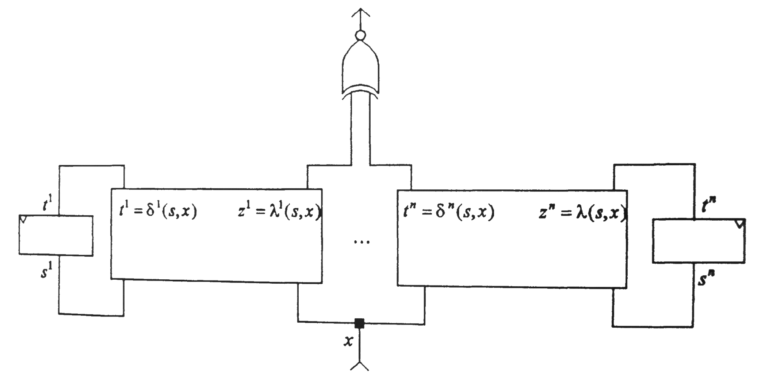
Product machine

Slide 58
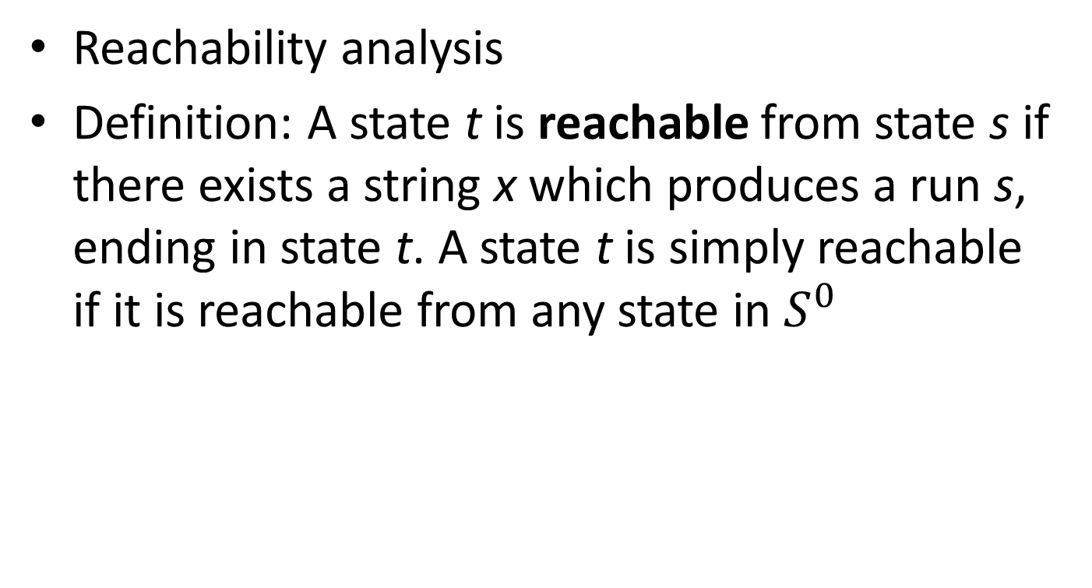
Equivalence Checking between FSMs
Reachability analysis
Definition: A state t is reachable from state s if there exists a string x which produces a run s, ending in state t. A state t is simply reachable if it is reachable from any state in $S^{0}$

Slide 59
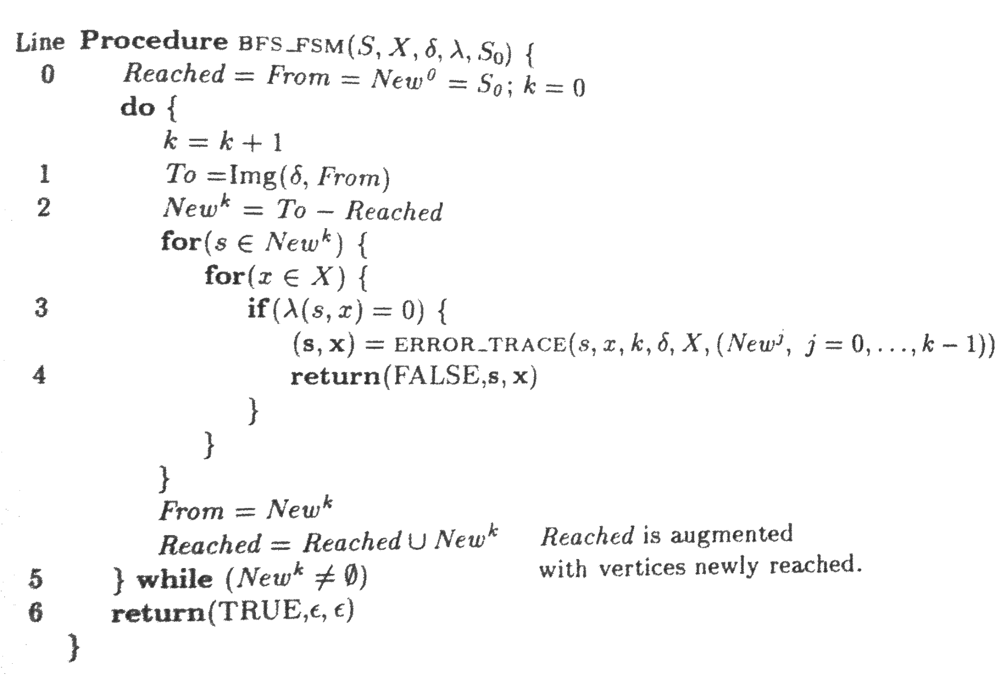
Reachability analysis

Slide 60
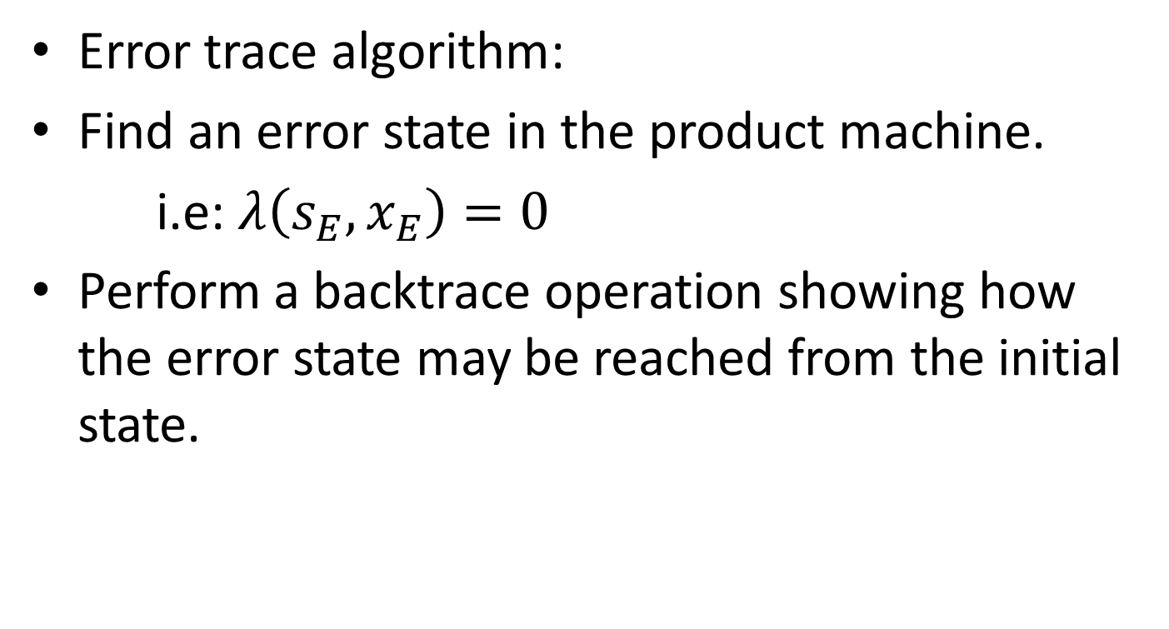
Equivalence Checking between FSMs
Error trace algorithm:
Find an error state in the product machine.
i.e: $λ\left(s_{E},x_{E}\right)=0$
Perform a backtrace operation showing how the error state may be reached from the initial state.

Slide 61

Error trace algorithm
$Error_Trace\left(s_{E},x_{E},k_{E},δ,X,\left({New}^{j},j=0,…k_{E}−1\right)\right)$
/*$Error state: λ\left(s_{E},x_{E}\right)=0$
$$s=\left(s_{E}\right);x=\left(x_{E}\right);$$
$$for\left(k=k_{E}−1;k≥1;k−−\right)\{$$
$for\left(s∈{New}^{k}\right)\{$
$for\left(x∈X\right)\{$
$if\left(s_{E}=δ\left(s,x\right)\right)\{$
$s_{E}=s;x_{E}=x;$
$s=\left(s_{E},s\right);x=\left(x_{E},x\right);$
$\}$
$\}$
$\}$
$$\}$$
$$return (s,x)$$

