Slide 1
Equivalence Checking with SAT
COPYRIGHT OF PROF. SHOBHA VASUDEVAN, ECE, UIUC.
PLEASE DO NOT DISTRIBUTE/REUSE ANY OF THESE SLIDES WITHOUT MY EXPLICIT PERMISSION.
Prof Shobha Vasudevan
ECE 519
Lecture 5

Slide 2
Some Terminology
Satisfiability (called “SAT” for short)
Give me an appropriate representation of function F(x1, x2, … xn)
Find an assignment of the variables (“vars” for short) (x1, x2, … xn) so F( ) = 1
Note – this assignment need not be unique. Could be many satisfying solutions
But if there are no satisfying assignments at all – prove it, and return this info
Some things you can do with BDDs, can do easier with SAT
SAT is aimed at scenarios where you just need one satisfying assignment…
…or prove that there is no such satisfying assignment

Slide 3
Example: Network Repair
(∀a,b Z)[d0,d1,d2,d3]
Assuming you can build the quantification function (∀a,b Z)
Go find a SAT assignment to get you the d values to repair the network
Or, if unSAT, know that there is no network repair possible

Slide 4
Standard SAT Form: CNF
Conjunctive Normal Form (CNF) = Standard POS form
Why CNF is useful
Need only determine that one clause evaluates to “0” to know whole formula = “0”
Of course, to satisfy the whole formula, you must make all clauses identically “1”.
ɸ = ( a + c ) ( b + c) ( ¬a + ¬b + ¬c)

Slide 5
Assignment to a CNF Formula
An assignment…
…gives values to some, not necessarily all, of variables (vars) xi in (x1, x2, … , xn).
Complete assignment: assigns value to all vars. Partial: some, not all, have values
Assignment means we can evaluate status of the clauses
Suppose a=0, b=1 but c, d are unassigned
ɸ = ( a + ¬b ) (¬a + b + ¬ c) ( a + c + d ) ( ¬a + ¬b + ¬c)

Slide 6
How Do We “Solve” This?
Recursively (…surprised?)
Strategy has two big ideas
DECISION:
Select a variable and assign its value; simplify CNF formula as far as you can
Hope you can decide if it’s SAT, yes/no, without further work
DEDUCTION:
Look at the newly simplified clauses
Iteratively simplify, based on structure of clauses, and value of partial assignment
Do this until nothing simplifies. If you can decide SAT yes/no, great.
If not, then you have to recurse some more, back up to DECIDE

Slide 7
How Do We “Solve” This?
ɸ = ( x + y + z)( ¬x + y )( ¬y + z ) ( ¬x + ¬y + ¬z)
x=1
x=0
( 1 )( y )( ¬y + z ) ( ¬y + ¬z )
( 1 )( y + z ) ( ¬y + z )
y=1
y=0
z=1
( 1 )( z ) ( ¬z )
0
( 1 ) ( 1 )
unSAT
SAT!!
z=0
z=1
0
0
How do we do this fast…?
unSAT
unSAT

Slide 8
BCP: Boolean Constraint Propagation
To do “deduction”, use BCP
Given a set of fixed variable assignments, what else can you “deduce” about necessary assignments by “propagating constraints”
Most famous BCP strategy is “Unit Clause Rule”
A clause is said to be “unit” if it has exactly one unassigned literal
Unit clause has exactly one way to be satisfied, ie, pick polarity that makes clause=“1”
This choice is called an “implication”
ɸ = ( a + c ) ( b + c) ( ¬a + ¬b + ¬c)
Assume:
a=1, b=1

Slide 9
BCP Iterative – Go Until No More Implications
ɸ = (ω₁)(ω₂)(ω₃)(ω₄)(ω₅)(ω₆)(ω₇)(ω₈)(ω₉)
ω₁ = ( ¬x1 + x2 )
ω₂ = ( ¬x1 + x3 + x9)
ω₃ = ( ¬x2 + ¬x3 + x4)
ω₄ = ( ¬x4 + x5 + x10)
ω₅ = ( ¬x4 + x6 + x11)
ω₆ = ( ¬x5 + ¬x6)
ω₇ = ( x1 + x7 + ¬x12)
ω₈ = ( x1 + x8)
ω₉ = ( ¬x7 + ¬x8 + ¬x13)
Example from
J.P. Marques-Silva and K. Sakallah, “GRASP: A Search Algorithm for Propositional Satisfiability”, IEEE Trans. Computers, Vol 8, No 5, May’99
Partial assignment is:
x9=0 x10=0 x11=0 x12=1 x13=1
To start…
What are obvious simplifications when we assign these variables?
0
0
No SAT
No BCP
Now what?
0
0
0

Slide 10

BCP Iterative – Go Until No More Implications
ɸ = (ω₁)(ω₂)(ω₃)(ω₄)(ω₅)(ω₆)(ω₇)(ω₈)(ω₉)
ω₁ = ( ¬x1 + x2 )
ω₂ = ( ¬x1 + x3 + x9)
ω₃ = ( ¬x2 + ¬x3 + x4)
ω₄ = ( ¬x4 + x5 + x10)
ω₅ = ( ¬x4 + x6 + x11)
ω₆ = ( ¬x5 + ¬x6)
ω₇ = ( x1 + x7 + ¬x12)
ω₈ = ( x1 + x8)
ω₉ = ( ¬x7 + ¬x8 + ¬x13)
Partial assignment is:
x9=0 x10=0 x11=0 x12=1 x13=1
Next: Assign a variable to value
Assign x1=1
0
0
0
Unit
0
0
Implications!
x1=1 → x2=1 && x3=1
1
0
1
SAT
0

Slide 11

BCP Iterative – Go Until No More Implications
ɸ = (ω₁)(ω₂)(ω₃)(ω₄)(ω₅)(ω₆)(ω₇)(ω₈)(ω₉)
ω₁ = ( ¬x1 + x2 )
ω₂ = ( ¬x1 + x3 + x9)
ω₃ = ( ¬x2 + ¬x3 + x4)
ω₄ = ( ¬x4 + x5 + x10)
ω₅ = ( ¬x4 + x6 + x11)
ω₆ = ( ¬x5 + ¬x6)
ω₇ = ( x1 + x7 + ¬x12)
ω₈ = ( x1 + x8)
ω₉ = ( ¬x7 + ¬x8 + ¬x13)
Partial assignment is:
x9=0 x10=0 x11=0 x12=1 x13=1
Next: Assign a var to value
Assign x1=1
Assign (implied): x2=1, x3=1
0
1
0
1
0
SAT
0
0
UNIT
0
0
Implications!
x2=1,x3=1 → x4=1
1
0
1
SAT
0

Slide 12

BCP Iterative – Go Until No More Implications
ɸ = (ω₁)(ω₂)(ω₃)(ω₄)(ω₅)(ω₆)(ω₇)(ω₈)(ω₉)
ω₁ = ( ¬x1 + x2 )
ω₂ = ( ¬x1 + x3 + x9)
ω₃ = ( ¬x2 + ¬x3 + x4)
ω₄ = ( ¬x4 + x5 + x10)
ω₅ = ( ¬x4 + x6 + x11)
ω₆ = ( ¬x5 + ¬x6)
ω₇ = ( x1 + x7 + ¬x12)
ω₈ = ( x1 + x8)
ω₉ = ( ¬x7 + ¬x8 + ¬x13)
Partial assignment is:
x9=0 x10=0 x11=0 x12=1 x13=1
Next: Assign a var to value
Assign x1=1
Assign (implied): x2=1, x3=1
Assign (implied): x4=1
0
1
0
1
0
SAT
0
0
1
0
0
0
0
UNIT
1
0
Implications!
x4=1 → x5=1 && x6=1
1
SAT
0

Slide 13

BCP Iterative – Go Until No More Implications
ɸ = (ω₁)(ω₂)(ω₃)(ω₄)(ω₅)(ω₆)(ω₇)(ω₈)(ω₉)
ω₁ = ( ¬x1 + x2 )
ω₂ = ( ¬x1 + x3 + x9)
ω₃ = ( ¬x2 + ¬x3 + x4)
ω₄ = ( ¬x4 + x5 + x10)
ω₅ = ( ¬x4 + x6 + x11)
ω₆ = ( ¬x5 + ¬x6)
ω₇ = ( x1 + x7 + ¬x12)
ω₈ = ( x1 + x8)
ω₉ = ( ¬x7 + ¬x8 + ¬x13)
Partial assignment is:
x9=0 x10=0 x11=0 x12=1 x13=1
Next: Assign a var to value
Assign x1=1
Assign (implied): x2=1, x3=1
Assign (implied): x4=1
Assign (implied): x5=1 && x6=1
0
1
0
1
0
SAT
0
0
1
0
1
0
0
1
0
UNIT
0
0
CONFLICT!
1
0
1
SAT
Conflict →unSAT
x5=1 && x6=1 → clause ω6==0!
0

Slide 14

BCP Iterative – Go Until No More Implications
ɸ = (ω₁)(ω₂)(ω₃)(ω₄)(ω₅)(ω₆)(ω₇)(ω₈)(ω₉)
ω₁ = ( ¬x1 + x2 )
ω₂ = ( ¬x1 + x3 + x9)
ω₃ = ( ¬x2 + ¬x3 + x4)
ω₄ = ( ¬x4 + x5 + x10)
ω₅ = ( ¬x4 + x6 + x11)
ω₆ = ( ¬x5 + ¬x6)
ω₇ = ( x1 + x7 + ¬x12)
ω₈ = ( x1 + x8)
ω₉ = ( ¬x7 + ¬x8 + ¬x13)
3 cases when BCP finishes
SAT: Find a SAT assignment, all clauses resolve to “1”. Return it.
UNRESOLVED: One or more clauses unresolved. Pick another unassigned var, and recurse more.
UNSAT: Like this. Found conflict, one or more clauses eval to “0”
Now what?
You need to undo one of our variable assignments, try again…
0
1
0
1
0
SAT
0
0
1
0
1
0
0
1
0
SAT
0
0
CONFLICT!
1
0
1
SAT
0
UNRESOLVED

Slide 15
This algorithm has a name!
Davis-Putnam-Logemann-Loveland (DPLL) Algorithm
Davis, Putnam published the basic recursive framework in 1960 (!)
Davis, Logemann, Loveland: found smarter BCP, eg, unit-clause rule, in 1962
Often called “Davis-Putnam” or “DP” in honor of the first paper in 1960, or DPLL
Big ideas
A complete, systematic search of variable assignments
Useful CNF form for efficiency
BCP makes search stop earlier, “resolving” more assignments without more recursion

Slide 16
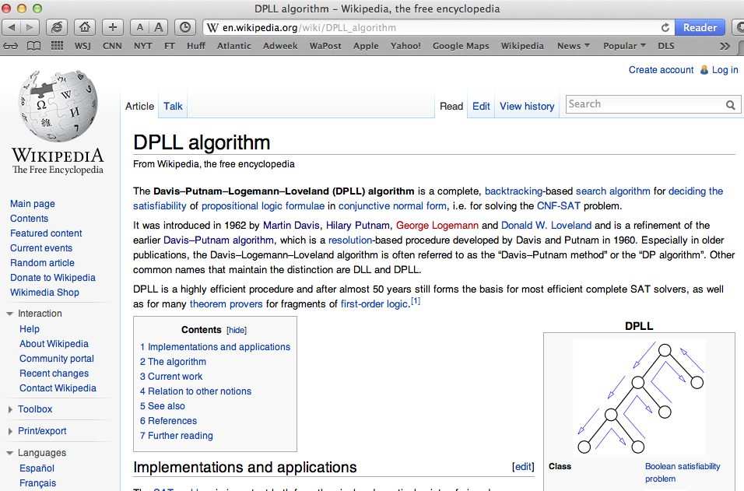
DPLL: Famous Stuff…

Slide 17
SAT: Huge Progress Last ~20 Years
But: DPLL is only the start…
SAT has been subject of intense work and great progress
Efficient data structures for clauses (so can search them fast)
Efficient variable selection heuristics (so search smart, find lots of implications)
Efficient BCP mechanisms (because SAT spends MOST of its time here)
Learning mechanisms (find patterns of vars that NEVER lead to SAT, avoid them)
Results: Good SAT codes that can do huge problems, fast
Huge means? 50,000 vars; 25,000,000 literals; 50,000,000 clauses (!!)

Slide 18
SAT Solvers
Many good solvers available online, open source
Examples
MiniSAT, from Niklas Eén, Niklas Sörensson in Sweden.
CHAFF, from Sharad Malik and students, Princeton University
GRASP, from Joao Marques-Silva and Karem Sakallah, University of Michigan
…and many others too. Go google around for them…

Slide 19
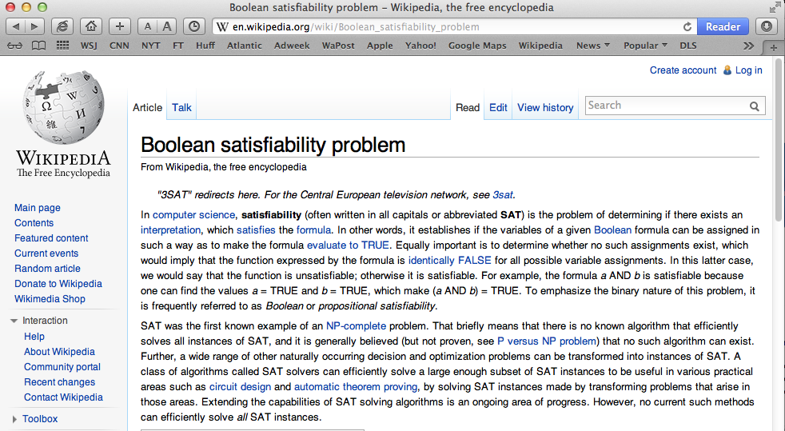
Lots of Information on SAT…

Slide 20
SAT solving using BDDs?

