Slide 1
Assertion based verification
ECE 598 SV
Shobha Vasudevan (slides from lecture co-taught with Harry Foster, Mentor Graphics)
PLEASE DO NOT DISTRIBUTE WITHOUT PERMISSION

Slide 2
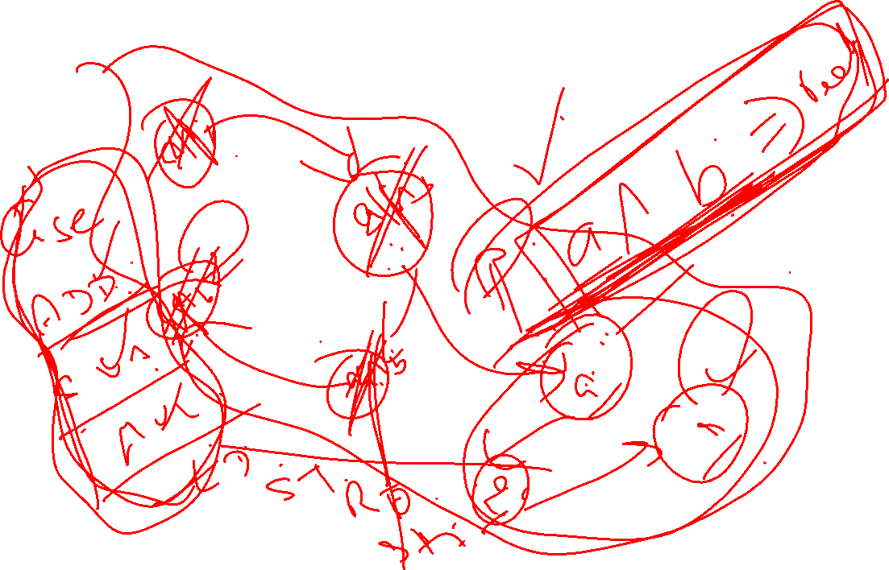

Slide 3

Assertion Language and Library Standards
1993-1997
1998
1999
2000
2001
2002
2003
2004
2005
2006
Sugar
RCTL
Sugar
1.0
Sugar
2.0
Assertion Languages
IBM
PSL
v1.01
PSL
v1.1
PSL
IEEE Std 1850-2005
CTL (1981)
Motorola
CBV
Verisity
Temporal e
Intel
LTL (1977)
FTL ForSpec
SVA
v3.0
SVA
v3.1
SVA
v3.1a
SVA
IEEE Std 1800-2005
Vera/TXP
OVA
OVA
v2.0
Sun -> Synopsys
Assertion Libraries
SMAC
OVL
OVL
OVL
1.0 R4
OVL
1.5
OVL
1.6 1.7
HP
Verplex
Accellera
CheckerWare
0-In/Mentor
Notes:
Assertion languages evolved from academic logic languages
Key benefits are:
Temporal (time sequence) expressions
Compact syntax for checking
Flexibility to express custom properties
Verification IP libraries evolved to make design checking easy
Key benefits are:
Easy to use
Pre-verified
Re-usable

Slide 4
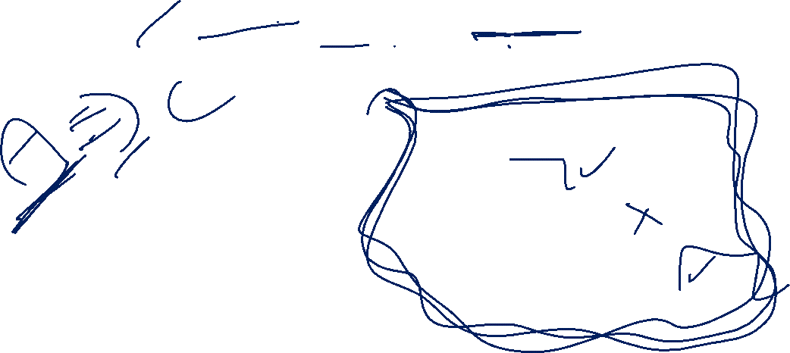
IEEE 1850 PSL Example
assert never ( { rose(req) ; { !gnt[0] [+] } && { gnt[1] [->2] } } ) @(posedge clk);
clk
req[0]
req[0]
Arbiter
gnt[0]
gnt[0]
req[1]
gnt[1]
gnt[1]

Slide 5
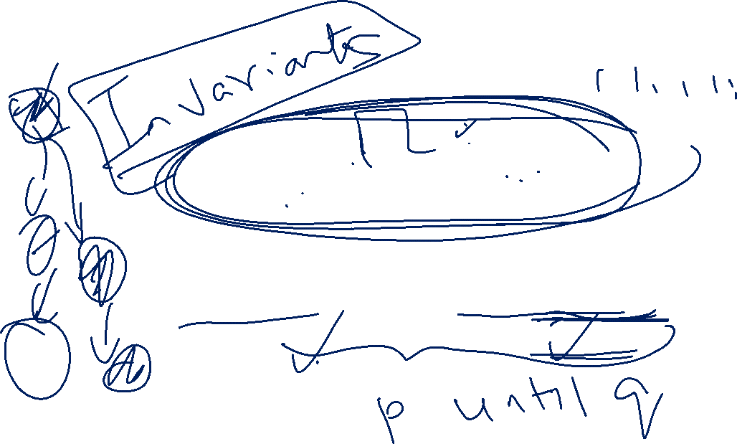
IEEE 1800 SystemVerilog Example
clk
start
done
error
assert property ( @(posedge clk) disable iff (~reset_n)
start |=> (!start throughout done [->1]) );

Slide 6

Accellera OVL Example
Semantics
  Between start_event and end_event inclusive, test_expr must not change
clk
we
addr[7:0]
8’b0
8’b1
done
error
test_expr
assert_win_unchange #(0,8) addrStbl ( clk, rst_n, we, addr, done);
severity
width
start_event
end_event

Slide 7
Industry Standards Usage
Source: 2007 Far West Research and Mentor Graphics

Slide 8
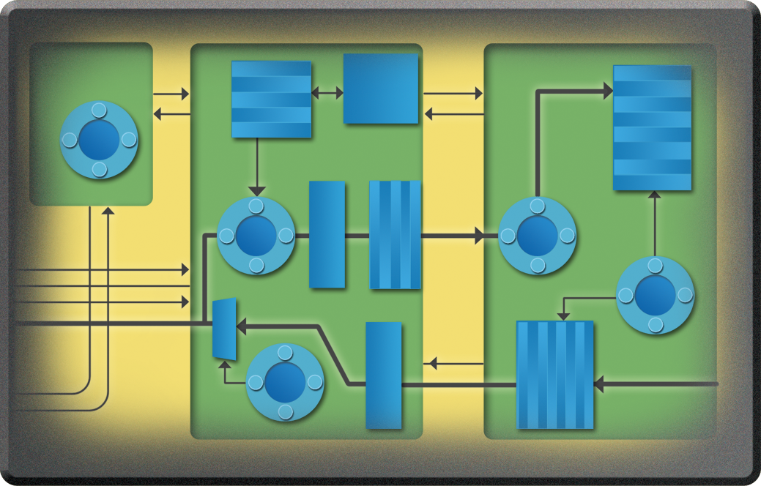



Assertions Improve Observability
Reduces time-to-bug
Testbench
=
Bugs missed due to
poor observability
=
Reduce debugging up to 50% [CAV 2000, IBM FoCs paper]
Bugs detected closer to their source due to improved observability

Slide 9
Verification Trends
Verification
Gap
Design
Gap
Ability to Fabricate
(57 % / yr))
Design Size in Millions of Gates
Ability to Design
(41 % / yr))
Ability to Verify
(25 % / yr))
The Verification Gap
  Many companies still using 1990’s verification technologies
  Traditional verification techniques can’t keep up
Based on data from the 2003 ITRS study and
Collett International 2004 FV Survey
9
Notes:
9
Design productivity
Increases due to:
Synthesis
IP/Reuse
The verification gap. We define the verification gap as follows. Advances in manufacturing technologies has made feature sizes smaller and thus, more functionality can be incorporated to an ever shrinking die size. To leverage this, advances in HDLs, synthesis, and the availability of ready-to-use IP and/or design reuse allow large designs to be implemented rather quickly. However…
There is a big gap between what can be designed and what can be verified. Verification has become the limiting factor on what can be safely designed. The good news is that this gap can be closed. If companies move away from their comfort zone of 1990’s verification techniques, and start employing more advanced techiques that better serve complex devices, the gap can be dramatically reduced.

Slide 10
Concurrency Challenge
Packet-Based Design
Arbiter
Tx
Transaction
Layer
Packets
From
Fabric
Retry Buffer
To
PHY
Data-Link
Layer
Packets
Rx
From Rx Channel

Slide 11

ABV Industry Adoption

Slide 12

Published Data on Assertions Use
Assertion Monitors 34%
Cache Coherency Checkers 9%
Register File Trace Compare 8%
Memory State Compare 7%
End-of-Run State Compare 6%
PC Trace Compare 4%
Self-Checking Test 11%
Simulation Output Inspection 7%
Simulation Hang 6%
Other 8%
17% of bugs found by assertions on Cyrix M3(p1) project
[Krolnik '98]
50% of bugs found by assertions on Cyrix M3(p2) project
[Krolnik ‘98]
85% of bugs found using over 4000 assertions on an HP server chipset project
[Foster and Coelho HDLCon 2001]
Thousands of assertions in Intel Pentium project
[Bentley 2001]
10,000 OVL assertion in Cisco project
[Sean Smith 2002]
Kantrowitz and Noack [DAC 1996]
Assertion Monitors 25%
Register Miscompare 22%
Simulation "No Progress” 15%
PC Miscompare 14%
Memory State Miscompare 8%
Manual Inspection 6%
Self-Checking Test 5%
Cache Coherency Check 3%
SAVES Check 2%
Taylor et al. [DAC 1998]
© DAC Tutorial 2003

Slide 13

Sun
Assertion-Based Verification of a 32 thread SPARC™ CMT Processor
[Turumella, Sharma, DAC 2008]
Category | Unique | Instantiated
Low-Level | 3912 | 132773
Interface | 5004 | 44756
High-Level | 1930 | 18618

Slide 14
Sun
Assertion-Based Verification of a 32 thread SPARC™ CMT Processor
DAC 2008, Turumella, Sharma
Category | Unique | Instantiated
Low-Level | 3912 | 132773
Interface | 5004 | 44756
High-Level | 1930 | 18618
85%
>50%

Slide 15
ABV Bus-Based Design Example
Using SystemVerilog Assertions (SVA)
Bridge
Control
CPU 1
CPU 2
Datapath
UART
AHB
FIFO
APB
Arbiter
I/F
I/F
Datapath
Memory
Graphics
FIFO
Timer
Controller
Controller

Slide 16

Assertion Building Blocks
Specifying A Sequence in SVA
Sequence
  Temporal delay ##n (where n is an integer)
start ##1 transfer
clk
start
transfer

Slide 17
Assertion Building Blocks
Specifying A Sequence in SVA
Sequence
  Temporal delay ##n
start ##2 transfer
clk
start
transfer

Slide 18

Assertion Building Blocks
SVA Properties
Properties
  Overlapping sequence implication operator |->
ready ##1 start |-> go ##1 done
clk
ready
start
go
done

Slide 19

SVA Language Structure
Properties
  Non-overlapping sequence implication operator |=>
ready ##1 start |=> go ##1 done
clk
ready
start
go
done
NOTE: start |=> go is the same as start |-> ##1 go

Slide 20

Building Blocks
SVA Properties
Properties
  Creating named properties
property p_valid_transaction;
@(posedge clk)
ready ##1 start |=> go ##1 done;
endproperty
assert property ( p_valid_transaction );

Slide 21
Nonpipelined Bus Interface
clk
I/F
I/F
rst_n
sel[0]
en
addr
write
rdata
Master
wdata
Slave 0

Slide 22

Non-Burst Write Cycle
The Only Legal Behavior!
0 1 2 3 4
addr
Addr 1
write
sel[0]
en
wdata
Data 1
conceptual
state
INACTIVE
START
ACTIVE
INACTIVE
Notice that !(sel[0]==0 & en==1) is not a legal state of the bus!

Slide 23

Non-Burst Read Cycle
The only legal behavior!
0 1 2 3 4
addr
Addr 1
write
sel[0]
en
rdata
Data 1
conceptual
state
INACTIVE
START
ACTIVE
INACTIVE
Notice that !(sel[0]==0 & en==1) is not a legal state of the bus!

Slide 24

Conceptual Bus State Transitions
INACTIVE
sel[0] == 0
en == 0
no transfer
setup
START
sel[0] == 1
en == 0
no transfer
transfer
setup
ACTIVE
sel[0] == 1
en == 1

Slide 25

Bus Properties
Property Name | Description
p_valid_inactive_transition | Only INACTIVE or START states follows INACTIVE
p_valid_start_transition | Only ACTIVE state follows START
p_valid_active_transition | Only INACTIVE or START states follows ACTIVE
p_no_error_state | Bus state must be valid: !(sel[0]==0 & en==1)
INACTIVE
sel[0] == 0
en == 0
setup
no transfer
START
sel[0] == 1
en == 0
transfer
setup
ACTIVE
sel[0] == 1
en == 1

Slide 26
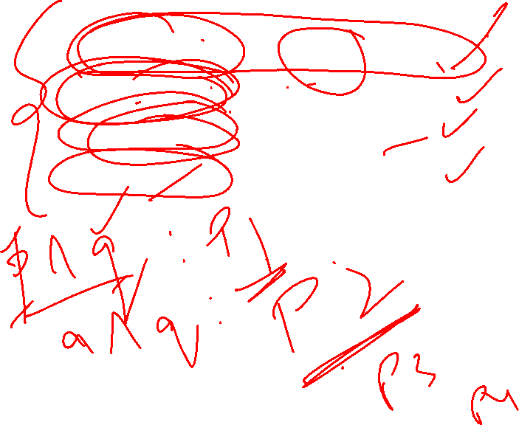
Use Modeling Code to Simplify Coding
bus_inactive = ~sel[0] & ~en;
bus_start = sel[0] & ~en;
bus_active = sel[0] & en;
bus_error = ~sel[0] & en;
INACTIVE
sel[0] == 0
en == 0
setup
no transfer
START
sel[0] == 1
en == 0
transfer
setup
ACTIVE
sel[0] == 1
en == 1

Slide 27
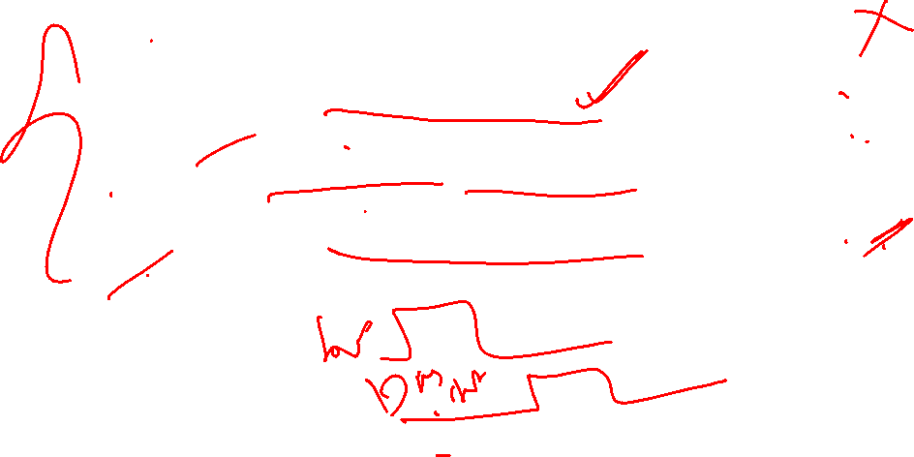
Formalize Properties
Property Name | Description
Bus legal treansitions
p_valid_inactive_transition |  | Only INACTIVE or START states follows INACTIVE
property p_valid_inactive_transition;
@(posedge clk) disable iff (bus_reset)
( bus_inactive) |=>
((bus_inactive) || (bus_start));
endproperty
assert property (p_valid_inactive_transition);
INACTIVE
sel[0] == 0
en == 0
setup
no transfer
START
sel[0] == 1
en == 0
transfer
setup
ACTIVE
sel[0] == 1
en == 1

Slide 28

Formalize Properties
Property Name | Description
Bus legal treansitions
p_valid_start_transition | Only ACTIVE state follows START
property p_valid_start_transition;
@(posedge clk) disable iff (bus_reset)
( bus_start ) |=> ( bus_active );
endproperty
assert property (p_valid_start_transition);
INACTIVE
sel[0] == 0
en == 0
setup
no transfer
START
sel[0] == 1
en == 0
transfer
setup
ACTIVE
sel[0] == 1
en == 1

Slide 29

Improved Observability
clk
I/F
I/F
rst_n
A
A
sel[0]
en
0010100101010001110101001110101010100000000011101011011011110111
addr
write
A
A
rdata
Master
wdata
Slave 0

Slide 30

Introduction to SVA
Assertions allow us to specify design intent in a way that lends itself to automation
Arbiter
clk
reset_n
grant0
grant1
req0
req1
// Assert that the grants for our simple arbiter are mutually exclusive

Slide 31

Introduction to SVA
For our arbiter example, we can write a Boolean expression for the error condition, as follows:
Arbiter
clk
reset_n
grant0
grant1
req0
req1
(grant0 & grant1) // error condition

Slide 32

Introduction to SVA
module arbiter (clk, rst_n, req0, req1, grant0, grant1);
. . .
always @(posedge clk or negedge rst_n) begin
if (rst_n != 1’b0)
if (grant0 & grant1)
$display (“ERROR: Grants not mutex”);
. . .
endmodule
Error
Condition
Boolean
Expression

Slide 33
Introduction to SVA
module arbiter (clk, rst_n, req0, req1, grant0, grant1);
. . .
assert property (@(posedge clk) disable iff (~rst_n)
!(grant0 & grant1));
. . .
endmodule

Slide 34
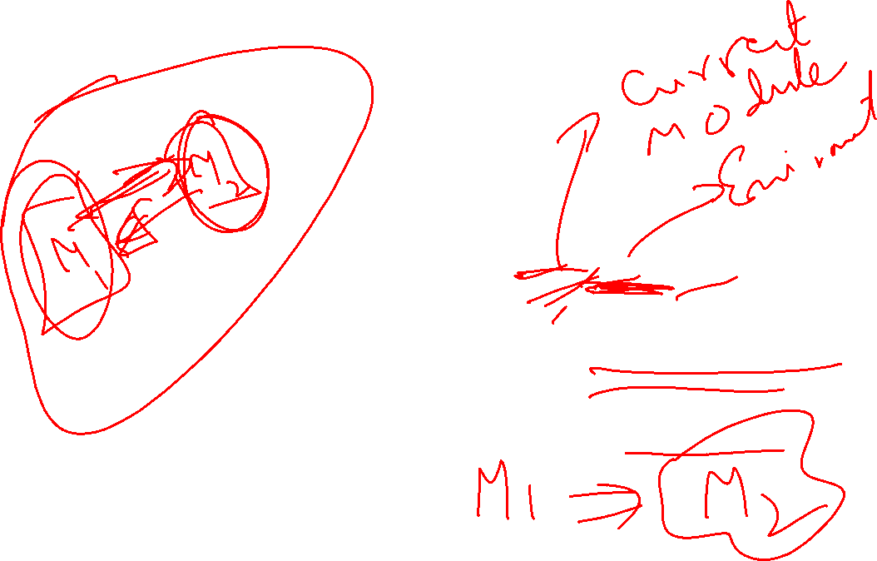
SVA Language Structure
Assertion
Units
Checker packaging
Directives
(assert, cover)
assert, assume, cover
Specification of behavior; desired or undesired
Properties
Sequences
(Sequential Expressions)
How Boolean events are related over time
Boolean Expressions
True or false
Notes:
This slide simply shows the different layers. Simply point out that booleans and sequences are used to build the properties and that these properties are used with a directive to tell the simulator what to do
with them. And both PSL and SVA have the ability to package assertions in separate files.

Slide 35
SVA Language Structure
assert
property (@(posedge clk) disable iff (~rst_n)
!(grant0 & grant1));
Assertion
Units
Directives
(assert, cover)
Properties
Sequences
(Sequential Expressions)
clk
Boolean Expressions
rst_n
!(grant0 & grant1)
error
Notes:
This slide simply shows the different layers. Simply point out that booleans and sequences are used to build the properties and that these properties are used with a directive to tell the simulator what to do
with them. And both PSL and SVA have the ability to package assertions in separate files.

Slide 36
SVA Language Structure
SVA contains two types of assertions:
  Immediate and concurrent
Immediate assertions evaluate within the context of a procedural block
  Similar to an if statement
  Check to see if a conditional expression holds
    If not, the verification tool generates an error message

Slide 37
SVA Language Structure
Immediate assertions within a procedural block
module my_arb (. . . );
. . .
always @* begin // arbiter code
. . .
if (rst_n)
assert (!(grant0 & grant1));
. . .
end
endmodule

Slide 38
SVA Language Structure
Concurrent assertions evaluate concurrently with respect to other procedural blocks
  Unlike immediate assertions that evaluate during a particular instance in which the line of procedural code containing the assertion is executed

Slide 39
SVA Language Structure
Concurrent assertions outside procedural blocks
module my_arb (. . . )
always @* begin // arbiter code
. . .
end
assert property ( @(posedge clk)
!(grant0 & grant1) );
endmodule

Slide 40
SVA Language Structure
SVA provides a mechanism to asynchronously disable an assertion during a reset using the SVA disable iff clause
assert property (@(posedge clk) disable iff (~rst_n)
!(grant0 & grant1));

Slide 41
SVA Language Structure
Sequences
  So far we have examined simple assertions
    A Boolean expression must hold at every clock
  Now we introduce SVA sequences
    Multiple Boolean expressions that
    are valuated in a linear order of
    increasing time
Assertion
Units
Directives
(assert, cover)
Properties
Sequences
(Sequential Expressions)
Boolean Expressions

Slide 42
SVA Language Structure
Sequence
  Temporal delay ##n — where n is an integer
start ##1 transfer
clk
start
transfer

Slide 43
SVA Language Structure
Sequence
  Temporal delay ##n — where n is an integer
start ##2 transfer
clk
start
transfer

Slide 44
SVA Language Structure
Sequence
  Temporal delay ## with range [m:n]
start ##[0:2] transfer
clk
start
transfer

Slide 45
SVA Language Structure
Sequence
  Consecutive repetition [*m] or [*m:n]
start[*2] ##1 transfer
clk
start
transfer

Slide 46
SVA Language Structure
Sequence
  Consecutive repetition [*m] or range [*m:n]
start[*1:2] ##1 transfer
clk
start
transfer

Slide 47
SVA Language Structure
Sequence
  Consecutive repetition [*m] or range [*m:n]
start[*1:2] ##1 transfer
clk
start
transfer

Slide 48
SVA Language Structure
Sequence
  Non-consecutive repetition [=m] or [=m:n]
start[=2] ##1 transfer
clk
start
[*0:$] represents
zero to infinity
transfer
start[=2] == !start[*0:$] ##1 start ##1 !start[*0:$] ##1 start ##1 !start[*0:$]

Slide 49
SVA Language Structure
Sequence
  Goto non-consecutive repetition [->m] or [->m:n]
start[->2] ##1 transfer
clk
start
[*0:$] represents
zero to infinity
transfer
start[->2] ➔ !start[*0:$] ##1 start ##1 !start[*0:$] ##1 start

Slide 50
SVA Language Structure
Properties
Assertion
Units
Directives
(assert, cover)
Properties
Sequences
(Sequential Expressions)
Boolean Expressions

Slide 51
SVA Language Structure
Properties
  Overlapping sequence implication operator |->
ready ##1 start |-> go ##1 done
clk
ready
start
go
done
assertion property ( @(posedge clk) ready ##1 start |-> go ##1 done );

Slide 52
SVA Language Structure
Properties
  Non-overlapping sequence implication operator |=>
ready ##1 start |=> go ##1 done
clk
ready
start
go
done
NOTE: A |=> B is the same as A |-> ##1 B

Slide 53
SVA Language Structure
Named properties and sequences
  To facilitate reuse, properties and sequences can be
  declared and then referenced by name
  Can be declared with or without parameters
sequence op_retry;
(req ##1 retry);
endsequence
sequence cache_fill(req, done, fill);
(req ##1 done [=1] ##1 fill);
endsequence

Slide 54
SVA Language Structure
Named properties and sequences
sequence s_op_retry;
(my_req ##1 my_retry);
endsequence
sequence s_cache_fill(rdy, done, fill);
(rdy ##1 done [=1] ##1 fill);
endsequence
assert property ( @(posedge clk) disable iff (!reset_n)
s_op_retry |=> s_cache_fill (my_rdy,my_done,my_fill));

Slide 55
SVA Language Structure
Named properties and sequences
property p_en_mutex(en0, en1);
@(posedge clk) disable iff (~reset_n)
~(en0 & en1);
endproperty
assert property (p_en_mutex(en[0], en[1]));

Slide 56
SVA Language Structure
System functions
  $onehot (<expression>)
    Returns true if only one bit of the expression is high
  $onehot0 (<expression>)
    Returns true if at most one bit of the expression is high
  $isunknown (<expression>)
    Returns true if any bit of the expression is X or Z
    This is equivalent to ^<expression> === ’bx

Slide 57
SVA Language Structure
System functions
$rose( expression )
$fell( expression )
$stable( expression )
$past( expression [, number_of_ticks] )

Slide 58
Introduction to SVA
Some assertions require additional modeling code
  In addition to the assertion constructs
FIFO
clk
Controller
clk
rst_n
rst_n
data_in
data_out
put
full
get
empty
// Assert that the FIFO controller cannot overflow nor underflow

Slide 59
Introduction to SVA
// assertion modeling code – not part of the design
`ifdef ASSERT_ON
int cnt = 0;
always @(posedge clk)
if (!rst_n)
cnt <= 0;
else
cnt <= cnt + push – pop;
// assert no overflow
assert property (@posedge clk disable iff (!rst_n)
!((cnt + push – pop) > `DEPTH));
// assert no underflow
assert property (@posedge clk disable iff (!rst_n) !((cnt + push - pop) < 0);
`endif

Slide 60
Introduction to SVA
SVA provides local variable support within properties and sequences
  Can eliminate the need for extra modeling code
property req_gnt;
logic [3:0] lv_id;
@(posedge clk) disable iff (~rst_n)
($rose(req), lv_id=req_id) |=> (gnt, gnt_id==lv_id);
endproperty

Slide 61
Summarize SVA Structure
assert
property (@(posedge clk) disable iff (~rst_n)
!(grant0 & grant1));
Assertion
Units
Directives
(assert, cover)
Properties
Sequences
(Sequential Expressions)
clk
Boolean Expressions
rst_n
!(grant0 & grant1)
error
Notes:
This slide simply shows the different layers. Simply point out that booleans and sequences are used to build the properties and that these properties are used with a directive to tell the simulator what to do
with them. And both PSL and SVA have the ability to package assertions in separate files.

Slide 62
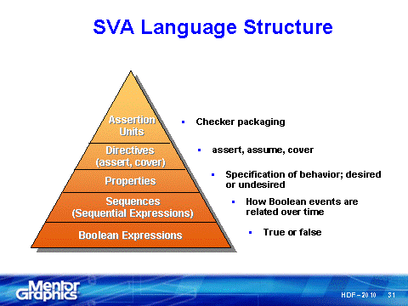
SVA Summary
Language structure
## sequence operator
Repetition operators
Overlapping |-> and
non-overlapping |=>
implication operator
Named properties
Directives: assert

