Slide 1
CS 440/ECE448 Lecture 23: Model-Based Reinforcement Learning
Mark Hasegawa-Johnson, 4/2021
Including slides by Svetlana Lazebnik, 11/2016
CC-BY 4.0: Re-use at will, but please cite the source.
By Nicolas P. Rougier - Own work, CC BY-SA 3.0, https://commons.wikimedia.org/w/index.php?curid=29327040

Slide 2
Reinforcement learning
Solving a known MDP
Given:
Transition model $P(s’| s, a)$
Reward function $R(s)$
Find:
Policy $(s)$
Reinforcement learning
Transition model and reward function initially unknown
Still need to find the right policy
“Learn by doing”

Slide 3
Reinforcement learning: Basic scheme
In each time step:
Take some action
Observe the outcome of the action: successor state and reward
Update some internal representation of the environment and policy
If you reach a terminal state, just start over (each pass through the environment is called a trial)
Notes:
See http://en.wikipedia.org/wiki/Reinforcement for discussion of reinforcement learning in psychology

Slide 4
Model-Based and Model-Free RL
Model-Based Reinforcement Learning:
Explore randomly.
At each state $s$, see what reward you get. Estimate $R(s)$ from these measurements.
At each state $s$, try some action $a$, and see what state $s’$ you end up in. Estimate $P(s’|s,a)$ from these measurements.
Once you have learned $P(s’|s,a)$ and $R(s)$ well enough, then solve the MDP to find the optimal policy, $π(s)$.
Model-Free Reinforcement Learning:
Learn a function $Q(s,a)$ = quality of action $a$ in state $s$, or…
Learn the best policy, $π(s)$, directly.
Next lecture: more about how you might accomplish these things.

Slide 5
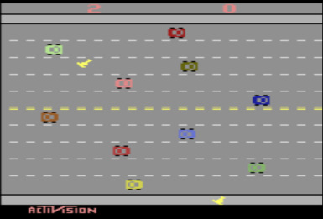
Example of model-based reinforcement learning: Playing classic Atari video games
Model-Based Reinforcement Learning for Atari (Kaiser, Babaeizadeh, Milos, Osinski, Campbell, Czechowski, Erhan, Finn, Kozakowski, Levine, Mohiuddin, Sepassi, Tucker, and Michalewski)
Blog and videos: https://sites.google.com/view/modelbasedrlatari/home
Article: https://arxiv.org/abs/1903.00374
Screenshot of the video game “Freeway,” copyright Activision. Reproduced here under the terms of fair use enumerated at https://en.wikipedia.org/w/index.php?curid=56419703

Slide 6
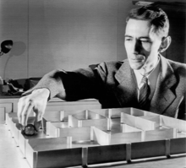
Example of model-based reinforcement learning: Theseus the Mouse
In 1950, Claude Shannon built a robot mouse named Theseus. As he explored his maze, Theseus learned:
$s=$ Position in the maze
$a=$ Forward, Left, Right, Back
$P\left(s’ | s,a\right)=1$ if the movement from $s$ to $s’$ succeeds, otherwise 0
$R\left(s\right)=1$ when Theseus reaches the end of the maze, 0 otherwise
Claude Shannon and Theseus the Mouse. Public domain image, Bell Labs.
For more information about Theseus, and for a great introduction to the goals of reinforcement learning in general (and the problem of exploration versus exploitation), I recommend this video.

Slide 7
Outline
Reinforcement learning
Model-based: learn $P(s’|s,a)$ and $R(s)$, then solve the MDP.
Model-free: learn $π(s)$ and/or $Q(s,a)$.
The observation, model, policy loop
How it works: observe at random, estimate model, optimize policy
How it can fail: an example
Exploration versus Exploitation
Epsilon-first learning: try every action, in every state, at least $ε$ times.
Epsilon-greedy learning: explore w/prob. $ε$, exploit w/prob $1−ε$.

Slide 8
Outline
Reinforcement learning
Model-based: learn $P(s’|s,a)$ and $R(s)$, then solve the MDP.
Model-free: learn $π(s)$ and/or $Q(s,a)$.
The observation, model, policy loop
How it works: observe at random, estimate model, optimize policy
How it can fail: an example
Exploration versus Exploitation
Epsilon-first learning: try every action, in every state, at least $ε$ times.
Epsilon-greedy learning: explore w/prob. $ε$, exploit w/prob $1−ε$.

Slide 9
The observation-model-policy loop
Basic idea:
Observation: Follow some initial policy, to guide your actions.
Model: Try to learn $P(s’|s,a)$ and $R(s)$.
Policy: Use your estimated $P(s’|s,a)$ and $R(s)$ to decide on a new policy, and repeat.

Slide 10
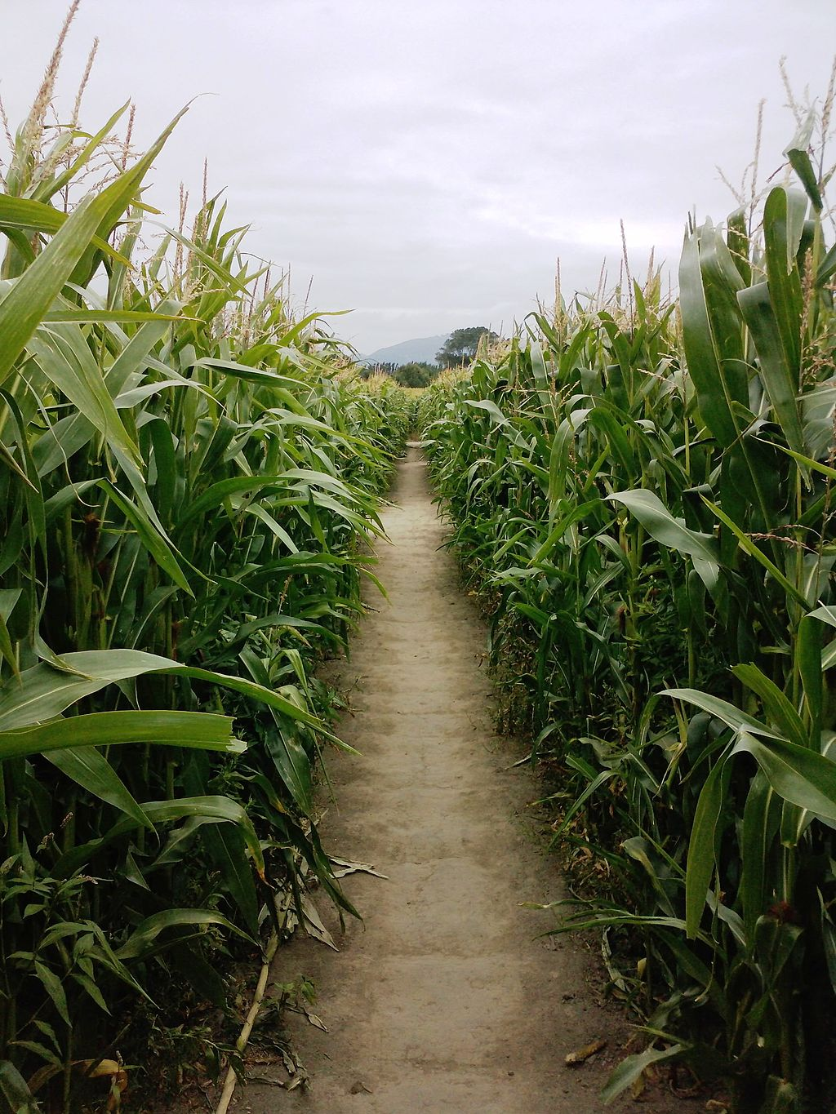
1. Observation: Follow some initial policy, and keep a record of what happens
Enter the maze…
A view from inside a corn maze near Christchurch, New Zealand
By Hugho226 - Own work, CC0, https://commons.wikimedia.org/w/index.php?curid=30724285

Slide 11
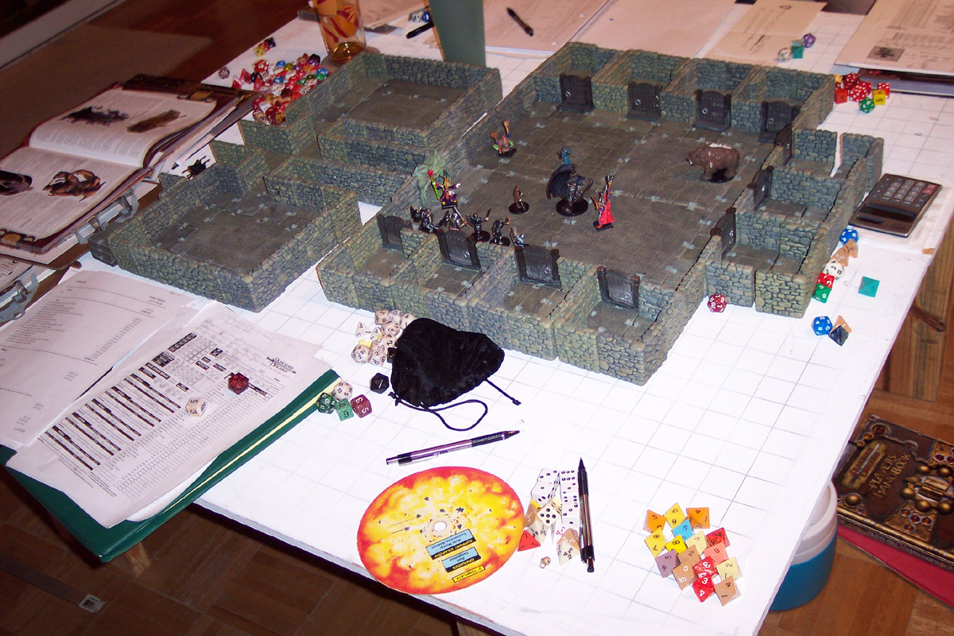
2. Model: Try to learn P(s’|s,a) and R(s)
Enter the maze…
…update your map as you go…
A view from inside a corn maze near Christchurch, New Zealand
By Hugho226 - Own work, CC0, https://commons.wikimedia.org/w/index.php?curid=30724285
By Philip Mitchell - http://www.dwarvenforge.com/dwarvenforums/viewtopic.php?pid=15595#p15595, CC BY-SA 3.0, https://commons.wikimedia.org/w/index.php?curid=1913429

Slide 12
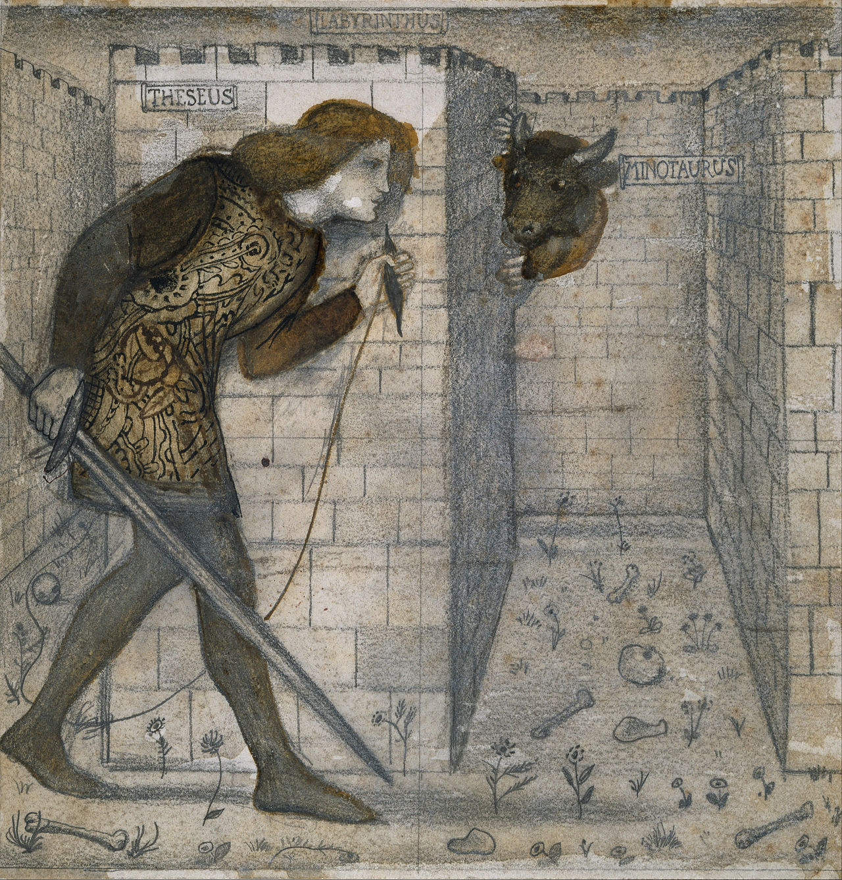
3. Policy: Solve the MDP to find a new policy
…and figure out what to do.
…update your map as you go…
By Edward Burne-Jones - lgFxdQtUgyzs7Q at Google Cultural Institute, zoom level maximum, Public Domain, https://commons.wikimedia.org/w/index.php?curid=29661124
By Philip Mitchell - http://www.dwarvenforge.com/dwarvenforums/viewtopic.php?pid=15595#p15595, CC BY-SA 3.0, https://commons.wikimedia.org/w/index.php?curid=1913429

Slide 13
1. Follow some initial policy, to guide your actions
For $t=1$ to $n$ (for some sufficiently large value of $n$):
Observe: find out what is your current state (s).
Act: use your current policy to choose an action (a).
Observe: see what state you move to (s’).
Observe: see what reward you receive (R).
If you finish the game within this many steps, start over, until you reach your desired $n$.
Keep a record of your $(s,a,s’,R)$ tuples. These are now your training database:
$$𝒟=\left\{\left(s_{1},a_{1},s_{1}^{′},R_{1}\right),\left(s_{2},a_{2},s_{2}^{′},R_{2}\right),…,(s_{n},a_{n},s_{n}^{′},R_{n})\right\}$$
By Hugho226 - Own work, CC0, https://commons.wikimedia.org/w/index.php?curid=30724285

Slide 14
2. Try to learn P(s’|s,a) and R(s)
Just like Bayesian networks! Use maximum likelihood parameter learning, possibly also with Laplace smoothing.
$$P\left(s^{′} | s,a\right)=\frac{\# times that action a in state s led to state s′}{\# times action a was performed in state s}$$
$$R\left(s\right)=R that was received when you were in state s$$
If $s$ or $a$ are continuous-valued, you’ll have to estimate these using a neural network or some other parametric model.
By Philip Mitchell - http://www.dwarvenforge.com/dwarvenforums/viewtopic.php?pid=15595#p15595, CC BY-SA 3.0

Slide 15
3. Update your policy
$$U\left(s\right)=R\left(s\right)+γ\max_{a}{\sum_{s′}{P\left(s^{′} | s,a\right)U(s^{′})}}$$
As you know from last lecture, you’ll have to use value iteration or policy iteration to solve for $π(s)$ given $P(s’|s,a)$ and $R(s)$.
By Edward Burne-Jones - lgFxdQtUgyzs7Q at Google Cultural Institute, zoom level maximum, Public Domain, https://commons.wikimedia.org/w/index.php?curid=29661124

Slide 16
Model-based reinforcement learning
Basic idea:
Observation: Follow some initial policy, to guide your actions.
Model: Try to learn P(s’|s,a) and R(s).
Policy: Use your estimated P(s’|s,a) and R(s) to decide on a new policy, and repeat.
Why does this fail?

Slide 17
Observe-Model-Policy loop
Suppose we know the states (A, B, C, …) and the actions (Right, Left, Up, Down), but we don’t know rewards or transition probabilities.
A | B | C
D | E | F
G | H | I
J | K | L

Slide 18
Observe
Start with some initial policy, e.g., “choose a direction at random.”
A | B | C
D | E | F
G | H | I
J | K | L

Slide 19
Observe
Record the sequence of actions and consequences.
A | B | C
D | E | F
G | H | I
J | K | L
s | a | s’ | R
A | Right | B | -0.04
B | Down | E | -0.04
E | Left | D | -0.04
D | Right | E | 1

Slide 20
Model
Estimate the transitions & rewards.
s | R(s)
A | -0.04
B | -0.04
D | 1
E | -0.04
Else | ?
s,a | s’ | P(s’|s,a)
A,Right | B | 1.0
A,Right | * | 0
B,Down | E | 1.0
B,Down | * | 0
D,Left | E | 1.0
D,Left | * | 0
E,Right | D | 1.0
E,Right | * | 0
Else | * | ?
A | B | C
D | E | F
G | H | I
J | K | L

Slide 21
Policy
Use value iteration or policy iteration to find the new optimal policy.
$$s$$ | $$π(s)$$
A | Right
B | Down
D | Left
E | Right
Else | ?
A | B | C
D | E | F
G | H | I
J | K | L

Slide 22
What went wrong?
If you always act according to your current estimated optimal policy, then you will never learn the consequences of any other action.
On the other hand, if you always act randomly, then you’ll never maximize reward.
How can we balance these things?

Slide 23
Outline
Reinforcement learning
Model-based: learn $P(s’|s,a)$ and $R(s)$, then solve the MDP.
Model-free: learn $π(s)$ and/or $Q(s,a)$.
The observation, model, policy loop
How it works: observe at random, estimate model, optimize policy
How it can fail: an example
Exploration versus Exploitation
Epsilon-first learning: try every action, in every state, at least $ε$ times.
Epsilon-greedy learning: explore w/prob. $ε$, exploit w/prob $1−ε$.

Slide 24
How did Theseus solve this problem?
If you’re in state $s$, and there’s an action, $a$, that you’ve never taken before while in this state, then take it.
If you’ve already taken all possible actions from this state, then choose the best one.
Continue re-estimating the model after every action. If transition probabilities change, compute a better policy.
Claude Shannon and Theseus the Mouse. Public domain image, Bell Labs.

Slide 25
Extending Theseus to stochastic environments: the epsilon-first strategy
If you have tried (state,action) combination less than $ε$ times, then try it.
Choose $ε$ so that your estimate of $P(s’|s,a)$ will have some desired precision, e.g., $ε=10$ gives precision of 0.1.
Continue re-estimating the model after every action. If transition probabilities change, compute a better policy.
Claude Shannon and Theseus the Mouse. Public domain image, Bell Labs.

Slide 26
Advantages and disadvantages of the epsilon-first strategy
Advantages:
After you’ve finished estimating the model, then you get to concentrate on maximizing reward.
Disadvantage:
Your understanding of disfavored actions will never improve, because you’ll stop using them.
Claude Shannon and Theseus the Mouse. Public domain image, Bell Labs.

Slide 27
Exploration vs. Exploitation
Exploration: take a new action with unknown consequences
Pros:
Get a more accurate model of the environment
Discover higher-reward states than the ones found so far
Cons:
When you’re exploring, you’re not maximizing your utility
Something bad might happen
Exploitation: go with the best strategy found so far
Pros:
Maximize reward as reflected in the current utility estimates
Avoid bad stuff
Cons:
Might also prevent you from discovering the true optimal strategy
“Search represents a core feature of cognition:” Exploration versus exploitation in space, mind, and society.

Slide 28
How to trade off exploration vs. exploitation
Epsilon-first strategy: when you reach state $s$, check how many times you’ve tested each of its available actions.
Explore for the first $ε$ trials: If the least-explored action has been tested fewer than $ϵ$ times, then perform that action ($ϵ$ is an integer).
Exploit thereafter: Once you’ve finished exploring, start exploiting (work to maximize your personal utility).
Epsilon-greedy strategy: in every state, every time, forever,
Explore with probability $0<ε<1$: choose any action, uniformly at random.
Exploit with probability $(1−ε)$: choose the action with the highest expected utility, according to your current estimates.
Guarantee: $P(s’|s,a)$ converges to its true value as #trials $→∞$.

Slide 29
Outline
Reinforcement learning
Model-based: learn $P(s’|s,a)$ and $R(s)$, then solve the MDP.
Model-free: learn $π(s)$ and/or $Q(s,a)$.
The observation, model, policy loop
How it works: observe at random, estimate model, optimize policy
How it can fail: an example
Exploration versus Exploitation
Epsilon-first learning: try every action, in every state, at least $ε$ times.
Epsilon-greedy learning: explore w/prob. $ε$, exploit w/prob $1−ε$.

