Slide 1
Lecture 17 – vector semantics
Mark Hasegawa-Johnson
3/29/2021
CC-BY 4.0: you may remix or redistribute if you cite the source

Slide 2
Outline
What is a word? Lemmas, wordforms, and word sense
Synonymy, similarity, and relatedness
Vector Semantics
A Neural Net solution: Word2vec
Visualizations
Bias

Slide 3
What is a word?

Slide 4
What is a word?
Is this a word?

Slide 5
What is a word?
Is this a different word, or the same word?
Is this a word?

Slide 6
What is a word?
Is this a different word, or the same word?
Is this a word?
Are these the same word, or different words?

Slide 7
Lemma
A lemma is what humans usually think of as a “word.” It is defined to be the form of the word that appears in a dictionary.
Other wordforms that can be easily predicted from the lemma need not be listed.

Slide 8
Wordform
A wordform is a unique sequence of characters.
Wordforms are much easier for computers to find than lemmas, therefore most automatic processing deals with wordforms.
…however, we lose something. “dog” and “dogs” become completely unrelated – as unrelated as “dog” and “exaggerate.”

Slide 9
Word sense
Often, a word has different meanings that are completely unrelated. We think of them as different words, that just happen to be spelled and pronounced the same way.
We say that these are different “senses” of the same word.
The Bank of England. By Diliff - Own work, CC BY-SA 3.0, https://commons.wikimedia.org/w/index.php?curid=40912212
The Bank of the Thames. By Diliff - Own work, CC BY 3.0, https://commons.wikimedia.org/w/index.php?curid=3639626

Slide 10
Wordform, lemma, and word sense
wordform
easy for a computer to work with: just look for space-bounded sequences of characters
lemma
This is what humans think of as a word. A cluster of wordforms whose spellings, pronunciations, and meanings can all be derived from one another by applying simple rules.
word sense
A meaning so distinct from the other meanings of the word that it’s hard to consider them the same word.

Slide 11
Outline
What is a word? Lemmas, wordforms, and word sense
Synonymy, similarity, and relatedness
Vector Semantics
A Neural Net solution: Word2vec
Visualizations
Bias

Slide 12
Synonymy and similarity
$$s\left(w_{1},w_{2}\right)$$
$$0.98$$
(vanish, disappear)
Words are “synonyms” if they have exactly the same meaning.
No words ever have exactly the same meaning, so no two words are ever exactly synonyms.
We prefer to talk about word similarity, $0≤s(w_{1},w_{2})≤1$
$s\left(w_{1},w_{2}\right)=1$: $w_{1}$and $w_{2}$are perfect synonyms. Never happens in practice, but sometimes close.
$s\left(w_{1},w_{2}\right)=0$: $w_{1}$and $w_{2}$are completely different.
$$0.73$$
(behave, obey)
$$0.60$$
(belief, impression)
$$0.37$$
(muscle, bone)
$$0.01$$
(modest, flexible)
$$0.003$$
(hole, agreement)

Slide 13
Algorithms that try to estimate the similarity of two wordforms can be tested on databases such as SimLex-999.
Humans rated the similarity of each word pair on a 10-point scale.

Slide 14
Similarity vs. Relatedness
Similarity
H20
water
coast
shore
$$0.9$$
Similar: words can be used interchangeably in most contexts
Related: there is some connection between the two words, such that they tend to appear in the same documents.
clothes
closet
touchdown
piano
$$0.8$$
$$0.9$$
Relatedness

Slide 15
Similarity: The Internet is the database
Similarity = words can be used interchangeably in most contexts
How do we measure that in practice?
Answer: extract examples of word $w_{1}$, +/- N words (N=2 or 3):
…hot, although iced coffee is a popular…
…indicate that moderate coffee consumption is benign…
…and of $w_{2}$:
…consumed as iced tea. Sweet tea is…
…national average of tea consumption in Ireland…
The words “iced” and “consumption” appear in both contexts, so we can conclude that $s(coffea,tea) > 0$. No other words are shared, so we can conclude $s(coffee,tea)<1$.

Slide 16
Outline
What is a word? Lemmas, wordforms, and word sense
Synonymy, similarity, and relatedness
Vector Semantics
The Neural Net solution: Word2vec
Visualizations
Bias

Slide 17
Vector semantics
If word $w_{1}$ is represented by vector ${\vec{v}}_{1}=\left[v_{11},…,v_{1D}\right]$, we say that ${\vec{v}}_{1}$ is the D-dimensional embedding of word $w_{1}$.
The general area of vector semantics (represent the meaning of a word as a vector) goes back to the 1950s, in the field of information retrieval.

Slide 18
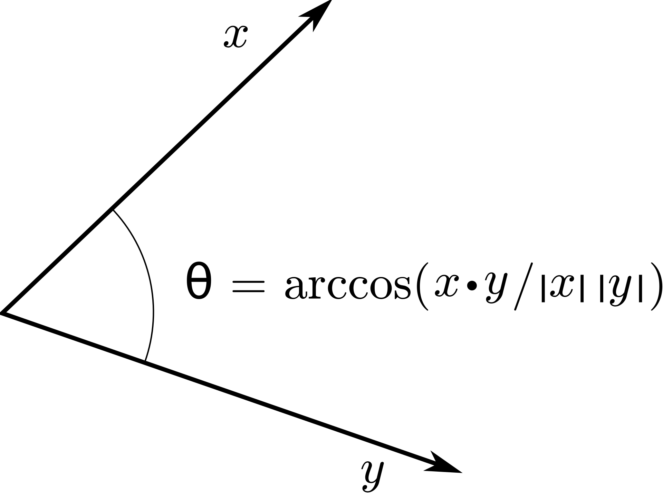
cosine similarity
If words $w_{1}$ and $w_{2}$ are similar, $w_{1}$ is represented by vector ${\vec{v}}_{1}$, and $w_{2}$ by vector ${\vec{v}}_{2}$, then the angle between the two vectors should be small.
Angle between two vectors can be measured by their dot product:
$$\cos{θ}=\frac{{\vec{v}}_{1}∙{\vec{v}}_{2}}{\left|{\vec{v}}_{1}\right|\left|{\vec{v}}_{2}\right|}$$
where
$${\vec{v}}_{1}∙{\vec{v}}_{2}=\sum_{d=1}^{D}{v_{1d}v_{2d}}, \left|{\vec{v}}_{1}\right|=\sqrt{\sum_{d=1}^{D}{v_{1d}^{2}}}$$
By BenFrantzDale at the English Wikipedia, CC BY-SA 3.0, https://commons.wikimedia.org/w/index.php?curid=49972362

Slide 19
Outline
What is a word? Lemmas, wordforms, and word sense
Synonymy, similarity, and relatedness
Vector Semantics
A Neural Net solution: Word2vec
Visualizations
Bias

Slide 20
word2vec
word2vec, or skip-gram, is an algorithm for training real-valued vectors to represent each word.
If word $w_{1}$ is represented by vector ${\vec{v}}_{1}=\left[v_{11},…,v_{1D}\right]$, we say that ${\vec{v}}_{1}$ is the D-dimensional embedding of word $w_{1}$.
The general area of vector semantics (represent the meaning of a word as a vector) goes back to the 1950s, in the field of information retrieval (more about that in the next lecture).
word2vec is an algorithm for learning those vectors using a one-layer neural network, in such a way that similar words are close together in the vector space.

Slide 21
Word2vec: context probability
The key innovation of word2vec is the idea of representing similarity as the probability that words $w_{1}$ and $w_{2}$ could occur in the same context, and of estimating the probability using a sigmoid.
Consider the “…hot although iced coffee is a popular…”.
Define the target word to be $w=$coffee.
Define the context words $c_{−3}=$hot, $c_{−2}=$although, …, $c_{3}=$popular.
Use a naïve Bayes model of the context probability:
$$p\left(c_{−3},…,c_{3} | w\right)=\prod_{\begin{aligned}i≠0 \\ i=−3\end{aligned}}^{3}{p(c_{i}|w)}$$

Slide 22
word2vec: context probability
Now suppose we want to embed $w=$coffee with a vector $\vec{v}$.
…and we want to embed $c_{−3}=$hot with a vector $\vec{c}$.
Define the probability that “hot” occurs within +/-N words of “coffee” to be just a sigmoid:
$$p\left(c | w\right)=\frac{1}{1+e^{−\vec{c}∙\vec{v}}}$$
$$p\left(c | w\right)$$
$$1$$
$$\vec{c}∙\vec{v}$$

Slide 23
word2vec: training
We train the neural network by listing, as positive examples, the words that occur in the context of “$w=$coffee,” e.g.,
$$𝒟_{+}(w)=\left\{hot,although,iced,moderate,the,hot, consumption,…\right\}$$
Create a negative database by selecting words at random from the vocabulary, each word in proportion to its frequency in the whole dataset:
$$𝒟_{−}(w)=\left\{aardvark,dog,gazebo, the,precipitates,…\right\}$$

Slide 24
word2vec: training
The coefficients ${\vec{v}}_{i}=\left[v_{i1},…,v_{iD}\right]$ for each vector are then learned in order to maximize the log probability of the dataset:
$$ℒ=\ln{p(Data)}=\sum_{w∈𝒱}{\ln{p(𝒟_{+}(w)|w)}+}\sum_{w∈𝒱}{\ln{p(𝒟_{−}(w)|w)}}$$
$$=\sum_{w∈𝒱}{\sum_{c∈𝒟_{+}(w)}{\ln{p\left(c | w\right)}}+}\sum_{w∈𝒱}{\sum_{c∈𝒟_{−}(w)}{\ln\left(1−p\left(c | w\right)\right)}}$$
$$=\sum_{\vec{v}∈𝒱}{\sum_{\vec{c}∈𝒟_{+}(w)}{\ln{\frac{1}{1+e^{−\vec{c}∙\vec{v}}}}}+}\sum_{\vec{v}∈𝒱}{\sum_{\vec{c}∈𝒟_{−}(w)}{\ln\left(1−\frac{1}{1+e^{−\vec{c}∙\vec{v}}}\right)}}$$
$$ℒ=\sum_{\vec{v}∈𝒱}{\sum_{\vec{c}∈𝒟_{+}(w)}{\ln{\frac{1}{1+e^{−\vec{c}∙\vec{v}}}}}+}\sum_{\vec{v}∈𝒱}{\sum_{\vec{c}∈𝒟_{−}(w)}{\ln{\frac{1}{1+e^{\vec{c}∙\vec{v}}}}}}$$

Slide 25
word2vec: training
The coefficients ${\vec{v}}_{i}=\left[v_{i1},…,v_{iD}\right]$ for each vector are then learned in order to maximize the log probability of the dataset:
$$v_{id}←v_{id}+η\frac{dℒ}{dv_{id}}$$
$$=v_{id}+η\frac{d}{dv_{id}}\left(\sum_{\vec{v}∈𝒱}{\sum_{\vec{c}∈𝒟_{+}(w)}{\ln{\frac{1}{1+e^{−\vec{c}∙\vec{v}}}}}+}\sum_{\vec{v}∈𝒱}{\sum_{\vec{c}∈𝒟_{−}(w)}{\ln{\frac{1}{1+e^{\vec{c}∙\vec{v}}}}}}\right)$$
There’s one more issue to consider here: if the word coffee occurs as a center word (w=coffee) or a context word (c=coffee), should those vectors ($\vec{v}$ and $\vec{c}$, respectively) be the same vector, or different vectors? The results are slightly different; which one is better depends on the application for which you’re training word2vec.

Slide 26
Outline
What is a word? Lemmas, wordforms, and word sense
Synonymy, similarity, and relatedness
Vector Semantics
A Neural Net solution: Word2vec
Visualizations
Bias

Slide 27
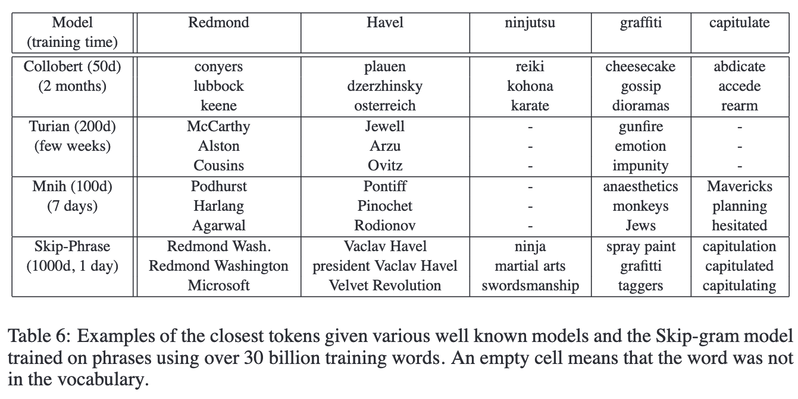
Visualizations: Similarity
Mikolov et al. (2013) tested word2vec on SimLex-999, and had better results than previously published baselines. Here are some examples from their paper. Notice that not all of their ”similar words” are really similar – some are just related. I’ll talk more about that next time.

Slide 28
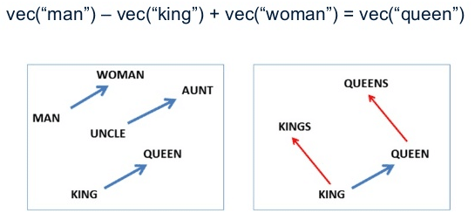
Visualizations: Relatedness
vec(“woman”) - vec(“man”) + vec(“king”) = vec(“queen”)
Christian S. Perone, "Voynich Manuscript: word vectors and t-SNE visualization of some patterns," in Terra Incognita, 16/01/2016, http://blog.christianperone.com/2016/01/voynich-manuscript-word-vectors-and-t-sne-visualization-of-some-patterns/.
Mikolov (2013) showed that word2vec captures similarity relationships among words. For example, the difference between the vectors for “woman” and “man” is roughly the same as the difference between the vectors for “queen” and “king.” Perone (2016) showed that this effect works differently depending on the training corpus: in his blog post, he looks at word relatedness in the 15th century Voynich manuscript.

Slide 29
Outline
What is a word? Lemmas, wordforms, and word sense
Synonymy, similarity, and relatedness
Vector Semantics
A Neural Net solution: Word2vec
Visualizations
Bias

Slide 30
Learning biased analogies from data
It’s useful that algorithms like word2vec learn appropriate analogies, like “Paris $→$ France as Tokyo $→$Japan” and “kings $→$ king as queens $→$ queen.”
Unfortunately, it also learns other analogies that were implied in the training corpus, but that are invalid analogies.
The paper that first demonstrated that problem was named after one of the worst such discovered analogies:
“Man is to Computer Programmer as Woman is to Homemaker? Debiasing Word Embeddings,” Bolukbasi et al., 2016

Slide 31
Biased analogies
Bolukbasi et al. defined a “male-female” continuum by subtracting vec(female)-vec(male), vec(woman)-vec(man), and so on, then averaging these difference vectors.
They then took all of the words whose dictionary definitions included gender-specific language (man, woman), and considered those to be the gender-specific words (words for which a gender difference is appropriate).
All other words were considered gender-neutral (any difference on the male-female dimension is inappropriate).
The result is a second dimension: the appropriateness of a gender bias.

Slide 32
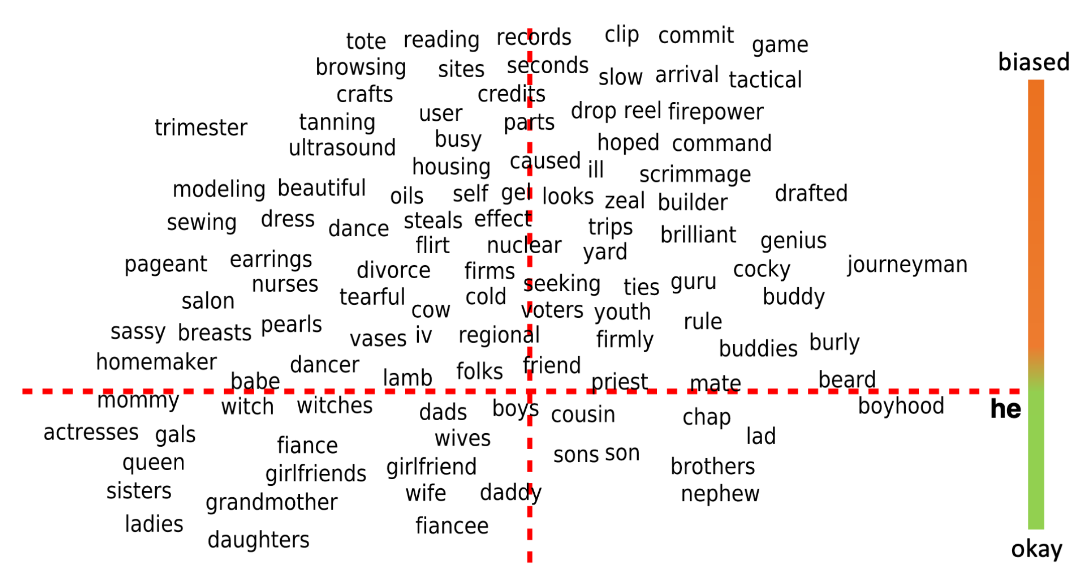
The Male-Female vs. Neutral-Specific Space
Here’s the resulting 2D space, from Bolukbasi et al., 2016:
she

Slide 33
Outline
What is a word? Lemmas, wordforms, and word sense
Synonymy, similarity, and relatedness
Word2vec: maximize
$$ℒ=\sum_{\vec{v}∈𝒱}{\sum_{\vec{c}∈𝒟_{+}(w)}{\ln{\frac{1}{1+e^{−\vec{c}∙\vec{v}}}}}+}\sum_{w∈𝒱}{\sum_{\vec{c}∈𝒟_{−}(w)}{\ln{\frac{1}{1+e^{\vec{c}∙\vec{v}}}}}}$$
Visualizations
Similarity: list the K-nearest neighbors, show that they are similar
Relatedness: analogies are shown as directions in the vector space!
Bias
Bias can be reduced by learning a direction that should not depend on the female-male axis, and then squashing the female-male axis to zero for words that should be gender-neutral.

