Slide 1
CS440/ECE448 Lecture 11: Exam 1 Review
3/3/2021

Slide 2
Topics covered
Lecture 2: Search
Lecture 3: A*
Lecture 4: Heuristics
Lecture 5: Probability
Lecture 6: Naïve Bayes
Lecture 7: Classifiers

Slide 3
Lecture 2: Search
Search in general:
State: enough info to decide if you’re at the goal state
Node: state + information about the path taken to get here (tree search)
Frontier
Explored Set/Explored Dict
Breadth-first search (BFS):
Frontier is a FIFO queue
Time complexity and space complexity are both $O\{b^{d}\}$.
Optimal, if each action has the same cost.
Depth-first search (DFS):
Frontier is a LIFO stack
Time complexity is $O\{b^{m}\}$, but space complexity is only $O\{mb\}$.
Not optimal. Not even complete.

Slide 4
Lecture 3: A*
Uniform Cost Search: Like BFS, but for variable-cost actions
Frontier is a priority queue, sorted by g(n)
Finds the optimal path
Greedy Search
Frontier is a priority queue, sorted by h(n)
Not optimal. Not even complete.
A* Search:
Frontier is a priority queue, sorted by f(n)=g(n)+h(n)
Optimal and complete, as long as h(n) is admissible

Slide 5
Lecture 4: Heuristics
Consistent
If heuristic is consistent, A* works with an explored set
With an inconsistent heuristic, A* works (1) with an explored dict, or (2) with neither an explored set nor an explored dict.
Zero = UCS
Dominant
Designing a heuristic by simplifying the problem
Dominant heuristic as the max of many heuristics

Slide 6
Lecture 5: Probability
Axioms of probability: non-negative, max 1, probability of union
Events
Random variables
Conditional probability
Marginal probability
Independence
Conditional Independence

Slide 7
Lecture 6: Naïve Bayes
Class labels and observations
Using Bayes’ rule to estimate the most probable class label
The naïve Bayes assumption: observations conditionally independent given the class label
Maximum likelihood estimation of the model parameters
Laplace smoothing

Slide 8
Lecture 7: Classifiers
The Bayesian classifier: MAP = MPE
False alarms, missed detections, and confusion matrix
Training a classifier, choosing a classifier, evaluating a classifier
Nearest-neighbor classifier
Linear classifiers
Implementation of symbolic logic using a linear classifier

Slide 9
Some sample problems, from the practice exam
Question 5: BFS, DFS, UCS, A*
Question 8: Axioms of probability
Question 6: Naïve Bayes

Slide 10
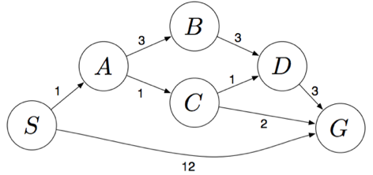
Question 5: BFS, DFS, UCS and A*
S denotes the start state, G denotes the goal state, step costs are written next to each arc. Assume that ties are broken alphabetically.

Slide 11
5(a): What path does BFS return?
Frontier starts with {S}
S is popped, A and G are inserted, so it contains {A,G}
A is popped, B and C are inserted, so it contains {G,B,C}
G is popped. It is the goal state.
Answer: S,G

Slide 12
5(b): What path does DFS return?
Frontier starts with {S}
S is popped, A and G are inserted, so it contains {A,G}
A is popped, B and C are inserted, so it contains {B,C,G}
B is popped, D is inserted, so it contains {D,C,G}
D is popped, G is inserted, so it contains {G,D,C,G}
G is popped. It is the goal state.
Answer: S,A,B,D,G

Slide 13
5(c): What path does UCS return?
Frontier starts with {0:S}
S is popped, A and G are inserted, so it contains {1:A,12:G}
A is popped, B and C are inserted, so it contains {2:C,4:B,12:G}
C is popped, D and G are inserted, so frontier contains {3:D,4:B,4:G,12:G}
D is popped, G is inserted, so frontier contains {4:B,4:G,6:G,12:G}
B is popped, and if there is no explored set, D is inserted, so frontier contains {4:G, 6:G, 7:D, 12:G}
G is popped. It is the goal.
Answer: S,A,C,G – the optimal path

Slide 14
5(d): Heuristic h1
Heuristic h1 has the following values:
h1(S)=5, h1(A)=3, h1(B)=6, h1(C)=2, h1(D)=3, h1(G)=0
Is it admissible?
No. h1(S) = 5, but d(S)=4.
Is it consistent?
No. An inadmissible heuristic is never consistent.

Slide 15
5(d): Heuristic h2
Heuristic h2 has the following values:
h2(S)=4, h2(A)=2, h2(B)=6, h2(C)=1, h2(D)=3, h2(G)=0
Is it admissible?
Yes. h2(n) <= d(n) for all nodes n.
Is it consistent?
No. d(S)-d(A)=1, but h2(S)-h2(A)=2.

Slide 16
Question 8: Axioms of probability
Use the axioms of probability to prove that P(¬A) = 1−P(A).

Slide 17
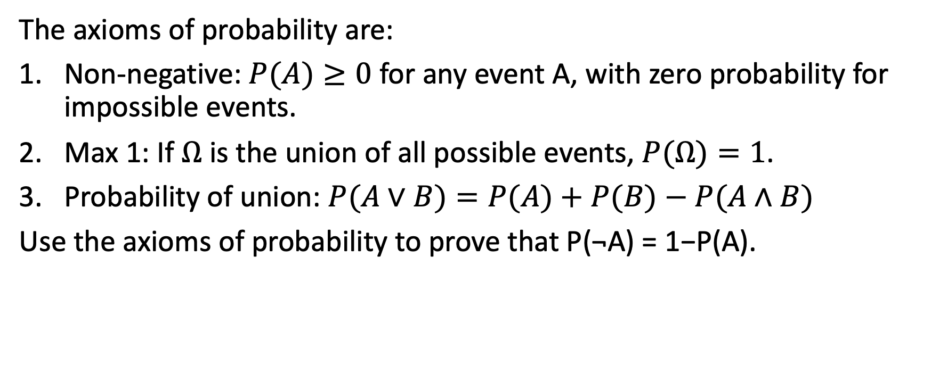
Question 8: Axioms of probability
The axioms of probability are:
Non-negative: $P(A)≥0$ for any event A, with zero probability for impossible events.
Max 1: If $Ω$ is the union of all possible events, $P(Ω)=1$.
Probability of union: $P(A∨B)=P(A)+P(B)−P(A∧B)$
Use the axioms of probability to prove that P(¬A) = 1−P(A).

Slide 18
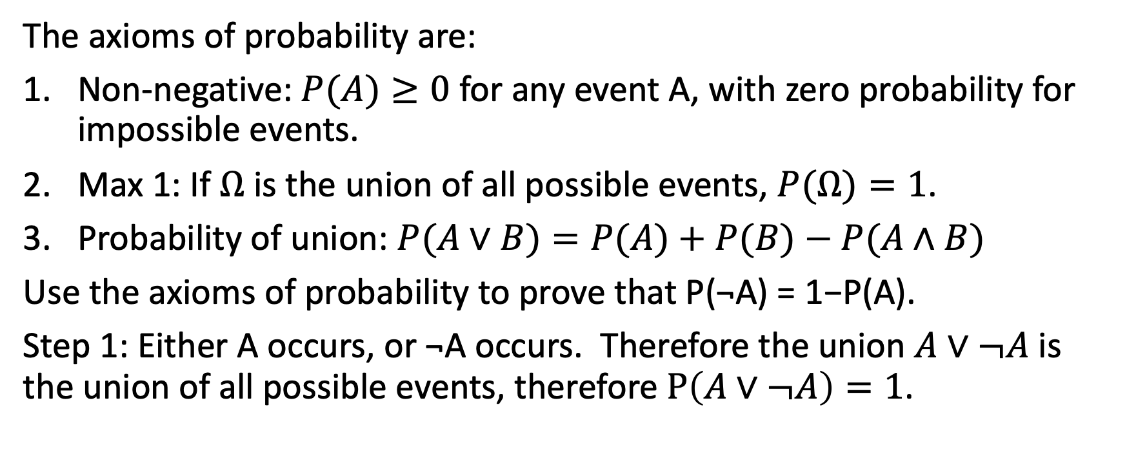
Question 8: Axioms of probability
The axioms of probability are:
Non-negative: $P(A)≥0$ for any event A, with zero probability for impossible events.
Max 1: If $Ω$ is the union of all possible events, $P(Ω)=1$.
Probability of union: $P(A∨B)=P(A)+P(B)−P(A∧B)$
Use the axioms of probability to prove that P(¬A) = 1−P(A).
Step 1: Either A occurs, or ¬A occurs. Therefore the union $A∨¬A$ is the union of all possible events, therefore $P\left(A∨¬A\right)=1$.

Slide 19
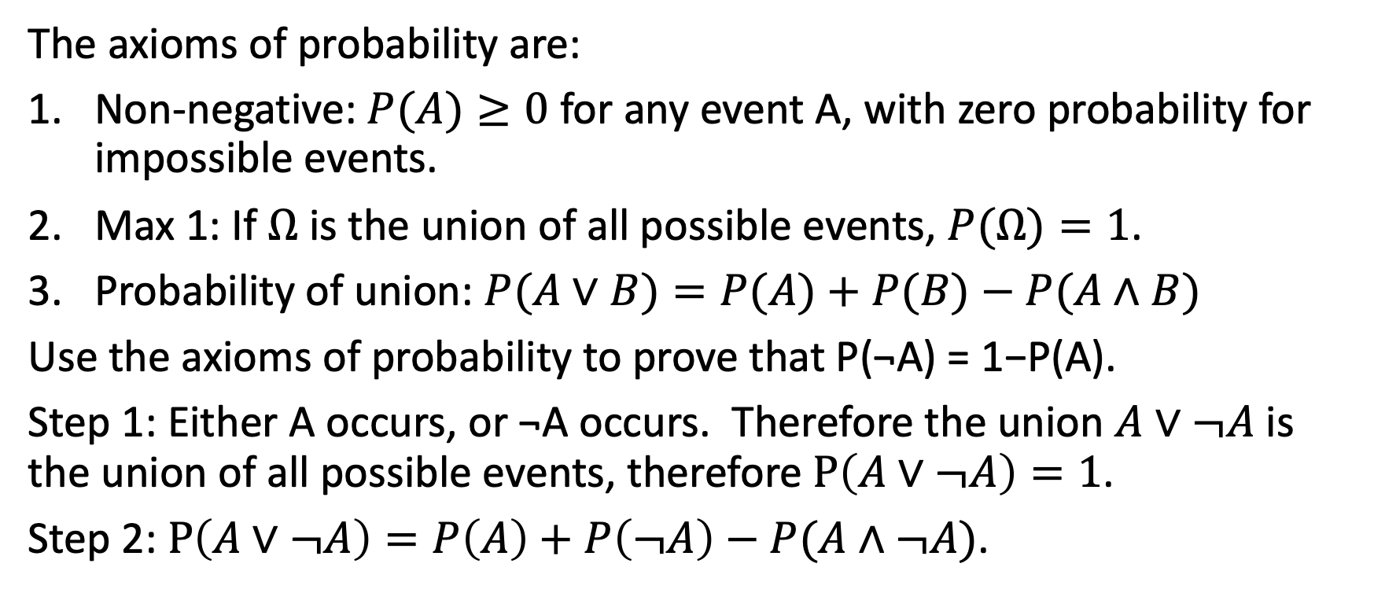
Question 8: Axioms of probability
The axioms of probability are:
Non-negative: $P(A)≥0$ for any event A, with zero probability for impossible events.
Max 1: If $Ω$ is the union of all possible events, $P(Ω)=1$.
Probability of union: $P(A∨B)=P(A)+P(B)−P(A∧B)$
Use the axioms of probability to prove that P(¬A) = 1−P(A).
Step 1: Either A occurs, or ¬A occurs. Therefore the union $A∨¬A$ is the union of all possible events, therefore $P\left(A∨¬A\right)=1$.
Step 2: $P\left(A∨¬A\right)=P\left(A\right)+P\left(¬A\right)−P(A∧¬A)$.

Slide 20
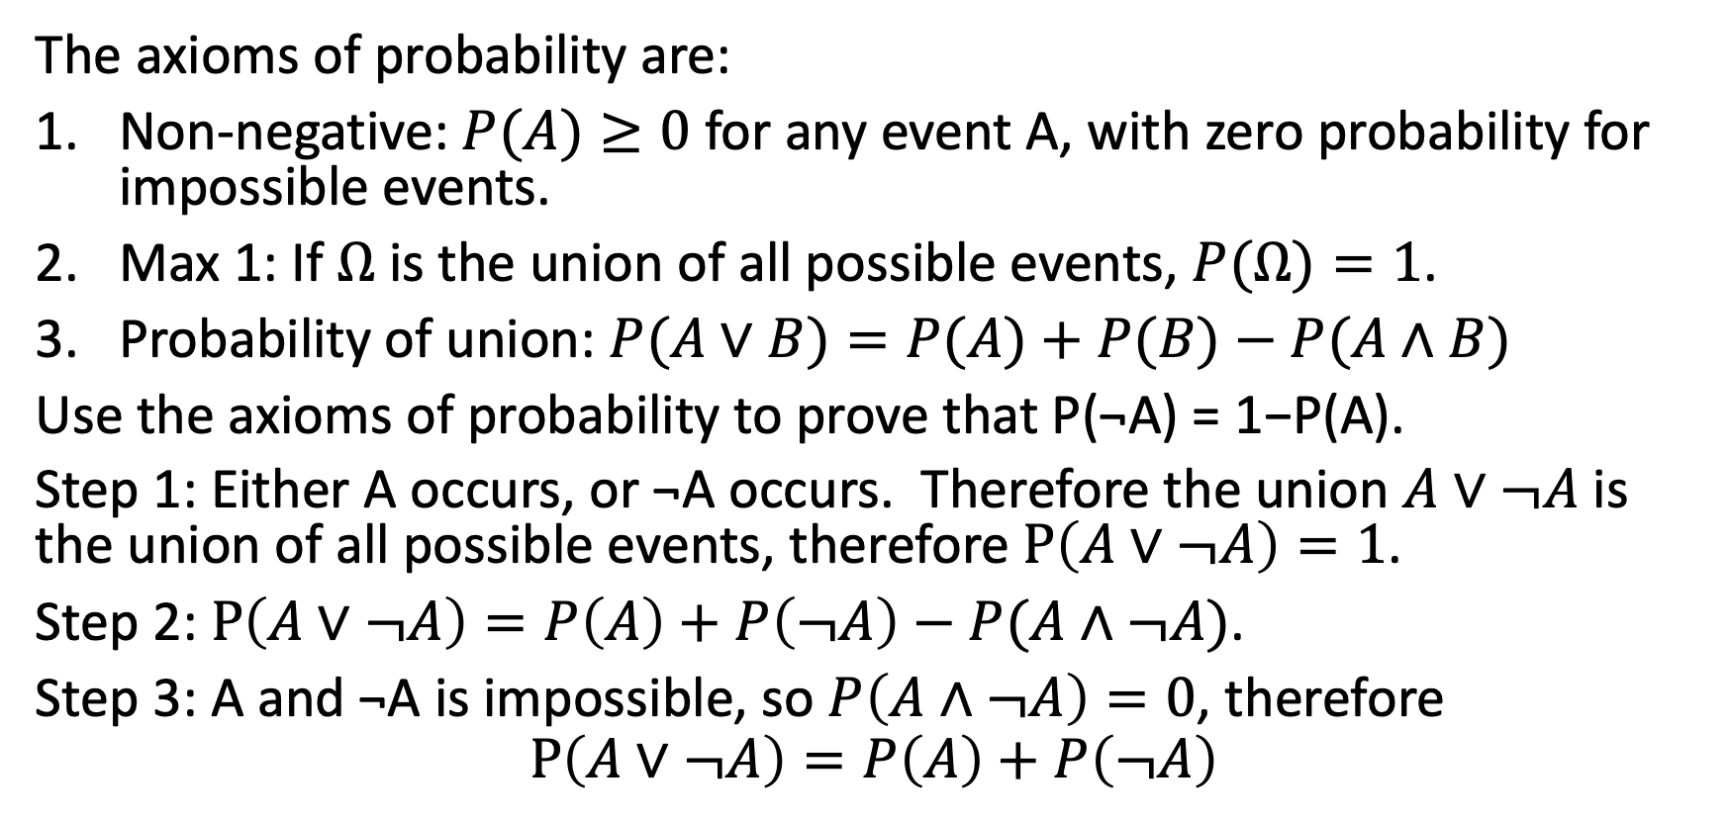
Question 8: Axioms of probability
The axioms of probability are:
Non-negative: $P(A)≥0$ for any event A, with zero probability for impossible events.
Max 1: If $Ω$ is the union of all possible events, $P(Ω)=1$.
Probability of union: $P(A∨B)=P(A)+P(B)−P(A∧B)$
Use the axioms of probability to prove that P(¬A) = 1−P(A).
Step 1: Either A occurs, or ¬A occurs. Therefore the union $A∨¬A$ is the union of all possible events, therefore $P\left(A∨¬A\right)=1$.
Step 2: $P\left(A∨¬A\right)=P\left(A\right)+P\left(¬A\right)−P(A∧¬A)$.
Step 3: A and ¬A is impossible, so $P\left(A∧¬A\right)=0$, therefore
$$P\left(A∨¬A\right)=P\left(A\right)+P\left(¬A\right)$$

Slide 21
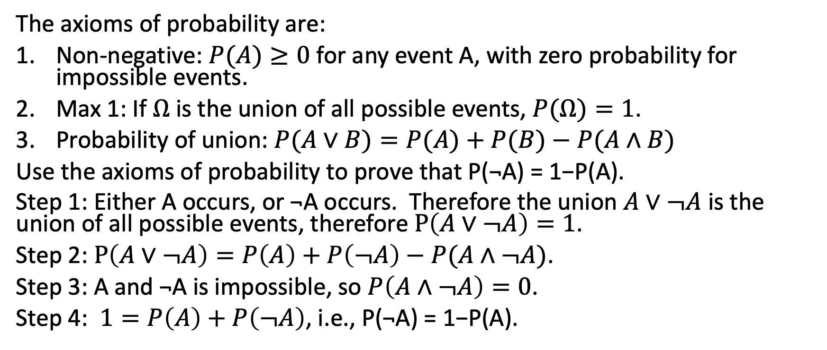
Question 8: Axioms of probability
The axioms of probability are:
Non-negative: $P(A)≥0$ for any event A, with zero probability for impossible events.
Max 1: If $Ω$ is the union of all possible events, $P(Ω)=1$.
Probability of union: $P(A∨B)=P(A)+P(B)−P(A∧B)$
Use the axioms of probability to prove that P(¬A) = 1−P(A).
Step 1: Either A occurs, or ¬A occurs. Therefore the union $A∨¬A$ is the union of all possible events, therefore $P\left(A∨¬A\right)=1$.
Step 2: $P\left(A∨¬A\right)=P\left(A\right)+P\left(¬A\right)−P(A∧¬A)$.
Step 3: A and ¬A is impossible, so $P\left(A∧¬A\right)=0$.
Step 4: $1=P\left(A\right)+P\left(¬A\right)$, i.e., P(¬A) = 1−P(A).

Slide 22
Question 6: Naïve Bayes
You’re creating a sentiment classifier. Let Y=1 for positive sentiment, Y=0 for negative sentiment. You have a training corpus with four movie reviews:
Index | Sentiment | Review
1 | 1 | what a great movie
2 | 1 | I love this film
3 | 0 | what a horrible movie
4 | 0 | I hate this film

Slide 23
Question 6(a-b)
Index | Sentiment | Review
1 | 1 | what a great movie
2 | 1 | I love this film
3 | 0 | what a horrible movie
4 | 0 | I hate this film
What’s the maximum likelihood estimate of P(Y=1)?
Solution: 2/4
(b) What are maximum likelihood estimates of P(W|Y=0) and P(W|Y=1)?
Solution: each part of the corpus has 8 words, so ML estimates are:
 | P(W|Y)
Y | what | a | movie | I | this | film | great | love | horrible | hate
1 | 1/8 | 1/8 | 1/8 | 1/8 | 1/8 | 1/8 | 1/8 | 1/8 | 0 | 0
0 | 1/8 | 1/8 | 1/8 | 1/8 | 1/8 | 1/8 | 0 | 0 | 1/8 | 1/8

Slide 24
Question 6(c)
Index | Sentiment | Review
1 | 1 | what a great movie
2 | 1 | I love this film
3 | 0 | what a horrible movie
4 | 0 | I hate this film
Use Laplace smoothing, with k=1.
Solution: add 10 to each denominator, and 1 to each numerator:
 | P(W|Y)
Y | what | a | movie | I | this | film | great | love | horrible | hate
1 | 2/18 | 2/18 | 2/18 | 2/18 | 2/18 | 2/18 | 2/18 | 2/18 | 1/18 | 1/18
0 | 2/18 | 2/18 | 2/18 | 2/18 | 2/18 | 2/18 | 1/18 | 1/18 | 2/18 | 2/18

Slide 25
Question 6(d)
Using methods unknown to your, your professor has come up with the following estimates:
 | P(W|Y
Y | great | love | horrible | hate
1 | 0.01 | 0.01 | 0.005 | 0.005
0 | 0.005 | 0.005 | 0.01 | 0.01
…and P(Y=1)=0.5. All other words are “out of vocabulary;” you can treat them as if they had P(W|Y=0)=P(W|Y=1)=1. Under these assumptions, what is the probability that the following review is a positive review:
I’m horrible fond of this movie, and I hate anyone who insults it.

Slide 26
Question 6(d) Solution
 | P(W|Y
Y | great | love | horrible | hate
1 | 0.01 | 0.01 | 0.005 | 0.005
0 | 0.005 | 0.005 | 0.01 | 0.01
I’m horrible fond of this movie, and I hate anyone who insults it.
Solution:
The only words not “out of vocabulary” are “horrible” and “hate.” We have
P(Y=0,horrible,hate)=P(Y=0)P(horrible|Y=0)P(hate|Y=0) = 0.5(0.01)(0.01)
P(Y=1,horrible,hate)=P(Y=1)P(horrible|Y=1)P(hate|Y=1) = 0.5(0.005)(0.005)
Using Bayes’ rule:
$$P\left(Y=1 | horrible,hate\right)=\frac{\text{0.5(0.005)(0.005) }}{\text{0.5(0.005)(0.005})+\text{0.5(0.01)(0.01) }}$$

Slide 27
Topics covered
Lecture 2: Search
Lecture 3: A*
Lecture 4: Heuristics
Lecture 5: Probability
Lecture 6: Naïve Bayes
Lecture 7: Classifiers

