Slide 1
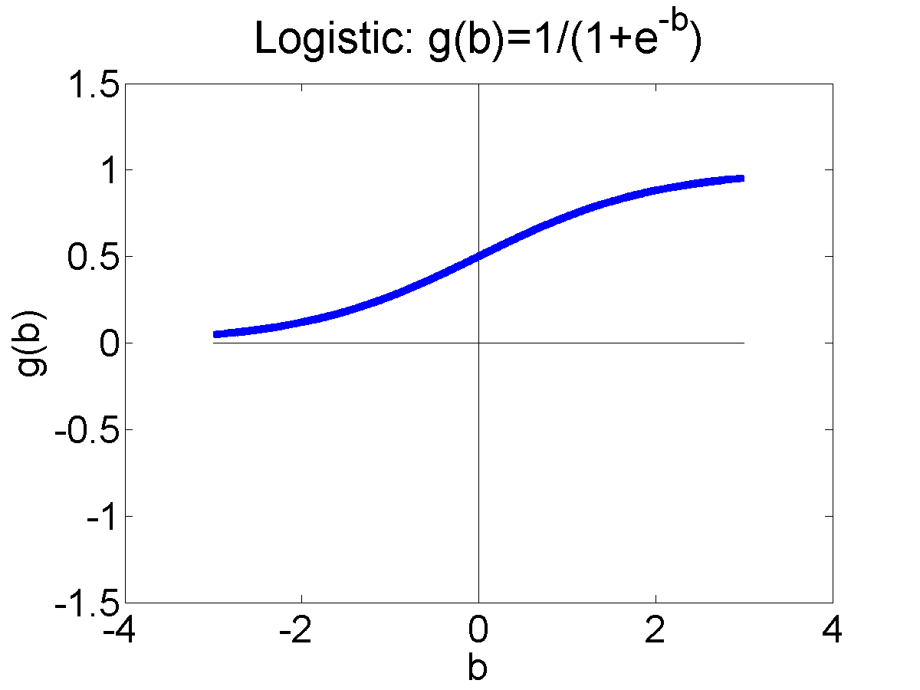
CS440/ECE448 Lecture 09: Logistic Regression
Mark Hasegawa-Johnson, 2/2021
License: CC-BY 4.0

Slide 2
Outline
Advantages and disadvantages of the perceptron
Probabilistic-boundary classifiers
How do you maximize a function?
Learning a logistic regression
Two-class logistic regression

Slide 3
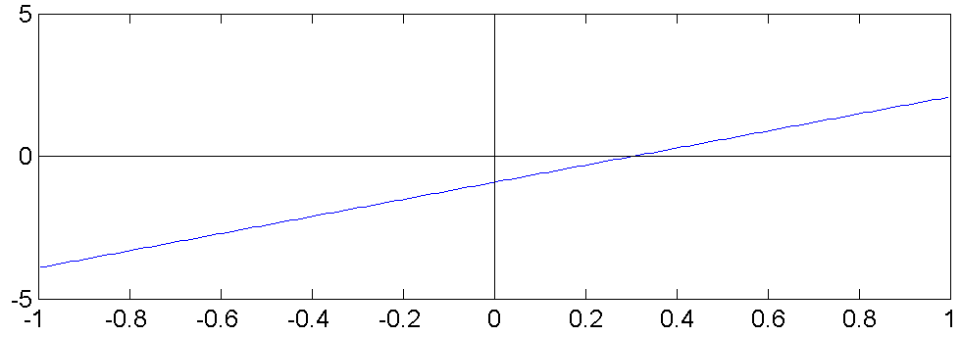
Linear Classifiers in General
Consider the classifier
$$\hat{y}=u\left(b+\sum_{j=1}^{D}{w_{j}x_{j}}\right)$$
This is called a “linear classifier” because the boundary between the two classes is a line.
$$\hat{y}=0$$
$$x_{2}$$
$$\hat{y}=1$$
$$x_{1}$$

Slide 4
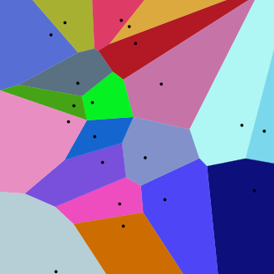
Multi-Class Linear Classifiers
$$x_{2}$$
$$\hat{y}=1$$
$$\hat{y}=2$$
$$\hat{y}=3$$
All multi-class linear classifiers have the form
$$\hat{y}={argmax}_{c=0}^{V−1}\left(w_{c}^{T}x\right)$$
The region of x-space associated with each class label is convex with piece-wise linear boundaries. Such regions are called “Voronoi regions.”
$$\hat{y}=4$$
$$\hat{y}=0$$
$$\hat{y}=5$$
$$\hat{y}=6$$
$$\hat{y}=8$$
$$\hat{y}=9$$
$$\hat{y}=10$$
$$\hat{y}=11$$
$$\hat{y}=12$$
$$\hat{y}=13$$
$$\hat{y}$$
$$=7$$
$$\hat{y}=14$$
$$\hat{y}=15$$
$$\hat{y}=16$$
$$\hat{y}=17$$
$$\hat{y}=18$$
$$\hat{y}=19$$
By Balu Ertl - Own work, CC BY-SA 4.0, https://commons.wikimedia.org/w/index.php?curid=38534275
$$x_{1}$$

Slide 5
Training a Multi-Class Perceptron
For each training instance $x$ w/ground truth label $y∈\{0,1,…,V−1\}$:
Classify with current weights: $\hat{y}={argmax}_{c=0}^{V−1}\left(w_{c}^{T}x\right)$
Update weights:
if $\hat{y}$ is correct ($y=\hat{y}$) then do nothing
If $\hat{y}$ is incorrect ($y≠\hat{y}$) then:
Update the correct-class vector as $w_{y}=w_{y}+ηx$
Update the wrong-class vector as $w_{\hat{y}}=w_{\hat{y}}−ηx$
Don’t change the vectors of any other class

Slide 6
Multi-class perceptron: advantages and disadvantages
ADVANTAGE: If the classes are linearly separable, then multi-class perceptron algorithm will find a set of linear functions that separate them
DISADVANTAGE: If the classes are not linearly separable, then the $w_{c}$ converge only if we force $η$ to decay to zero ($η=\frac{1}{n}$for the n^{th} training token). After they’ve converged, we don’t know exactly how good or how bad the resulting $w_{c}$ are.

Slide 7
Outline
Advantages and disadvantages of the perceptron
Probabilistic-boundary classifiers
How do you maximize a function?
Learning a logistic regression
Two-class logistic regression

Slide 8
Probabilistic boundaries
Instead of trying to find the exact boundaries, logistic regression models the probability that token x belongs to class y.
$$x_{2}$$
In this region,
$$P\left(Y=1 | X=x\right)≈1$$
$$x_{1}$$
In this region,
$$P\left(Y=1 | X=x\right)≈0$$
In this region,
$$0<P\left(Y=1 | X=x\right)<1$$

Slide 9
Logistic regression and the softmax function
Perceptron: $\hat{y}={argmax}_{c=0}^{V−1}\left(w_{c}^{T}x\right)$
Logistic regression: $P(Y=c|X=x)={softmax}_{c=0}^{V−1}\left(w_{c}^{T}x\right)$
where the “softmax” function is defined as
$${softmax}_{c=0}^{V−1}\left(w_{c}^{T}x\right)=\frac{e^{w_{c}^{T}x}}{\sum_{k=0}^{V−1}{e^{w_{k}^{T}x}}}$$

Slide 10
Logistic regression and the softmax function
$$P\left(Y=c | X=x\right)={softmax}_{c=0}^{V−1}\left(w_{c}^{T}x\right)=\frac{e^{w_{c}^{T}x}}{\sum_{k=0}^{V−1}{e^{w_{k}^{T}x}}}$$
The exponential function ($e^{w_{c}^{T}x}$, sometimes written as $exp⁡(w_{c}^{T}x)$) guarantees that $P\left(Y=c | X=x\right)$ is a positive number.
The sum, in the denominator, guarantees that
$$1=\sum_{c=0}^{V−1}{P\left(Y=c | X=x\right)}$$

Slide 11
Learning logistic regression
Suppose we have some data.
We want to learn vectors $w_{c}={\left[w_{c1},…,w_{cD}\right]}^{T}$ so that $P\left(Y=c | X=x\right)={softmax}_{c=0}^{1}\left(w_{c}^{T}x\right)$.
$$x_{i2}$$
$$x_{i1}$$

Slide 12
Learning logistic regression: Training data
Data:
$$𝔇=\left\{\left(x_{1},y_{1}\right),\left(x_{2},y_{2}\right),…,\left(x_{n},y_{n}\right)\right\}$$
where each $x_{i}={\left[x_{i1},…,x_{iD}\right]}^{T}$ is a vector, and each $y_{i}$ is an integer class label, $0≤y_{i}≤V−1$.
$$(x_{1},y_{1}=0)$$
$$x_{i2}$$
$$(x_{2},y_{2}=1)$$
$$(x_{3},y_{3}=1)$$
$$x_{i1}$$
$$(x_{4},y_{4}=0)$$

Slide 13
Learning logistic regression: Model parameters
We want to learn the model parameters
$$θ=\left\{w_{0},…,w_{V−1}\right\}$$
so that
$$P\left(Y=y_{i} | X=x_{i}\right)=\operatorname{softmax}\left(w_{y_{i}}^{T}x_{i}\right)$$
$$(x_{1},y_{1}=0)$$
$$x_{i2}$$
$$(x_{2},y_{2}=1)$$
$$(x_{3},y_{3}=1)$$
$$x_{i1}$$
$$(x_{4},y_{4}=0)$$

Slide 14
Learning logistic regression: Training criterion
We want to learn the model parameters, $θ=\left\{w_{0},…,w_{V−1}\right\}$, in order to maximize the probability of the observed data:
$$P\left(𝔇 | θ\right)=\prod_{i=1}^{n}{P\left(Y=y_{i}|X=x_{i}\right)}$$
$$x_{i2}$$
$$(x_{2},y_{2}=1)$$
$$(x_{3},y_{3}=1)$$
$$x_{i1}$$
$$(x_{4},y_{4}=0)$$

Slide 15
Learning logistic regression
We want to learn the model parameters, $θ=\left\{w_{0},…,w_{V−1}\right\}$, in order to maximize the probability of the observed data:
$$P\left(𝔇 | θ\right)=\prod_{i=1}^{n}{\operatorname{softmax}\left(w_{y_{i}}^{T}x_{i}\right)}$$
$$x_{i2}$$
$$(x_{2},y_{2}=1)$$
$$(x_{3},y_{3}=1)$$
$$x_{i1}$$
$$(x_{4},y_{4}=0)$$

Slide 16
Learning logistic regression
We want to learn the model parameters, $θ=\left\{w_{0},…,w_{V−1}\right\}$, in order to maximize the probability of the observed data:
$$P\left(𝔇 | θ\right)=\prod_{i=1}^{n}{\frac{\exp\left(w_{y_{i}}^{T}x_{i}\right)}{\sum_{k=0}^{V−1}{\exp\left(w_{k}^{T}x_{i}\right)}}}$$
$$x_{i2}$$
$$(x_{2},y_{2}=1)$$
$$(x_{3},y_{3}=1)$$
$$x_{i1}$$
$$(x_{4},y_{4}=0)$$

Slide 17
Outline
Advantages and disadvantages of the perceptron
Probabilistic-boundary classifiers
How do you maximize a function?
Learning a logistic regression
Two-class logistic regression

Slide 18
How do you maximize a function?
Our goal is to find $θ=\left\{w_{0},…,w_{V−1}\right\}$ in order to maximize
$$P\left(𝔇 | θ\right)=\prod_{i=1}^{n}{\frac{\exp\left(w_{y_{i}}^{T}x_{i}\right)}{\sum_{k=0}^{V−1}{\exp\left(w_{k}^{T}x_{i}\right)}}}$$
Here are some things you know:
Logarithm turns products into sums.
Gradient ascent: if you want to find $θ$ in order to maximize $f(θ)$, you take a step in the direction $+∇_{θ}f$.

Slide 19
How do you maximize minimize a function?
Our goal is to find $θ=\left\{w_{0},…,w_{V−1}\right\}$ in order to maximize
$$𝔏=−\log{P\left(𝔇 | θ\right)}=−\log{\prod_{i=1}^{n}{\frac{\exp\left(w_{y_{i}}^{T}x_{i}\right)}{\sum_{k=0}^{V−1}{\exp\left(w_{k}^{T}x_{i}\right)}}}}$$
Here are some things you know:
Logarithm turns products into sums.
Gradient ascent descent: if you want to find $θ$ in order to maximize minimize $f(θ)$, you take a step in the direction $−∇_{θ}f$.

Slide 20
How do you maximize minimize a function?
Our goal is to find $θ=\left\{w_{0},…,w_{V−1}\right\}$ in order to maximize
$$𝔏=−\log{P\left(𝔇 | θ\right)}=−\sum_{i=1}^{n}{\left(w_{y_{i}}^{T}x_{i}−\log{\sum_{k=0}^{V−1}{\exp\left(w_{k}^{T}x_{i}\right)}}\right)}$$
Here are some things you know:
Logarithm turns products into sums.
Gradient ascent descent: if you want to find $θ$ in order to maximize minimize $f(θ)$, you take a step in the direction $−∇_{θ}f$.

Slide 21
How do you minimize a function?
Our goal is to find $θ=\left\{w_{0},…,w_{V−1}\right\}$ by taking a step in the direction:
$$−∇_{θ}𝔏=∇_{θ}\log{P\left(𝔇 | θ\right)}=\sum_{i=1}^{n}{∇_{θ}\left(w_{y_{i}}^{T}x_{i}−\log{\sum_{k=0}^{V−1}{\exp\left(w_{k}^{T}x_{i}\right)}}\right)}$$
Here are some things you know:
Logarithm turns products into sums.
Gradient descent: if you want to find $θ$ in order to minimize $f(θ)$, you take a step in the direction $−∇_{θ}f$.

Slide 22
The gradient of the log softmax
Our goal is to find $θ=\left\{w_{0},…,w_{V−1}\right\}$ by taking a step in the direction $−∇_{θ}𝔏$. The gradient is just the partial derivative w.r.t. each vector:
$$∇_{w_{c}}\left(w_{y_{i}}^{T}x_{i}−\log{\sum_{k=0}^{V−1}{\exp\left(w_{k}^{T}x_{i}\right)}}\right)=\left\{\begin{matrix}\left(1−\frac{\exp\left(w_{c}^{T}x_{i}\right)}{\sum_{k=0}^{V−1}{\exp\left(w_{k}^{T}x_{i}\right)}}\right)x_{i} & c=y_{i} \\ \left(0−\frac{\exp\left(w_{c}^{T}x_{i}\right)}{\sum_{k=0}^{V−1}{\exp\left(w_{k}^{T}x_{i}\right)}}\right)x_{i} & c≠y_{i}\end{matrix}\right.$$

Slide 23
Outline
Advantages and disadvantages of the perceptron
Probabilistic-boundary classifiers
How do you maximize a function?
Learning a logistic regression
Two-class logistic regression

Slide 24
Logistic regression training
In each iteration, present a batch of training data, $𝔇=\left\{\left(x_{1},y_{1}\right),\left(x_{2},y_{2}\right),…,\left(x_{n},y_{n}\right)\right\}$.
If the batch contains all the data, this is called “gradient descent”
If the batch contains a randomly chosen subset of the data, this is called “stochastic gradient descent”
Calculate $P\left(Y=c | X=x_{i}\right)=\operatorname{softmax}\left(w_{c}^{T}x_{i}\right)$ for each training token $x_{i}$, for each class $c$.
Update all the weight vectors as $w_{c}=w_{c}−η∇_{w_{c}}𝔏$

Slide 25
Logistic regression training example
Start with the given dataset $𝔇$ (left side), and with randomly initiated weight vectors (right side).
$$x_{i2}$$
$$w_{1}$$
$$x_{i1}$$
$$w_{0}$$
$$w_{2}$$

Slide 26
Logistic regression training example
Calculate the probabilities $P\left(Y=c | X=x_{i}\right)$ for every class $c$, for every training token $x_{i}$ (shown as transparency and color change, left side)
$$x_{i2}$$
$$w_{1}$$
$$x_{i1}$$
$$w_{0}$$
$$w_{2}$$

Slide 27
Logistic regression training example
Modify the weight vectors to reduce the loss function, as
$$w_{c}=w_{c}−η∇_{w_{c}}𝔏$$
$$x_{i2}$$
$$w_{1}$$
$$w_{2}$$
$$x_{i1}$$
$$w_{0}$$

Slide 28
Logistic regression training example
Repeat until the loss stops decreasing.
$$x_{i2}$$
$$w_{2}$$
$$w_{1}$$
$$x_{i1}$$
$$w_{0}$$

Slide 29
Some details: Learning Rate
The learning rate, for logistic regression, is much smaller than for perceptron. Typically $η≈0.001.$
It’s very hard to know in advance what learning rate will work for a particular problem. Usually you need to try some experiments to see what works.

Slide 30
Some details: Cross entropy
The loss function is called “cross entropy,” because it is similar in some ways to the entropy of a thermodynamic system in physics.
Usually we normalize by the number of training tokens, so that the scale is easier to understand:
$$𝔏=−\frac{1}{n}\log{P\left(𝔇 | θ\right)}=−\frac{1}{n}\sum_{i=1}^{n}{\log{P\left(Y=y_{i} | X=x_{i}\right)}}$$

Slide 31
Outline
Advantages and disadvantages of the perceptron
Probabilistic-boundary classifiers
How do you maximize a function?
Learning a logistic regression
Two-class logistic regression

Slide 32
Some details: Binary cross entropy
For two-class problems, it’s wasteful to compute both $P\left(Y=0 | X=x_{i}\right)$ and $P\left(Y=1 | X=x_{i}\right)$, so sometimes we don’t.
Instead, we use binary cross entropy, which is:
$$𝔏=−\frac{1}{n}\left(\sum_{i:y_{i}=1}{\log{P\left(Y=1 | X=x_{i}\right)}}+\sum_{i:y_{i}=0}{log\left(1−P\left(Y=1 | X=x_{i}\right)\right)}\right)$$

Slide 33
Some details: Logistic function
The probability $P\left(Y=1 | X=x\right)$ in the two-class case is particularly simple. It’s
$$P\left(Y=1 | X=x\right)=\operatorname{softmax}\left(w_{1}^{T}x\right)=\frac{e^{w_{1}^{T}x}}{e^{w_{1}^{T}x}+e^{w_{0}^{T}x}}=\frac{1}{1+e^{−w^{T}x}}$$
where $w=w_{1}−w_{0}$.

Slide 34
Some details: Logistic function
This function,
$$P\left(Y=1 | X=x\right)=\frac{1}{1+e^{−w^{T}x}}$$
is called the “logistic sigmoid function.”
It’s called “sigmoid” because it is S-shaped.
It was first discovered by Verhulst in the 1830s, as a model of population growth. The idea was that the population grows exponentially until it runs up against resource limitations, and then starts to stagnate.

Slide 35
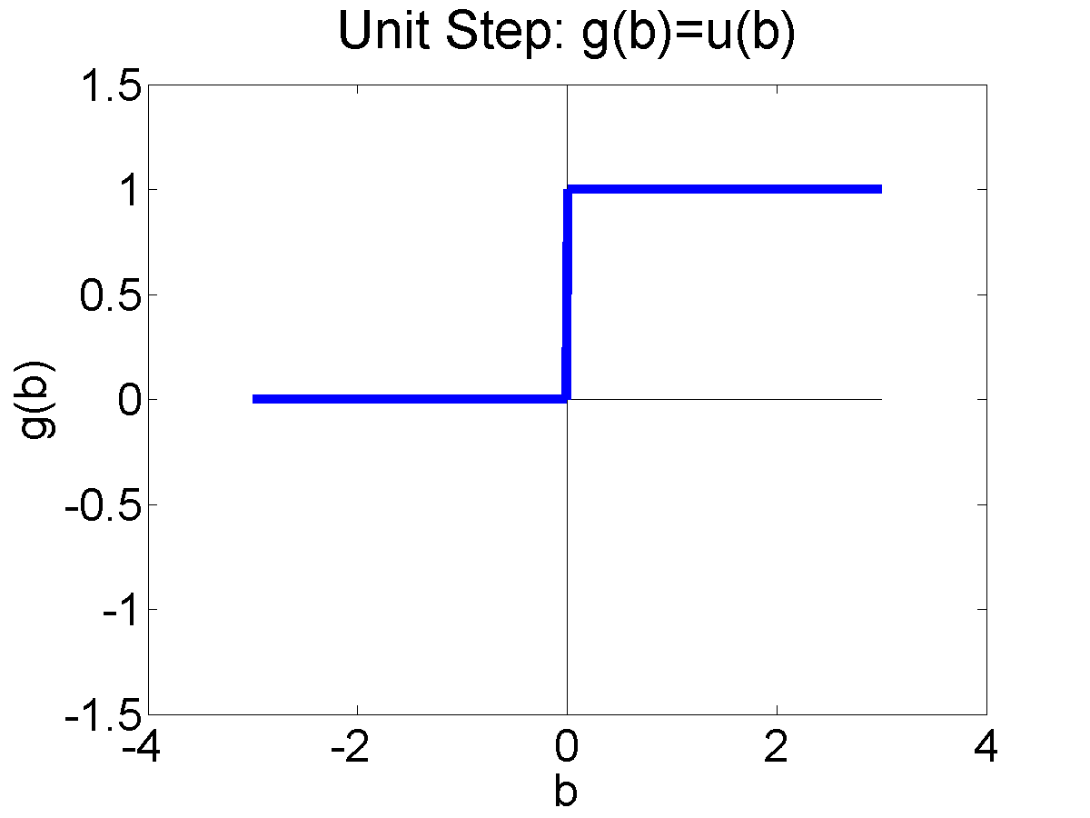
Logistic Regression
We can frame the basic idea of logistic regression in this way: replace the non-differentiable decision function
$$\hat{y}=u(w^{T}x)$$
with a differentiable decision function:
$$\hat{y}=σ\left(w^{T}x\right)=\frac{1}{1+e^{−w^{T}x}}$$
…so that the classifier can be trained using gradient descent.

Slide 36
Conclusion: Comparing logistic regression vs. the perceptron
Logistic regression:
For all training tokens, whether right or wrong,
$$w=w−η∇_{w}𝔏=w+η\frac{1}{n}∇_{w}\log{P\left(Y=y_{i} | X=x_{i}\right)}$$
Perceptron:
If $y_{i}=\hat{y_{i}}$ then do nothing.
If $y_{i}≠\hat{y_{i}}$ then set $w=w+η{y_{i}x}_{i}$

Slide 37
Conclusion: Comparing multi-class logistic regression vs. multi-class perceptron
Logistic regression:
For all training tokens, for all classes, even if $c≠y_{i}$,
$$w_{c}=w_{c}−η∇_{w_{c}}𝔏=w_{c}+η\frac{1}{n}∇_{w_{c}}\log{P\left(Y=y_{i} | X=x_{i}\right)}$$
Multi-class Perceptron:
If $y_{i}=\hat{y_{i}}$ then do nothing.
If $y_{i}≠\hat{y_{i}}$ then
update the correct class, $y_{i}$, as $w_{y_{i}}=w_{y_{i}}+ηx_{i}$
update the incorrect class, $\hat{y_{i}}$, as $w_{\hat{y_{i}}}=w_{\hat{y_{i}}}−ηx_{i}$

