Slide 1
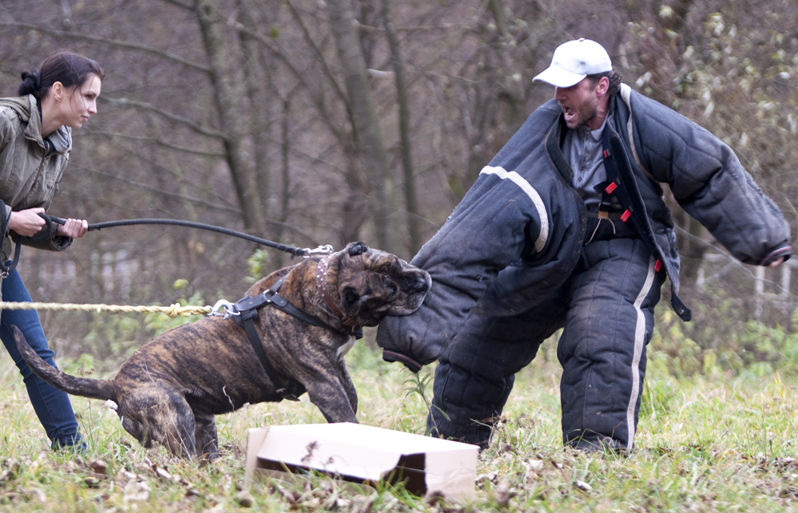
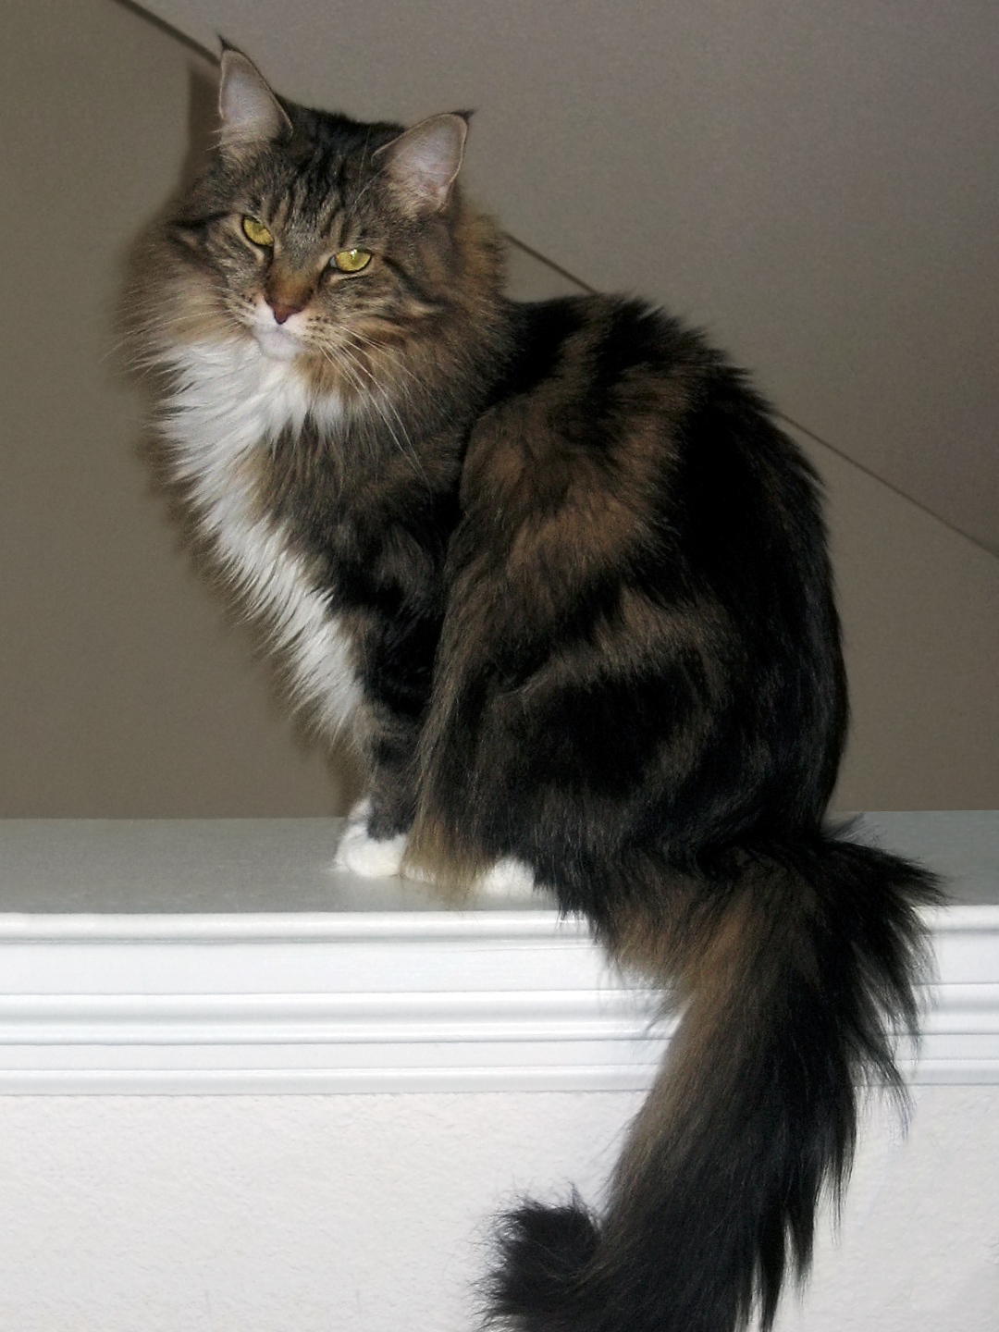
CS440/ECE448 Lecture 7: Classifiers
Mark Hasegawa-Johnson, 2/2021
CC-BY 4.0: you can redistribute as long as you attribute the source.
$$x_{2}$$
$$u\left(w^{T}x+b\right)=1$$
$$u\left(w^{T}x+b\right)=0$$
$$x_{1}$$

Slide 2
Classifiers
What is a classifier?
The Naïve Bayes classifier
General Bayesian classifier
False alarms and missed detections
Training, development test, and evaluation test datasets
The nearest-neighbor classifier
Linear classifiers
Many logic functions are linear classifiers!
Binary naïve Bayes is a linear classifier!

Slide 3
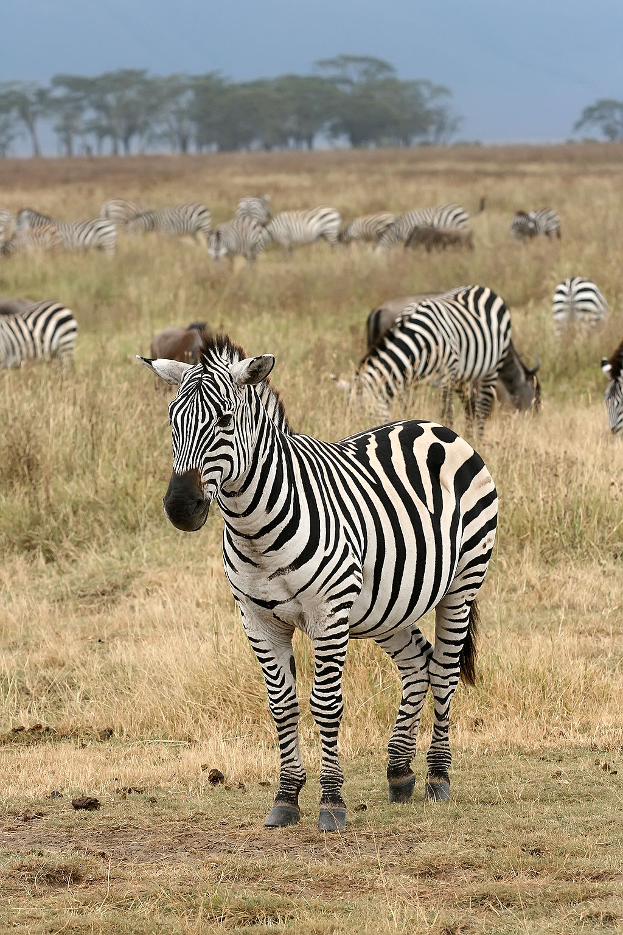
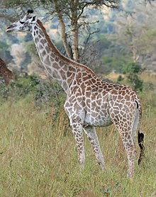
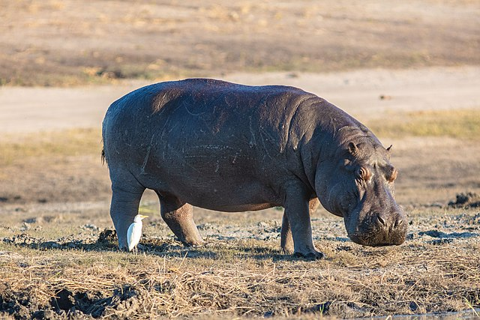
A classifier is a function $\hat{y}=f(x)$, where $x$=features, $y$=true label, $\hat{y}$=estimated label
Features ($x$)
Class label ($y$)
Zebra
Classifier Y=f(X)
GFDL 1.2, Muhammad Mahdi Karim
Giraffe
GFDL 1.2, Muhammad Mahdi Karim
Hippopotamus
CC-BY-SA, Diego Delso

Slide 4
Classifiers
What is a classifier?
The Naïve Bayes classifier
General Bayesian classifier
False alarms and missed detections
Training, development test, and evaluation test datasets
The nearest-neighbor classifier
Linear classifiers
Many logic functions are linear classifiers!
Binary naïve Bayes is a linear classifier!

Slide 5
Example: Naïve Bayes
Class label = $Y$, drawn from some set of labels
Features = $X_{1},…,X_{D}$
Classification function: output the label, $Y=y$, which maximizes $P\left(Y=y,X_{1},…,X_{D}\right)$ under the following “naïve Bayes” assumption:
$$P\left(Y=y,X_{1},…,X_{D}\right)=P(Y=y)\prod_{d=1}^{D}{P\left(X_{d}|Y=y\right)}$$

Slide 6
Naïve Bayes as a Function
Let’s try to figure out how to make that a function, $\hat{y}=f(x)$.
A particular test token has the features $x=[x_{1},…,x_{D}]$.
For the classifier output, $\hat{y}$, we want to choose the value of $y$ that maximizes the probability:
$$\hat{y}=\underset{y}{argmax}{P(Y=y)\prod_{d=1}^{D}{P\left(X_{d}=x_{d}|Y=y\right)}}$$

Slide 7
Classifiers
What is a classifier?
The Naïve Bayes classifier
General Bayesian classifier
False alarms and missed detections
Training, development test, and evaluation test datasets
The nearest-neighbor classifier
Linear classifiers
Many logic functions are linear classifiers!
Binary naïve Bayes is a linear classifier!

Slide 8
General Bayesian Classifier
Class label $Y=y$, drawn from some set of labels
Observation $X=x$, drawn from some set of features
Bayesian classifier: choose the class label, $y$, that minimizes your probability of making a mistake:
$$\hat{y}=\underset{y}{argmin}{P(Y≠y|X=x) }$$

Slide 9
MPE = MAP
The minimum probability of error (MPE) classifier is the one that minimizes your probability of making a mistake:
$$\hat{y}=\underset{y}{argmin}{P(Y≠y|X=x) }$$
The maximum a posteriori (MAP) classifier is the one that maximizes your probability of being correct:
$$\hat{y}=\underset{y}{argmax}{P(Y=y|X=x) }$$
Notice: they’re the same! This is called the MPE=MAP rule.

Slide 10
Accuracy
When we train a classifier, the metric that we usually report is “accuracy.”
$$Accuracy= \frac{\# tokens correctly classified}{\# tokens total}$$

Slide 11
Error Rate
Equivalently, we could report error rate, which is just 1-accuracy:
$$Error Rate= \frac{\# tokens incorrectly classified}{\# tokens total}$$

Slide 12
Error Rate
Error rate is the probability that the classifier output, $\hat{y}$, is not equal to the correct label, $y$, averaged over all possible $x$:
$$Error Rate=\sum_{x}{P\left(X=x\right)P(Y≠\hat{y}|X=x)}$$

Slide 13
Bayes Error Rate
The “Bayes Error Rate” is the smallest possible error rate of any classifier with labels $y$ and features $x$:
$$Error Rate=\sum_{x}{P\left(X=x\right)\min_{y}{P(Y≠y|X=x)}}$$
It’s called the “Bayes error rate” because it’s the error rate of the Bayesian classifier.

Slide 14
Classifiers
What is a classifier?
The Naïve Bayes classifier
General Bayesian classifier
False alarms and missed detections
Training, development test, and evaluation test datasets
The nearest-neighbor classifier
Linear classifiers
Many logic functions are linear classifiers!
Binary naïve Bayes is a linear classifier!

Slide 15
Accuracy
When we train a classifier, the metric that we usually report is “accuracy.”
$$Accuracy= \frac{\# tokens correctly classified}{\# tokens total}$$

Slide 16
The problem with accuracy
In most real-world problems, there is one class label that is much more frequent than all others.
Words: most words are nouns
Animals: most animals are insects
Disease: most people are healthy
It is therefore easy to get a very high accuracy. All you need to do is write a program that completely ignores its input, and always guesses the majority class. The accuracy of this classifier is called the “chance accuracy.”
It is sometimes very hard to beat the chance accuracy. If chance=90%, and your classifier gets 89% accuracy, is that good, or bad?

Slide 17
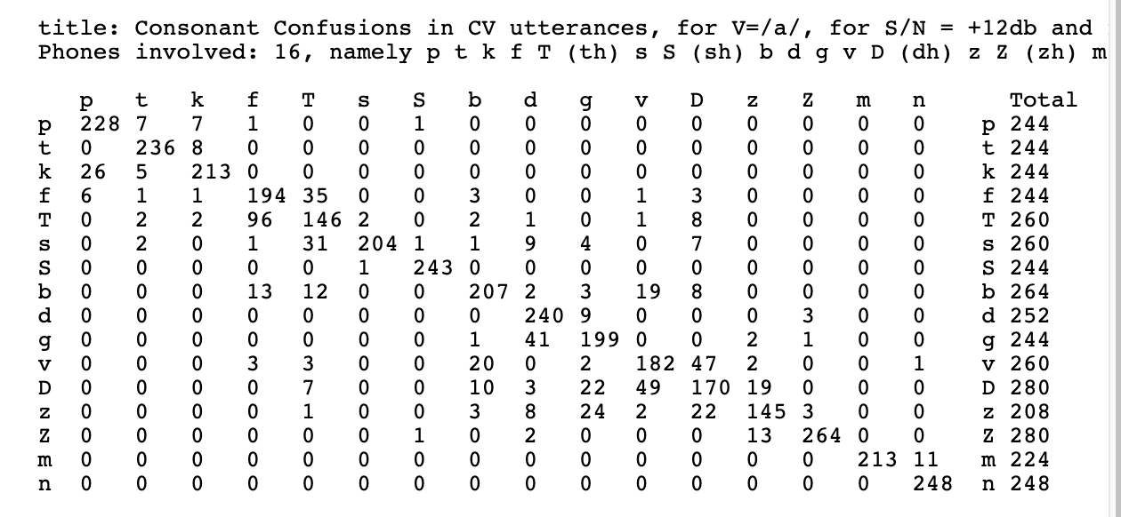
The solution: Confusion Matrix
Confusion Matrix =
${\left(m,n\right)}^{\text{th}}$ element is
the number of tokens of the $m^{\text{th}}$ class
that were labeled, by the classifier, as belonging to the $n^{\text{th}}$ class.
Plaintext versions of the Miller & Nicely matrices, posted by Dinoj Surendran, http://people.cs.uchicago.edu/~dinoj/research/nicely.html

Slide 18
Confusion matrix for a binary classifier
Suppose that the correct label is either 0 or 1. Then the confusion matrix is just 2x2.
Classified As:
 | 0 | 1
0
1
Correct Label:
For example, in this box, you would write the # tokens of class 1 that were misclassified as class 0

Slide 19
False Positives & False Negatives
TP (True Positives) = tokens that were correctly labeled as “1”
FN (False Negatives) = tokens that should have been “1”, but were mislabeled as “0”
FP (False Positives) = tokens that should have been “0”, but were mislabeled as “1”
TN (True Negative) = tokens that were correctly labeled as “0”
Classified As:
 | 0 | 1
0 | TN | FP
1 | FN | TP
Correct Label:

Slide 20
False Alarms and Missed Detections
The false alarm rate of a classifier is the fraction of tokens that should have been 0, but were misclassified as 1:
$$False Alarm Rate= \frac{FP}{TN+FP}$$
The missed detection rate of a classifier is the fraction of tokens that should have been 1, but were misclassified as 0:
$$Missed Detection Rate= \frac{FN}{TP+FN}$$
Classified As:
 | 0 | 1
0 | TN | FP
1 | FN | TP
Correct Label:

Slide 21
Classifiers
What is a classifier?
The Naïve Bayes classifier
General Bayesian classifier
False alarms and missed detections
Training, development test, and evaluation test datasets
The nearest-neighbor classifier
Linear classifiers
Many logic functions are linear classifiers!
Binary naïve Bayes is a linear classifier!

Slide 22
Accuracy on which corpus?
Consider the following experiment: among all of your friends’ pets, there are 4 dogs and 4 cats.
Measure several attributes of each animal: weight, height, domesticity, color, number of letters in its name…
You discover that, among your friends’ pets, all dogs have 1-syllable names, while the names of all cats have 2+ syllables.
Your classifier: an animal is a cat if its name has 2+ syllables.
Your accuracy: 100%
Is it correct to say that this classifier has 100%? Is it useful to say so?

Slide 23
Training vs. Test Corpora
Training Corpus = a set of data that you use in order to optimize the parameters of your classifier (for example, optimize which features you measure, what are the weights of those features, what are the thresholds, and so on).
Test Corpus = a set of data that is non-overlapping with the training set (none of the test tokens are also in the training dataset) that you can use to measure the accuracy.
Measuring the training corpus accuracy is useful for debugging: if your training algorithm is working, then training corpus accuracy should always go up.
Measuring the test corpus accuracy is the only way to estimate how your classifier will work on new data (data that you’ve never yet seen).

Slide 24
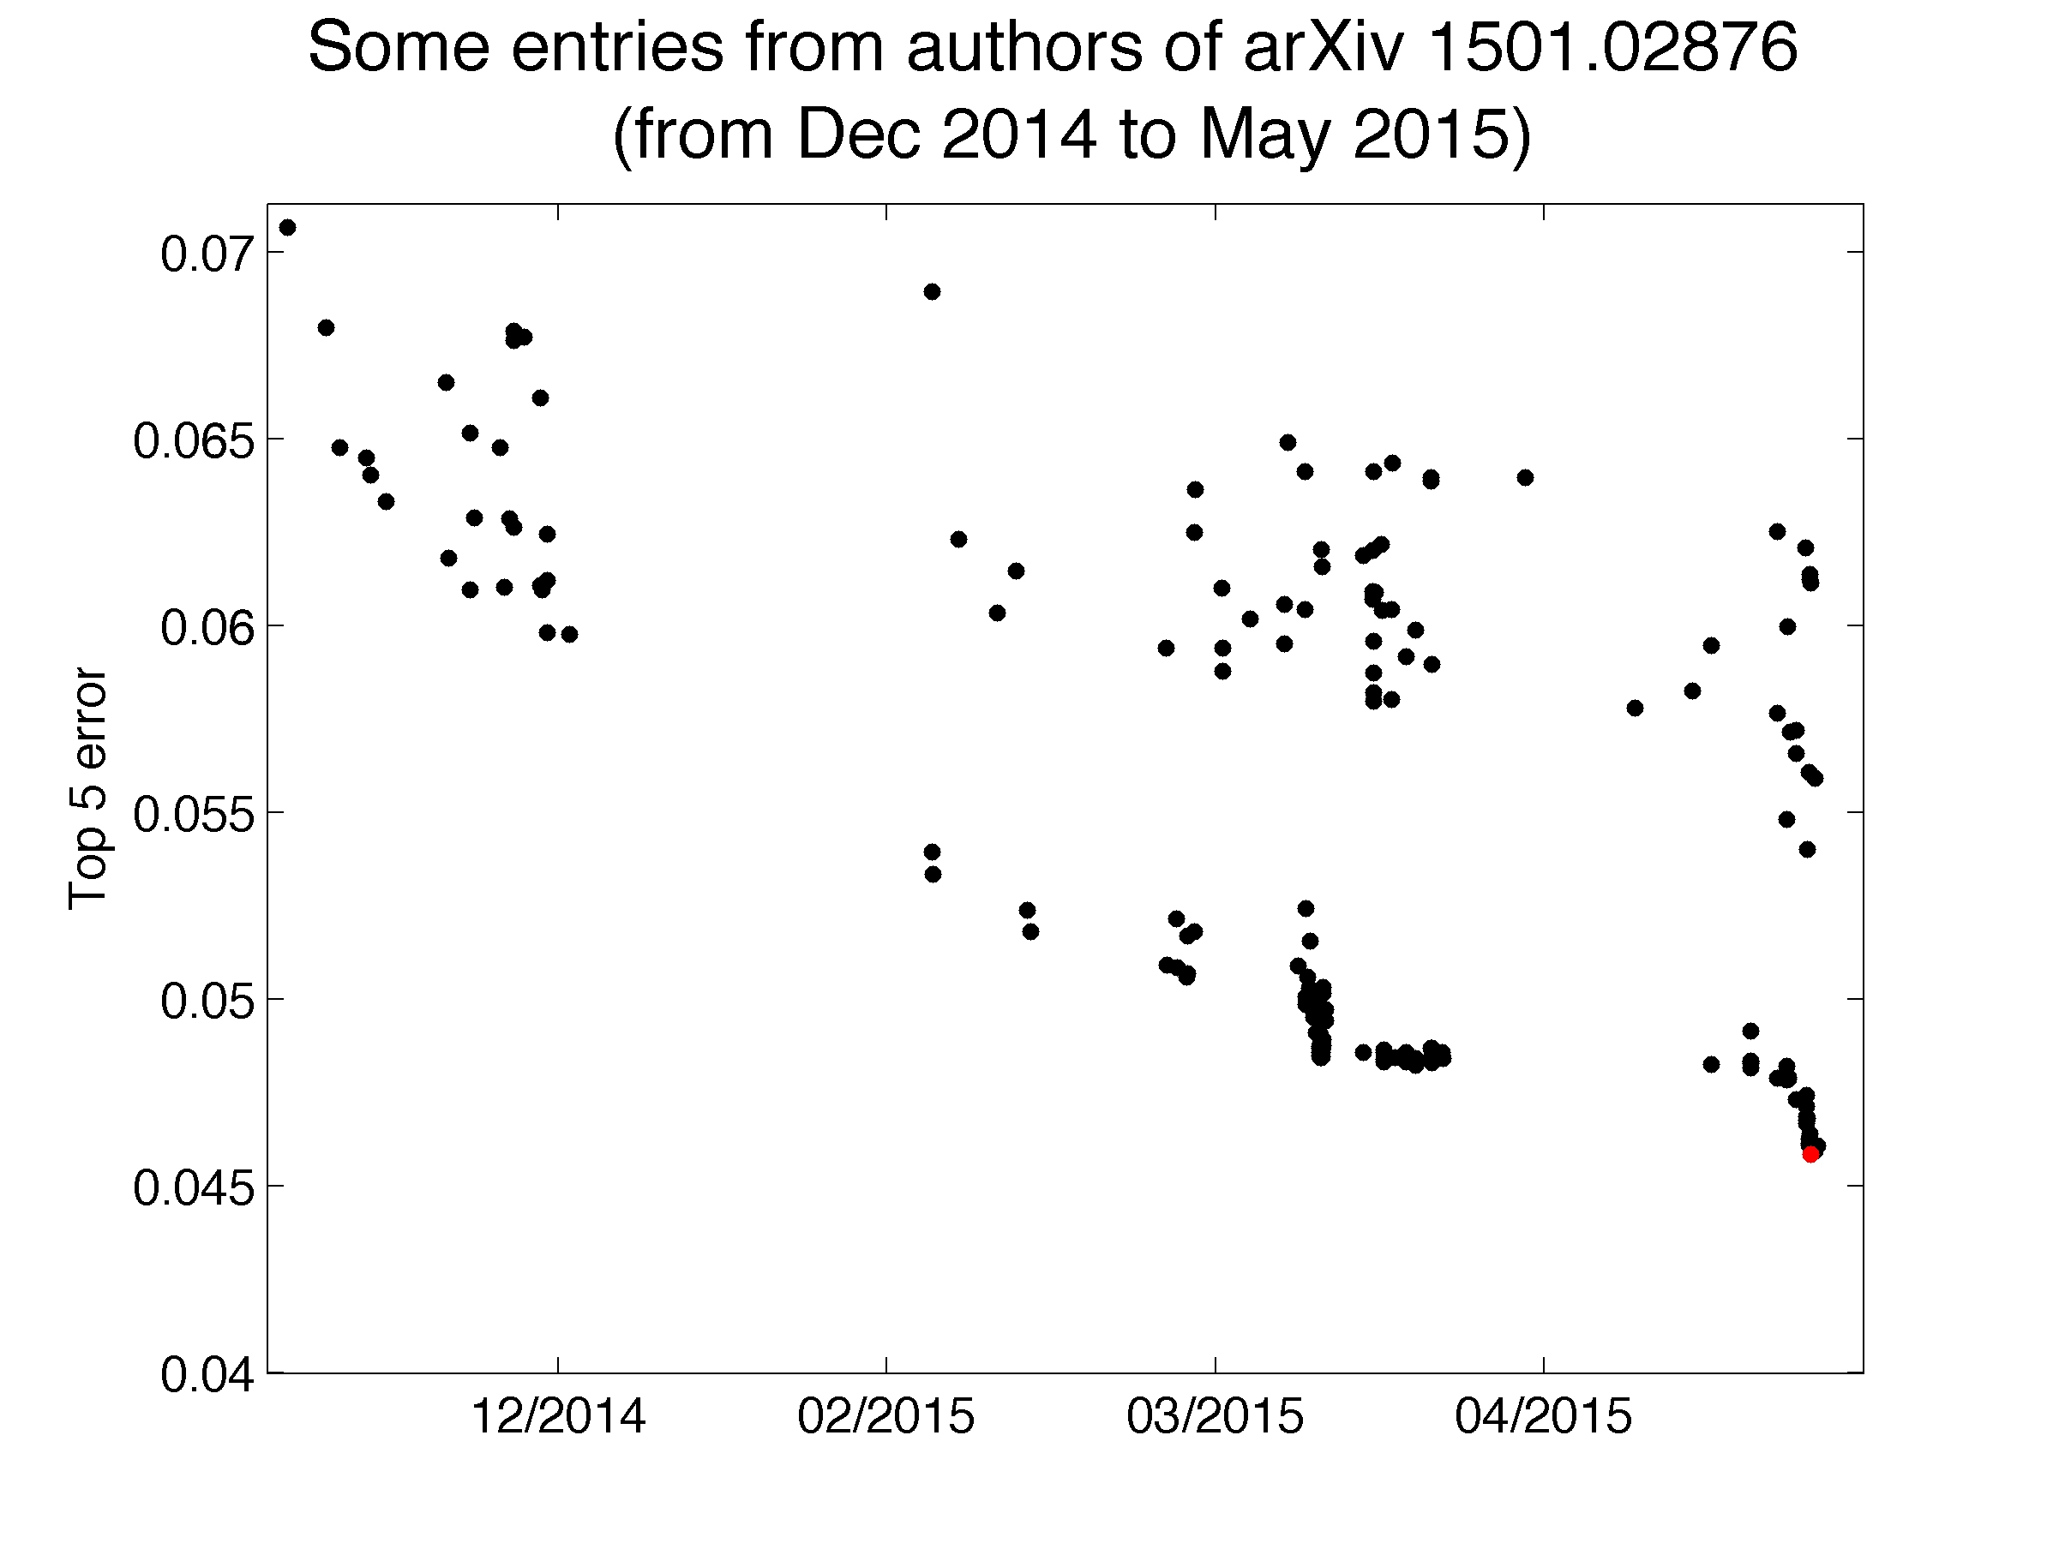
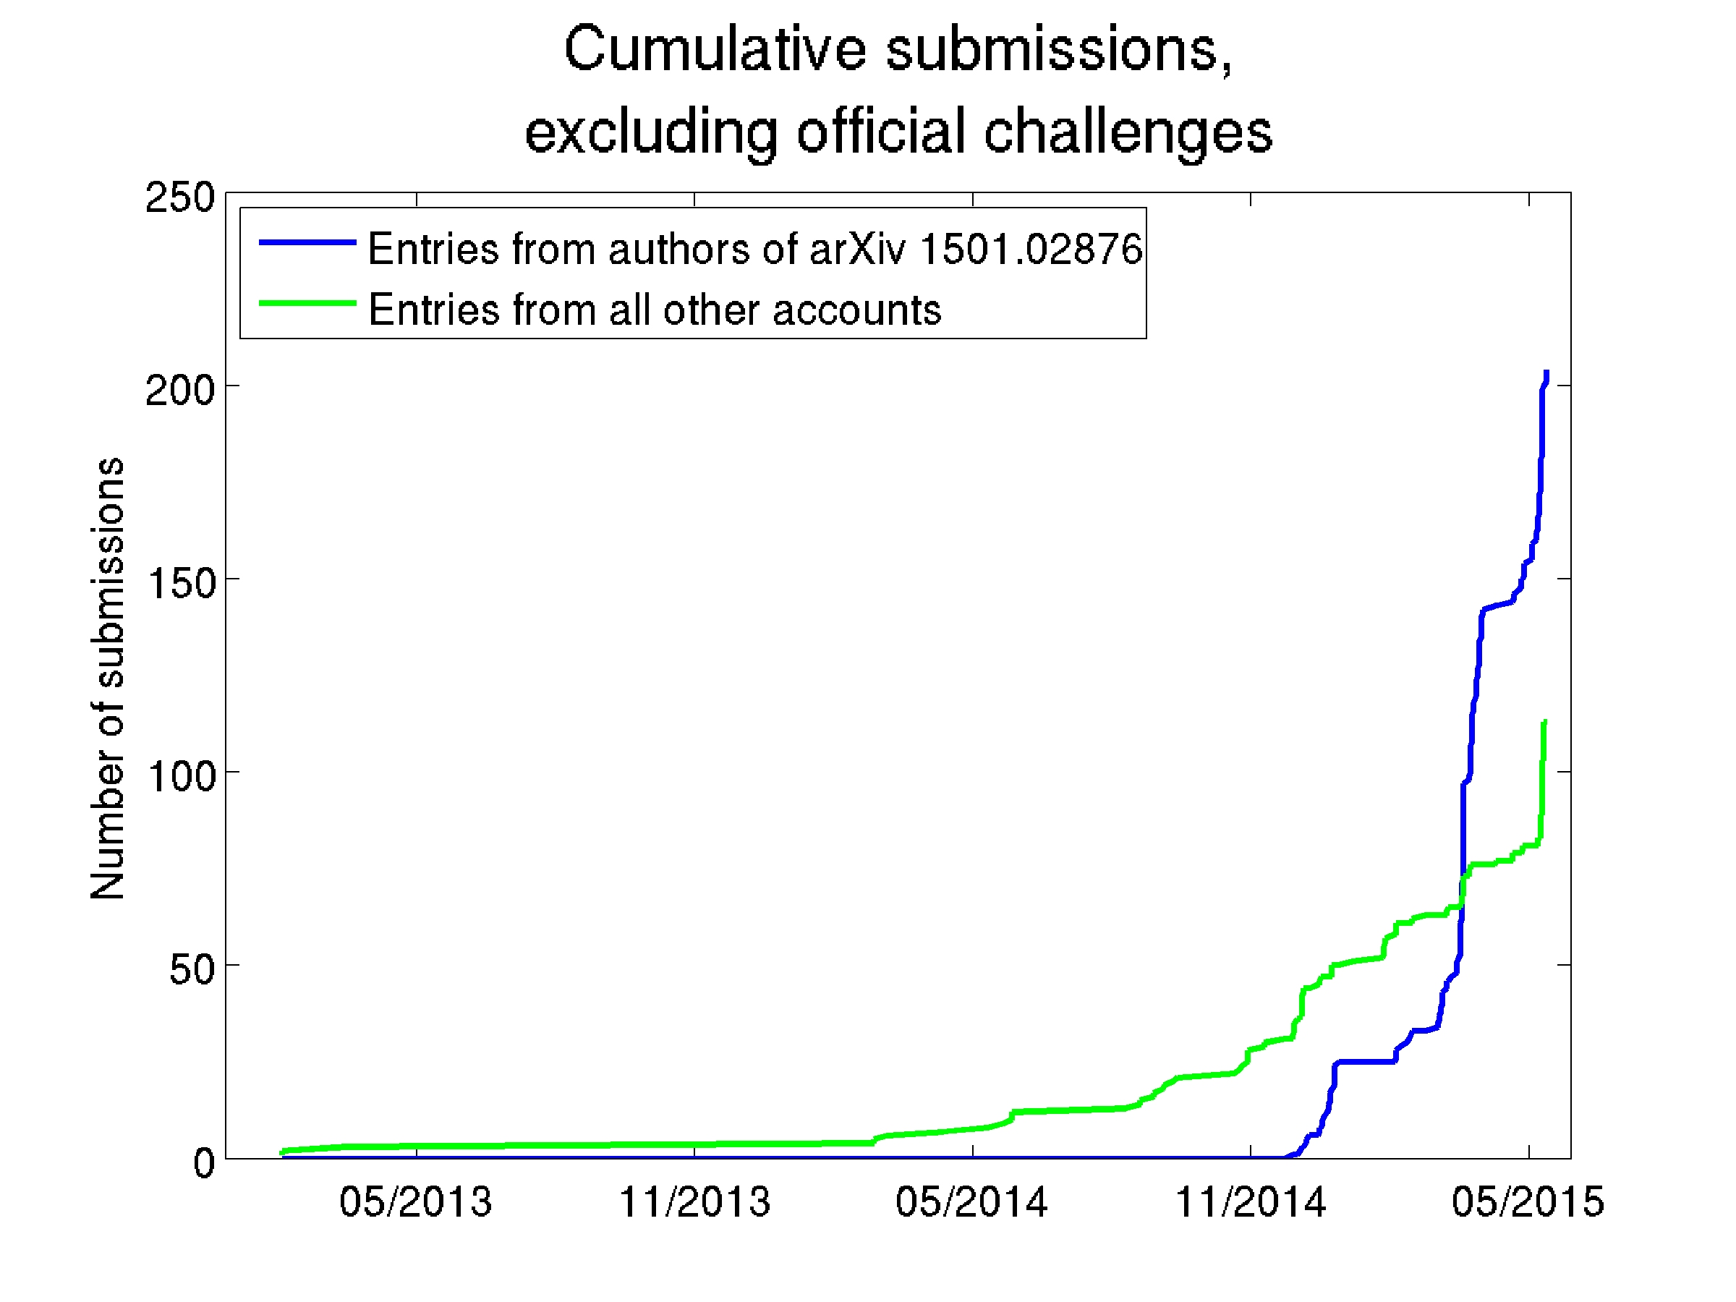
Accuracy on which corpus?
This happened:
Large Scale Visual Recognition Challenge 2015: Each competing institution was allowed to test up to 2 different fully-trained classifiers per week.
One institution used 30 different e-mail addresses so that they could test a lot more classifiers (200, total). One of their systems achieved <46% error rate – the competition’s best, at that time.
That institution was forbidden from participating in the ImageNet competitions for the following 12 months.

Slide 25
Training vs. development test vs. evaluation test corpora
Training Corpus = a set of data that you use in order to optimize the parameters of your classifier (for example, optimize which features you measure, what are the weights of those features, what are the thresholds, and so on).
Development Test (DevTest or Validation) Corpus = a dataset, separate from the training dataset, on which you test 200 different fully-trained classifiers (trained, e.g., using different training algorithms, or different features), in order to see which one works best.
Evaluation Test Corpus = a dataset that is used only to test the ONE classifier that does best on DevTest. From this corpus, you learn how well your classifier will perform in the real world.

Slide 26
Classifiers
What is a classifier?
The Naïve Bayes classifier
General Bayesian classifier
False alarms and missed detections
Training, Development Test, and Evaluation Test datasets
The nearest-neighbor classifier
Linear classifiers
Many logic functions are linear classifiers!
Binary naïve Bayes is a linear classifier!

Slide 27
Nearest Neighbors Classifier
Given n different training tokens. Each one has a known class label.
Input to the classifier: a test token $x$ whose correct label is unknown.
Classification function:
Find the training token, $x_{i}$, that is most similar to the test token.
Find out the corresponding class label, $y_{i}=$correct_label($x_{i}$).
Output $y_{i}$ as the best guess for the label of test token $x$.

Slide 28
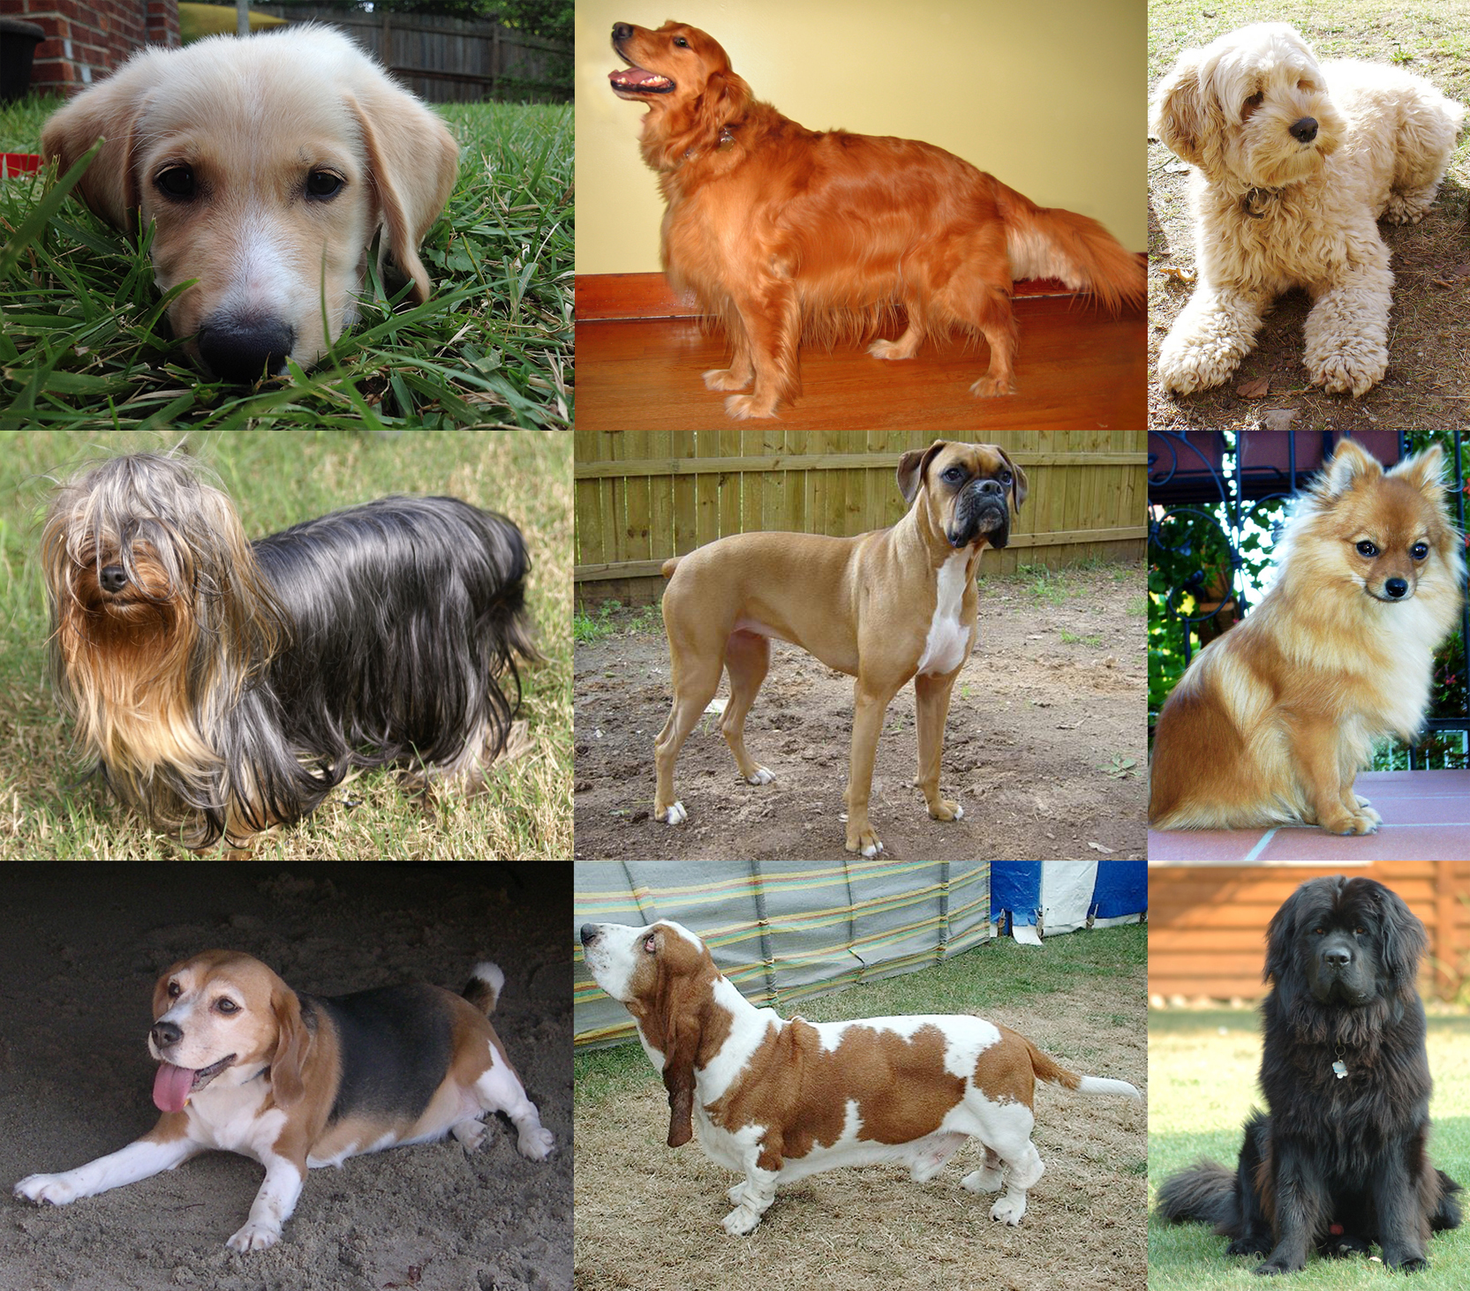
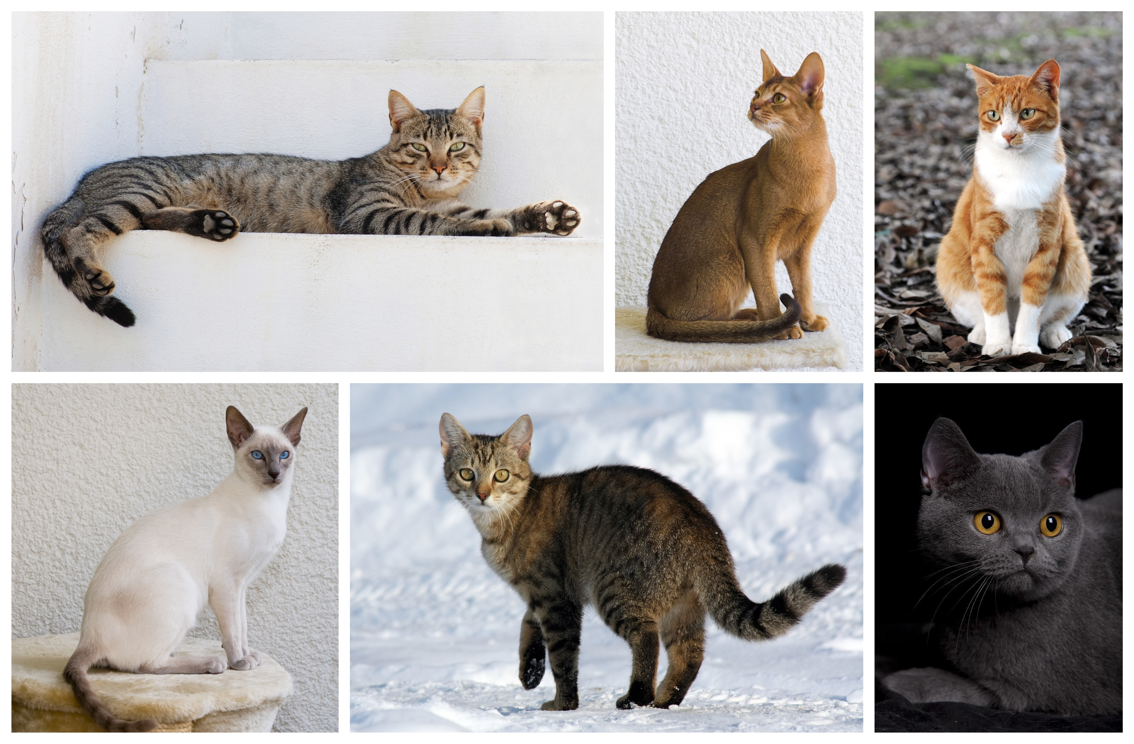
Example of Nearest-Neighbor Classification
Test Token: Maltese
This is the most similar training token…
CC BY-SA 4.0, https://commons.wikimedia.org/w/index.php?curid=55084303
Therefore the Maltese is classified as a dog.
Training Tokens:
By YellowLabradorLooking_new.jpg: *derivative work: Djmirko (talk)YellowLabradorLooking.jpg: User:HabjGolden_Retriever_Sammy.jpg: Pharaoh HoundCockerpoo.jpg: ALMMLonghaired_yorkie.jpg: Ed Garcia from United StatesBoxer_female_brown.jpg: Flickr user boxercabMilù_050.JPG: AleRBeagle1.jpg: TobycatBasset_Hound_600.jpg: ToBNewfoundland_dog_Smoky.jpg: Flickr user DanDee Shotsderivative work: December21st2012Freak (talk) - YellowLabradorLooking_new.jpgGolden_Retriever_Sammy.jpgCockerpoo.jpgLonghaired_yorkie.jpgBoxer_female_brown.jpgMilù_050.JPGBeagle1.jpgBasset_Hound_600.jpgNewfoundland_dog_Smoky.jpg, CC BY-SA 3.0, https://commons.wikimedia.org/w/index.php?curid=10793219
By Alvesgaspar - Top left:File:Cat August 2010-4.jpg by AlvesgasparTop middle:File:Gustav chocolate.jpg by Martin BahmannTop right:File:Orange tabby cat sitting on fallen leaves-Hisashi-01A.jpg by HisashiBottom left:File:Siam lilacpoint.jpg by Martin BahmannBottom middle:File:Felis catus-cat on snow.jpg by Von.grzankaBottom right:File:Sheba1.JPG by Dovenetel, CC BY-SA 3.0, https://commons.wikimedia.org/w/index.php?curid=17960205

Slide 29
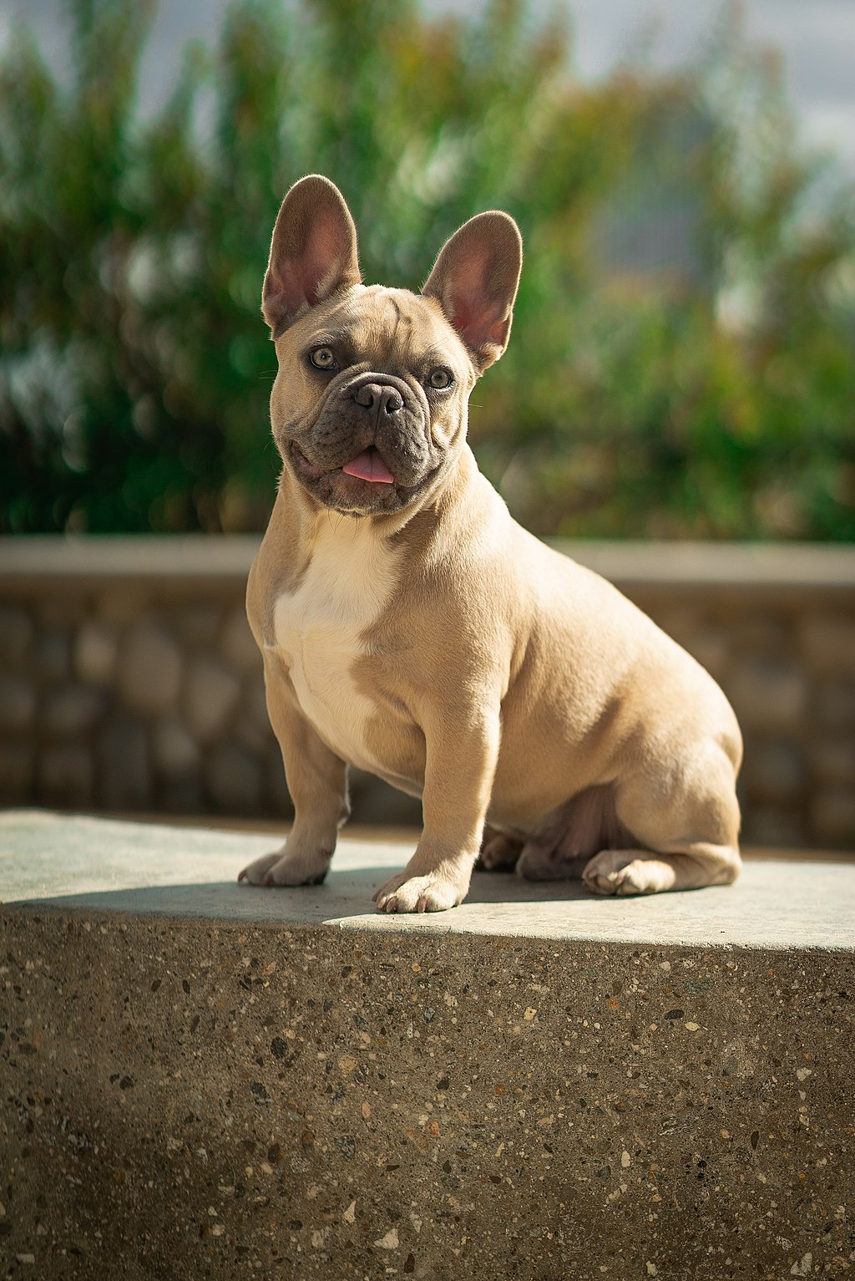
K-Nearest Neighbors (KNN) Classifier
The nearest-neighbors classifier sometimes fails if one of the training tokens is unusual. In that case, a test token that is similar to the weird training token might get misclassified. Solution: K-Nearest Neighbors.
Test token:
Most similar training token:
Mandruss, CC BY-SA 4.0
DK1k, CC BY-SA 4.0

Slide 30
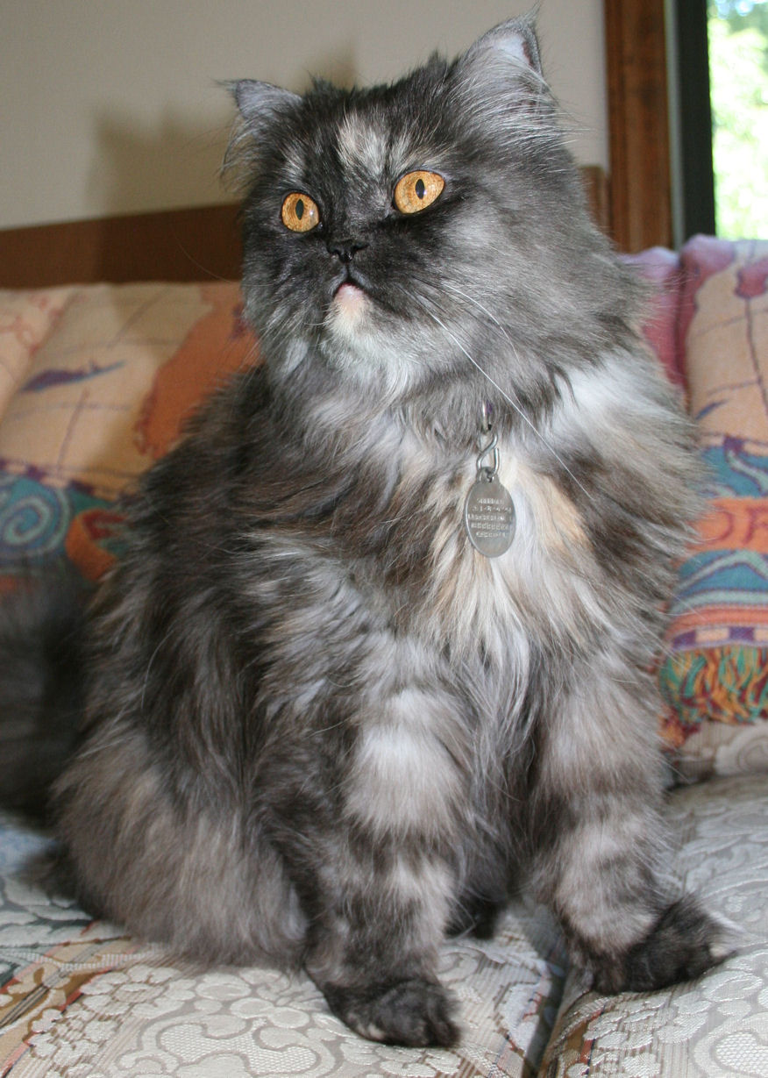
K-Nearest Neighbors Classification Function
Find the K training tokens, $x_{i}$, that are most similar to the test token (K is a number chosen in advance by the system designer, e.g., $K=3$).
Find out the corresponding class labels, $y_{i}=$correct_label($x_{i}$).
Vote! Find the class label that is most frequent among the K-nearest neighbors, and output that as the label of the test token.
Test token:
3 most similar training tokens:
Mandruss, CC BY-SA 4.0
DK1k, CC BY-SA 4.0
Mike Powell, CC BY-SA 2.0
Dustin Warrington, CC BY-SA.

Slide 31
Classifiers
What is a classifier?
The Naïve Bayes classifier
General Bayesian classifier
False alarms and missed detections
Training, Development Test, and Evaluation Test datasets
The nearest-neighbor classifier
Linear classifiers
Many logic functions are linear classifiers!
Binary naïve Bayes is a linear classifier!

Slide 32
Classifier example: dogs versus cats
Can you write a program that can tell which ones are dogs, and which ones are cats?
By YellowLabradorLooking_new.jpg: *derivative work: Djmirko (talk)YellowLabradorLooking.jpg: User:HabjGolden_Retriever_Sammy.jpg: Pharaoh HoundCockerpoo.jpg: ALMMLonghaired_yorkie.jpg: Ed Garcia from United StatesBoxer_female_brown.jpg: Flickr user boxercabMilù_050.JPG: AleRBeagle1.jpg: TobycatBasset_Hound_600.jpg: ToBNewfoundland_dog_Smoky.jpg: Flickr user DanDee Shotsderivative work: December21st2012Freak (talk) - YellowLabradorLooking_new.jpgGolden_Retriever_Sammy.jpgCockerpoo.jpgLonghaired_yorkie.jpgBoxer_female_brown.jpgMilù_050.JPGBeagle1.jpgBasset_Hound_600.jpgNewfoundland_dog_Smoky.jpg, CC BY-SA 3.0, https://commons.wikimedia.org/w/index.php?curid=10793219
By Alvesgaspar - Top left:File:Cat August 2010-4.jpg by AlvesgasparTop middle:File:Gustav chocolate.jpg by Martin BahmannTop right:File:Orange tabby cat sitting on fallen leaves-Hisashi-01A.jpg by HisashiBottom left:File:Siam lilacpoint.jpg by Martin BahmannBottom middle:File:Felis catus-cat on snow.jpg by Von.grzankaBottom right:File:Sheba1.JPG by Dovenetel, CC BY-SA 3.0, https://commons.wikimedia.org/w/index.php?curid=17960205

Slide 33
Classifier example: dogs versus cats
Can you write a program that can tell which ones are dogs, and which ones are cats?
Idea #1: Cats are smaller than dogs.
Our robot will pick up the animal and weigh it.
If it weighs more than 20 pounds, call it a dog. Otherwise, call it a cat.

Slide 34
Classifier example: dogs versus cats
Can you write a program that can tell which ones are dogs, and which ones are cats?
Oops.
CC BY-SA 4.0, https://commons.wikimedia.org/w/index.php?curid=55084303

Slide 35
Classifier example: dogs versus cats
Can you write a program that can tell which ones are dogs, and which ones are cats?
Idea #2: Dogs are tame, cats are wild.
We’ll try the following experiment: 40 different people call the animal’s name. Count how many times the animal comes when called.
If the animal comes when called, more than 20 times out of 40, it’s a dog.
If not, it’s a cat.

Slide 36
Classifier example: dogs versus cats
Can you write a program that can tell which ones are dogs, and which ones are cats?
Oops.
By Smok Bazyli - Own work, CC BY-SA 3.0, https://commons.wikimedia.org/w/index.php?curid=16864492

Slide 37
Classifier example: dogs versus cats
Can you write a program that can tell which ones are dogs, and which ones are cats?
Idea #3:
$x_{1}=$ # times the animal comes when called (out of 40).
$x_{2}=$ weight of the animal, in pounds.
If $0.5x_{1}+0. 5x_{2}>20$, call it a dog.
Otherwise, call it a cat.
This is called a “linear classifier” because $0.5x_{1}+0. 5x_{2}=20$ is the equation for a straight line.

Slide 38
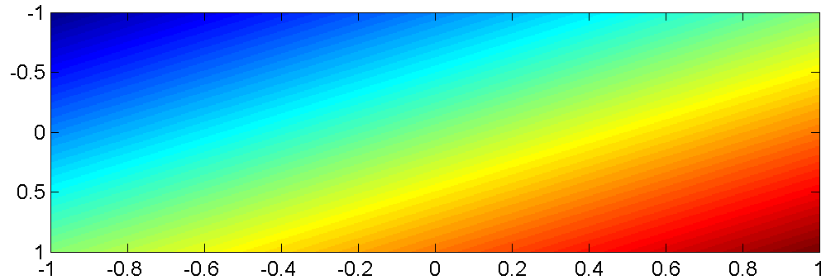
Linear Classifiers in General
The function $b+\sum_{j=1}^{D}{w_{j}x_{j}}$ is an affine function of the features $x_{j}$. That means that its contours are all straight lines. Here is an example of such a function, plotted as variations of color in a two-dimensional space $x_{1}$ by $x_{2}$:
$$x_{2}$$
$$x_{1}$$

Slide 39
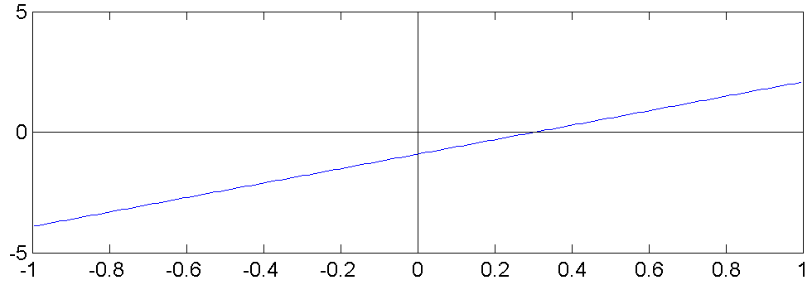
Linear Classifiers in General
Consider the classifier
$\hat{y}=1 if b+\sum_{j=1}^{D}{w_{j}x_{j}}>0$, otherwise $\hat{y}=0$
This is called a “linear classifier” because the boundary between the two classes is a line. Here is an example of such a classifier, with its boundary plotted as a line in the two-dimensional space $x_{1}$ by $x_{2}$:
$$\hat{y}=0$$
$$x_{2}$$
$$\hat{y}=1$$
$$x_{1}$$

Slide 40
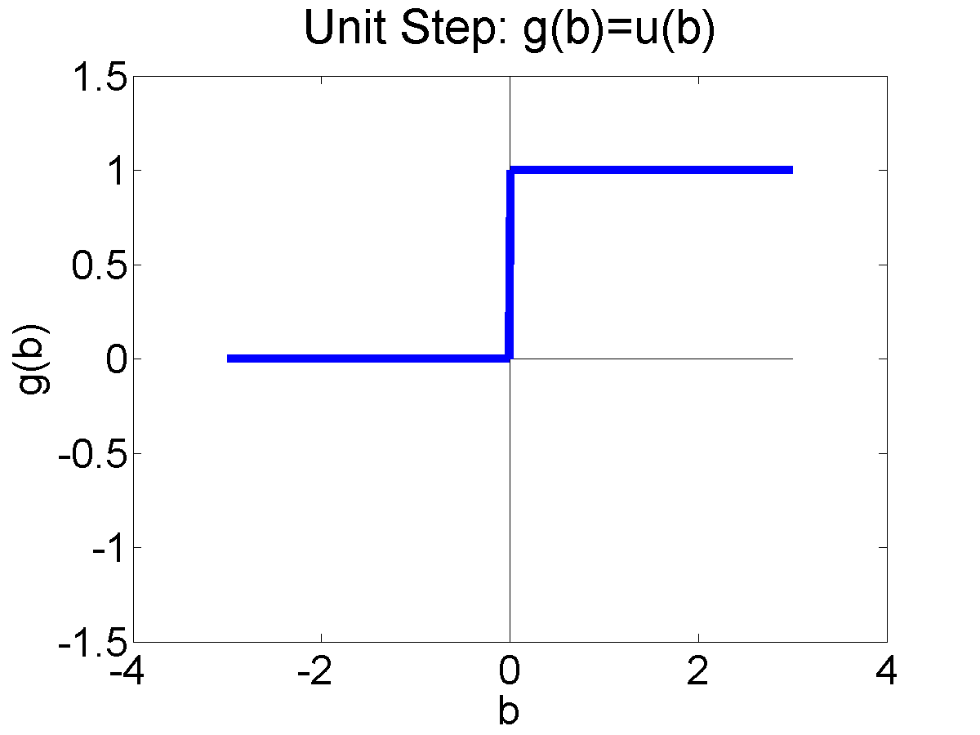
The Unit Step Function
Binary Classifier: Unit Step
The unit step function is defined as:
$$u\left(b\right)=\left\{\begin{matrix}1 & b≥0 \\ 0 & otherwise\end{matrix}\right.$$

Slide 41
Linear Classifiers in General
Consider the classifier
$$\hat{y}=u\left(b+\sum_{j=1}^{D}{w_{j}x_{j}}\right)$$
This is called a “linear classifier” because the boundary between the two classes is a line.
$$\hat{y}=0$$
$$x_{2}$$
$$\hat{y}=1$$
$$x_{1}$$

Slide 42
Classifiers
What is a classifier?
The Naïve Bayes classifier
General Bayesian classifier
False alarms and missed detections
Training, Development Test, and Evaluation Test datasets
The nearest-neighbor classifier
Linear classifiers
Many logic functions are linear classifiers!
Binary naïve Bayes is a linear classifier!

Slide 43
Many logic functions are linear classifiers!
Many (but not all!) binary logic functions can be re-written as linear classifiers. For example, the function
$$\hat{y}=(x_{1}∨x_{2})$$
can be re-written as
$$\hat{y}=u(x_{1}+x_{2}−0.5)$$
Similarly, the function
$$\hat{y}=(x_{1}∧x_{2})$$
can be re-written as
$$\hat{y}=u(x_{1}+x_{2}−1.5)$$
$$x_{2}$$
$$x_{2}$$
$$(x_{1}∨x_{2})$$
$$(x_{1}∧x_{2})$$
$$1$$
$$1$$
$$0$$
$$x_{1}$$
$$0$$
$$x_{1}$$
$$0$$
$$1$$
$$0$$
$$1$$

Slide 44
… but not all logic functions are linear.
Not all logical functions can be written as linear classifiers!
Minsky and Papert wrote a book called Perceptrons in 1969. Although the book said many other things, the only thing most people remembered about the book was that:
“A linear classifier cannot learn an XOR function.”
Because of that statement, most people gave up working on neural networks from about 1969 to about 2006.
Minsky and Papert also proved that a two-layer neural net can learn an XOR function. But most people didn’t notice.
$$x_{2}$$
$$1$$
$$0$$
$$x_{1}$$
$$0$$
$$1$$

Slide 45
Classifiers
What is a classifier?
The Naïve Bayes classifier
General Bayesian classifier
False alarms and missed detections
Training, Development Test, and Evaluation Test datasets
The nearest-neighbor classifier
Linear classifiers
Many logic functions are linear classifiers!
Binary naïve Bayes is a linear classifier!

Slide 46
Naïve Bayes as a Classifier
Remember that Naïve Bayes can be written as a classifier, $\hat{y}=f(x)$.
A particular test token has the features $x=[x_{1},…,x_{D}]$.
For the classifier output, $\hat{y}$, we want to choose the value of $y$ that maximizes the probability:
$$\hat{y}=\underset{y}{argmax}{P(Y=y)\prod_{d=1}^{D}{P\left(X_{d}=x_{d}|Y=y\right)}}$$

Slide 47
Example: Binary Naïve Bayes
For example, suppose all of the features are binary, $x_{d}∈\left\{0,1\right\}.$ Then:
$$\hat{y}=\underset{y}{argmax}{P(Y=y)\prod_{d=1}^{D}{{\left(P\left(X_{d}=1|Y=y\right)\right)}^{x_{d}}{\left(P\left(X_{d}=0|Y=y\right)\right)}^{1−x_{d}}}}$$

Slide 48
Example: Binary Naïve Bayes
Suppose the class labels are also binary, $y∈\left\{0,1\right\}.$ Then:
$\hat{y}=1$ if
$$P\left(Y=1\right)\prod_{d=1}^{D}{{\left(P\left(X_{d}=1|Y=1\right)\right)}^{x_{d}}{\left(P\left(X_{d}=0|Y=1\right)\right)}^{1−x_{d}}}≥ P\left(Y=0\right)\prod_{d=1}^{D}{{\left(P\left(X_{d}=1|Y=0\right)\right)}^{x_{d}}{\left(P\left(X_{d}=0|Y=0\right)\right)}^{1−x_{d}}}$$
Otherwise, $\hat{y}=0$.

Slide 49
Taking the logarithm
Multiplying together lots of terms can cause floating-point problems on a computer. Let’s take the logarithms of both sides, in order to turn the multiplications into additions:
$\hat{y}=1$ if
$$\log{P\left(Y=1\right)}+\sum_{d=1}^{D}{x_{d}\log{P\left(X_{d}=1|Y=1\right)}+\left(1−x_{d}\right)}\log{P\left(X_{d}=0|Y=1\right)}≥\log{P\left(Y=0\right)}+\sum_{d=1}^{D}{x_{d}\log{P\left(X_{d}=1|Y=0\right)}+\left(1−x_{d}\right)}\log{P\left(X_{d}=0|Y=0\right)}$$
Otherwise, $\hat{y}=0$.

Slide 50
Simplifying the equation
The equation is getting much too long. Let’s re-arrange, to reduce the number of terms.
$\hat{y}=1$ if
$$\log\left(\frac{P\left(Y=1\right)P\left(X_{1}=0|Y=1\right)⋯P\left(X_{D}=0|Y=1\right)}{P\left(Y=0\right)P\left(X_{1}=0|Y=0\right)⋯P\left(X_{D}=0|Y=0\right)}\right)+\sum_{d=1}^{D}{x_{d}\log\left(\frac{P\left(X_{d}=1|Y=1\right)P\left(X_{d}=0|Y=0\right)}{P\left(X_{d}=0|Y=1\right)P\left(X_{d}=1|Y=0\right)}\right)}$$
$$≥0$$
Otherwise, $\hat{y}=0$.

Slide 51
New names for the model parameters
Now let’s give new names to the model parameters.
$\hat{y}=1$ if
$$b+\sum_{d=1}^{D}{x_{d}w_{d}}≥0$$
Otherwise, $\hat{y}=0$.

Slide 52
Binary Naïve Bayes is a Linear Classifier
A “linear classifier” is a classifier of the form:
$\hat{y}=1$ if
$$b+\sum_{d=1}^{D}{x_{d}w_{d}}≥0$$
Otherwise, $\hat{y}=0$.
Binary Naïve Bayes is a linear classifier.

Slide 53
Binary Naïve Bayes is a Linear Classifier
Why did we go through this complicated derivation?
In order to use naïve Bayes in any practical situation (e.g., MP2), you need to know that logarithms turn multiplication into addition.
You need to know that naïve Bayes has two types of trainable parameters:
The priors, $P(Y=y)$
The likelihoods, $P\left(X_{d}=x_{d}|Y=y\right)$
You need to know that a linear classifier has two types of trainable parameters:
The offset, $b$
The weights, $w_{d}$

Slide 54
How to learn a linear classifier
So far, you’ve learned three different ways to find the parameters of a linear classifier:
Plot scatter plots of $x$, for $y=0$ and $y=1$, and draw a line, or
Plot the outcomes of a binary logic function and draw a line, or
Convert naïve Bayes parameters into linear classifier parameters.
Next week, you’ll learn two new methods:
Perceptron algorithm, and
Logistic regression, a.k.a. one-layer neural network.

Slide 55
Classifiers
What is a classifier? Answer: $\hat{y}=f(x)$
The Naïve Bayes classifier: $\hat{y}=\underset{y}{argmax}{P(y)\prod_{d=1}^{D}{P\left(x_{d}|y\right)}}$
General Bayesian classifier: $\hat{y}=\underset{y}{argmax}{P(y|x) }$
False alarm rate $= \frac{FP}{TN+FP}$, missed detection rate $= \frac{FN}{TP+FN}$
Training, development test, and evaluation test datasets
The nearest-neighbor classifier
Linear classifier: $\hat{y}=u\left(b+\sum_{d=1}^{D}{w_{d}x_{d}}\right)$
Many logic functions are linear classifiers!
Binary naïve Bayes is a linear classifier!

