Slide 1
Instruction-level Parallelism

Slide 2
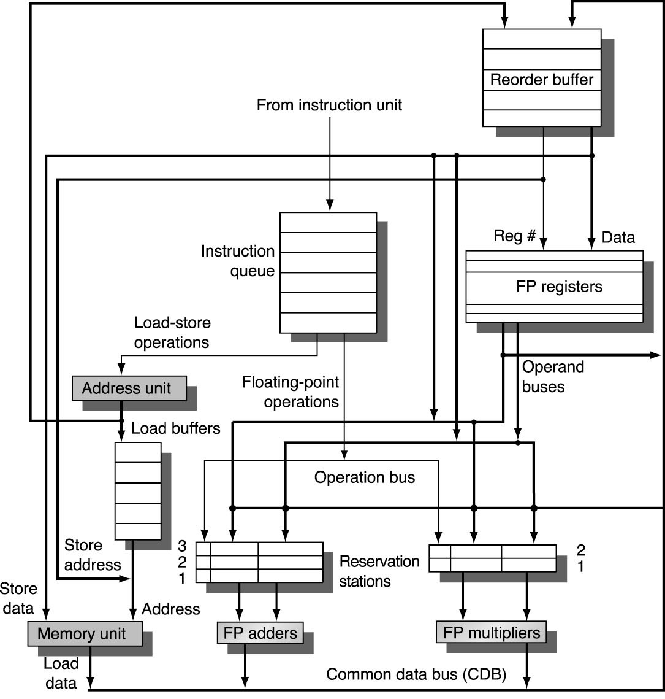
Hardware Speculative Execution
Need HW buffer for results of uncommitted instructions: reorder buffer
Reorder buffer can be operand source
Once operand commits, result is found in register
3 fields: instr. type, destination, value
Use reorder buffer number instead of reservation station as “name” of result
Instructions commit in order
As a result, its easy to undo speculated instructions on mispredicted branches or on exceptions

Slide 3
Four Steps of Speculative Tomasulo Algorithm
1. Issue—get instruction from FP Op Queue
If reservation station and reorder buffer slot free, issue instr & send operands & reorder buffer no. for destination. Operands may be read from register file or reorder buffer.
2. Execution—operate on operands (EX)
When both operands ready then execute; if not ready, watch CDB for result; when both in reservation station, execute
3. Write result—finish execution (WB)
Write on Common Data Bus to all awaiting FUs & reorder buffer; mark reservation station available.
4. Commit—update register with reorder result
When instr. at head of reorder buffer & result present, update register with result (or store to memory) and remove instr from reorder buffer.

Slide 4
Tomasulo – cycle 0
ROB
Loop:
ADDD F4, F2, F0
MULD F8, F4, F2
ADDD F6, F8, F6
SUBD F8, F2, F0
SUBI …
BNEZ …, Loop
Instruction Queue
SUBI …
SUBD F8, F2, F0
F0
F2
F4
F6
F8
0.0
ADDD F6, F8, F6
2.0
MULD F8, F4, F2
4.0
ADDD F4, F2, F0
6.0
8.0
1
2
3
1
2
integer
FP adders
FP mult’s

Slide 5
Tomasulo – cycle 1
ROB
0
1
2
3
4
5
6
ADDD
F4
-
Loop:
ADDD F4, F2, F0
MULD F8, F4, F2
ADDD F6, F8, F6
SUBD F8, F2, F0
SUBI …
BNEZ …
Instruction Queue
BNEZ
SUBI
F0
F2
F4
F6
F8
0.0
SUBD F8, F2, F0
2.0
ADDD F6, F8, F6
4.0
ROB0
MULD F8, F4, F2
6.0
8.0
1
2
3
ADDD
2.0
0.0
ROB0
1
2
integer
FP adders
FP mult’s

Slide 6
Tomasulo – cycle 2
ROB
0
1
2
3
4
5
6
ADDD
F4
-
MULD
F8
-
Loop:
ADDD F4, F2, F0
MULD F8, F4, F2
ADDD F6, F8, F6
SUBD F8, F2, F0
SUBI …
BNEZ …
Instruction Queue
ADDD F4, F2, F0
BNEZ
F0
F2
F4
F6
F8
0.0
SUBI
2.0
SUBD F8, F2, F0
4.0
ROB0
ADDD F6, F8, F6
6.0
8.0
ROB1
1
2
3
ADDD
2.0
0.0
ROB0
1
2
MULD
ROB0
2.0
ROB1
integer
FP adders
FP mult’s

Slide 7
Tomasulo – cycle 3
ROB
0
1
2
3
4
5
6
ADDD
F4
-
MULD
F8
-
ADDD
F6
-
Loop:
ADDD F4, F2, F0
MULD F8, F4, F2
ADDD F6, F8, F6
SUBD F8, F2, F0
SUBI …
BNEZ …
Instruction Queue
MULD F8, F4, F2
ADDD F4, F2, F0
F0
F2
F4
F6
F8
0.0
BNEZ
2.0
SUBI
4.0
ROB0
SUBD F8, F2, F0
6.0
ROB2
8.0
ROB1
1
2
3
ADDD
2.0
0.0
ROB0
ADDD
ROB1
6.0
ROB2
1
2
MULD
ROB0
2.0
ROB1
integer
FP adders
FP mult’s

Slide 8
Tomasulo – cycle 4
ROB
0
1
2
3
4
5
6
ADDD
F4
-
MULD
F8
-
ADDD
F6
-
SUBD
F8
-
Loop:
ADDD F4, F2, F0
MULD F8, F4, F2
ADDD F6, F8, F6
SUBD F8, F2, F0
SUBI …
BNEZ …
Instruction Queue
ADDD F6, F8, F6
MULD F8, F4, F2
F0
F2
F4
F6
F8
0.0
ADDD F4, F2, F0
2.0
BNEZ
4.0
ROB0
SUBI
6.0
ROB2
8.0
ROB3
1
2
3
ADDD
2.0
0.0
ROB0
ADDD
ROB1
6.0
ROB2
1
2
MULD
ROB0
2.0
ROB1
integer
SUBD
2.0
0.0
ROB3
FP adders
FP mult’s

Slide 9
Tomasulo – cycle 5
ROB
0
1
2
3
4
5
6
ADDD
F4
2.0
MULD
F8
-
ADDD
F6
-
SUBD
F8
-
Loop:
ADDD F4, F2, F0
MULD F8, F4, F2
ADDD F6, F8, F6
SUBD F8, F2, F0
SUBI …
BNEZ …
SUBI
Instruction Queue
SUBD F8, F2, F0
ADDD F6, F8, F6
F0
F2
F4
F6
F8
0.0
MULD F8, F4, F2
2.0
ADDD F4, F2, F0
4.0
ROB0
BNEZ
6.0
ROB2
8.0
ROB3
SUBI
1
2
3
ADDD
2.0
0.0
ROB0
ADDD
ROB1
6.0
ROB2
1
2
MULD
2.0
2.0
ROB1
integer
SUBD
2.0
0.0
ROB3
FP adders
FP mult’s
2.0 (ROB0)

Slide 10
Tomasulo – cycle 6
ROB
0
1
2
3
4
5
6
MULD
F8
-
ADDD
F6
-
SUBD
F8
-
Loop:
ADDD F4, F2, F0
MULD F8, F4, F2
ADDD F6, F8, F6
SUBD F8, F2, F0
SUBI …
BNEZ …
SUBI
Instruction Queue
BNEZ
SUBI
SUBD F8, F2, F0
F0
F2
F4
F6
F8
0.0
ADDD F6, F8, F6
2.0
MULD F8, F4, F2
2.0
ADDD F4, F2, F0
6.0
ROB2
8.0
ROB3
SUBI
1
2
3
BNEZ
ADDD
ROB1
6.0
ROB2
1
2
MULD
2.0
2.0
ROB1
integer
SUBD
2.0
0.0
ROB3
FP adders
FP mult’s

Slide 11
Tomasulo – cycle 8
ROB
0
1
2
3
4
5
6
MULD
F8
-
MULD
F8
-
ADDD
F6
-
SUBD
F8
2.0
Loop:
ADDD F4, F2, F0
MULD F8, F4, F2
ADDD F6, F8, F6
SUBD F8, F2, F0
SUBI …
BNEZ …
SUBI
Instruction Queue
BNEZ
ADDD F4, F2, F0
ADDD
F4
BNEZ
F0
F2
F4
F6
F8
0.0
SUBI
2.0
SUBD F8, F2, F0
2.0
ROB6
ADDD F6, F8, F6
6.0
ROB2
8.0
ROB0
SUBI
1
2
3
ADDD
2.0
0.0
ROB6
BNEZ
ADDD
ROB1
6.0
ROB2
1
2
MULD
2.0
2.0
ROB1
integer
SUBD
2.0
0.0
ROB3
MULD
ROB6
2.0
ROB0
FP adders
FP mult’s
2.0 (ROB3)

Slide 12
Tomasulo – cycle 9
ROB
0
1
2
3
4
5
6
MULD
F8
-
MULD
F8
-
ADDD
F6
-
SUBD
F8
2.0
Loop:
ADDD F4, F2, F0
MULD F8, F4, F2
ADDD F6, F8, F6
SUBD F8, F2, F0
SUBI …
BNEZ …
SUBI
Instruction Queue
BNEZ
ADDD F4, F2, F0
ADDD
F4
BNEZ
F0
F2
F4
F6
F8
0.0
SUBI
2.0
SUBD F8, F2, F0
2.0
ROB6
ADDD F6, F8, F6
6.0
ROB2
8.0
ROB0
SUBI
1
2
3
ADDD
2.0
0.0
ROB6
BNEZ
ADDD
ROB1
6.0
ROB2
1
2
MULD
2.0
2.0
ROB1
integer
MULD
ROB6
2.0
ROB0
FP adders
FP mult’s

Slide 13
Tomasulo – cycle 11
ROB
0
1
2
3
4
5
6
MULD
F8
-
MULD
F8
-
ADDD
F6
-
SUBD
F8
2.0
Loop:
ADDD F4, F2, F0
MULD F8, F4, F2
ADDD F6, F8, F6
SUBD F8, F2, F0
SUBI …
BNEZ …
SUBI
Instruction Queue
BNEZ
ADDD F4, F2, F0
ADDD
F4
2.0
BNEZ
F0
F2
F4
F6
F8
0.0
SUBI
2.0
SUBD F8, F2, F0
2.0
ROB6
ADDD F6, F8, F6
6.0
ROB2
8.0
ROB0
SUBI
1
2
3
ADDD
2.0
0.0
ROB6
BNEZ
ADDD
ROB1
6.0
ROB2
1
2
MULD
2.0
2.0
ROB1
integer
MULD
2.0
2.0
ROB0
FP adders
FP mult’s
2.0 (ROB6)

Slide 14
Tomasulo – cycle 15
ROB
0
1
2
3
4
5
6
MULD
F8
-
MULD
F8
4.0
ADDD
F6
-
SUBD
F8
2.0
Loop:
ADDD F4, F2, F0
MULD F8, F4, F2
ADDD F6, F8, F6
SUBD F8, F2, F0
SUBI …
BNEZ …
SUBI
val
Instruction Queue
BNEZ
ADDD F4, F2, F0
ADDD
F4
2.0
BNEZ
F0
F2
F4
F6
F8
0.0
SUBI
2.0
SUBD F8, F2, F0
2.0
ROB6
ADDD F6, F8, F6
6.0
ROB2
8.0
ROB0
1
2
3
BNEZ
ADDD
4.0
6.0
ROB2
1
2
MULD
2.0
2.0
ROB1
integer
MULD
2.0
2.0
ROB0
FP adders
FP mult’s
4.0 (ROB1)

Slide 15
Tomasulo – cycle 16
ROB
0
1
2
3
4
5
6
MULD
F8
-
ADDD
F6
-
ADDD
F6
-
SUBD
F8
2.0
Loop:
ADDD F4, F2, F0
MULD F8, F4, F2
ADDD F6, F8, F6
SUBD F8, F2, F0
SUBI …
BNEZ …
SUBI
val
Instruction Queue
BNEZ
MULD F8, F4, F2
ADDD
F4
2.0
ADDD F4, F2, F0
F0
F2
F4
F6
F8
0.0
BNEZ
2.0
SUBI
2.0
ROB6
SUBD F8, F2, F0
6.0
ROB2
4.0
ROB0
1
2
3
ADDD
ROB0
ROB2
ROB1
BNEZ
ADDD
4.0
6.0
ROB2
1
2
integer
MULD
2.0
2.0
ROB0
Branch
Mispredicted!
FP adders
FP mult’s

Slide 16
Tomasulo – cycle 17
ROB
0
1
2
3
4
5
6
flushed
flushed
ADDD
F6
-
SUBD
F8
2.0
Loop:
ADDD F4, F2, F0
MULD F8, F4, F2
ADDD F6, F8, F6
SUBD F8, F2, F0
SUBI …
BNEZ …
SUBI
val
Instruction Queue
BNEZ
nt
flushed
flushed
flushed
F0
F2
F4
F6
F8
0.0
flushed
2.0
flushed
2.0
flushed
6.0
ROB2
4.0
ROB3
1
2
3
ADDD
4.0
6.0
ROB2
1
2
integer
FP adders
FP mult’s

Slide 17
Tomasulo – cycle 19
ROB
0
1
2
3
4
5
6
ADDD
F6
10.0
SUBD
F8
2.0
Loop:
ADDD F4, F2, F0
MULD F8, F4, F2
ADDD F6, F8, F6
SUBD F8, F2, F0
SUBI …
BNEZ …
SUBI
val
Instruction Queue
BNEZ
nt
F0
F2
F4
F6
F8
0.0
2.0
2.0
6.0
ROB2
4.0
ROB3
1
2
3
ADDD
4.0
6.0
ROB2
1
2
integer
FP adders
FP mult’s
10.0 (ROB2)

Slide 18
Tomasulo – cycle 20
ROB
0
1
2
3
4
5
6
Loop:
ADDD F4, F2, F0
MULD F8, F4, F2
ADDD F6, F8, F6
SUBD F8, F2, F0
SUBI …
BNEZ …
Instruction Queue
F0
F2
F4
F6
F8
0.0
2.0
2.0
10.0
2.0
1
2
3
1
2
integer
FP adders
FP mult’s

