Slide 1
Lecture 4:
Memory Hierarchy
Some slides adapted from Mary Jane Irwin at Penn State University for Computer Organization and Design, Patterson & Hennessy, © 2005

Slide 2

Amdahl’s Law
law of diminishing returns
  make the common case faster
  speedup = Perf_{new} / Perf_{old} = T_{old} / T_{new} =
Example
  Suppose floating point instructions occupy10% of a program, they are improved to run 2X faster, what’s the speedup?
$$\frac{1}{(1−f)+\frac{f}{P}}$$
T_{old}
(1 - f)
f
T_{new}
(1 - f)
f / P
Notes:
1/（0.9+0.1/2） = 1.05

Slide 3
Parallelism vs. Speedup
1
0.9
0.8
0.7
0.6
Amdahl's Law speed-up as a function of parallelism
Code portion in Faster mode (f)
0.5
0.4
1.97x
0.3
1.11x
1.33x
0.2
0.1
P=1
P=2
P=4
P=8
P=16
P=32
P=64
100
10
1
0
Speed-up

Slide 4
Gustafson’s Law
Amdahl’s Law killed massive parallel processing (MPP)
Gustafson came to rescue
  more workloads
  assume: seq + parallel = 1 (Tnew)
  speedup = seq + p × (1 – seq) where p = parallel factor
  if seq diminishes w/ increased problem size, speedup → p
T_{new}
seq
parallel
T_{old}
seq
P×parallel time

Slide 5
New Breed of Metrics
performance/Watt
  performance achievable at the same cooling capacity
performance/Joule (energy)
  achievable performance at the lifetime of the same energy source (i.e., battery = energy)
  equivalent to reciprocal of energy-delay product (the product of E and D)

Slide 6
(Dynamic) Power Dissipation
transition power
Vdd
Vin
Vout
C_{L}
energy/transition = C_{L} × V_{DD}² × P _{0/1→1/0}
power = C_{L} × V_{DD}² × f
Notes:
Power = current^2 * resistance

Slide 7
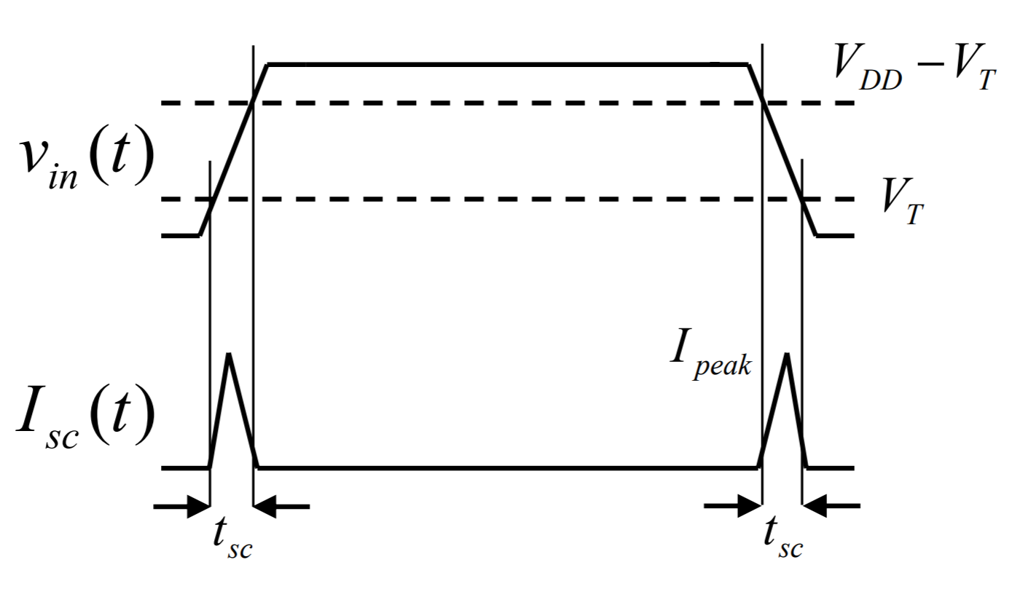
(Short Circuit) Power Dissipation
Short-circuit Power
Vdd
Vin
Vout
C_{L}
Energy/transition = t_{sc} × V_{DD} × I_{peak} × P _{0/1→1/0}
Power = t_{sc} × V_{DD} × I_{peak} × f

Slide 8
CMOS Energy & Power Equations
E = C_{L} V_{DD}² P_{0→1} + t_{sc} V_{DD} I_{peak} P_{0→1} + V_{DD} I_{leakage}
P = C_{L} V_{DD}² f_{0→1} + t_{sc}V_{DD} I_{peak} f_{0→1} + V_{DD} I_{leakage}
f_{0→1} = P_{0→1} * f_{clock}
dynamic power
(≈ 40 - 70% today and decreasing relatively)
short-circuit power
(≈ 10 % today and decreasing absolutely)
leakage power
(≈ 20 – 50 % today and increasing)
Notes:
f0->1 represents the energy consuming transition

Slide 9
Power and Energy Metrics
power in Watts
  Watt = Energy / Time
  poses constraints:
    i.e., processor can only work fast enough to max out the power delivery or cooling solution
  Peak power
    determines power ground wiring designs
    sets packaging/cooling limits
    impacts signal noise margin and reliability analysis
Notes:
power is the rate at which energy is delivered or exchanged; power dissipation is the rate at which energy is taken from the source (Vdd) and converted into heat (electrical energy is converted into heat energy during operation)
Hard to get large current into a chip (amps of current) – 30W at 3V is 10amps

Slide 10
Power and Energy Metrics
Energy in Joules
  ultimate metric, i.e., the true “cost” of performing a fixed task
  energy = power × delay
    Joules = Watts × seconds
    Lower energy means less power to perform a computation at the same frequency
Example:
  if processor A consumes 1.2× power of processor B, but finishes the task in 30% less time, which processor is more energy efficient and by how much?
Notes:
1.2 * 0.7 = 0.84 energy consumption
Energy efficiency speedup = 1/0.84 = 1.2x

Slide 11
Power versus Energy
Power is height of curve
Watts
Lower power design could simply be slower
Approach 1
Approach 2
time
Energy is area under curve
Watts
Two approaches require the same energy
Approach 1
Approach 2
time
Notes:
Energy – changing the operating frequency does not change the energy consumption!

Slide 12
More Energy Metrics
EDP = Energy Delay Product = E x D
EDDP = Energy Delay^2 Product = ED² (more emphasis on performance)
Lower
EDP
b
better
Energy
a
c
d
1/Delay
better

Slide 13


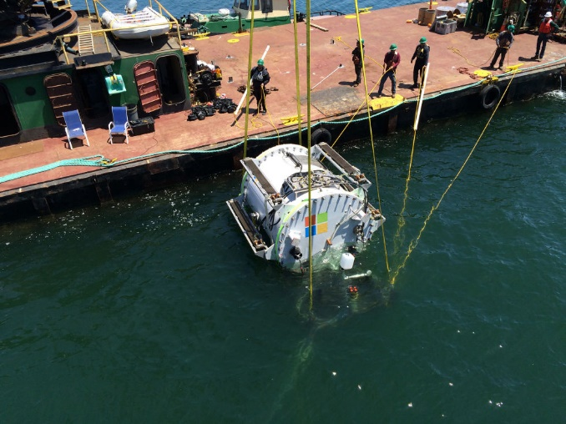
Research on Power/Energy
What happens when a CPU heatsink is removed
  Check this YouTube link
Google Data Center Cooling System
Microsoft Experimental Datacenter

Slide 14
Physical Memory Systems
so far, we’ve viewed memory as a black box that you can put data and programs into for later access
memory
data
Processor
program
general-
purpose
registers
ALUs
MAR
MDR
PC
control
logic
CC

Slide 15
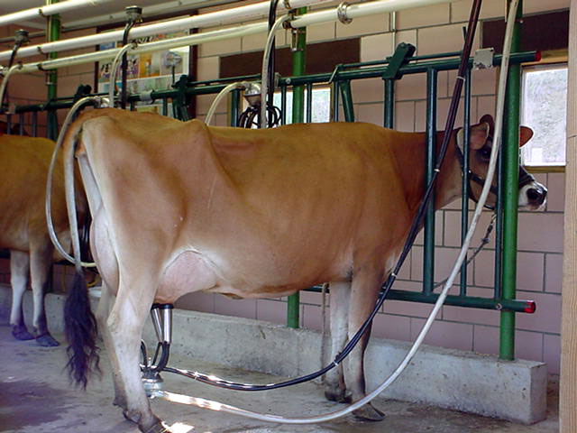

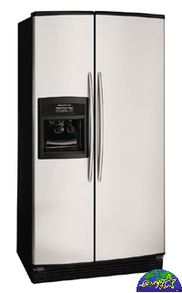

Model of Memory Hierarchy
Increasing Speed
SRAM
Physical Memory
DRAM
Virtual Memory
DISK
Reg
File
L1
Data cache
L2
Cache
Main
Memory
L1
Inst cache
Increasing Capacity

Slide 16
Types of Memories
SSD: $0.75 /GB, HD: $0.1-0.2/GB
DRAM: $20-25/GB
more on bandwidth later
Type | Size | Latency | Cost/bit
Register | < 1KB | < 1ns | $$$$
On-chip SRAM | 8KB-6MB | < 2ns | $$$
Off-chip SRAM | 1Mb – 16Mb | < 10ns | $$
DRAM | 64MB – 1TB | < 100ns | $
Disk (SSD, HD) | 40GB – 1PB | < 20ms | < $1/GB

Slide 17
Memory Hierarchy
CAPACITY
SPEED and COST
Registers
On-Chip
SRAM
Off-Chip
SRAM
DRAM
Disk

Slide 18
Why Does a Hierarchy Work?
locality of reference
  temporal locality
    reference same memory location many times (close together, in time)
  spatial locality
    reference near neighbors around the same time

Slide 19
Example of Locality
int A[100], B[100], C[100], D;
for (i=0; i<100; i++) {
C[i] = A[i] * B[i] + D;
}
D
C[99]
C[98]
C[97]
C[96]
. . . . . . . . . . . . . .
C[7]
C[6]
C[5]
C[4]
C[3]
C[2]
C[1]
C[0]
. . . . . . . . . . . . . .
B[11]
B[10]
B[9]
B[8]
B[7]
B[6]
B[5]
B[4]
B[3]
B[2]
B[1]
B[0]
A[99]
A[98]
A[97]
A[96]
. . . . . . . . . . . . . .
A[7]
A[6]
A[5]
A[4]
A[3]
A[2]
A[1]
A[0]
a cache line (one fetch)

Slide 20
Memory Hierarchy
temporal locality
keep recently referenced items at higher levels
future references satisfied quickly
CPU
spatial locality
bring neighbors of recently referenced to higher levels
future references satisfied quickly
I & D L1 cache
shared L2 cache
main memory
disk

Slide 21
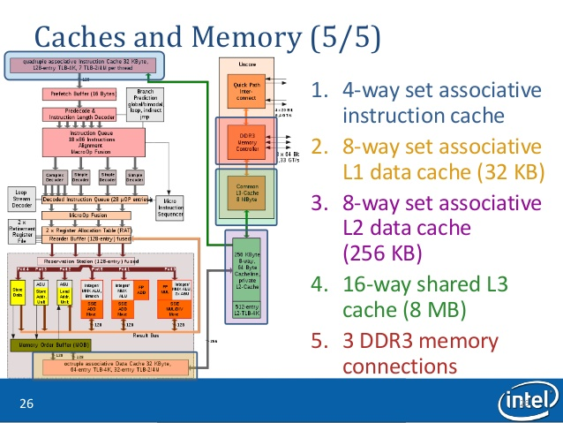
Example: Intel Nehalem Memory Hierarchy

Slide 22
Typical Memory Organization
row
decoder
memory cell
core Array
row
addr
sense amps
column latches
Wide
column
addr
pin interface
mux
Narrow
off-chip data

Slide 23
Basic Cache Operation
lower Level
memory
upper level
memory
from processor
blk X
blk Y
to processor

Slide 24
Cache Terminology
hit: data appears in some block
  hit rate: the fraction of accesses found in the level
  hit time: time to access the level (consists of RAM access time + time to determine hit)
miss: data needs to be retrieved from a block in the lower level (e.g., block Y)
  miss rate = 1 - (hit rate)
  miss penalty: time to replace a block in the upper level + time to deliver the block to the processor
hit time << miss penalty

Slide 25
Average Memory Access Time
average memory-access time
= hit time + miss rate x miss penalty
miss penalty: time to fetch a block from lower memory level
  access time: function of latency
  transfer time: function of bandwidth b/w levels
    transfer one “cache line/block” at a time
    transfer at the size of the memory-bus width

Slide 26
Memory Hierarchy Performance
Average Memory Access Time (AMAT)
  = hit time + miss rate × miss penalty
  = T_{hit}(L1) + miss%(L1) × T(memory)
example:
  cache hit = 1 cycle
  miss rate = 10% = 0.1
  miss penalty = 300 cycles
  AMAT = 1 + 0.1 × 300 = 31 cycles
can we improve it?
1 clk
300 clks
main
memory
(DRAM)
$
miss % × miss penalty
hit time

Slide 27
Reducing Penalty: Multi-Level Cache
Average Memory Access Time (AMAT)
  = T_{hit}(L1) + miss%(L1)×(T_{hit}(L2) + miss%(L2)×(T_{hit}(L3) + miss%(L3)×T(memory) ) )
  = T_{hit}(L1) + miss%(L1)×T_{miss}(L1)
  = T_{hit}(L1) + miss%(L1)×{T_{hit}(L2) + miss%(L2)×(T_{miss}(L2) }
  = T_{hit}(L1) + miss%(L1)×{T_{hit}(L2) + miss%(L2)×(T_{miss}(L2) }
  = T_{hit}(L1) + miss%(L1)×{T_{hit}(L2) + miss%(L2)×[ T_{hit}(L3) + miss%(L3)×T(memory) ] }
1 clk
10 clks
20 clks
300 clks
Main
Memory
(DRAM)
L1
L2
on-die
L3

Slide 28
AMAT Example
  = T_{hit}(L1) + miss%(L1)×(T_{hit}(L2) + miss%(L2)×(T_{hit}(L3) + miss%(L3) ×T(memory) ) )
Example:
  miss rate L1=10%, T_{hit}(L1) = 1 cycle
  miss rate L2=5%, T_{hit}(L2) = 10 cycles
  miss rate L3=1%, T_{hit}(L3) = 20 cycles
  T(memory) = 300 cycles
AMAT = ?
  2.115 (compare to 31 with no multi-levels)
  14.7× speed-up!

Slide 29
A memory system consists of a cache and a main memory. If it takes 1 cycle to complete a cache hit, and 100 cycles to complete a cache miss, what is the average memory access time if the hit rate in the cache is 97%?

Slide 30
A memory system has a cache, a main memory, and a virtual memory. If the hit rate in the cache is 98% and the hit rate in the main memory is 99%, what is the average memory access time if it takes 2 cycles to access the cache, 150 cycles to fetch a line from main memory, and 100,000 cycles to access the virtual memory?

